Slide 1

RTI Implementer Series
Module 2: RTI Progress Monitoring
National Center on Response to Intervention
Notes:
Welcome participants to the training on Progress Monitoring.
This is the second in a series of three modules developed by the National Center on Response to Intervention (NCRTI) aimed at district or school teams involved in initial planning for Response to Intervention (RTI) implementation.
Introduce yourself (or selves) as the facilitator(s) and briefly cite your professional experience in regards to RTI implementation.

Slide 2
Session Agenda
Welcome and Introductions
Brief Review
Part 1: Overview & Purpose of Progress Monitoring
Part 2: Using the Progress Monitoring Tool Chart
Part 3: Using Progress Monitoring Data for Decision Making
Part 4 Decision-Making Examples
Part 5: Considerations for SLD Eligibility (brief)
Closing
Notes:
Read slide to participants.
The agenda may be changed to fit the timeframe and focus of the training. See the Facilitator’s Guide : Appendix B for suggested agendas and considerations for adapting the presentation.
If you choose to deliver the slides over multiple days, consider the following:
Day 1: Review , Part 1, and Part 2 (slides 1-60)
Days 2-3: Part 3 (slides 61-140); You may choose to deliver over one or two days, depending on time)
Day 4: Parts 4-5 & Closing (slides 141-175)

Slide 3
Upon completion of this training, participants will be able to:
Identify the importance of progress monitoring
Interpret the Progress Monitoring Tool Chart
Use progress monitoring to improve student outcomes
Use progress monitoring data for making decisions about instruction and interventions
Develop guidance for using progress monitoring data
Notes:
The objectives for this training are:
Read slide to participants.
If Module 2: Progress Monitoring is not being presented as part of a series, present slides 4-64 of Module 1: Screening (“What is RTI?” and “Understanding Types of Assessment Within an RTI Framework” section) prior to introducing the “What is Progress Monitoring?” section. Delete slides 37-46 to reduce redundancy. See Appendix B in the facilitator’s guide for more information on adapting this module as a standalone module.

Slide 4
Review: What is RTI?
Notes:
Before we begin discussing progress monitoring we will briefly review the definition of RTI and the essential components that make up RTI, with particular emphasis on screening.
If Module 2: Progress Monitoring is not being presented as part of a series, replace the following review section with the 60 minute “What is RTI?” section found in Module 1: Screening.

Slide 5
Defining RTI
Response to intervention (RTI) integrates assessment and intervention within a school-wide, multi‑level prevention system to maximize student achievement and reduce behavior problems.
With RTI, schools identify students at risk for poor learning outcomes, monitor student progress, provide evidence-based interventions and adjust the intensity and nature of those interventions based on a student’s responsiveness, and RTI may be used as part of the determination process for identifying students with specific learning disabilities or other disabilities.
(National Center on Response to Intervention)
Notes:
Review definition.

Slide 6
RTI as a Preventive Framework
RTI is a multi-level instructional framework aimed at improving outcomes for ALL students.
RTI is preventive and provides immediate support to students who are at risk for poor learning outcomes.
RTI may be a component of a comprehensive evaluation for students with learning disabilities.
Notes:
Remember, RTI is a preventive framework. RTI is not the new name for a pre-referral process. The intent of RTI is to improve outcomes for all students while providing immediate supplemental supports to students at risk for poor learning outcomes. And remember, RTI may be a component of a comprehensive evaluation for specific learning disability determination, but that is not the overarching purpose of RTI.

Slide 7
Essential RTI Components
Screening (All students, occurs 3x per year)
Progress Monitoring (Students at risk, occurs at regular intervals)
Schoolwide, Multi-Level Prevention System
  Primary Level (Core Instruction, Level 1)
  Secondary Level (Strategic Intervention, Level 2)
  Tertiary Level (Intensive Intervention, Level 3)
Data-Based Decision Making for:
  Instruction
  Movement within the multi-level system
  Disability identification (in accordance with state law)
Notes:
So as you saw in the definition, the Center has identified four essential components for RTI.
Screening – a system for identifying students at-risk for poor learning outcomes.
Progress Monitoring – a system for monitoring the effectiveness of the supports provided to students.
Schoolwide, Multi-Level Prevention System – at least three increasingly intense levels of instructional support.
Primary – which is the core instruction and curriculum.
Secondary – which is in addition to the primary level and provides supports targeted to students’ needs
Tertiary – also supplemental to primary, but more intense than secondary.
Data-Based Decision Making for
Instruction – determining who needs assistance, what type of instruction or assistance is needed, is the duration and intensity sufficient, etc.
Movement within the multi-level system – when to move students to something more or less intense, who is responding and/or not responding, etc.
Disability identification – when to refer for special education evaluation, how does the student compare to his/her peers, did he/she receive appropriate instruction, etc. This is, of course, in accordance with the state law.

Slide 8
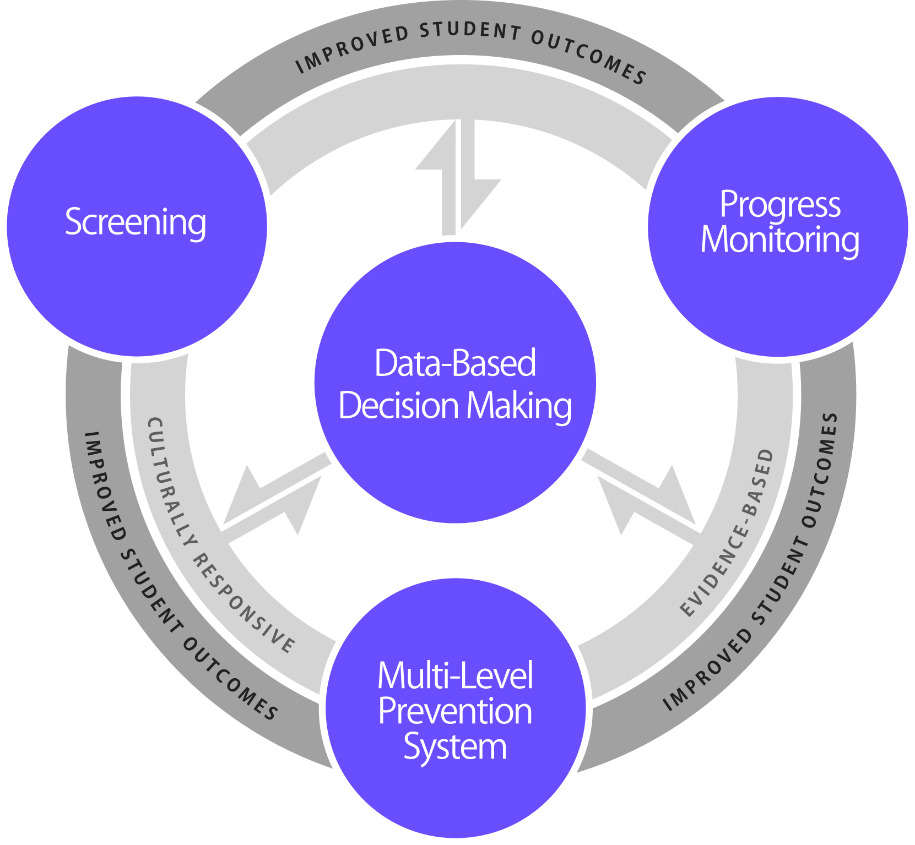
Essential Components of RTI
Notes:
The Center has developed this graphic to highlight the RTI framework. Many of you probably associate the red, green, and yellow triangle with RTI. In reality, the triangle does not represent the RTI framework; it only represents one component, the multi-level prevention system. The Center graphic takes into account all of the essential components and most importantly the use of data to make decisions, which is often absent from the traditional RTI triangle.
If you look to the far left, you see screening; to the far right, progress monitoring; and at the bottom, the multi-level prevention system. The three outer components require and are necessary parts of data-based decision making, which is why the arrows travel in both directions. If the 3 other components are in place, but data decision making is absent, then RTI is technically not being implemented.
In the center ring, you will see the phrase “culturally responsive,” meaning the screening tools, progress monitoring tools, core instruction, interventions, and data-based decision making procedures should all be culturally responsive. In the same ring, you will notice the phrase “evidence-based,” implying that all components are evidence based. If these components are implemented through a cohesive model, we would expect to see improved student outcomes. I’m now going to talk about each essential component in a little more detail.

Slide 9
MODULE 1: QUICK REVIEW
List the four essential components of RTI.
Do screening tools tend to overidentify or underidentify? Why?
What is classification accuracy?
Provide three examples of questions you can answer based on screening data.
Who should receive a screening assessment & how often?
What is the difference between a Mastery Measure and a General Outcome Measure?
What is the definition of norm referenced? Criterion referenced?
Notes:
Optional Audience Involvement Activity (1-2 minutes) to be used as a review activity if participants completed the screening module.
Note: Below is a simple way to conduct a review of content from the screening module. Feel free to change the format to meet the needs of the audience.
Depending on time available, give pairs 5-10 minutes to answer questions. Review the questions and answers with the group.
List the four essential components of RTI: screening, progress monitoring, multi-level system of prevention, and data-based decision making.
Do screening tools tend to overidentify or underidentify? Why? Overidentify – we’d rather “catch” students who do not need extra help rather than “miss” students who do.
What is classification accuracy? The classification accuracy indicates the extent to which a screening tool is able to accurately classify students into “at risk “ and “not at risk” categories.
Provide three examples of questions you can answer based on screening data: Is your core curriculum effective? What students need additional support? What grades/schools need additional support? Are certain policies effective?
What is criterion referenced? In criterion-referenced assessments, students are measured against defined (and objective) criteria , assessments are often used to establish a person’s confidence, and the criteria tend to be consistent year to year.
What is the difference between a summative and formative assessment? Provide an example of each. Summative assessments are typically administered after instruction and tell us what a student learned (ex., end of chapter tests, high stakes tests, final exams.) Formative assessments are administered during instruction and tell us how well students are responding to instruction (ex. mastery measures, general outcome measures.)
Who should receive a screening assessment? All students

Slide 10
Review: Types of Assessment
Type | When? | Why?
Summative | After | Assessment of Learning
Diagnostic | Before | Identify skill strengths and weakness
Formative | During | Assessment for Learning
Type | When? | Why?
Summative | After | Assessment of Learning
Diagnostic | Before | Identify skill deficits
Formative | During | Assessment for Learning
Notes:
If Module 2: Progress Monitoring is not being presented as part of the complete series, consider presenting the complete “Understanding Types of Assessment Within an RTI Framework” found in slides 37-46 (approximately) of Module 1: Screening.
There are three types of assessments commonly used within an RTI framework: summative, diagnostic, and formative. Summative assessments occur after instruction and are assessments of learning. Diagnostic assessments occur before instruction and help to identify skill strengths and weakness. Formative assessments occur during instruction and are assessments for learning.
We will now spend some more time on reviewing information about formative assessments.

Slide 11
Review: Formative Assessments
PURPOSE: Tells us how well students are responding to instruction
Administered during instruction
Typically administered to all students during screening and some students for progress monitoring
May be formal (i.e., standardized) or informal
Notes:
Formative assessment is a form of evaluation used to plan instruction in a recursive way. Formative assessments tell us how well students are responding to instruction. With formative assessment, student progress is systematically assessed during instruction to provide continuous feedback to both the student and the teacher concerning learning successes and failures. Formative assessments are typically administered to all students during screening/benchmarking and some students for progress monitoring.
Formative assessments may be informal or formal. Informal assessments are not data-driven but rather content and performance-driven. Examples include observations and teacher-made assessments. Formal assessments have data which support the conclusions made from the test. We usually refer to these types of tests as standardized measures. These tests have been tried before on students and have statistics which support the conclusion such as the student is reading below average for his age. The data are often mathematically computed and summarized. Scores such as percentiles, stanines, or standard scores are commonly received from this type of assessment. Examples include (but are not limited to): CBM, CBA, pre/post tests, benchmark assessments, and quizzes.
With formative assessment, teachers diagnose skill, ability, and knowledge gaps; measure progress; and evaluate instruction. Educational decisions that can be made using formative assessments include:
Identification of students who are nonresponsive to instruction or interventions (screening and progress monitoring);
Curriculum and instructional decisions;
Program evaluation;
Resource allocation (this is proactive as this information is provided as the instruction is occurring); and
Comparison of instruction and intervention efficacy.
Formative assessments are not necessarily used for grading purposes.

Slide 12
Part 1: overview & purpose of progress monitoring
Notes:
You may want to provide a short break at this time.
If Module 2: Progress Monitoring is not being presented in a series, present slides 36-64 (Approximately 30 minutes) from Module 1: Screening to ensure participants have a clear understanding of formative, diagnostic, and summative assessments before introducing this section.
The following are key terms and main points that should be focused on during this segment of the presentation.
Key Terms:
Formative assessments
Mastery measure
General outcome measure
Main Points:
Progress monitoring data can be used to estimate student improvement, compare the efficacy of different interventions, and identify students who are and are not responding to instruction.
Progress monitoring is an example of a formative assessment. Although teachers can use the data to make decisions about what is or is not working, they are not considered to be diagnostic assessments.
Progress monitoring tools can either be mastery measures or general outcomes measures. When used as a progress monitoring tool, they address very different questions: 1) Can the students learn the skills? and 2) Can the student generalize and maintain the learned skills, respectively.
No progress monitoring tool is perfect. Participants must take into account their needs and priorities as well as the technical adequacy of the tool when selecting progress monitoring tools.

Slide 13
Progress Monitoring
Standardized type of formative assessment
Allows you evaluate progress over time to determine:
  Student response to instruction/intervention
  Instructional effectiveness for groups & individuals
  SLD eligibility (in accordance with law)

Slide 14
Screening v. Progress Monitoring
“Close Cousins”
Often the same measures used
In some publications, you may see screening described as a type of progress monitoring.
Within RTI it is important to differentiate:
  Universal Screening, which is for all students from
  Progress Monitoring, which is for some students who have been identified as at-risk for poor academic or behavioral outcomes.

Slide 15
Why Progress Monitoring?
Progress monitoring research has been conducted over the past 30 years
Research has demonstrated that when teachers use progress monitoring for instructional decision making:
  Students learn more
  Teacher decision making improves
  Students are more aware of their performance
Notes:
Progress monitoring research, specifically focused on Curriculum Based Measurement (CBM), a type of progress monitoring , has occurred for more than 30 years.
Research has demonstrated that when teachers use progress monitoring for instructional decision making, students learn more, teacher decision making improves, and students are more aware of their own performance (e.g., Fuchs, Deno, & Mirkin, 1984). CBM research, has also shown CBMs to be reliable and valid (e.g., Deno, 1985; Germann & Tindal, 1985; Marston, 1988; Shinn, 1989).
A more in-depth bibliography of CBM research is available in the Progress Monitoring Manual.
Examples of Resources:
Deno, S.L. (1985). Curriculum-based measurement: The emerging alternative. Exceptional Children, 52, 219-232.
Fuchs, L.S., Deno, S.L., & Mirkin, P.K. (1984). Effects of frequent curriculum-based measurement of evaluation on pedagogy, student achievement, and student awareness of learning. American Educational Research Journal, 21, 449-460.
Germann G., & Tindal, G. (1985). An application on curriculum-based assessment: The use of direct and repeated measurement. Exceptional Children, 52, 244-265.
Marston, D. (1988). The effectiveness of special education: A time-series analysis of reading performance in regular and special education settings. The Journal of Special Education, 21, 13-26.
Shinn, M.R. (Ed.). (1989). Curriculum-based measurement: Assessing special children. New York: Guilford Press.

Slide 16
Progress Monitoring
PURPOSE: monitor students’ response to primary, secondary, or tertiary instruction in order to estimate rates of improvement, identify students who are not demonstrating adequate progress, and compare the efficacy of different forms of instruction
FOCUS: students identified through screening as at risk for poor learning outcomes
TOOLS: brief assessments that are valid, reliable, and evidence based
TIMEFRAME: students are assessed at regular intervals (e.g., weekly, biweekly, or monthly)
Notes:
The purpose of progress monitoring is to monitor students’ response to primary, secondary and tertiary instruction. Progress monitoring data can be used to 1) estimate the rates of improvement which allows for comparison to peers; 2) identify students who are not demonstrating or making adequate progress so that instructional changes can be made, and 3) compare the efficiency of different forms of instruction – in other words, which instructional approach or intervention led to the greatest growth among students.
It is not just for those students identified for supplemental instruction. The focus is on students who have been identified through screening as at risk for poor learning outcomes. This could include students just above the cut score as well as those scoring below the cut score.
Progress monitoring tools, just like screening tools, should be brief, valid, reliable, and evidence based. Common progress monitoring tools include general outcome measurements, including curriculum-based measurements, as well as mastery measurements.
The timeframe for progress monitoring assessment is really dependent on the tools being used and the typical rate of growth for the student.
Progress monitoring can be used anytime throughout the school year. With progress monitoring, students are assessed at regular intervals (weekly, bi-weekly, monthly) to produce accurate and meaningful results that teachers can use to quantify short- and long-term student gains toward end-of-year goals. At a minimum, progress monitoring tools should be administered at least monthly. However, more frequent data collection is recommended given the amount of data needed for making decisions with confidence (6-9 data points for many tools). With progress monitoring, teachers establish long-term (i.e., end-of-year) goals indicating the level of proficiency students should demonstrate by the end of the school year.

Slide 17
Purpose of Progress Monitoring
Allows practitioners to…
Estimate rates of improvement
Identify students who are not demonstrating adequate progress
Compare the efficacy of different forms of instruction in order to design more effective, individualized instruction
Notes:
Progress monitoring data allows practitioners to…
Read slide bullets
Note: Confirming/disconfirming screening data can be done through the first two.

Slide 18
Estimate Rates of Improvement
.3 WRC
6 WRC
Notes:
The graph on the left shows a student with sharply increasing CBM scores. The increasing scores may indicate the student is responding to his or her current instructional program.
The graph on the right shows a student with fairly flat CBM scores. The flatter scores may indicate that the student is not responding to his or her current instruction, and perhaps an instructional change for the student should occur.
However, a visual inspection of the data points is not sufficient to tell us if the student is making adequate progress. To be sure, we can quantify a rate of improvement through a technique we will learn about later in the training. With this rate of improvement, we can compare this student’s growth rate to his or her peers or to a local or national norm.

Slide 19
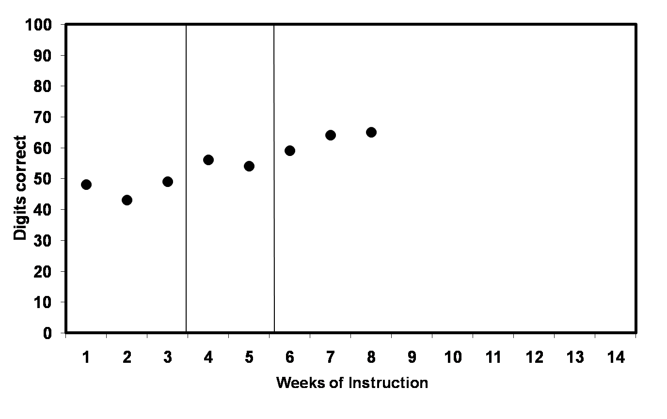
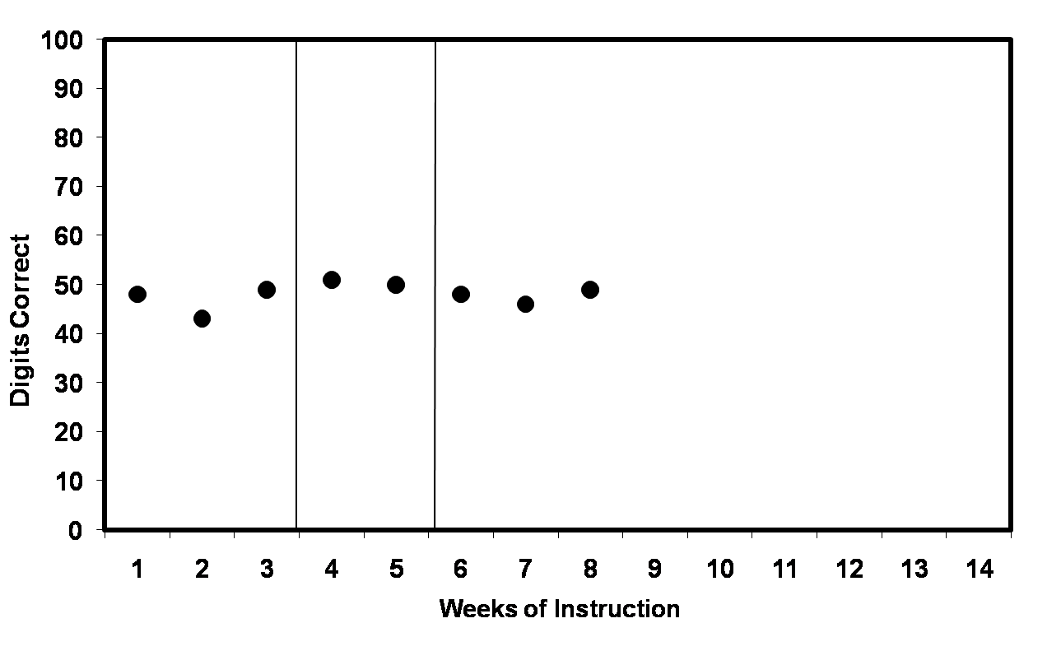
Identify Students Not Making Adequate Progress
Flat Scores:
Increasing Scores:
trend line
Goal line
X
X
X
Goal line
X
X
X
trend line
Notes:
We can also see improvement by looking at trend lines in comparison to their goal lines.
On the graph on the left, the trend line is steeper than the goal line. The student is showing increasing scores; therefore, the student is making adequate progress and the end-of-year goal may need to be adjusted to provide more of a challenge.
On the graph on the right, the trend line is flatter than the goal line. The student is not profiting from the instruction and, therefore, the teacher needs to make a change in instructional program. Remember, you never lower the goal. Instead, the instructional program should be tailored to bring a student’s scores up so the scores match or surpass the goal line.
We will discuss trend lines and goal lines and how to set appropriate goals later.

Slide 20
Compare Efficacy of Interventions
Growth by Intervention Type
Score
Notes:
Using average progress monitoring scores of students in different intervention groups, practitioners can compare and contrast the efficacy of interventions. Continued use of ineffective interventions can be costly and harmful to students (increases the learning gap). In this graph, intervention A appears to be more effective than B or C. Instead of providing three different interventions to address similar issues, it might be more efficient and effective to focus resources on implementing intervention A. This type of data can also provide information about what is a realistic growth rate for students in these interventions. The advanced trainings will provide additional information on how to calculate this information.

Slide 21
Thus, Progress Monitoring Tools Should…
Be valid and reliable for both:
  Level (i.e., that performance at a specific time point is stable and predicts end-end-of year achievement)
  AND
  Growth (i.e., that rate of improvement is also stable and predictive of end-of-year achievement)
Use standardized administration & scoring procedures
Have alternate forms of comparable difficulty
Notes:
To evaluate progress over time in a valid and reliable way, measures should include the elements listed in this slide.

Slide 22
When appropriate measures are used, progress monitoring can help determine…
Are students making progress at an acceptable rate?
Are students meeting short- and long-term performance goals?
Does the instruction or intervention need to be adjusted or changed?
Notes:
In summary, progress monitoring data can help answer these questions.
Are students making progress at an acceptable rate? It isn’t enough to make progress. The progress must be meaningful and sufficient to close the gap between the student’s progress and that of his/her peers.
Are students meeting short-term goals, which will help them reach their long-term goals?
Does the instruction need to be adjusted or changed? Using pre-established data decision rules, progress monitoring allows you to determine if the instruction is working for the student and evaluate the effectiveness of changes.

Slide 23
THINK-PAIR-SHARE
How is progress monitoring being used in your district?
Notes:
Think about how progress monitoring is being used in your district.
Give participants approximately 20 seconds.
Pair and share with your neighbor/table and jot down your answer.
Give participants approximately 2-3 minute.
Allow two or three pairs/tables to orally share their answers.

Slide 24
Approaches to Progress Monitoring
Progress monitoring tools are:
  brief assessments
  reliable, valid, and evidence based
  repeated measures that capture student ability
  measures of age-appropriate outcomes
Different progress monitoring tools may be used to assess different outcomes of interest
Notes:
Progress monitoring tools are brief assessments that are reliable, valid, and evidence based and use repeated measures that capture student ability. They should be measures of age- appropriate outcomes
No one progress monitoring tool can monitor for all outcome areas. Different tools may be necessary for different areas.

Slide 25
Common Formative Assessments Used for Progress Monitoring
Mastery Measurement
General Outcome Measures
vs.
Multidigit Addition
Multidigit
Subtraction
Multiplication
Facts
10
8
6
Number of problems correct in 5 minutes
4
2
0
2
4
6
8
10
12
14
WEEKS
Notes:
The two types of formative assessment provide different information. Mastery Measurement data indicates progress towards mastery of specific subskills (e.g., decoding short vowel sounds, calculating none math facts) while General Outcome Measures (GOMs) indicate progress toward a broader outcome. The latter involves the application of all of the subskills learned over time.
One key difference between Mastery Measures and General Outcome Measures is comparability of data longitudinally. With GOM you can compare the score a student received in May to a score they had in September. This cannot be done with Mastery Measures.
Note the red goal line on the GOM graph. Its counterpart on the GOM graph is the horizontal mastery line that is stagnant at 80%. In contrast, the goal line on a GOM graph is dynamic; it indicates the changing desired score indexed to the week in the school year. With this dynamic goal line, teachers always have an indicator of where the student is in relation to the goal for right now as well as the goal for the end of the year. Therefore, it is always evident how the student’s current abilities compare to where you want them to be right now, considering where you want them to be at the end of the year, giving you an idea of the extent to which you need to ACCELERATE progress to get on track, stay on track, and meet the goal. In other words, the GOM graph shows you immediately where the achievement gap is and how much progress needs to be made to close it.

Slide 26
Quick Review: Mastery Measurement
Describes mastery of a series of short-term instructional objectives
To implement Mastery Measurement, the teacher:
  Determines a sensible instructional sequence for the school year
  Designs criterion-referenced testing procedures to match each step in that instructional sequence
Notes:
A Mastery Measure
Read slide
There are some advantages to using Mastery Measures. By focusing on a single skill, practitioners can assess whether a student can learn target skills in isolation. Teachers can use the information from the ongoing progress monitoring data to make decisions about changing target skill instruction. Until recently, the psychometric properties of most mastery measures were not valid and reliable. However, as you can see by the addition of Mastery Measures to the NCRTI Progress Monitoring Tools Chart, there is increasing research demonstrating the validity and reliability of some tools. Mastery measure are typically not valid screening measures. They are often used for progress monitoring students identified through screening measures. There are also some problems associated with mastery measurement . They include:
Hierarchy of skills is logical, not empirical – meaning that while it may seem logical to teach addition first and then subtraction, there is no evidence-based research that says you have to do it that way.
Assessment does not reflect maintenance or generalization. You don’t know after teaching subtraction with regrouping if the student remembers how to do addition with regrouping.
Number of objectives mastered does not relate well to performance on criterion measures – meaning how a student does on these assessments does not indicate how he or she will do on standardized tests.
Measurement methods are designed by teachers, with unknown reliability and validity.

Slide 27
Mastery Measure: Multidigit Addition Assessment
Notes:
This is an example of a Mastery Measure for multidigit addition with regrouping. While teaching multidigit addition with regrouping, the teacher may give assessments that look something like this. There are 10 problems, all dealing with multidigit addition with regrouping.

Slide 28
Quick Review: General Outcome Measures (GOM)
A GOM is a measure that reflects overall competence in the annual curriculum.
Describes individual student’s growth and development over time (both “current status” and “rate of development”).
Provides a decision-making model for designing and evaluating interventions.
Is used for individuals and groups of students.
Notes:
General Outcome Measures often address the problems associated with Mastery Measures.
A General Outcome Measure:
Is program independent – GOMs reflect overall competence in the year-long curriculum as opposed to being dependent on a particular program
Describes individual children’s growth and development over time (both “current status” and “rate of development”)
Provides a decision-making model for designing and evaluating interventions
Is used for individual children and for groups of children
As a result, GOM can serve as both screening and progress monitoring measures.
The focus of GOMs is on repeated measures of performance. GOMs make no assumptions about instructional hierarchy for determining measurement. In other words, GOMs fit with any instructional approach. Also, GOMs incorporate automatic tests of retention and generalization. Therefore, the teacher is constantly able to assess whether the student is retaining what was taught earlier in the year.
The point here is not to say that practitioners should always use GOMs or Mastery Measures, but that it is important to think about which measure is better for each objective.
For screening purposes, GOMs should always be used as GOMs work better to fulfill the objective of a screener.

Slide 29
GOM Example: CBM
Curriculum-Based Measure (CBM)
  a General Outcome Measure (GOM) of a student’s performance in either basic academic skills or content knowledge
  CBM tools available in basic skills and core subject areas grades K-8 (e.g., DIBELS, AIMSweb)
Notes:
An example of a General Outcome Measure is a Curriculum-Based Measure (CBM). CBM was initially developed more than 30 years ago by Stanley Deno and others at the University of Minnesota Institute for Research on Learning Disabilities to develop a reliable and valid measurement system for evaluating basic skills growth. They are GOMs of a student's performance in either basic academic skills or content knowledge.
Research began in the area of reading and has expanded to additional tools in basic skills and other core subject areas in grades K-8 (e.g., literacy, math, writing and tools in Spanish).
CBM tests (also called “probes”) are relatively brief and easy to administer. The probes are administered the same way every time. Each probe is a different test, but the probes assess the same skills at the same difficulty level.
Focus is on repeated measures of performance
Makes no assumptions about instructional hierarchy for determining measurement
Incorporates automatic tests of retention and generalization
Curriculum independent
Throughout the presentation, progress monitoring will be operationalized through the use of Curriculum-Based Measurement (CBM).

Slide 30
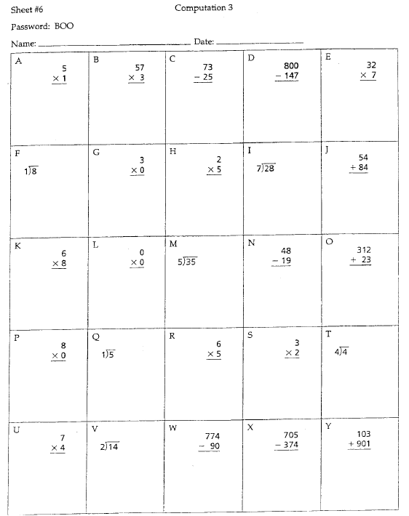
CBM Math Example
Random numerals within problems (considering specifications of problem types)
Random placement of problem types on page
Notes:
Here is an example of a CBM for math. Rather than only assessing for the first objective that is being taught, as was done for the mastery measure, all objectives in the curriculum are assessed. Different types of problems are placed randomly throughout the page.

Slide 31
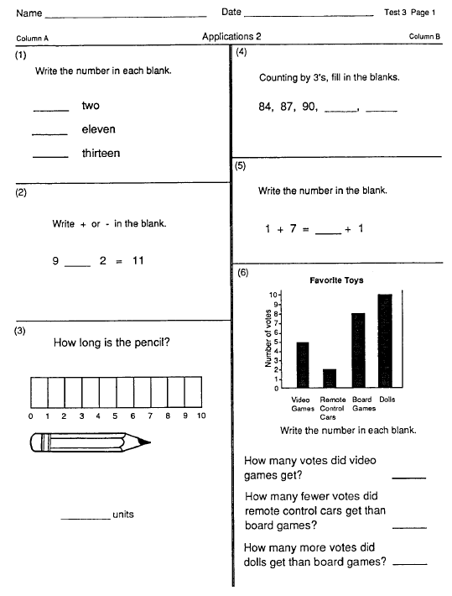
Sample Grade 2 Math Concepts & Applications CBM (full test is 3 pages)

Slide 32
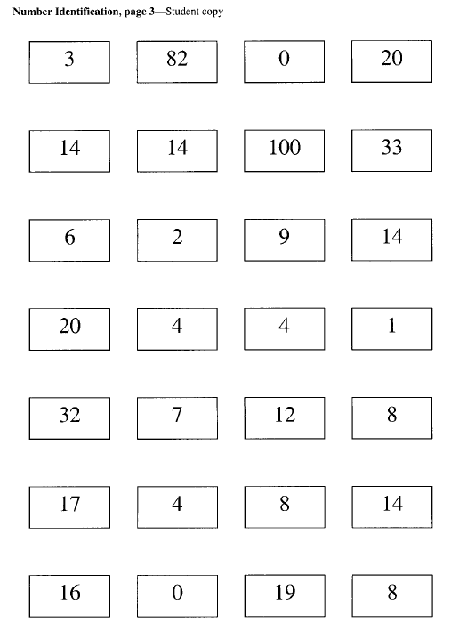
Sample Early Numeracy CBM: Number Identification (actual test is 3 pages)

Slide 33
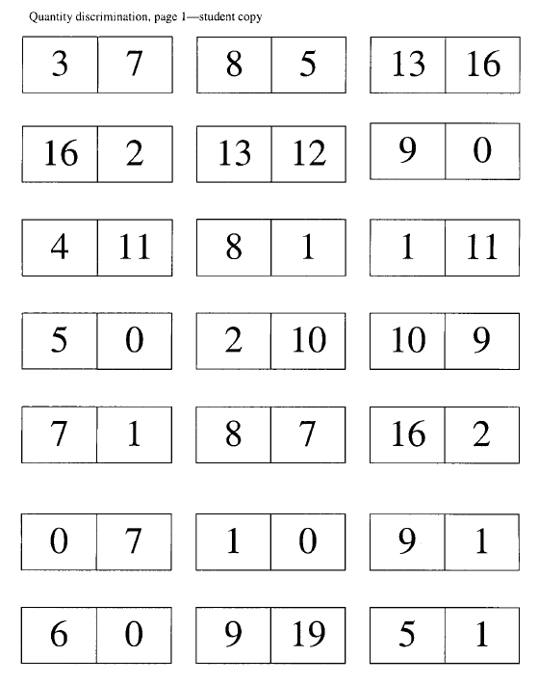
Sample Early Numeracy CBM: Quantity Discrimination(actual test is 3 pages)

Slide 34
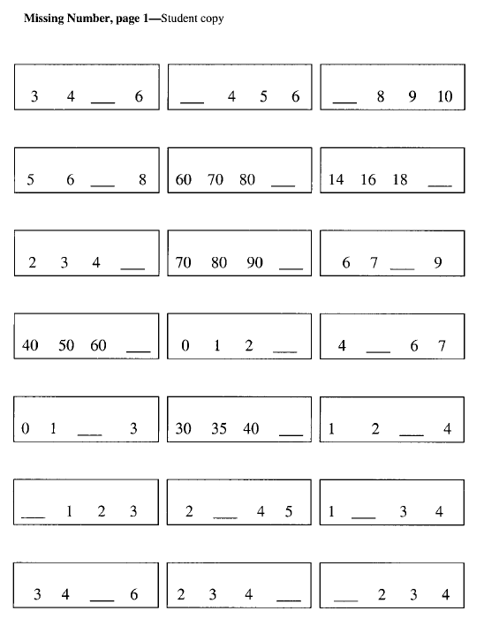
Sample Early Numeracy CBM: Missing Number (actual test is 3 pages)

Slide 35
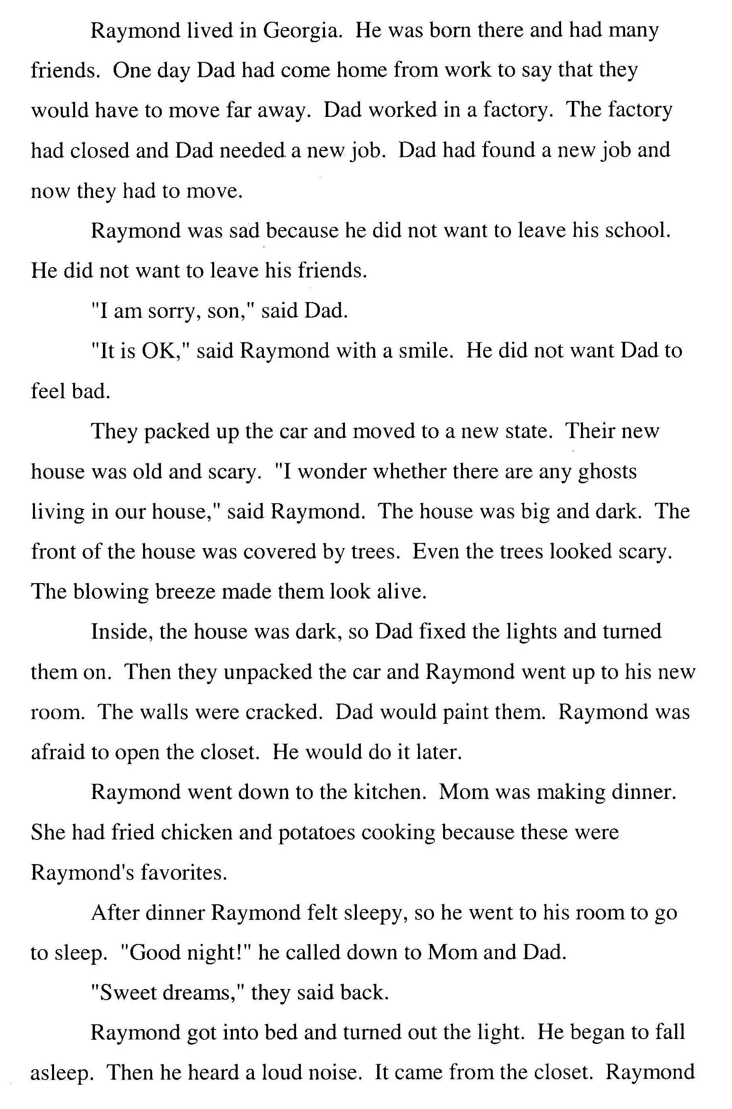
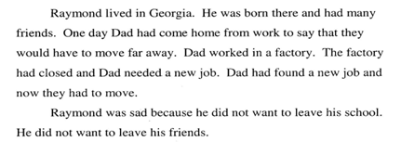
CBM Passage Reading Fluency
Student copy
Notes:
35
This is the student copy of a CBM Passage Reading Fluency probe. This copy is placed in front of the student.
Students are provided standardized directions and asked to read aloud for one minute. The teacher scores the probes for words read correct, marking only words read incorrectly. The total words read correctly in one-minute is considered the score for that passage. To get an accurate score for the baseline, students read three one minute passages, and the median (middle) score is recorded. Once the baseline is established, during progress monitoring, the passage is only read one time.

Slide 36
THINK-PAIR -SHARE
What mastery measures and general outcome measures are being used in your district?
What are the advantages/disadvantages of each approach?
Notes:
Think What mastery measures and GOMs are used in my district or school?
Give participants approximately 20 seconds.
Pair and share with your neighbor/table and discuss.
Give participants approximately 2-3 minutes.
Allow two or three pairs/tables to orally share their thoughts.

Slide 37
Group Discussion
Why might GOMs be advantageous for progress monitoring within an RTI system (when they are available)?
Notes:
Pose this question the group. Be sure these key points are addressed:
-Sample entire yearlong curriculum (what you want kids to know)
-Incorporates tests of maintenance and generalization (That is, have students retained covered concepts, and can they extend learning to novel concepts?)
-GOMs do not assume a specific instructional progression
-Parallel/alternate forms allow you to evaluate growth over time to determine instructional effectiveness

Slide 38
PART 2: USING THE PROGRESS MONITORING TOOLS CHART

Slide 39
Should my assessment tool be used for progress monitoring?
Although a many assessments provide useful information and may be part of your broad approach to formative assessment, consider the following when deciding whether a tool should be used for progress monitoring within your RTI system...
Are there standardized administration & scoring instructions?
Are parallel/alternate forms available to allow for repeated assessment?
Is there evidence of reliability & validity of performance level?
Is there evidence or reliability & validity of the slope (i.e., growth rate)?
The Progress Monitoring Tools Chart can help you answer these questions!

Slide 40
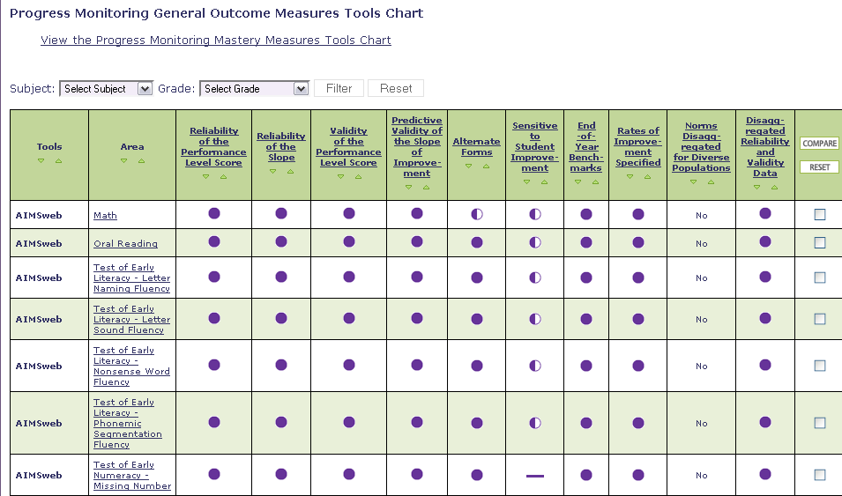
NCRTI Progress Monitoring Tools Chart
www.rti4success.org
Notes:
The Center has developed the Progress Monitoring Tools Chart that can be accessed through the National Center on RTI’s website at www.rti4success.org. The columns on the tools chart are indictors of the technical rigor of the tools. You will notice in several of the columns circles filled completely, partially, or not at all. The tools chart does not recommend tools, but provides users with a consumer report on available tools, similar to what you may find when searching for a car.
There are many progress monitoring tools available and all are not listed on the Progress Monitoring Tools Chart. Only tools that have been submitted by the tool vendor appear on the chart. When selecting a tool, it is important to consider both the technical rigor of the tool as well as your needs and priorities. We will discuss the tool chart in more depth later in the training.

Slide 41
Process for Using the Tools Chart
Possible Steps…
Gather a team
Determine your needs
Determine your priorities
Familiarize yourself with the content and language of the chart
Review the ratings and implementation data
Ask for more information
Notes:
The tools chart includes a large amount of information designed to assist you in selecting a tool that is most appropriate for use in your classroom, school, or district. The “best” tool is not going to be the same for every user and is not determined by any single element on the chart. Users of the chart should review all of the different elements of the chart when making a decision.
Read the slide.
For more information about the six recommended steps for using the Progress Monitoring Tools Chart and selecting a tool, check out the NCRTI Users Guide available for download on the NCRTI website, www.rti4success.org.

Slide 42
1. Gather a Team
Who should be involved in selecting a progress monitoring tool?
What types of expertise and what perspectives should be involved in selecting a tool?
Notes:
Often, decisions about appropriate progress monitoring tools will involve the input of multiple teachers and staff. When using the tools chart, a team of key constituents in your school and district should review the information together. In gathering this team, you should think about the following questions:
Read the slide.

Slide 43
2. Determine Your Needs
For what skills or set of skills do you need a progress monitoring tool?
What population will you progress monitor (grades, subgroups)?
When and how frequently will progress monitoring occur?
Who will conduct the progress monitoring and what is their knowledge and skill level?
What kind of training do they need and who will provide it?
What materials will you need (computer, paper and pencil)?
How much funding will you need?
Notes:
The most appropriate progress monitoring tool for you will depend on your specific needs. In determining your needs, you should think about the following questions:
Read the slide. Refer participants to the Progress Monitoring Tools Chart Users Guide for the list of questions.

Slide 44
3. Determine Your Priorities
Is it a tool that can be purchased for a reasonable cost?
Is it a tool that does not take long to administer and score?
Is it a tool that offers ready access to training and technical support for staff?
Is it a tool that meets the highest standards for technical rigor?
Notes:
In addition to determining your needs for a progress monitoring tool, your team should also consider its priorities. Although you may want a tool that meets all of these criteria, such a tool may not exist. You will need to weigh your priorities carefully when making your selection. In determining your priorities, you should think about the following questions. For example, if cost is a priority ask, “Is it a tool that can be purchased for a reasonable cost?”
Other priorities may be administration time (read bullet 2), training required (read bullet 3), standard of technical rigor (read bullet 4), or demonstrated effectiveness (read bullet 4).
Refer participants to the Progress Monitoring Tools Chart User’s Guide for the list of questions.

Slide 45
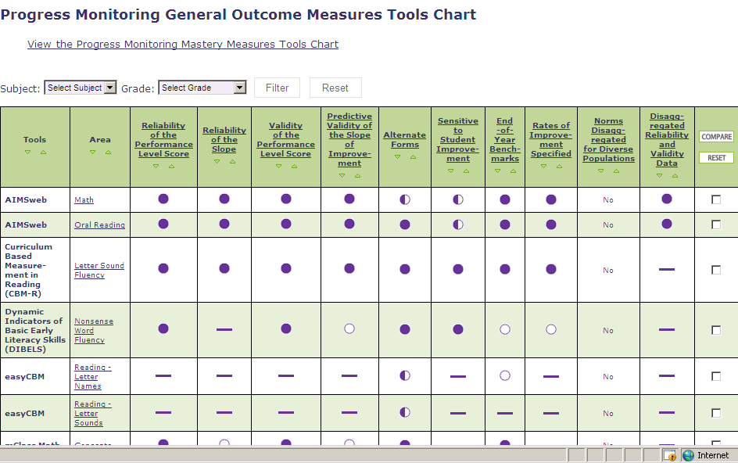
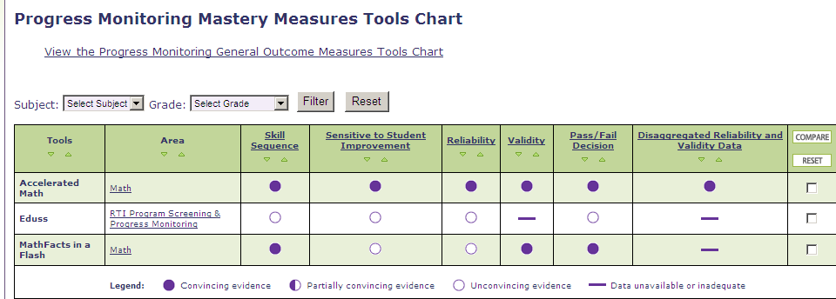
4. Familiarize Yourself with the Content and Language of the Chart
General Outcome Measures
Mastery Measures
Notes:
Presenters may chose two options for the overview of the Progress Monitoring Tools Chart. Option 1: Use the following slides to demonstrate how the tools chart is designed. Option 2: Provide a live demonstration of the tools chart. This would require deviating from the slides.
The Progress Monitoring Tools Chart includes information about two types of progress monitoring tools:
General Outcome Measures reflect overall competence in the annual curriculum.
Mastery Measures index a student’s successive mastery of a hierarchy of objectives.
When you visit www.rti4sucess.org and click on the Progress Monitoring Tools Chart tab you will see the General Outcome Measures Tools Chart. To view the Mastery Measures Tools Chart click the link that appears above the tools chart. Once you are on the Mastery Measure chart you can return to the General Outcome Measures chart by clicking the link. For each tool, the chart provides information about technical rigor and implementation requirements.
Click the links or the bullets to see more information like Implementation Requirements (e.g. cost, training needs), and Data (e.g., reliability data, validity data).
45

Slide 46
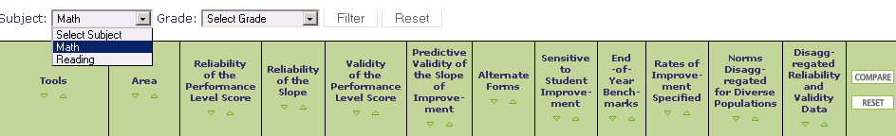
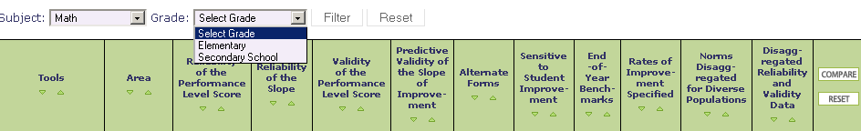
Select Reading or Math to limit the tools to the subject of interest
Select Elementary or Secondary School to select the grade level of interest
Notes:
Some new features that have recently been added to the tools charts are the ability to sort tools and programs by the subject (math and reading) and grade (elementary and secondary) to narrow down the tools to those that fit your needs. To use these features select the appropriate subject or grade level and press the filter button. If you want to return to all the tools simply press reset.

Slide 47
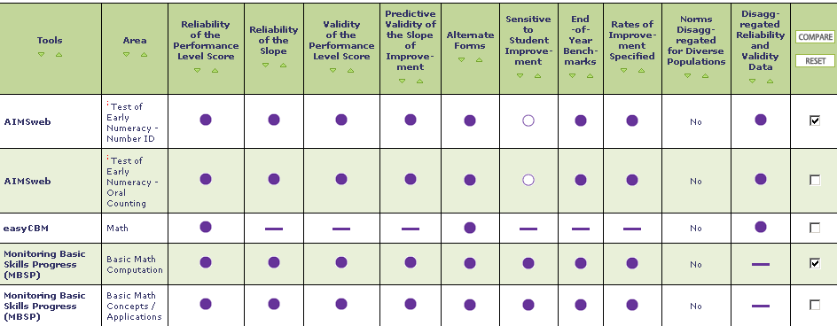
Comparing Tools
limit your search by selecting tools that appear to fit your needs
Notes:
Another new feature is the ability to limit the number of tools to compare. To select certain tools to compare, simply check the box in the last column of the chart. You can select as many tools as you would like. Press the Compare button and the chart will appear with the tools you selected.

Slide 48
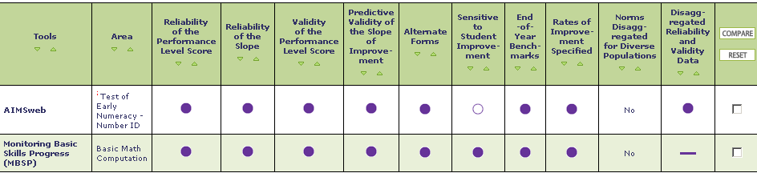
Comparing Tools
And compare them side by side
Notes:
This allows you to compare tools of interest side by side.

Slide 49
Technical Rigor
NCRTI Progress Monitoring Tool Chart –
General Outcome Measures
Notes:
Across the top you can see the Technical Rigor Standards listed for General Outcome Measures.

Slide 50
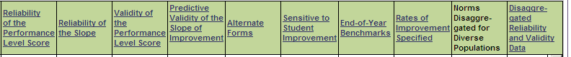
General Outcome Measures:
Technical Rigor
Technical Rigor Standards:
  Reliability of the Performance Level Score
  Reliability of the Slope
  Validity of the Performance Level Score
  Predictive Validity of the Slope of Improvement
  Alternate Forms
  Sensitive to Student Improvement
  End-of-Year Benchmarks
  Rates of Improvement Specified
  Norms Disaggregated for Diverse Populations
  Disaggregated Reliability and Validity Data
Notes:
For General Outcome Measures, the Technical Review Committee (TRC) has established nine standards for technical rigor of progress monitoring tools. These are:
Reliability of the performance level score: The extent to which the score (or average/median of 2 or 3 scores) is accurate and consistent.
Reliability of the slope: An indicator of how well individual differences in growth trajectories can be detected using a particular measure.
Validity of the performance level score: The extent to which the score (or average/median of 2 or 3 scores) represents the underlying construct. In other words, does the score actually represent the student’s performance level on the skill (e.g., decoding, reading fluency) or domain (e.g., general reading, math) we are interested in?
Predictive validity of the slope of improvement: The extent to which the slope of improvement corresponds with end-level performance on highly valued outcomes.
Alternate forms: Parallel versions of the measure of comparable difficulty (or with Item Response Theory based or with item or ability invariance) within a grade level.
Sensitive to student improvement: The extent to which a measure reveals improvement over time, when improvement actually occurs.
End-of-year benchmarks: The level of performance expected at the end of the grade, by grade level.
Rates of improvement specified: The expected slopes of improvement or average weekly increases, based on a line of best fit through the student’s scores.
Norms Disaggregated for Diverse Populations: Norms that are calculated and reported separately for diverse populations.
Disaggregated reliability and validity data: Scores that are calculated and reported separately for specific subgroups (e.g., race, economic status, special education status, etc.).

Slide 51
Technical Rigor
NCRTI Progress Monitoring Tool Chart –
Mastery Measures
Notes:
Across the top you can see the Technical Rigor Standards listed for Mastery Measures.

Slide 52
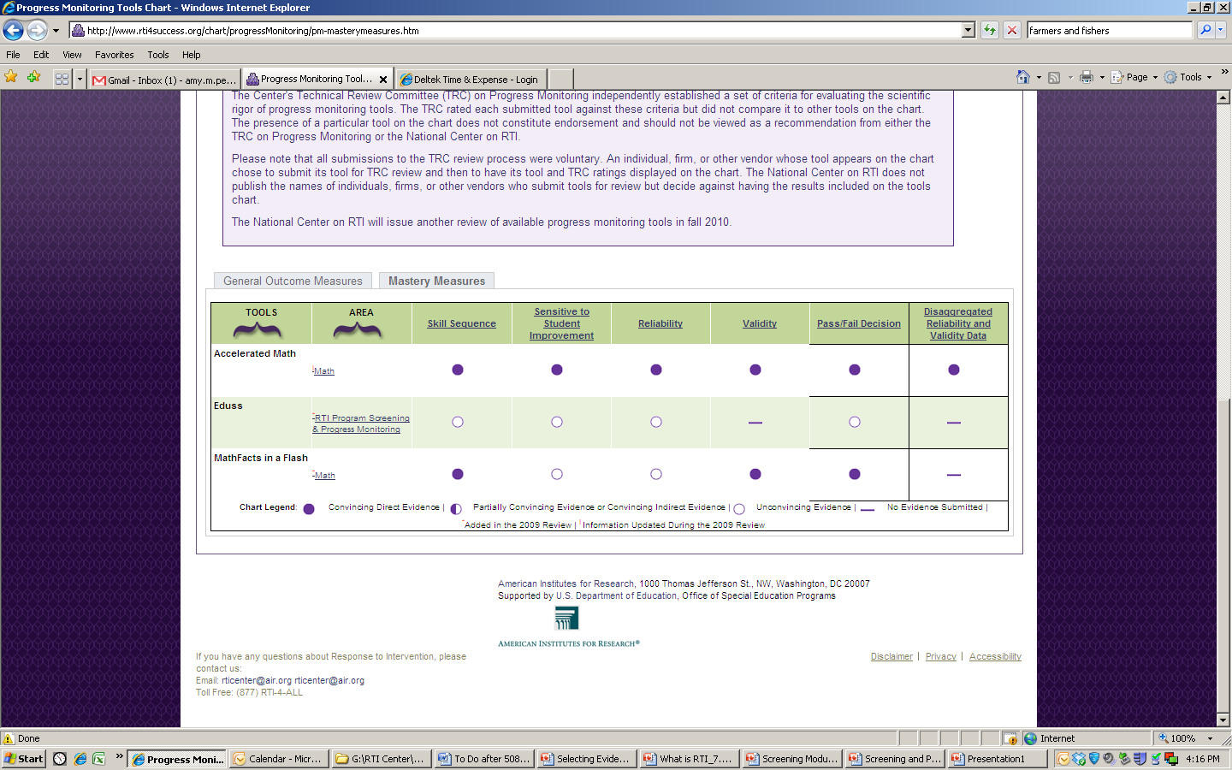
Mastery Measures: Technical Rigor
Technical Rigor Standards:
  Skill Sequence
  Sensitivity to Student Improvement
  Reliability
  Validity
  Pass/Fail Decision
  Disaggregated Reliability and Validity Data
Notes:
For Mastery Measures, the TRC has established six standards for technical rigor. These are:
Skill sequence: The series of objectives corresponds to the instructional hierarchy through which mastery is assessed.
Sensitivity to student improvement: The extent to which a measure reveals improvement over time, when improvement actually occurs.
Reliability: The extent to which scores are accurate and consistent.
Validity: The extent to which scores represent the underlying construct.
Pass/fail decision: The metric in which mastery measurement scores are reported.
Disaggregated reliability and validity data: Scores that are calculated and reported separately for specific subgroups (e.g., race, economic status, special education status, etc.).

Slide 53
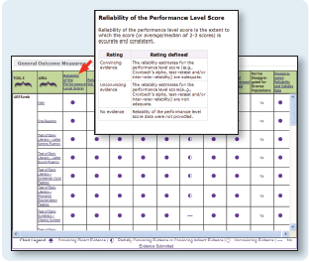
Notes:
For each of these standards, the TRC reviewed data submitted by developers of the tools and gave a rating of “convincing,” “partially convincing,”
“unconvincing,” or “no evidence.” Click on the name of the standard in the column heads of the chart to view a definition of the standard and a rubric
describing the specific criteria used by the TRC to rate tools on that standard.

Slide 54
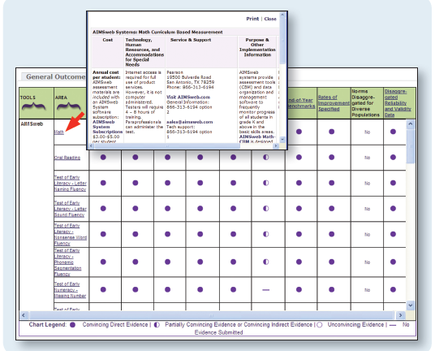
Implementation Requirements
Cost of tool
Training required to implement tool
Level of expertise required to administer tool
Training and technical support offered
How are scores reported
Notes:
The tools chart offers an “implementation table” for each tool. The implementation table can be accessed by clicking on the name of the tool. The implementation
table includes the following Information:
Cost of the tool
Training required to implement the tool
Level of staff expertise required to administer the tool
Where to go for training and technical support
How scores are reported

Slide 55
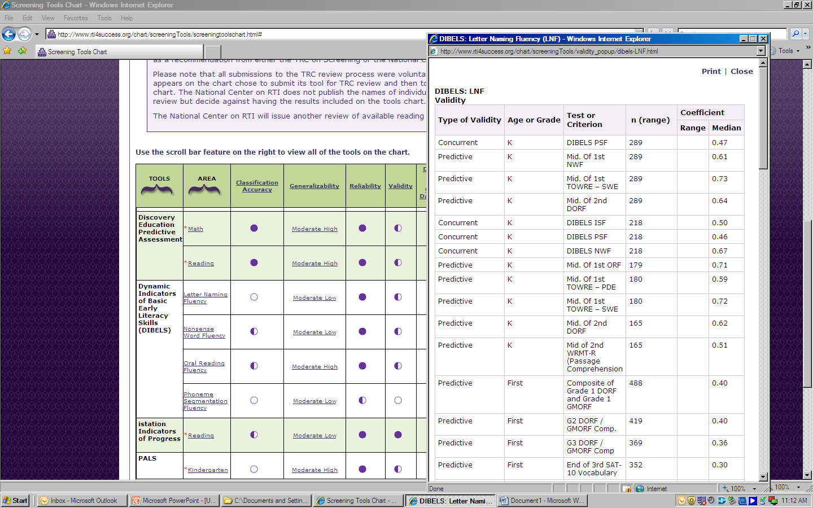
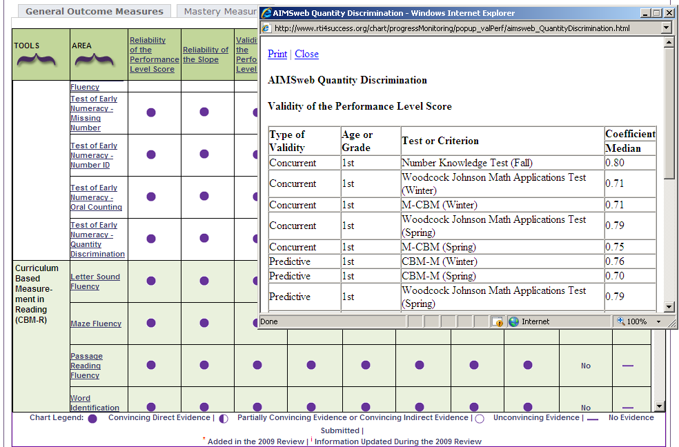
5. Review the Ratings and Implementation Data
Data:
Look for tools that conducted studies with outcome measures and samples similar to your population and outcome of interest
Determine if tools are appropriate for certain subgroups (e.g., ELLs)
Click on any rating bubble to view data
Notes:
The tools chart also includes detail about the actual data that were submitted to the TRC for review. These data can be viewed by clicking on any of the rating bubbles in the cells in the chart.
We recommend that you look for tools that conducted studies with outcome measures and samples similar to your population and outcome of interest.
By clicking on the rating bubble, you will obtain more information about which tool(s) is (are) most appropriate for which populations of students.
We recommend that someone on the team be familiar with data and can explain the ratings.

Slide 56
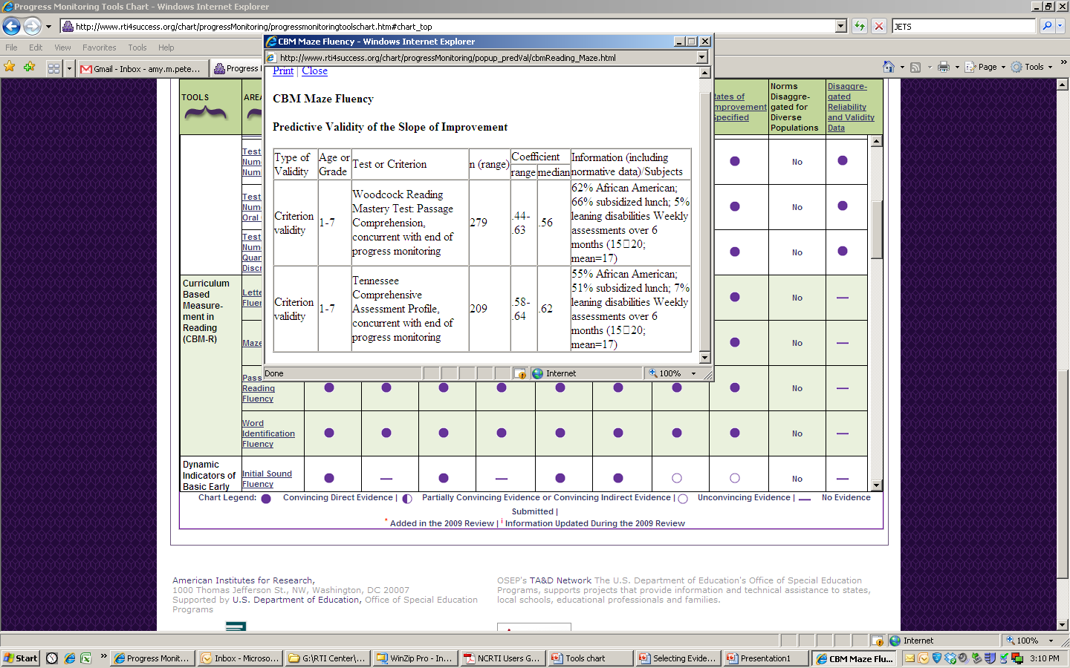
Example of Data
Notes:
Using the results of your needs and priority assessments, identify tools on the chart that could potentially be appropriate for you. For example, if you are interested
in a tool that measures progress in oral reading for use in Grades 4–6, use the filter button and implementation tables to identify which tools meet those criteria.
Next, use the compare feature to narrow your search. Then review the technical ratings for the subset of tools in which you interested. Work with a technical expert, such as your school psychologist or local university faculty, to understand how each standard is relevant to your needs and the relative importance of a “convincing” rating for each standard. For example, reliability and validity of the performance score are foundational psychometric standards. Therefore, you may be interested in a tool that excels in these two areas. Reliability of the slope and predictive validity of the slope of improvement, which also measure key aspects of psychometric quality, may not be as important to you as the reliability and validity standards.
Alternatively, you may have a stronger interest in tools that specify clearly the rates of improvement and/or end-of-year benchmarks than you do in tools that have high ratings for reliability and validity. When selecting a tool, you should carefully consider the unique and specific needs of your situation.

Slide 57
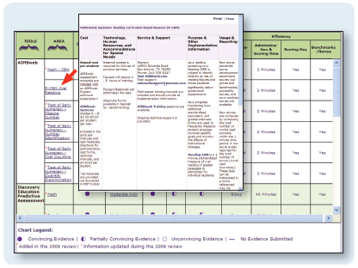
6. Ask for More Information
Notes:
You may find that the tools chart does not provide you with all the information you need. For example, what if a tool in which you are interested does not have disaggregated data for a particular subgroup that is important to you? Ask the vendor or developer. Developers who have chosen to submit their tools for review and publish them on the chart are interested in meeting the needs of their customers. As such, they are interested in doing more research to provide the data that you need.
Similarly, if a tool that you currently use or are interested in learning about is not on the chart, call the developer of that tool. Let them know about the TRC review process and the tools chart, and ask them to consider submitting the tool for review.
The tools chart provides publisher contact information in the pop-ups found in the second column.

Slide 58
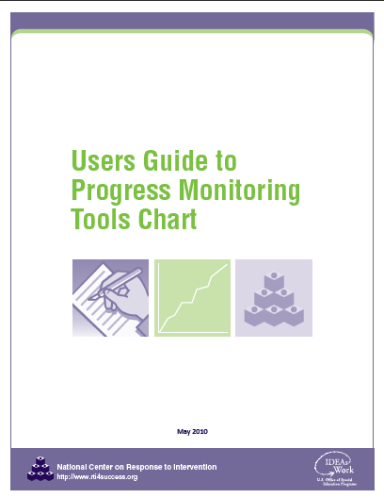
The NCRTI Progress Monitoring Tools Chart Users Guide
Notes:
For more information about the six recommended steps for using the Progress Monitoring Tool Chart and selecting a tool, check out the NCRTI Progress Monitoring Tools Chart Users Guide.

Slide 59
Planning for Progress Monitoring
Timeframe
Throughout instruction at regular intervals (e.g., weekly, bi-weekly, monthly)
Teachers use student data to quantify short- and long-term goals that will meet end-of-year goals
Notes:
Progress monitoring is used to monitor student progress across the entire school year. Students are given standardized probes at regular intervals (weekly, bi-weekly, monthly) to produce accurate and meaningful results that teachers can use to quantify short- and long-term student gains toward end-of-year goals.
At a minimum, progress monitoring tools should be administered monthly. However, more frequent data collection is recommended given the amount of data needed for making decisions with confidence. Research suggests that there needs to be six to nine data points to accurately make instructional decisions. As the number of data points increases, the effects of measurement error on the trend line decreases. The frequency in which a tool can be used for progress monitoring depends on the tool. Some tools are more sensitive than others, so they can be used more frequently.
59

Slide 60
Optional Team Time: Progress Monitoring
If you are here with a team, review the Progress Monitoring Tools Chart
  Are your tools there?
  What evidence exists for their reliability and validity?
  Are parallel/alternate forms available?
Notes:
Read slides.
Allow 10-15 minutes for teams to look more closely at the Progress Monitoring Tools Chart, either online if computers are available, or printed copies. The time for this team time activity will depend of the needs of the group. If time allows, consider having two or three teams share their tools and the evidence they found that supports their validity and reliability.

Slide 61
Part 3: progress monitoring Data- Based Decision Making
Notes:
Now that you have an understanding of what progress monitoring is, let’s look at how progress monitoring data can be used in the decision making process.
Key Terms:
Weekly Rate of Improvement (ROI)
Slope
Cut Score
Target or Benchmark
Trend Line
Trend Line Analysis
4-Point Rule
Main Points:
Goal setting for most students will be either through End-of-year Benchmarking or National Norms. Intra-individual Framework is limited to students well below grade level and most likely served by special education.
Basic decision rules, such as trend-line analysis and the 4-Point rule can be effective ways to begin to develop a systematic decision making process. As teams develop more experience, they can increase the sophistication of the process.
Data should drive decisions about program changes, movement between levels of instruction, and responsiveness and nonresponsivess.
No one tool or process is best. Teams will need to ongoing data analysis to determine the effectiveness and limitations of their selected process and tools.

Slide 62
Making Decisions with Progress Monitoring Data
Establish Data Review Team
Determine Frequency of Data Collection
Establish Baseline and Progress Monitoring Level
Establish Goal
Collect and Graph Data
Analyze Data & Make Instructional Decisions
Continue Progress Monitoring
Notes:
In general, the decision making process for progress monitoring follows several basic steps.
Read the slide.
These are suggested steps. We will talk about each of these steps in more detail.

Slide 63
Steps in the Decision Making Process
Establish Data Review Team
Determine Frequency of Data Collection
Establish Baseline and Progress Monitoring Level
Establish Goal
Collect and Graph Frequent Data
Analyze and Make Instructional Decisions
Continue Progress Monitoring
Notes:
Now that we have the goals set, we need to determine the frequency of data collection.

Slide 64
Data Review Teams
Include at least three members
Plan meetings to regularly review PM data (e.g., every four to six weeks)
Follow established systemic data review procedures
  Many schools have established agendas
  Resources are available online
Notes:
We recommend including at least three people in a data review team so there can be a focused discussion about the data with various viewpoints. Data review teams should include a general education teacher and other decision makers, such as special educators and instructional specialists, and/or a school psychologist. At least one team member should have data interpretation skills and experience. It is important to meet regularly, such as every four to six weeks, and follow established systematic data review procedures.

Slide 65
Roles and Responsibilities of Team Members
Ensure progress monitoring data are accurate
  Administration & scoring training
  Monitor fidelity of implementation
  Provide additional training as needed
Review progress monitoring data regularly
Identify students in need of supplemental interventions
Evaluate efficacy of supplemental interventions
Notes:
Team members should
Read the slide.
For bullet 1:
Remember, consistent implementation matters. Technical characteristics apply only when standardized administration and scoring procedures are used.
Train and check all staff who administer/score assessments
Monitor fidelity to:
Identify errors and re-teach in a timely manner
Help determine the reason(s) for low/flat achievement
Isolate reasons for inconsistent screening/outcome performance

Slide 66
Plan to Regularly Review Progress Monitoring Data
Conduct at logical, predetermined intervals
Schedule prior to the beginning of instruction
Involve relevant team members
Use established meeting structures
  Standard Agenda
  Minutes assigned to each section to be covered
  Rules about individual student v. group discussions
Notes:
It is important that there is a process in place for regularly reviewing progress monitoring data.
Read the slide.

Slide 67
Establish Systematic Data Review Procedures
Articulate routines and procedures in writing
Implement established routines and procedures with integrity
Ensure routines and procedures are culturally and linguistically responsive
  Limit time spent “admiring data”
  Discuss intervention/accommodation options that school staff have at their disposal
Notes:
Articulating routines and procedures in writing helps ensure and assess if established routines and procedures are being implemented with integrity. Ongoing evaluation of the selected routines and procedures is necessary to ensure they are culturally and linguistically responsive and lead to the desired outcome.

Slide 68
Establish Systematic Data Review Procedures
Consider clarifying the following in writing:
What you are looking for?
How will you look for it?
How will you know if you found it?
Notes:
Consider clarifying the following in writing:
What are you looking for?
Data fishing can be fun, but may lead to problems. It can cause a delay in the use of data (especially if there are a lot of data), change the focus of the analysis, or miss important trends or issues. Identity what you are interested in knowing prior to your data analysis. If you are unclear what you are looking for, conduct an analysis of the more critical outcomes first (graduation, reading performance) and then focus on outcomes in other issues. It is important to prioritize.
Identify what you are looking for at all levels of analysis (district, school, grade, class, students) and levels of prevention (primary, secondary, or tertiary).
How will you look for it?
Develop a plan on how you will systematically analyze your data. This can increase the efficiency of your data analysis activities. It also helps manage the output many data systems offer. Only the most critical data is needed first. It allows you to know where to delve in deeper.
How will you know if you found it?
Determine how much evidence is needed for the team to identify a problem. Once identified the team can continue moving through the problem solving process in order to develop a plan of action.

Slide 69
Think-Pair-Share
In your school sites…
  Who should be involved in the review of progress monitoring data?
  What data review schedule is available?
  How should meetings be facilitated?
Notes:
Think about the data review process in your school sites.
Who should be involved in the review of progress monitoring data?
What data review schedule is available?
How should meetings be facilitated?
Give participants approximately 20 seconds.
Pair and share with your neighbor/table
Give participants approximately 2-3 minute.
Allow 2 or 3 pairs/tables to orally share their lists.

Slide 70
Steps in the Decision Making Process
Establish Data Review Team
Determine Frequency of Data Collection
Establish Baseline and Progress Monitoring Level
Establish Goal
Collect and Graph Frequent Data
Analyze and Make Instructional Decisions
Continue Progress Monitoring
Notes:
Now that we have identified our review team, we need to determine the frequency of data collection across levels of the prevention system.

Slide 71
Frequency of Progress Monitoring
IDEAL
vs.
FEASIBLE
Notes:
Ideally, the more frequently data is collected and used the more responsive we become to students. However, given the structure of the school day, it may not be possible to collect as much data as you would like. Determine what is the frequency of data collection that will meet the data decision making needs.

Slide 72
Frequency of Progress Monitoring
Should occur at least monthly.
  Ideal: 2x per month at secondary level
  Ideal: 1-2 x per week at tertiary level
As the number of data points increases, the effects of measurement error on the trend line decreases.
Christ & Silberglitt (2007) recommended six to nine data points.
Notes:
By the Center’s definition, progress monitoring should occur at least monthly. As the number of data points increases, the effects of measurement error on the trend line decreases. Researchers Christ & Silberglitt (2007) recommended between six and nine data points.
For more information see, Christ, T. J., & Silberglitt, B. (2007). Estimates of the standard error of measurement for curriculum-based measures of oral reading fluency. School Psychology Review, 36, 130–146.

Slide 73
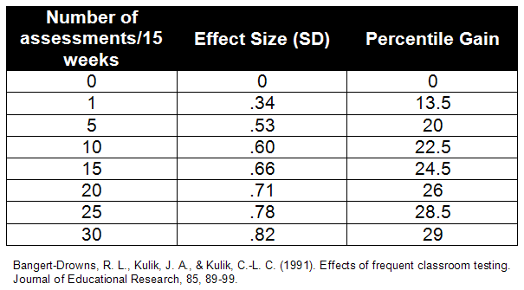
Frequency of Progress Monitoring
Similar results found by Fuchs & Fuchs (1986)
Notes:
In this study by Bangert-Drowns, Kulik, and Kulik (1991), how frequently data was collected had a direct impact on the performance of students. They found that progress monitoring at least once a week led to measureable positive benefit for students. Notice that ideally, progress monitoring twice a week would lead to better results. However, it is important to consider whether it is feasible and whether the benefit warrants the extra time spent.
For more information, see
Bangert-Drowns, R. L., Kulik, J. A., & Kulik, C.-L. C. (1991). Effects of frequent classroom testing. Journal of Educational Research, 85, 89-99.
Fuchs, L. S. & Fuchs, D. (1986). Effects of systematic formative evaluation: A meta-analysis. Exceptional Children , 53(3), 199-208.
NOTE: This may be a good place for a break, or a stopping point for the day if the modules are being delivered over multiple days

Slide 74
Steps in the Decision Making Process
Establish Data Review Team
Determine Frequency of Data Collection
Establish Baseline and Progress Monitoring Level
Establish Goal
Collect and Graph Frequent Data
Analyze and Make Instructional Decisions
Continue Progress Monitoring
Notes:
Now that we have determined frequency of data collection, it is time to collect baseline data

Slide 75
Establishing the Baseline Score
To begin progress monitoring you need to know the student’s initial knowledge level or baseline knowledge
Having a stable baseline is important for goal setting
To establish the baseline use the median scores of three probes. (You may choose to use screening data for this, if progress monitoring occurs at the student’s chronological grade level.)
Notes:
Read slide

Slide 76

Example: Finding the Baseline Score
83 / 2 wrc 72 / 7 wrc 79 / 6 wrc
Median is preferred to a measure of the average score because averages are susceptible to outliers when dealing with small number sets. Stable baselines are important in goal setting.
Notes:
This slide presents one student’s three benchmark scores. For CBM, benchmark scores are presented as words read correct (wrc; numerator) over errors (denominator).
During the screening process, this student received the following scores. If we take the median score, what would be the student’s baseline score?
Why do we use the median instead of the average? Median is preferred to a measure of the average score as averages are susceptible to outliers when dealing with small number sets. Stable baselines are important in goal setting. It is used when three scores are collected at a single data collection period (not over time)

Slide 77
THINK-PAIR-SHARE
What is Billy’s baseline score?
  97/3 wrc
  88/2 wrc
  96/6wrc
Notes:
Think What is Billy’s baseline score
Give participants approximately 15 seconds.
Pair and share with your neighbor/table.
Give participants approximately 30 seconds
Allow someone to share their answer.
Answer: 96/3. The median of errors is also taken to avoid outliers.

Slide 78
Other Approaches
Monitor student over time (e.g., three data points over three weeks) to establish stable baseline. Take the average of the scores.
Baseline Average
8 +9+10 / 3 = 9 WRC
Notes:
In this example, the performance data is collected over time, not at a single data collection point. In these cases, an average is used to account for general performance over a larger period of time and any growth that occurred during the baseline collection period (e.g., three weeks). We will use this approach in our activity handouts.
This is a good approach for those students who are identified through the screening and are progress monitored to confirm or disconfirm. Through this approach, students making progress before intervention is delivered may not actually need secondary interventions. In this case, the baseline is stable and it appears unlikely that this student will make progress without an intervention.

Slide 79
Progress Monitoring Grade Level
When possible, assess students at their chronological grade level
The goal should be set where you expect the student to perform at the end of the intervention period
Off grade-level assessment may be used with students performing below grade level.
  Many PM tools have specific procedures for appropriately placing students.
  Screening data should still be collected at grade level, however.
Notes:
Establishing the level that the student should be progress monitored at:
Read Slide
Note this might be an area where many people have questions. Below is some background information that might be helpful. It is important to recognize that this is not an extensive overview of this issue or the focus of this presentation. It may be necessary to move people past this even if they still have some questions.
For reference:
For Passage Reading Fluency (PRF) and Maze Fluency, teachers use CBM passages written at the student’s current grade level. However, if a student is well below grade-level expectations, then he or she may need to read from a lower grade-level passage. If teachers are worried that a student is too delayed in reading to make the grade-level passages appropriate, then find the appropriate CBM level by following these steps.
1. Determine the grade-level text at which you expect the student to read competently by year’s end.
2. Administer three passages at this level. Use generic CBM Passage Reading Fluency (PRF) passages, not passages that teachers use for
instruction.
If the student reads fewer than 10 correct words in one minute, then use the CBM word identification fluency measure instead of CBM PRF or
CBM Maze Fluency for progress monitoring.
If the student reads between 10 and 50 correct words in one minute but less than 85–90% correct, then move to the next lower level of text
and try 3 passages.
If the student reads more than 50 correct words in one minute, then move to the highest level of text where he/she reads between 10 and 50
words correct in 1 minute (but not higher than the student’s grade-appropriate text).
3. Maintain the student on this level of text for the purpose of progress monitoring for the entire school year.For Computation and Concepts and
Applications, teachers use CBM probes at the student’s current grade level. However, if a student is performing well below grade-level
expectations, then he or she may need to use lower-grade probes. If teachers are worried that a student is too delayed in math for the appropriate
grade-level probe, then they can find the appropriate CBM level by following these steps.
4. Determine the grade-level probe at which you expect the student to perform in math competently by year’s end. On two separate days, administer
a CBM test (either Computation or Concepts and Applications) at the grade level lower than the student’s grade-appropriate level. Use the correct
time limit for the test at the lower grade level, and score the tests according to the directions.
If the student’s average score is between 10 and 15 digits or blanks, then use this lower grade-level test.
If the student’s average score is less than 10 digits or blanks, then move down one more grade level or stay at the original lower grade level
and repeat this procedure.
If average is greater than 15 digits or blanks, then reconsider grade-appropriate material.
Maintain the student on this grade level for the purpose of progress monitoring for the entire school year.

Slide 80
Steps in the Decision Making Process
Establish Data Review Team
Determine Frequency of Data Collection
Establish Baseline Data and Progress Monitoring Level
Establish Goal
Collect and Graph Frequent Data
Analyze and Make Instructional Decisions
Continue Progress Monitoring
Notes:
Now that we collected baseline data, it is time to establish goals.

Slide 81
Set Goals Based on Logical & Research-Based Practices
Stakeholders should know…
Why and how the goal was set
How long the student has to achieve the goal
What the student is expected to do when the goal is met
Notes:
The stakeholders mentioned on this slide include team members, school personnel, family members, and community members. It is important that everyone understands the basis for the goal that was set. This includes why and how the goal was set, how long the student has to achieve the goal, and what the student is expected to do when the goal is met.

Slide 82
Goal Setting Approaches
Three options for setting goals:
  End-of-year benchmarking
  National norms for weekly rate of improvement (slope)
  Intra-individual framework (Tertiary)
Notes:
There are three options for setting goals. The first option uses end-of-year benchmarking. The second option uses national norms for weekly rate of improvement. The third option uses an intra-individual framework. Let’s look at these three options in more detail now.

Slide 83
NOTE
  Sample Progress Monitoring tools are used for illustrative purposes only. We do not endorse or recommend a specific product.

Slide 84
Option 1: Using Benchmarks
End-of-year benchmarking steps:
  Identify appropriate grade-level benchmark
  Mark benchmark on student graph with an X
  Draw goal line from first three CBM scores to X
Notes:
The first option is end-of-year benchmarking. For typically developing students at the grade level where the student is being monitored, identify the end-of-year CBM benchmark. This is the end-of-year performance goal. The benchmark is represented on the graph by an X at the date marking the end of the year. A goal line is then drawn between the median of at least the first three CBM graphed scores and the end-of-year performance goal.

Slide 85
Option 1: Setting Goals With
End-of-Year Benchmarking
Grade | Reading | Computation | Concepts and Applications
Kindergarten | 40 sounds/minute (LSF) | — | —
Grade 1 | 60 words/minute (WIF) | 20 digits | 20 points
Grade 2 | 75 words/minute (PRF) | 20 digits | 20 points
Grade 3 | 100 words/minute (PRF) | 30 digits | 30 points
Grade 4 | 20 replacements/2.5 minutes (Maze) | 40 digits | 30 points
Grade 5 | 25 replacements/2.5 minutes (Maze) | 30 digits | 15 points
Grade 6 | 30 replacements/2.5 minutes (Maze) | 35 digits | 15 points
Note: These figures may change pending additional RTI research.
Notes:
Here are sample end-of-year benchmarks. Remember, the benchmarks you use will depend on which tool you have selected, as well as other factors such as additional analysis conducted for your specific population.
NOTE: If the participants are using a specific tool, consider including a sample of its norm chart.

Slide 86
Option 1: Setting Goals With
End-of-Year Benchmarking
end-of-year benchmark
X
Goal line
Notes:
This graph shows a sample graph for a third-grade student working on CBM computation. The end-of-year benchmark of 35 digits is marked with an X, and a goal line is drawn between the first few data points and the X.

Slide 87
Option 1: Setting Goals With End-of-Year Benchmarking: Handout 1 – Gunnar
Notes:
Turn to Handout 1. This is Gunnar’s graph. He is a fourth-grade student using CBM computation for progress monitoring. Use the chart provided at the bottom of the page to find Gunnar’s end-of-year benchmark. Then, mark the benchmark with an X and draw a goal line for Gunnar. (Allow 3 minutes).
Baseline performance in this example is calculated by adding the baseline scores (the first three scores) together and dividing by the number of scores. Remember, the baseline scores were collected over time, not in a single data-collection period, so the average is used.

Slide 88
Option 1: Setting Goals With End-of-Year Benchmarking: Handout 1 Answer- Gunnar
end-of-year benchmark
X
goal-line
Notes:
Gunnar’s graph should look like this. The end-of-year benchmark for fourth-grade students on CBM Computation is 40. Forty is marked with an X. Then, a goal-line is drawn from Gunnar’s first few data points to the X.

Slide 89
Option 2: Setting Goals With National Norms for Weekly Improvement (slope)
Grade | Reading— Slope | Computation CBM—Slope for Digits Correct | Concepts and Applications CBM— Slope for Points
1 | 1.8 (WIF) | .35 | No data available
2 | 1.5 (PRF) | .30 | .40
3 | 1.0 (PRF) | .30 | .60
4 | .40 (Maze) | .70 | .70
5 | .40 (Maze) | .70 | .70
6 | .40 (Maze) | .40 | .70
Note: These figures may change pending additional RTI research.
Notes:
The second option for setting goals is by using national norms of improvement. For typically developing students at the grade level where the student is being monitored, identify the average rate of weekly increase from a national norm chart. No national norms are available at the kindergarten level.
Here are sample national norms for weekly improvement. Remember, the national norms for weekly improvement you select will depend on which tool you have selected, as well as other factors such as additional analysis conducted for your specific population.

Slide 90
Option 2: Setting Goals With National Norms for Weekly Improvement (slope)
Standard Formula for Calculating Goal Using Rate of Improvement (ROI):
( (ROI) x (# Weeks) ) + Baseline Score = GOAL
Notes:
Some tools, as we saw on the NCRTI tools chart, already have established growth rates. These growth rates can be used to set a goal by using the following calculation.
Read slide.

Slide 91
Option 2: Setting Goals With National Norms for Weekly Improvement (slope)
  Example Using national norms for weekly rate of improvement (slope)
    Find baseline (e.g., average of first three data points) = 14
    Identify ROI norm for fourth-grade computation = 0.70
    Multiply norm by number of weeks left in instructional period
      16 × 0.70 = 11.2
    Add to baseline
        11.2 + 14 = 25.2
    End-of-year goal is: 25.2 (or 25)
Notes:
For example, a fourth-grade student’s average score from his first three CBM computation probes is 14. The norm for fourth-grade students is 0.70. To set an ambitious goal for the student, multiply the weekly rate of growth (norm) by the number of weeks left until the end of the instructional period. If there are 16 weeks left, multiply 16 by 0.70: 16 × 0.70 = 11.2. Add 11.2 to the baseline average of 14 (11.2 + 14 = 25.2). This sum (25.2) is the end-of-year performance goal. This sum, 25.2, would be plotted on the student’s graph and a goal-line would be drawn.

Slide 92
Option 2: Setting Goals With National Norms for Weekly Improvement Handout 2 - Jane
Notes:
Turn to Handout 2. This is Jane’s graph. Jane is a second-grade student using CBM computation for progress monitoring. Use the national norms for weekly rate of improvement table (next slide) to determine Jane’s end-of-year goal. Jane is a second-grade student using CBM computation for progress monitoring, so a slope of 0.30 is the national norm for weekly rate of improvement for Jane.
(Allow 3 minutes.)
Baseline performance in this example is calculated by adding the baseline scores (the first three scores) together and dividing by the number of scores. Remember, the baseline scores were collected over time, not at a single data collection period, so the average is used.

Slide 93
Option 2: Setting Goals With National Norms for Weekly Improvement
Grade | Reading—Slope | Computation CBM—Slope for Digits Correct | Concepts and Applications CBM—Slope for Points
K | No data available | — | —
1 | 1.8 (WIF) | 0.35 | No data available
2 | 1.5 (PRF) | 0.30 | 0.40
3 | 1.0 (PRF) | 0.30 | 0.60
4 | 0.40 (Maze) | 0.70 | 0.70
5 | 0.40 (Maze) | 0.70 | 0.70
6 | 0.40 (Maze) | 0.40 | 0.70
Note: These figures may change pending additional RTI research.
Notes:
Here are sample national norms for weekly improvement for math. Remember, the national norms for weekly improvement you select will depend on which tool you have selected, as well as other factors such as additional analysis conducted for your specific population.
Jane is a second-grade student using CBM computation for progress monitoring. A slope of 0.30 is the national norm for weekly rate of improvement for Jane.
NOTE: If the participants are using a specific tool, consider including a sample of its norm chart.

Slide 94
Option 2: Setting Goals With National Norms for Weekly Improvement
Handout 2 Answer - Jane
Establish (baseline): Baseline = (12 + 10 + 12) ÷ 3 = 11.33
Find the appropriate norm from the table: 0.30
Multiply norm by number of weeks left in year: 0.30 × 17 = 5.1
Add sum from #3 to baseline: 5.1 + 11.33 = 16.43
Mark goal (16.43 ~ 16) on student graph with an X
Draw goal line from baseline
Notes:
This is how to use national norms for weekly rate of improvement to calculate Jane’s end-of-year goal. First, the baseline of the first three scores is calculated. Jane’s baseline is 11.33. Then the norm is found on a table. We just looked at this. The norm is Jane’s grade level on CBM computation: 0.30. The norm is multiplied by the number of weeks until the end of year: (0.30 × 17 = 5.1). 5.1 is added to Jane’s baseline score (5.1 + 11.33 = 16.43). Jane’s end-of-year goal is 16.43.

Slide 95
Option 2: Setting Goals With National Norms for Weekly Improvement
Handout 2 Answer - Jane
X
Notes:
This is Jane’s graph, where 16.43 is marked with an X. A goal line is drawn from the first three scores to the X.

Slide 96
Rates of Weekly Improvement
Three things to keep in mind when using ROI for goal setting:
What research says are “realistic” and “ambitious” growth rates
What norms indicate about “good” growth rates
Local versus national norms
Notes:
Read slide.
Realistic is often considered what students would make given decent instruction. Ambitious should, at a minimum, be more than the average growth, otherwise we will continue to maintain the performance gap, not close it. Some progress monitoring tool publishers have recommendations for using the growth rates they provide. For example, AIMSweb recommends doubling the growth rate found at the percentile rank in which the student currently performs. Using the recommendations from AIMSweb, if the students baseline is in the 10th to 25th percentile and the growth rate for student’s at that performance level is .6 wrc (words read correct), then the ambitious growth rate would be 1.2 wrc. If .6 wrc were used, the student would be likely to maintain or increase the achievement gap. It is important to contact the publisher to clarify how to best use the growth rates they offer.
To balance the competing challenges of realistic versus ambitious goals, teachers may also consider setting realistic goals at first that will lead to student success, then raising the goal to a more ambitious ROI after the student sees they can succeed.
Keep in mind that norms are established based on what is considered good growth. Growth may vary based on the domain being assessed.
In comparing local versus national norms we see that the benefits of local norms include correlations with state testing outcomes and comparisons within district/state. Challenges with local norms include small sample size, norms being unavailable, and the potential to lead to lower expectations. For national norms, the benefits include a large sample size and established cut scores, but the challenges include inequities in school resources, which can lead to over/under identification.
96

Slide 97
Option 3: Setting Goals With Intra-Individual Framework (Tertiary)
Intra-individual framework
  Identify weekly rate of improvement (slope) using at least eight data points
  Multiply slope by 1.5
  Multiply by number of weeks until end of year
  Add to student’s baseline score
  This is the end-of-year goal
Notes:
Multiply this slope by 1.5 (we want the student to not only maintain that growth, but increase it by at least half). Take this product and multiply it by the number of weeks until the end of the year. Add this product to the student’s baseline score. This sum is the end-of-year goal.
Baseline performance is calculated by adding the baseline scores (in this approach it is at least the first eight scores, although more could be included) and dividing by the number of scores.

Slide 98
Considerations for using the Intra-Individual Framework
Typically used for setting IEP goals and is not very appropriate for students performing at or near grade level.
Since the student’s performance is being compared to his/her previous performance (not a national or local norm) we need to have enough data to demonstrate the existing performance level or rate, which is why at least 8 data points are needed.
Recommended data collection 2x per week to obtain sufficient data points when this option is used.
Notes:
Read this slide

Slide 99
Identify incoming weekly ROI (slope) using at least 8 data points
First 8 scores: 3, 2, 5, 5, 5, 6, 7, 4
Slope = (median_{last 3} – median_{first 3}) / (#data points – 1)
Slope = (6 – 3) ÷ 7 = .43

Slide 100
Option 3 Example: Setting Goals With Intra-Individual Framework
  Identify weekly rate of improvement using at least eight data points First eight scores slope = 0.43
  Multiply slope by 1.5 0.43 × 1.5 = 0.645
  Multiply by number of weeks until end of year
    0.645 × 14 = 9.03
  Add to student’s baseline score (avg. of first 8 data points)
    9.03 + 4.625 = 13.66
  13.66 (or 14) is student’s end-of-year goal
Notes:
For example, a student’s first eight CBM scores were 3, 2, 5, 5, 5, 6, 7, and 4. To calculate the weekly rate of improvement (slope), find the difference between third median point and first median point. In this instance, that’s approximately 6 – 3 = 3. Since eight scores have been collected, divide the difference by the number of data points minus 1. So, (6 – 3) ÷ 7 = 0.43.
0.43 is multiplied by 1.5: 0.43 × 1.5 = 0.645. Multiply the product of 0.645 by the number of weeks until the end of the year. If there are 14 weeks left until the end of the year:
0.645 × 14 = 9.03. The average score of the first eight data points was 4.625. The sum of 9.03 and the average score is the end-of-year performance goal: 9.03 + 4.625 = 13.66. The student’s end-of-year performance goal would be 13.66. 13.66 would be plotted on the student’s graph and a goal-line would be drawn.

Slide 101
Option 3: Setting Goals With Intra-Individual Framework Handout 3 - Cecelia
Slope = 1.0
X
X
Notes:
Turn to Handout 3. This is Cecelia’s graph. Use the intra-individual framework steps to calculate Cecelia’s end-of-year goal. Then, mark the goal with an X and draw the goal ine. (Allow 3 minutes.).
Baseline performance is calculated by adding the baseline scores (in this approach it is at least the first eight scores, although more could be included) and dividing by the number of scores.

Slide 102
Option 3: Setting Goals With Intra-Individual Framework Handout 3 Answer - Cecelia
Identify weekly rate of improvement (slope) using at least eight data points: slope = (18 – 11) ÷ 7 = 1.0
Multiply slope by 1.5: 1.0 × 1.5 = 1.5
Multiply (slope × 1.5) by number of weeks until end of year:
1.5 × 12 = 18
4. Add to student’s baseline score (the baseline is the average of Cecelia’s first eight scores): 18 + 14.65 = 32.65
5. Mark goal (32.65 ) on student graph with an X
6. Draw goal-line from baseline to X
Notes:
This is how the intra-individual framework would be used to calculate Cecelia’s end-of-year goal. First, the slope from the first eight data points is calculated. Cecelia’s slope is 1.0. The slope is multiplied by 1.5: 1.0 × 1.5 = 1.5. This is multiplied by the number of weeks until the end of year: 1.5 × 12 = 18. Eighteen is added to Cecelia’s baseline score. The baseline score is the average of Cecelia’s first eight scores: 18 + 14.65 = 32.65. So, Cecelia’s end-of-year goal is 32.65.
Why did we use a 1.5 growth rate or ROI? If we were to just use one, remember we are maintaining the previous rate of growth. Because we are attempting to close the gap through supplemental supports (or those above and beyond what was previously provided), we would expect the students to make the previous rate of growth plus additional growth. By using 1.5 ROI, we are saying that in addition to maintaining previous growth, we are expecting to make half as much growth more.

Slide 103
Option 3: Setting Goals With Intra-Individual Framework Handout 3 Answer - Cecelia
X
Notes:
This is Cecelia’s graph, where 32.65 is marked with an X. A goal line is drawn from the first eight scores to the X.
NOTE: This may be a good time for a break; If you are delivering the module over multiple sessions, this may be a good stopping point.

Slide 104
Steps in the Decision Making Process
Establish Data Review Team
Determine Frequency of Data Collection
Establish Baseline Data and Progress Monitoring Level
Establish Goal
Collect and Graph Frequent Data
Analyze and Make Instructional Decisions
Continue Progress Monitoring
Notes:
Now that we have the goals set, we need collect and graph data.

Slide 105
Graphing Progress Monitoring Data
Graphed data allows teachers to quantify rate of student improvement:
  Increasing scores indicate student is making progress and responding to the curriculum.
  Flat or decreasing scores indicate non-response.
    Student is not benefiting from instruction and requires a change in the instructional program.
Notes:
To monitor progress, teachers create individual student graphs so they can interpret the CBM scores of every student and see progress or lack thereof. Alternatively, teachers can use software to handle graphs and data analysis. The CBM graphs allow teachers to quantify the rate at which students improve or decrease academic performance over time. Increasing scores indicate that the student is responding to the instructional program. Flat or decreasing scores indicate that the student is not responding to the instructional program, and a change to the student’s instructional program needs to take place.
To reiterate, we want to see increasing scores, which means that a student is making progress and responding to the instruction. We also want to look for flat scores to let us know that a student is not benefiting from instruction. This means that we need to alter the instruction for the student.

Slide 106
Graphing CBM Scores
25
The vertical axis is labeled with the range of student scores.
20
15
Problems Correct in 3 Minutes
10
The horizontal axis is labeled with the number of instructional weeks.
5
0
1
2
3
4
5
6
7
8
9
10
11
12
13
14
Weeks of Instruction
Notes:
Teachers should create a master CBM graph in which the vertical axis accommodates the range of the scores of all students in the class, from zero to the highest possible CBM score. On the horizontal axis, the number of weeks of instruction is listed. Once the teacher creates the master graph, it can be copied and used as a template for every student. An example is found in the appendix of the training manual.

Slide 107
Trend Line, Slope, and ROI
Trend Line – a line through the scores that visually represents the performance trend
Rate of Improvement (ROI) - specifies the improvement, or average weekly increases, based on a line of best fit through the student’s scores.
Slope – quantification of the trend line, or the rate of improvement (ROI)
Notes:
The next step is to use the student’s data points to establish a trend line, or a line that helps us see a visual representation of the student’s growth. By extending this trend line, we can predict how a student will do if status quo is maintained. We can quantify the trend line to create the slope, commonly referred to as the rate of improvement.
Here are some important things to clarify for the audience:
Trend Line -A trend line is a line on a graph that represents a line of best fit through a student’s data points. The trend line can be compared against the aim line to help inform responsiveness to intervention and to tailor a student’s instructional program.
Slope – quantification of the trend line. It becomes the ROI.
Rate of Improvement (ROI) – specifies the improvement, or average weekly increases, based on a line of best fit (trend line) through the student’s scores.

Slide 108
Graphing CBM Scores
25
20
15
Problems Correct in 3 Minutes
10
5
0
1
2
3
4
5
6
7
8
9
10
11
12
13
14
Weeks of Instruction
Notes:
Every time a CBM probe is administered, the teacher scores the probe and then records the score on a CBM graph. A line can be drawn connecting each data point. In addition, a trend line may also be drawn through these data points. The measure (as indicated by the axis labels), the goal line, the trend line, and student data points are necessary for making decisions about students’ responsiveness to instruction.

Slide 109
Calculating Slope:
Step 1 - Draw a Trend Line
Step 1: Divide the data points into three equal sections by drawing two vertical lines. (If the points divide unevenly, group them approximately.)
Step 2: In the first and third sections, find the median data point and median instructional week. Locate the place on the graph where the two values intersect and mark with an “X.”
Step 3: Draw a line through the two Xs, extending to the margins of the graph. This represents the trend line or line of improvement.
X
X
trend line
Notes:
Calculating the slope of a CBM graph is important to assist in determining student growth during primary, secondary, and tertiary prevention. First, graph the CBM scores. Then, draw a trend line and determine slope using a procedure called the Tukey method. Let’s look at how the Tukey method works.
Divide the data points into three equal sections by drawing two vertical lines. (If the points divide unevenly, group them approximately.)
In the first and third sections, find the median data point and median instructional week. Locate the place on the graph where the two values intersect and mark with an X.
Draw a line through the two Xs.

Slide 110
Step 1: Draw a Trend Line
100
Step 1: Divide the data points into three equal sections by drawing two vertical lines. (If the points divide unevenly, group them approximately.)
Step 2: In the first and third sections, find the median data point and median instructional week. Locate the place on the graph where the two values intersect and mark with an “X.”
Step 3: Draw a line through the two Xs, extending to the margins of the graph. This represents the trend line or line of improvement.
90
80
70
60
WIF: Correctly Read Words Per Minute
50
40
30
20
10
0
1
2
3
4
5
6
7
8
9
10
11
12
13
14
Weeks of Primary Prevention
Notes:
First, divide the data points into three equal sections. If the points divide unevenly, try to group them approximately. Once the data points are divided into three sections, draw two vertical lines to separate the sections.

Slide 111
Step 1: Draw a Trend Line
Step 1: Divide the data points into three equal sections by drawing two vertical lines. (If the points divide unevenly, group them approximately.)
Step 2: In the first and third sections, find the median data point and median instructional week. Locate the place on the graph where the two values intersect and mark with an “X.”
Step 3: Draw a line through the two Xs, extending to the margins of the graph. This represents the trend line or line of improvement.
X
X
Notes:
In the first and third sections, find the median data point and the median instructional week. In the first section, the median data point is 34 and the median instructional week is 2. Mark where these values intersect with an X. In the third section, the median data point is 50 and the median instructional week is 7. Mark where these values intersect with an X.
Some people often misplace the X in the first and third section. Regardless of which data point match the median for either section, the ‘X’ is always placed horizontally in the middle of the section. For example, if the median score is the last of three points in the first section, the X is NOT placed directly over the third data point that represents the median score. Instead, the X is placed horizontally in the middle of the section (above or below the data point for week 2) on the score that represents the median. The X is representing the median score at the median week of that section.

Slide 112
Step 1: Draw a Trend Line
Step 1: Divide the data points into three equal sections by drawing two vertical lines. (If the points divide unevenly, group them approximately.)
Step 2: In the first and third sections, find the median data point and median instructional week. Locate the place on the graph where the two values intersect and mark with an “X.”
Step 3: Draw a line through the two Xs, extending to the margins of the graph. This represents the trend line or line of improvement.
X
X
trend line
Notes:
Draw a line through the two Xs. This is the trend line and shows the rate of improvement.

Slide 113
Step 1 – Draw a Trend Line
Handout 4 – Tukey Method
Step 1: Divide the data points into three equal sections by drawing two vertical lines. (If the points divide unevenly, group them approximately.)
Step 2: In the first and third sections, find the median data point and median instructional week. Locate the place on the graph where the two values intersect and mark with an “X.”
Step 3: Draw a line through the two Xs, extending to the margins of the graph. This represents the trend line or line of improvement.
Notes:
Now it’s your turn to use the Tukey method. Turn to Handout 4 in your materials packet. Remember to follow these steps:
Divide the data points into three equal sections by drawing two vertical lines. (If the points divide unevenly, group them approximately.)
In the first and third sections, find the median data point and the median instructional week. Locate the place on the graph where these two values intersect and mark with an X.
Draw a line through the two Xs.
Go ahead and work on that now.
(Allow 3 minutes.)

Slide 114
Step 1: Draw a Trend Line
Handout 4 Answer– Tukey Method
X
X
Notes:
Your graph should look similar to this. Any questions?
Some people often misplace the X in the section. Regardless of where the median data point falls in the first of third sections, the ‘X’ is always placed in the middle of the section. For example, if the median score is the last of three points in the first section, the X is NOT placed directly over the data point that represents the median score. Instead, the X is placed in the middle of the section (e.g., center of the lines) on the score that represents the middle week . The X is representing the score at the median week of the section.

Slide 115
Calculating Slope: Step 2 - Quantify Weekly Rate of Improvement with the Tukey Method
Third median point – First median point
number of data points – 1
(50 – 34) ÷ 7 = 2.3
X
X
Notes:
The slope is calculated by first subtracting the median point (notated with an X) in the first section from the median point (notated with an X) in the third section. This is then divided by the number of data points minus 1.
For example, on this graph the score in the third section is 50, and the score in the first section is 34. The total number of data points is 8, so the number of data points minus 1 is 7. So, 50 minus 34 equals 16, and 16 divided by 7 equals 2.3. The slope of this graph is 2.3.

Slide 116
Step 2 - Quantify Weekly ROI
Handout 5 – Tukey Method and Slope
Third median point – First median point
number of data points – 1
Notes:
Turn to Handout 5. Use the Tukey method to calculate the slope of the line.
(Allow 5 minutes.)

Slide 117
Step 2 - Quantify Weekly ROI
Handout 5 Answer – Tukey Method & Slope
Third median point – First median point
number of data points – 1
(40 – 20) ÷ 8 = 2.5 slope
X
X
Notes:
Your graph should look like this. The slope of the line is calculated by first subtracting 40 minus 20, then dividing 20 by 8. The slope of this line equals 2.5.

Slide 118
Sarah’s Graph: Primary Prevention
X
Sarah’s slope:
(16 – 3) ÷ 7 = 1.9 slope
X
Notes:
Let’s look at a few student graphs and how decisions concerning RTI can be made using the graphs.
First-grade student, Sarah, was suspected of being at risk for reading difficulties after scoring below the CBM Word Identification Fluency (WIF) screening cut-off. Her progress in primary prevention was monitored for 8 weeks. Sarah’s progress on the number of words read correctly looks like it’s increasing, and the slope is calculated to quantify the weekly increase and to confirm or disconfirm at-risk status.
Sarah’s slope is (16 – 3) ÷ 7 = 1.9. Her slope is above the first-grade cut-off of 1.8 for adequate growth in general education. Sarah is benefiting from the instruction provided in primary prevention, and she does not need secondary prevention at this time.

Slide 119
Jessica’s Graph: Primary Prevention
Jessica’s slope:
(6 – 6) ÷ 7 = 0.0 slope
X
X
Notes:
Look at Jessica’s graph for primary prevention. Jessica is also a first-grade student who was suspected of being at risk for reading difficulties after scoring below the CBM Word Identification Fluency (WIF) screening cut-off point in September. After monitoring her progress for 8 weeks, it looks like Jessica’s scores on the number of words read correctly are not increasing. Jessica’ slope is (6 – 6) ÷ 7 = 0. Her slope is not above the first-grade cut-off of 1.8. Jessica needs secondary prevention at this time.

Slide 120
Jessica’s Graph: Secondary Prevention
30
X
28
26
Jessica’s slope:
(28 – 6) ÷ 11 = 2.0 slope
24
22
20
18
16
Intervention
Change
Words Read Correctly
14
12
10
8
6
X
4
2
0
1
2
3
4
5
6
7
8
9
10
11
12
13
14
15
16
17
18
19
20
Weeks of Instruction
Notes:
This is Jessica’s graph from primary and secondary prevention. The dotted vertical line shows the point when Jessica began secondary prevention. Jessica has completed 12 weeks of secondary prevention tutoring. Her progress has been monitored weekly. Over 12 weeks of tutoring Jessica’s scores are increasing. Jessica’s slope is calculated as (28 – 6) ÷ 11 = 2.0 for secondary prevention.

Slide 121
Think-pair-share
Has Jessica responded adequately?
Refer to the table on slide 93 to help you determine if Jessica’s rate of progress in Secondary Prevention is sufficient.
Notes:
Refer to prior slide: Jessica’s slope is above the first-grade cut-off of 1.8 for growth in secondary prevention. Jessica can exit secondary prevention at this time and go back to primary prevention.
Give people 2-3 minutes to think and discuss with a partner. Have 2-3 table groups share their decisions

Slide 122
Steps in the Decision Making Process
Establish Data Review Team
Determine Frequency of Data Collection
Establish Baseline Data and Progress Monitoring Level
Establish Goal
Collect and Graph Frequent Data
Analyze and Make Instructional Decisions
Continue Progress Monitoring
Notes:
Now that we have the goals set, we need to determine the frequency of data collection.

Slide 123
Collecting Data Is Great…
But using data to make instructional decisions is the most important.
Select a decision making rule and stick with it.
Notes:
We have discussed how to collect and graph data, set goals, and calculate ROI, but in order for the data collected to be valuable, we need to use the data to make instructional decisions based on explicit decision rules.

Slide 124
Why Use PM Data?
Identify students who aren’t making progress and need additional assessment and instruction
Confirm or disconfirm screening data
Evaluate effectiveness of interventions and instruction
Allocate resources
Evaluate effectiveness of instruction programs for target groups (e.g., ELL, Title 1)
Notes:
The decisions that can be made using progress monitoring data are numerous.
Read the slide.

Slide 125
PM Instructional Decision Making
Decision rules for PM graphs
  Option 1: Based on four most recent consecutive scores
  Option 2: Based on student’s trend line
Notes:
Once goals are set and individualized programs are implemented, it is important to monitor student progress. CBM can judge the adequacy of student progress and the need to change instructional programs. Standard decision rules guide decisions about the adequacy of student progress and the need to revise goals and instructional programs. Decision rules are based on the four most recent consecutive scores or on the student’s trend line. Let’s look at examples now.

Slide 126
Decision Rules Based on Four-Point Method
If three weeks of instruction have occurred AND at least six data points have been collected, examine the four most recent data points.
  If all four are above goal line, increase goal.
  If all four are below goal line, make an instructional change.
  If the four data points are both above and below the goal line, keep collecting data until trend line rule or four- point rule can be applied.
Notes:
Here are some decision basic rules for using the four-point rule.
Read the slide.

Slide 127
Four-Point Method
most recent four points
X
goal-line
Notes:
On this graph, the four most recent scores are above the goal line. Therefore, the student’s end-of-year performance goal needs to be adjusted. The teacher increases the desired rate (or goal) to boost the actual rate of student progress. The point of the goal increase is notated on the graph as a dotted vertical line. This allows teachers to visually note when the student’s goal was changed. The teacher reevaluates the student graph in another seven to eight data points.
Mnemonic strategies may be useful to help participants remember this rule. For example, some refer to this as the “Abraham Lincoln” rule (i.e., 4 score and seven yrs ago...) to help participants recall the importance of using at least four data points.

Slide 128
Four-Point Method
X
goal-line
most recent four points
Notes:
On this graph, the four most recent scores are below the goal line. Therefore, the teacher needs to change the student’s instructional program. The end-of-year performance goal and goal line never decrease; they can only increase. The instructional program should be tailored to bring a student’s scores up so they match or surpass the goal line. The teacher draws a dotted vertical line when making an instructional change. This allows teachers to visually note when changes to the student’s instructional program were made. The teacher reevaluates the student graph in another seven to eight data points to determine whether the change was effective.

Slide 129
Question
What implications does the four-point method have for frequency of progress monitoring data collection?
Notes:
Read Slide
It is important for people to understand that when data are collected less frequently, it hinders the team’s ability to make timely instructional decisions.

Slide 130
Decision Rules Based on the Trend Line
If four weeks of instruction have occurred AND at least eight data points have been collected, figure trend of current performance and compare to goal line.
Calculate by hand or by computer.
Like with the four-point method, more frequent data collection will allow for more timely decisions!
Notes:
We have already talked about how to calculate a trend line earlier, but we will now discuss how to use the trend line to make decisions.
Read slide

Slide 131
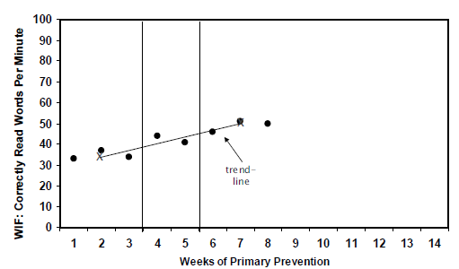
Calculating the Trend Line
Third median point – First median point
number of data points – 1
(50 – 34) ÷ 7 = 2.3 slope
trend line
Notes:
Calculating the slope alone can be used if there are established norms for what is an appropriate growth rate. However, rate of improvement can be better interpreted when presented in conjunction with the goal. In this case, this student’s rate of improvement is unlikely to help them reach their goal.

Slide 132
Decision Rules Based on the Trend Line:
If the student’s trend line is steeper than the goal line, the student’s end-of-year performance goal needs to be increased.
If the student’s trend line is flatter than the goal line, the teacher needs to revise the instructional program.
If the student’s trend line and goal line are the same, no changes need to be made.
Notes:
Here are some basic decision rules based on trend line analysis.
Read the slide.

Slide 133
Trend Line Analysis
trend line
X
goal line
Notes:
On this graph, the trend line is steeper than the goal line. The student is showing increasing scores; therefore, the student’s end-of-year goal needs to be adjusted to provide more of a challenge.

Slide 134
Trend Line Analysis
indicates change
trend line
X
X
X
revised
goal line
X
Notes:
Now that we know the trend line is steeper than the goal line, we need to adjust the student’s end-of-year performance goal. The teacher increases the desired rate (or goal) to boost the actual rate of student progress. The new goal line can be an extension of the trend line.
The point of the goal increase is notated on the graph as a dotted vertical line. This allows teachers to visually note when the student’s goal was changed. The teacher reevaluates the student graph in another seven to eight data points. The data prior to the goal change serves as a baseline for the new goal. The student could also be moved to less intensive support if he/she met the grade-level benchmark.

Slide 135
Trend Line Analysis
indicates change
X
X
X
goal line
trend line
End-of-year performance goal and goal line are never decreased
Notes:
On this graph, the trend line is flatter than the performance goal line. A trend line below the goal-line indicates that student progress is inadequate to reach the end-of-year performance goal. The instructional program should be tailored to bring a student’s scores up.
The point of the instructional change is represented on the graph as a dotted vertical line. This allows teachers to visually note when the student’s instructional program was changed. The teacher reevaluates the student graph in another seven to eight data points.
Again, the end-of-year performance goal and goal line are never decreased!

Slide 136
Trend Line Analysis
X
X
goal line
X
trend line
Notes:
In this graph, the trend line is similar to the goal line. If the trend line matches the goal line, then no change is currently needed for the student. The teacher reevaluates the student graph in another seven to eight data points to determine whether an end-of-year performance goal or instructional change needs to take place.

Slide 137
Decision Rules Summary
Four-point rule—easy to implement, but not as sensitive
The trend line rule—more sensitive to changes, but requires calculation to obtain
Notes:
In summary,
The four-point rule is easy to implement but not as sensitive.
The trend line rule is more sensitive to changes but requires calculation to obtain.

Slide 138
Steps in the Decision Making Process
Establish Data Review Team
Determine Frequency of Data Collection
Establish Baseline Data and Progress Monitoring Level
Establish Goal
Collect and Graph Frequent Data
Analyze and Make Instructional Decisions
Continue Progress Monitoring
Notes:
Now that we have analyzed the data, it is time to implement instructional decisions and continue progress monitoring.

Slide 139
Continue Progress Monitoring
Follow a set data collection schedule
Communicating purpose of data collection AND results regularly
  Share with parents, teachers, and students
Dissemination with discussion is preferred
  Encourage all school teams to talk about results, patterns, possible interpretations, and likely next steps.
Notes:
Teams should establish procedures for sharing progress monitoring data.
Read the slide.

Slide 140
Quick Reminder about Frequency of Ongoing Progress Monitoring
Similar results found by Fuchs & Fuchs (1986)
Notes:
Keep these data in mind as you determine the frequency of ongoing progress monitoring assessments for students in your school.
NOTE: This may be a good place for a break, or a stopping point for the day if the modules are being delivered over multiple days

Slide 141
Part 4: Decision-making examples

Slide 142
Quick Review of Commonly
Confused Terms
Cut Score – score on a screening test that divides students who are considered potentially at risk from those who are considered not at risk.
Target or Benchmark – pre-determined level of performance on a screening test that is considered representative of proficiency or mastery of a certain set of skills.
Criterion Scores – scores on a screening test that separate students into performance levels (e.g., established, emerging, deficient); May be used to designate primary/secondary/tertiary levels
Notes:
Before moving forward, let’s review some of the more common, and sometimes confused, terms you may see while analyzing and interpreting data. You may have seen the terms used the interchangeably, especially by publishers of screening tools. For purposes of this presentation, we refer to these terms as follows.
Read the slide.
The target or benchmark is more often than not the same score as the cut score, especially when the cut score is predictive of the state test. However, it does not have to be. For example, schools or districts may choose to set higher benchmarks or targets that are predictive of higher standards while setting cut scores to be more predictive who is at risk and not at risk. This is why it is essential for teams to understand how the cut scores, targets, and benchmarks were established. The term “cut score” is sometimes used to refer to criterion scores that separate students by performance levels – commonly viewed by green (e.g., primary), yellow (e.g., secondary), and red (e.g., tertiary) highlighted students. It is important to remember that the purposes of these two terms, cut score and criterion score, are very different. We will talk more about this in a bit.

Slide 143
EXAMPLE 1: Primary Prevention: Confirming At-risk Status With PM
All students screened using CBM
Students scoring below a cut score are suspected to be at risk for poor learning outcomes
Students suspected to be at risk are monitored for six to ten weeks during primary prevention using CBM
Notes:
Let’s apply the trend line analysis in order to confirm or disconfirm screening data and assess response to secondary intervention. In this sample model, students are screened (i.e., tested once) in the fall using CBM. Students scoring below or just above a cut score are suspected to be at risk. For these students suspected to be at risk, response to general education is monitored using CBM.

Slide 144
Primary Prevention:
Screening for Possible Math Risk
Grade | Computation Cut-Off | Concepts and Applications Cut-Off
Grade 1 | < 5 digits | < 5 points
Grade 2 | < 10 digits | < 10 points
Grade 3 | < 10 digits | < 10 points
Grade 4 | < 10 digits | < 5 points
Grade 5 | < 15 digits | < 5 points
Grade 6 | < 15 digits | < 5 points
Note: These figures may change pending additional RTI research.
Notes:
This sample chart that shows the cut-off points for math screening in which students are considered to be at risk for math failure. Remember, the cut points you select will depend on which tool you have selected, as well as other factors such as additional analysis conducted for your specific population.
In this sites model, if students fall just above or below the appropriate cut-off, they are suspected to be at risk and are then monitored for six to ten weeks to confirm or disconfirm whether they are truly at risk for math failure. Note the data provided may change pending additional RTI research.
NOTE: If the participants are using a specific tool, consider including a sample of its norm chart.

Slide 145
Primary Prevention: Confirming At-risk Status With PM
At the end of six–ten weeks, student risk status is confirmed or disconfirmed by evaluating the student’s slope of improvement.
Grade | Inadequate Reading Slope | Inadequate Math Computation Slope | Inadequate Math Concepts and Applications Slope
Kindergarten | < 1 (LSF) | < 0.20 | < 0.20
Grade 1 | < 1.8 (WIF) | < 0.25 | < 0.30
Grade 2 | < 1 (PRF) | < 0.20 | < 0.30
Grade 3 | < 0.75 (PRF) | < 0.20 | < 0.50
Grade 4 | < 0.25 (Maze) | < 0.50 | < 0.50
Grade 5 | < 0.25 (Maze) | < 0.50 | < 0.50
Grade 6 | < 0.25 (Maze) | < 0.50 | < 0.50
Note: These figures may change pending additional RTI research.
Notes:
Again, this is sample data. Sites will need to refer to existing research or conduct their own in order to develop appropriate scores for conforming or disconfirming risk.
At the end of the six to ten weeks, the student’s risk status is confirmed or disconfirmed by quantifying the response to primary prevention. To do this, the student’s rate of improvement or slope across six to ten CBM data points is calculated. Students with low slope, indicating inadequate progress, are confirmed to be at risk and then moved to secondary prevention.
We’ve already discussed calculating slope. This table shows the reading and math slopes deemed inadequate as measured by CBM after six to ten weeks of primary prevention. The data provided may change pending additional RTI research.
NOTE: If the participants are using a specific tool, consider including a sample of its norm chart.

Slide 146
Primary Prevention: Confirming At-risk Status With PM:
4th Grade Computation
(14 – 5) ÷ 7 = 1.29 (slope)
X
X
Notes:
This student’s graph has a CBM computation slope of (14 – 5) ÷ 7 = 1.29, so this fourth-grade student is exceeding the 0.50 cut-off for CBM computation. This student is progressing adequately in primary prevention in the general education classroom.

Slide 147
Primary Prevention: Confirming At-risk Status With PM
X
X
Notes:
Look at this student’s graph. The slope for this student’s computation CBM is (5 – 5) ÷ 7 = 0. This student’s slope is less than the 0.50 CBM computation cut-off for Grade 4. This student’s risk status would be confirmed, and he or she would enter secondary prevention.

Slide 148
Primary Prevention: Confirming At-risk Status With PM Handout 6 - Arthur
Notes:
Turn to Handout 6. This is Arthur’s graph. Use the Tukey method and calculate the slope for Arthur’s second-grade CBM computation graph. Then, using the information in the table at the bottom of the page, determine whether Arthur is responsive or unresponsive to primary prevention. (Allow 3 minutes.)

Slide 149
Primary Prevention: Confirming At-risk Status With PM Handout 6 - Arthur
Grade | Inadequate Reading Slope | Inadequate Math Computation Slope | Inadequate Math Concepts and Applications Slope
Kindergarten | < 1 (LSF) | < 0.20 | < 0.20
Grade 1 | < 1.8 (WIF) | < 0.25 | < 0.30
Grade 2 | < 1 (PRF) | < 0.20 | < 0.30
Grade 3 | < 0.75 (PRF) | < 0.20 | < 0.50
Grade 4 | < 0.25 (Maze) | < 0.50 | < 0.50
Grade 5 | < 0.25 (Maze) | < 0.50 | < 0.50
Grade 6 | < 0.25 (Maze) | < 0.50 | < 0.50
Note: These figures may change pending additional RTI research.
Notes:
Again, this is sample data. Sites will need to refer to existing research or conduct their own in order to develop appropriate scores for conforming or disconfirming risk.
Since Arthur is a second-grade student using CBM computation, his slope for demonstrating adequate progress in primary prevention should not fall below 0.20.
NOTE: If the participants are using a specific tool, consider including a sample of its norm chart.

Slide 150
Primary Prevention: Confirming At-risk Status With PM Handout 6 Answer - Arthur
Arthur’s slope:
(6 – 6) ÷ 8 = 0.0
X
X
Notes:
Your graph should look like this. Arthur’s slope is calculated as (6 – 6) ÷ 8 = 0.0. This slope falls below the second-grade CBM computation cut-off slope of 0.20. Arthur is not responding to primary prevention, so he should move to secondary prevention.

Slide 151
Primary Prevention: Review
All classroom students are screened to identify students suspected to be at risk.
Students suspected to be at risk remain in primary prevention and are monitored using CBM for six to ten weeks:
  Students with adequate slopes remain in primary prevention.
  Students with inadequate slopes move to
  secondary prevention.
Notes:
Let’s review primary prevention.
All classroom students are screened in the fall to identify suspected at-risk students. These students suspected to be at risk students are identified by low performance on reading or math CBM.
Suspected at-risk students remain in the general education intervention and are monitored weekly using CBM for six to ten weeks to confirm or disconfirm at-risk status. CBM scores are graphed and slopes are calculated.
Students with adequate slopes remain in primary prevention.
Students with inadequate slopes move to secondary prevention.

Slide 152
Example 2: Secondary Prevention:
Determining Response in Reading
Grade | CBM Probe | < Slope | < End Level
Kindergarten | Letter Sound Fluency | < 1 | < 30
Grade 1 | Word Identification Fluency | < 1.8 | < 30
Grade 2 | Passage Reading Fluency | < 1 | < 60
Grade 3 | Passage Reading Fluency | < 0.75 | < 70
Grade 4 | Maze Fluency | < 0.25 | < 25
Grade 5 | Maze Fluency | < 0.25 | < 25
Grade 6 | Maze Fluency | < 0.25 | < 25
Note: These figures may change pending additional RTI research.
Notes:
Again, this is sample data. Sites will need to refer to existing research or conduct their own in order to develop appropriate scores for conforming or disconfirming risk.
During secondary prevention student progress is monitored on a more frequent basis. Student reading or math scores are graphed and the slopes are calculated. After the tutoring has ended, the student response to tutoring is assessed.
This table shows sample cut-off response rates to secondary prevention tutoring in reading. Unresponsiveness can be determined by an inadequate slope or end CBM level. If students fall below the appropriate cut-off, they may enter another secondary tutoring program or be transitioned to Tertiary where a special education evaluation may occur. The data provided may change pending additional RTI research.
NOTE: If the participants are using a specific tool, consider including a sample of its norm chart.

Slide 153
Secondary Prevention:
Determining Response in Math
Grade | Computation |  | Concepts and Applications
 | < Slope | < End level | < Slope | < End level
Grade 1 | < 0.50 | < 20 digits | < 0.40 | < 20 points
Grade 2 | < 0.40 | < 20 digits | < 0.40 | < 20 points
Grade 3 | < 0.40 | < 20 digits | < 0.70 | < 20 points
Grade 4 | < 0.70 | < 20 digits | < 0.70 | < 20 points
Grade 5 | < 0.70 | < 20 digits | < 0.70 | < 20 points
Grade 6 | < 0.70 | < 20 digits | < 0.70 | < 20 points
Note: These figures may change pending additional RTI research.
Notes:
Again, this is sample data. Sites will need to refer to existing research or conduct their own in order to develop appropriate scores for conforming or disconfirming risk.
This table shows sample cut-off response rates to secondary prevention tutoring in math. Unresponsiveness can be determined by an inadequate slope or end CBM level, or a combination of both. The data provided may change pending additional RTI research.
Remember that many times students in secondary prevention use CBM computation or concepts and applications tests that are below their actual grade level. We discussed how to find the appropriate CBM level for students a little earlier. This information is also highlighted in the “Using CBM for Progress Monitoring in Math” which can be found on www.rti4success.org.
NOTE: If the participants are using a specific tool, consider including a sample of its norm chart.

Slide 154
Secondary Prevention: Inadequate Response
If student response to secondary prevention is inadequate:
  First:
    Student participates in more small-group tutoring while weekly PM continues.
  Second:
    Student moves to tertiary prevention.
    Multidisciplinary assessment to determine disability (in accordance with state policy).
Notes:
If student performance is inadequate according to either the slope or end-level tables we just saw, two courses of action can be taken.
First, in some versions of RTI, the student participates in another round of small-group tutoring either similar to or different from the tutoring that already was delivered. Student progress is monitored weekly, and the student’s slope and end level are evaluated at the end of the second secondary prevention round of tutoring.
Second, the student would move into tertiary prevention. Some RTI models then conduct a multidisciplinary assessment to answer questions generated during primary and secondary prevention and to determine whether the student has a disability. If this is the case, tertiary prevention may be conducted under the auspices of special education.

Slide 155
Secondary Prevention: Determining Response With PM Handout 7 - David
Notes:
NOTE: This is an optional activity.
Turn to Handout 7. This is David’s graph. Use the Tukey method and calculate the slope for David’s third-grade CBM Passage Reading Fluency graph. Then, using the information in the table at the bottom of the page, determine whether David is responsive or unresponsive to secondary prevention. (Allow 3 minutes.)

Slide 156
Secondary Prevention:
Confirming Risk Status With PM
Grade | CBM Probe | < Slope | < End Level
Kindergarten | Letter Sound Fluency | < 1 | < 30
Grade 1 | Word Identification Fluency | < 1.8 | < 30
Grade 2 | Passage Reading Fluency | < 1 | < 60
Grade 3 | Passage Reading Fluency | < 0.75 | < 70
Grade 4 | Maze Fluency | < 0.25 | < 25
Grade 5 | Maze Fluency | < 0.25 | < 25
Grade 6 | Maze Fluency | < 0.25 | < 25
Note: These figures may change pending additional RTI research.
Notes:
Again, this is sample data. Sites will need to refer to existing research or conduct their own in order to develop appropriate scores for conforming or disconfirming risk.
Since David is a third-grade student using CBM Passage Reading Fluency, his slope for demonstrating adequate progress in secondary prevention should not fall below 0.75.

Slide 157
Secondary Prevention: Determining Response With PM Handout 7 Answer - David
David’s slope:
(54 – 24) ÷ 8 = 3.75
X
X
Notes:
Your graph should look like this. David’s slope is calculated as (54 – 24) ÷ 8 = 3.75. This slope falls above the third-grade CBM Passage Reading Fluency cut-off of 0.75. David is responsive secondary prevention tutoring. He can return to Tier 1 primary prevention.

Slide 158
Secondary Prevention: Determining Response With PM Handout 8 – Martha (Optional)
Notes:
NOTE: This is an optional activity.
Turn to Handout 8. This is Martha’s graph. Use the Tukey method to calculate the slope for Martha’s third-grade CBM concepts and applications graph. Then, using the information in the table at the bottom of the page, determine whether Martha is responsive or unresponsive to secondary prevention. (Allow 3 minutes.)

Slide 159
Secondary Prevention:
Confirming Risk Status With PM
Grade | Computation |  | Concepts & Applications
 | < Slope | < End level | < Slope | < End level
Grade 1 | < 0.50 | < 20 digits | < 0.40 | < 20 points
Grade 2 | < 0.40 | < 20 digits | < 0.40 | < 20 points
Grade 3 | < 0.40 | < 20 digits | < 0.70 | < 20 points
Grade 4 | < 0.70 | < 20 digits | < 0.70 | < 20 points
Grade 5 | < 0.70 | < 20 digits | < 0.70 | < 20 points
Grade 6 | < 0.70 | < 20 digits | < 0.70 | < 20 points
Note: These figures may change pending additional RTI research.
Notes:
NOTE: This is an optional activity. Again, this is sample data. Sites will need to refer to existing research or conduct their own in order to develop appropriate scores for conforming or disconfirming risk.
Since Martha is a third-grade student using CBM concepts and applications, her slope for demonstrating adequate progress in secondary prevention should not fall below 0.70, and she should not have an end level of fewer than 20 points correct.

Slide 160
Secondary Prevention: Determining Response With PM Handout 8 Answer - Martha
Martha’s slope:
(10 – 6) ÷ 8 = 0.5
X
X
Notes:
NOTE: This is an optional activity.
Your graph should look like this. Martha’s slope is calculated as (10 – 6) ÷ 8 = 0.5. This slope falls below the third-grade CBM concepts and applications cut-off of 0.70. Martha is unresponsive to secondary prevention tutoring. She should move to tertiary prevention.

Slide 161
Calculating Growth on the Computer
EXCEL: Right click on graphed data, add trend line, click on options, and add equation. y=mx+b (m=rate or slope)
DATA SYSTEMS: Most progress monitoring data systems automatically establish trend lines and calculate rate of improvement
Notes:
While we have discussed how to graph student progress and how to calculate rates of improvement by hand, we recognize that many times computers are used to help calculate and track student progress. Both published data systems and computer applications such as Excel can be helpful.
Review slide.

Slide 162
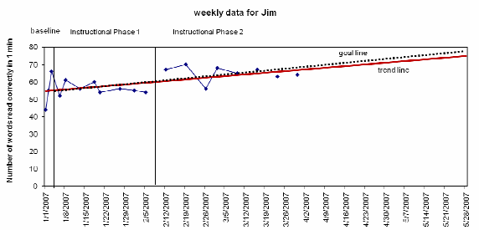
Problems with Excel – Does Not Recalculate Trend Line after Intervention Change
Notes:
One big problem with Excel is that it does not recalculate after the intervention has been changed. As you can see the trend line uses all the data points on the graph and doesn’t differentiate those before and after the intervention was adjusted.

Slide 163
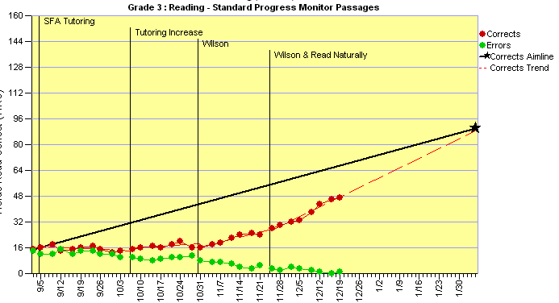
Published Data Systems often Recalculate Trend Line and ROI after Changes
Notes:
As you can see in this example, the commercial graphing program AIMSweb recalculates the trend line and ROI after the intervention changes. This graph shows four separate trend lines based on four different interventions. It is important to check with the publisher to determine if the data system will recalculate trend lines after each intervention change.

Slide 164
Part 5: Considerations for SLD Eligibility

Slide 165
Progress Monitoring Data May Inform Specific Learning Disability Eligibility
Criteria Related to Progress Monitoring
To ensure that underachievement in a child suspected of having a specific learning disability is not due to lack of appropriate instruction in reading or math, the group must consider, as part of the evaluation described in 34 CFR 300.304 through 300.306:
Data that demonstrate that prior to, or as a part of, the referral process, the child was provided appropriate instruction in regular education settings, delivered by qualified personnel; and
Data-based documentation of repeated assessments of achievement at reasonable intervals, reflecting formal assessment of student progress during instruction, which was provided to the child’s parents.
(www.idea.ed.gov)
Notes:
Progress monitoring is also essential for providing data for SLD eligibility. Specifically, the regulations, regardless of the use of RTI, requires that documentation of repeated assessments of achievement at reasonable intervals, reflecting formal assessment of student progress during instruction, which was provided to the child’s parents.
BACKGROUND INFORMATION: The final regulations incorporate new requirements regarding identifying children with specific learning disabilities (SLD) and early intervening services (EIS). With regard to identifying children with SLD, the regulations: (1) allow a local educational agency (LEA) to consider a child’s response to scientific, research-based intervention as part of the SLD determination process; (2) allow States to use other alternative research-based procedures for determining whether a child has a SLD; (3) provide that States may not require the use of a severe discrepancy between intellectual ability and achievement to determine whether a child has a SLD; and (4) require a public agency to use the State criteria in determining whether a child has a SLD and discuss the role that response to scientific research-based interventions plays in a comprehensive evaluation process.
The regulations regarding EIS permit an LEA to use not more than 15% of its IDEA Part B funds to develop and implement EIS. The regulations also indicate how EIS funds can be expended; on whom the EIS funds can be spent; the reporting requirements for EIS; special provisions regarding disproportionality based on race and ethnicity and how that affects an LEA’s use of EIS funds; and the relationship of EIS to maintenance of effort. The purpose of the questions and answers that follow is to provide additional guidance to States and LEAs in complying with the requirements regarding EIS and response to scientific research-based interventions to identify students with a SLD.
Authority: see www.idea.ed.gov for more information

Slide 166
SLD Eligibility Guidance from NCRTI
RTI and Learning Disability (LD) Identification Part I – Regulatory Requirements
http://www.rti4success.org/webinars/video/992%20
RTI and Learning Disability (LD) Identification Part II – OSEP Policy Letters
http://www.rti4success.org/webinars/video/995%20

Slide 167
Using RTI for SLD Eligibility in Washington
Rules for the Provision of Special Education: Chapter 392-172A WAC http://apps.leg.wa.gov/WAC/default.aspx?cite=392-172A WAC 392-172A-03045: http://apps.leg.wa.gov/WAC/default.aspx?cite=392-172A-03045 WAC 392-172A-03060: http://apps.leg.wa.gov/WAC/default.aspx?cite=392-172A-03060 Washington State SLD Guide: http://www.k12.wa.us/SpecialEd/pubdocs/SLD_Guide.pdf
Notes:
Although use of RTI for special education eligibility under the category of SLD is an option in Washington state, it goes beyond the intended scope of today’s presentation. These links will provide you with additional information regarding current state requirements.

Slide 168
Closing
Notes:
Before we wrap up, let’s see what you learned today and discuss next steps.

Slide 169
Things to Remember
Good data IN… good data OUT
  Know where your data came from and the validity of that data
Focus on the big picture for ALL Students
  Are most students making progress?
ALL instructional and curriculum decisions should be based on DATA.
Keep it Simple and Efficient!
Notes:
Read the slide.

Slide 170
Review Activity
What is the difference between a mastery measure and general outcome measure?
T or F: All progress monitoring tools are created equal.
Where can you find evidence of the reliability and validity of progress monitoring tools?
Name three uses of progress monitoring data.
What is a trend line?
What are three ways to establish PM goals?
Describe two ways to analyze PM data.
Notes:
AUDIENCE INVOLVEMENT: (1-2 minutes)
Note: Below is a simple way to conduct a review of content from the entire progress monitoring module. Feel free to change the format to meet the needs of the presentation time & audience.
Depending on time available, give pairs 5 – 10 minutes to answer questions. Review the questions and answers with the group.
What is the difference between a mastery measure and general outcome measure? Mastery measures assess a student’s mastery of a specific skills while general outcome measures assess whether students are progressing in a general domain. The latter can provide information about if students are maintaining and generalized mastered skills.
T or F: All progress monitoring tool are created equal? False
Where can I find evidence of the reliability and validity of progress monitoring tools? NCRTI Progress Monitoring Tools Chart
Name three uses of progress monitoring data.
estimate rates of improvement,
identify students who are not demonstrating adequate progress, and/or
compare the efficacy of different forms of instruction to design more effective, individualized instruction.
What is a trend line? a line through the scores that visually represents the performance trend
What are three ways to establish PM goals?
End-of-year benchmarking
National norms for weekly rate of improvement (slope)
Intra-individual framework (Tertiary)
Describe two ways to analyze PM data. Trend line analysis (based on whether the trend line’s trajectory is above or below the goal) and 4-Point rule (decision is based on whether four most recent points are above or below the goal line)

Slide 171
Review Objectives
Identify the importance of progress monitoring
Use progress monitoring to improve student outcomes
Use progress monitoring data for making decisions about instruction and interventions
Develop guidance for using progress monitoring data
Notes:
Today, you learned how to…
Read the slide.

Slide 172
Next Steps (Optional)
Develop a plan for how the district will provide guidance on the following:
  Selecting progress monitoring tools
  Setting progress monitoring goals
  Establishing the frequency of progress monitoring by tiers
  Ensuring accuracy of the progress monitoring results (e.g., are tools administered with fidelity, do staff know how to analyze PM data and make decisions?)
  Making decisions with progress monitoring data (e.g., when to refer for special education evaluation, move to next tier, change instruction)
Notes:
This slide is optional. Homework may be altered depending on time elapsing before next session, needs of group, etc. Encourage participants to use the training manual and the handouts as discussion guides when they reconvene as a team.
Before we meet again on ____(fill in appropriate date), please complete the following steps:
Read the slide.

Slide 173
Need More Information?
National Center on Response to Intervention
www.rti4success.org
RTI Action Network
www.rtinetwork.org
IDEA Partnership
www.ideapartnership.org
Notes:
For more information, visit these websites.

Slide 174
Questions?
National Center on Response to Intervention
www.rti4success.org

Slide 175
National Center on
Response to Intervention
This document was produced under U.S. Department of Education, Office of Special Education Programs Grant No. H326E07000.4 Grace Zamora Durán and Tina Diamond served as the OSEP project officers. The views expressed herein do not necessarily represent the positions or policies of the Department of Education. No official endorsement by the U.S. Department of Education of any product, commodity, service or enterprise mentioned in this publication is intended or should be inferred. This product is public domain. Authorization to reproduce it in whole or in part is granted. While permission to reprint this publication is not necessary, the citation should be: www.rti4success.org.

Slide 176
WA OSPI
DISCLAIMER
The opinions and positions expressed herein are not intended to ensure compliance with any particular law or regulation pertaining to the provision of educational services for eligible students. This presentation and/or materials should be viewed and applied by users according to their specific needs. This presentation and/or materials represent the views of the presenter(s) regarding what constitutes preferred practice based on research available at the time of this publication. The presentation and/or materials should be used as guidance. Any references specific to any particular education product are illustrative, and do not imply endorsement of these products by OSPI, or to the exclusion of other products that are not referenced in the presentation materials. OSPI, Special Education, is not responsible for the content of those educational product(s) referenced in this presentation.
Douglas H. Gill, Ed.D.,
Director, Special Education

