Slide 1



Fiscal Training
2020-2021
@NWESD
@NWESD189
@nwesd189

Slide 2
Federal Grants
Online communities has been updated with Uniform Grant Guidance Information
  Form 6070-F1 has been updated with the latest information
  Per our policy, if you receive a federal grant this form must be filled out and returned to fiscal within 10 days
  If you are applying for a NEW federal grant, please contact fiscal
  Purchases must be necessary and reasonable in order to be charged to the federal grant
  Quotes are required for all purchases over $10,000 per vendor per fiscal year

Slide 3
eSign Processes
Online Communities
Time and Effort
Advance Travel
Travel Expense
Reimbursement
Contracts: AR
Contracts: Interlocals
Contracts: Limited Professional Services

Slide 4
Electronic Process/Qmlativ
Currently we are processing the following Electronically in Qmlativ
JVs- be sure that your back up documents are readable (look at them after you attach them)
    they can be pdf, excel or word document
    they need to justify what you are moving and why
A/R invoices-Notify Noreen when ready to batch and emailed

Slide 5
Purchasing
POLICY 6210 –
Staff members who obligate the NWESD 189 without proper prior authorization may be held personally responsible for payment of such obligations.
Purchase requisitions need to be fully approved (not just by immediate supervisor) before any purchases are made
Contracts must be fully signed prior to contractor starting work
MUST include the contract check list
NOTE: Do not sign binding agreements only Larry or Lisa have this authority
Important Notes
Purchase Orders have a 2nd page that is the terms and conditions of the purchase order that must ALWAYS be included when sending a PO to a vendor either electronically or by mail.
Page 2 can be found on the OC under purchasing.

Slide 6
AP Invoice Approvals Review
Important things to remember:
All accounts payable invoices should be e-mailed or mailed to
accounts_payable@nwesd.org or
Northwest ESD, 1601 R Ave Anacortes, WA 98221
Invoices should not be sent to your individual ESD e-mail or program address.
Due Dates for Payments
AP invoices turned into fiscal by the 1st will be paid on the 15th
AP invoices turned into fiscal by the 16th will be paid on the 30th/31st
**NEW** Travel Expense forms turned in by 8th of the month will be paid on the 30th/31st
Notify AP to close the PO at time of invoice approval (both internal & external invoices)
For credit card charges forward the credit card receipt/invoice immediately to AP

Slide 7
Travel Overview
Board Policy 6213
The actual and necessary expenses of a staff member of the NWESD 189 incurred in the course of performing services for the NWESD may be reimbursed in accordance with the approval and reimbursement procedures of the NWESD.
The full board policy can be found on Online Communities under Travel
A few definitions:
Commuting: Travel between the employee’s official residence and employee’s official workstation.
Official Workstation: The city, town, or other location where the employee’s work is performed on a permanent basis. The Superintendent shall designate each official workstation.
Travel Status: The official status of an employee when away from both the official residence and the official workstation on official business, exclusive of commuting.
Three Hour Rule: To qualify for a meal reimbursement, an employee must be in travel status for total of three (3) hours beyond the regular scheduled work day and for the entire meal period.
Per Diem Costs: Those costs covering meals while in travel status reimbursed at a set rate rather than on a cost-reimbursement basis.
Employees are encouraged to utilize alternatives to travel, as well as less expensive means of travel

Slide 8
Advance Travel Requests
Advance travel approval requirements
  Overnight In-State: approval by a program manager and the Superintendent, or designee
  Out-of-State: approval by the Superintendent and the Board of Directors;
  Employee’s of NWESD189 cooperatives must also be approved in the minutes of the advisory committee meetings (attached to request)
Advance Travel Request Form (Form 6213-F1)
  All Expenses: travel request must show meals, lodging, transportation, registration, and any other estimated expenses for which reimbursement shall be requested upon completion of travel
    Approved (E-signed)form must be attached to purchase requisition (before travel)
    Approved (E-signed)form must be filed on the common drive
Reimbursement for meal costs will not be provided if the meeting/conference or hotel/motel provides the same meal
Limited exceptions to this rule are to be documented on form 6213-F3 under the following conditions:
  documented medical condition (contact HR)
  unplanned event/activity precluded participation in furnished meal
  furnished meal did not offer protein (receipt required for meal)
  Any exceptions require prior approval and must be on the Advance Travel Request form

Slide 9
Travel Expense Reimbursements
Travel claim expenses are submitted on Travel & Expense Report Form 6213-F3
  Must be Signed by traveler and approved by supervisor (E-Sign is available)
  Approved E-signed Advance Travel form 6213-F1 for overnight travel needs to be filed on the common drive
  Attach Agenda for meeting/conference if a registration fee was paid and meals are being claimed
  Detailed receipts must be attached (with itemized costs) for meals that are not reimbursed at per diem rate
  Detailed receipts must be attached (with itemized costs) for misc travel expenses up to $50*
  * anything over $50 must be submitted on prior reimbursement form FSC-100
Important Information
  Employee must incur an expense in order claim reimbursement, even if per diem is allowed
  Eating a meal - employee may not stop for a meal just to meet the 3 hour rule
  Once you arrive back at the area of your official workstation, travel status stops
  Mileage claimed must be the lesser of miles driven from official workstation or official residence
Know what you are signing! It is up to you to verify that your travel is completed correctly!
Expense forms must be submitted within 60 days after the date of travel

Slide 10
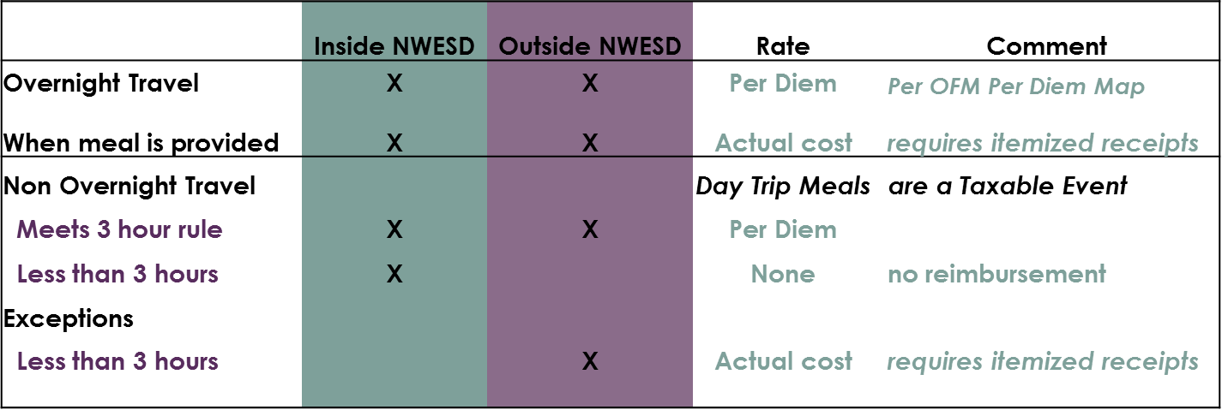

Meal Reimbursement Chart
  Employee must incur an expense and be in travel status the entire meal period to qualify for reimbursement:
  Breakfast 7:00-8:00 am
  Lunch 12:00-1:00 pm
  Dinner 5:00-6:00 pm
Tips in excess of 20% will not be reimbursed
Taxable Meals are paid through your Payroll check

Slide 11
Future changes
Employee reimbursement via ACH (once a mth)
Budget revisions electronically in Qmlativ
The OC is your best friend!!
A Friendly Reminder - Please pass on the information presented today to any staff members that were not present at your dept. meeting.
Questions?

Slide 12
Thank you!
@NWESD
@NWESD189
@nwesd189

