Slide 1
HOW TO MAKE A POWERPOINT TIMER IN 5 EASY STEPS!
A POWERPOINT TIDBIT
KINDA’ LIKE A TIMBIT…
(THAT WAS A JOKE. BUT YOU’LL LIKELY ONLY GET IT IF YOU LIVE NEAR THE CANADIAN BORDER… OR ARE CANADIAN… IT INVOLVES DONUT PARTS.)

Slide 2
STEP 1
CREATE A SIMPLE IMAGE.
SELECT THE INSERT MENU AND SELECT SHAPES.
CHOOSE SOMETHING YOU LIKE.
I CHOSE A CIRCLE.
(THEY REMIND ME OF TIMBITS. SEE SLIDE #1)

Slide 3
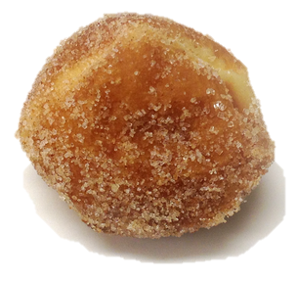
STEP 1
IN FACT, I’LL JUST REPLACE MY CIRCLE WITH SOMETHING BETTER… A TIMBIT!
DON’T BE DISTRACTED BY THE PASTRY, IT’S JUST AS INSTRUCTIVE AS A CIRCLE.
IT ALSO MEANS YOU CAN DO THIS TRICK WITH JUST ABOUT ANY ELEMENT ON THE SCREEN!

Slide 4
STEP 2
SELECT YOUR SHAPE AND THEN SELECT THE ANIMATIONS MENU.
SELECT EXIT EFFECTS AND CHOOSE YOUR FAVORITE ONE.
THIS IS LESS INTUITIVE IN WINDOWS AND YOU’LL HAVE TO USE THE SECRET MENU ON THE NEXT SCREEN TO SEE IT.

Slide 5
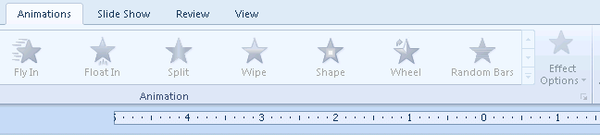
STEP 2
POWERPOINT FOR WINDOWS 2010.
(LESS INTUITIVE THAN TIMBITS)
CLICK ON THIS STRANGE LITTLE ARROW BOX

Slide 6

BY THE WAY…
TIMBITS ARE SOLD IN PACKS OF 10…
OR MORE!
O, CANADA!

Slide 7


STEP 3
SELECT THE ANIMATION PANE. THEN SELECT THE EXIT ANIMATION YOU CHOSE.
POWERPOINT FOR MAC OS 2011:
SELECT THE TIMING AREA BELOW.
POWERPOINT FOR WINDOWS 2010:
RIGHT CLICK ON YOUR ANIMATION AND SELECT TIMING.

Slide 8
STEP 3
TYPE IN A DELAY OF 60 SECONDS.
  THIS MEANS THAT YOUR EXIT ANIMATION WILL HAPPEN 60 SECONDS AFTER THE “TRIGGER EVENT” (USUALLY A CLICK).
  60 SECONDS IS ABOUT THE TIME IT TAKES TO EAT 6 TIMBITS.
CHANGE YOUR EVENT TRIGGER FROM “ON CLICK” TO “AFTER PREVIOUS”
  THIS MEANS YOUR ANIMATION WILL TRIGGER AUTOMATICALLY AFTER THE LAST EVENT (SLIDE CHANGE, ANIMATION, ETC.)

Slide 9
STEP 4
DUPLICATE YOUR IMAGE FOR AS MANY MINUTES AS YOU WANT THE TIMER TO LAST.
I WILL PRETEND MINE LASTS 3 MINUTES. BUT I’VE CHANGED MY TIMING TO A 10 SECOND DELAY SO YOU WILL SEE IT FASTER.

Slide 10
GET READY!
IN THE NEXT SLIDE YOU’LL SEE THESE TIMBITS DISPPEAR.
THEY HAVE A DELAY OF 10 SECONDS
(YOU DON’T REALLY WANT TO WAIT 60 SECONDS WATCHING EACH TIMBIT DISAPPEAR… YOU’LL GET HUNGRY)
THE “TRIGGER EVENT” IS THE SLIDE CHANGE.

Slide 11
TRIGGER!

Slide 12
STEP 5
TO CONTROL THE TIMER TO START “ON A CLICK”, DO THESE THINGS:
SET YOUR FIRST EXIT ANIMATION TO TRIGGER “ON CLICK”
THE OTHER TIMBITS ALREADY ARE SET TO TRIGGER AFTER THAT ONE.
SEE IT ON THE NEXT SLIDE!

Slide 13
CLICK THE MOUSE!

Slide 14
CAUTIONS
ALWAYS CHECK TO MAKE SURE THINGS WORK.
SOME COMPUTERS HANDLE TIMING DIFFERENTLY. ALWAYS TEST YOUR TIMING TO BE SAFE.
WHEN PRESENTING, ALWAYS WATCH A CLOCK TO MAKE SURE THE ANIMATIONS ARE HAPPENING AT THE INTENDED SPEED SO YOU CAN ADJUST THINGS IF NEEDED.
TIMBITS ARE ADDICTIVE. ALSO, TIM HORTON’S WILL TRY TO SELL YOU TIMBITS AS A SIDE ORDER WITH CHEDDAR BROCCOLI SOUP.
I REALLY CAN’T RECOMMEND THIS COMBINATION.

Slide 15
THE END
* NO TIMBITS WERE INJURED IN THE MAKING OF THIS TUTORIAL.

