Slide 1



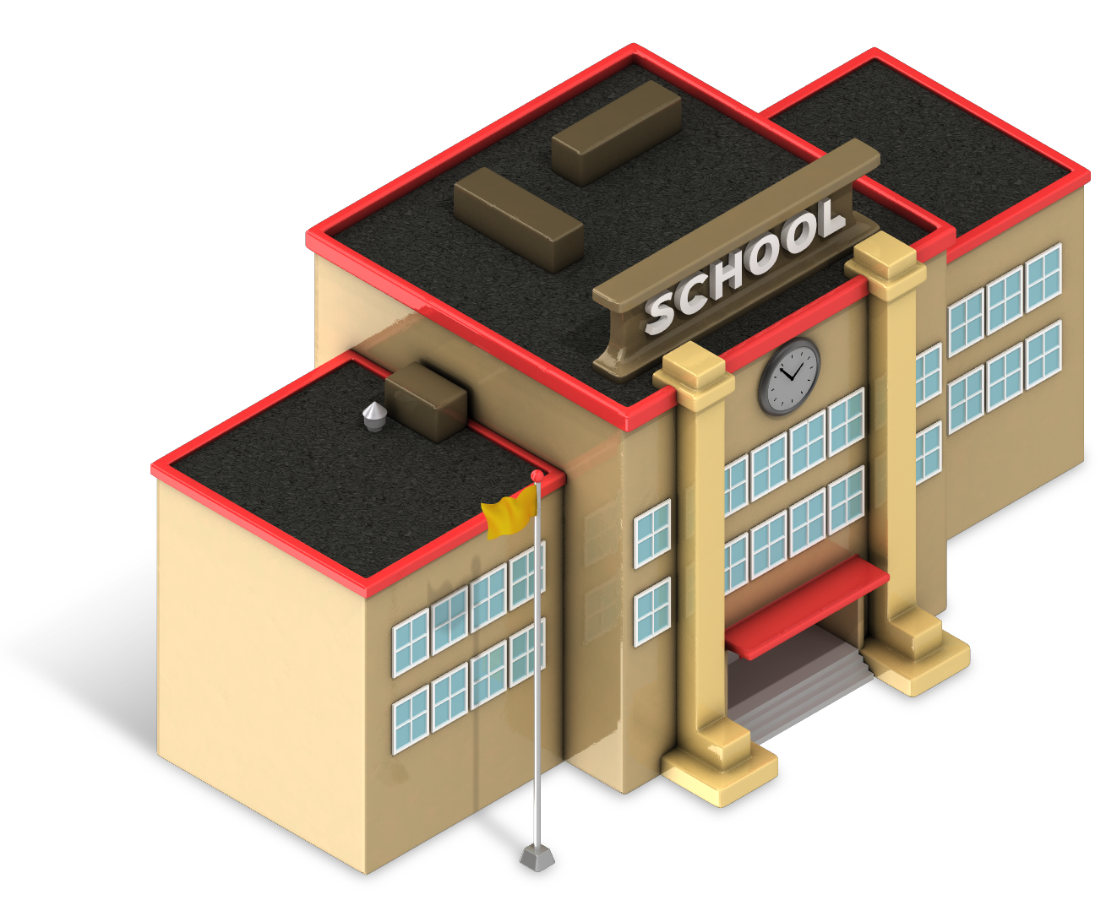











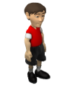












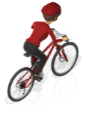

NWESD 189
2017-18

Slide 2
Today
8:00-9:30 Nuts and Bolts--Pam
9:45-10:15 Equity—Joanne
10:15-10:30 Break
10:30-11:45 Goal setting--Gayle
12-1:00 ESCAPE
1:00-2:00 Lunch at Bob’s Chowder

Slide 3

Who are we?
                35 districts in 5 counties
                165,791 students
                439 schools
                8845 classrooms

Slide 4

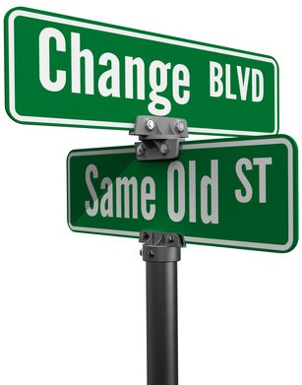

Changes at OSPI
State level

Slide 5
OSPI
Educator Growth & Development
System and School Improvement
Special Education
Learning & Teaching
Student Engagement and Support
Federal Programs
Assessment and Student Information

Slide 6
Accountability
Academic Indicators
School Quality or Student Success
Proficiency
Growth
English Learner Progress
Elementary
Chronic Absenteeism
Middle School
Proficiency
Growth
English Learner Progress
Chronic Absenteeism
Chronic Absenteeism
High School
Proficiency
Graduation Rate
English Learner Progress
9th Graders on Track
Advanced Course-Taking (dual credit)
Notes:
Pay attention to Elementary, Middle, and High as you scroll across. (Grad in HS, Growth in Elementary and Middle)
Various TAC work related to measures (impact of various ‘detail’ rules).
Phase 2 – dual credit – explore including and defining industry certification.
Additional measures will be considered for Phase II: disproportionate discipline, teacher assignment and equity, and a school climate and engagement survey

Slide 7
Indicator | Description
i. Academic Achievement | Percentage of students at Level 3 or Level 4 in ELA and Math.
ii. Academic Progress | Student growth percentiles for 4th to 8th graders on the statewide assessments in ELA and mathematics. Academic growth as measured by Student Growth Percentiles (SGPs)
iii. Graduation Rate | Four-year graduation rate, adjusted for extra credit for relatively larger increases in extended-year graduation rates.
iv. Progress in Achieving English Language Proficiency | Percentage of students who are making enough progress to transition out of the program within 6 years.
v. School Quality and Student Success | Percentage of students who regularly attend school (are present for 90% or more of school days)
 | The percent of first time ninth grade students passing all attempted credits.
 | The percent of students who completed a dual credit course or program (AP, IB, College in the High School, Cambridge, Running Start or Tech Prep).

Slide 8

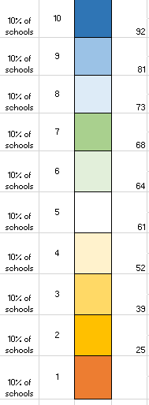
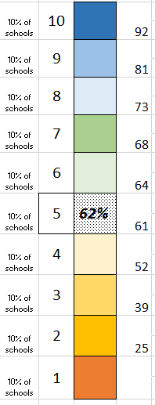
School performance by measure
  1-10 scale, such that ~10% of schools in each– an even spread of schools from 1-10
  Cut points (thresholds) will be frozen for at least several years
  School’s performance on a measure translates to a box (decile)
  School can see how to move up, for each measure, over time

Slide 9
Multiple Measures Framework

Slide 10

Use Comprehensive Threshold to Identify Subgroups for Targeted Support
Combined Multiple Measure
Threshold For Comp Support
Identified for Targeted Support

Slide 11
What is the opportunity?
How can we lead in helping our schools once they learn of a target area

Slide 12

Student growth
How do teachers know if students are growing?

Slide 13
What is the law?
The Revised Code of Washington (RCW 28A.405.100) stipulates that “student growth data must be a substantial factor in evaluating the summative performance of certified classroom teachers for at least three of the evaluation criteria.”
Defining student growth as the change in student achievement between two points in time, the law further states that “student growth data that is relevant to the teacher and subject matter
must be a factor in the evaluation process” and “must be based on multiple measures that can include classroom-based, school-based, district-based, and state-based tools. Student growth data elements may include the teacher’s performance as a member of a grade-level,
subject-matter, or other instructional team within a school when the use of this data is relevant and appropriate.

Slide 14
Defining Key Terms
G!
RCW 28A.405.100
Student Achievement: The status of subject-matter knowledge, understandings, and skills at one point in time.
Student Growth (Learning): The growth in subject-matter knowledge, understandings, and skill over time.
It is student growth, not student achievement, that is relevant in demonstrating impacts teachers and principals have on students.

Slide 15
Using District, School, and
Classroom-Based Data (Teachers)
G!
RCW 28A.405.100
Five Student Growth Criteria
  3.1 Establish Student Growth Goals
    Re: individual or subgroups of students (achievement/opportunity gap)
  3.2 Achievement of Student Growth Goals
    Re: individual or subgroups of students (achievement/opportunity gap)
  6.1Establish Student Growth Goals Using Multiple Student
  Data Elements
    Re: whole class based on grade-level standards and aligned to school and district goals
  6.2 Achievement of Student Growth Goals
    Re: whole class based on grade-level standards and aligned to school and district goals
  8.1 Establish Team Student Growth Goals
    Re: Teacher as part of a grade-level, content area, or other school/district team

Slide 16


Slide 17
Core beliefs for adult learning
Leading adult learning requires a sophisticated set of facilitation skills and intentional design.
Effective professional learning guides participants to connect what they already know to their new contexts.
Everyone has valuable knowledge and things to learn.

Slide 18
Question:
What is the learning that is leaving the room with you today?

Slide 19


Nuts & Bolts

Slide 20

A Final Thought . . .
"If you want to feel secure, do what you already know how to do. If you want to be a true professional and continue to grow. . . go to the cutting edge of your competence—which means a temporary loss of security.
So whenever you don't quite know what you're doing, know you're growing.” Madeline Hunter
Notes:
Eval

Slide 21
9:30 Joanne is on…..
During the transition, reflect how these opening comments will affect your work this year

Slide 22
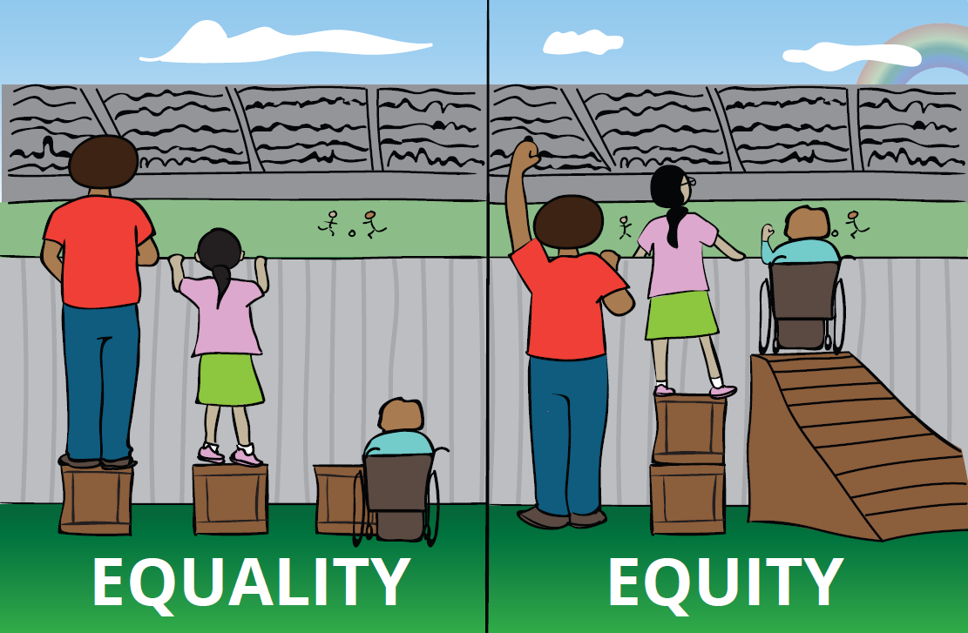

Slide 23
Goal setting with Gayle

Slide 24


Slide 25
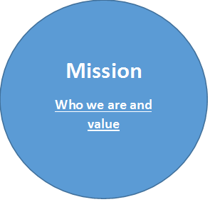
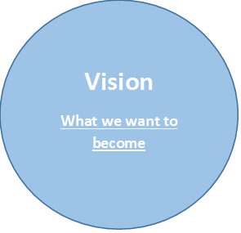
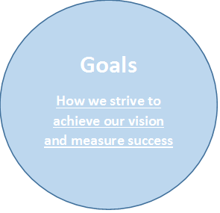


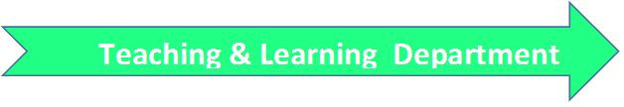

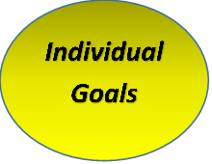

Slide 26
SMART Goal Process
S
Specific- The goal addresses student needs within the content.
The goal is focused on a specific area of need.
M
Measurable-
An appropriate instrument or measure is selected to assess the goal.
The goal is measurable and uses an appropriate instrument.
A
Appropriate-
The goal is clearly related to the role and responsibilities of the teacher.
The goal is standards-based and directly related to the subject and students that the teacher teaches.
R
T
Realistic-
The goal is attainable.
The goal is doable, but rigorous and stretches the outer bounds of what is attainable.
The goal is bound by a timeline that is definitive and allows for determining goal attainment.
Time-bound- The goal is contained to a single school year/course.

Slide 27
What’s next?
Escape 12-1:00
Lunch 1-2:00

