Slide 1

eVAL Introduction RIG 2 – Cohort 1
October 29, 2012
Cathey Frederick
ESD 189 eVAL Specialist

Slide 2

Goals
Review the evaluation process and understand how the eVAL tool can support it
View the role of Evaluatee in eVAL
View the role of Evaluator in eVAL
Review next steps to get ready to use eVAL in your district

Slide 3
What is eVAL?
eVAL is a web-based tool designed to manage the evaluation process and documentation. Developed in partnership with the Washington Education Association, the Office of Superintendent of Public Instruction, and Educational Service District 113, eVAL is:
a free resource currently being used by our pilot and RIG districts for 2012-13;
personalized for each district for their instructional framework, resources, and documents;
voluntary for all districts, who can use as many or as few of eVAL’s features as they’d like (or none at all); and
extremely secure with limited access physically and virtually to its servers

Slide 4
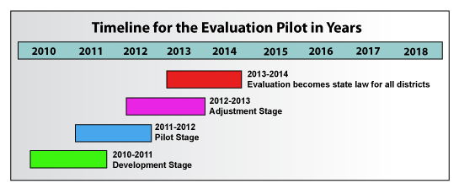
Teacher Principal Evaluation Pilot

Slide 5
Evaluation Process
Training
Orientation
8. Professional Development Plans
3. Self-Assessment
7. Summary Evaluation Conference
4. Pre-Observation Conference
6. Post-Observation Conference
5. Observations
Notes:
Self assessment F

Slide 6
Why use eVAL?
Supports dialog between supervisor and supervisee
Assists reflection about an individual’s practice
Facilitates collection of evidence of effective practice
Serves as a central storage and reporting tool for many aspects of the evaluation process

Slide 7
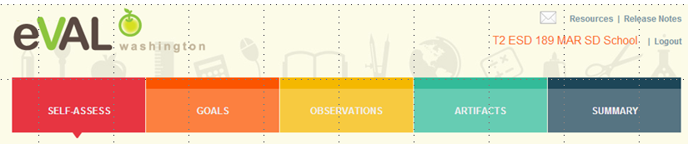
Role of Evaluatee Either Principal or Teacher
An evaluatee has three primary responsibilities in eVAL:
self-assessment and goal-setting;
interacting with the evaluator in the observation process; and
uploading artifacts

Slide 8

What Can Evaluatees Do in eVAL?
Under Evaluatees can:
be reminded of the date, time and location of events related to planned observations
respond to questions prior to their pre-conferences
enter notes for their principal
reflect upon their lessons

Slide 9

What Can Evaluatees Do in eVAL?
Under Evaluatees can:
Develop self-assessments by scoring rubrics organized by the state criteria or local instructional models
Determine whether self-assessment will remain private, or be shared at teachers’ discretion with supervisors

Slide 10

What Can Evaluatees Do in eVAL?
Under Evaluatees can:
Add goal prompts
Align their goals to the state criteria or local instructional model
Add artifacts to provide support for their goals
Dialogue with their supervisor around their goals

Slide 11

What Can Evaluatees Do in eVAL?
Under Evaluatees can:
Load evidence such as documents, spreadsheets, or presentations
Align documents to the state criteria

Slide 12

What Can Evaluatees Do in eVAL?
Under Evaluatees can:
View the summative scores, self-assessment scores, and observations scores aligned to the state criteria
View observation notes and reflections
Generate and print a summative report

Slide 13

What Can Evaluators Do in eVAL?
Under Evaluators can:
Create question prompts for goals, pre-conference, reflection, and post conference
Assign questions to evaluatees

Slide 14

What Can Evaluators Do in eVAL?
Under Evaluators can:
Use the practice section to enter formative evaluation data regarding videos or classroom observations
Engage in dialog regarding shared (or different) perceptions of quality instruction
View dashboards that display multiple data points summarizing many evaluator perspectives

Slide 15

What Can Evaluators Do in eVAL?
Under Evaluators can:
Schedule pre-conference, conference, and post-conference sessions
Enter notes during lessons (or paste them from other software afterwards)
Align the evidence from their notes to state or local rubrics and provide feedback regarding the level of quality observed
Score rubric, annotate scores and manage all aspects of evidence gathered during observations
Print post-conference observation reports

Slide 16

What Can Evaluators Do in eVAL?
Under Evaluators can:
Submit final summative scores to their district office
Print summative reports

Slide 17

What Can Evaluators Do in eVAL?
Under Evaluators can:
View a variety of reports including
School-wide evaluation summaries
Individual teacher evaluation trends
Discrepancies between teacher self-assessments and evaluator scores

Slide 18
What’s Next?
Determine Framework
Notify OSPI of choice
David Morrill (david.morrill@k12.wa.us)
Check out eVAL Video Tutorials on OSPI site: http://tpep-wa.org/resources/eval/eval-video-walkthroughs/
In preparation for next training, watch: “Exploring Roles in eVAL” and“Requesting Access to eVAL”

Slide 19
More Information?
ESD 189 eVAL Training Documents
https://library.nwesd.org/tpep/eval-training-documents
OSPI eVAL
http://tpep-wa.org/resources/eval/
eVAL Sandbox Demonstration Site
http://sandbox.eval-wa.org/
https://files.nwesd.org/~jlongchamps/TPEP/eVAL/Getting_Started_with_Sandbox.pdf

Slide 20
Questions?
cathey Frederick
ESD 189 eVAL Specialist
Cathey.frederick@seaotters.us

