Slide 1

TPEP and System Reliability:
Winter, 2015
Notes:
Note to Facilitator – See Facilitator Directions on Agenda Document.

Slide 2

Session Norms
Pausing
Paraphrasing
Posing Questions
Putting Ideas on the Table
Providing Data
Paying Attention to Self and Others
Presuming Positive Intentions
Notes:
Review Garmston’s Norms of Collaboration. Ask participants to reflect on one of the norms they would like to focus on for today.
Handout.

Slide 3
Session Learning Targets
Participants will…
Understand the Continuous Improvement Process and its role with the District TPEP Leadership Team.
Understand the current TPEP landscape of their District Team and District Staff.
Identify a data-driven process to locate gaps within a system and develop a plan to address those gaps.

Slide 4
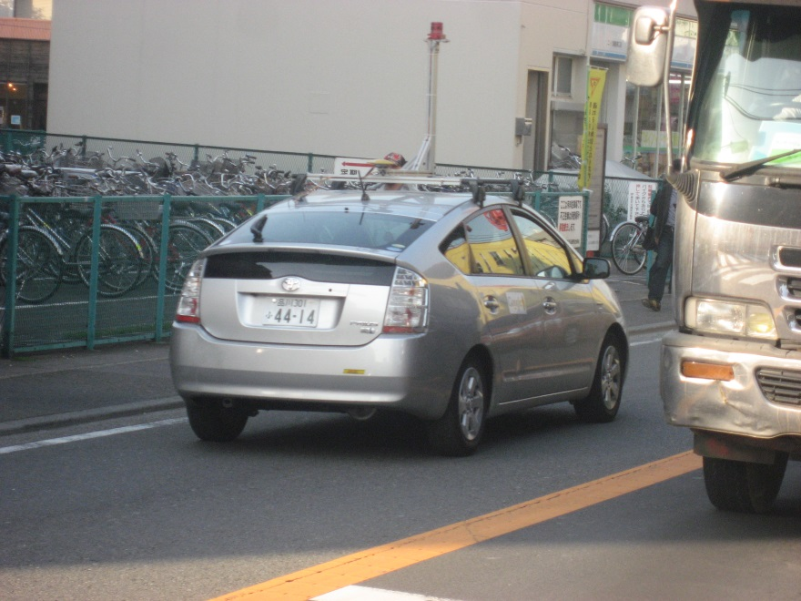
On a post it or note card, jot…..
What are three words which emerge if you think of the following:
  Toyota
  Honda
  Subaru

Slide 5
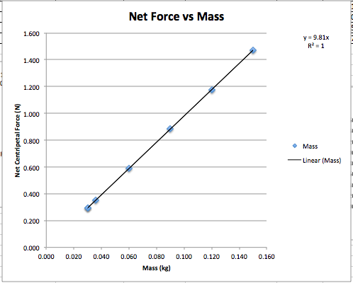
Continuous Improvement: Deming
Japan post-WW2: Toyota
USA in 1981: Ford
You can expect what you inspect. (Deming)
What does variation try to tell us about a process or a system?
In God we trust; all others must bring data.
Notes:
Deming: American engineer, statistician, professor and management consultant.
Developed sampling techniques still used by the US Dept of Census and Bureau of Labor Statistics.
Developed the PDSA process (adopted from Walter Shewart, Statistician)
Best known for working in Japan beginning in 1950…with manufacturing leaders.
Japanese still credit him with the rise of Japan’s economy post war.

Slide 6
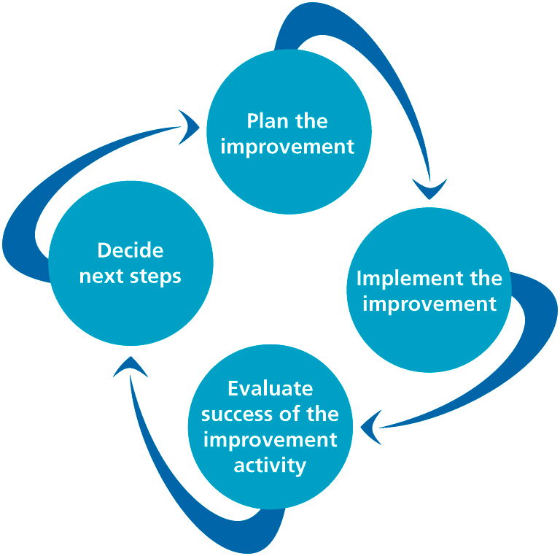

Slide 7
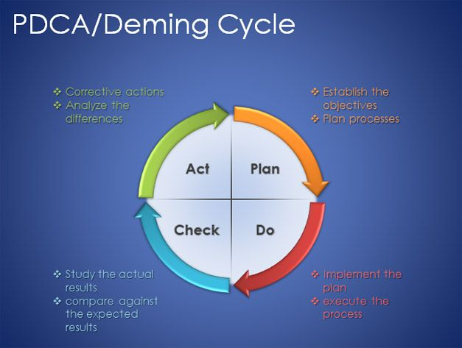
Deming’s PDSA Cycle:
Embedded in the Continuing System
Plan
Do
Check/Study
Act
Analyze
Plan again
…

Slide 8
Continuous Improvement
Build a quality (continuous improvement) culture. Positive and Constructive.
Drive out fear.
Provide organization-structural assurance for continuing feedback system.
Respond to customers needs and solve problems timely.
Standardize the procedure and continuously improve it.

Slide 9
Problem Solving for TPEP: Your Continuous Effort
Identify problems as an opportunity
Analyze the problem: to find root causes
Develop optimal and cost effective solutions
Implement changes: system wide
Study the results: worked or not? Need adjustment?
Standardize solution: Keep problems from reoccurring.
Notes:
Where are you now???

Slide 10

Your TPEP PD Plan
What do you recall about…
The Plan?
Your Role?
Record for 10 minutes
Notes:
Allow 10 -15 minutes for folks to work alone. SILENTLY.

Slide 11
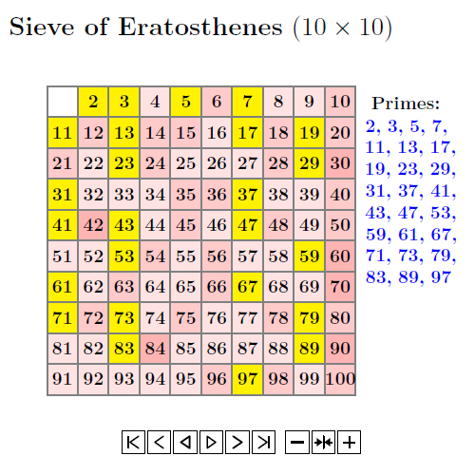
Learning from our Team Data
Needed:
Heterogeneous groups of 3-5
A recorder
Your reflections
20 minutes
Report out: what are 2-3 ideas to remember?

Slide 12
Learning from our TPEP Survey Data: Initial Analysis
Rules of Engagement:
Follow your norms
Work in heterogeneous pairs
Examine all displays
Use the protocol
predict
observe
infer

Slide 13
District TPEP Survey: Predictions
What do I think the results will be re :
Knowledge of the work of the TPEP Leadership team?
Understanding of the IFW?
Understanding of the self-assessment process?
Understanding of the Goal Setting process and tools?
Knowledge of the PD plan made by the TPEP Leadership team?
From these Groups:
Admin
Teachers
T: Comprehensive
T: Focused

Slide 14
For the next 60-70 minutes…..
Rules of Engagement:
Follow your norms
Work in heterogeneous pairs
Examine all displays
Use the protocol
predict
observe
infer
Take your break as you need it

Slide 15
Done? One additional analysis step…
Each pair examines notes for 1-2 Data Summaries (Use the INFERENCES Page)
That pair prepares a poster report to the group for each Data Summary, to include :
What top 1-2 messages from the data?
What good news?
What top 1-2 opportunities exist for future actions?
20 minutes to create reports
Report out

Slide 16

Lunch!

Slide 17
Deming’s PDSA Cycle:
Embedded in the Continuing System
Plan
Do
Check/Study
Act
Analyze
Plan again
…

Slide 18
What Next?
You have planned and done.
You have studied.
Now…what are the opportunities?
Action planning.
Communication of the plan.
Persistence in monitoring the plan.
Making Data part of the monitoring.

Slide 19
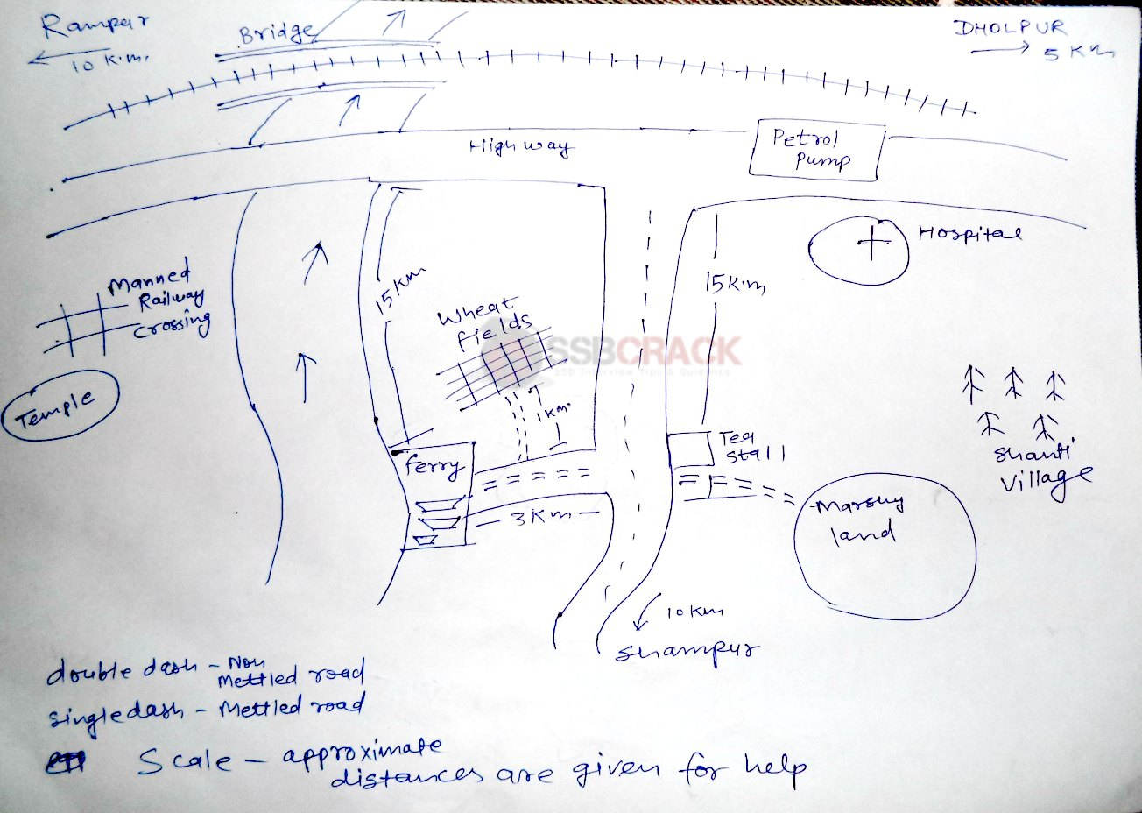

Slide 20

Thanks!!
Evaluations
Clock Hours

