Slide 1

Teacher & Principal Professional Growth and Evaluation
Overview Presentation
Jim Koval
OSPI
Michaela Miller
OSPI

Slide 2

Follow this presentation
www.tpep-wa.org or google “tpep”

Slide 3
The Wisdom of Practice
“After 30 years of doing such work, I have concluded that classroom teaching…is perhaps the most complex, most challenging, and most demanding, subtle, nuanced, and frightening activity that our species has ever invented…The only time a physician could possibly encounter a situation of comparable complexity would be in the emergency room of a hospital during or after a natural disaster.”
– Lee Shulman
Stanford University

Slide 4
Why Assess Teacher & Principal Effectiveness?
Quality Assurance
Professional Learning

Slide 5
Teacher/Principal Evaluation Project
Teacher and Principal Evaluation System Overview
Instructional and Leadership Frameworks
Definitions of comprehensive and focused evaluations
Summative Methodology
Criterion Scoring
Student Growth within Teacher and Principal Evaluation
Support and Resources
Rater Agreement Definition/Principal Training
eVAL Management System

Slide 6
TPEP Core Principles
“We Can’t Fire Our Way to Finland”
The critical importance of teacher and leadership quality.
The professional nature of teaching and leading a school.
The complex relationship between the system for teacher and principal evaluation and district systems and negotiations.
The belief in professional learning as an underpinning of the new evaluation system.
The understanding that the career continuum must be addressed in the new evaluation system.
The system must determine the balance of “inputs or acts” and “outputs or results.”

Slide 7
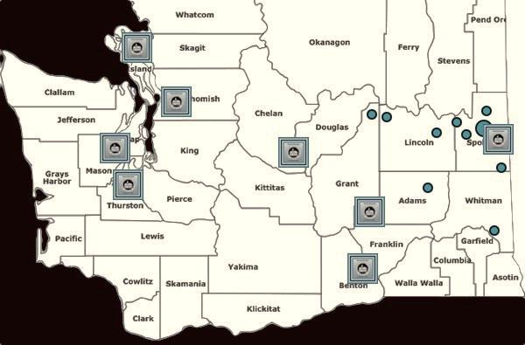

TPEP Pilot Sites Teacher and Principal Evaluation Project (TPEP)
Anacortes
Central Valley
Kennewick
North Thurston
North Mason
Othello
Snohomish
Wenatchee
ESD 101 Consortium
Almira
Davenport
Liberty
Medical Lake
Pullman
Reardan-Edwall
Wellpinit
Wilbur

Slide 8






Steering Committee

Slide 9
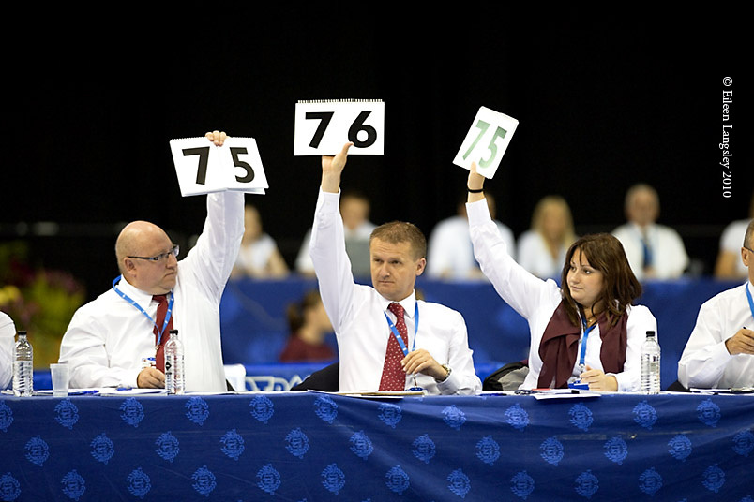
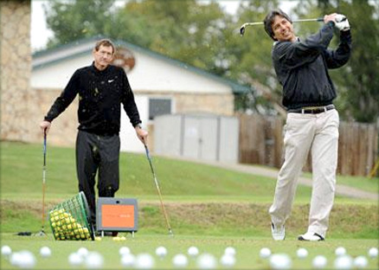
E2SSB 6696
(2010)
8 Teacher Evaluation Criteria
8 Principal Evaluation Criteria
SB 5895
(2012)
3 Criteria must include student growth
Evaluations will be used in HR decisions
ESEA Waiver
(Summer 2012)
Summative Scoring Formula
Matrix for analyzing summative and student growth scores
4-Tiered Rating System
Up to 3 instructional and leadership frameworks
Experienced teachers and principals cannot be basic
Separate analysis of Student Growth Criteria
Options for low student growth scores
Summative/Accountability
Formative/Growth
Notes:
The tension between accountability and professional growth has haunted our work since the beginning of the project.

Slide 10
Instructional and Leadership Frameworks
Teacher and Principal Evaluation Criteria

Slide 11
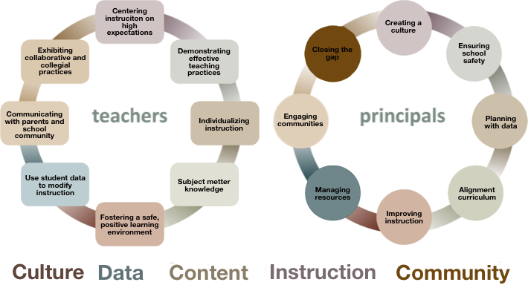
TPEP Criteria Themes

Slide 12
Frameworks in 2013-14
Framework | Changes from Framework Authors | Modification and Adaptations from Districts
CEL 5 Dimensions + | NO | NO Changes to Rubrics/Adding Indicators May add to Possible Observables
Danielson | Yes- Danielson 2013 Very Minor Changes to Framework Available May 2013 | NO Changes to Rubrics/Adding Components May add to Critical Attributes/Examples
Marzano (Instructional) | NO | NO Changes to Rubrics/Adding Components May add to Possible Evidence
AWSP Leadership | Yes- AWSP 2013 Very Minor Changes to Framework – May 2013 | NO Changes to Rubrics/Adding Components May add to possible Measures/Evidence
Marzano (Leadership) | NO | NO Changes to Rubrics/Adding Components May add to Possible Evidence

Slide 13
Comprehensive Evaluation Teachers
Assesses all 8 evaluation criteria.
All criteria contribute to the comprehensive summative evaluation rating.
Student Growth Rubrics embedded in Criterion. (3, 6, 8)
All provisional classroom teachers and any classroom teacher not on level 3 or level 4 receive Comprehensive evaluation.
All classroom teachers shall receive a comprehensive summative evaluation at least once every four years.

Slide 14
Comprehensive Evaluation Principals
Assesses all 8 evaluation criteria.
All criteria contribute to the comprehensive summative evaluation rating.
Student Growth Rubrics embedded in Criterion. (3,5,8)
“Due to the importance of instructional leadership and assuring rater agreement among evaluators, particularly those evaluating teacher performance, school districts are encouraged to conduct comprehensive summative evaluations of principal performance on an annual basis.”
Section 1, (12 c(v))

Slide 15
Comprehensive Evaluation Scoring Process Teachers and Principals
Evidence
Criterion
Rating
Summative Rating
Standards
Criteria 1
Observation
Artifacts
Student Growth
Other evidence relevant to the frameworks
District
determined process
Distinguished
Proficient
Basic
Unsatisfactory
State determined process
Distinguished
Proficient
Basic
Unsatisfactory
Criteria 2
Criteria 3
Frameworks
+
Student Growth Rubrics
Criteria 4
Criteria 5
Criteria 6
Student Growth Measures
(From 3 specific criteria)
Student Growth Impact Ratings:
Low, Average, High
Criteria 7
Criteria 8

Slide 16
Focused Evaluation Certificated Classroom Teachers
Includes an assessment of one of the eight criterion.
Student Growth Rubrics from one of the three criterion
If a teacher chooses 3,6 or 8; their accompanying student growth rubrics will be used.
If a teacher chooses Criterion 1,2,4,5,7, the accompanying student growth rubrics from Criterion 3 or 6 will be used.
Approved by the teacher’s evaluator.
A focused evaluation must be performed in any year that a comprehensive evaluation is not scheduled.

Slide 17
Focused Evaluation Principals and Assistant Principals
Includes an assessment of one of the eight criterion.
Student Growth Rubrics from one of the three criterion
The focused evaluation will include the student growth rubric row selected by the principal or assistant principal.
Criterion and Student Growth Rubric Rows must be approved by the principal’s evaluator.
A focused evaluation must be performed in any year that a comprehensive evaluation is not scheduled.

Slide 18
Focused Evaluation Scoring Process
Teachers and Principals
Standards
Evidence
Criterion = Summative Rating
One Criterion is chosen and approved by evaluator
Criteria 1
Observation
Artifacts
Student Growth
Other evidence relevant to the frameworks
Criteria 2
Distinguished
Proficient
Basic
Unsatisfactory
Criteria 3
Framework Components
+
Student Growth Rubrics
Criteria 4
Criteria 5
Criteria 6
Student Growth Measures
(A rating of 1 in the rubric rows triggers a student growth inquiry)
Criteria 7
Criteria 8

Slide 19
Criterion Scoring student growth Process Summative scoring methodology
And now for something much easier to talk about…

Slide 20
Criterion Scoring
1. Guiding Principles
2. Formative Evidence Gathering Matrix
(Framework Specific)
3. Summative Criterion Rating
4. Guiding Questions for Criterion Rating
5. Use OSPI Summative Scoring Process for Final Rating

Slide 21
Guiding Principles for Criterion Scoring
The primary goal of any system of teacher or principal evaluation is to promote principal, teacher and student learning.
Accurate teacher and principal evaluation requires trained observers using a research-based instructional or leadership framework. Trained observers make accurate assessments of practice based on evidence.
The value of accurate assessments of practice is to shape the conversations that lead to improved practice.
Embedded in each instructional or leadership framework is a system for growth in practice.
Reliability and validity of the instructional or leadership framework relies on implementation of the full framework rather than individual components/indicators. (comprehensive)
It is imperative to remain in the formative mindset until the final summative rating is determined.

Slide 22
Using the Matrix
Gather formative evidence of observed practice to enter (a minimum of three pieces or touch point evidence is recommended before each conference). FORMATIVE
Using the rubrics of your districts’ chosen framework, make a determination that represents the preponderance of evidence that defines the rating for each component/indicator. FORMATIVE
Taking the rating generated from the preponderance of evidence and generating a component/indicator score on the four level rating system. MOVING FROM FORMATIVE TO SUMMATIVE.

Slide 23
Evidence
Evidence means observed practice, products or results of a certificated classroom teacher or certificated principal's work that demonstrates knowledge and skills of the educator with respect to the four-level rating system. (WAC 392-191A-030)

Slide 24
Criterion Scoring
Teacher/Principal Self-Assessment
Repeat Cycle of Formative Evidence Gathering, Conference & Feedback
Summative Scoring
Goal Setting Conference
(Framework and Student Growth)
Gathering of Formative Evidence against the framework
(Shared Responsibility)
Conference focused on Formative Feedback

Slide 25
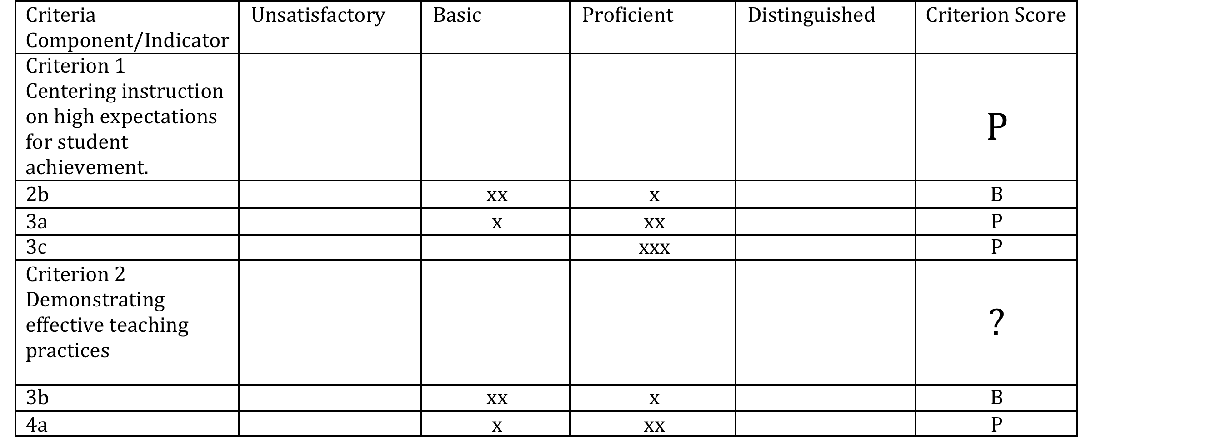
Criterion Scoring

Slide 26
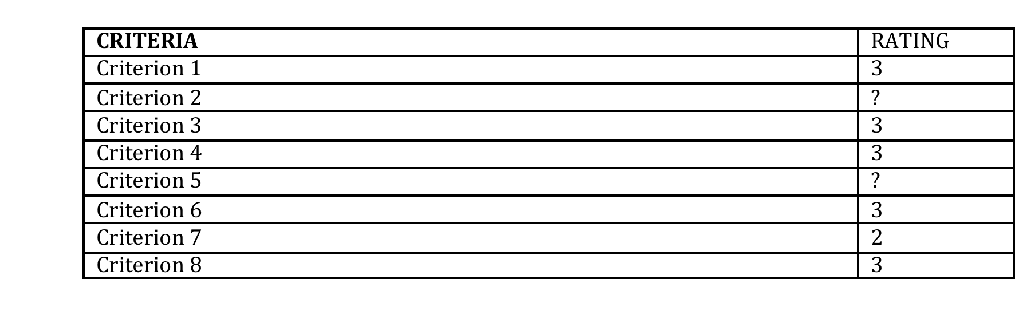
How do you deal with “?”

Slide 27
Sample Guiding Questions:
What else do I need to see or consider to make a final decision – what is available to me?
What is the distribution of evidence over time?
Has there been demonstrated and consistent improvement? If there was growth, was the growth sustained?
What would be the tipping point? If I consistently saw X, I would feel confident that the performance is “Basic” – if I consistently saw “Y”, I would feel confident that the performance is “Proficient”?
What is the essence of this criterion? (ie: the big picture) – go back and find the key words in the framework/rubric. What does the evidence tell you about the evaluatee’s performance and growth with regards to this essential aspect of the components/indicators criterion?
Is this evaluatee more basic than s/he is proficient, or more proficient than s/he is basic in this area? What is your evidence based in the framework/rubric to support your decision?

Slide 28
Know Thy Impact!
“There is no recipe, no professional development set of worksheets, no new teaching method, and no band-aid remedy.
It is a way of thinking: ‘My role, as a teacher, is to evaluate the effect I have on my students.’ It is to ‘know thy impact,’ it is to understand this impact, and it is to act on this knowing and understanding. John Hattie, Visible Learning (2012)

Slide 29
Know Thy Impact!
This requires that teachers (and leaders) gather defensible and dependable evidence from many sources, and hold collaborative discussions with colleagues and students about this evidence, thus making the effect of their teaching visible to themselves and to others.”
John Hattie, Visible Learning (2012)

Slide 30
Evaluation Measures Current vs. New
Current Evaluation System | New Evaluation System
Observation | Observation
YES | YES
Student Growth | Student Growth
NO | YES
Other Evidence | Other Evidence
NO | YES

Slide 31
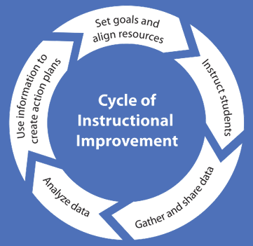
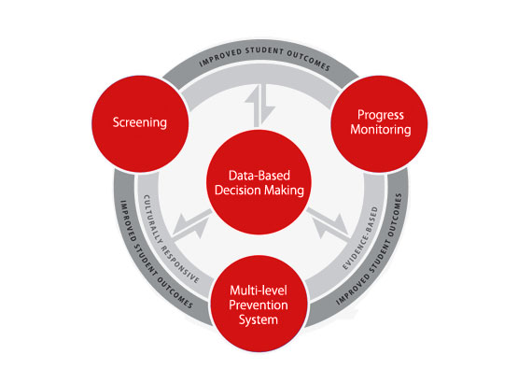

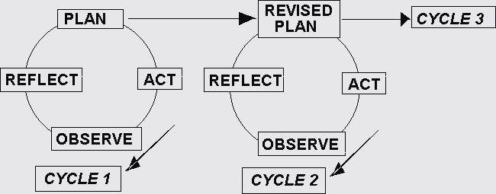
We have been working hard on the Improvement of Instructional Practice
Notes:
Cycle of Instructional Improvement
RTI
Architecture of Accomplished Teaching
Action Research

Slide 32
ESSB 5895 Establishes New Definitions Around Student Growth Measures
Both E2SSB 6696 and ESSB 5895 contain language around student growth including:
Changes…
Student growth data must be a substantial factor in evaluating the summative performance of certificated classroom teachers for at least three of the evaluation criteria.
Student growth data elements may include the teacher’s performance as a member of a grade-level, subject matter, or other instructional team within a school when the use of this data is relevant and appropriate.
Student growth data that is relevant to the teacher and subject matter must be a factor in the evaluation process and must be based on multiple measures that can include classroom-based, school-based, district-based, and state-based tools. Student growth means the change in student achievement between two points in time.

Slide 33
Student Growth Theory of Action
If state leaders allocate student growth funds and provide a viable structure for setting, monitoring and evaluating student learning goals…
Then teachers and principals will set meaningful learning targets and monitor growth for all students…
(3.1, 6.1,8.1)
And specific outcomes for students will result in all students reaching their full learning potential.
(3.2, 6.2)
Then district leaders will present a vision for student learning that starts with the students, data and standards…

Slide 34
Defining Key Terms
Student Achievement: The status of subject-matter knowledge, understandings, and skills at one point in time.
Student Growth (Learning): The growth in subject-matter knowledge, understandings, and skill between two points in time.

Slide 35
It is student growth, not student achievement, that is relevant in demonstrating impacts teacher and principals have on students.
Formal Tests in
Core Subjects Only
Knowledge and Learning that can be Measured
All Classroom Learning
State-based
Tools
District and School-Based Tools
Classroom-based Tools

Slide 36
Student Growth Rubrics
The TPEP steering committee organizations approved statewide rubrics for student growth to ensure consistency in implementation of the evaluation system across Washington State.
The rubrics for student growth describe both goal-setting and outputs of student learning.
OSPI has provided student growth rubrics for each of the three criterion
Teachers #3, #6, and #8
Principals #3, #5, and #8
Notes:
Committee was formed in August of 2011
Concluded work June, 2012
18 TPEP Practitioners (2 from each site)
7 Experts from higher education, districts outside of TPEP pilots, SIG/MERIT districts
Recommendations were completed on Student Growth, Perception Data and Evaluator Training and Support

Slide 37
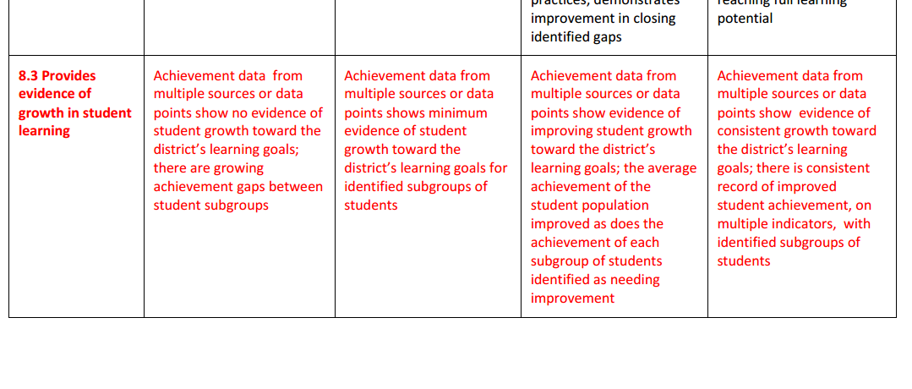
Student Growth Principal Rubric Language SG 8.3

Slide 38
Student Growth Teacher Rubric Language SG 3.1 & 3.2
Student Growth Criterion 3: Recognizing individual student learning needs and developing strategies to address those needs.
Student Growth 3.1: Establish Student Growth Goal(s)
Unsatisfactory | Basic | Proficient | Distinguished
Does not establish student growth goals or establishes inappropriate goals for subgroups of students not reaching full learning potential. Goals do not identify multiple, high-quality sources of data to monitor, adjust, and evaluate achievement of goals. | Establishes appropriate student growth goals for subgroups of students not reaching full learning potential. Goals do not identify multiple, high-quality sources of data to monitor, adjust, and evaluate achievement of goals. | Establishes appropriate student growth goals for subgroups of students not reaching full learning potential. Goals identify multiple, high-quality sources of data to monitor, adjust, and evaluate achievement of goals. | Establishes appropriate student growth goals for subgroups of students not reaching full potential in collaboration with students, parents, and other school staff. Goals identify multiple, high-quality sources of data to monitor, adjust, and evaluate achievement of goals.
Student Growth 3.2: Achievement of Student Growth Goal(s)
Unsatisfactory | Basic | Proficient | Distinguished
Growth or achievement data from at least two points in time shows no evidence of growth for most students. | Multiple sources of growth or achievement data from at least two points in time show some evidence of growth for some students. | Multiple sources of growth or achievement data from at least two points in time show clear evidence of growth for most students. | Multiple sources of growth or achievement data from at least two points in time show evidence of high growth for all or nearly all students.
38

Slide 39
Student Growth/Learning - Teachers
Five Student Growth Rubric Rows
3.1 Establish Student Growth Goals
Re: individual or subgroups of students (achievement/ opportunity gap)
3.2 Achievement of Student Growth Goals
Re: individual or subgroups of students (achievement/ opportunity gap)
6.1 Establish Student Growth Goals using Multiple Student Data Elements
Re: whole class based on grade-level standards and aligned to school and district goals
6.2 Achievement of Student Growth Goals
Re: whole class based on grade-level standards and aligned to school and district goals
8.1 Establish Team Student Growth Goals
Re: Teacher as part of a grade-level, content area, or other school/district team
39

Slide 40
Student Growth/Learning - Principals
Three Student Student Growth Rubric Rows
Criterion 3: Demonstrated and measureable improvements in student academic growth readily apparent (whole school data)
Criterion 5: Assessment results of selected teachers show measurable and improving academic growth of students (selected subgroup of teachers)
Criterion 8 Provides evidence of growth in student learning achievement data related to school and subgroups (achievement/opportunity gap)
40

Slide 41




Nesting Dolls
Notes:
One approach to the student growth goals is to look at them in a “nested” fashion. That the goals should logically sit inside one another. In the case of an elementary school it may look like this:

Slide 42
Student Growth/Learning Goals Defining Key Terms
Goal: A Student Learning Goal is a standards-based, rigorous and relevant learning target that teachers set for groups (Criterion 6 & 8) or subgroups of students (Criterion 3).
Specific and measureable
Based on prior learning data
Aligned to state and content standards
Aligned to school and district priorities/ SIP
Learning Targets: Learning Targets are statements of intended learning that are used to create and carry out the student learning goal.

Slide 43
Student Growth/Learning Goals Grain Size
Finding the right grain size for the “goal(s)” is a major challenge. Some things to keep in mind:
There is no perfect grain size, because we are definitely in search of the Goldilocks or “just right” goal.
The grain size should be relevant to the rubric language. (i.e. 3 around subgroups or 6 around whole class)
Larger grain size “goals” might require multiple assessments, while more specific goals could probably be measured with a minimum of 2 performance tasks or other relevant assessment.

Slide 44
Creating Growth Goals: First Steps The Goldilocks Approach
STUDENT GROWTH GOAL Literacy: Informational Text Writing K-5
 | Too Narrow | JUST RIGHT | Too Broad
6.1 Whole Group | All students (with 100% accuracy) will determine the meaning of the root word when the affix ‘un’ is added. | In the 2013-2014 year students in my science class will accurately identify, define and use vocabulary appropriate to the rocks and minerals content area. Tier II word use will transfer to other subject areas i.e. observation, properties. This will be measured through a pre-test, formative assessment, think~write~pair~share, reflective writing and a post-test. | All of my students will understand and apply grade level vocabulary to content areas.
Notes:
This is one lens of looking at first pass at writing goals – too broad and too narrow.

Slide 45
Student Growth/Learning District Preparation
How can districts prepare for implementing the student growth component of the new evaluation system?
1. Goal Setting: Provide support for teachers and principals to set quality, rigorous and aligned (to standards) goals.
2. Data: Provide relevant student growth data for principals and teachers to use prior to September.
2. Measures: In 2013-14 stay close to the classroom, but experiment with school, district and state-based tools.

Slide 46
Assessments
We need high quality assessments to evaluate the extent to which students have achieved the goals
Some thoughts before delving into “assessments”:
Think broadly about “assessment” (i.e. performance assessments, project-based and
Do not let the assessment drive the goal; the assessment should be used to support learning goals (let’s move to “enduring understandings”)
The learning goal and assessment should be things that teachers would use in the classroom as part of good instructional practice
Beware of Campbell’s Law!
Determine how students can be incorporated in the goal setting process in order to have them take some ownership of their own learning.
Notes:
"The more any quantitative social indicator is used for social decision-making, the more subject it will be to corruption pressures and the more apt it will be to distort and corrupt the social processes it is intended to monitor."

Slide 47
Creating Your Own Data Pyramid
Annually
2-4 Times a Year
Quarterly or end of unit
1-4 times a month
Daily/Weekly

Slide 48
Summative Rating Process Overview
ESSB 5895 requires OSPI to determine a summative scoring methodology (In WAC 392-191A)
Summative Rating is determined through a “Raw Score” Model
Generated from the TPEP Pilot Sites and approved by the TPEP Steering Committee
Used for both the teacher and principal evaluation systems
Determination of overall criterion score based on both:
Instructional framework rubrics
Student growth rubrics

Slide 49
Teacher & Principal Raw Score Model Sample
Evaluation Criteria * Student Growth- Teachers ** Student Growth- Principals | Overall Criterion Scores
Criterion 1 | 3
Criterion 2 | 4
*/**Criterion 3 | 3
Criterion 4 | 2
** Criterion 5 | 3
* Criterion 6 | 2
Criterion 7 | 3
*/**Criterion 8 | 2
Total Summative Score | 22
OSPI Approved Summative Scoring Band
8-14 | 15-21 | 22-28 | 29-32
1 Unsatisfactory | 2 Basic | 3 Proficient | 4 Distinguished
49
Notes:
The reason for the word “preliminary” is the fact that the student growth has not yet been computed.

Slide 50
Student Growth Rubric and Rating (Teacher)
Student Growth | Goal-Setting Score Based on Rubric | Student Growth* Score Based on Rubric | Overall Student Growth Criterion Score
Criterion 3 | 3 | 2** | 5
Criterion 6 | 2 | 2** | 4
Criterion 8 | 2 | N/A | 2
Student Growth Score | 7 | 4 | 11
OSPI Approved Student Growth Impact Rating Scoring Band
5-12 | 13-17 | 18-20
Low | Average | High
*Must include a minimum of two student growth measures (i.e., state-, district-, school-, and classroom-based measures).
** A student growth score of “1” in any of the student growth rubrics will result in a Low growth rating.
Evaluators place teachers into summative rating categories based on score bands. As illustrated below, this teacher would receive a low student growth rating
50

Slide 51
Student Growth Rubric and Rating (Principal)
Student Growth | Student Growth* Score Based on Rubric
Criterion 3.4 | 2**
Criterion 5.2 | 2**
Criterion 8.3 | 1**
Student Growth Score | 5
3-5 | 6-9 | 10-12
Low | Average | High
*Must include a minimum of two student growth measures (i.e., state-, district-, school-, and classroom-based measures).
** A student growth score of “1” in any of the student growth rubrics will result in a low growth rating.
Evaluators place principals into summative rating categories based on score bands. As illustrated below, this principal would receive a low student growth rating

Slide 52
Summative Rating & Impact on Student Learning Matrix
Summative Rating | Distinguished | Proficient Rating Student Growth Inquiry | Distinguished Rating
 | Proficient | Proficient Rating Student Growth Inquiry | Proficient Rating
 | Basic | Basic Rating Student Growth Inquiry | Basic Rating
 | Unsatisfactory | Unsatisfactory Rating Plan of Improvement
Consequences as a result of Intersection between Summative Rating and Impact on Student Learning Rating |  | Low | Average | High
 |  | Impact on Student Learning
52
Notes:
Educators with preliminary rating of Distinguished with Average or High Student Growth Rating: These educators will receive an overall Distinguished Rating and will be formally recognized and/or rewarded (per regulations).
Educators with preliminary rating of Unsatisfactory and High Student Growth Rating: These evaluations will be reviewed by the evaluator’s supervisor when an educator is rated Unsatisfactory and receives a High student growth rating. The supervisor will take these discrepancies into account in the evaluator’s evaluation.
Educators who receive a score of 1 in on the Achievement of Student Growth Goals will automatically receive a low student growth rating

Slide 53
Student Growth Inquiry Consequences:
Within two months of receiving the low student growth score or at the beginning of the following school year, whichever is later, one or more of the following must be initiated by the evaluator:
Triangulate student growth measure with other evidence (including observation, artifacts and student evidence) and additional levels of student growth based on classroom, school, district and state-based tools;
Examine extenuating circumstances possibly including: goal setting process/expectations, student attendance, and curriculum/assessment alignment;
Schedule monthly conferences with the teacher to discuss/revise goals, progress toward meeting goals, and best practices; and/or
Create and implement a professional development plan to address student growth areas.

Slide 54
Modules
Introduction to Educator Evaluation in Washington
Using Instructional and Leadership Frameworks in Educator Evaluation
Preparing and Applying Formative Multiple Measures of Performance: An Introduction to Self-Assessment, Goal Setting, and Criterion Scoring
Including Student Growth in Educator Evaluation
Conducting High-Quality Observations and Maximizing Rater Agreement
Providing High-Quality Feedback for Continuous Professional Growth and Development
Combining Multiple Measures into a Summative Rating

Slide 55
Rater Agreement
Principal and Administrator Training

Slide 56
Rater Agreement Background
The TPEP project has relied heavily on the growing body of research, the framework authors and the practical input from practitioners in the pilot sites to create a “working definition” of rater agreement for the 2012-13 school year.
The new law requires that evaluators of both teachers and principals “must engage in professional development designed to implement the revised systems and maximize rater agreement.”

Slide 57
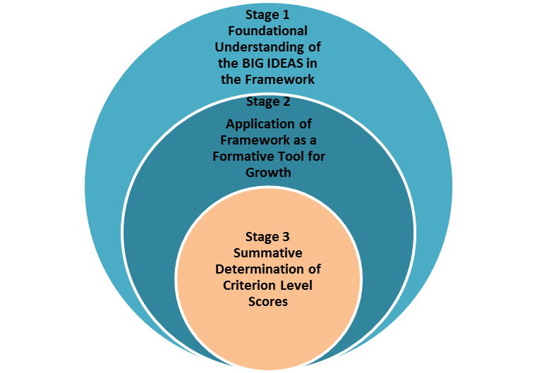
Stages of Rater Agreement
2-3 Day Foundational Training
Ongoing Rater Agreement Training

Slide 58
eval management system
Support and Resources

Slide 59


Slide 60
What you need to know…
2013 Legislative Session:
OSPI requested 30 million to support the following aspects of the project:
Continued Evaluator Training
Instructional Framework Training for all Classroom Teachers
Student Growth District Training
Staff time to implement student growth component

Slide 61
Final Thought
“It is the mark of an educated man (or woman)….that in every subject he (she) looks for only so much precision as its nature permits.”
(Aristotle, 350 BC)
Notes:
We must seek precision, but I invite you to take the next three years to make this system work for the students of Olympia School District.

Slide 62
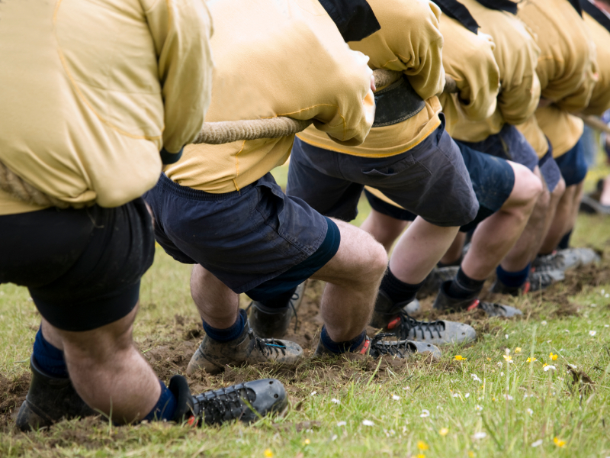
When systems align and work together,
real progress is made.

Slide 63


Follow Us
http://www.tpep-wa.org
Follow us @waOSPI_TPEP
Search for “TPEP” in the iTunes Store for our videos

