Slide 1

eVAL Practice RIG 2-2
May 29, 2013
Cathey Frederick
ESD 189 eVAL Specialist

Slide 2

Learning Targets
Practice using eVAL observation tool
Preview End of Year Summary
Determine next steps

Slide 3
Evaluation Process
Training
Orientation
8. Professional Development Plans
3. Self-Assessment and Goal Setting
7. Summary Evaluation Conference
4. Pre-Observation Conference
6. Post-Observation Conference
5. Observations
Notes:
Self assessment F

Slide 4
eVAL is like….
…a cruise ship buffet. Take only what you need. There will be more tomorrow!

Slide 5

Play in the Sandbox ADMIN Set Up
District Name <space> SD <space> School <space> number 1 <space> Role Abbreviation (AD)
Anacortes SD School 1 AD
http://sandbox.eval-wa.org/
Password=password
Notes:
Self assessment F

Slide 6
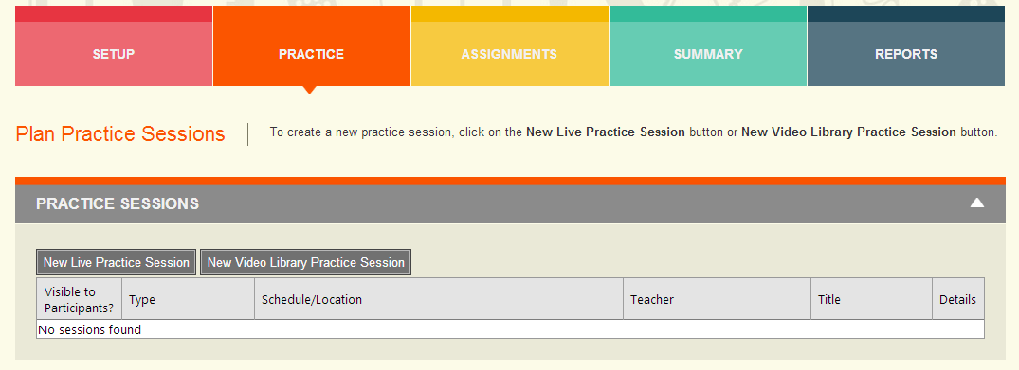
Principal/School Administrator Planning Practice Session
Click here or here
You must be logged in as School or District Administrator to set up a practice session.
Notes:
Self assessment F

Slide 7
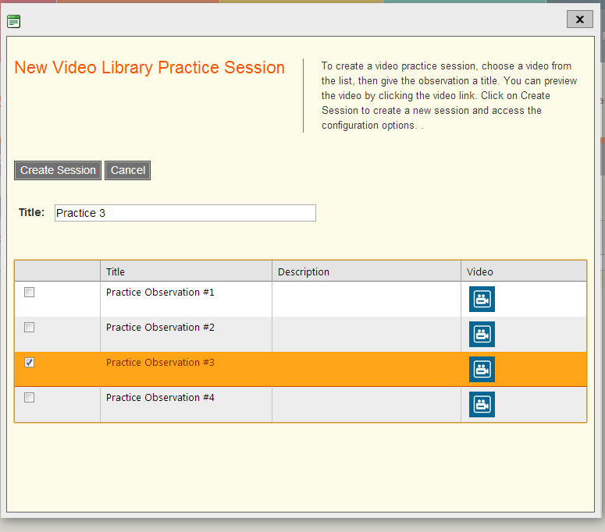
Principal/School Administrator Planning Practice Session
Be sure to
Click Create
Session to
Save
Notes:
Self assessment F

Slide 8
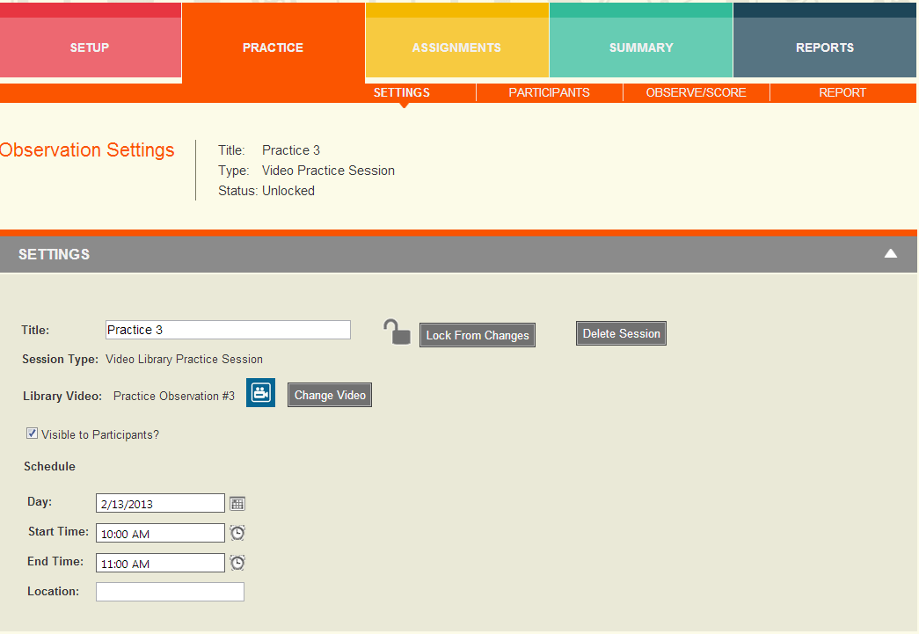
Principal/School Administrator Planning Practice Session
Be sure to
Click Make
Visible to
Participants
Notes:
Self assessment F

Slide 9
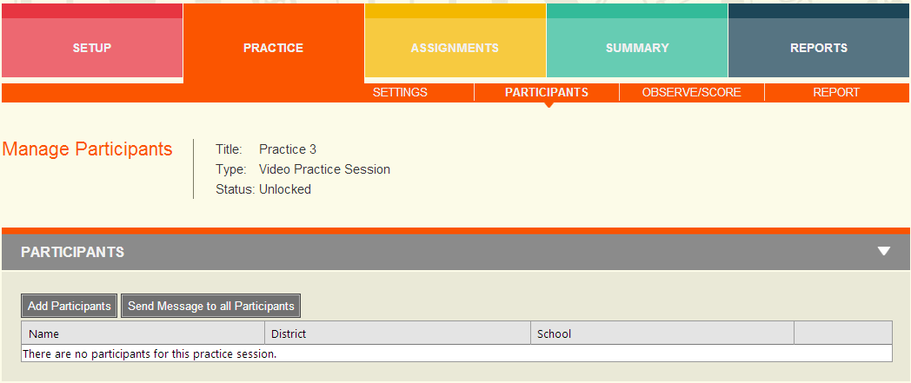
Principal/School Administrator Planning Practice Session
Notes:
Self assessment F

Slide 10
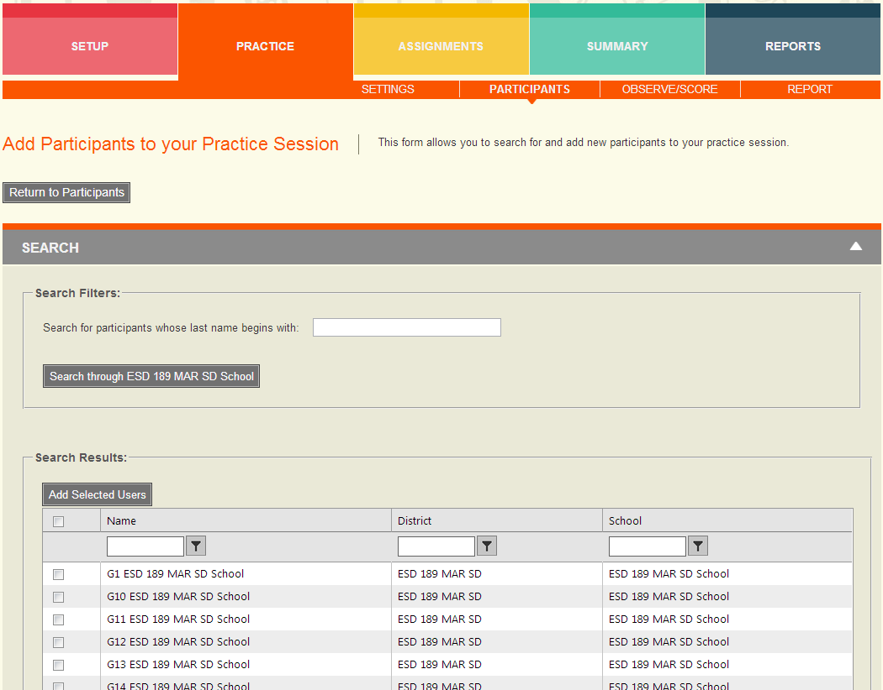
Principal/School Administrator Planning Practice Session
Select all by clicking
here
Select individual
Participants by
clicking here
Then click Add
Selected Users
Notes:
Self assessment F

Slide 11
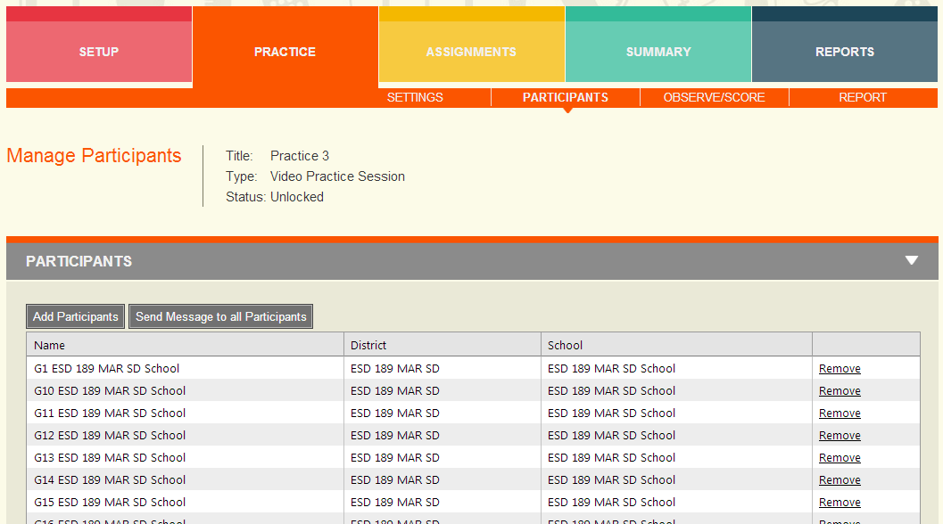
Principal/School Administrator Planning Practice Session
List of participants – you can add or remove from this screen. You can
Send a message to all participants.
Notes:
Self assessment F

Slide 12
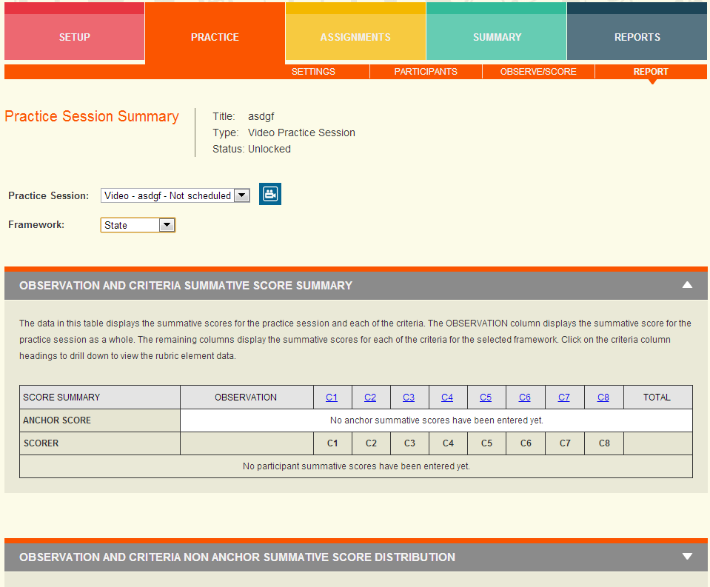
Principal/School Administrator Practice Session
To create
anchor
scores,
mark
rubrics
while
logged
in as
admin
Notes:
Self assessment F

Slide 13
Play in the Sandbox
District Name <space> SD <space> School <space> number 1-5 <space> Role Abbreviation (T1-20, or PR or AD)
Anacortes SD School 1 T1
http://sandbox.eval-wa.org/
Password=password
Notes:
Self assessment F

Slide 14
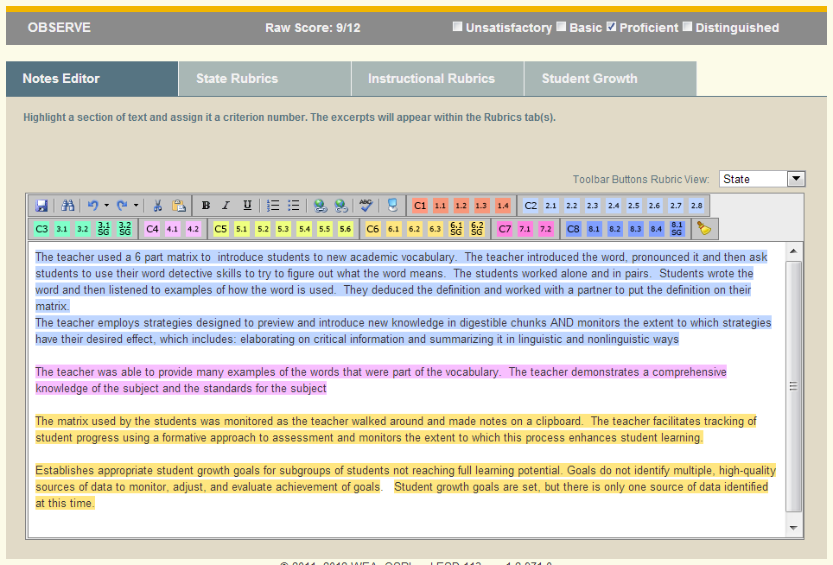
Practice Observe/Score
Change
To
Instructional
Rubrics

Slide 15
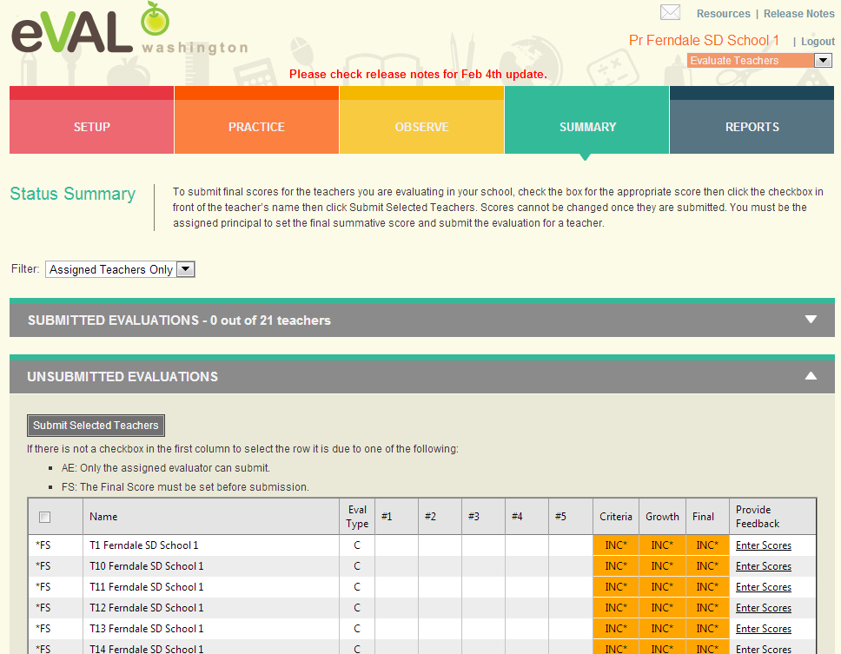
Principal – Summary View
Notes:
http://demo.eval-wa.org/login.aspx?ReturnUrl=%2f
Esd 189 mar sd school pr

Slide 16
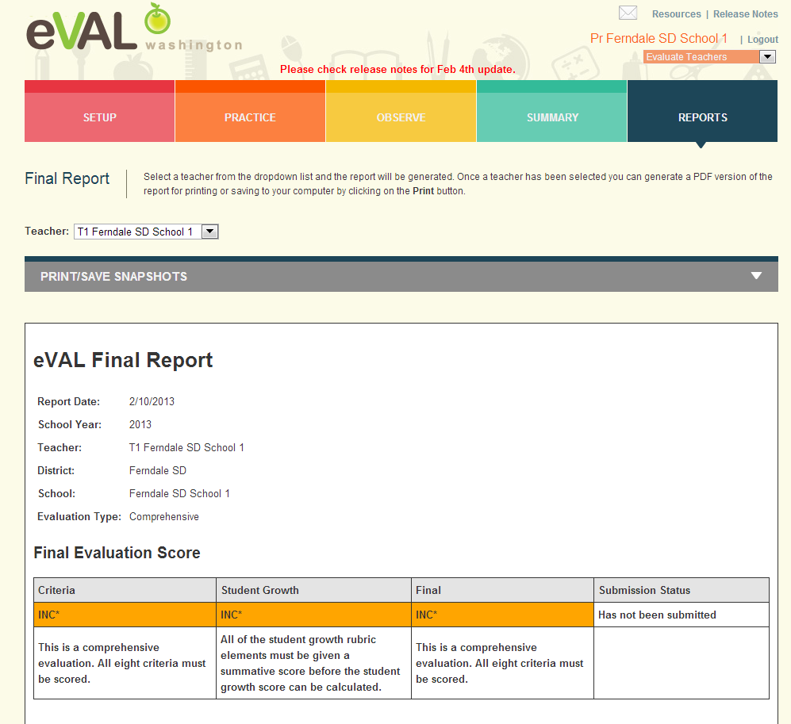
Principal – Final Report, Part 1

Slide 17
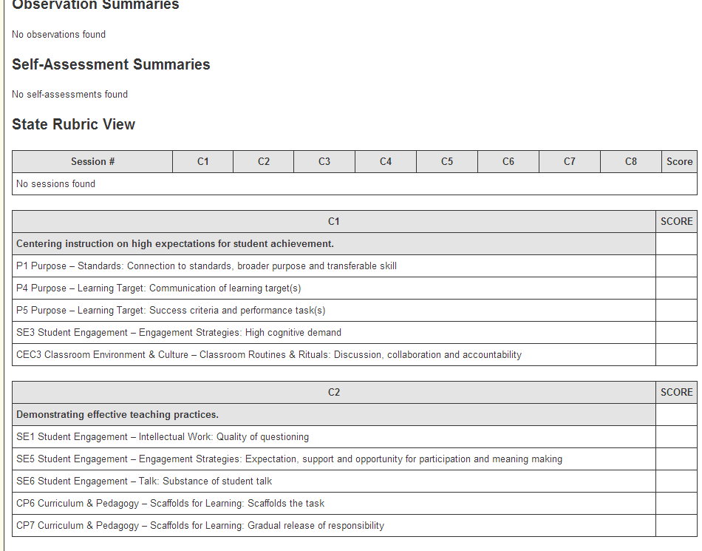
Principal – Final Report, Part 2

Slide 18
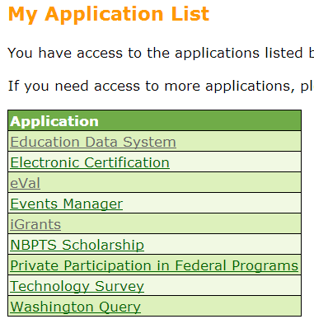
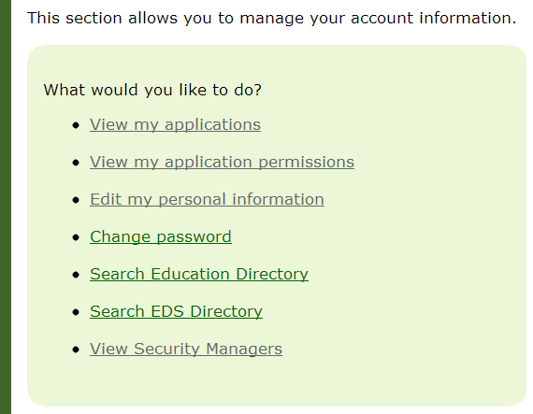
Logging into eVAL
Log into OSPI’s EDS: https://eds.ospi.k12.wa.us/
Notes:
Self assessment F

Slide 19
Next Steps
What do you need to do next?
Who needs to be involved?
When does it need to happen?
How can I help?

Slide 20
More Information?
ESD 189 eVAL Training Documents
https://library.nwesd.org/tpep/eval-training-documents
OSPI eVAL
http://tpep-wa.org/resources/eval/
eVAL Sandbox Demonstration Site
http://sandbox.eval-wa.org/
https://files.nwesd.org/~jlongchamps/TPEP/eVAL/Getting_Started_with_Sandbox.pdf

Slide 21
Questions?
cathey Frederick
ESD 189 eVAL Specialist
cfrederick@nwesd.org

