Slide 1

eVAL and The Evaluation Cycle A Look at the Principal’s Roles of Evaluatee and the Interaction of Principal as Evaluator and Teacher Roles
Cathey Frederick
eVAL Specialist - ESD 189
cfrederick@nwesd.org

Slide 2

Goals
Understand principal role as evaluatee and the supports offered by eVAL
Review evaluation steps for teacher evaluations
Understand supports offered to evaluator by eVAL
Understand specific tasks evaluator and evaluatee might want to do in eVAL
Understand interaction between evaluator and evaluatee roles in eVAL

Slide 3
Evaluation Process
Training
Orientation
8. Professional Development Plans
3. Self-Assessment and Goal Setting
7. Summary Evaluation Conference
4. Pre-Observation Conference
6. Post-Observation Conference
5. Observations
Notes:
Self assessment F

Slide 4
eVAL is like….
…a cruise ship buffet. Take only what you need. There will be more tomorrow!

Slide 5
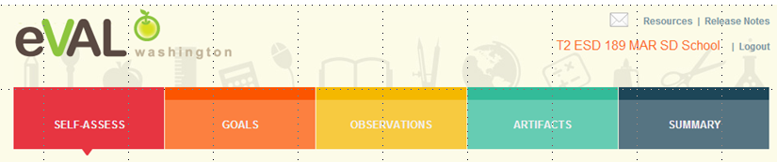
Role of Evaluatee
An evaluatee has three primary responsibilities in eVAL:
self-assessment and goal-setting;
interacting with the evaluator in the observation process; and
uploading artifacts

Slide 6
Logging into eVAL Sandbox
http://sandbox.eval-wa.org/
District Name<space>SD<space>School <space>number 1-5 <space>Role Abbreviation (PR)
Example (Sedro Woolley District, School 1, PR): Sedro Woolley SD School 1 PR
Password = password
Notes:
Self assessment F

Slide 7

Principal Log In Screen

Slide 8
Logging into eVAL Sandbox
http://sandbox.eval-wa.org/
District Name<space>SD<space>School <space>number 1-5 <space>Role Abbreviation (AD)
Example (Concrete District, School 1, AD): Concrete SD School 1 AD
Password = password
Notes:
Self assessment F

Slide 9
Principal Log In Screen
Select Administrator
In live version

Slide 10
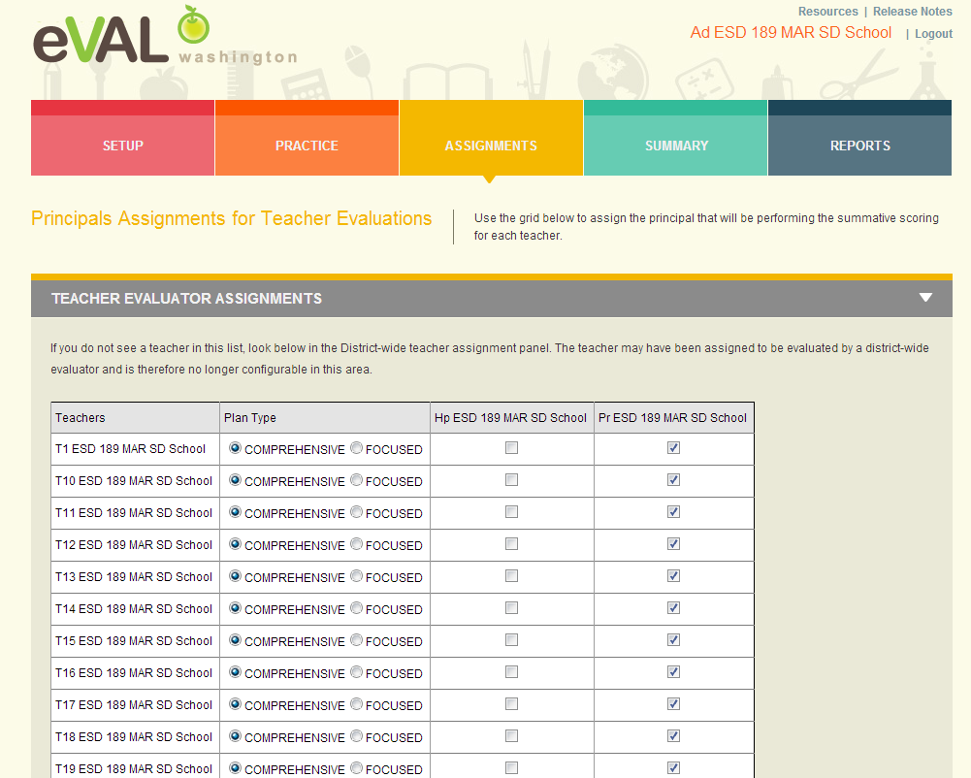
Principal/School Administrator Assigning Teachers
Either the District or School Administrator has to assign teachers to a principal
before the evaluation process can start.
Notes:
Self assessment F

Slide 11
Principal Log In Screen

Slide 12
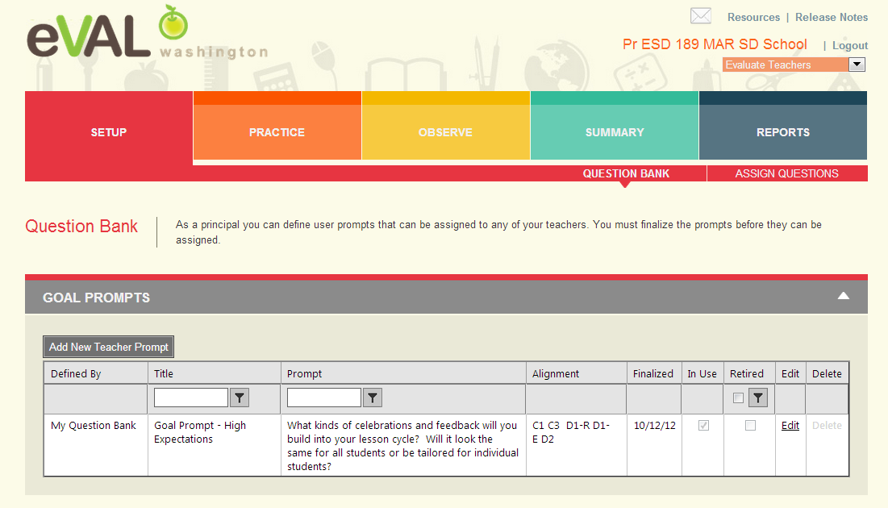
Principal Creates Goal Prompt in Question Bank

Slide 13
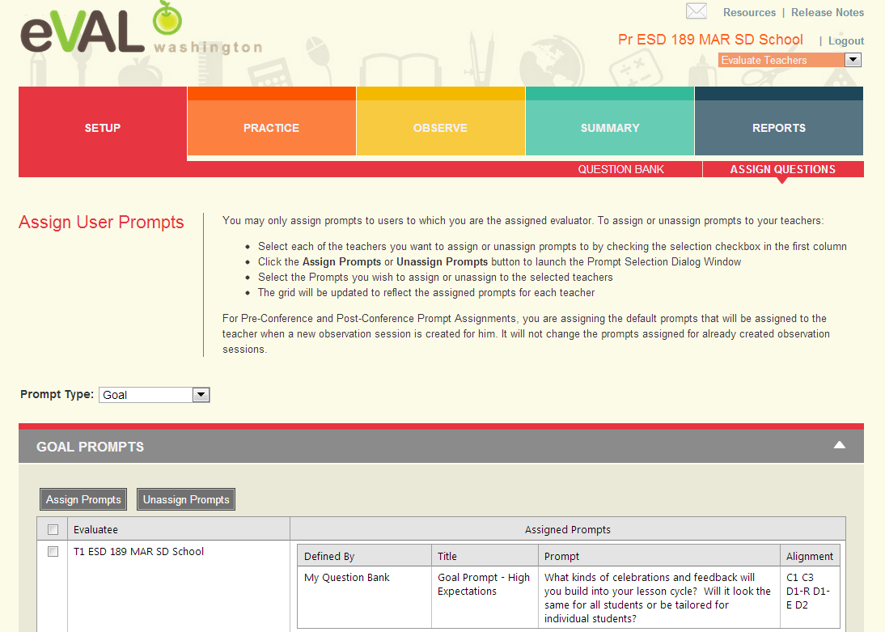
Principal Assigns Goal Prompt to Teacher
Choose type of
prompt here
Click on box
next to teacher’s
name and then
click on Assign
Prompt

Slide 14
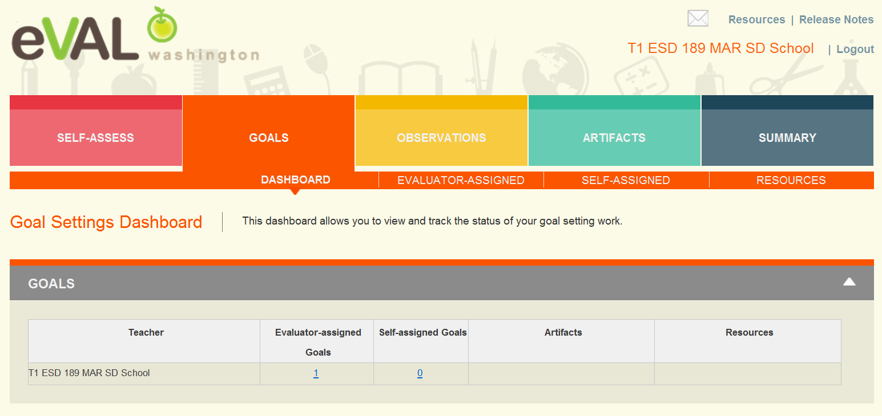
Teacher Goals Dashboard
Clicking on Evaluator-assigned Goals will open up next screen.

Slide 15
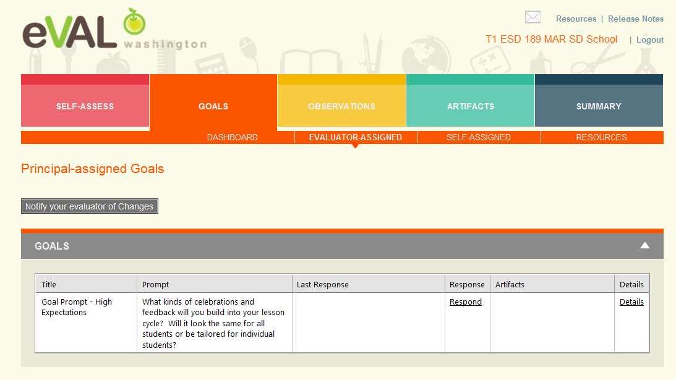
Teacher Reviews Principal-Assigned Goal Prompt
Clicking on Respond will open next screen.

Slide 16
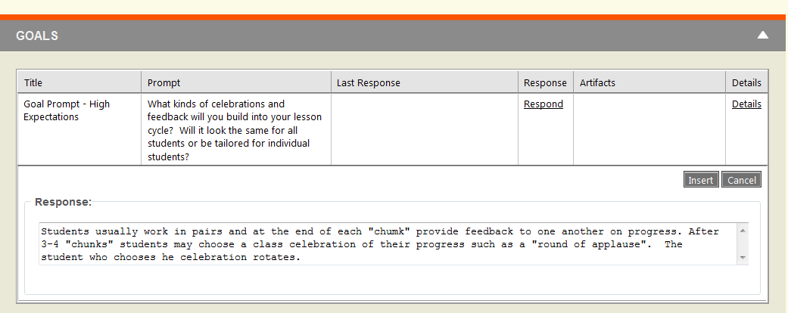
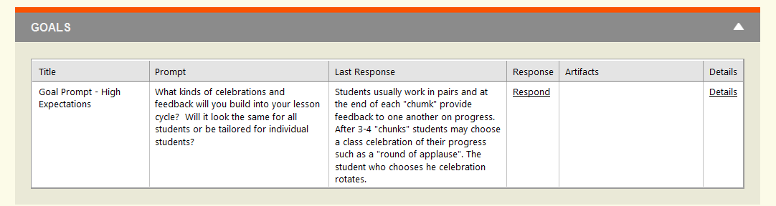
Teacher Responds to Principal Goal Prompt
Insert

Slide 17
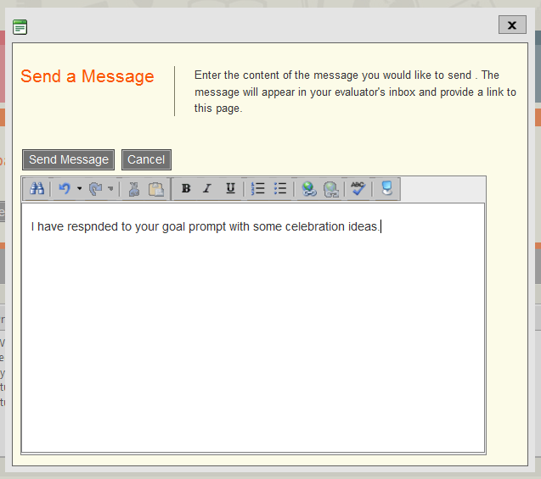
Teacher Notifies Evaluator

Slide 18
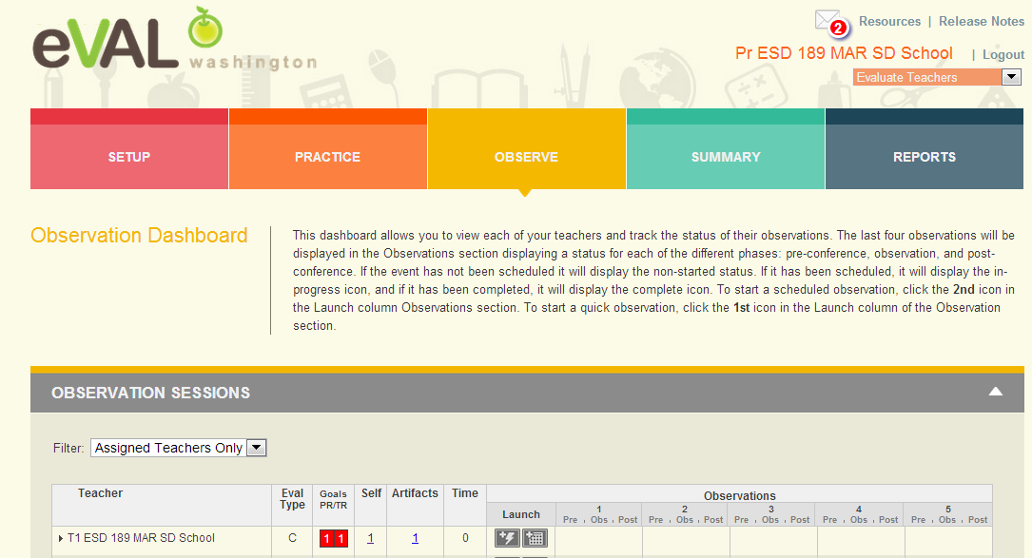
Principal Dashboard
Notice
message
in
mail box
Self evaluation shows because teacher made visible to evaluator.
To schedule a formal observation, click on the calendar; to schedule an informal observation,
click on the lightening bolt.

Slide 19
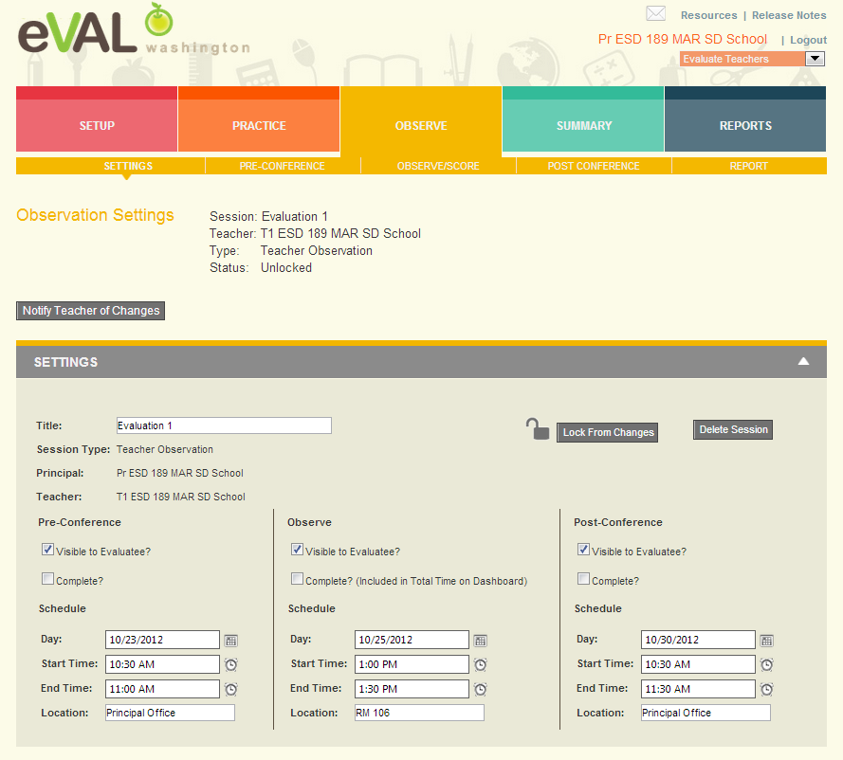
Principal Schedules Formal Observation

Slide 20
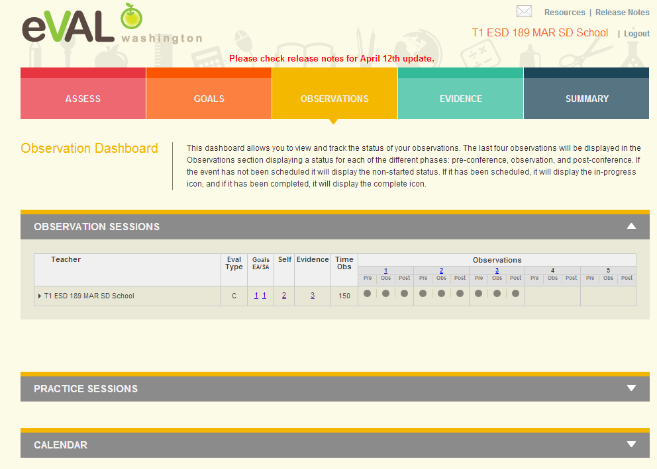
Teacher Observation Dashboard Part 1
Clicking on any one of the circles will bring up that section.

Slide 21
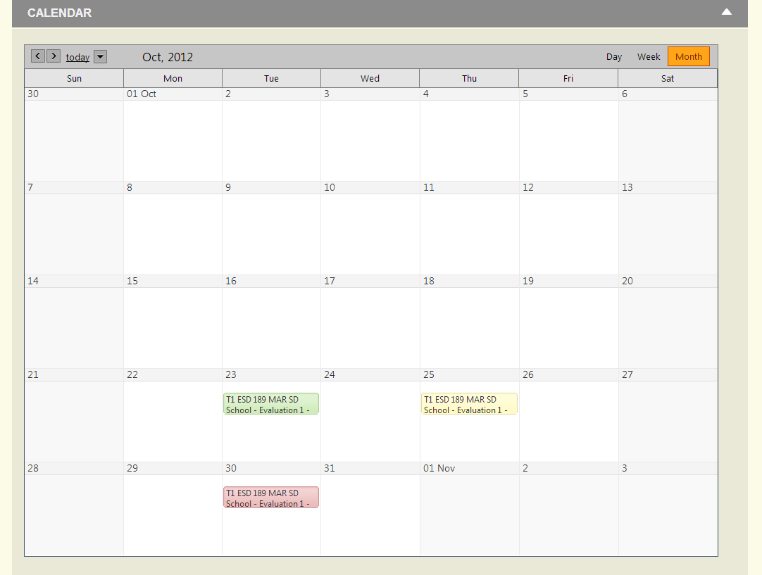
Teacher Observation Dashboard Part 2

Slide 22
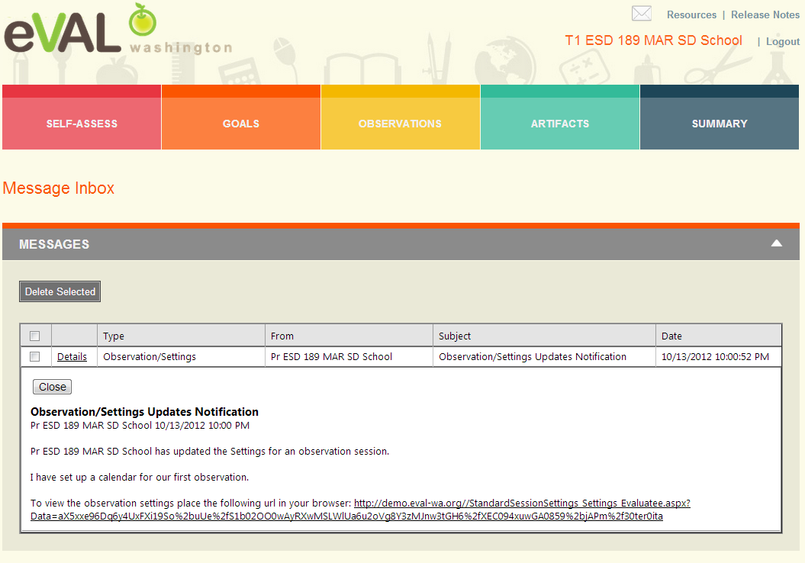
Teacher Mailbox

Slide 23
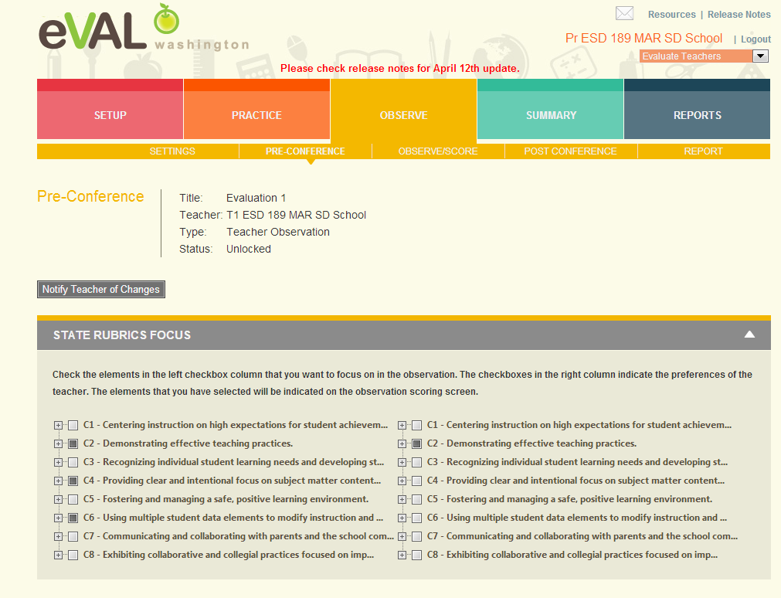
Principal Preconference Part 1
Select
focus
here

Slide 24
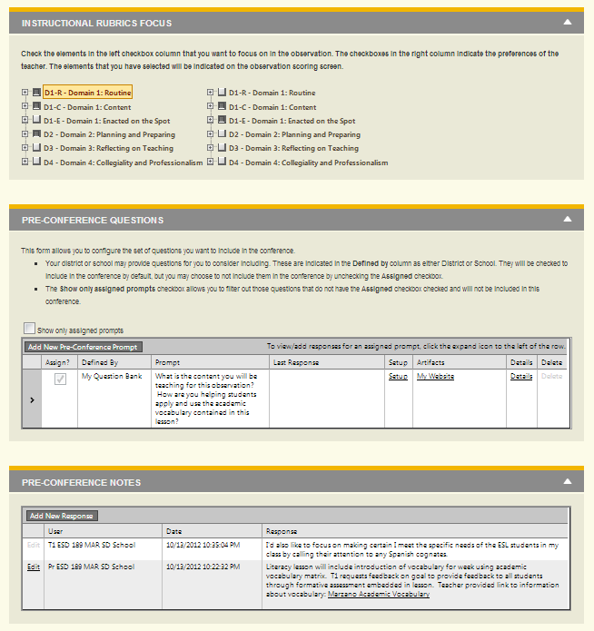
Principal Preconference Part 2

Slide 25
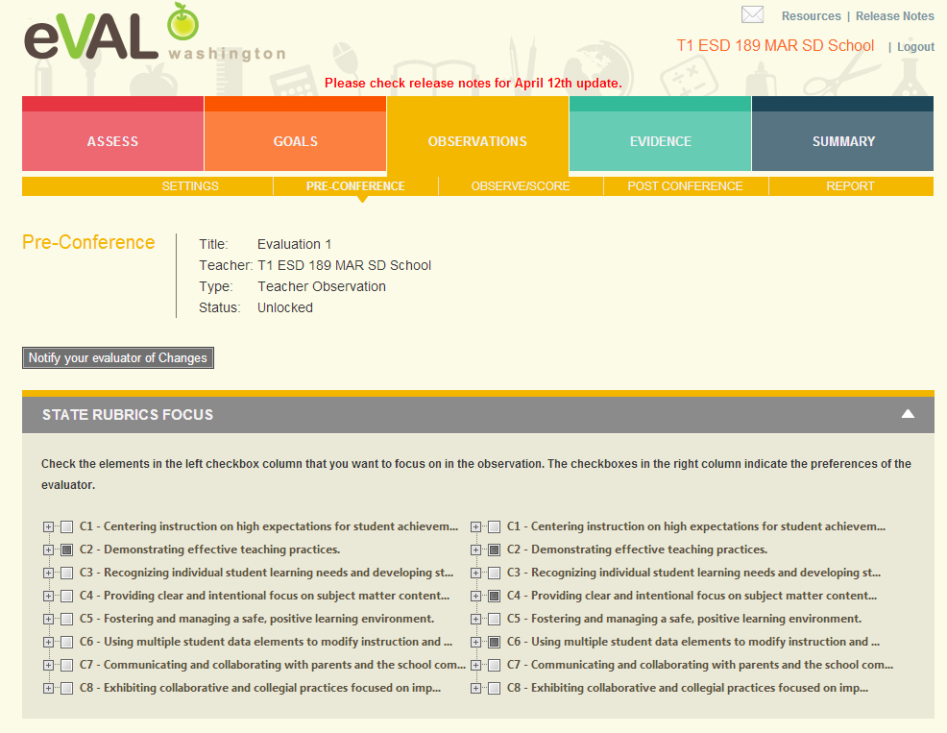
Teacher Preconference Part 1
Select
focus
here

Slide 26
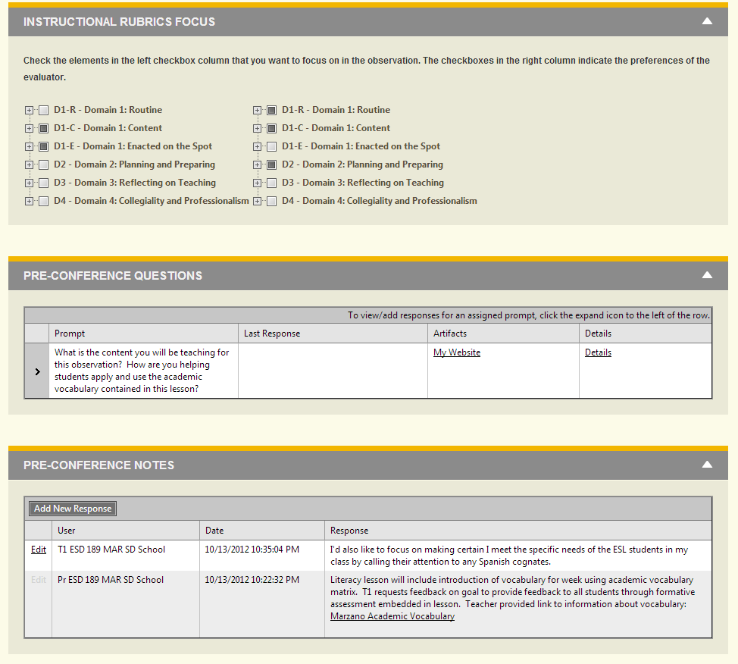
Teacher Preconference Part 2
Click to
expand
and add
response

Slide 27
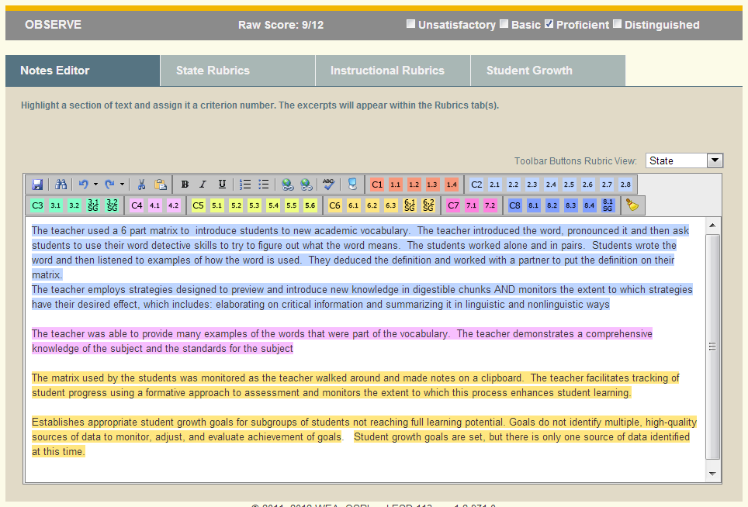
Principal Observe/Score
Change
To
Instructional
Or
Growth
Rubrics

Slide 28
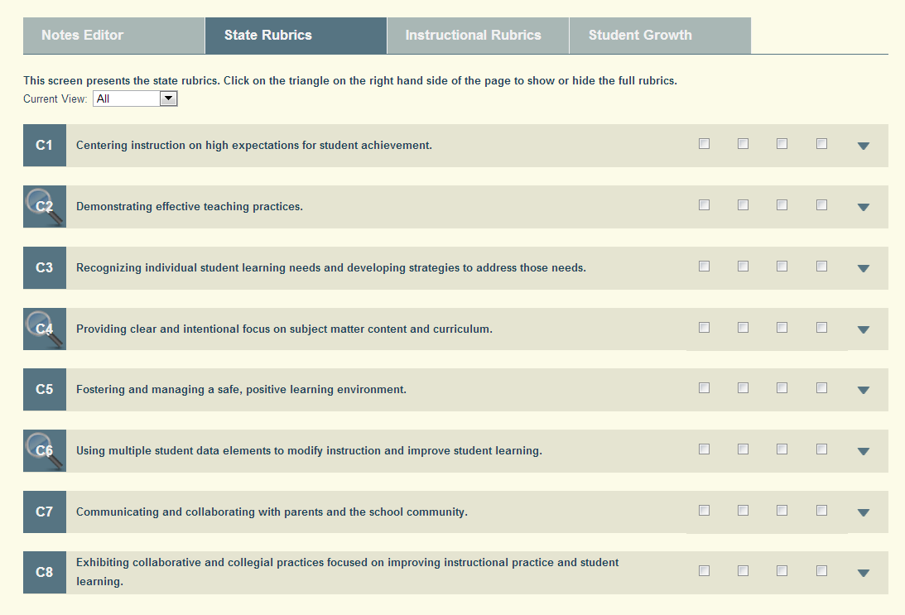
Principal State Rubrics
Magnifying
glasses
point
to
areas
of
focus

Slide 29
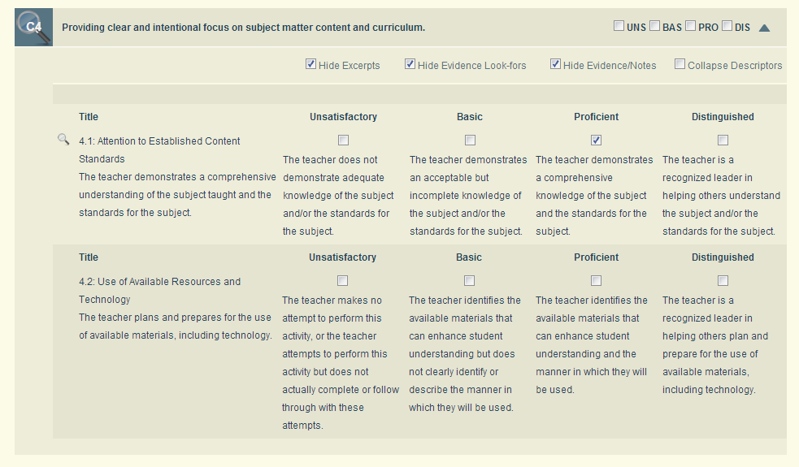
Principal C4.1 – Expanded View
Evidence notes show
up below when you
uncheck Hide
Evidence/Notes

Slide 30
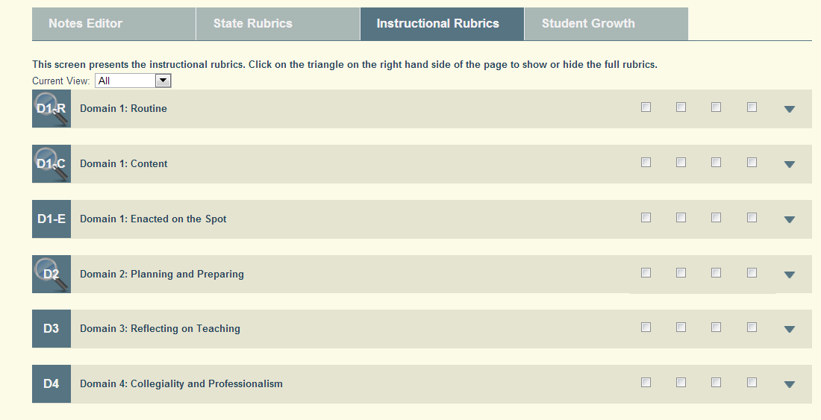
Principal Instructional Rubrics

Slide 31
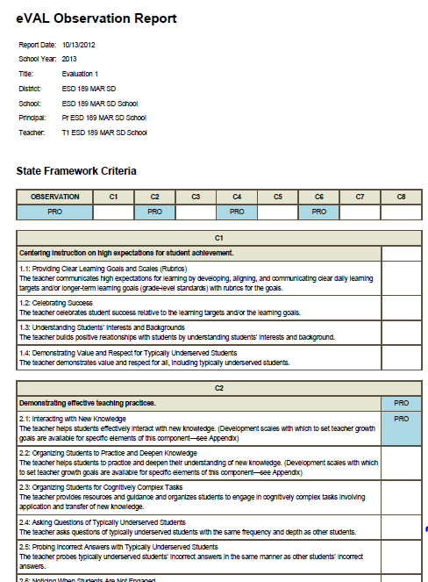
Principal – Generated Report in Observation Dashboard

Slide 32
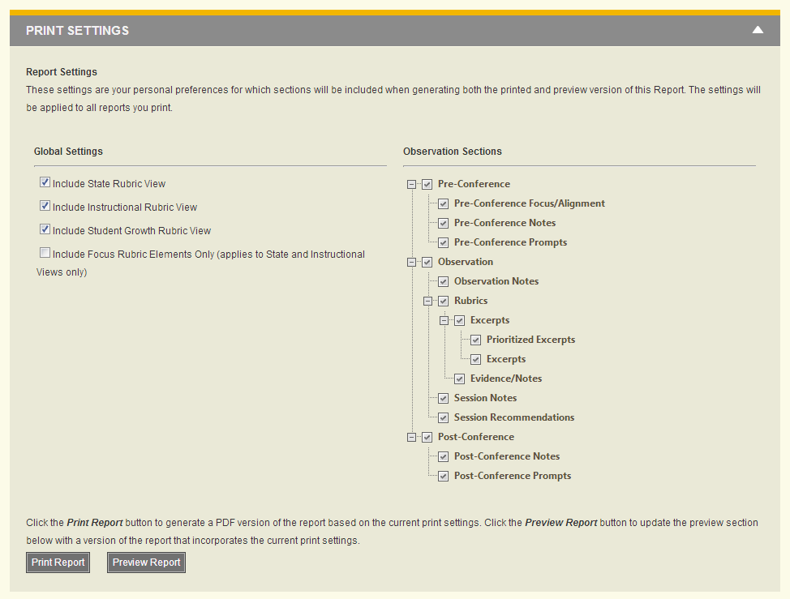
Principal – Generated Report in Observation Dashboard

Slide 33
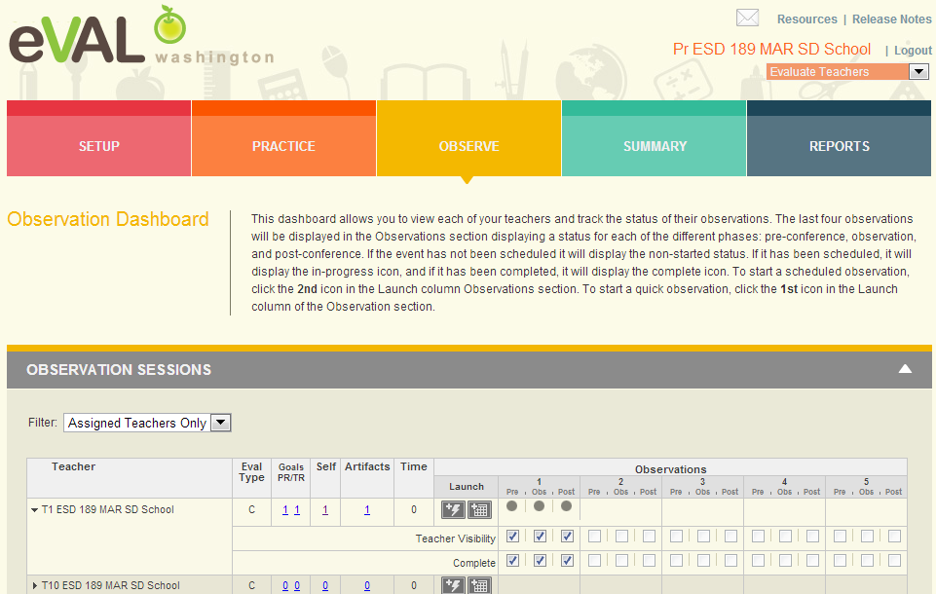
Principal – Observation 1 Complete
Another place to click on teacher name to open up section to mark complete.

Slide 34
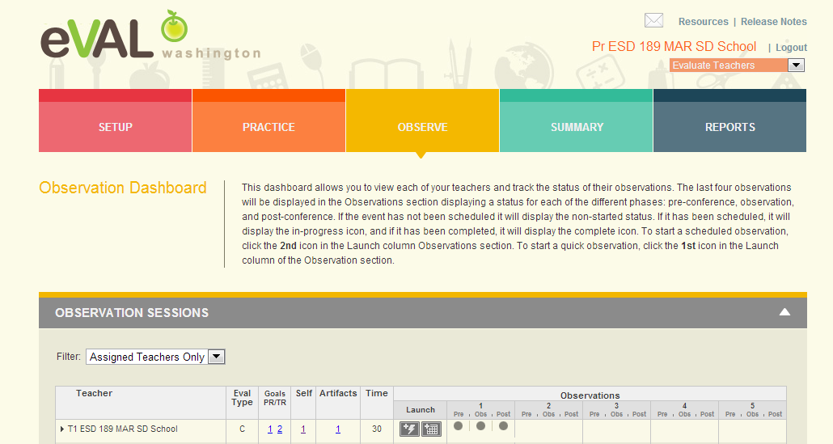
Principal Observation Dashboard

Slide 35
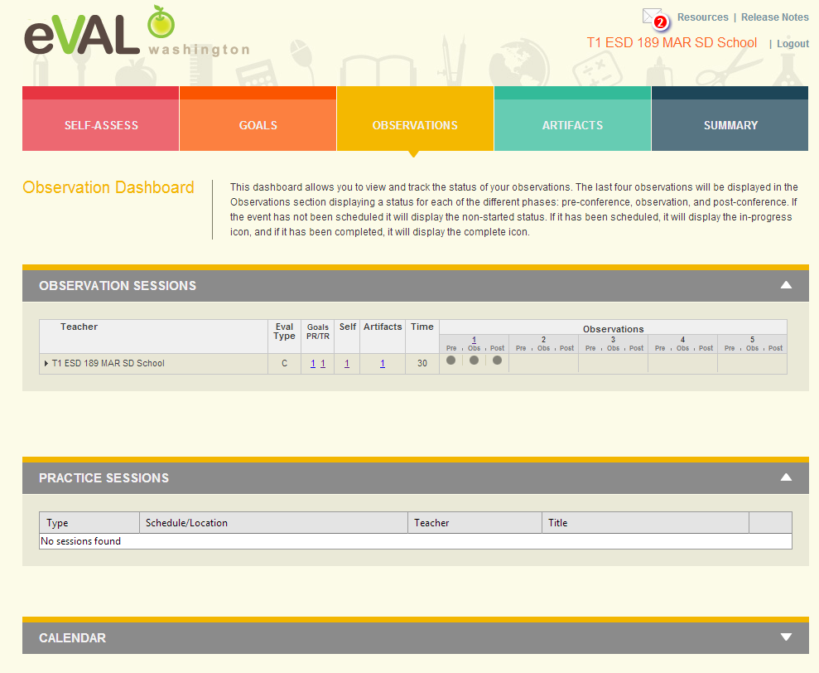
Teacher Dashboard – Observation 1 Complete

Slide 36
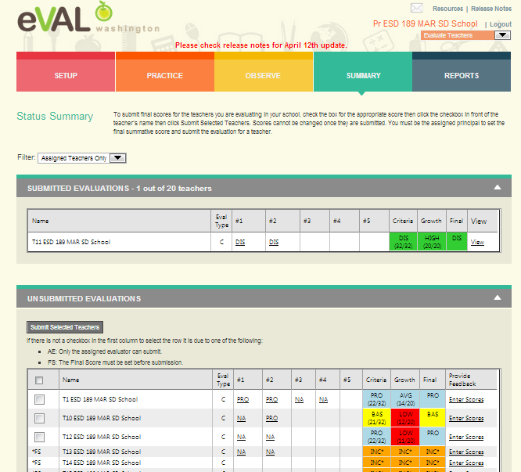
Principal – Summary View
Click on
Enter Scores

Slide 37
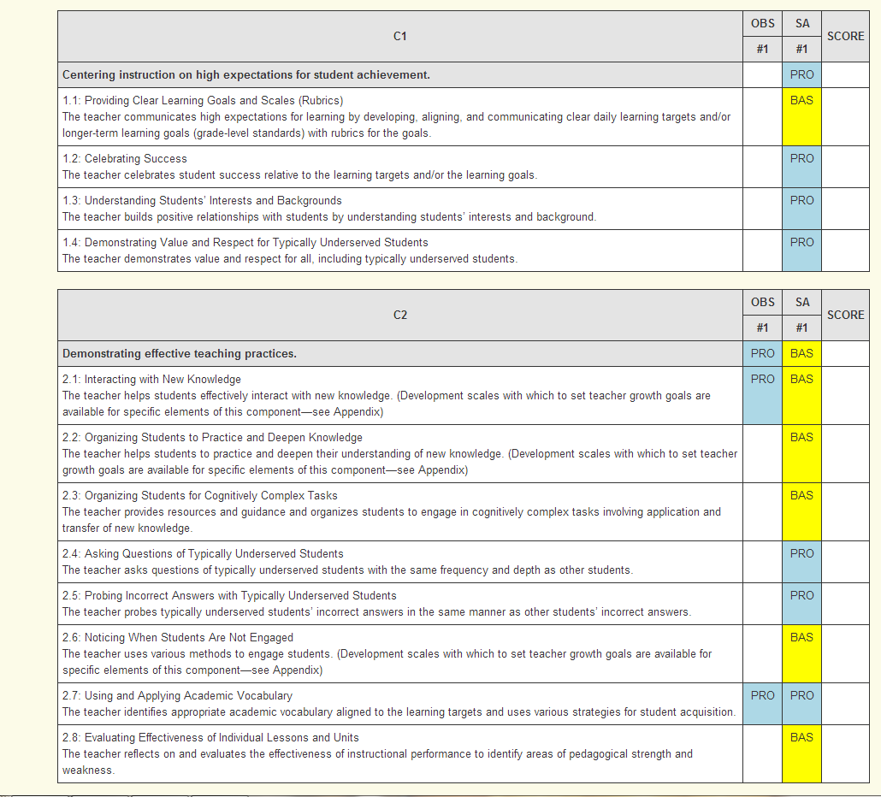
Principal – Final Report

Slide 38
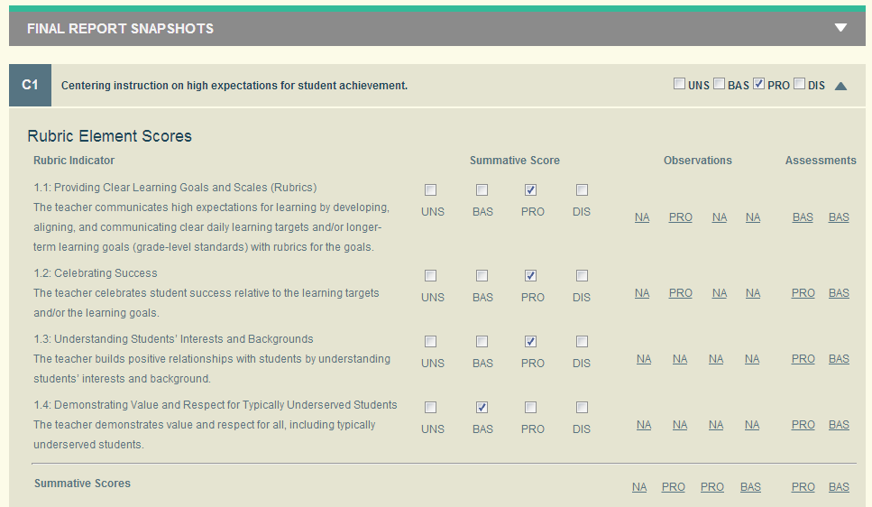
Principal – Summative Scoring

Slide 39
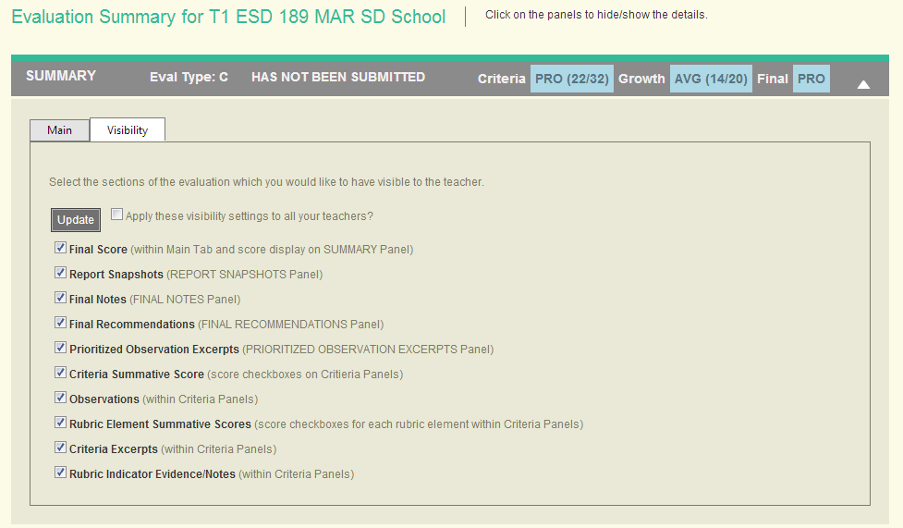
Principal – Visibility to Teacher

Slide 40
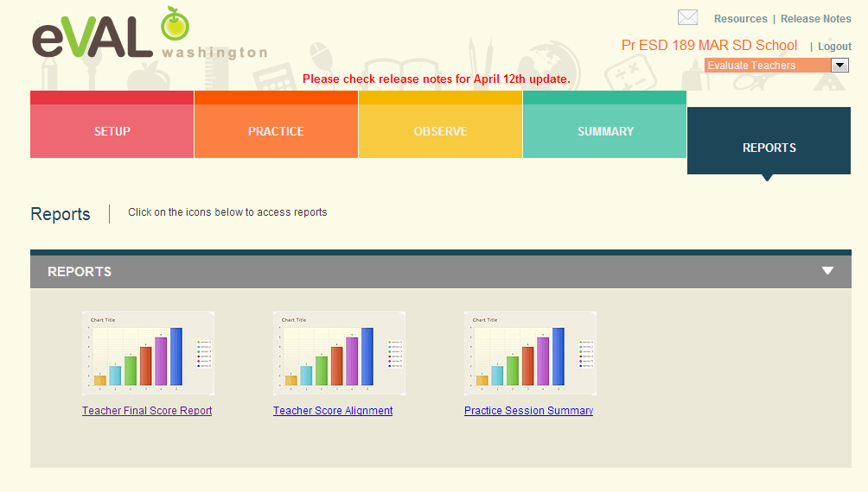
Principal – Final Report for Teacher

Slide 41
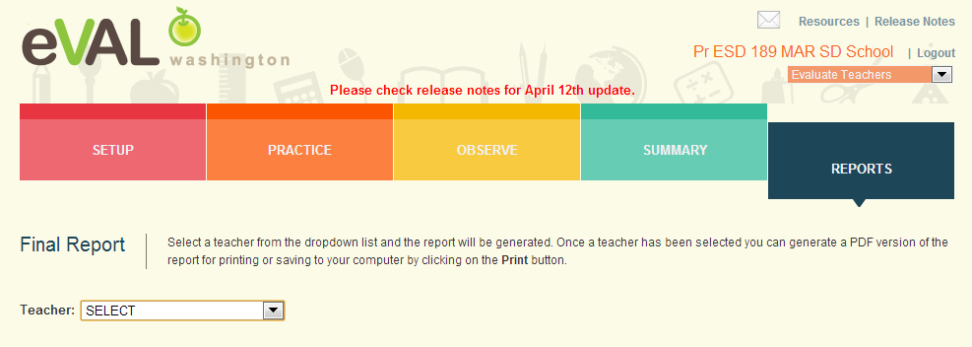
Principal – Final Report for Teacher

Slide 42
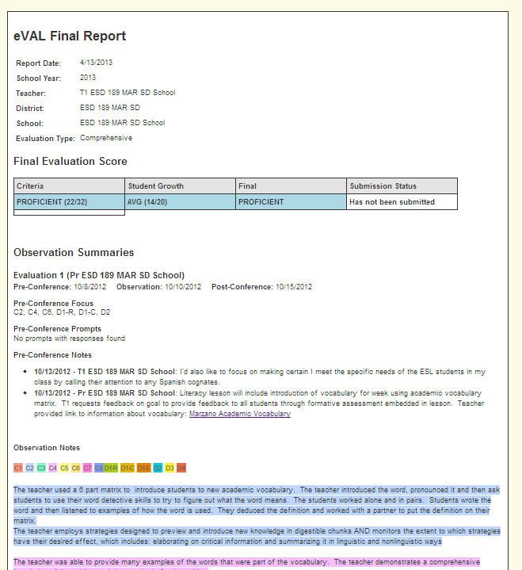
Principal – Final Report for Teacher

Slide 43
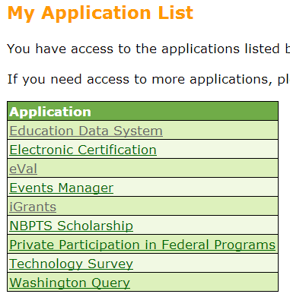
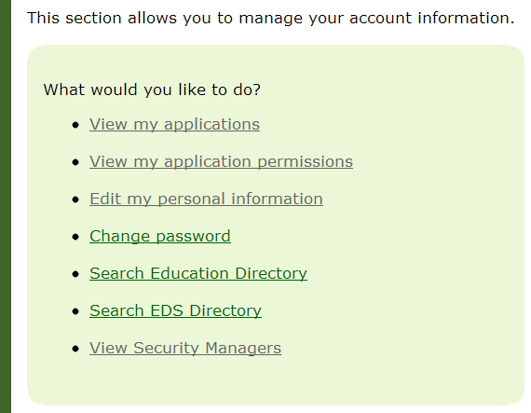
Logging into eVAL
Log into OSPI’s EDS: https://eds.ospi.k12.wa.us/
Notes:
Self assessment F

Slide 44
Next Steps
What do you need to do next?
Who needs to be involved?
When does it need to happen?
How can I help?

Slide 45
Goals
Understand principal role as evaluatee and the supports offered by eVAL
Review evaluation steps for teacher evaluations
Understand supports offered to evaluator by eVAL
Understand specific tasks evaluator and evaluatee might want to do in eVAL
Understand interaction between evaluator and evaluatee roles in eVAL
Self Assessment
Your familiarity with the eVAL tool 1----5

Slide 46
Thank You!
Cathey Frederick
ESD 189 eVAL Specialist
cfrederick@nwesd.org

