Slide 1

eVAL Online Tool Training for District and School Administrators
Cathey Frederick
eVAL Specialist - ESD 189
cathey.frederick@seaotters.us
425.358.0545

Slide 2

Goals
Understanding of all roles
Understanding of process
Fluency and practice with your role
Planning for next steps

Slide 3
Norms
Start and end on time
Participate
Listen
Assume good intentions
There is no “stupid question”
Learn together

Slide 4
Agenda
Welcome, parking lot, introductions, and norms
Pre-training data collection
Overview of eVAL
Overview of roles
Overview of tasks
Assigning evaluators and plan types for evaluatees
Adding district resources including questions, prompts, and look-fors
Creating practice sessions
Summary and Reports
Post-training data collection
Work time on the tool

Slide 5
eVAL – Data Collection
Which framework? 1. Marzano 2. CEL
3. Danielson
I can articulate how the new evaluation process is intended to work 1. Expert --- 5. Not Yet
Your familiarity with the eVAL tool 1----5
Self-Assessments by Evaluatees are required by the state. 1. T 2. F 3. Don’t Know
Notes:
Self assessment F

Slide 6
eVAL – Data Collection
No personally identifiable evaluation data will be reported to OSPI at the end of the year. 1. T 2. F 3. Don’t Know
Have you watched any eVAL trainings videos? 1. Yes 2. No
Did you use either the School Improvement Planning (SIP) tool or the Student Learning Plan (SLP) tool? 1. Yes 2. No
Notes:
Personally identifiable T

Slide 7
eVAL is…
Under Construction
eVAL Training is…
Under Construction
eVAL Online Support is…
Under Construction (barely)

Slide 8
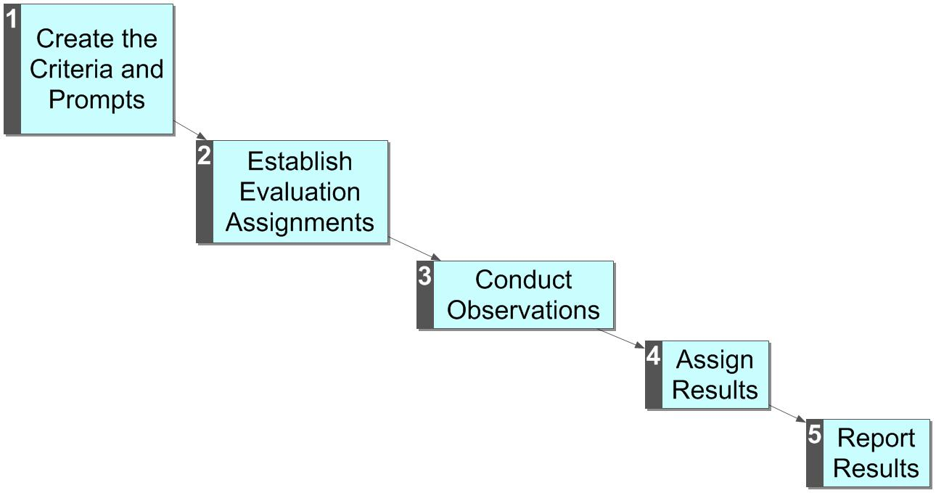
The Evaluation Process
In TPEP the evaluation process, like curriculum has been for 18+ years, is being aligned to state standards.
There are now four possible outcomes:
Unsatisfactory
Basic
Proficient
Distinguished
Aggregated results are shared with the state.
In eVAL-WA the process is conducted entirely online.
Traditionally, this process has been conducted entirely on paper. Usually the criteria and prompts are established in collective bargaining.

Slide 9
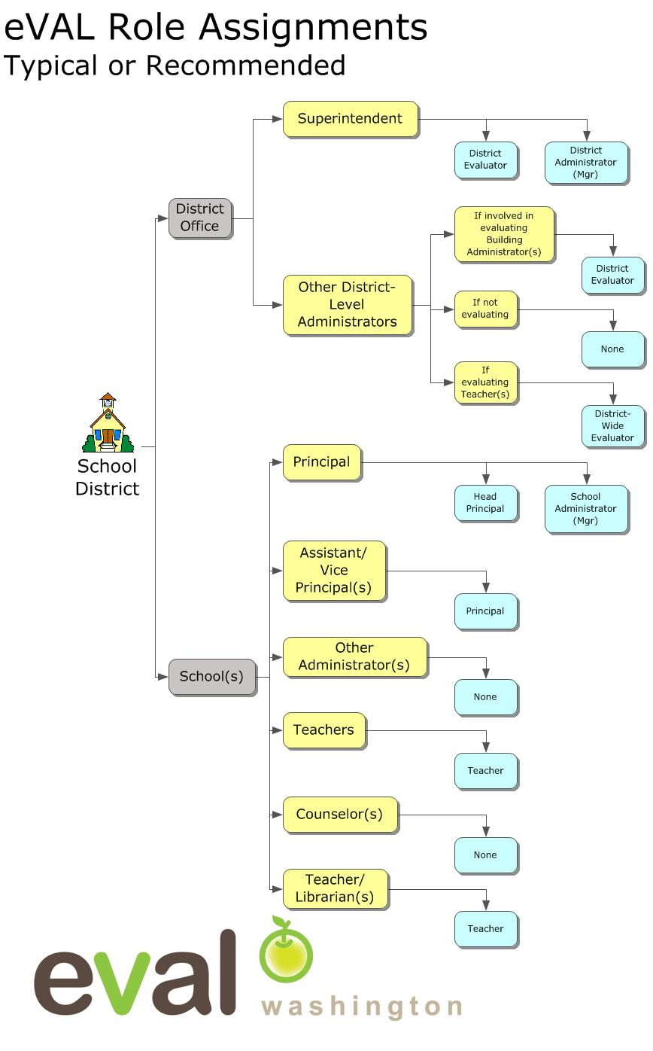
In eVAL there are many roles:
Evaluator Roles
District Evaluator
District-Wide Evaluator
Head Principal
Principal
Materials/Management Roles
District Administrator
School Administrator
Scope
Each role can “impact” only the section of the district assigned
Notes:
In eVAL there are many roles

Slide 10
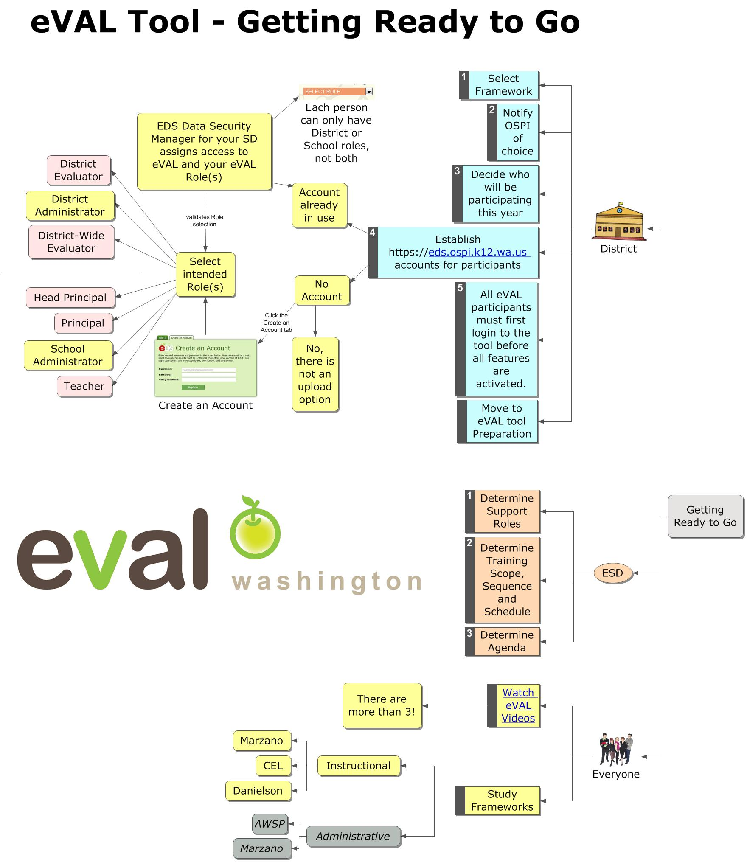
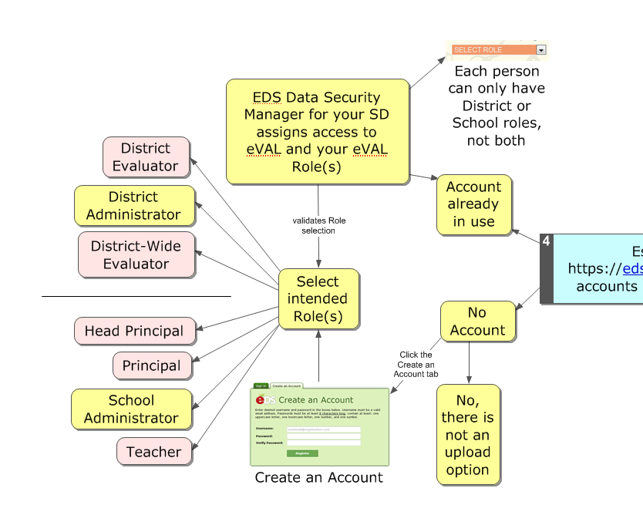

Slide 11
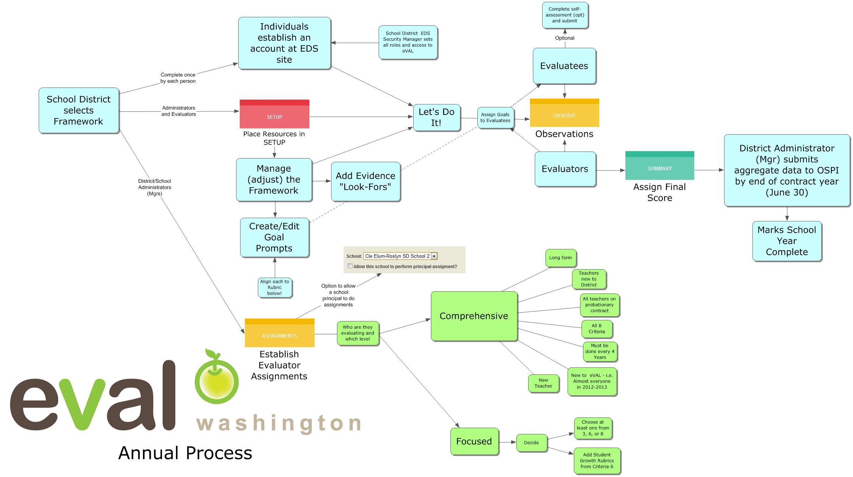

Slide 12
General Guidelines
Evaluator and Administrator actions have impact within their “realms”
Within School or District
Within Evaluatees
For Reports as well

Slide 13

Today We Are Playing in the Sandbox
http://sandbox.eval-wa.org/

Slide 14
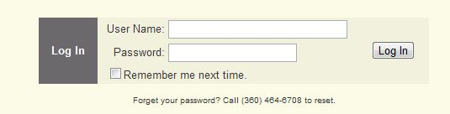
Sandbox Password = password
User Names for district users looks like this:
District Name<space>SD<space>Role Abbreviation (DE DA)
Example (Everett District Administrator): Everett SD DA
Usernames for school users look like this:
District Name<space>SD<space>School <space>#<space>Role Abbreviation (PR AD T1-20)
Example (Everett District, School 1, AD): Everett SD School 1 AD

Slide 15

Log In Screen

Slide 16
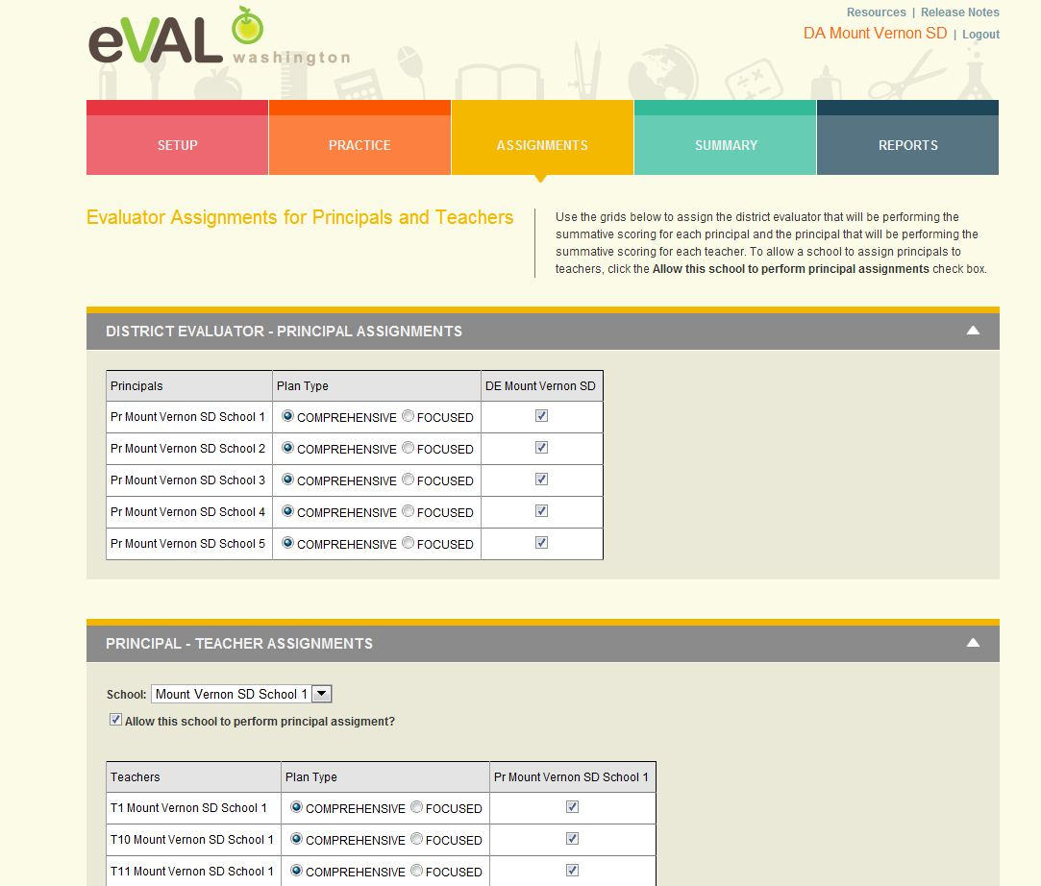
District Administrator Assignments

Slide 17
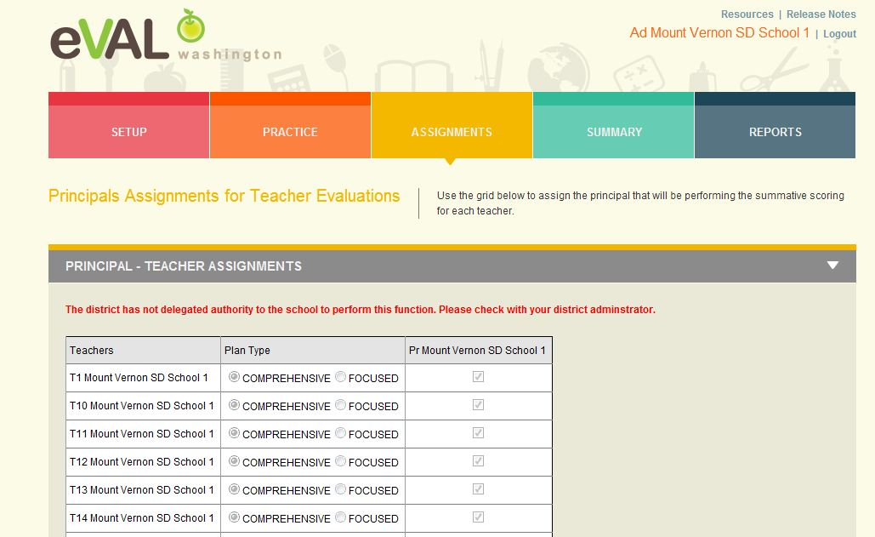
School Administrator Assignments

Slide 18
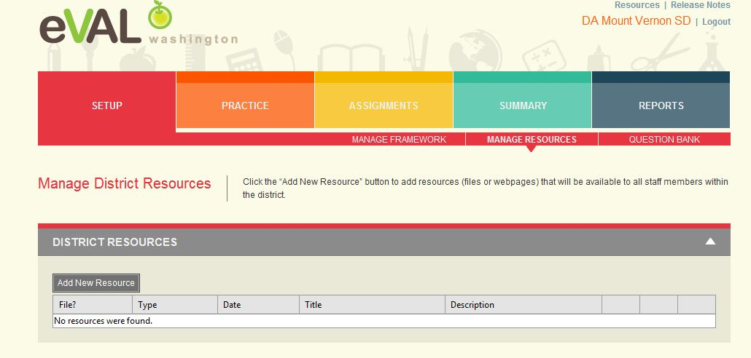
Setup
Same for School Administrator

Slide 19
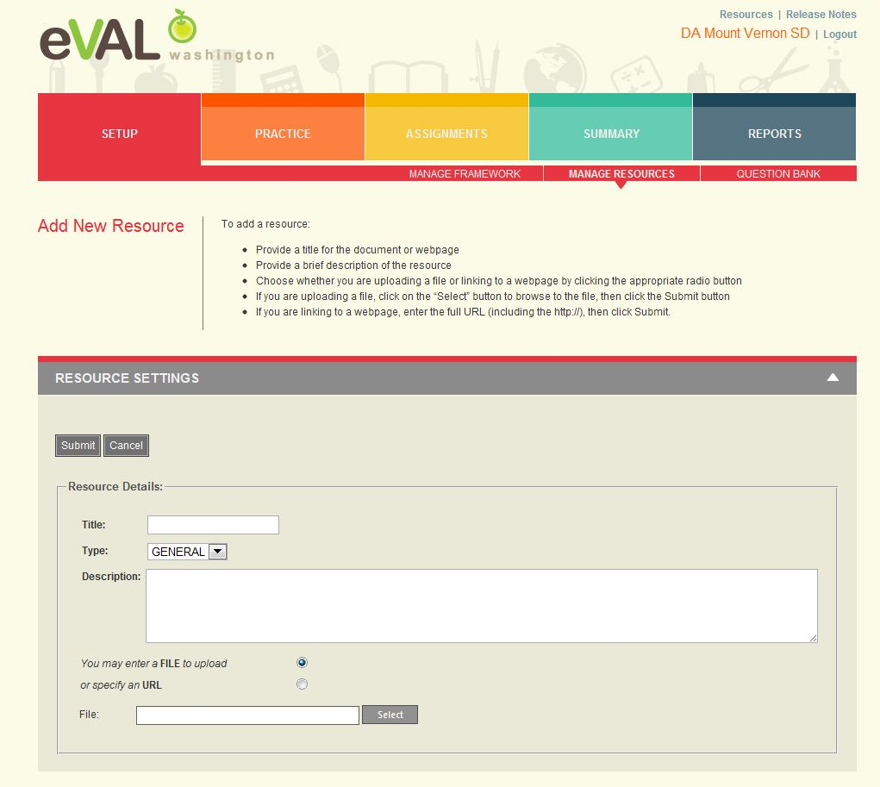
Add New Resources
Same for School Administrator

Slide 20
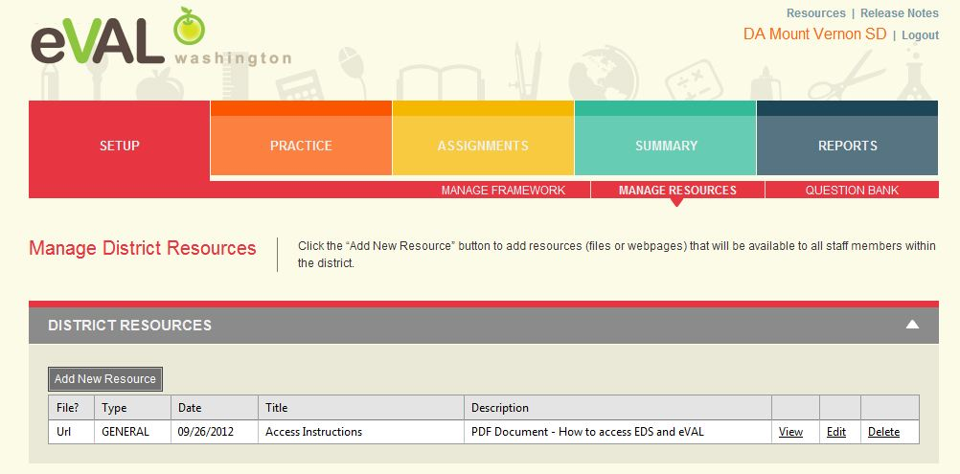
Resource Added
Same for School Administrator

Slide 21
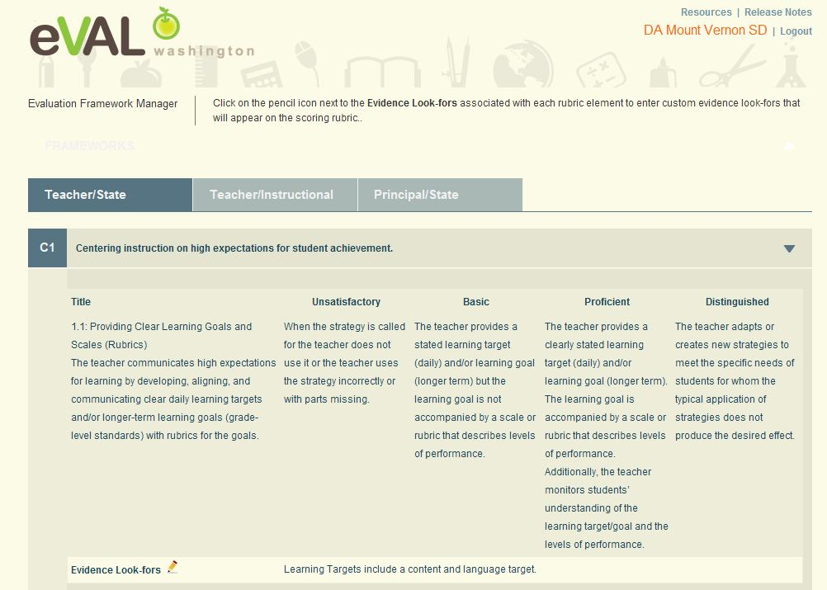
Manage Framework

Slide 22
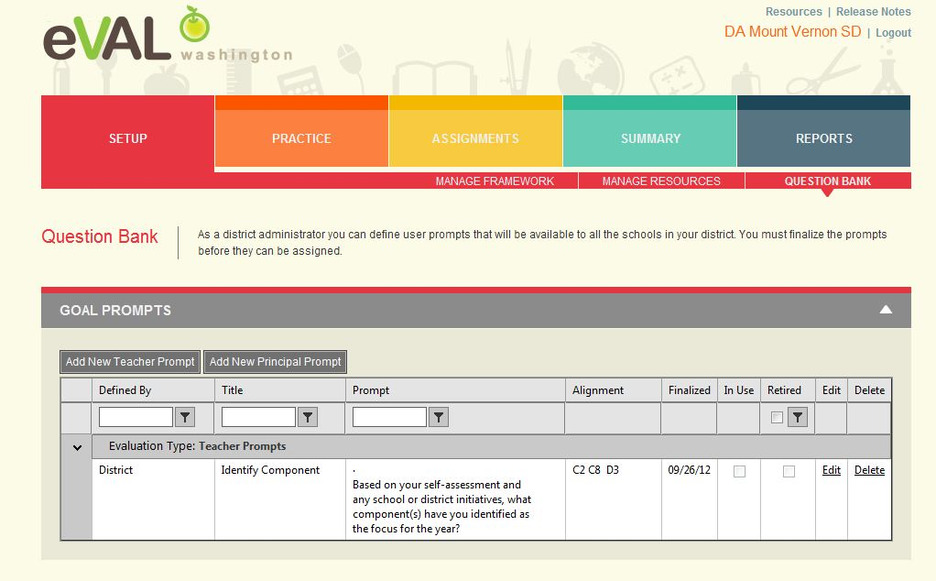
Question Bank
Same for School Administrator

Slide 23
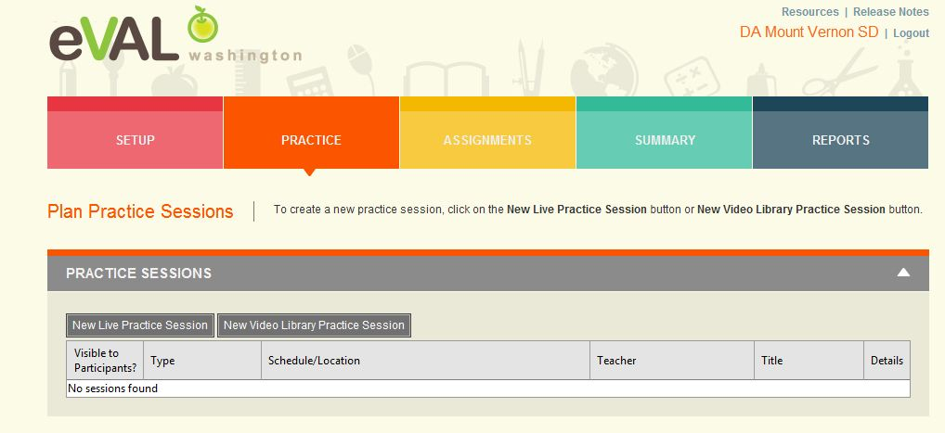
Practice
Same for School Administrator

Slide 24
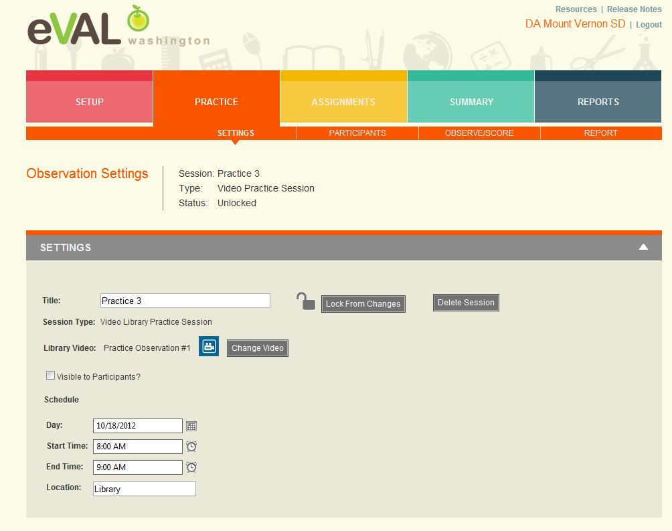
Practice Sessions
Same for School Administrator

Slide 25
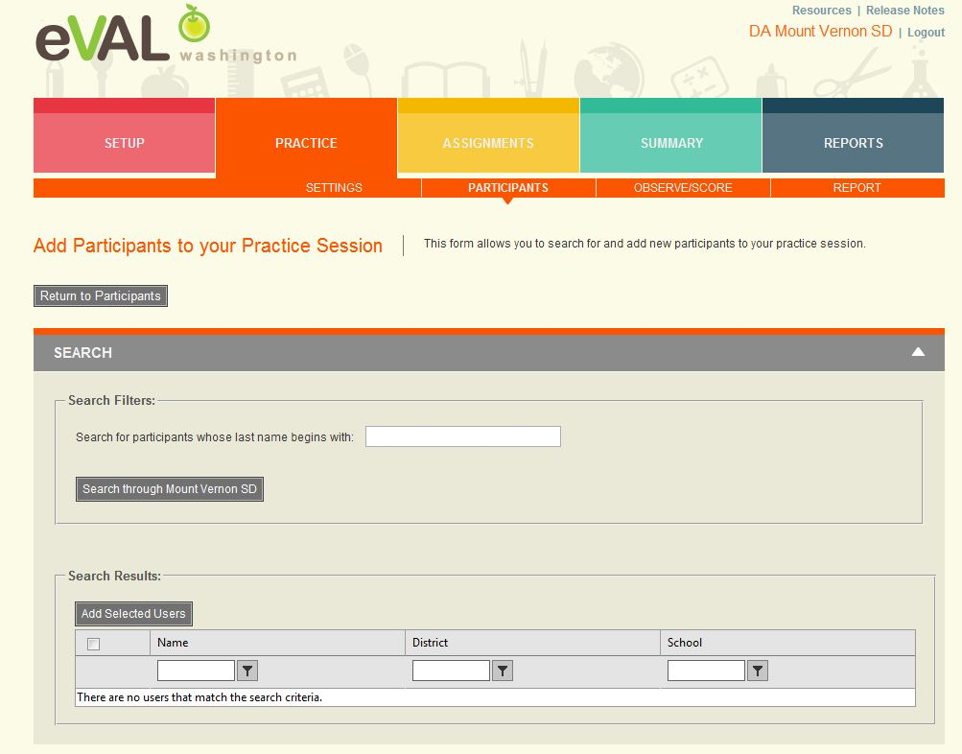
Add Participants to Practice Sessions
Same for School Administrator

Slide 26
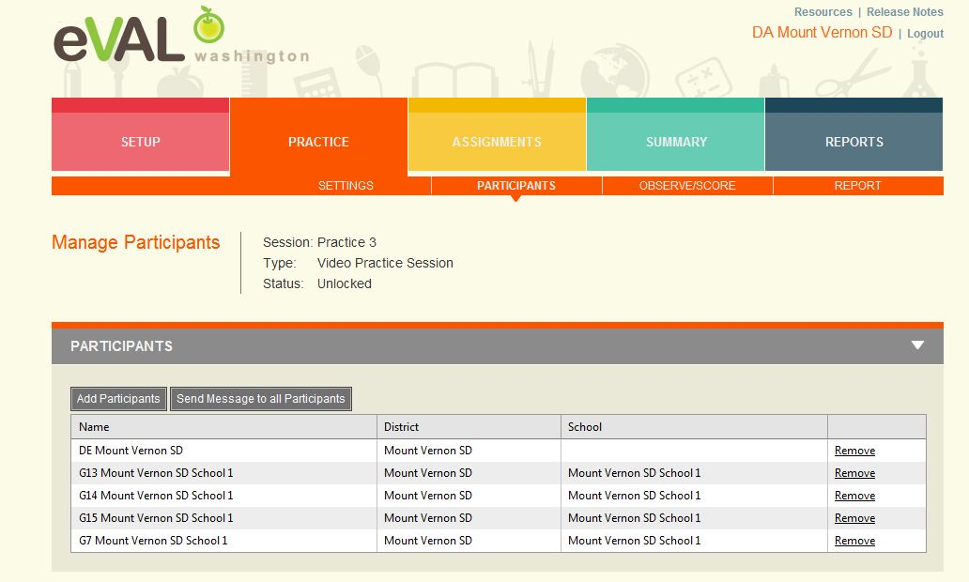
Participants Added
Same for School Administrator

Slide 27
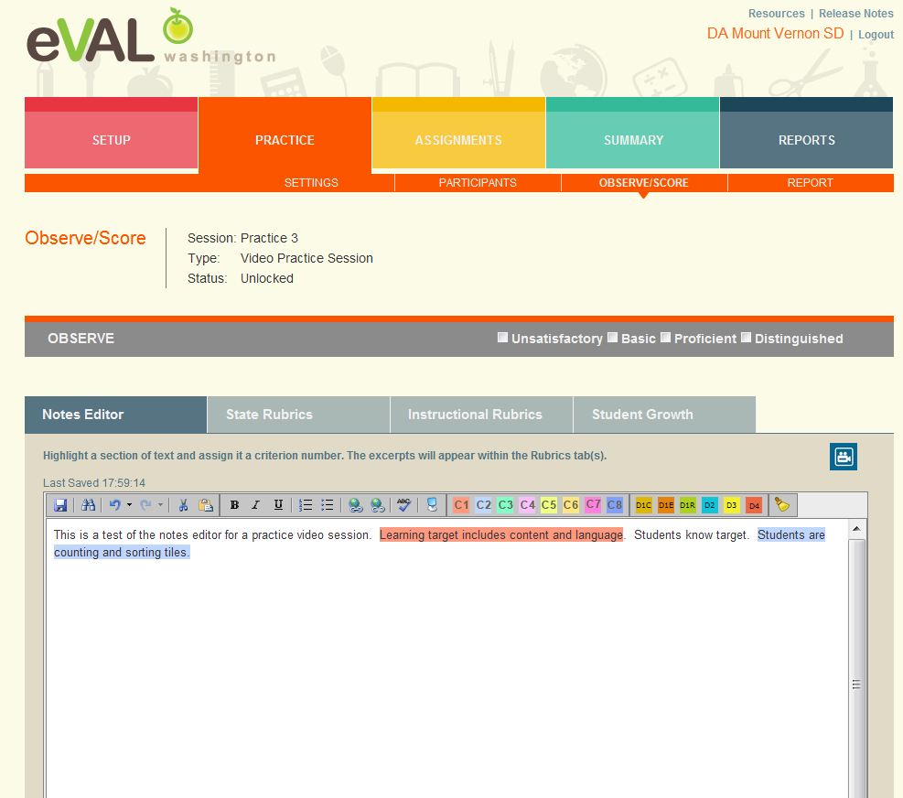
Observe/Score Practice
Same for School Administrator

Slide 28
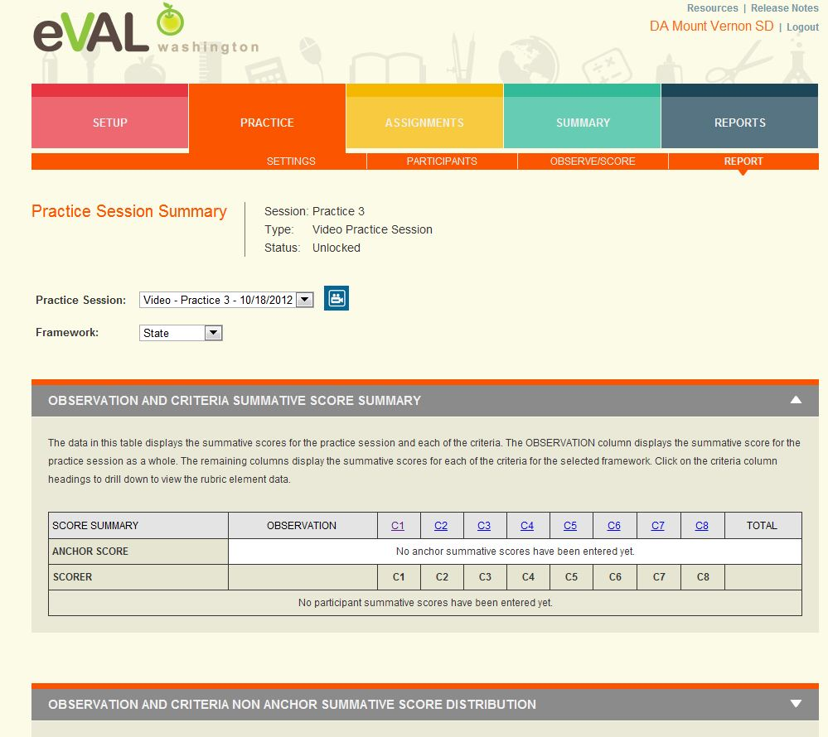
Practice Report
Same for School Administrator

Slide 29
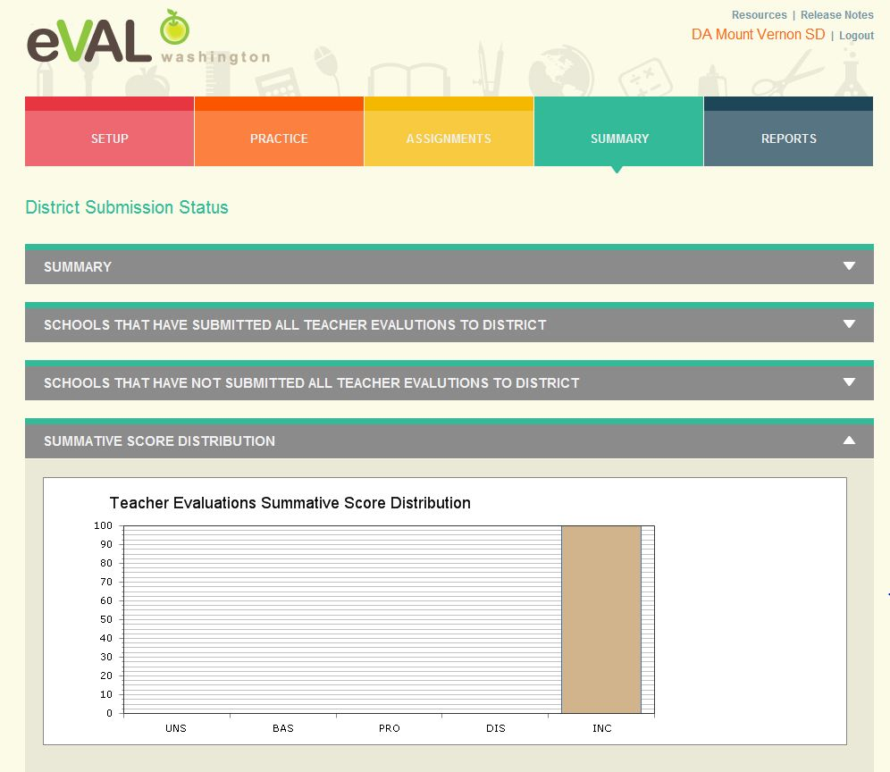
Summary
Same for School Administrator – Sees Teachers Only

Slide 30
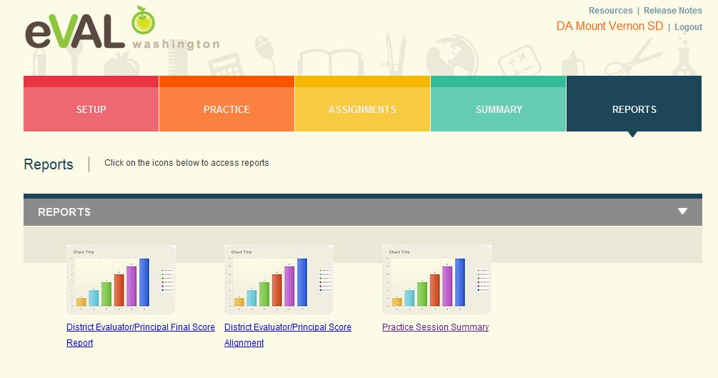
Reports
Same for School Administrator – Sees Principal/Teacher Data

Slide 31
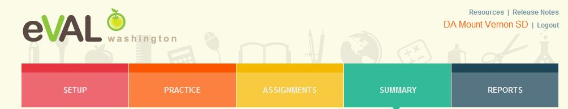
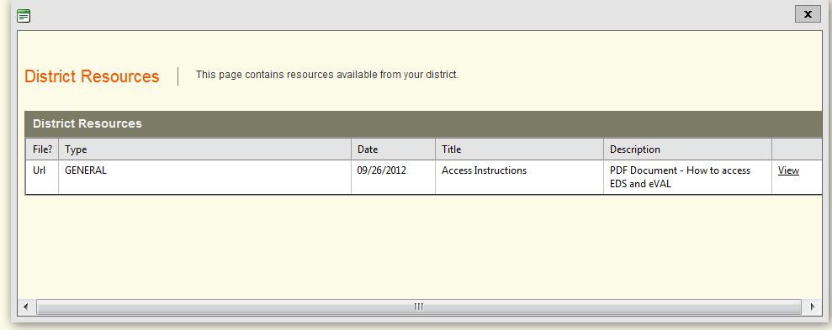
Resources
Same for School Administrator

Slide 32
Next Steps
What do you need to do next?
Who needs to be involved?
When does it need to happen?
How can I help?

Slide 33
Goals
Understanding of all roles
Understanding of process
Fluency and practice with your role
Planning for next steps
Self Assessment
Your familiarity with the eVAL tool 1----5

Slide 34
Thank You!
Cathey Frederick
ESD 189 eVAL Specialist
cathey.frederick@seaotters.us
425.358.0545

