Slide 1

eVAL Online Tool Training for Principal and School Administrator Roles
Cathey Frederick
eVAL Specialist - ESD 189
cathey.frederick@seaotters.us
425.358.0545

Slide 2

Goals
Understanding of all roles
Understanding of process
Fluency and practice with your role
Planning for next steps

Slide 3
Norms
Start and end on time
Participate
Listen
Assume good intentions
There is no “stupid question”
Learn together

Slide 4
Agenda
Welcome, parking lot, introductions, and norms
Pre-training data collection
Overview of eVAL
Overview of roles
Overview of tasks
Creating practice sessions
Summary and Reports
Post-training data collection
Work time on the tool

Slide 5
eVAL – Data Collection
Which framework? 1. Marzano 2. CEL
3. Danielson
I can articulate how the new evaluation process is intended to work 1. Expert --- 5. Not Yet
Your familiarity with the eVAL tool 1----5
Self-Assessments by Evaluatees are required by the state. 1. T 2. F 3. Don’t Know
Notes:
Self assessment F

Slide 6
eVAL – Data Collection
No personally identifiable evaluation data will be reported to OSPI at the end of the year. 1. T 2. F 3. Don’t Know
Have you watched any eVAL trainings videos? 1. Yes 2. No
Did you use either the School Improvement Planning (SIP) tool or the Student Learning Plan (SLP) tool? 1. Yes 2. No
Notes:
Personally identifiable T

Slide 7
eVAL is…
Under Construction
eVAL Training is…
Under Construction
eVAL Online Support is…
Under Construction (barely)

Slide 8
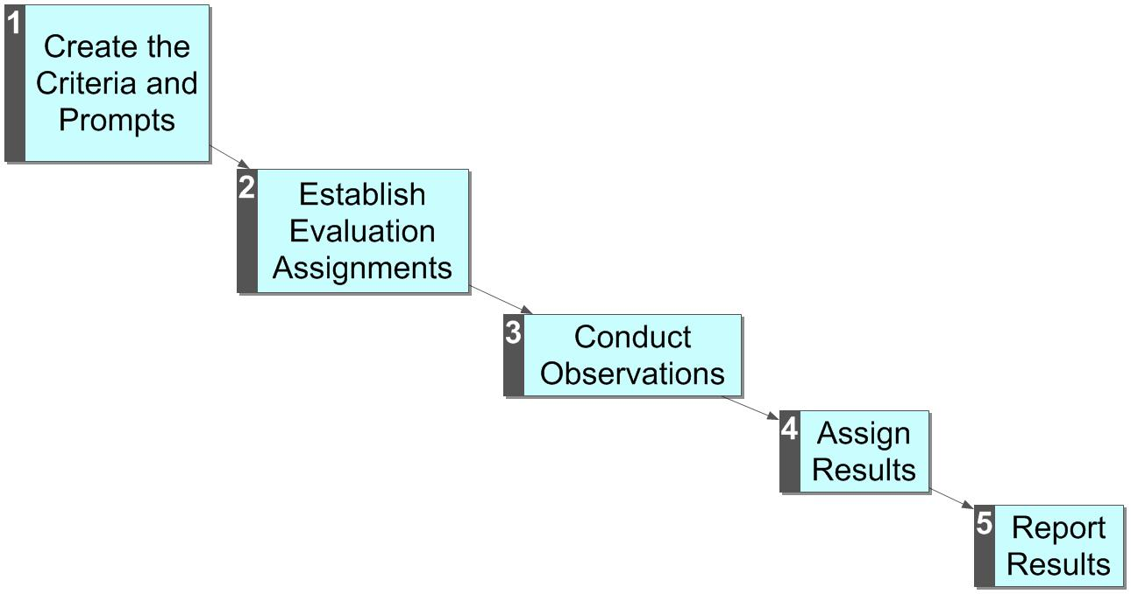
The Evaluation Process
In TPEP the evaluation process, like curriculum has been for 18+ years, is being aligned to state standards.
There are now four possible outcomes:
Unsatisfactory
Basic
Proficient
Distinguished
Aggregated results are shared with the state.
In eVAL-WA the process is conducted entirely online.
Traditionally, this process has been conducted entirely on paper. Usually the criteria and prompts are established in collective bargaining.

Slide 9
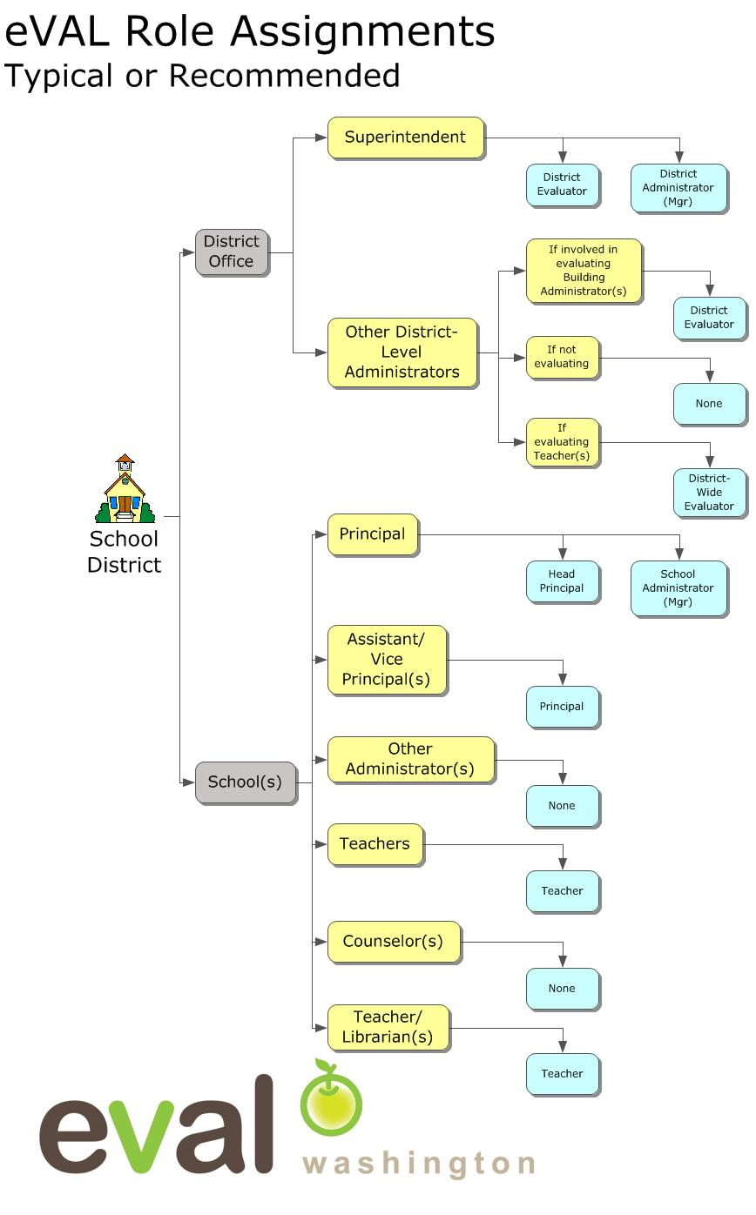
Evaluator Roles
District Evaluator
District-Wide Evaluator
Head Principal
Principal
Materials/Management Roles
District Administrator
School Administrator
Scope
Each role can “impact” only the section of the district assigned
Notes:
In eVAL there are many roles

Slide 10

Today We Are Playing in the Sandbox
http://sandbox.eval-wa.org/

Slide 11
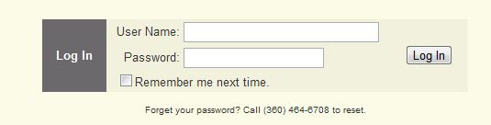
Sandbox Password = password
User Names for district users looks like this:
District Name<space>SD<space>Role Abbreviation (DE DA)
Example (Everett District Administrator): Everett SD DA
Usernames for school users look like this:
District Name<space>SD<space>School <space>#<space>Role Abbreviation (PR AD T1-20)
Example (Everett District, School 1, AD): Everett SD School 1 AD

Slide 12

Principal Log In Example (Everett District, School 1, PR): Everett SD School 1 PR

Slide 13

Prepare for My Evaluation

Slide 14
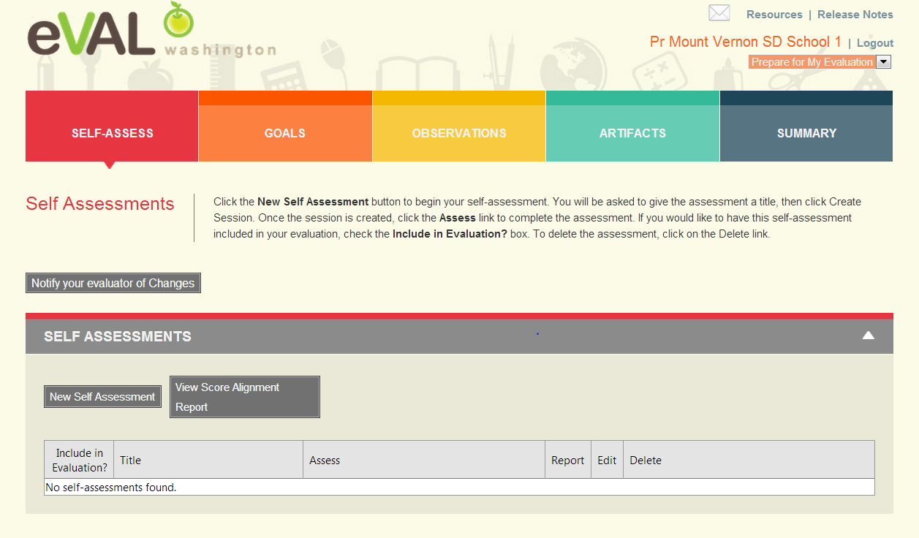
Self Assessment
Same as Teacher Self Assessment

Slide 15
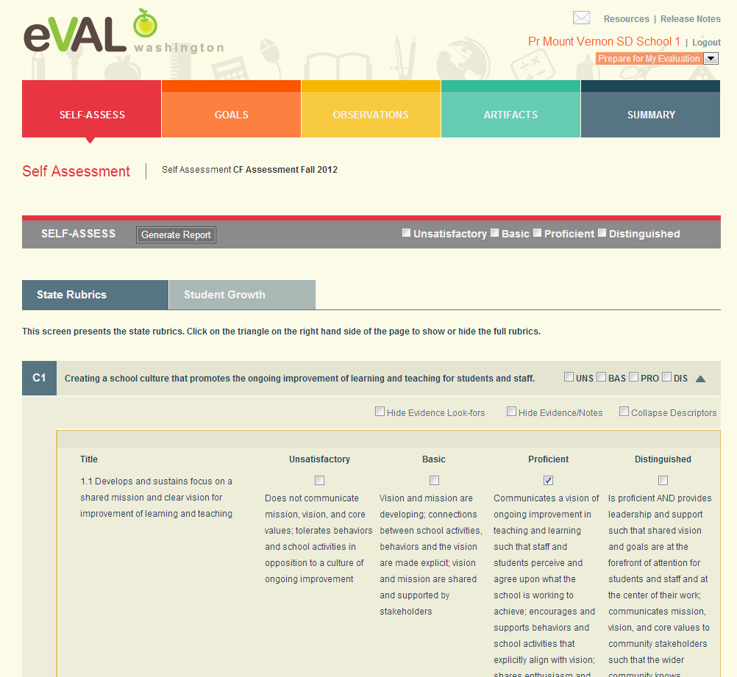
Self Assessment – State Criteria

Slide 16
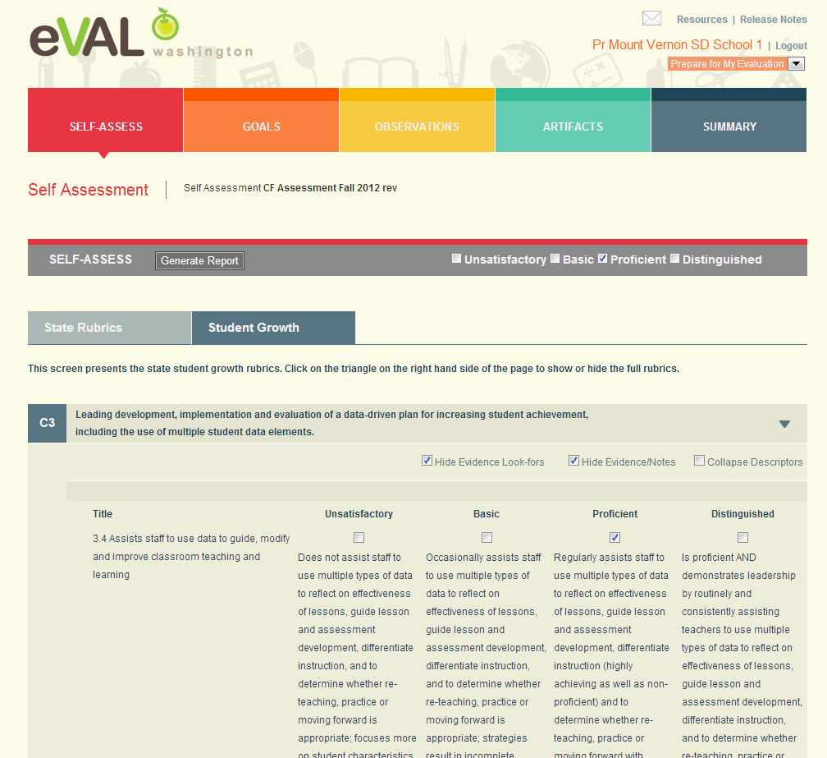
Self Assessment – Student Growth

Slide 17
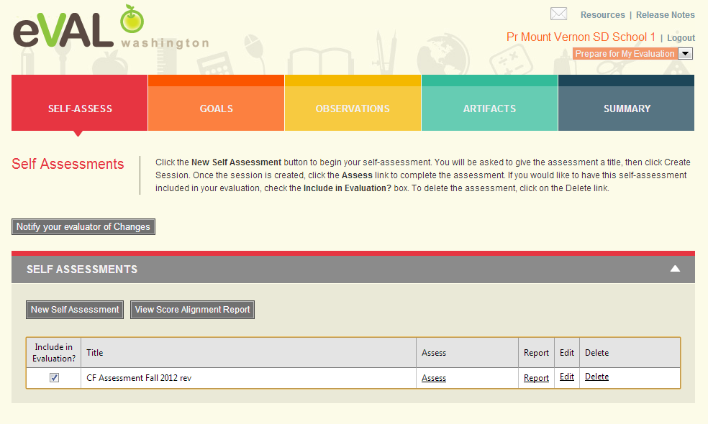
Self Assessment - Choices

Slide 18
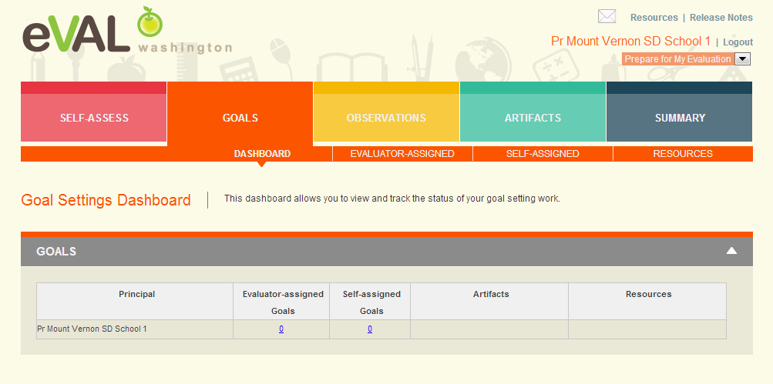
Goals

Slide 19
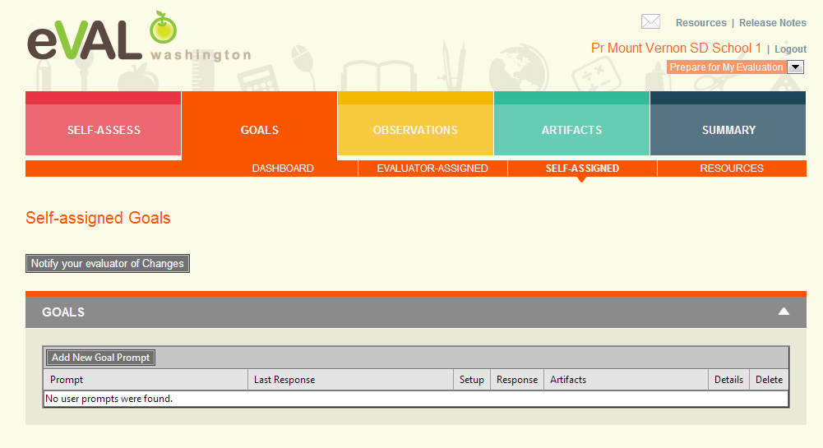
Goals – Self Assigned

Slide 20
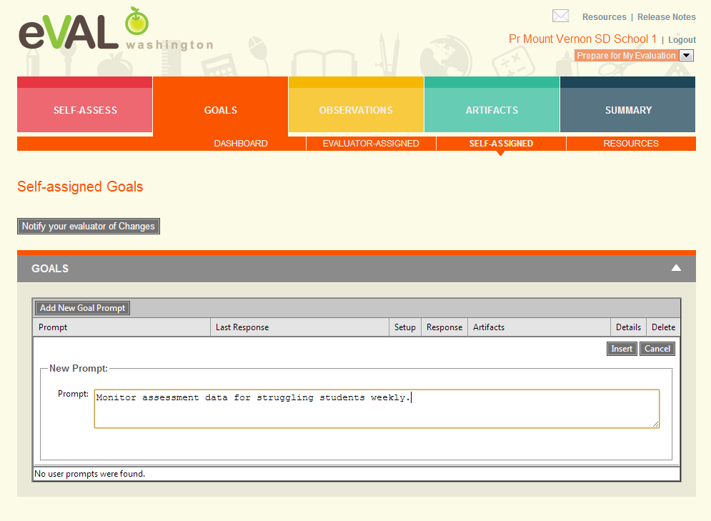
Goals – Add Goal Prompt

Slide 21
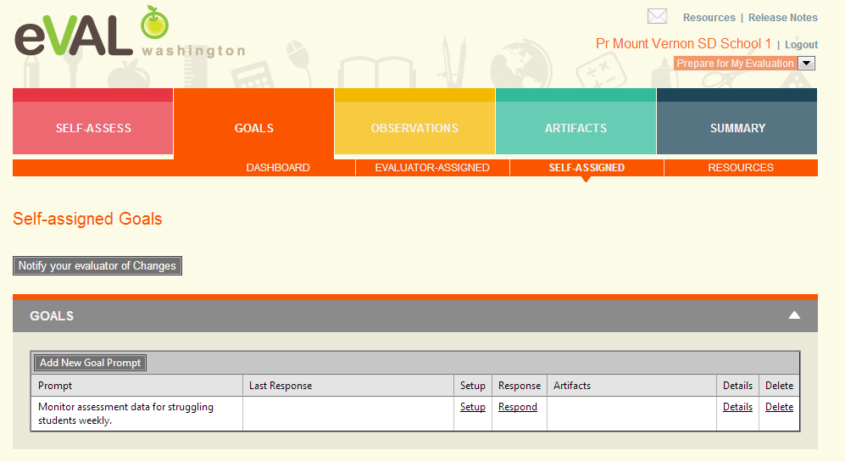
Goal Prompt Added

Slide 22
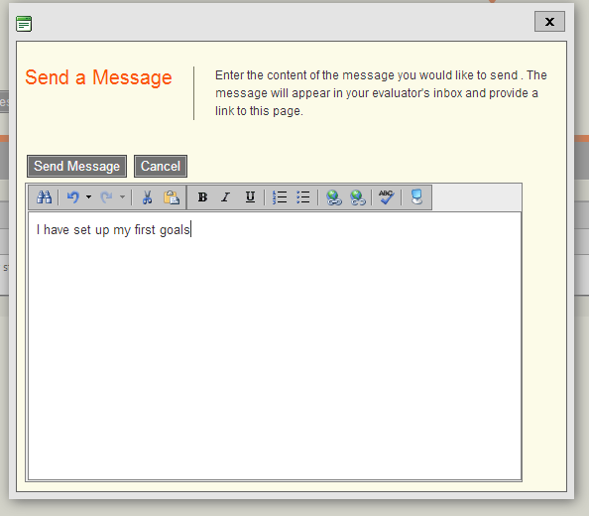
Notify Evaluator of Changes

Slide 23
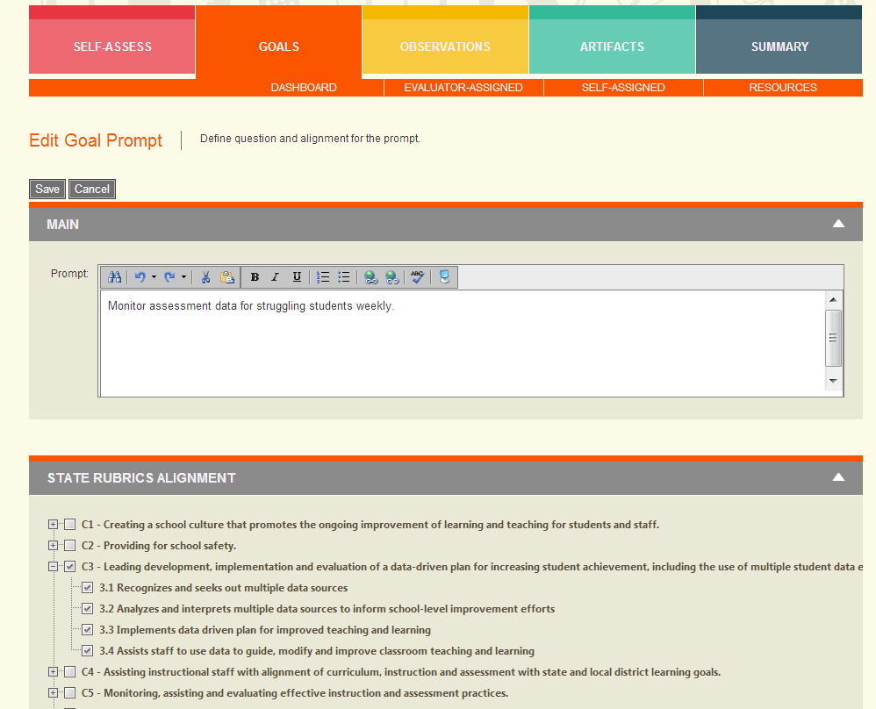
Goal Prompt – Set Up

Slide 24
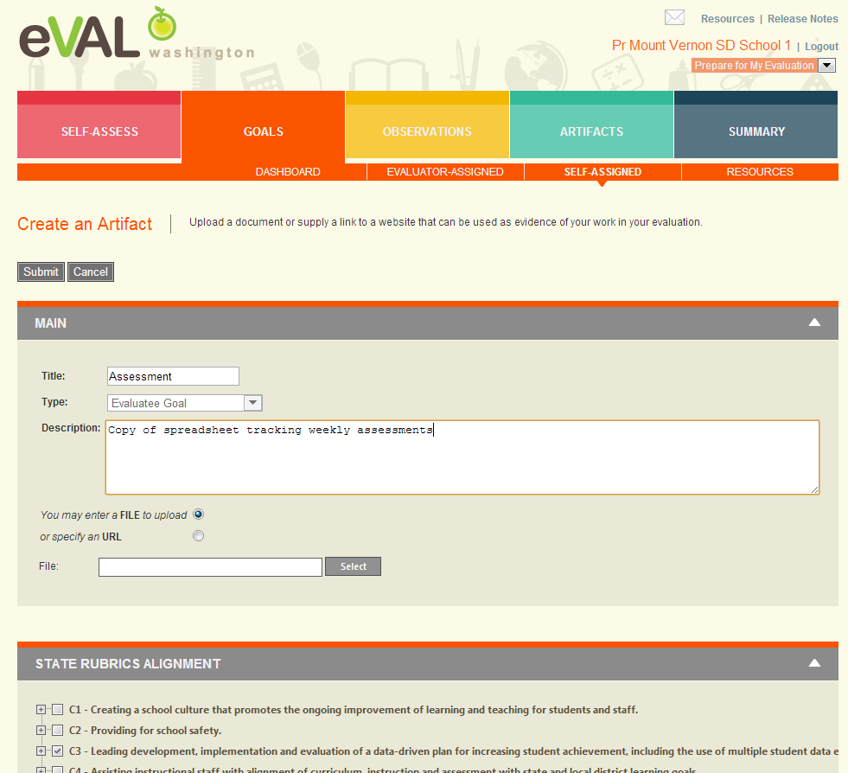
Goal Prompt – Add Artifact

Slide 25
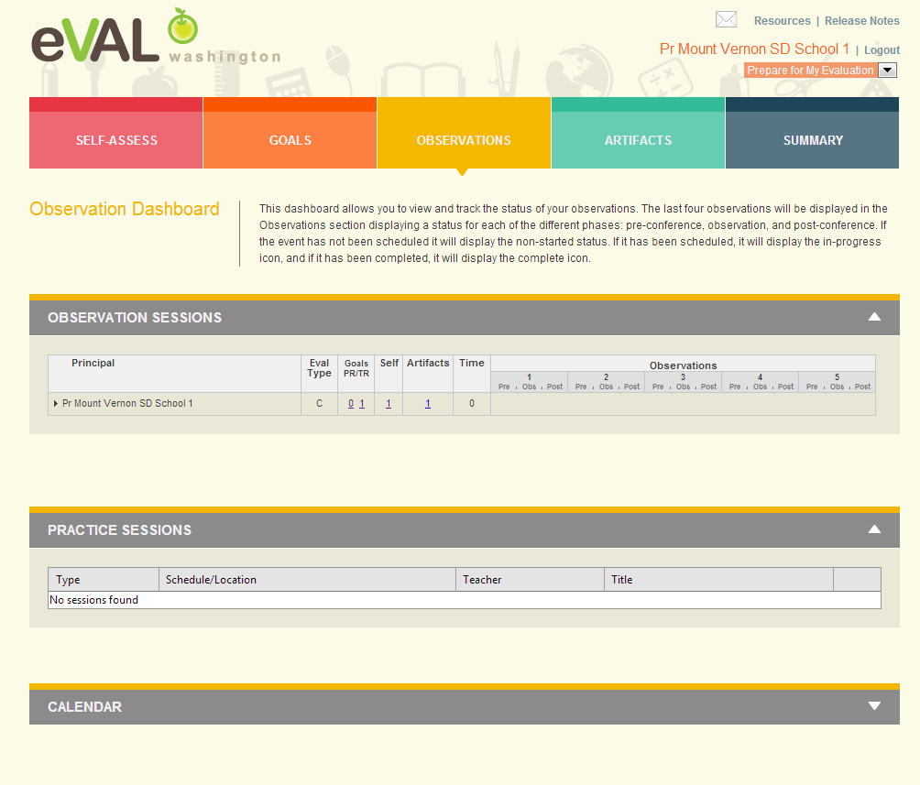
Observation Dashboard

Slide 26
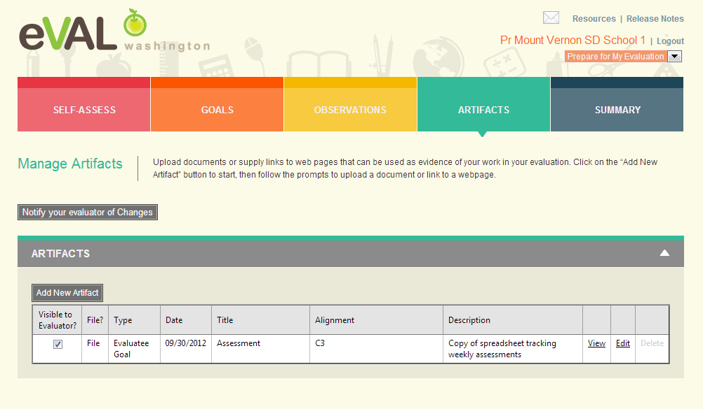
Adding Artifacts

Slide 27
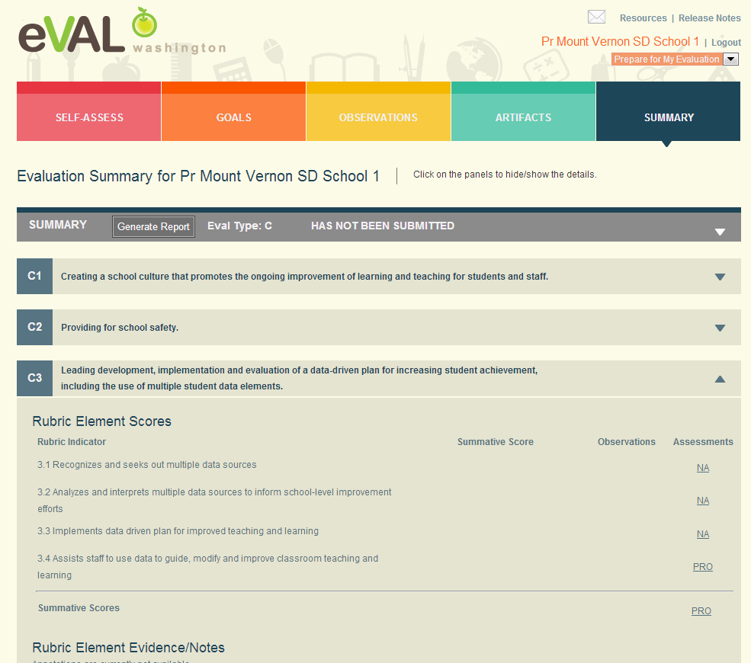
Summary

Slide 28

School Administrator Log In Example (Everett District, School 1, AD): Everett SD School 1 AD

Slide 29
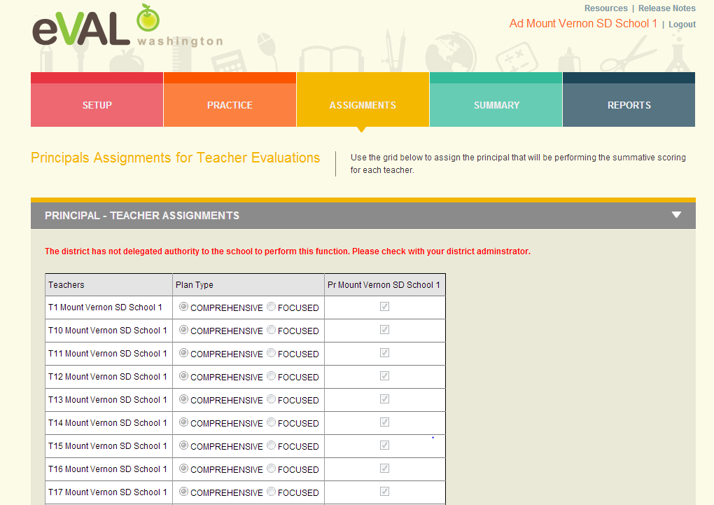
School Administrator Assignments

Slide 30
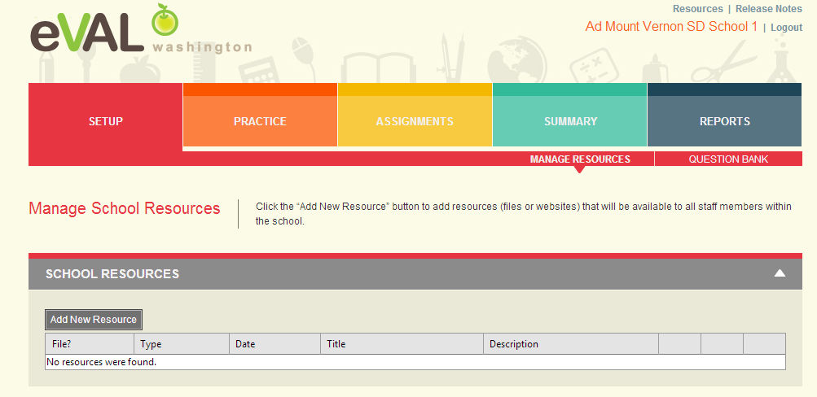
Setup

Slide 31
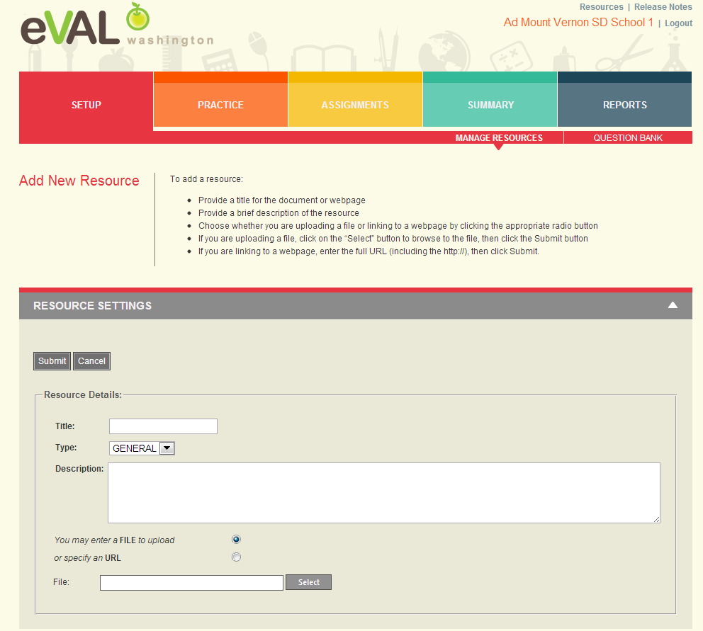
Add New Resources

Slide 32
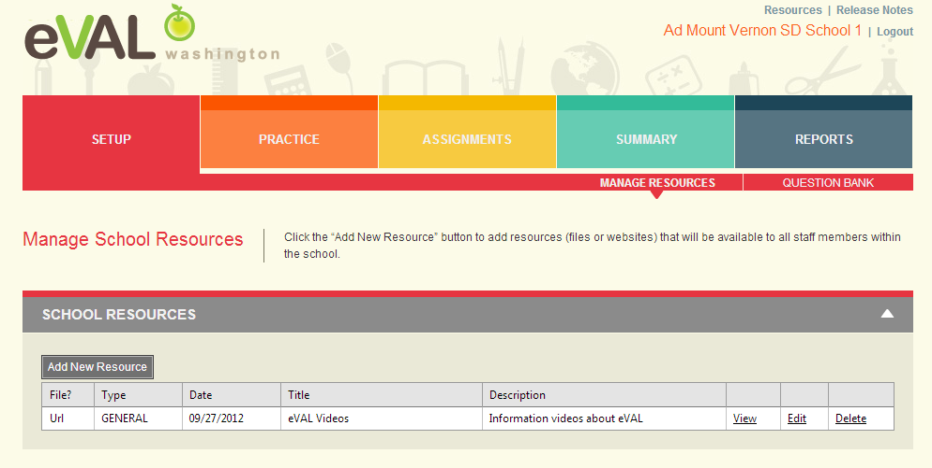
Resource Added

Slide 33
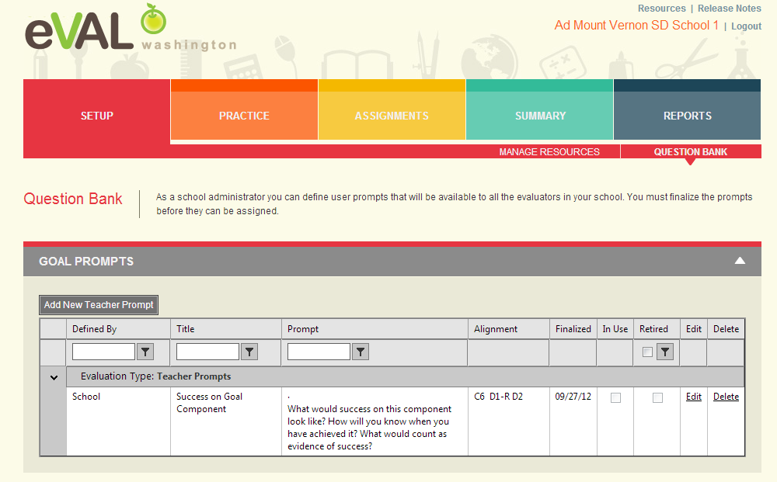
Question Bank
Same for Principal Role

Slide 34
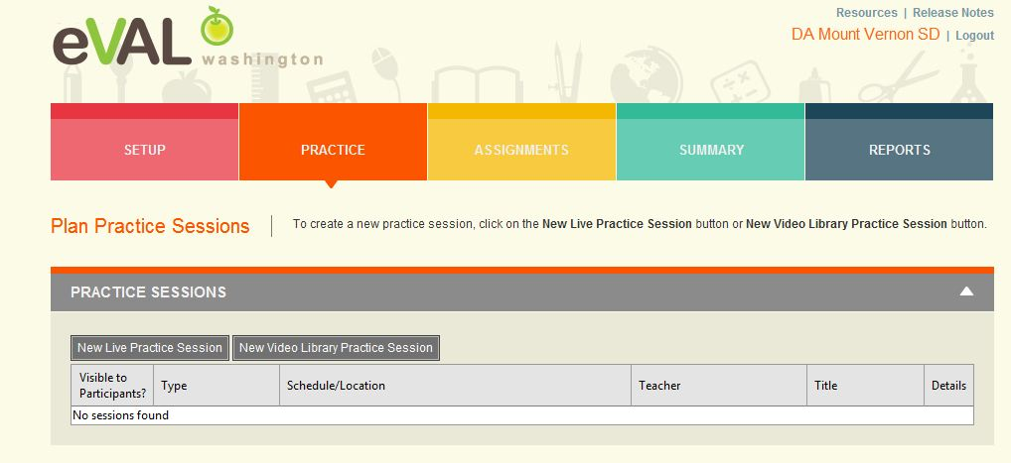
Practice

Slide 35
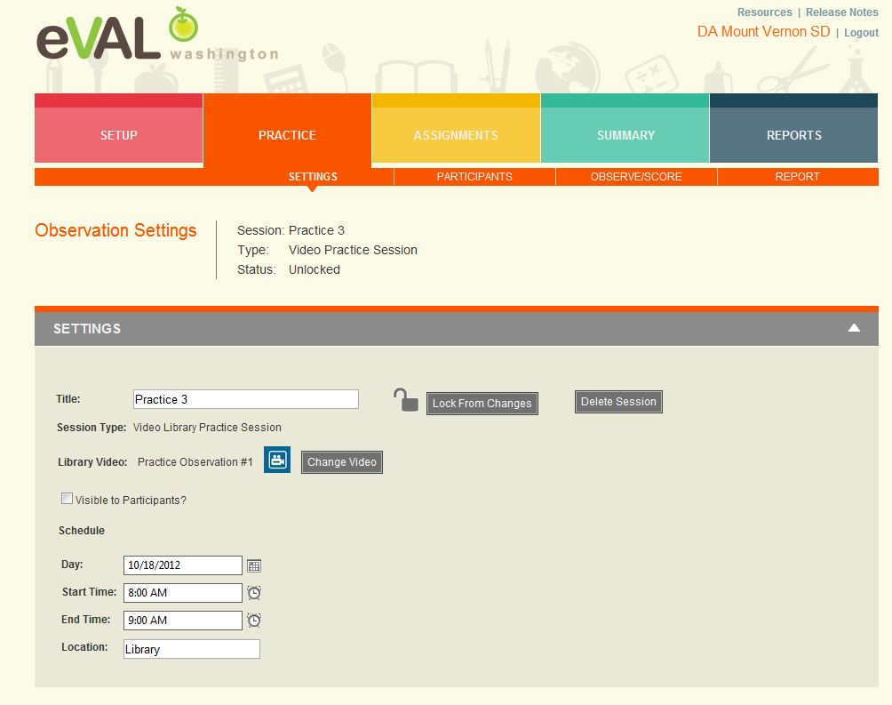
Practice Sessions

Slide 36
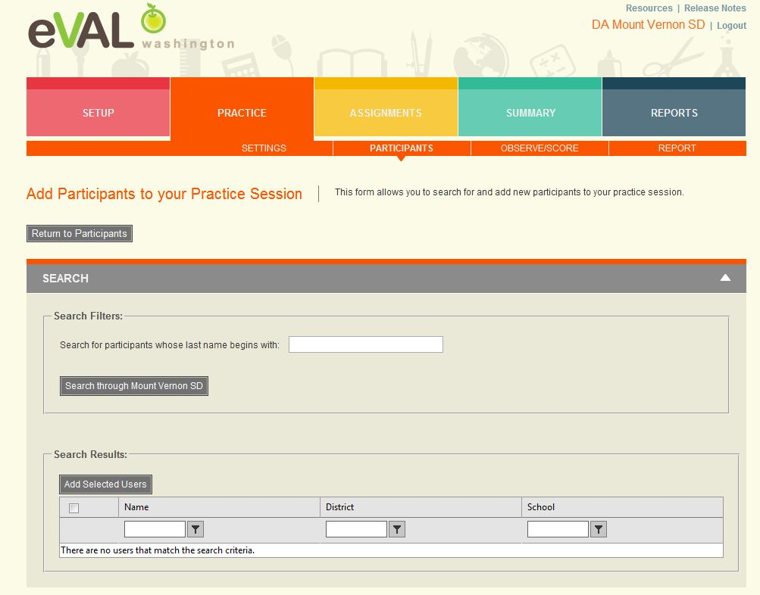
Add Participants to Practice Sessions

Slide 37
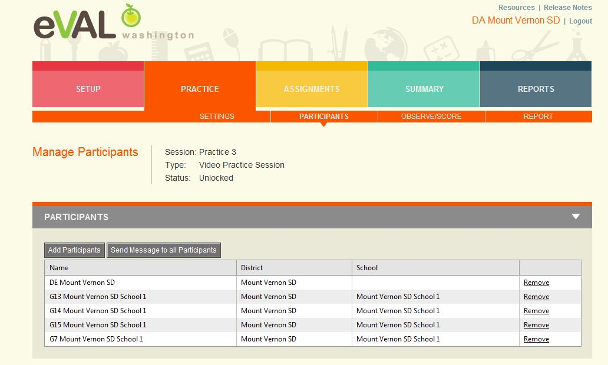
Participants Added

Slide 38
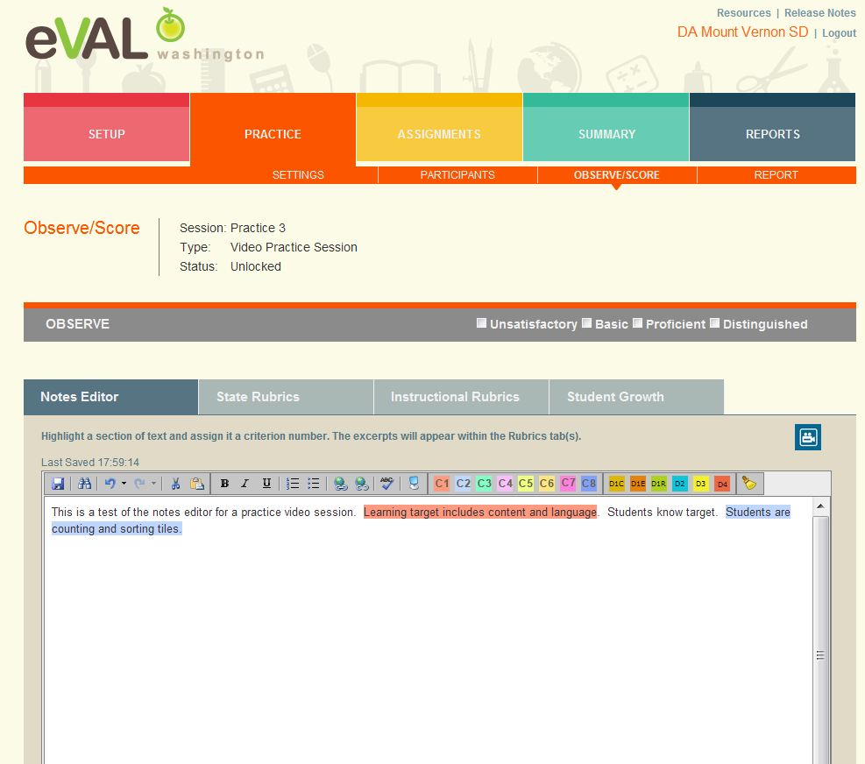
Observe/Score Practice

Slide 39
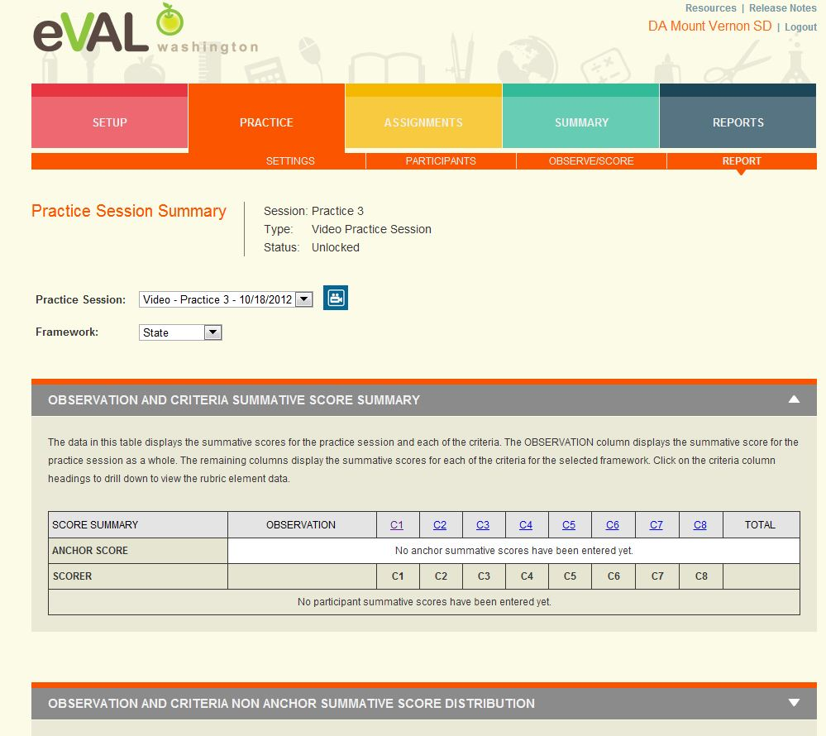
Practice Report

Slide 40
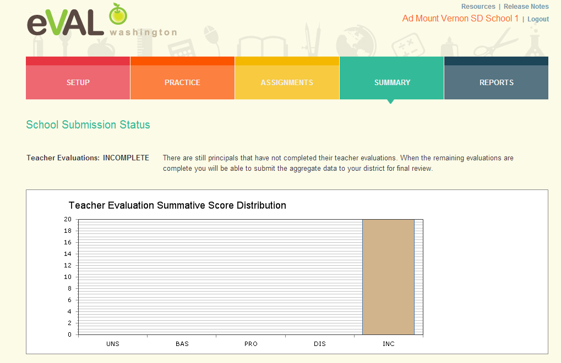
Summary

Slide 41
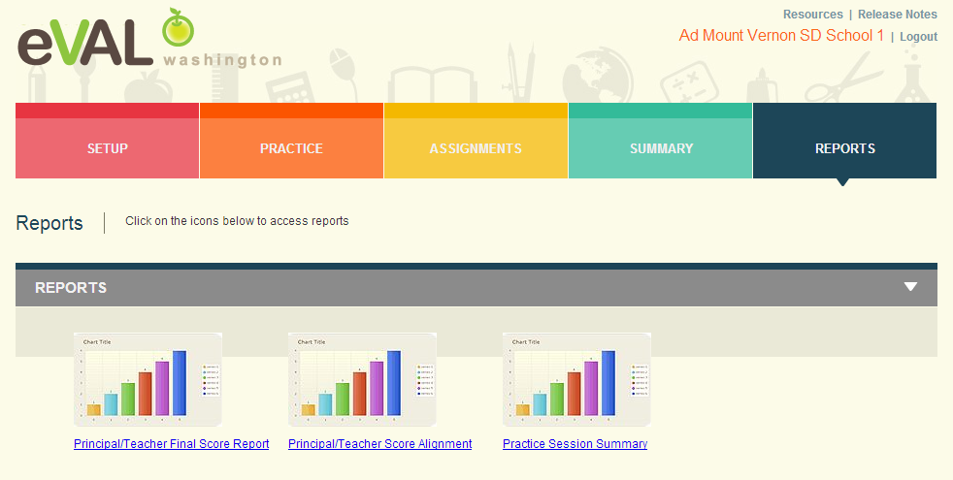
Reports

Slide 42
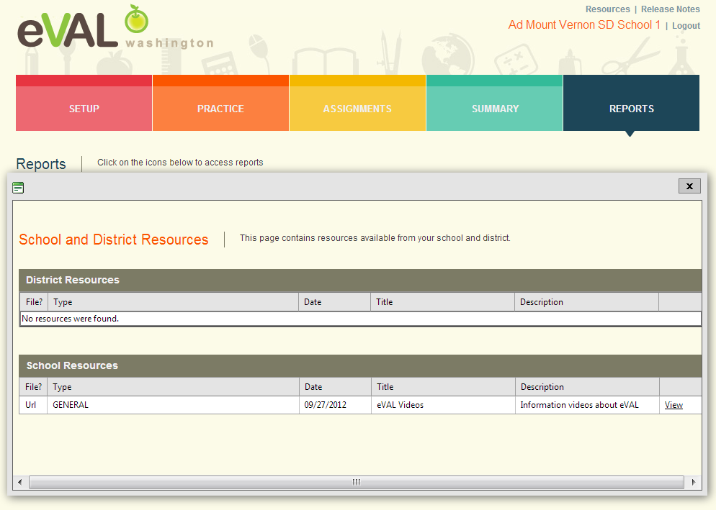
Resources

Slide 43
Principal Log In Example (Everett District, School 1, PR): Everett SD School 1 PR

Slide 44
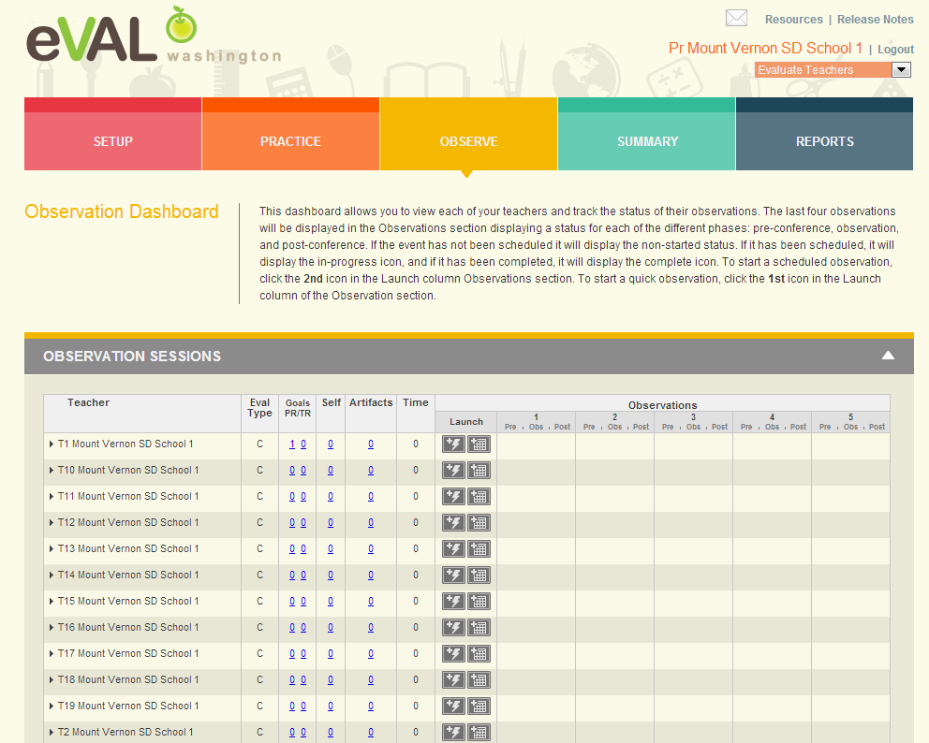
Observation Dashboard

Slide 45
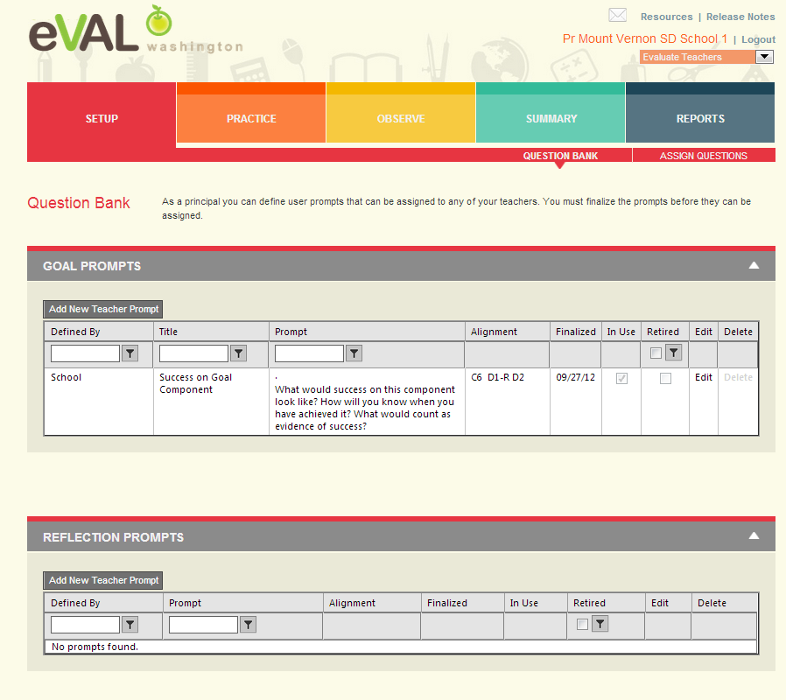
Setup for Evaluations – Question Bank

Slide 46
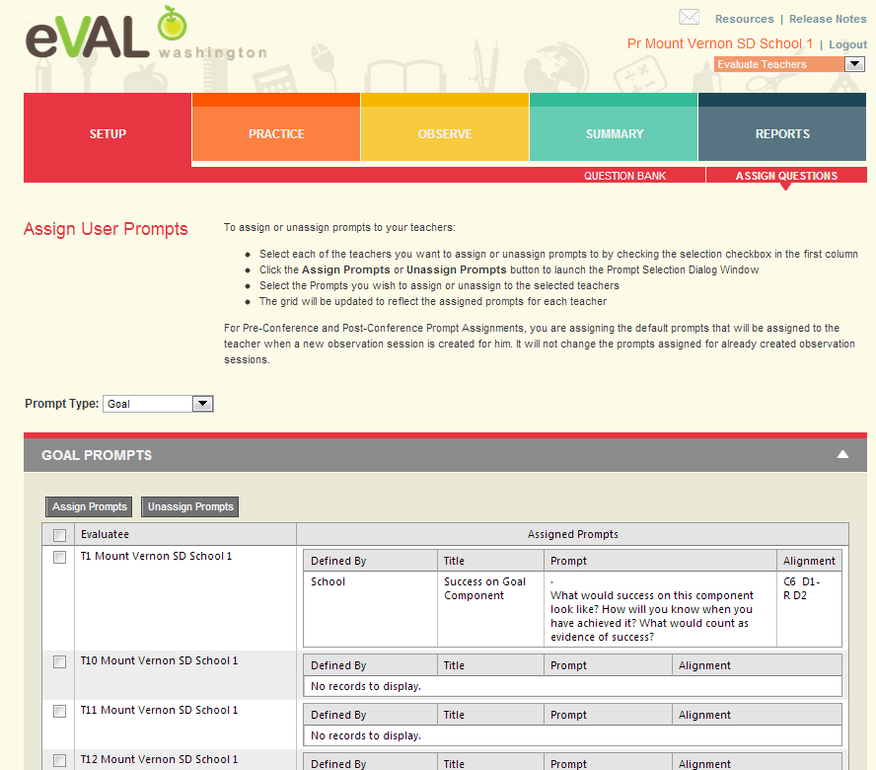
Set Up – Assign Questions

Slide 47
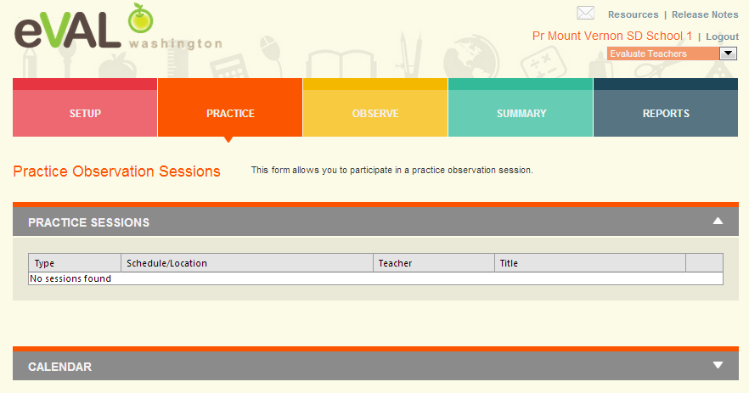
Practice

Slide 48
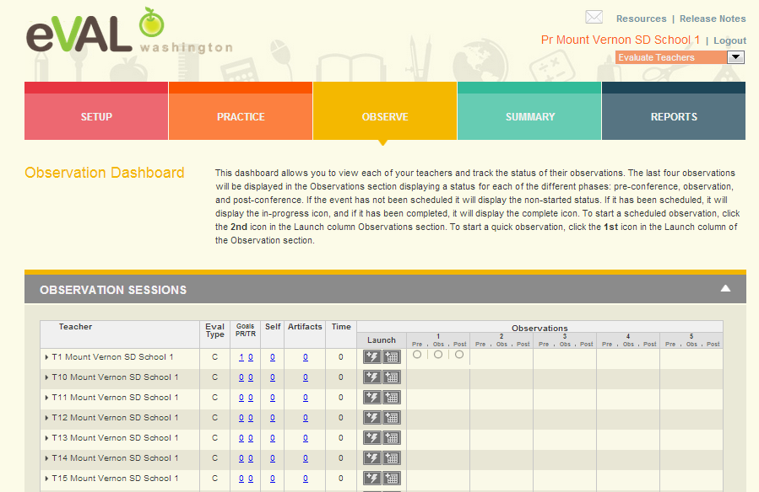
Observation Dashboard

Slide 49
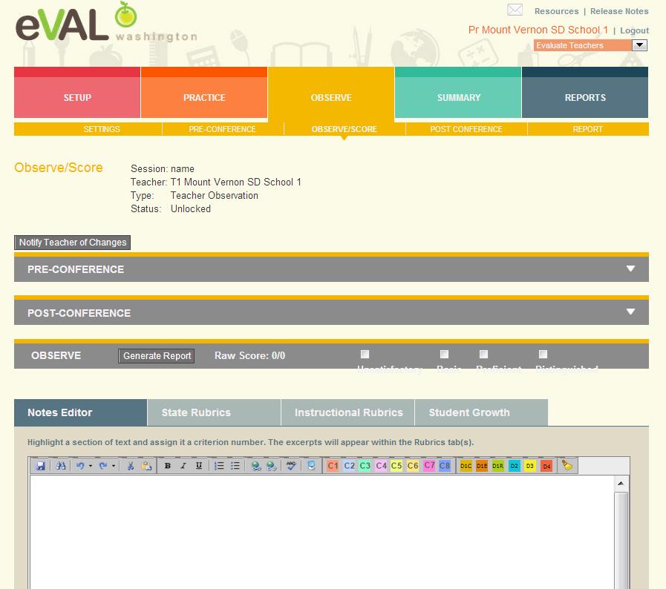
Observe Score

Slide 50
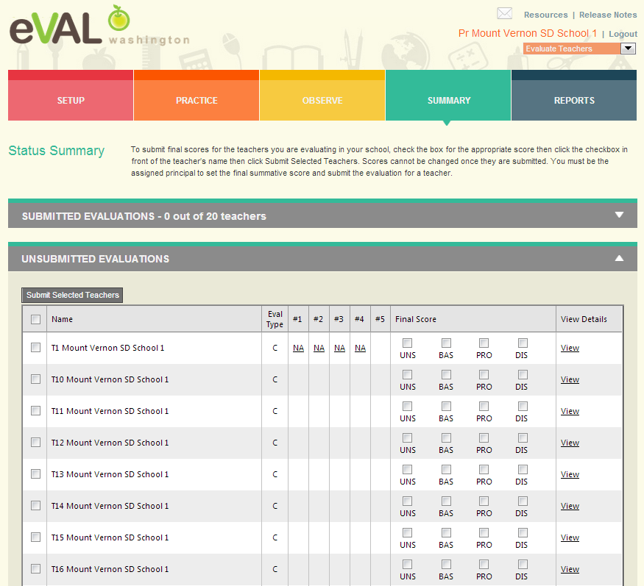
Summary

Slide 51
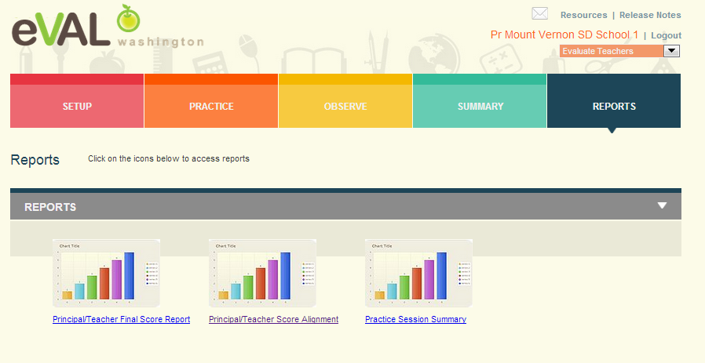
Reports

Slide 52
Next Steps
What do you need to do next?
Who needs to be involved?
When does it need to happen?
How can I help?

Slide 53
Goals
Understanding of all roles
Understanding of process
Fluency and practice with your role
Planning for next steps
Self Assessment
Your familiarity with the eVAL tool 1----5

Slide 54
Thank You!
Cathey Frederick
ESD 189 eVAL Specialist
cathey.frederick@seaotters.us
425.358.0545

