Slide 1

eVAL Online Tool
Training for Evaluators of Principals and Teachers
Cathey Frederick
eVAL Specialist - ESD 189
cathey.frederick@seaotters.us
425.358.0545

Slide 2

Goals
Understanding of all roles
Understanding of process
Fluency and practice with your role
Planning for next steps

Slide 3
Norms
Start and end on time
Participate
Listen
Assume good intentions
There is no “stupid question”
Learn together

Slide 4
Agenda
Welcome, parking lot, introductions, and norms
Pre-training data collection
Overview of eVAL
Overview of roles
Overview of tasks
Creating practice sessions
Summary and Reports
Post-training data collection
Work time on the tool

Slide 5
eVAL – Data Collection
Which framework? 1. Marzano 2. CEL
3. Danielson
I can articulate how the new evaluation process is intended to work 1. Expert --- 5. Not Yet
Your familiarity with the eVAL tool 1----5
Self-Assessments by Evaluatees are required by the state. 1. T 2. F 3. Don’t Know
Notes:
Self assessment F

Slide 6
eVAL – Data Collection
No personally identifiable evaluation data will be reported to OSPI at the end of the year. 1. T 2. F 3. Don’t Know
Have you watched any eVAL trainings videos? 1. Yes 2. No
Did you use either the School Improvement Planning (SIP) tool or the Student Learning Plan (SLP) tool? 1. Yes 2. No
Notes:
Personally identifiable T

Slide 7
eVAL is…
  Under Construction
eVAL Training is…
  Under Construction
eVAL Online Support is…
  Under Construction (barely)

Slide 8
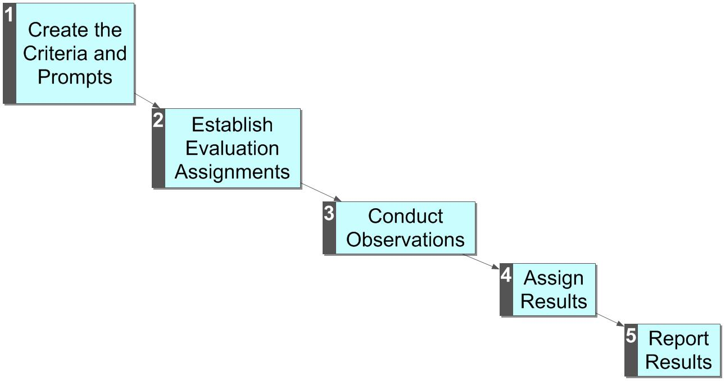
The Evaluation Process
In TPEP the evaluation process, like curriculum has been for 18+ years, is being aligned to state standards.
There are now four possible outcomes:
Unsatisfactory
Basic
Proficient
Distinguished
Aggregated results are shared with the state.
In eVAL-WA the process is conducted entirely online.
Traditionally, this process has been conducted entirely on paper. Usually the criteria and prompts are established in collective bargaining.

Slide 9
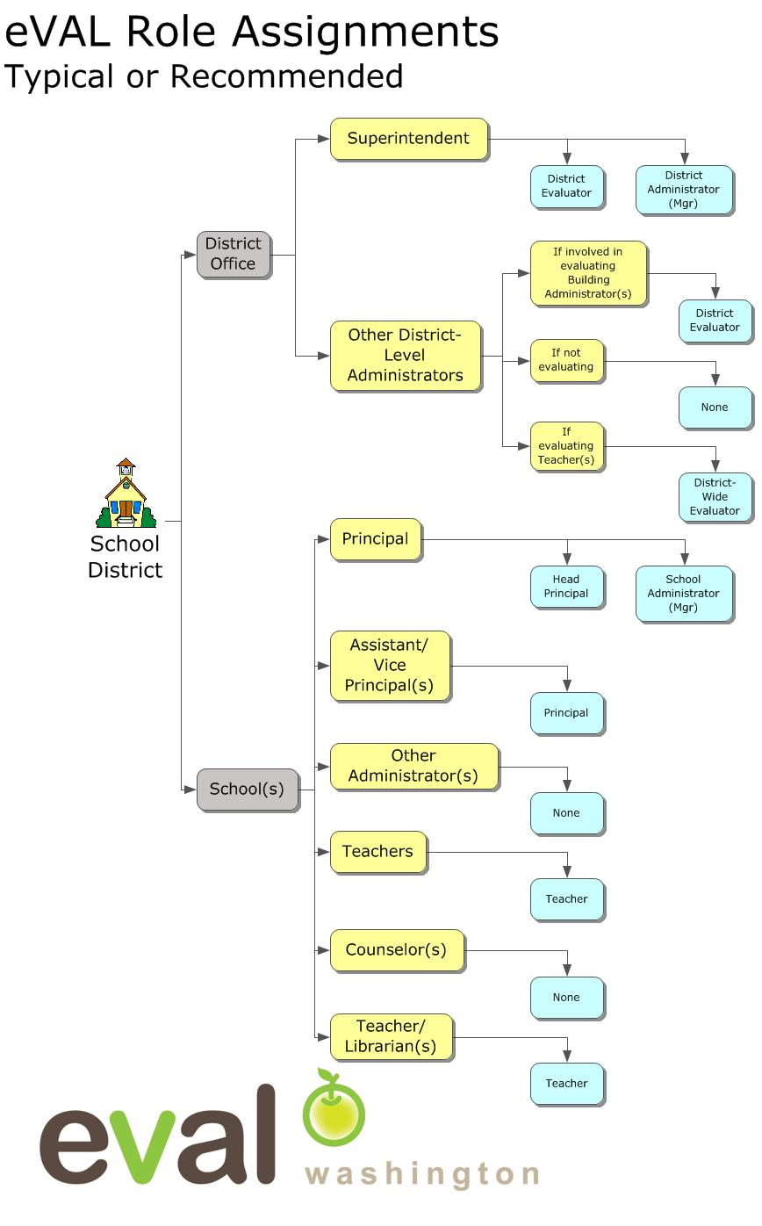
In eVAL there are many roles:
Evaluator Roles
District Evaluator
District-Wide Evaluator
Head Principal
Principal
Materials/Management Roles
District Administrator
School Administrator
Scope
Each role can “impact” only the section of the district assigned
Notes:
In eVAL there are many roles

Slide 10

Today We Are Playing in the Sandbox
http://sandbox.eval-wa.org/

Slide 11
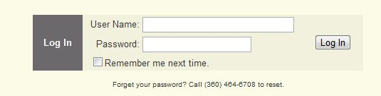
Sandbox Password = password
User Names for district users looks like this:
District Name<space>SD<space>Role Abbreviation (DE DA)
Example (Everett District Administrator): Everett SD DA
Usernames for school users look like this:
District Name<space>SD<space>School <space>#<space>Role Abbreviation (PR AD T1-20)
Example (Everett District, School 1, AD): Everett SD School 1 AD

Slide 12

School Administrator Log In
Example (Everett District, School 1, AD): Everett SD School 1 AD

Slide 13
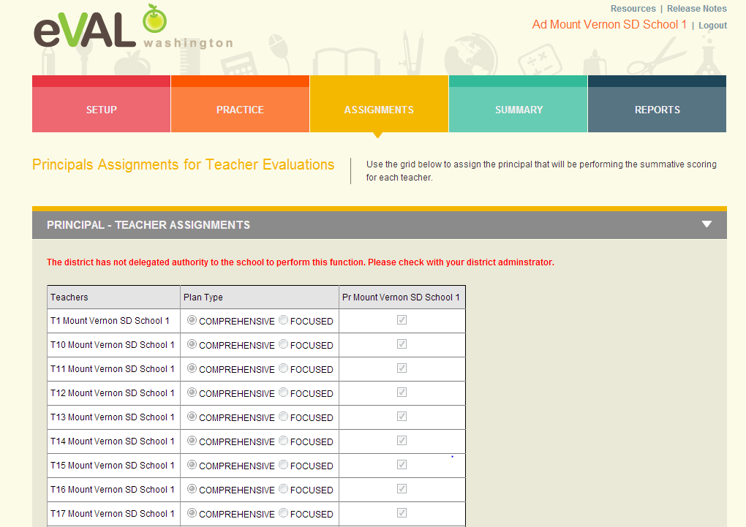
School Administrator Assignments

Slide 14
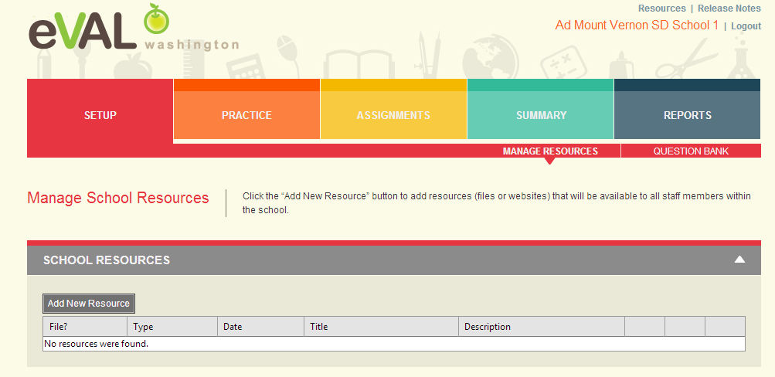
Setup

Slide 15
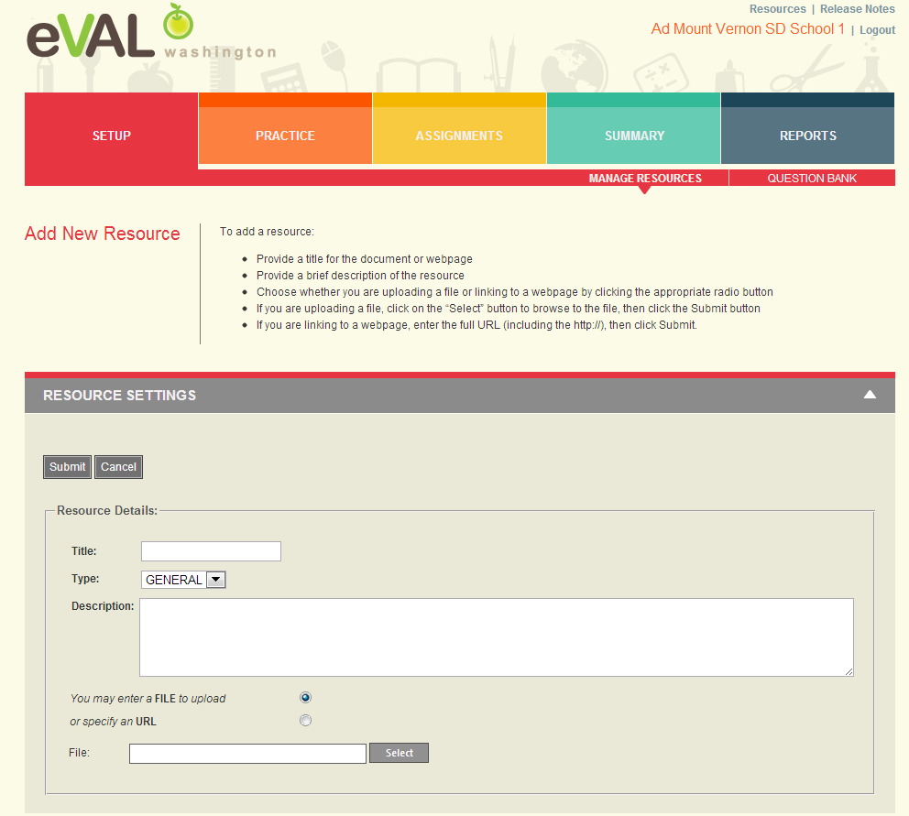
Add New Resources

Slide 16
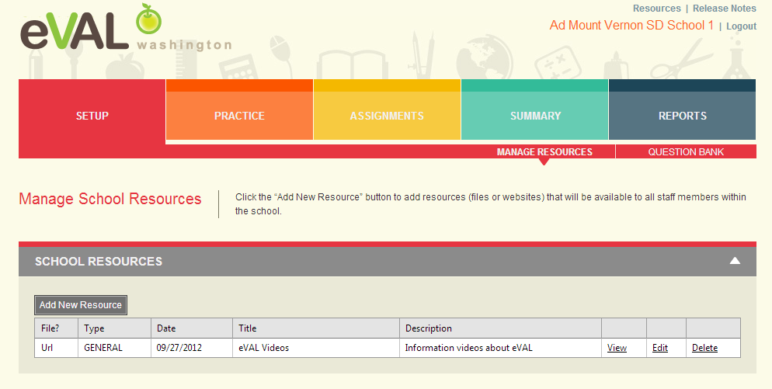
Resource Added

Slide 17
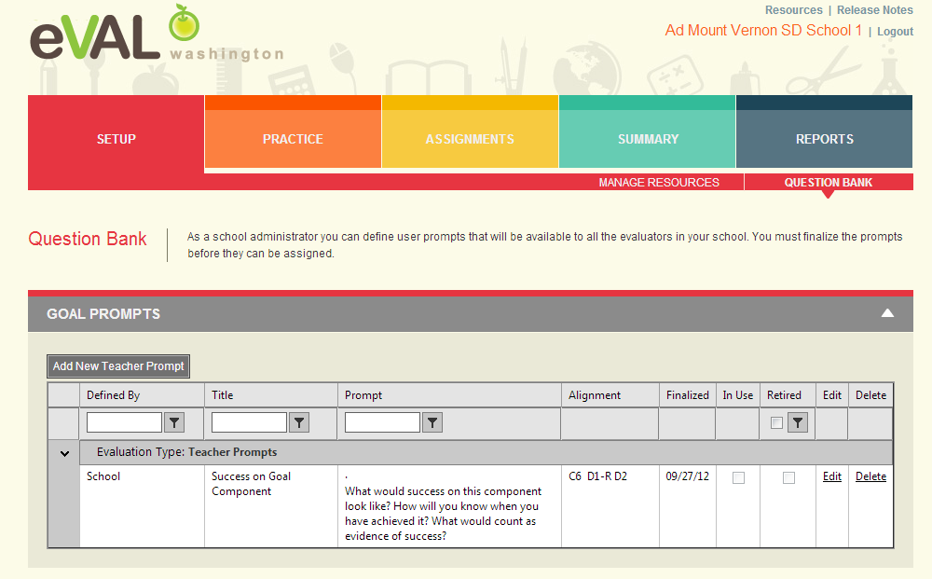
Question Bank
Same for Principal Role

Slide 18
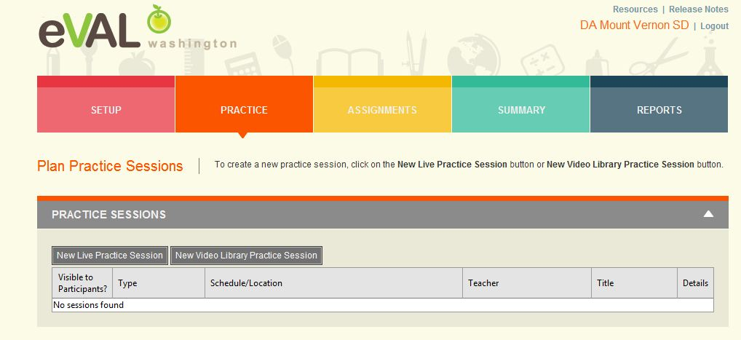
Practice

Slide 19
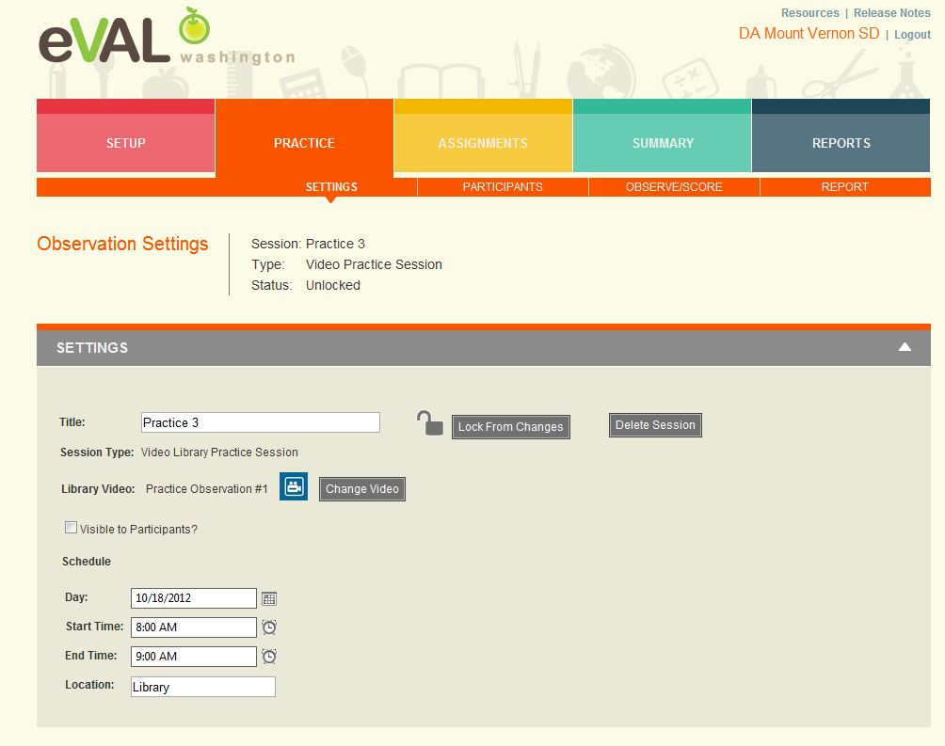
Practice Sessions

Slide 20
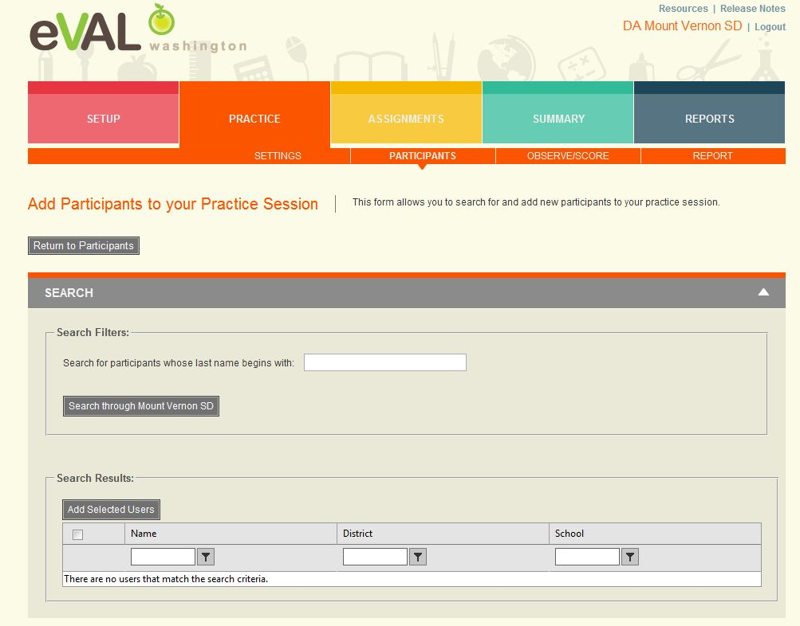
Add Participants to Practice Sessions

Slide 21
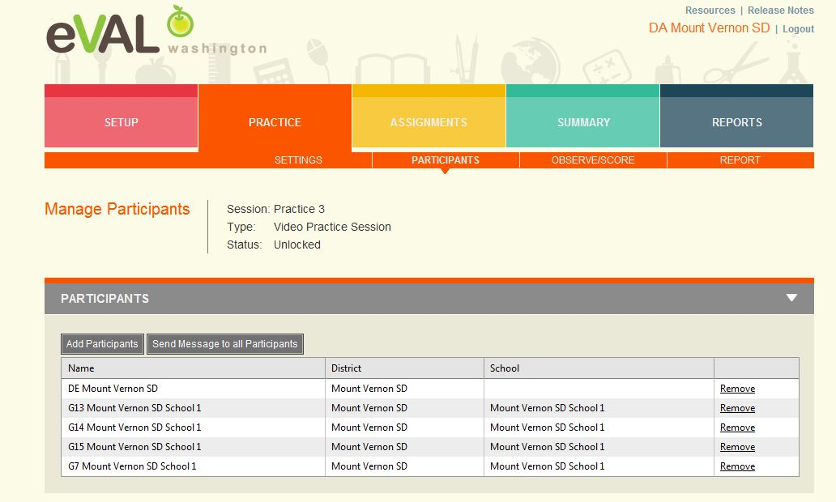
Participants Added

Slide 22
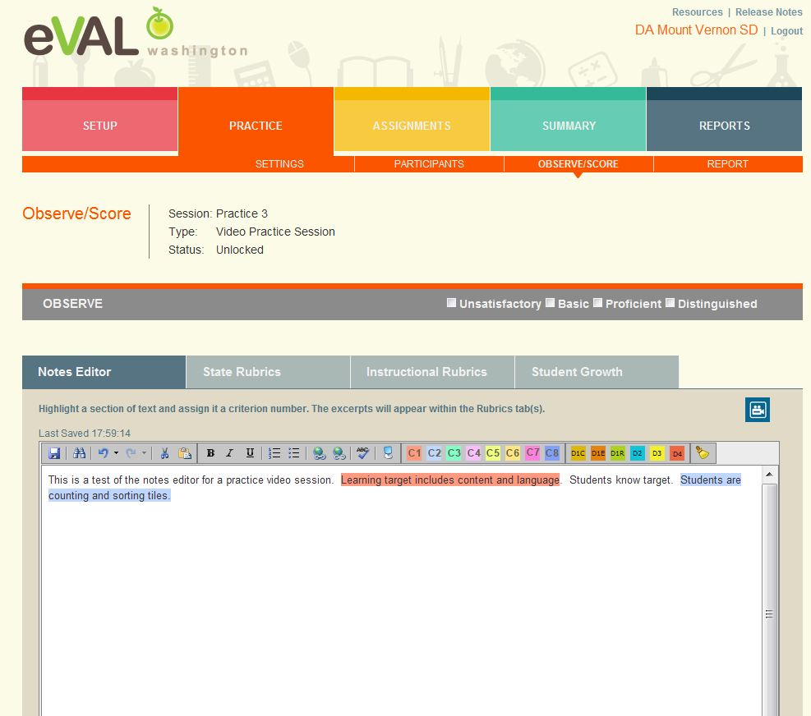
Observe/Score Practice

Slide 23
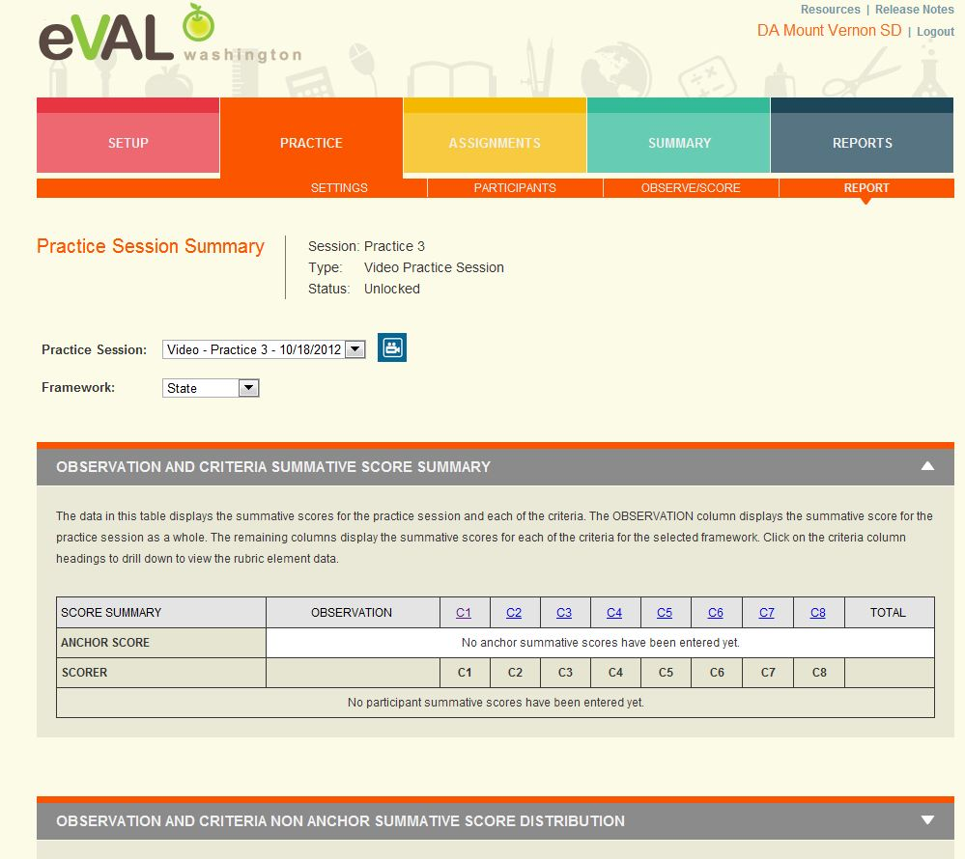
Practice Report

Slide 24
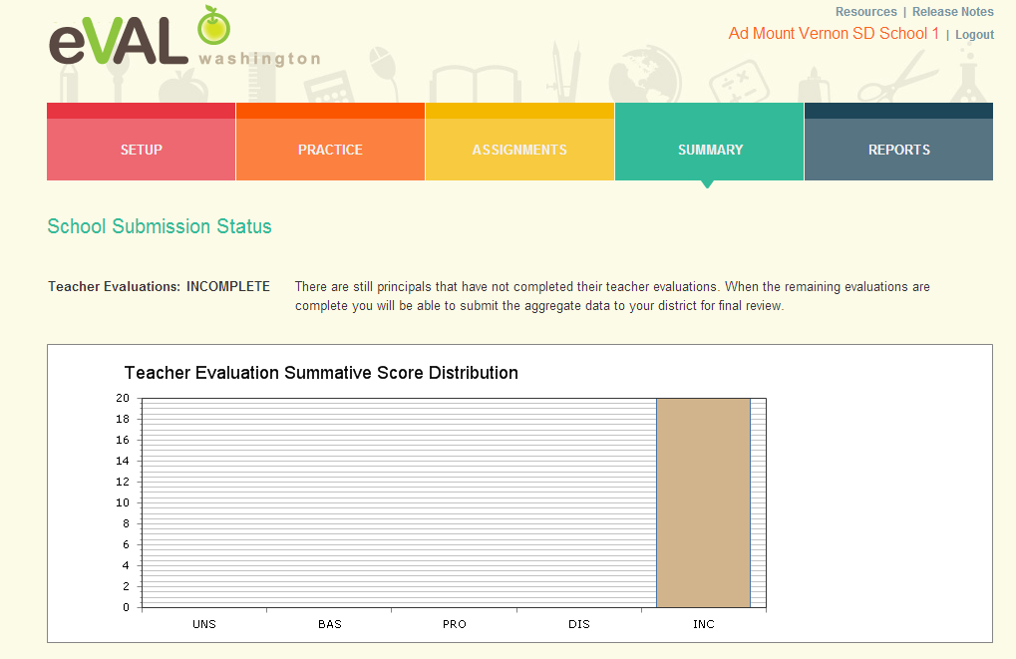
Summary

Slide 25
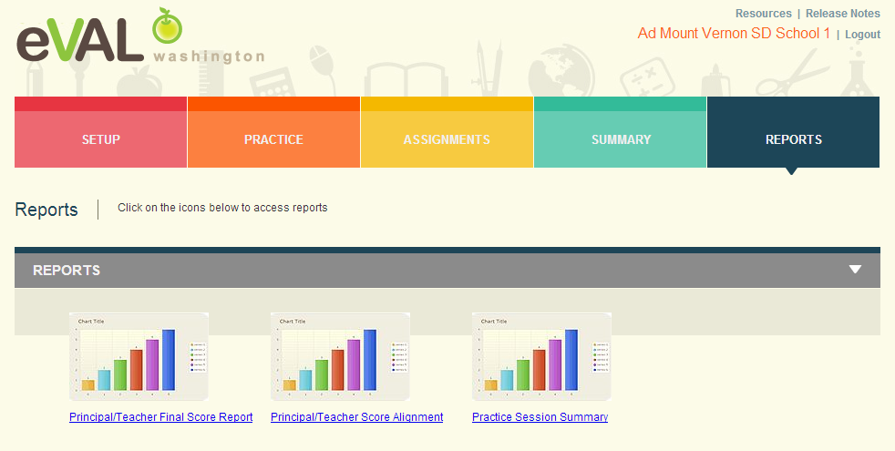
Reports

Slide 26
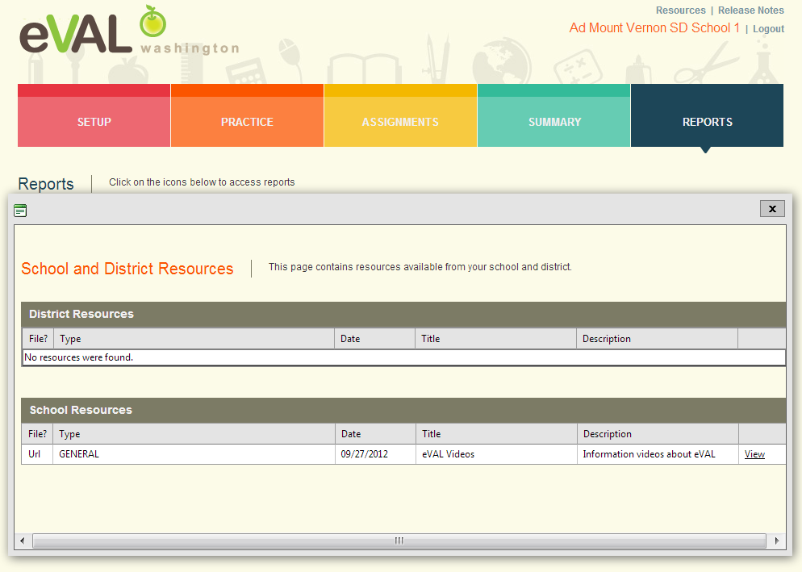
Resources

Slide 27

Principal Log In
Example (Everett District, School 1, PR): Everett SD School 1 PR

Slide 28
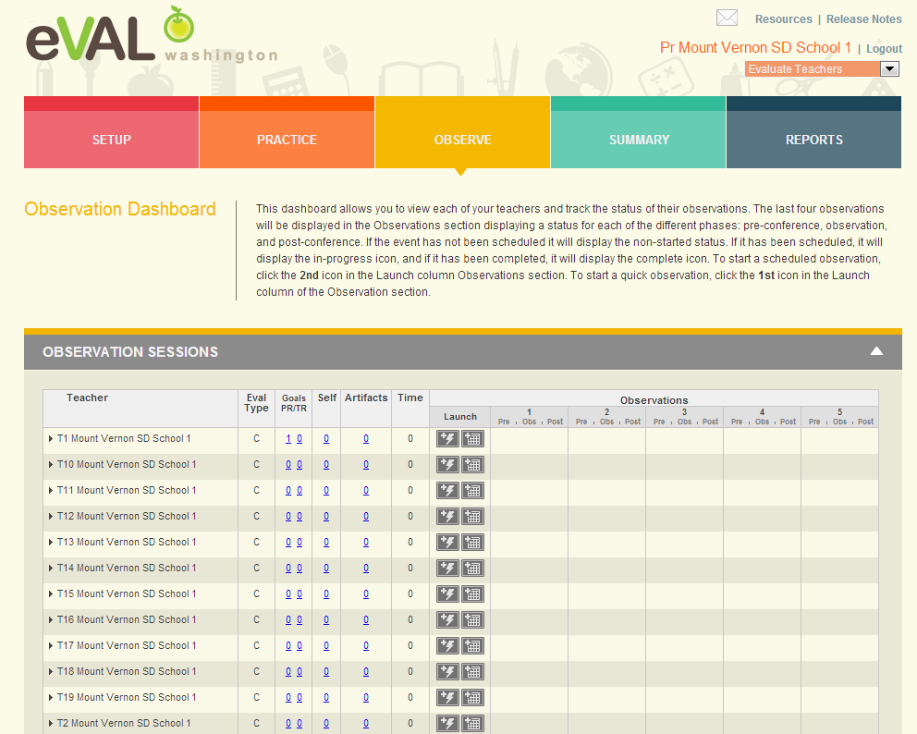
Observation Dashboard

Slide 29
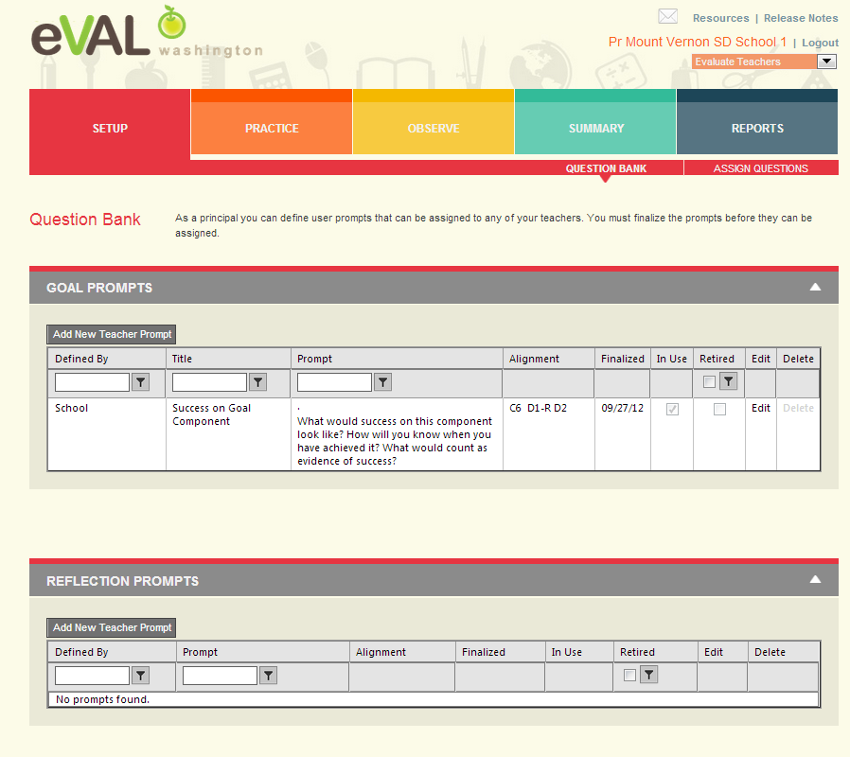
Setup for Evaluations – Question Bank

Slide 30
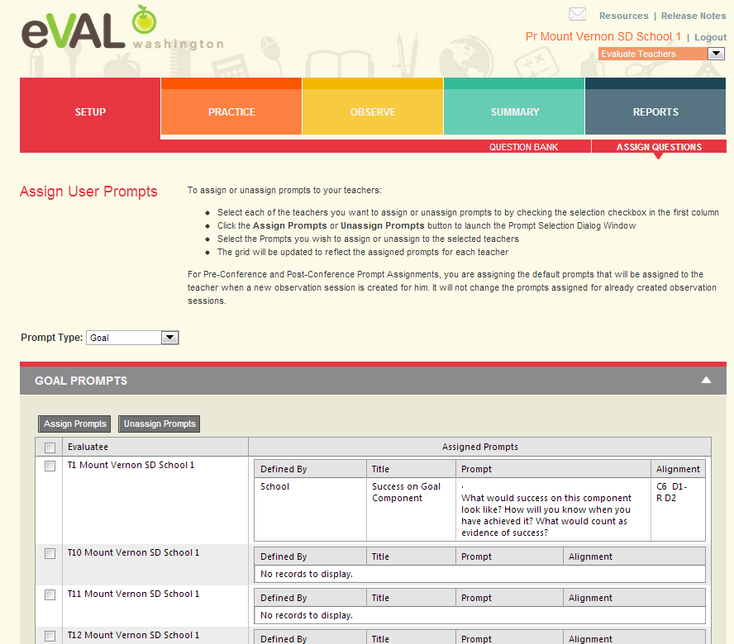
Set Up – Assign Questions

Slide 31
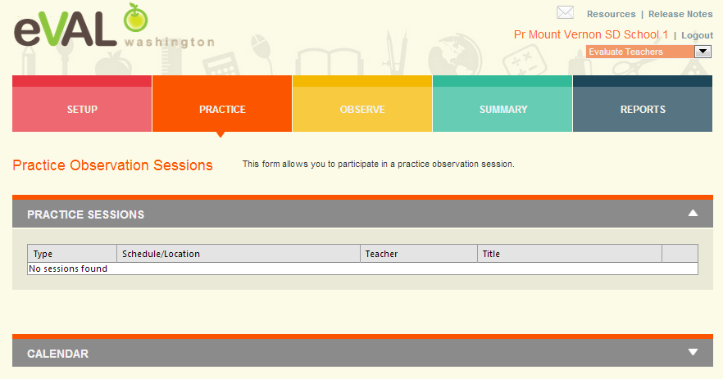
Practice

Slide 32
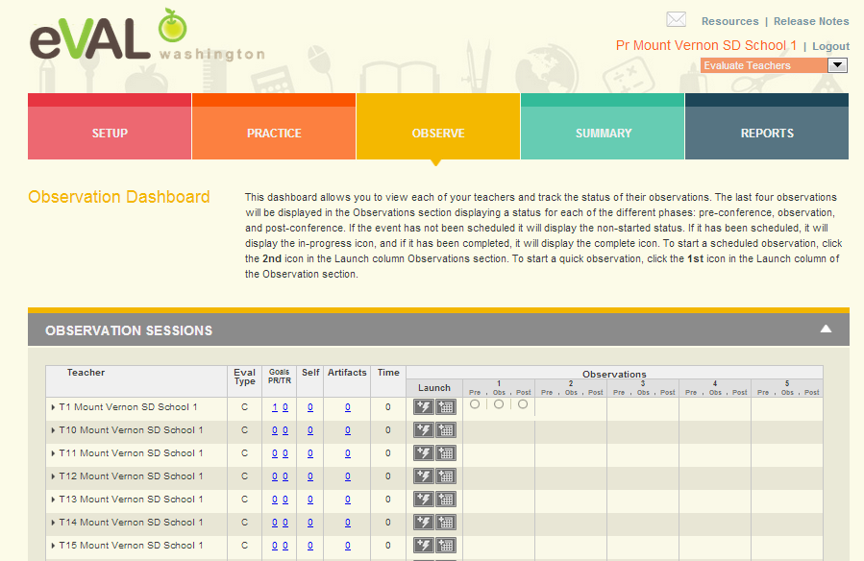
Observation Dashboard

Slide 33
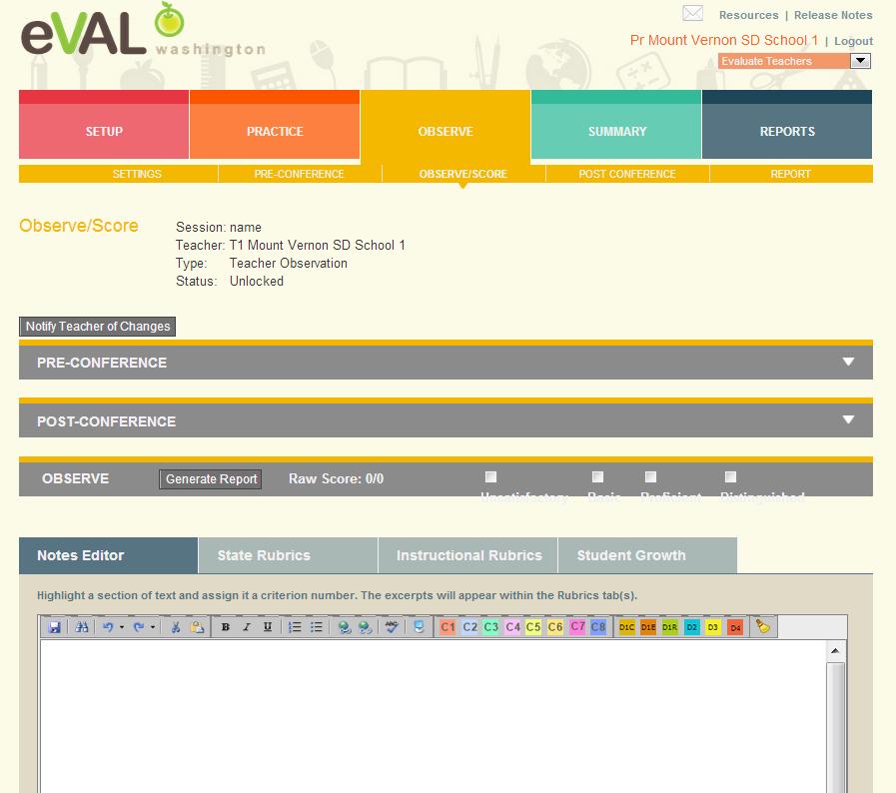
Observe Score

Slide 34
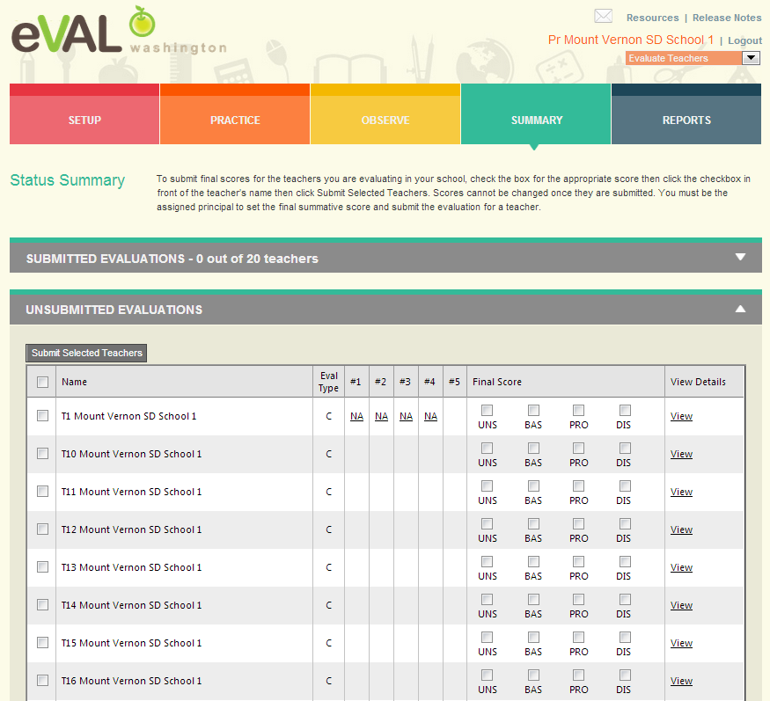
Summary

Slide 35
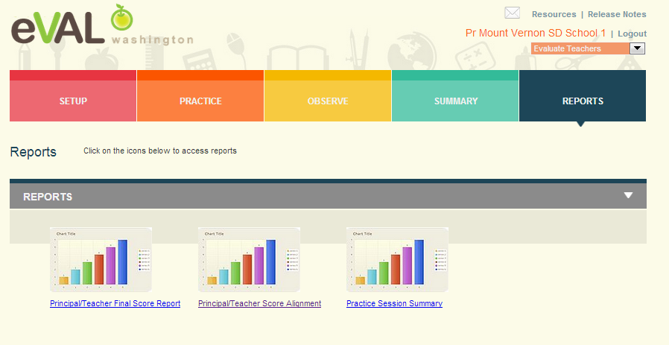
Reports

Slide 36

Prepare for My Evaluation

Slide 37
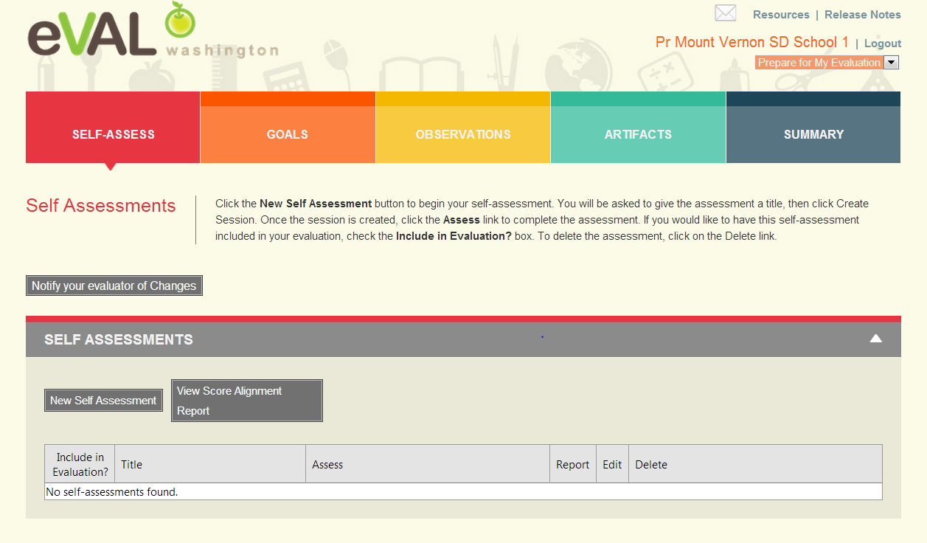
Self Assessment
Same as Teacher Self Assessment

Slide 38
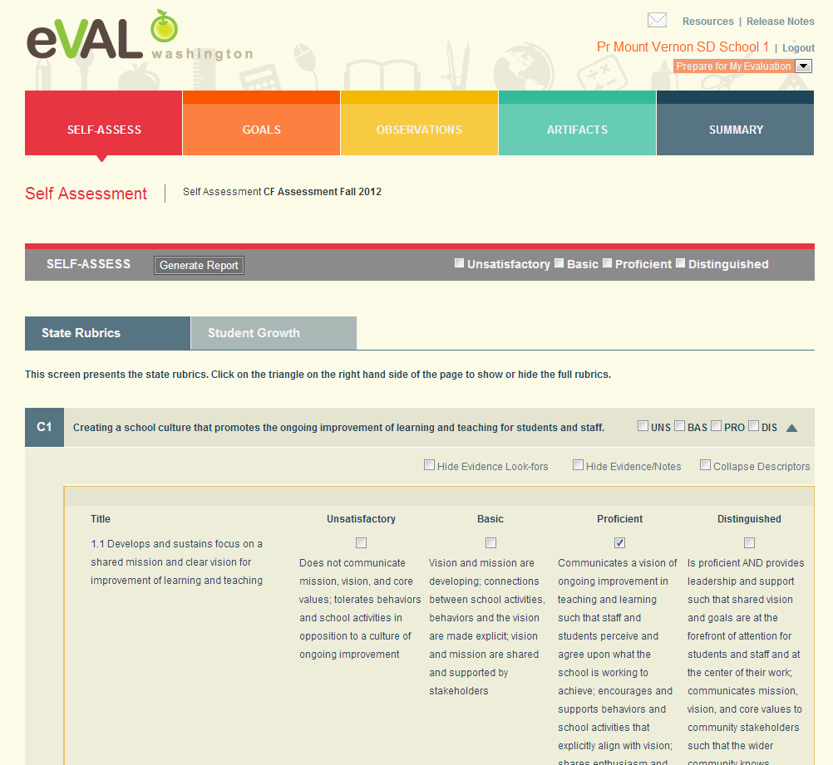
Self Assessment – State Criteria

Slide 39
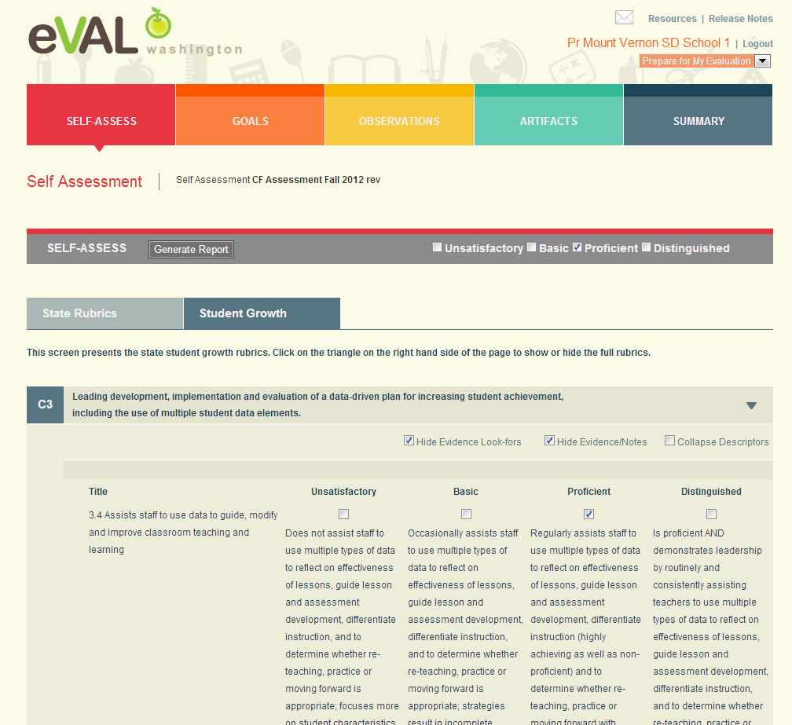
Self Assessment – Student Growth

Slide 40
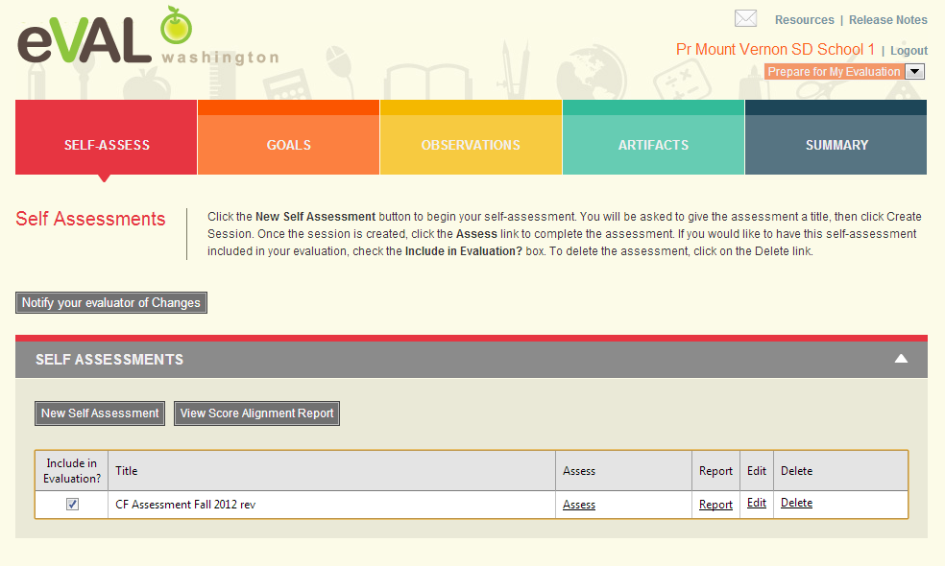
Self Assessment - Choices

Slide 41
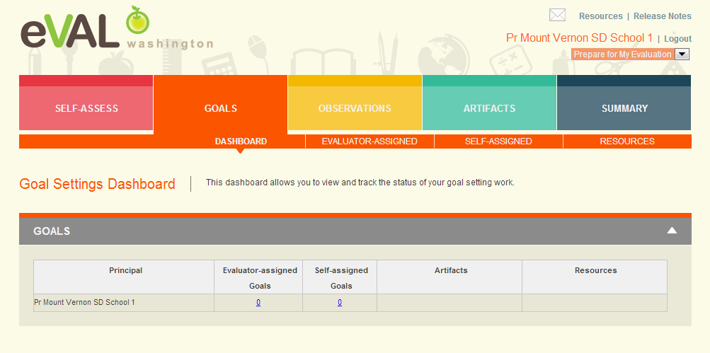
Goals

Slide 42
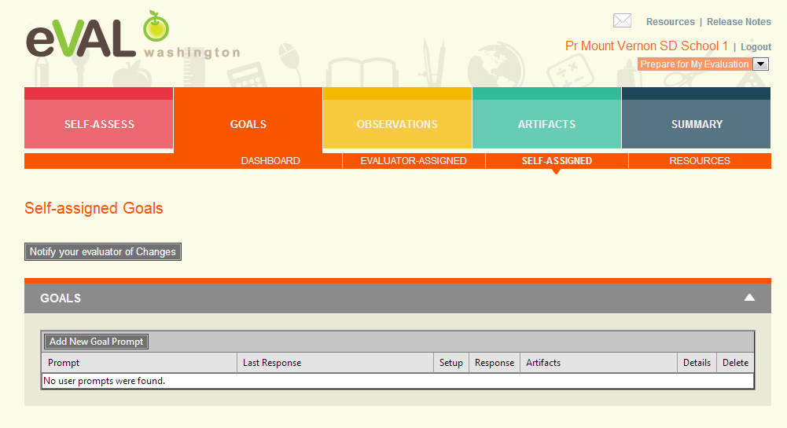
Goals – Self Assigned

Slide 43
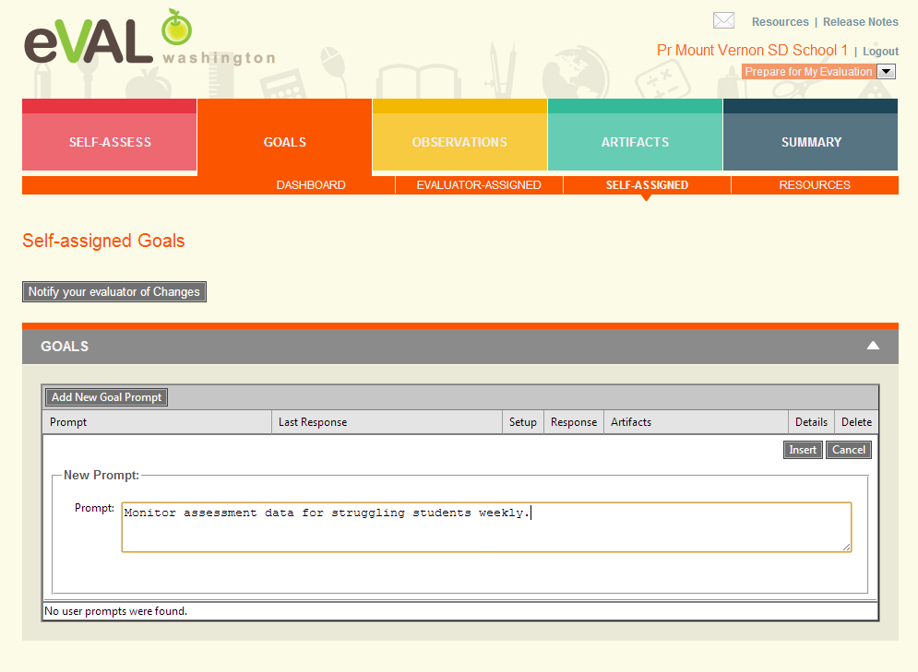
Goals – Add Goal Prompt

Slide 44
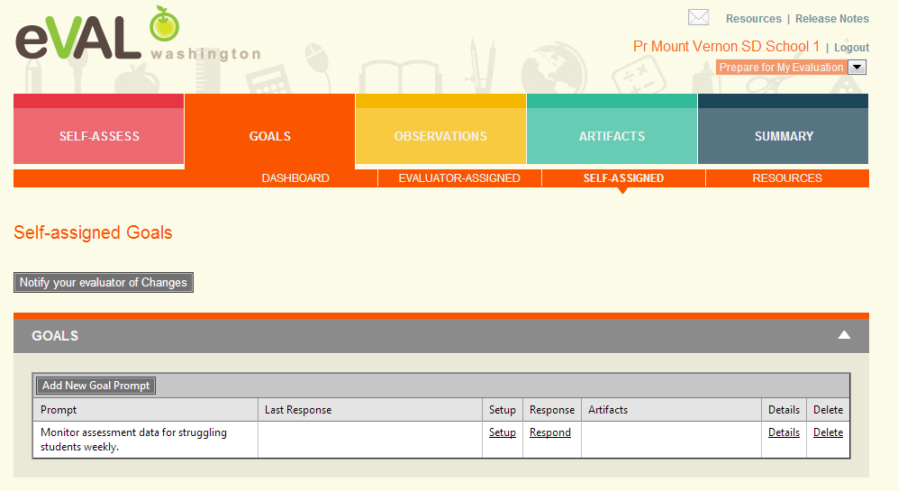
Goal Prompt Added

Slide 45
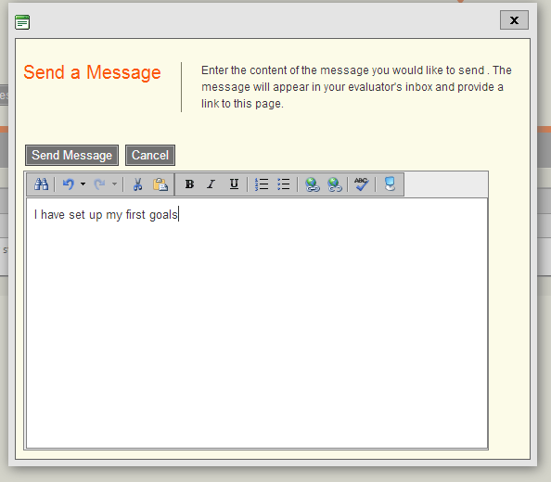
Notify Evaluator of Changes

Slide 46
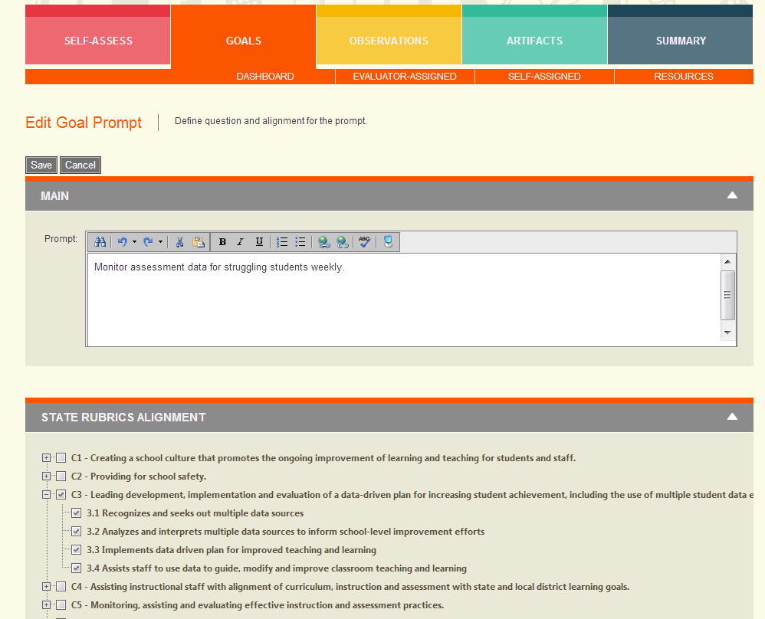
Goal Prompt – Set Up

Slide 47
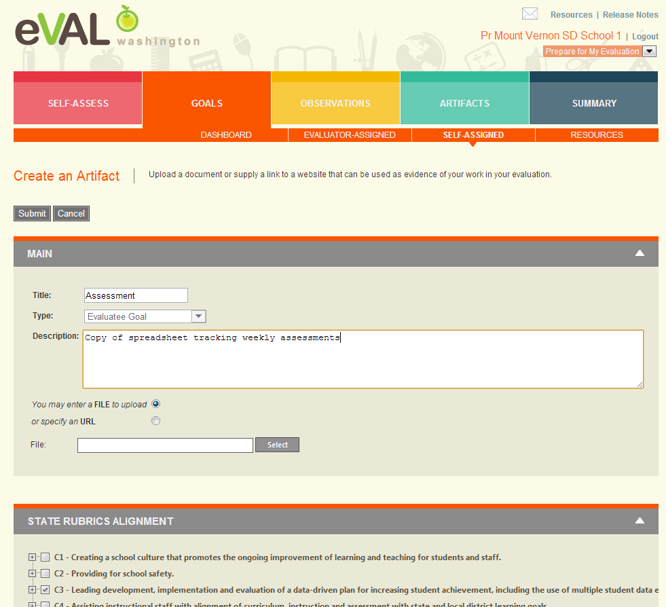
Goal Prompt – Add Artifact

Slide 48
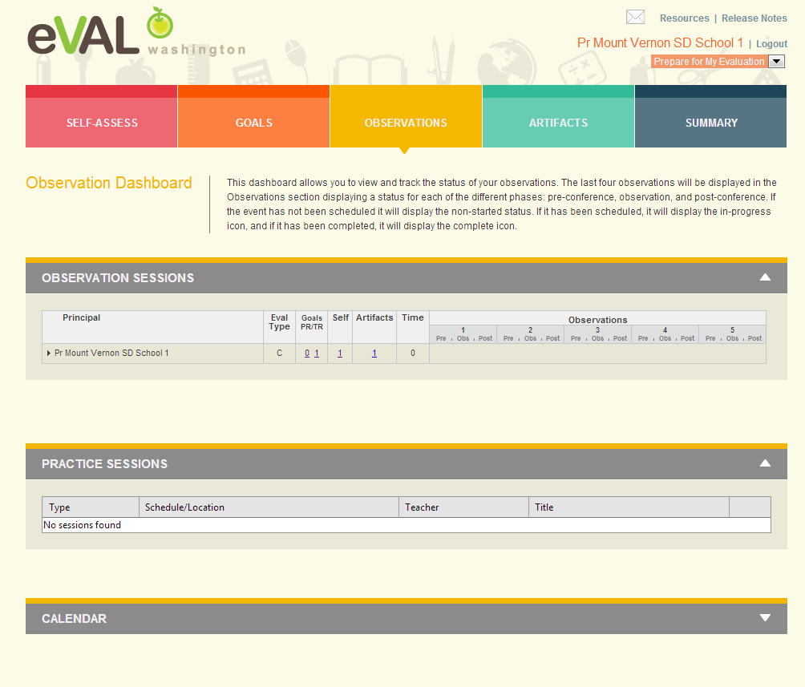
Observation Dashboard

Slide 49
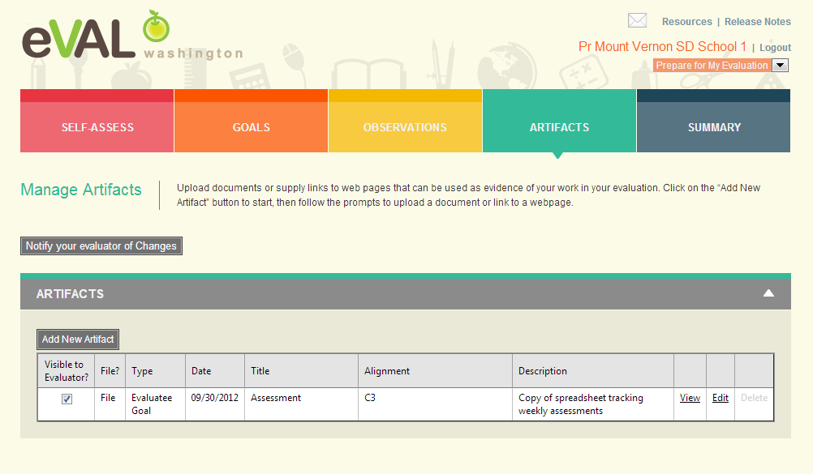
Adding Artifacts

Slide 50
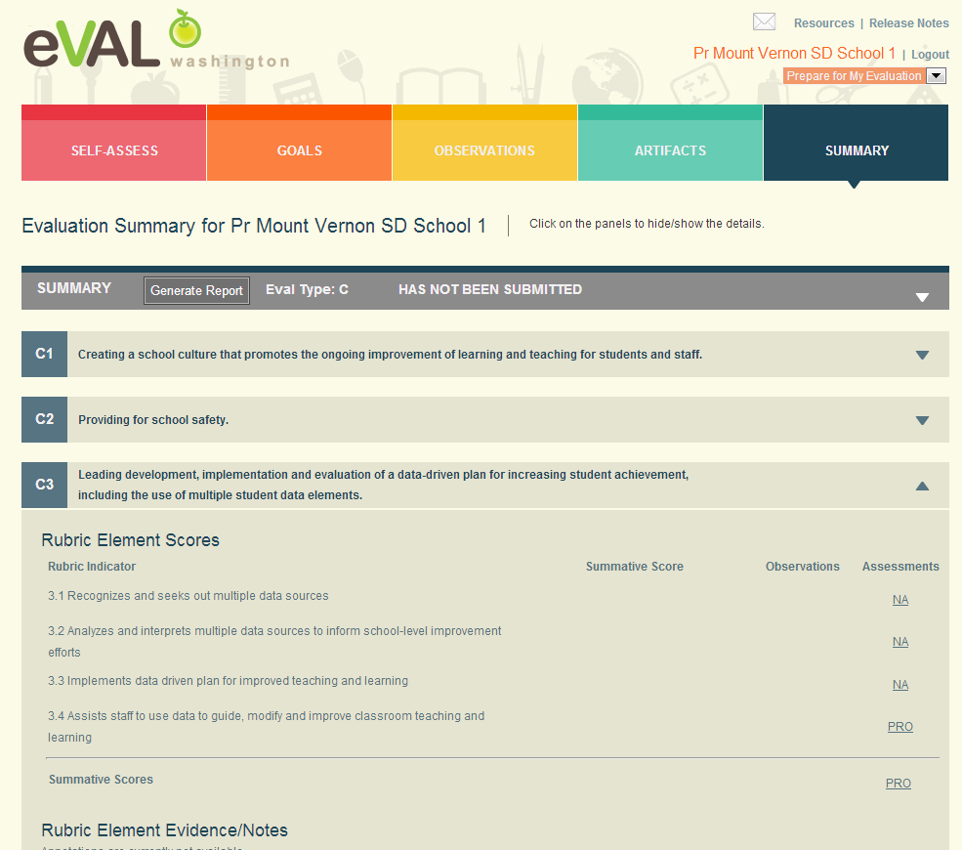
Summary

Slide 51
Next Steps
What do you need to do next?
Who needs to be involved?
When does it need to happen?
How can I help?

Slide 52
Goals
Understanding of all roles
Understanding of process
Fluency and practice with your role
Planning for next steps
Self Assessment
Your familiarity with the eVAL tool 1----5

Slide 53
Thank You!
Cathey Frederick
ESD 189 eVAL Specialist
cathey.frederick@seaotters.us
425.358.0545

