Slide 1

eVAL and The Evaluation Cycle Coupeville Teachers October 26, 2012
Cathey Frederick
eVAL Specialist - ESD 189
cathey.frederick@seaotters.us
425.358.0545

Slide 2

Goals
Review evaluation steps for teacher evaluations
Understand specific supports and tasks teachers might want to use in eVAL
Practice using eVAL
Create plan for sharing eVAL with other teachers

Slide 3
Norms
Start and end on time
Participate
Listen
Assume good intentions
There is no “stupid question”
Learn together

Slide 4
Agenda
Welcome, review norms
Pre-training data collection
Review evaluation process
Overview of eVAL supports and tasks
Overview of tasks in eVAL
Hands-on practice with eVAL
Create a plan for training other teachers

Slide 5
eVAL – Data Collection
We are going to use an online tool called Poll Everywhere from polleverywhere.com
You will need your cell phone to text or respond in the browser, or you can use your computer and browser
Are you ready?
Notes:
Self assessment F

Slide 6
Don’t forget: You can copy-paste this slide into other presentations, and move or resize the poll.
Notes:
Press F5 or enter presentation mode to view the poll In an emergency during your presentation, if the poll isn't showing, navigate to this link in your web browser: http://www.polleverywhere.com/multiple_choice_polls/MTUwOTgwMDQxMw
If you like, you can use this slide as a template for your own voting slides. You might use a slide like this if you feel your audience would benefit from the picture showing a text message on a phone.

Slide 7
Don’t forget: You can copy-paste this slide into other presentations, and move or resize the poll.
Notes:
Press F5 or enter presentation mode to view the poll In an emergency during your presentation, if the poll isn't showing, navigate to this link in your web browser: http://www.polleverywhere.com/multiple_choice_polls/LTY5NTAwOTI1NQ
If you like, you can use this slide as a template for your own voting slides. You might use a slide like this if you feel your audience would benefit from the picture showing a text message on a phone.

Slide 8
Don’t forget: You can copy-paste this slide into other presentations, and move or resize the poll.
Notes:
Press F5 or enter presentation mode to view the poll In an emergency during your presentation, if the poll isn't showing, navigate to this link in your web browser: http://www.polleverywhere.com/multiple_choice_polls/MTg4NDMyMDg5Mg
If you like, you can use this slide as a template for your own voting slides. You might use a slide like this if you feel your audience would benefit from the picture showing a text message on a phone.

Slide 9
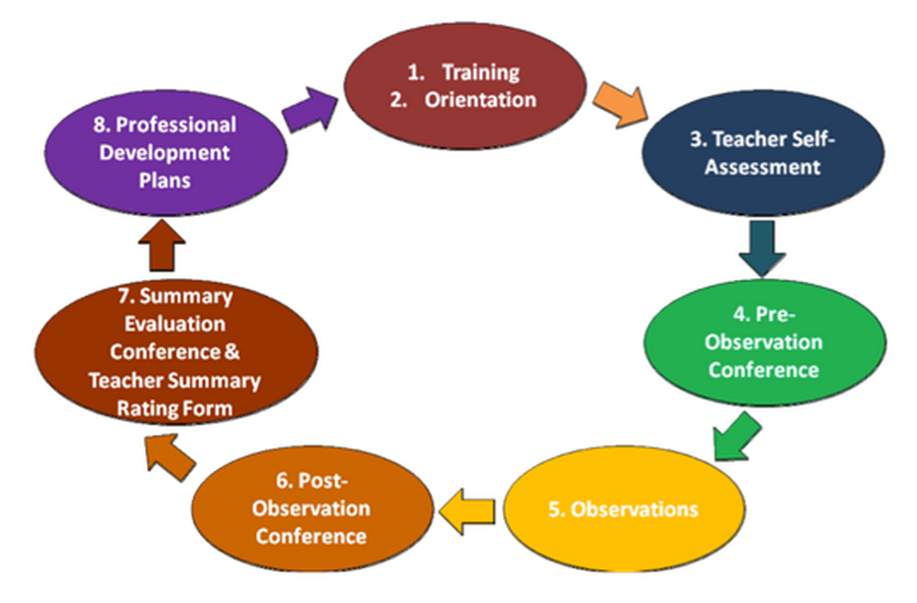
Evaluation Process
Notes:
Self assessment F

Slide 10
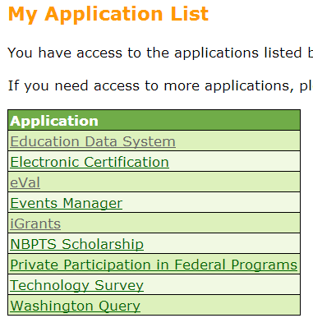
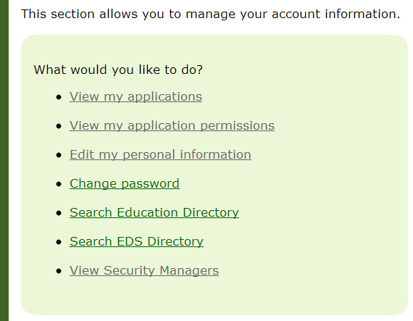
Logging into eVAL
Log into OSPI’s EDS: https://eds.ospi.k12.wa.us/
Notes:
Self assessment F

Slide 11
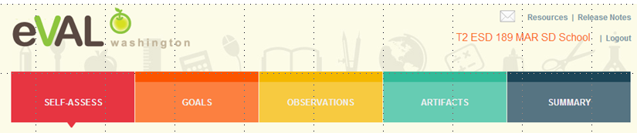
Role of Evaluatee
An teacher has three primary responsibilities in eVAL:
self-assessment and goal-setting;
interacting with the evaluator in the observation process; and
uploading artifacts

Slide 12
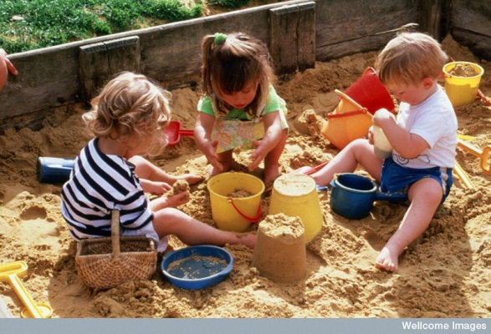
Today We are Playing in the Sandbox
District Name <space> SD <space> School <space> number 1-5 <space> Role Abbreviation (T1-20)
Example (Coupeville District, School 1, Teacher 1):
Coupeville SD School 1 T1
http://sandbox.eval-wa.org/
Password is password
Notes:
Self assessment F

Slide 13
Self Assessment, Goals, Artifacts, Summary
We will use the Sandbox to practice and review these areas
We will look at slides demonstrating the interaction of principal and teacher in the observation section

Slide 14
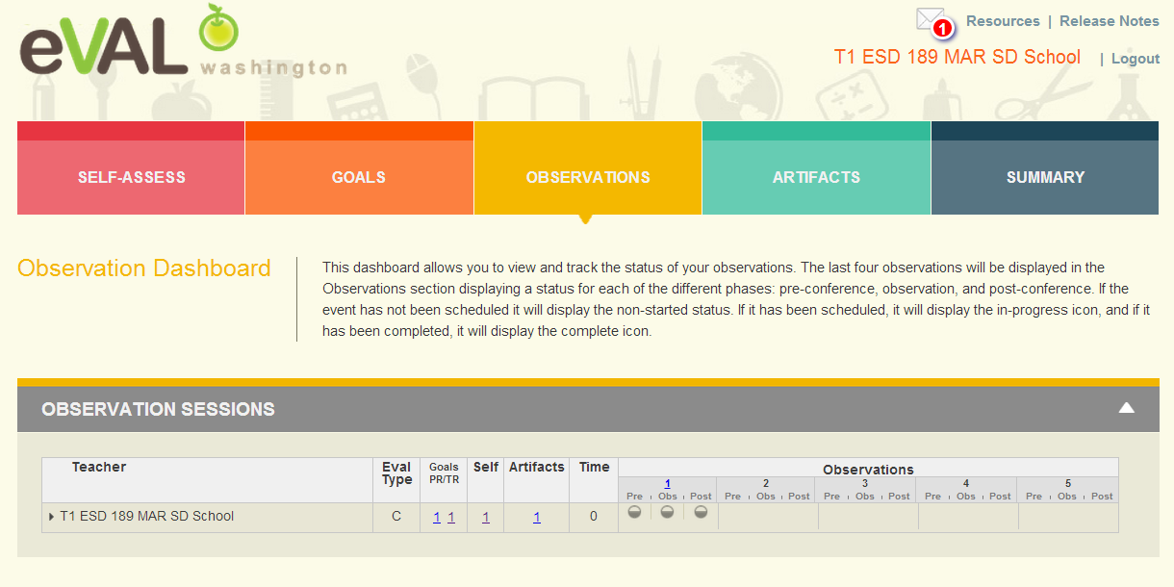
Teacher Observation Dashboard Part 1
Pre- and Post- Conferences along with Observation are scheduled.
Clicking on any one of the circles will bring up that section.

Slide 15
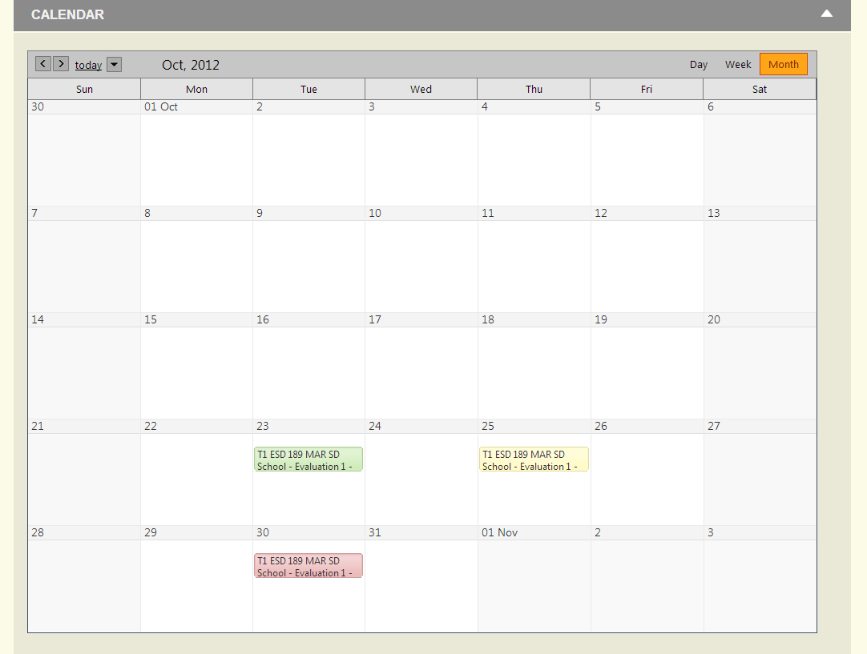
Teacher Observation Dashboard Part 2

Slide 16
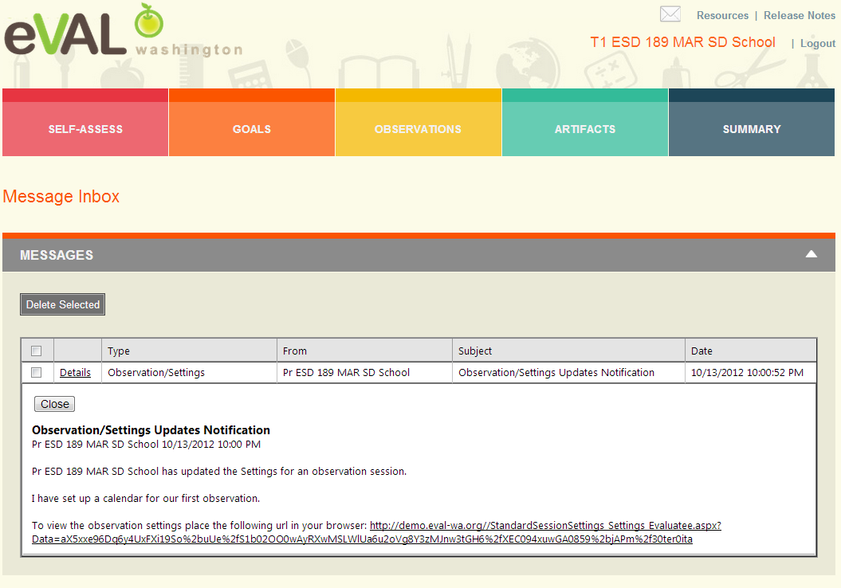
Teacher Mailbox

Slide 17

Teacher Preconference Part 1

Slide 18
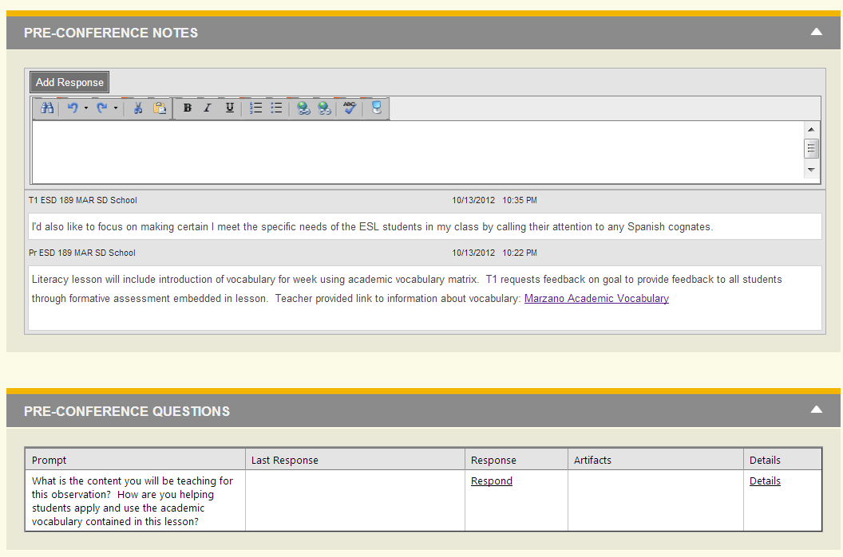
Teacher Preconference Part 2

Slide 19
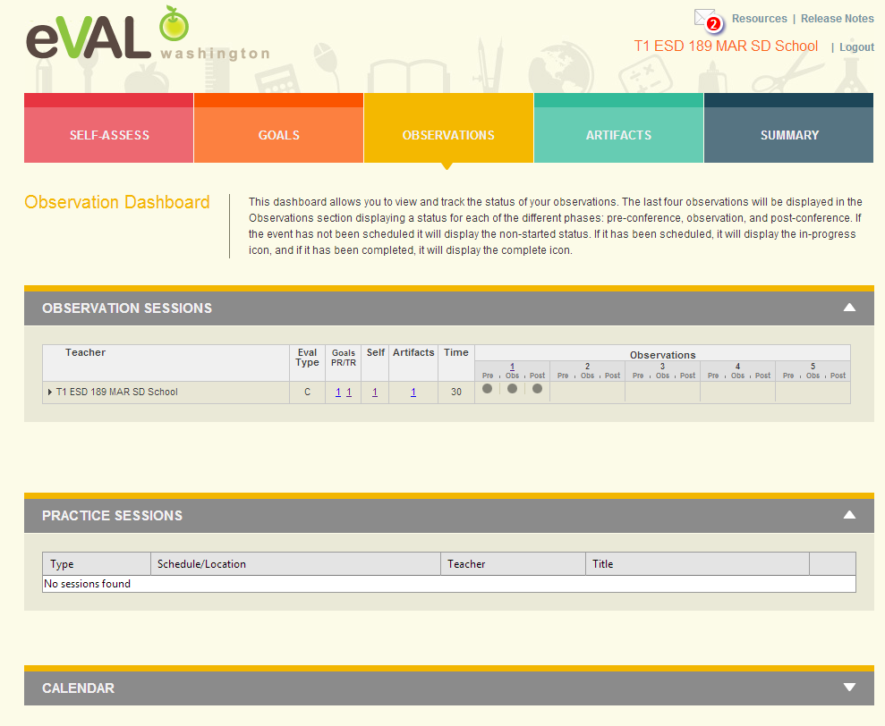
Teacher Dashboard – Observation 1 Complete

Slide 20
Next Steps
What do you need to do next?
Who needs to be involved?
When does it need to happen?
How can I help?

Slide 21
Goals
Review evaluation steps for teacher evaluations
Understand specific supports and tasks teachers might want to use in eVAL
Practice using eVAL
Create plan for sharing eVAL with other teachers

Slide 22
Don’t forget: You can copy-paste this slide into other presentations, and move or resize the poll.
Notes:
Press F5 or enter presentation mode to view the poll In an emergency during your presentation, if the poll isn't showing, navigate to this link in your web browser: http://www.polleverywhere.com/multiple_choice_polls/LTEyODM2MDE5MQ
If you like, you can use this slide as a template for your own voting slides. You might use a slide like this if you feel your audience would benefit from the picture showing a text message on a phone.

Slide 23
Don’t forget: You can copy-paste this slide into other presentations, and move or resize the poll.
Notes:
Press F5 or enter presentation mode to view the poll In an emergency during your presentation, if the poll isn't showing, navigate to this link in your web browser: http://www.polleverywhere.com/free_text_polls/LTI2NDA1NTY0OA
If you like, you can use this slide as a template for your own voting slides. You might use a slide like this if you feel your audience would benefit from the picture showing a text message on a phone.

Slide 24
Thank You!
Cathey Frederick
ESD 189 eVAL Specialist
cathey.frederick@seaotters.us
425.358.0545

