Slide 1

eVAL and The Evaluation Cycle A Look at the Interaction of District Evaluator/Principal Roles
Cathey Frederick
eVAL Specialist - ESD 189
cathey.frederick@seaotters.us
425.358.0545

Slide 2

Goals
Review evaluation steps that are part of the principal evaluation process
Understand supports offered to evaluator and evaluatee by eVAL
Understand specific tasks evaluator and evaluatee might want to do in eVAL
Understand interaction between evaluator and evaluatee roles in eVAL

Slide 3
Norms
Start and end on time
Participate
Listen
Assume good intentions
There is no “stupid question”
Learn together

Slide 4
Agenda
Welcome, review norms
Pre-training data collection
Review evaluation process
Overview of eVAL supports
Overview of tasks in eVAL
Work through the evaluation process through the lens of evaluator and evaluatee

Slide 5
eVAL – Data Collection
I would describe my familiarity with the eVAL tool as: 1----5 with 1 being beginner and 5 being expert
I have participated in an eVAL practice session 1=yes 2=no
I have, or am, a new principals that need to be evaluated within 90 days 1=yes 2=no
Notes:
Self assessment F

Slide 6
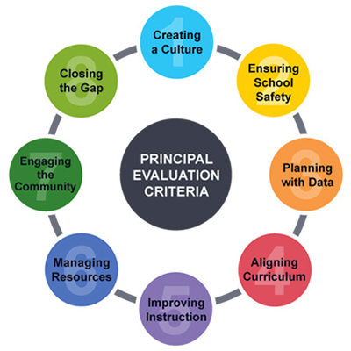
Evaluation Criteria
Notes:
Self assessment F

Slide 7
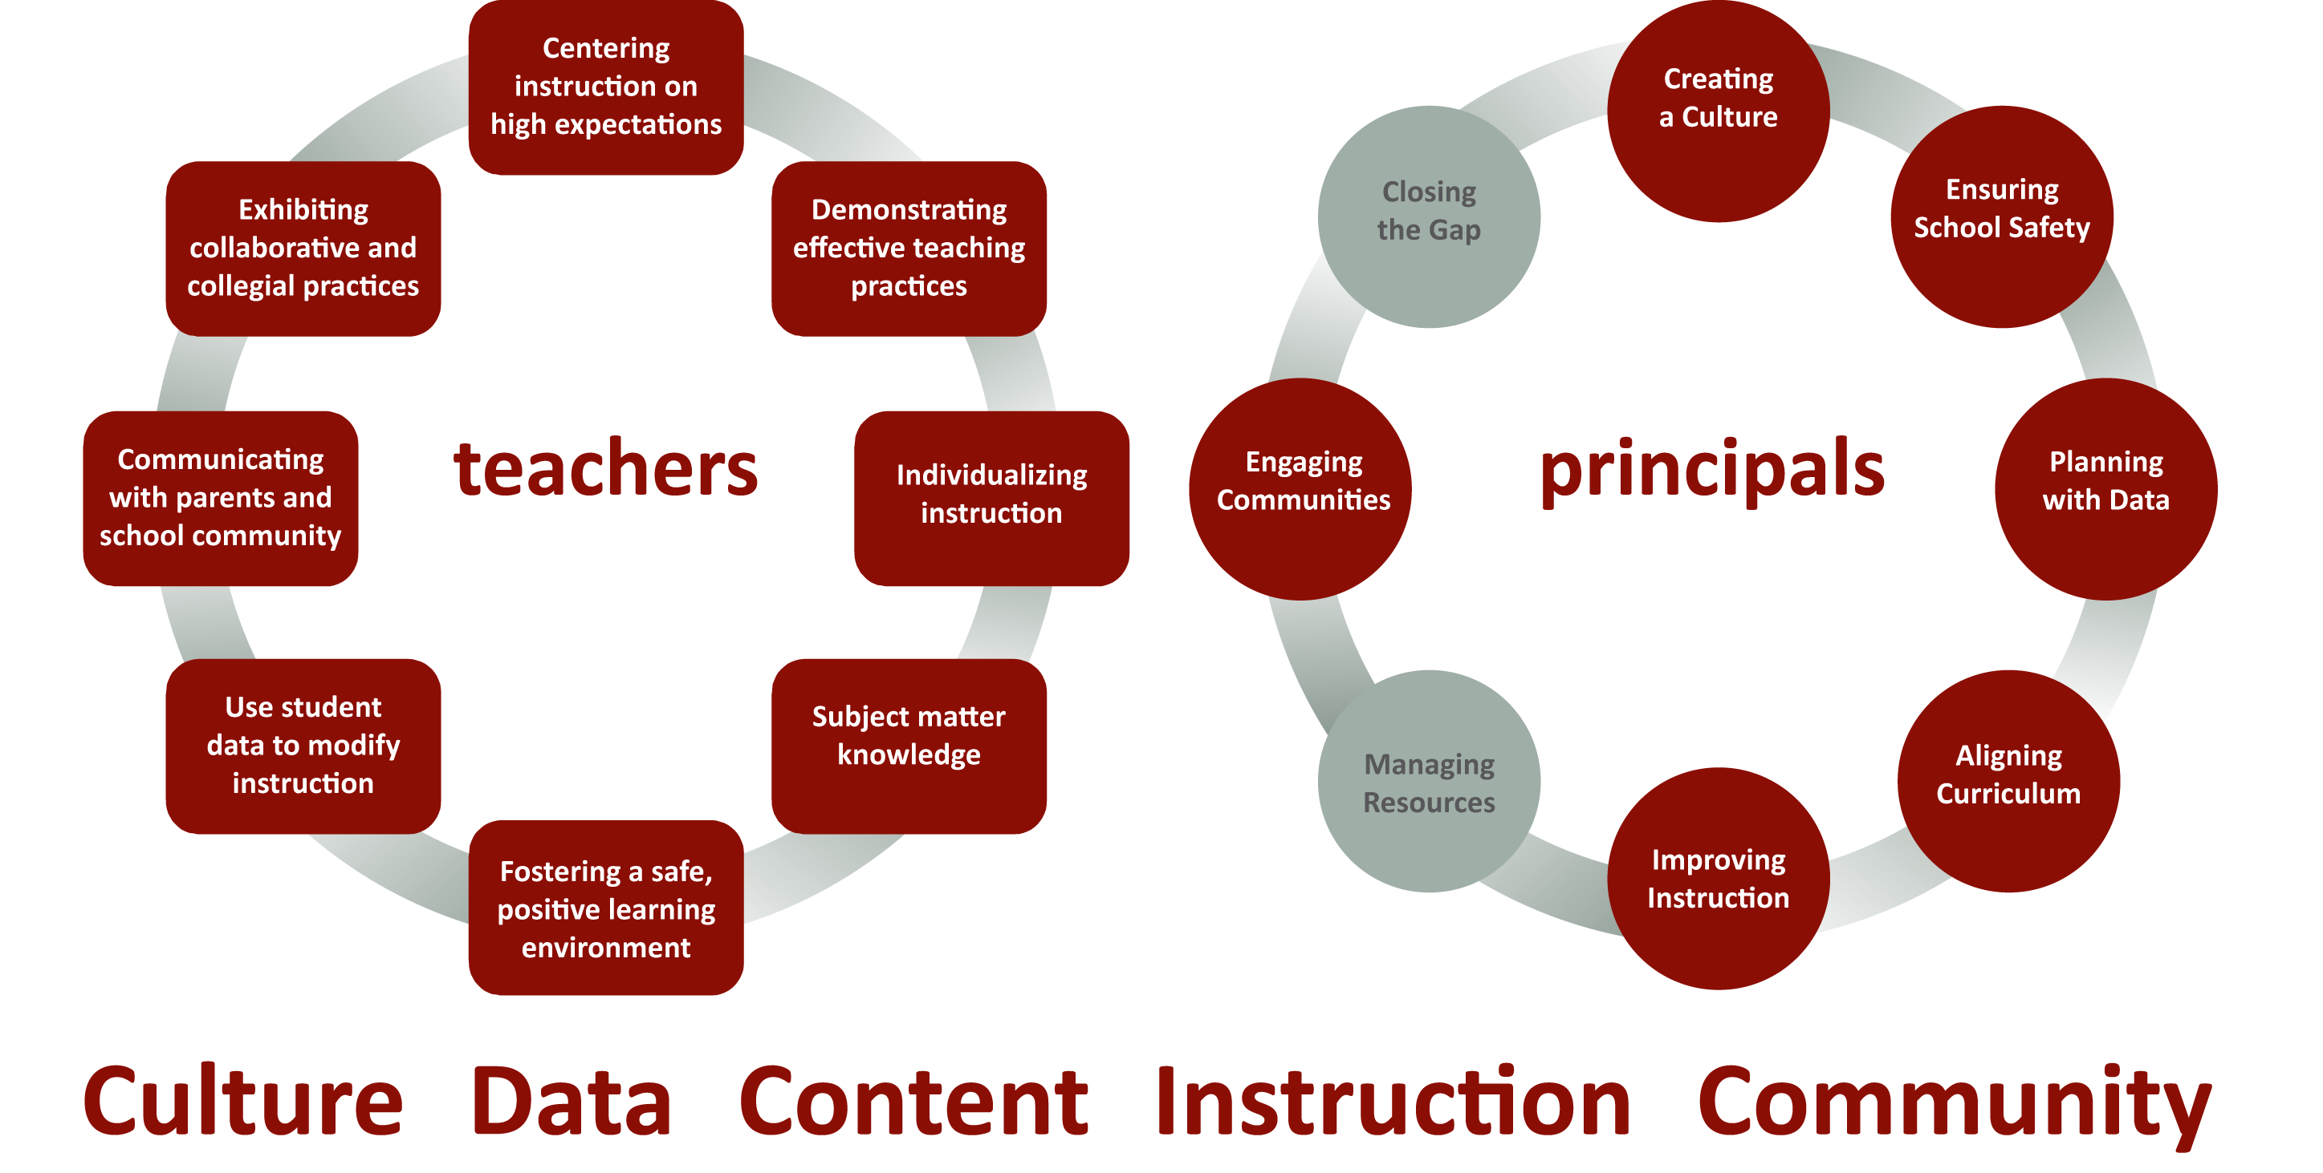
Alignment of Teacher and Principal Evaluations
Notes:
Self assessment F

Slide 8
Evaluation Process
Training
Orientation
8. Professional Development Plans
3. Self-Assessment
7. Summary Evaluation Conference
4. Pre-Observation Conference
6. Post-Observation Conference
5. Observations
Notes:
Self assessment F

Slide 9
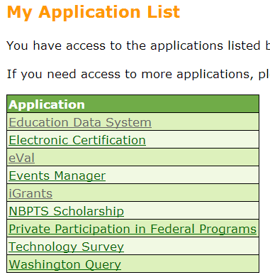
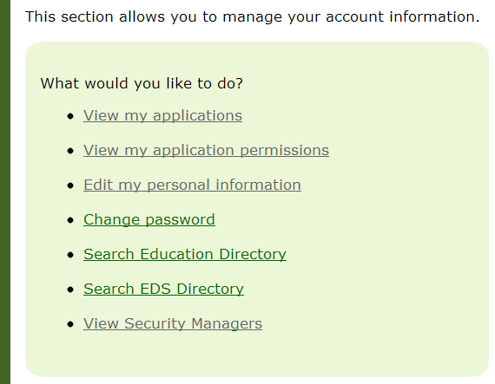
Logging into eVAL
Log into OSPI’s EDS: https://eds.ospi.k12.wa.us/
Notes:
Self assessment F

Slide 10
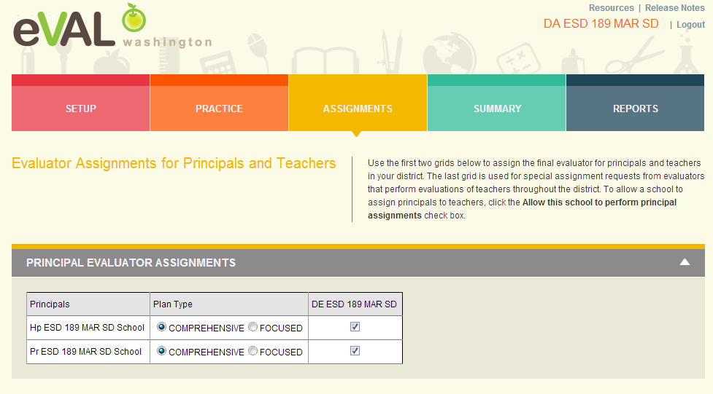
District Administrator Assigns Evaluators to Principals
The District Administrator has to assign evaluators to principals
before the process can begin.
Notes:
Self assessment F

Slide 11
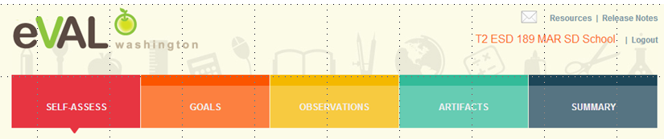
Role of Evaluatee
An evaluatee has three primary responsibilities in eVAL:
self-assessment and goal-setting;
interacting with the evaluator in the observation process; and
uploading artifacts

Slide 12
Logging into eVAL Sandbox
http://sandbox.eval-wa.org/
District Name<space>SD<space>School <space>number 1-5 <space>Role Abbreviation (PR AD T1-20)
Example District Evaluator (Mount Vernon District, District Evaluator):
Mount Vernon SD DE
Example Principal (Everett District, School 1, PR): Everett SD School 1 PR
Password is password
Notes:
Self assessment F

Slide 13
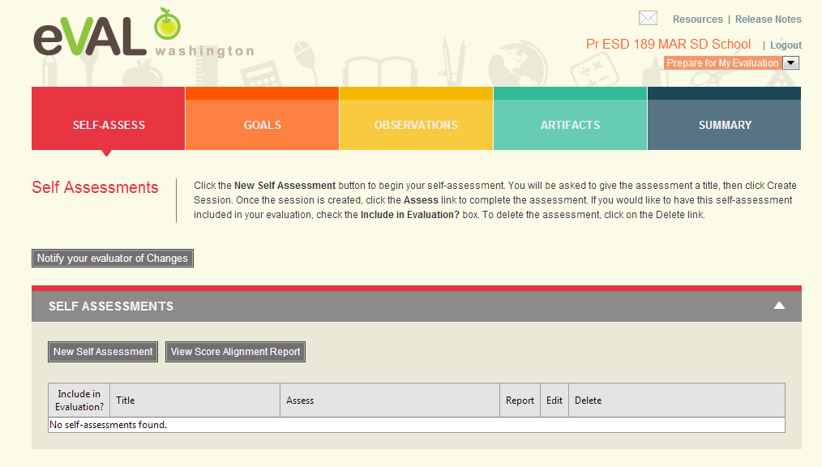
Principal Self Assessment

Slide 14
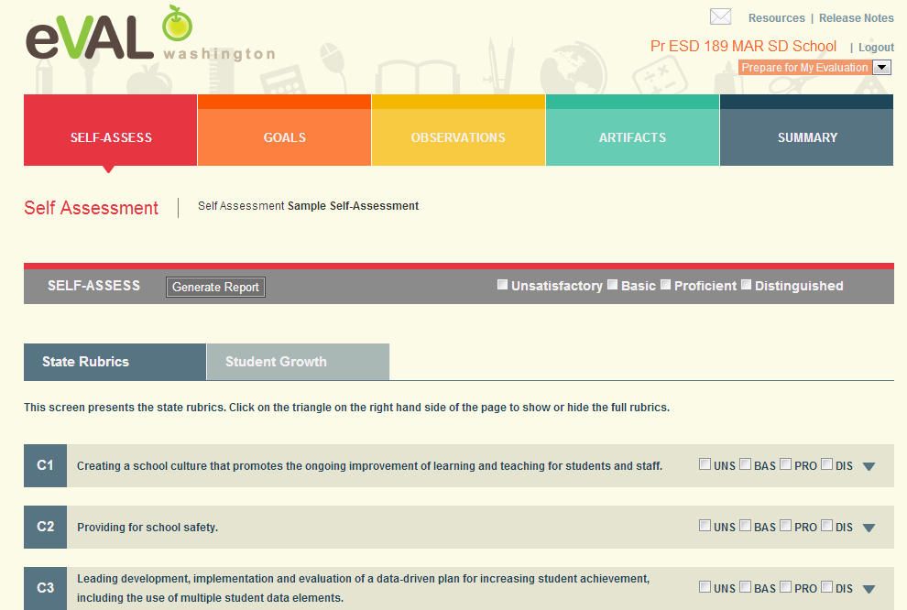
Principal Self Assessment
Either self assess at the top level or click on triangle to see sub-criteria.

Slide 15
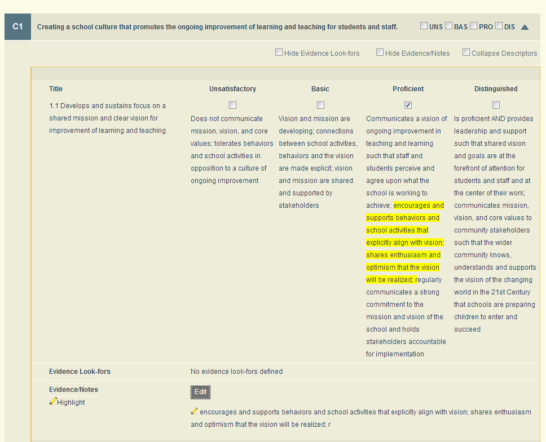
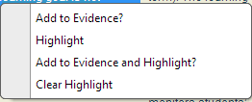
Principal Self Assessment – Sub Criteria
Uncheck box “hide evidence
notes and highlight text.
Highlight text and right click
and choose add to evidence
and highlight

Slide 16
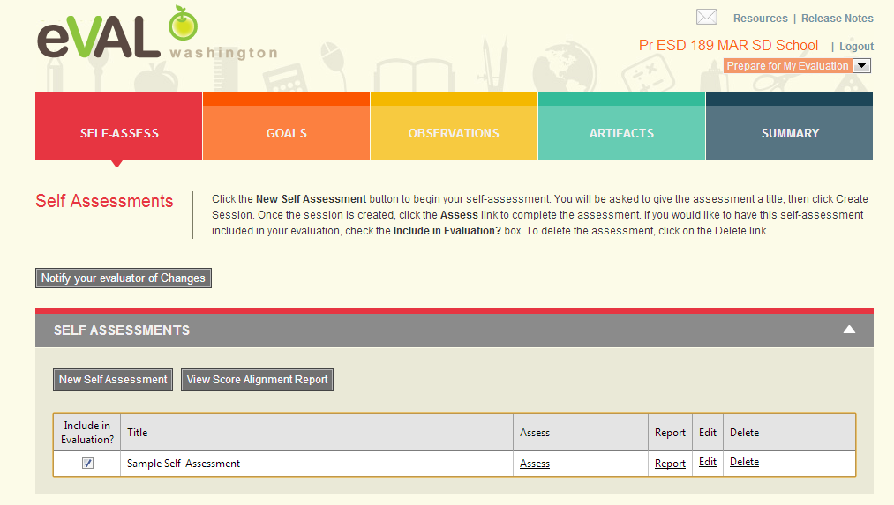
Principal Self Assessment
Principal can choose to include or not include self assessment in evaluation.

Slide 17
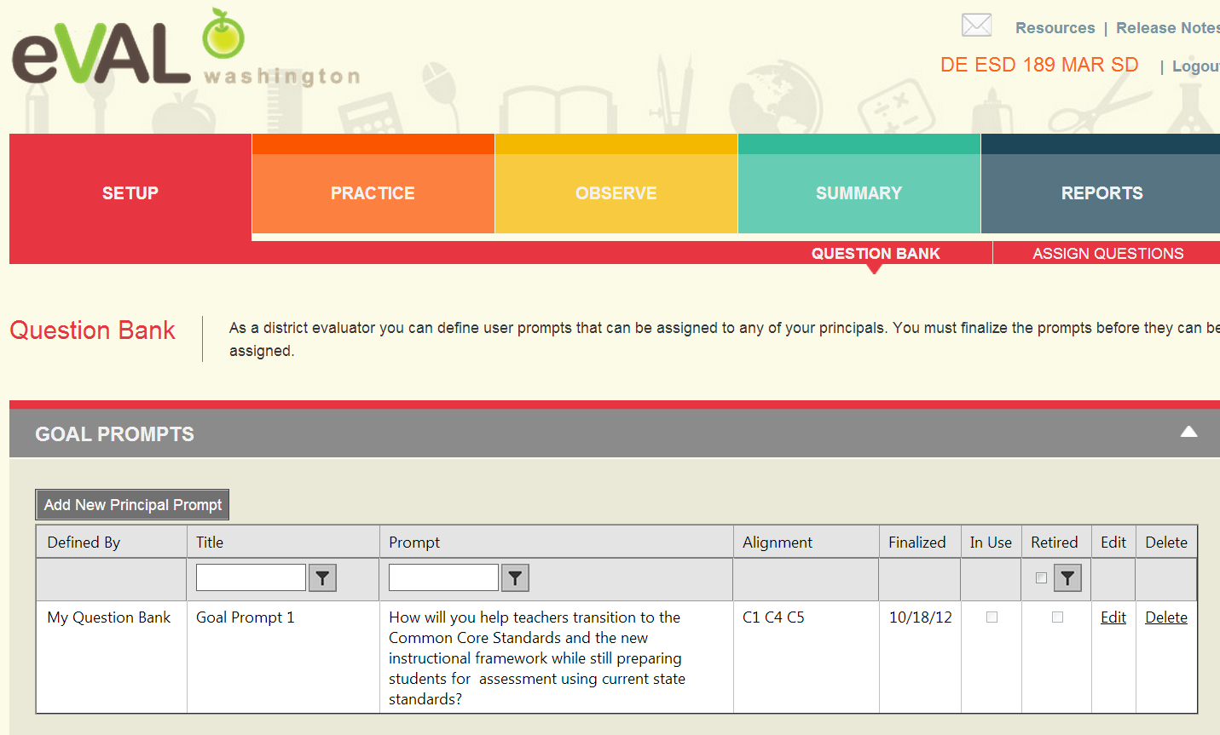
District Evaluator Creates Prompts in Question Bank

Slide 18
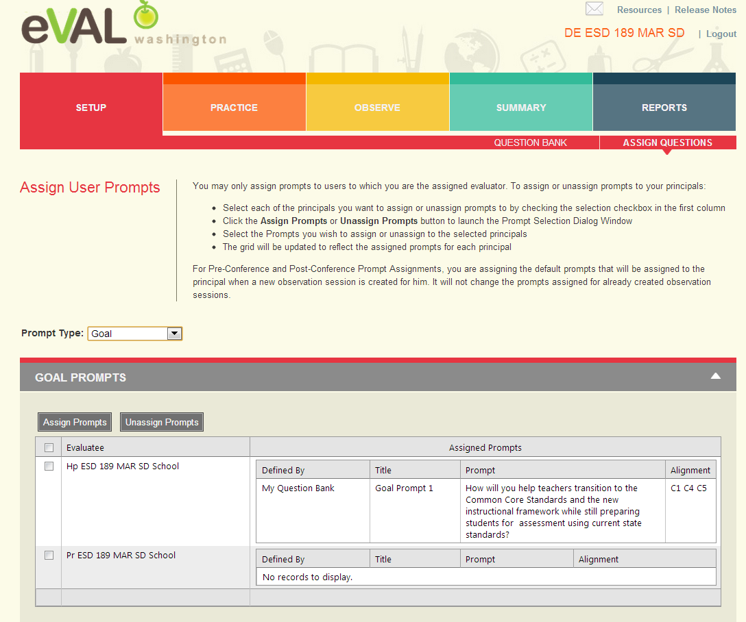
District Evaluator Assigns Goal Prompt to Principal
Choose type of
Prompt here
Click on box
next to principal’s
name and then
click on Assign
Prompt

Slide 19
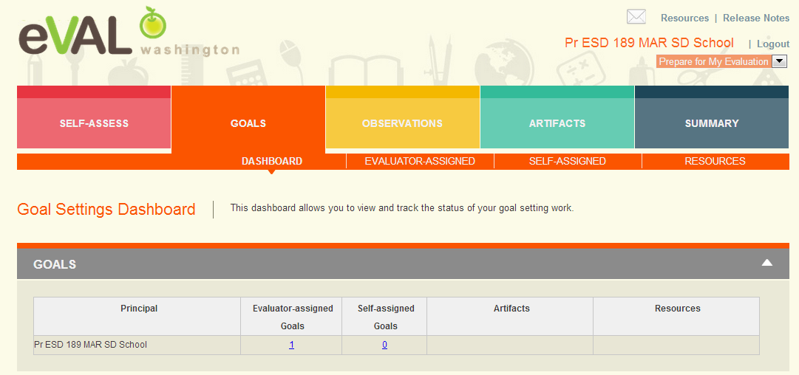
Principal Goals Dashboard
Clicking on Evaluator-assigned Goals will open up next screen.

Slide 20
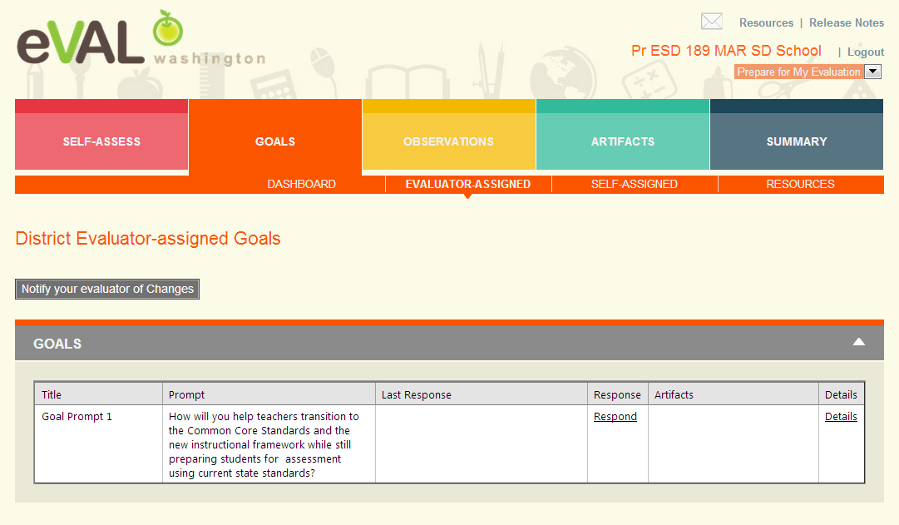
Principal Reviews Evaluator-Assigned Goal Prompt
Clicking on Respond will open next screen.

Slide 21
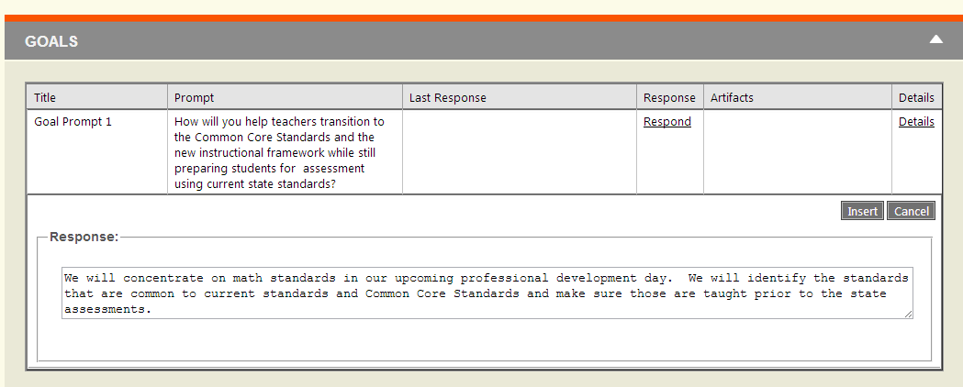
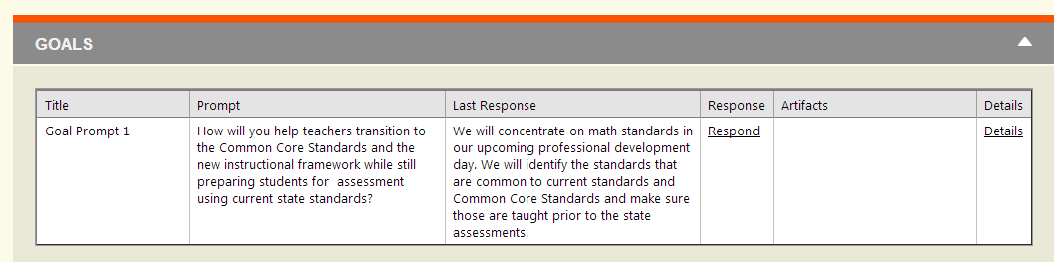
Principal Responds to Evaluator Goal Prompt
Insert

Slide 22
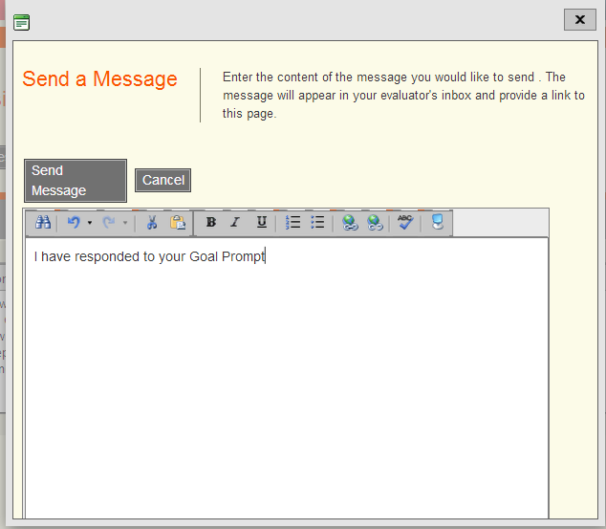
Principal Notifies Evaluator

Slide 23
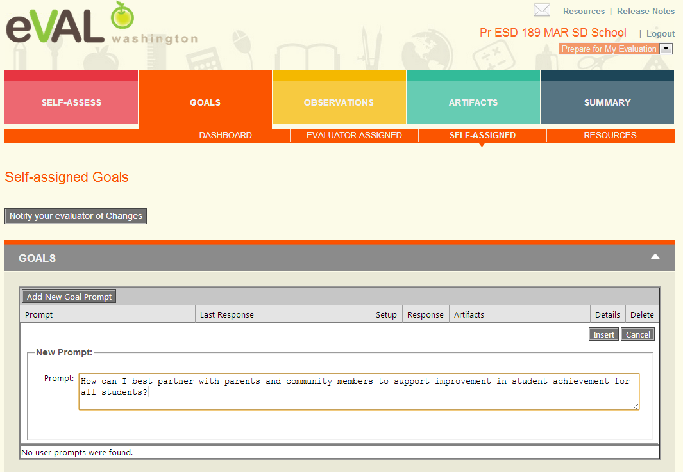
Principal Self-Assigned Goal

Slide 24
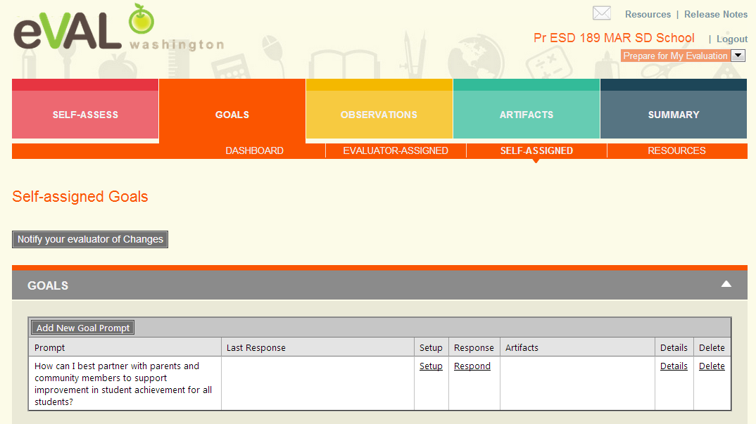
Principal Self-Assigned Goal
Clicking on Setup allows the principal to edit prompt and align to the State and
Instructional Framework Criteria.

Slide 25
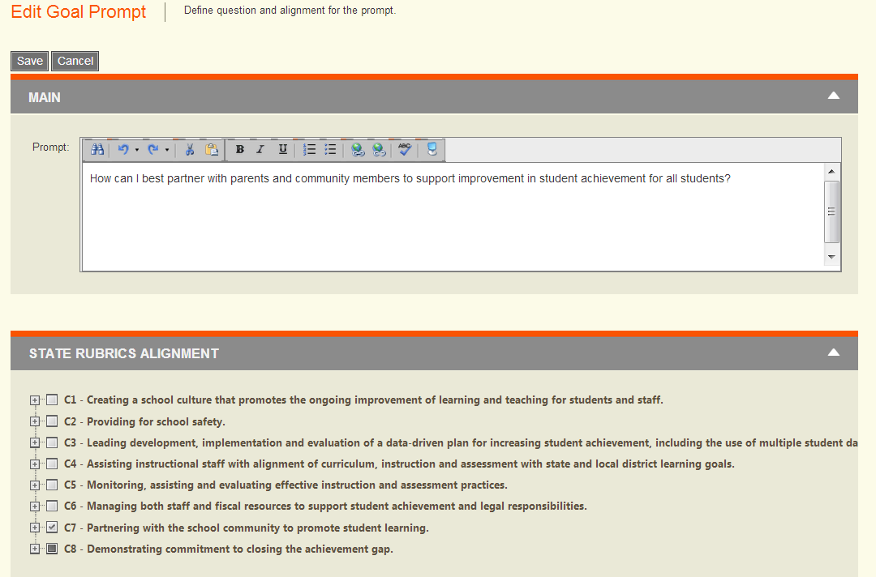
Principal Self-Assigned Goal

Slide 26
Principal Self-Assigned Goal
Clicking on Details allows the principal to add responses, manage the alignment
to the framework or add artifacts.

Slide 27
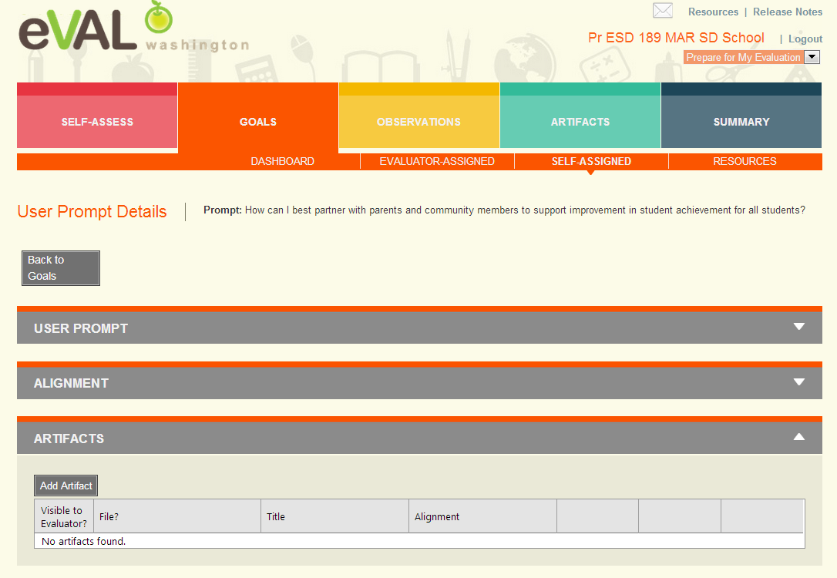
Principal Adds Artifact

Slide 28
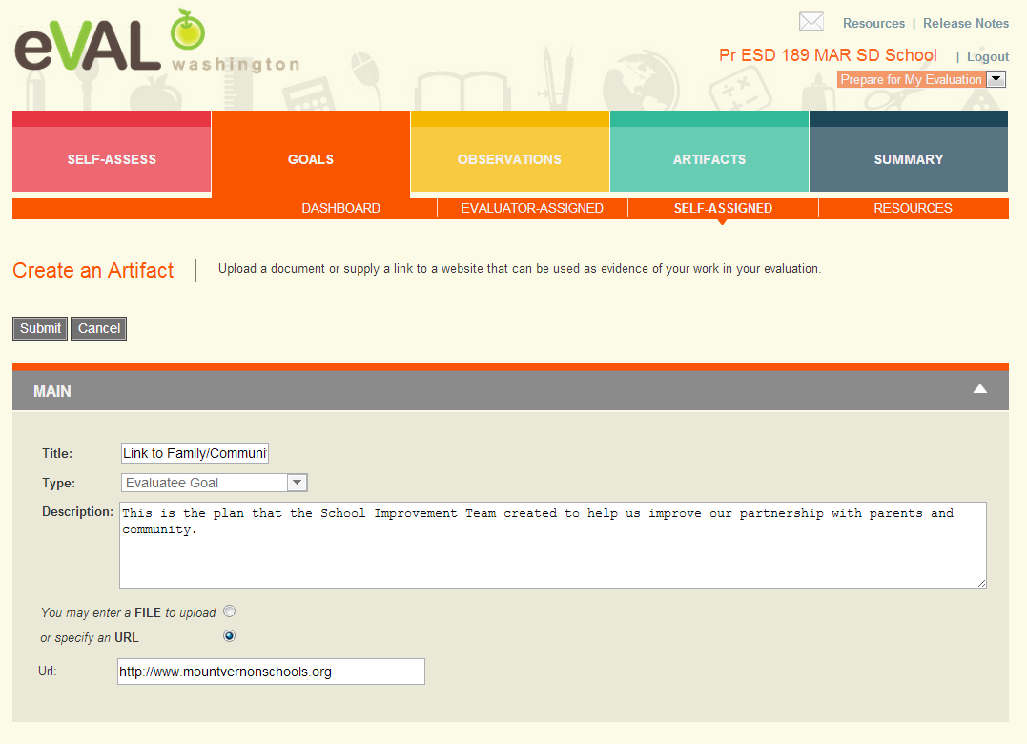
Principal Adds Artifact
Be
sure
to
submit
Artifacts
can
also
be
added
here

Slide 29
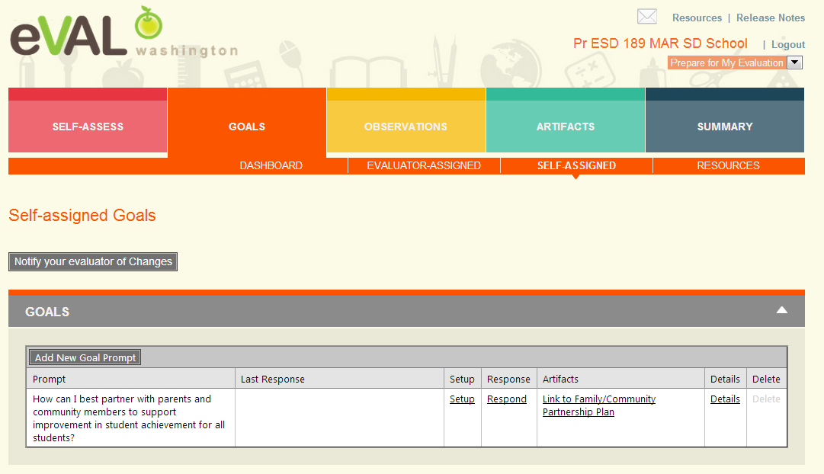
Principal Artifact Added

Slide 30
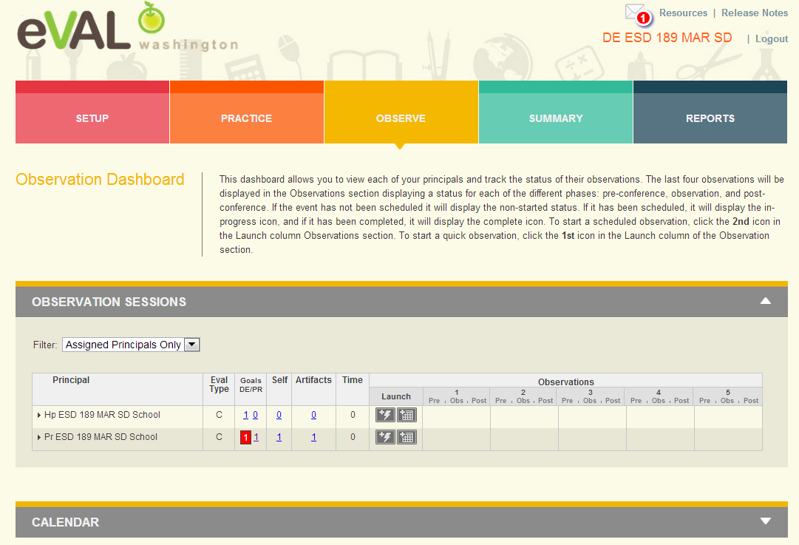
District Evaluator Dashboard
Notice
message
in
mail box
Self evaluation shows because principal made part of evaluation.
Notes:
.

Slide 31
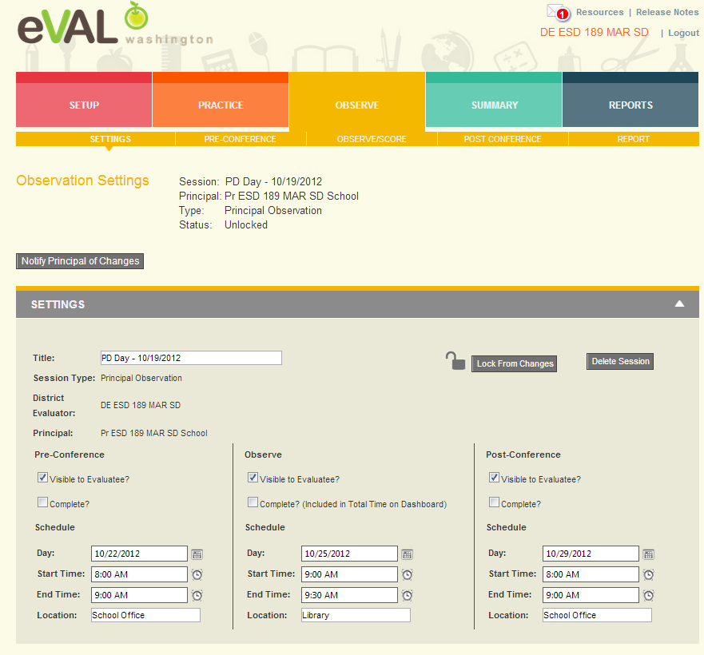
District Evaluator Schedules Formal Observation

Slide 32
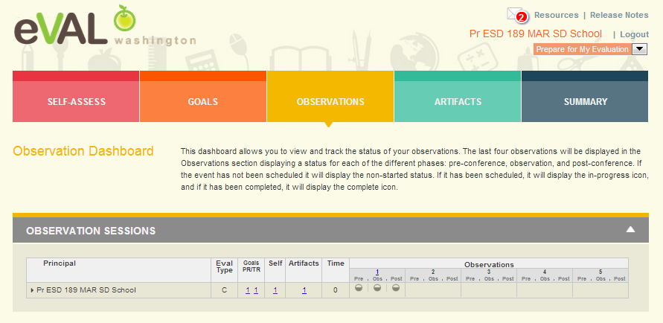
Principal Observation Dashboard Part 1
Pre- and Post- Conferences along with Observation are scheduled.
Clicking on any one of the circles will bring up that section.

Slide 33
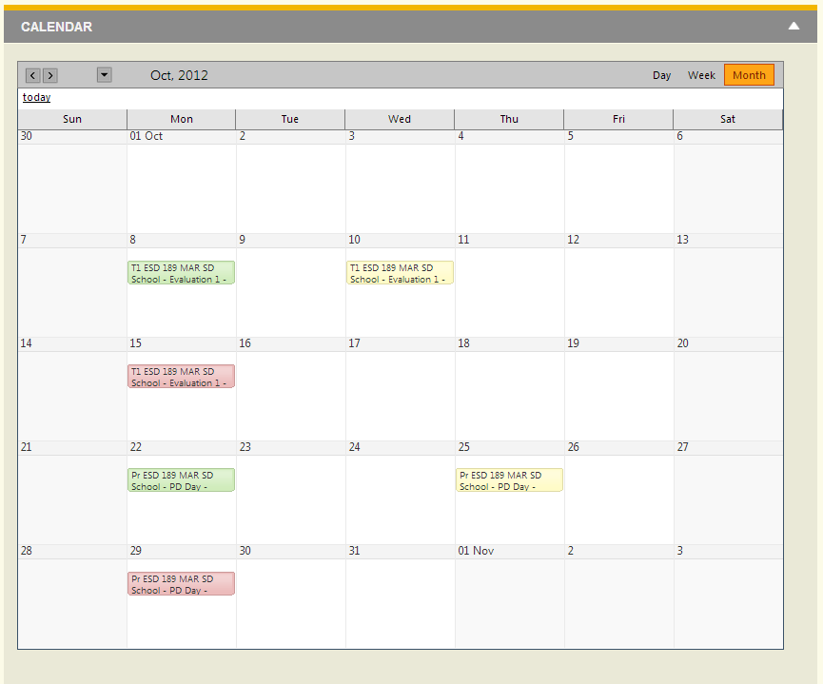
Principal Observation Dashboard Part 2
Calendar includes teacher observations as well as principal’s own observation.

Slide 34
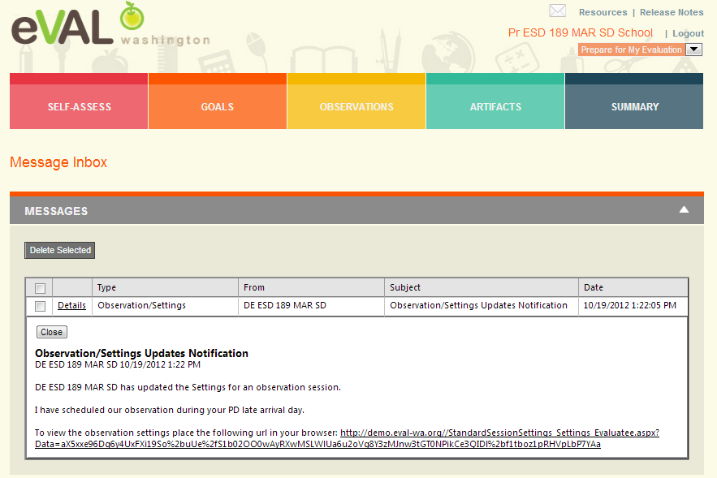
Principal Mailbox

Slide 35
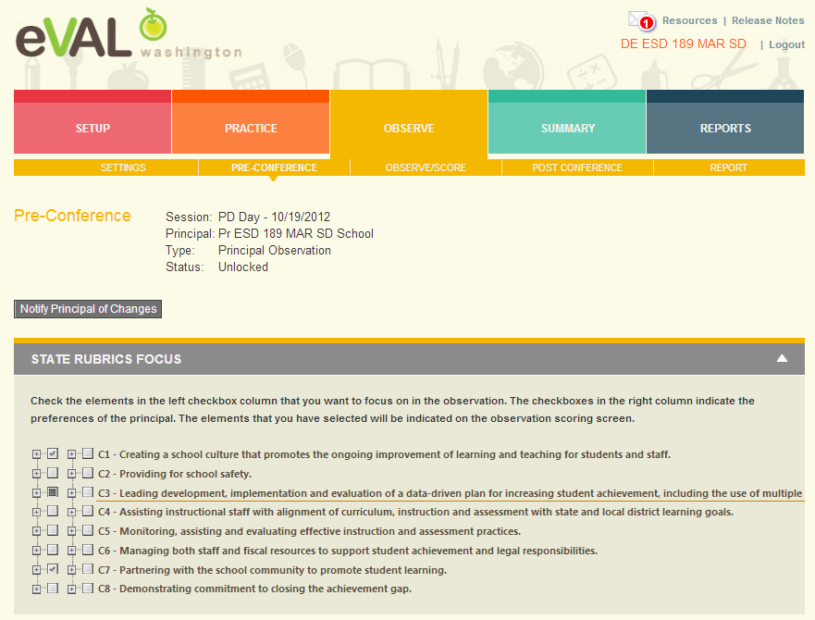
District Evaluator Preconference Part 1
Select
focus
here

Slide 36
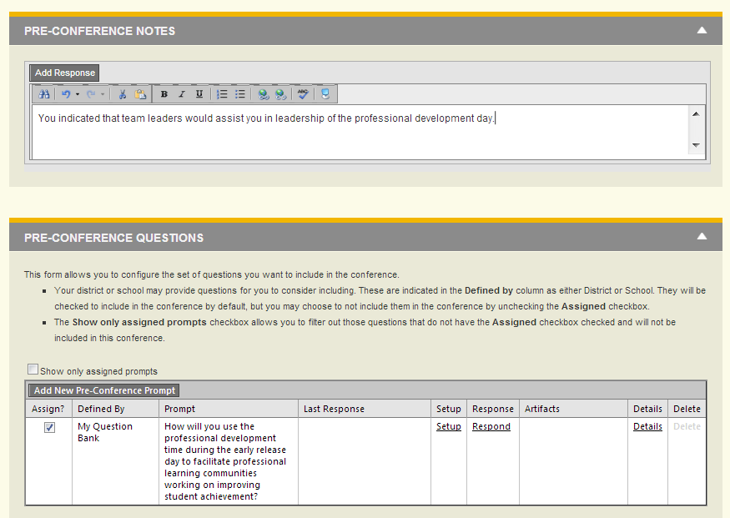
District Evaluator Preconference Part 2

Slide 37
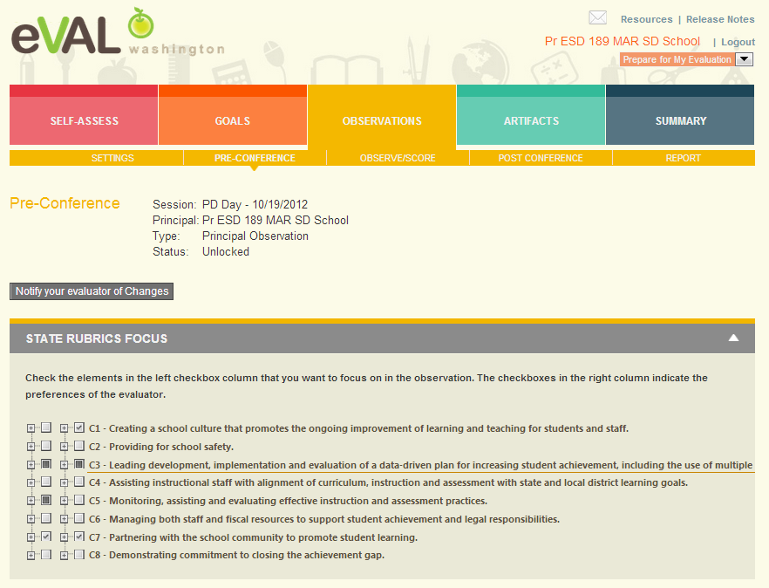
Principal Preconference Part 1

Slide 38
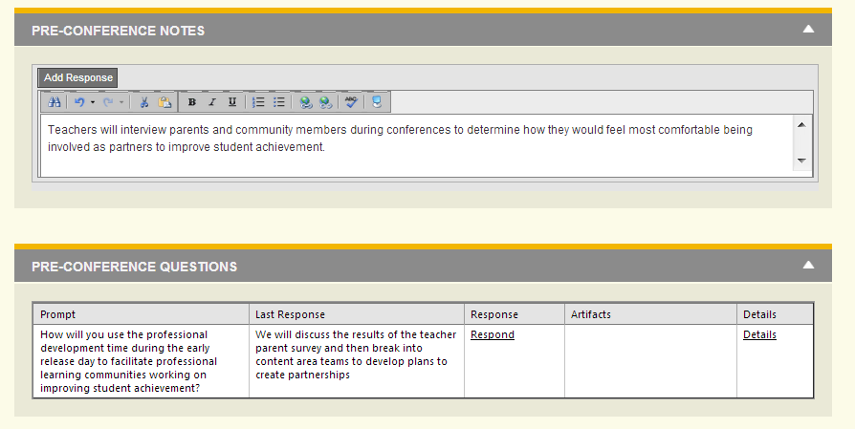
Principal Preconference Part 2

Slide 39
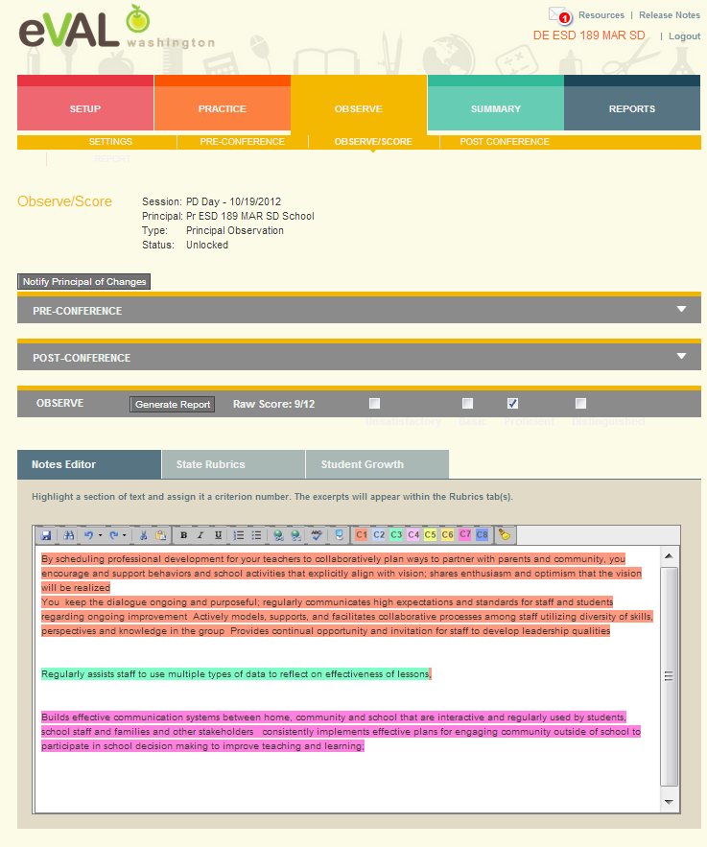
District Evaluator Observe/Score

Slide 40
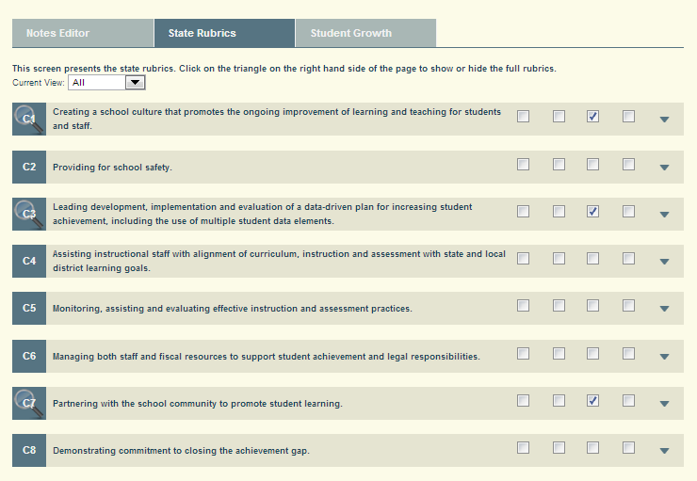
District Evaluator State Rubrics
Magnifying
glasses
point
to
areas
of
focus

Slide 41
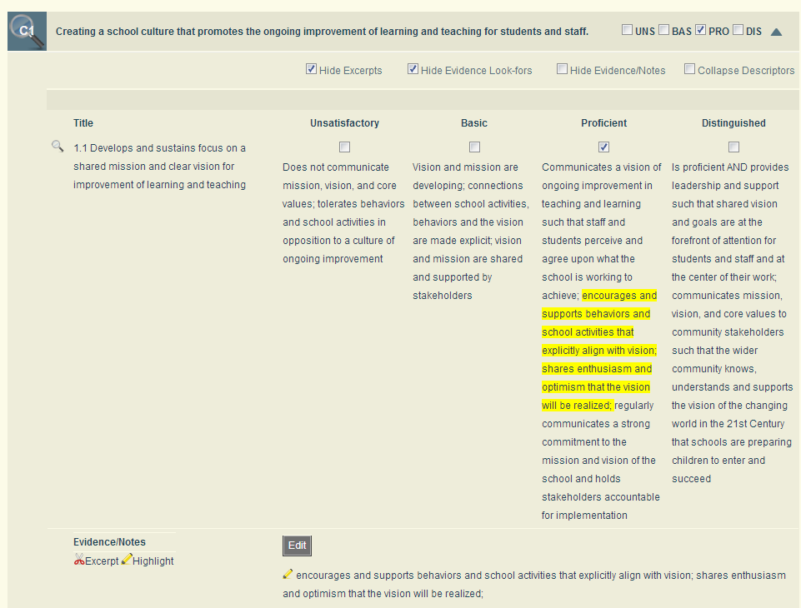
District Evaluator C1.1 – Expanded View
Evidence notes show
up below when you
uncheck Hide
Evidence/Notes
To highlight and
excerpt – highlight
and right click on
highlighted section

Slide 42
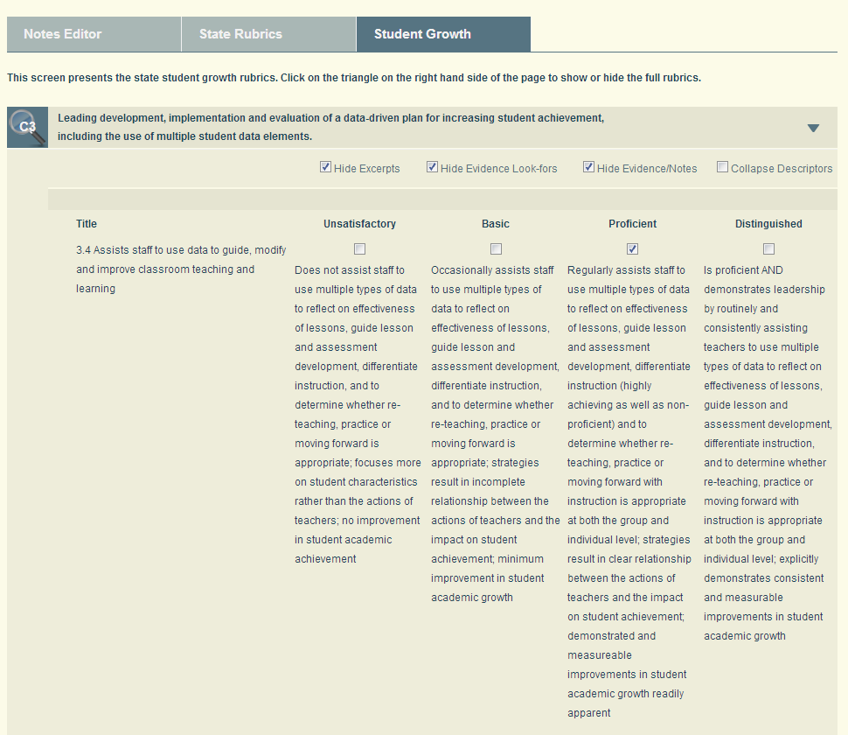
District Evaluator Student Growth Rubrics

Slide 43
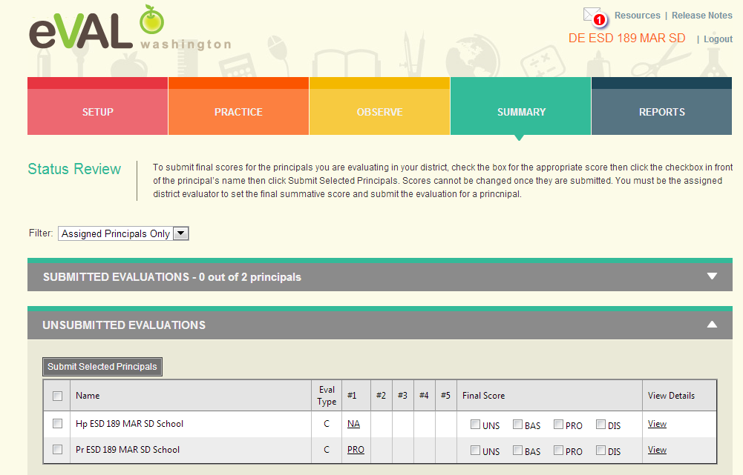
District Evaluator – Summary View – After All Observation Data Complete – End of Year Submission

Slide 44
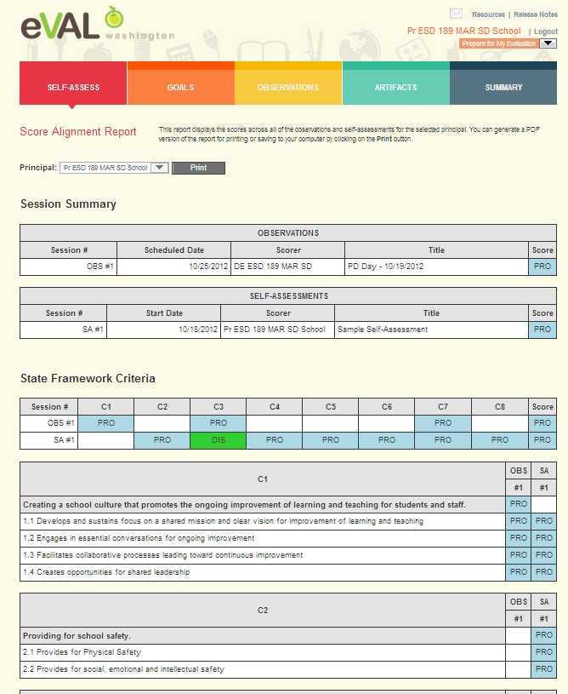
Principal – Score Alignment Report

Slide 45
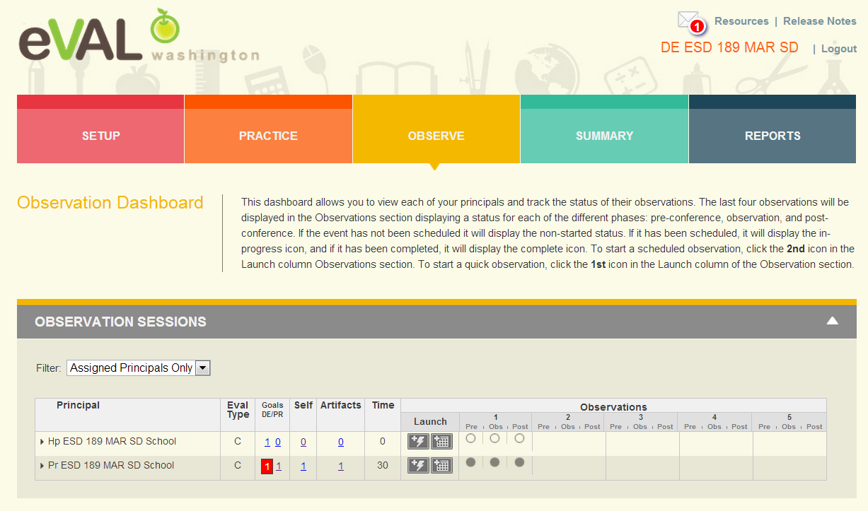
District Evaluator Observation 1 Complete

Slide 46
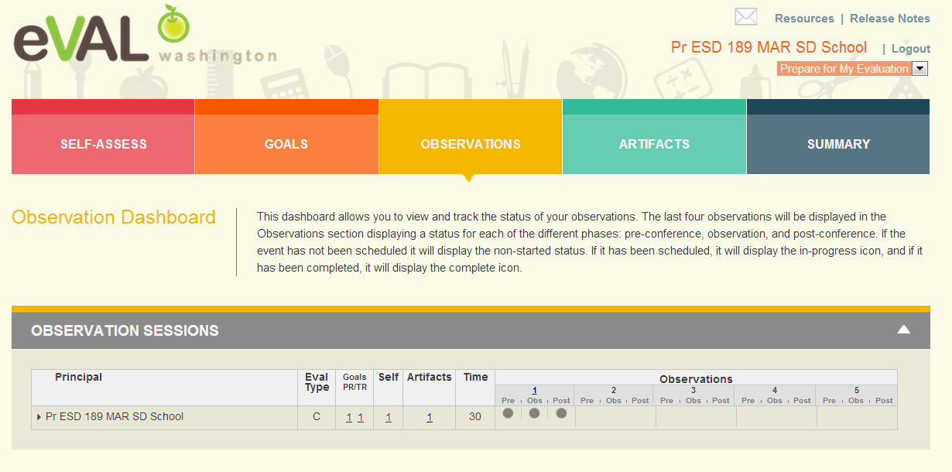
Principal Dashboard – Observation 1 Complete

Slide 47
Next Steps
What do you need to do next?
Who needs to be involved?
When does it need to happen?
How can I help?

Slide 48
Goals
Review evaluation steps that are part of the principal evaluation process
Understand supports offered to evaluator and evaluatee by eVAL
Understand specific tasks evaluator and evaluatee might want to do in eVAL
Understand interaction between evaluator and evaluatee roles in eVAL
Self Assessment
Your familiarity with the eVAL tool 1----5

Slide 49
Thank You!
Cathey Frederick
ESD 189 eVAL Specialist
cathey.frederick@seaotters.us
425.358.0545

