Slide 1

eVAL and The Evaluation Cycle
A Look at the Interaction of Evaluator/Teacher Roles
Cathey Frederick
eVAL Specialist - ESD 189
cathey.frederick@seaotters.us
425.358.0545

Slide 2

Goals
Review evaluation steps for teacher evaluations
Understand supports offered to evaluator and evaluatee by eVAL
Understand specific tasks evaluator and evaluatee might want to do in eVAL
Understand interaction between evaluator and evaluatee roles in eVAL

Slide 3
Norms
Start and end on time
Participate
Listen
Assume good intentions
There is no “stupid question”
Learn together

Slide 4
Agenda
Welcome, review norms
Pre-training data collection
Review evaluation process
Overview of eVAL supports
Overview of tasks in eVAL
Work through the evaluation process through the lens of evaluator and evaluatee

Slide 5
eVAL – Data Collection
I would describe my familiarity with the eVAL tool as: 1----5 with 1 being beginner and 5 being expert
I have participated in an eVAL practice session 1=yes 2=no
I have, or am, a new teacher that has to be evaluated within 90 days 1=yes 2=no
Notes:
Self assessment F

Slide 6
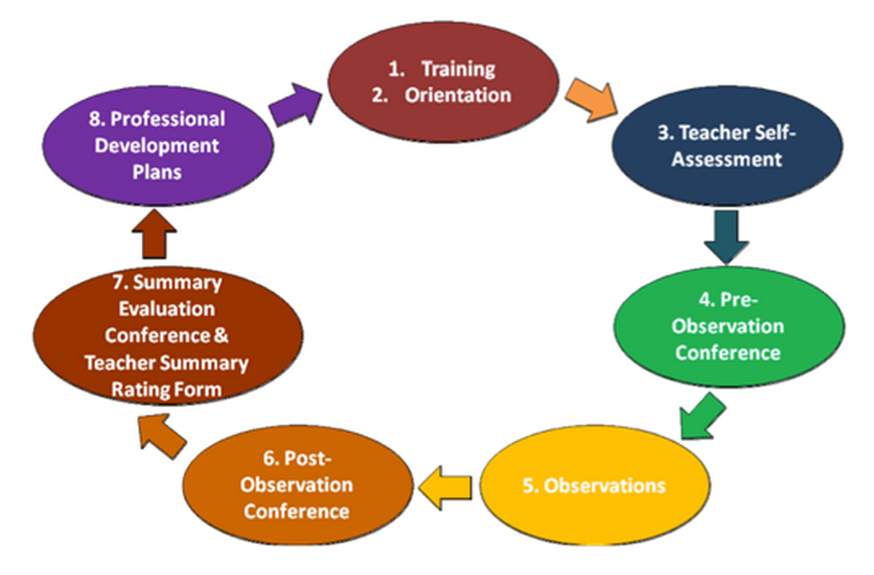
Evaluation Process
Notes:
Self assessment F

Slide 7
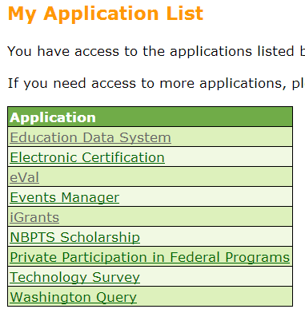
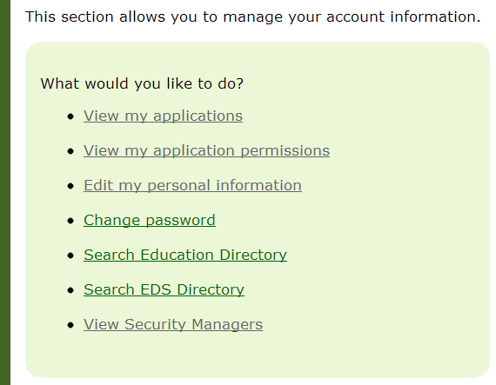
Logging into eVAL
Log into OSPI’s EDS: https://eds.ospi.k12.wa.us/
Notes:
Self assessment F

Slide 8
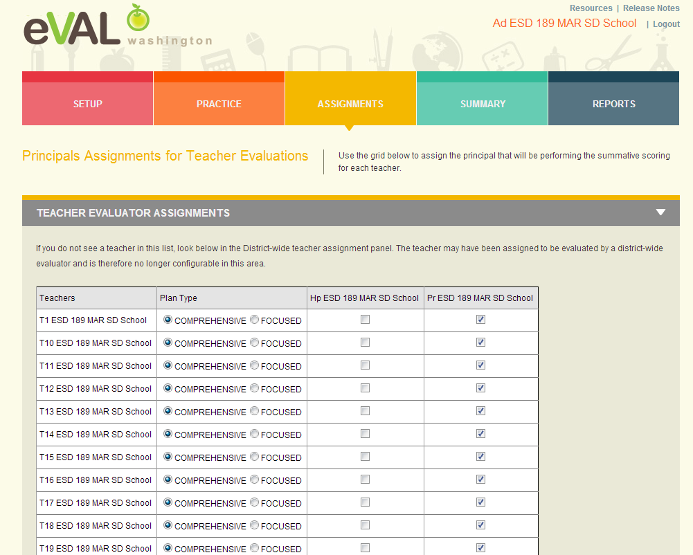
Principal/School Administrator
Assigning Teachers
Either the District or School Administrator has to assign teachers to a principal
before the evaluation process can start.
Notes:
Self assessment F

Slide 9
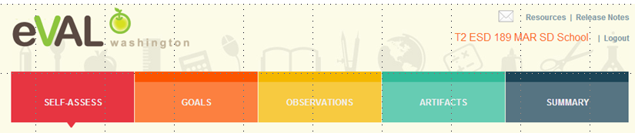
Role of Evaluatee
An evaluatee has three primary responsibilities in eVAL:
  self-assessment and goal-setting;
  interacting with the evaluator in the observation process; and
  uploading artifacts

Slide 10
Logging into eVAL Sandbox
http://sandbox.eval-wa.org/
District Name<space>SD<space>School <space>number 1-5 <space>Role Abbreviation (PR AD T1-20)
Example (Everett District, School 1, PR): Everett SD School 1 PR
Example (Mount Vernon District, School 1, T1):
Mount Vernon SD School 1 T1
Password is password
Notes:
Self assessment F

Slide 11
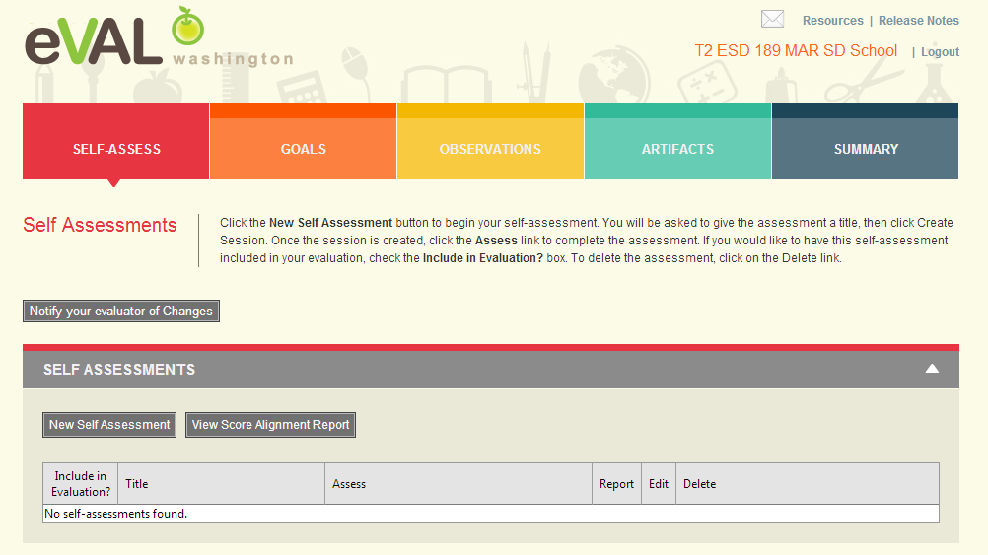
Teacher Self Assessment

Slide 12
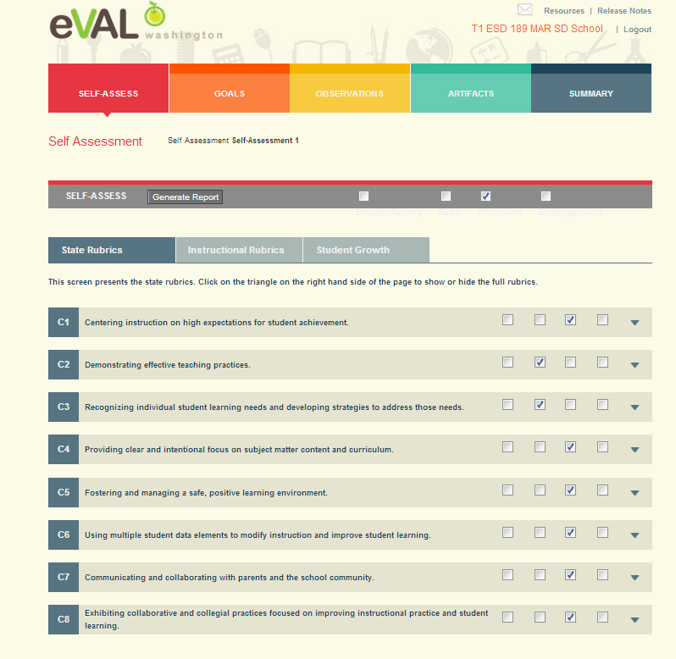
Teacher Self Assessment
Either self assess at the top level or click on triangle to see sub-criteria.

Slide 13
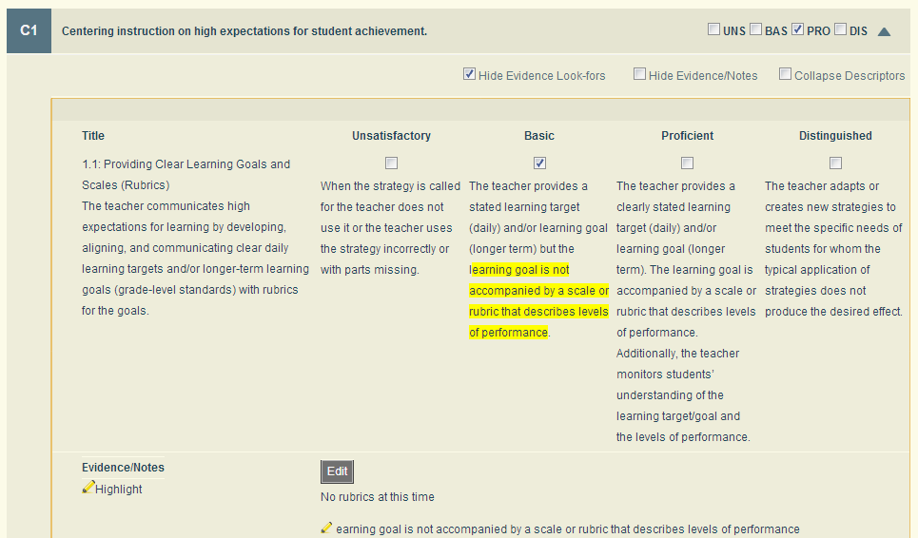
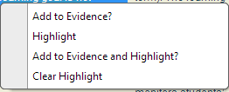
Teacher Self Assessment
Sub-Criteria
Uncheck box “hide evidence
notes and highlight text.
Highlight text and right click;
choose add to evidence
and highlight

Slide 14
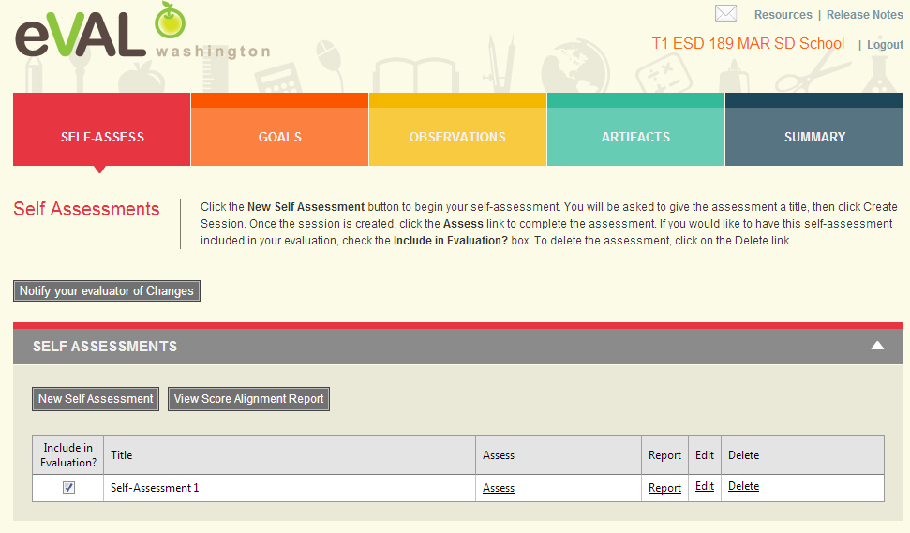
Teacher Self Assessment
Teacher can choose to include or not include self assessment in evaluation.

Slide 15
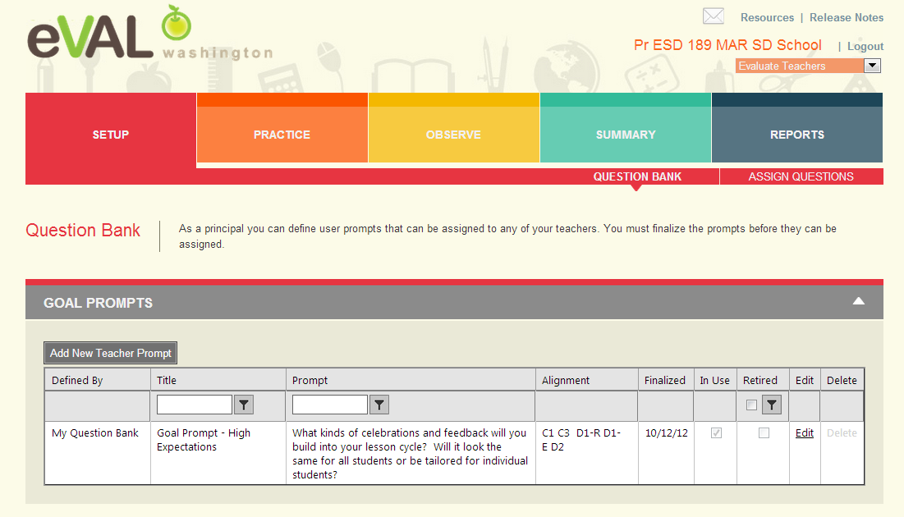
Principal Creates Goal Prompt in
Question Bank

Slide 16
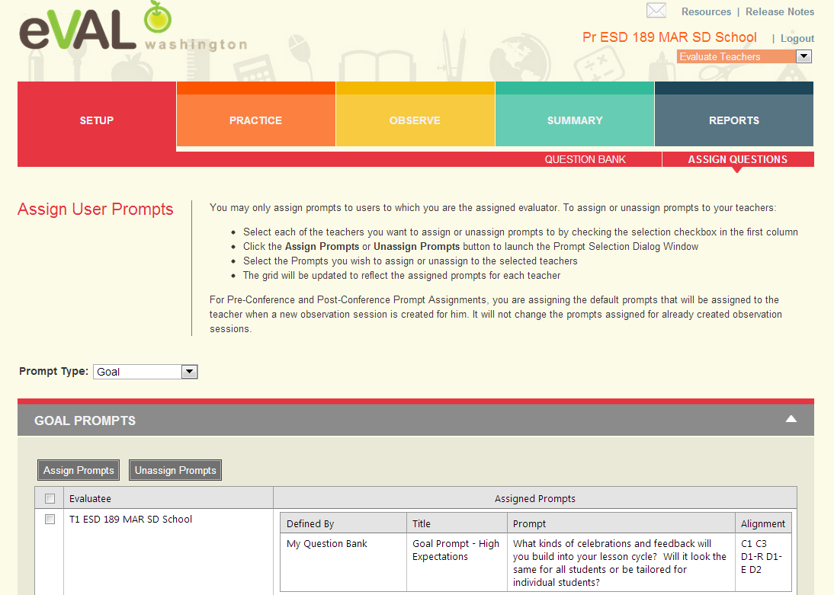
Principal Assigns Goal Prompt to Teacher
Choose type of
prompt here
Click on box
next to teacher’s
name and then
click on Assign
Prompt

Slide 17
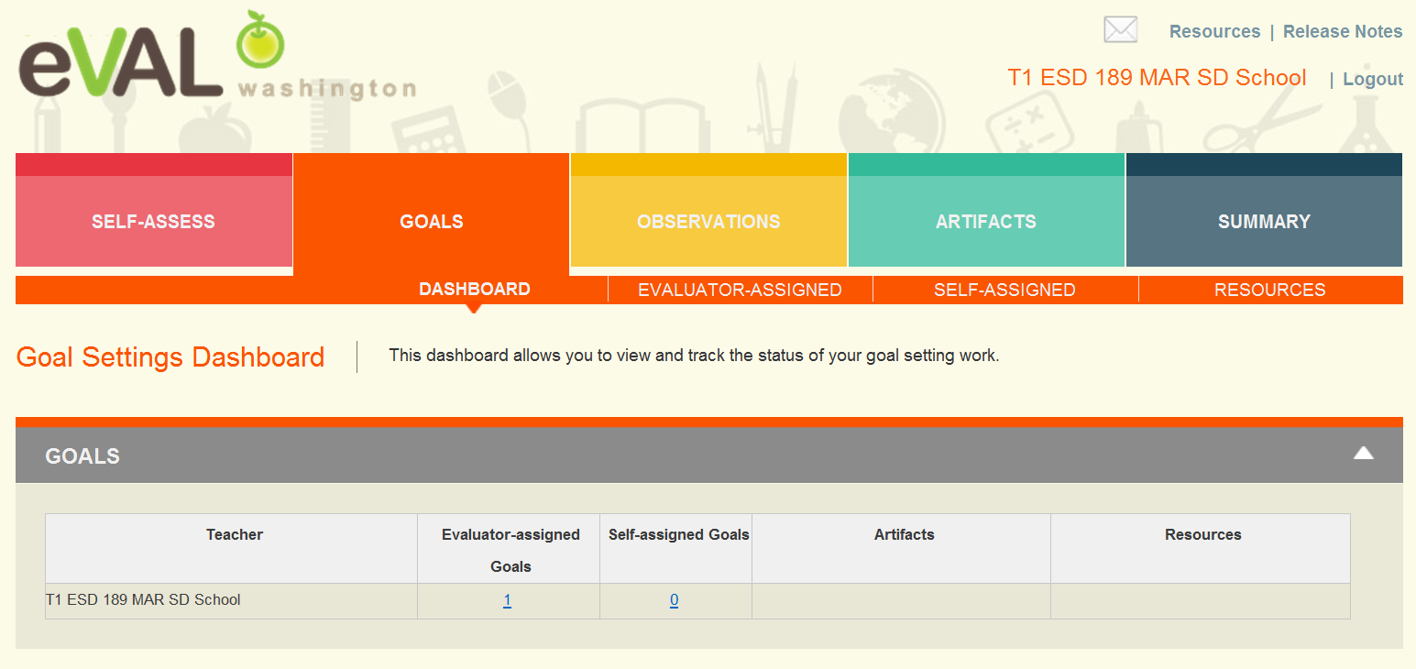
Teacher Goals Dashboard
Clicking on Evaluator-assigned Goals will open up next screen.

Slide 18
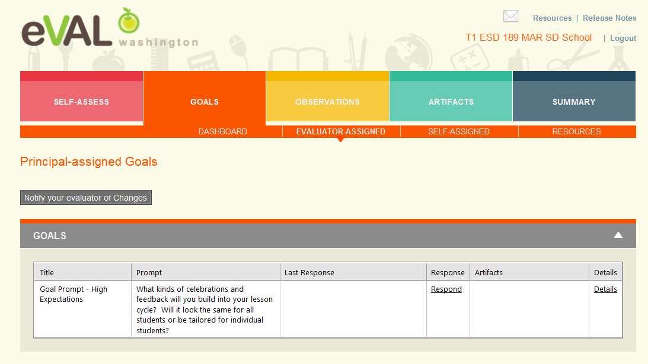
Teacher Reviews Principal-Assigned Goal Prompt
Clicking on Respond will open next screen.

Slide 19
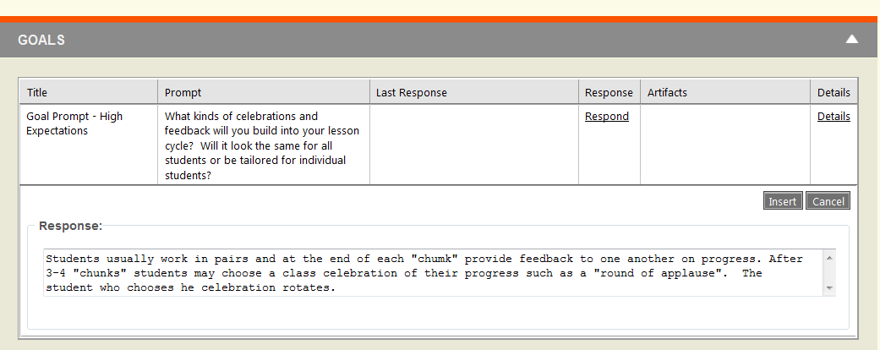
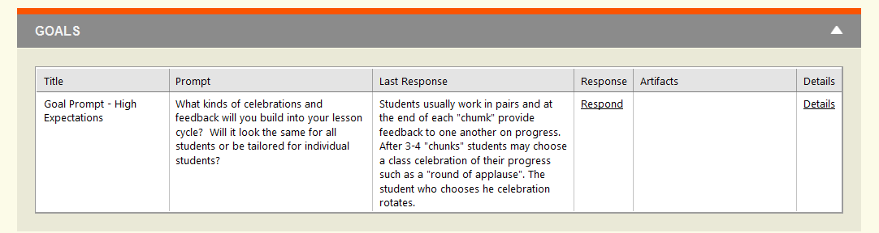
Teacher Responds to
Principal Goal Prompt
Insert

Slide 20
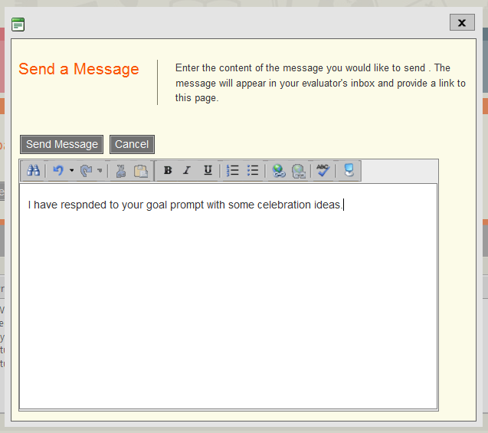
Teacher Notifies Evaluator

Slide 21
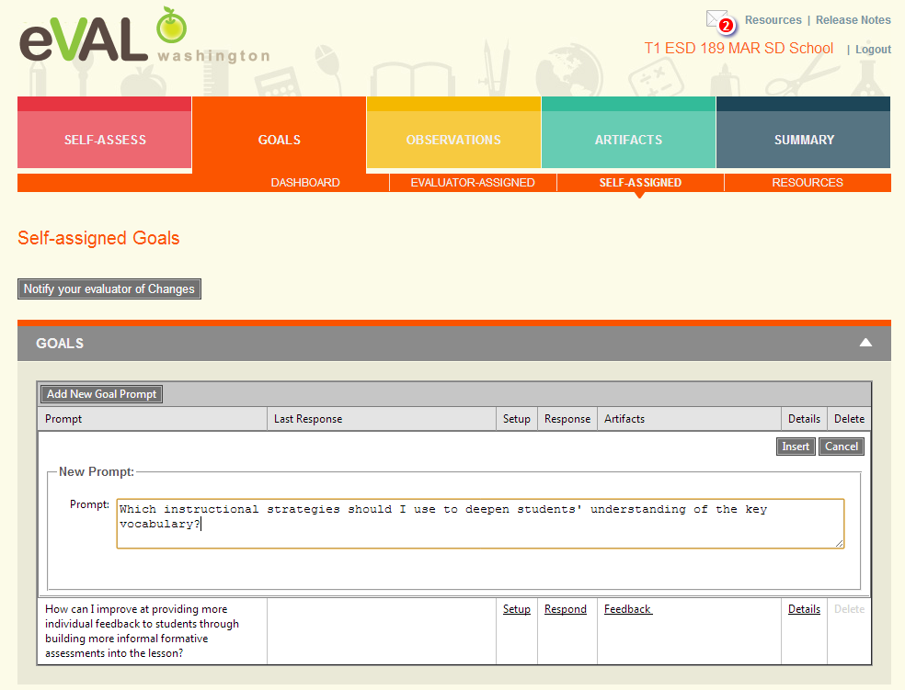
Teacher Self-Assigned Goal

Slide 22
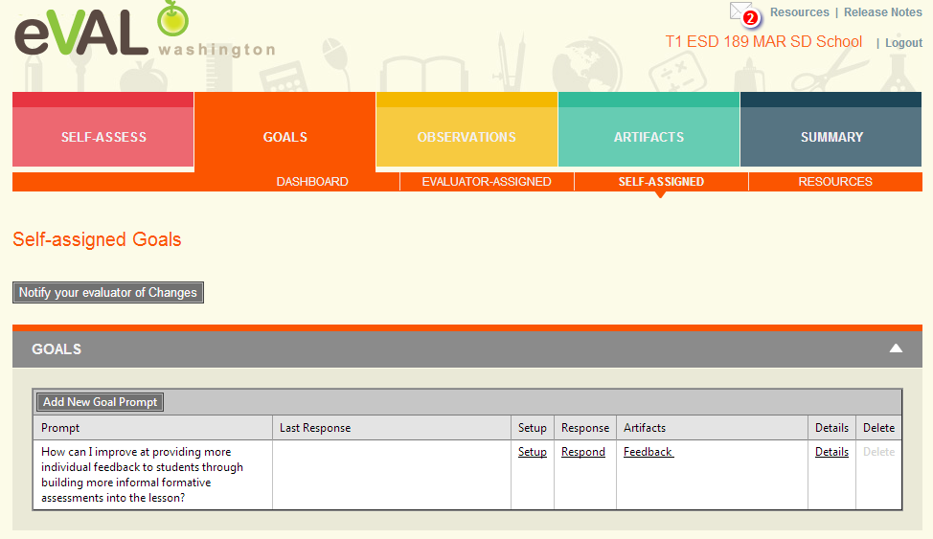
Teacher Self-Assigned Goal
Clicking on Setup allows the teacher to edit prompt and align to the State and
Instructional Framework Criteria.

Slide 23
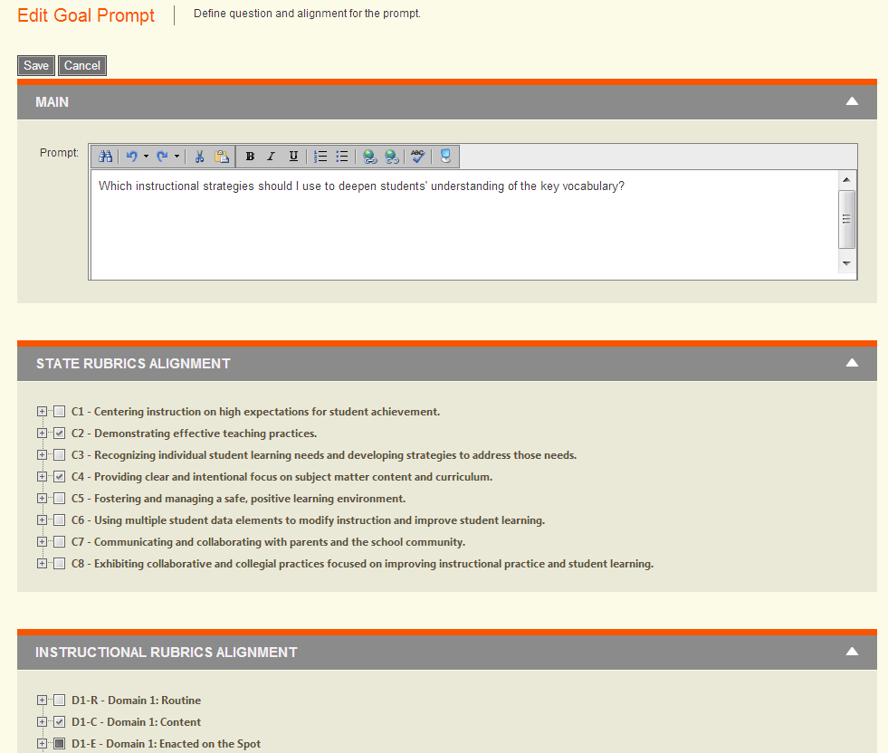
Teacher Self-Assigned Goal

Slide 24
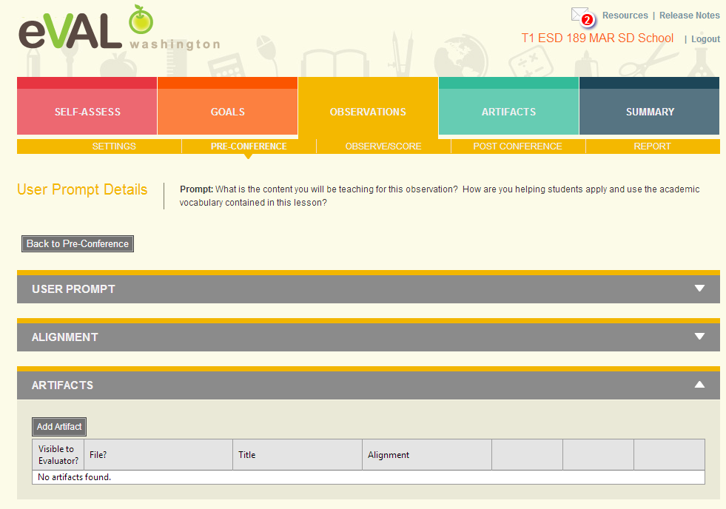
Teacher Adds Artifact

Slide 25
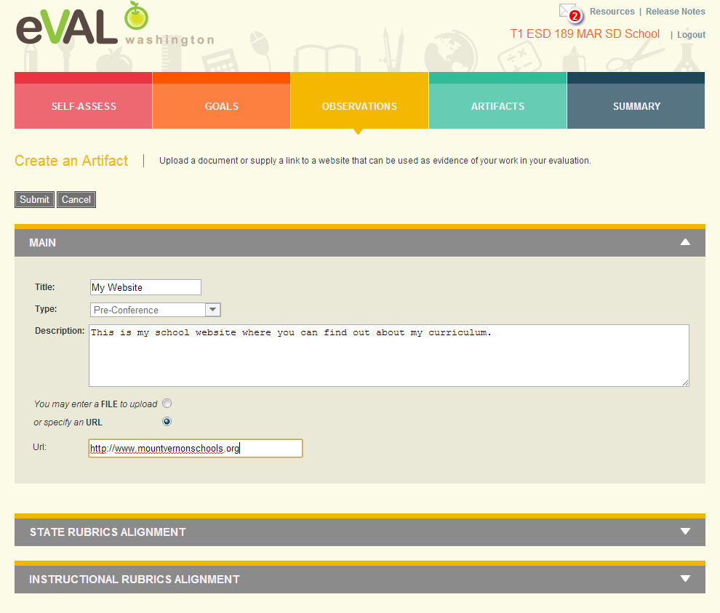
Teacher Adds Artifact
Be
Sure
To
Submit
Artifacts
Can
Also
Be
Added
Here

Slide 26
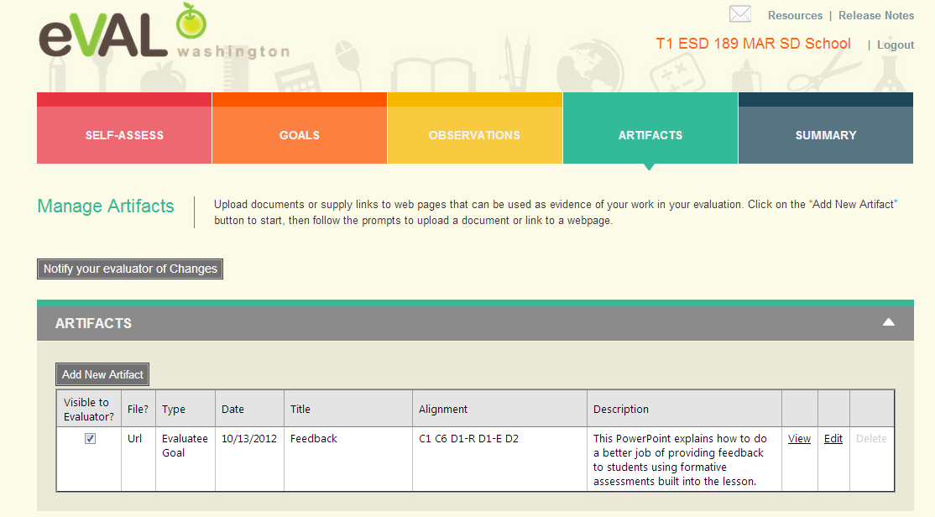
Teacher Artifact Added

Slide 27
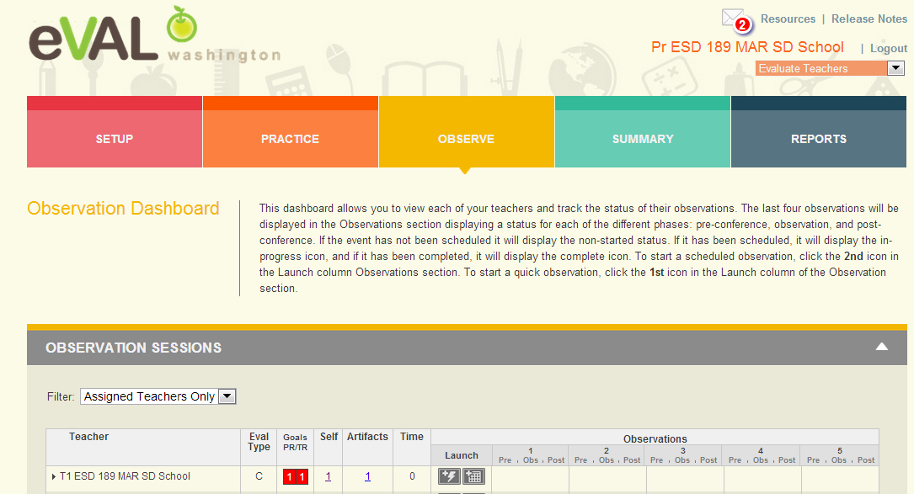
Principal Dashboard
Notice
message
in
mail box
Self evaluation shows because teacher made part of evaluation.
To schedule a formal observation, click on the calendar; to schedule an informal observation,
click on the lightening bolt.

Slide 28
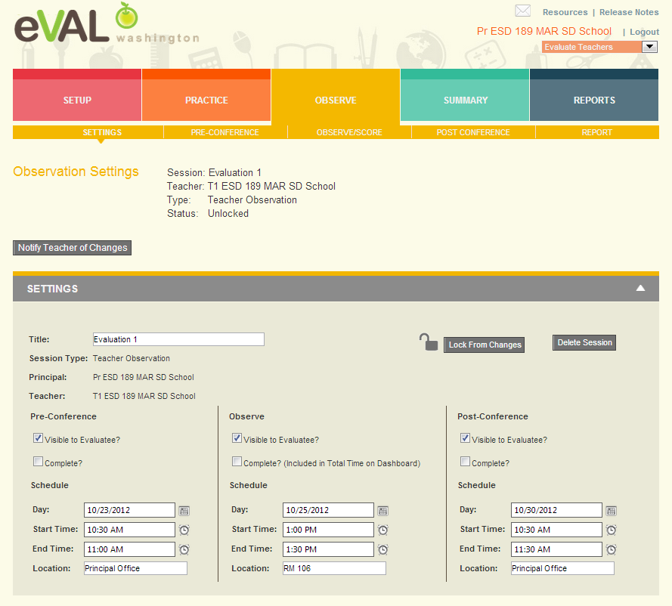
Principal Schedules Formal Observation

Slide 29
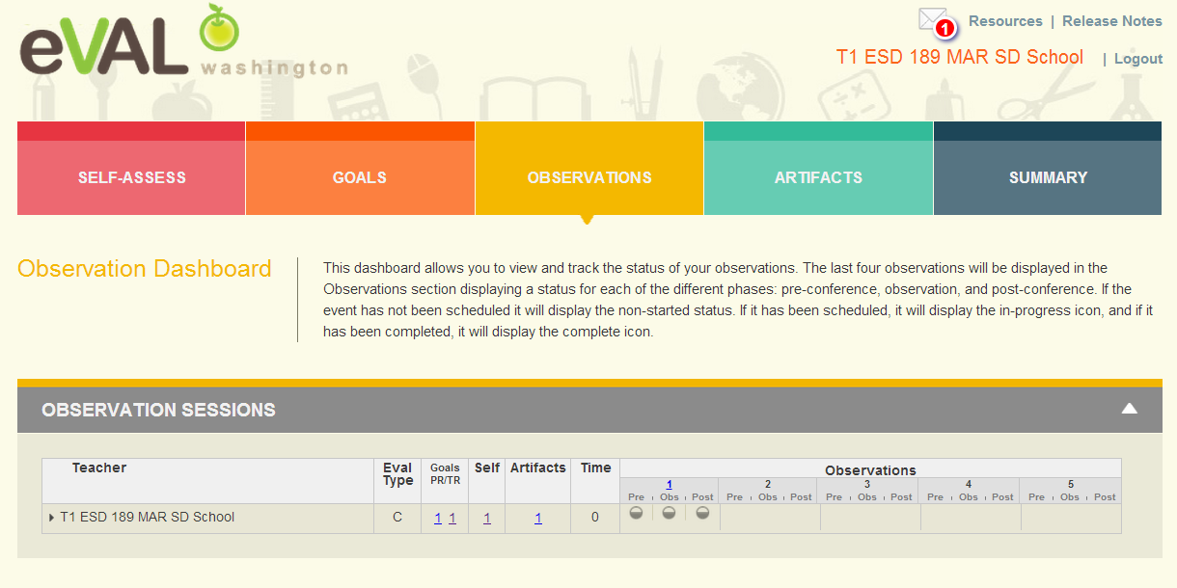
Teacher Observation Dashboard Part 1
Pre- and Post- Conferences along with Observation are scheduled.
Clicking on any one of the circles will bring up that section.

Slide 30
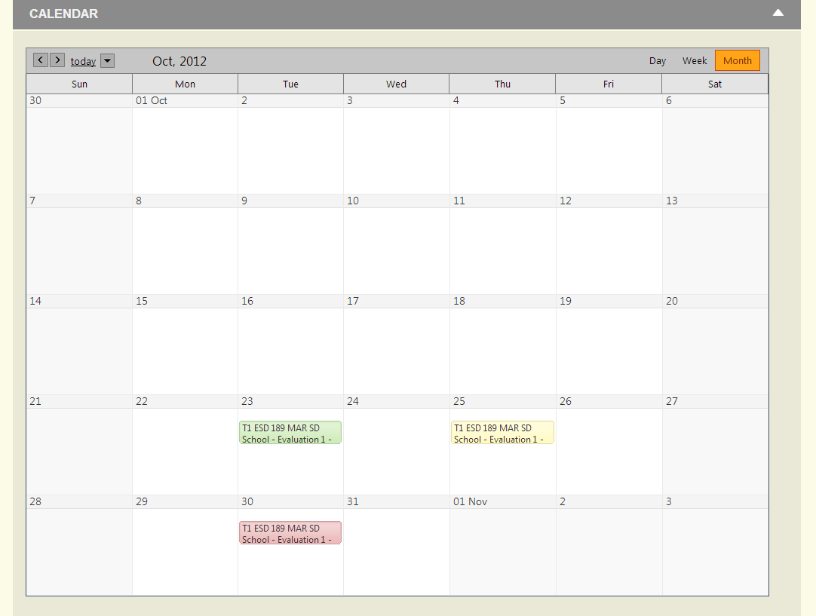
Teacher Observation Dashboard Part 2

Slide 31
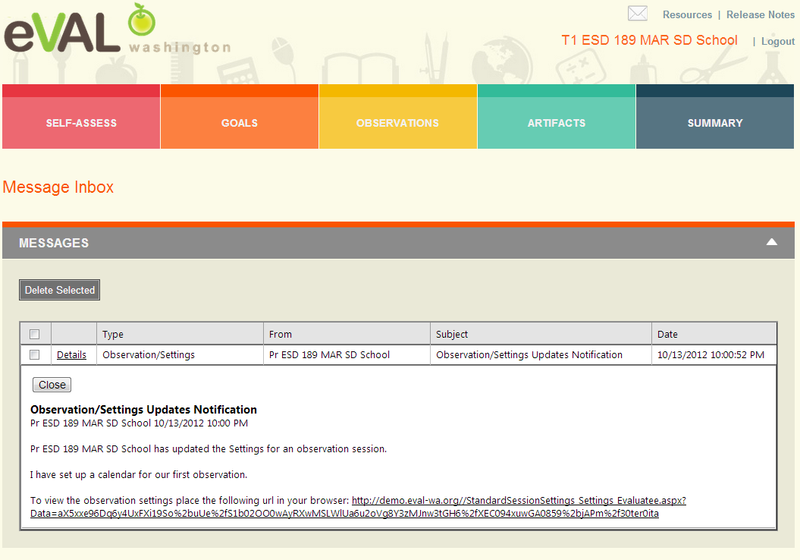
Teacher Mailbox

Slide 32
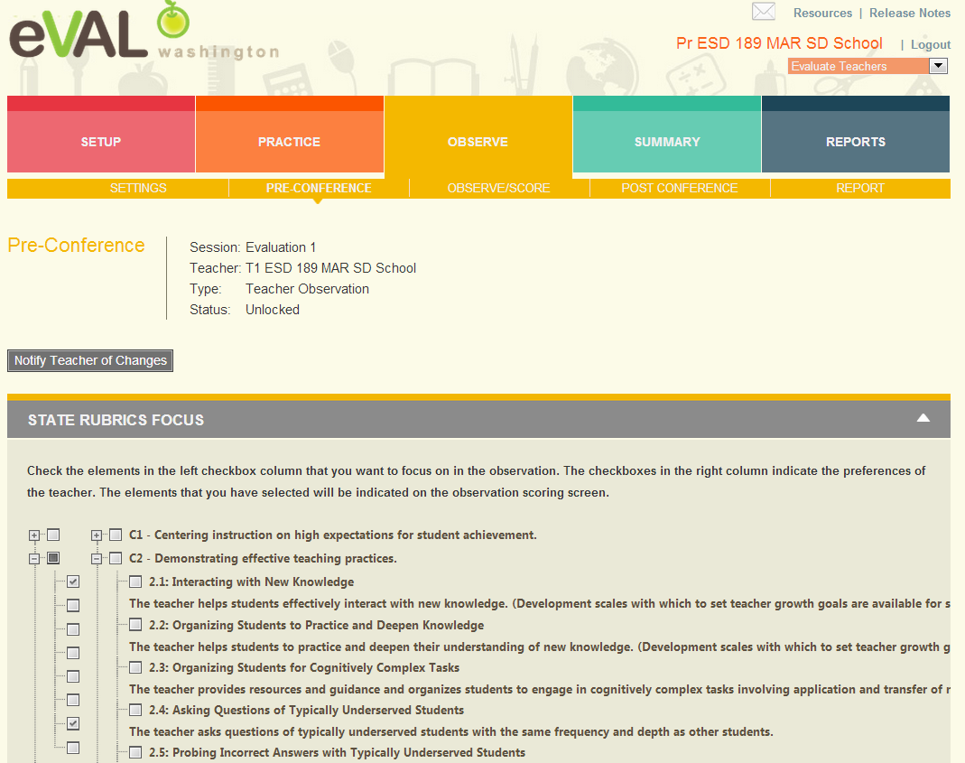
Principal Preconference Part 1
Select
focus
here

Slide 33
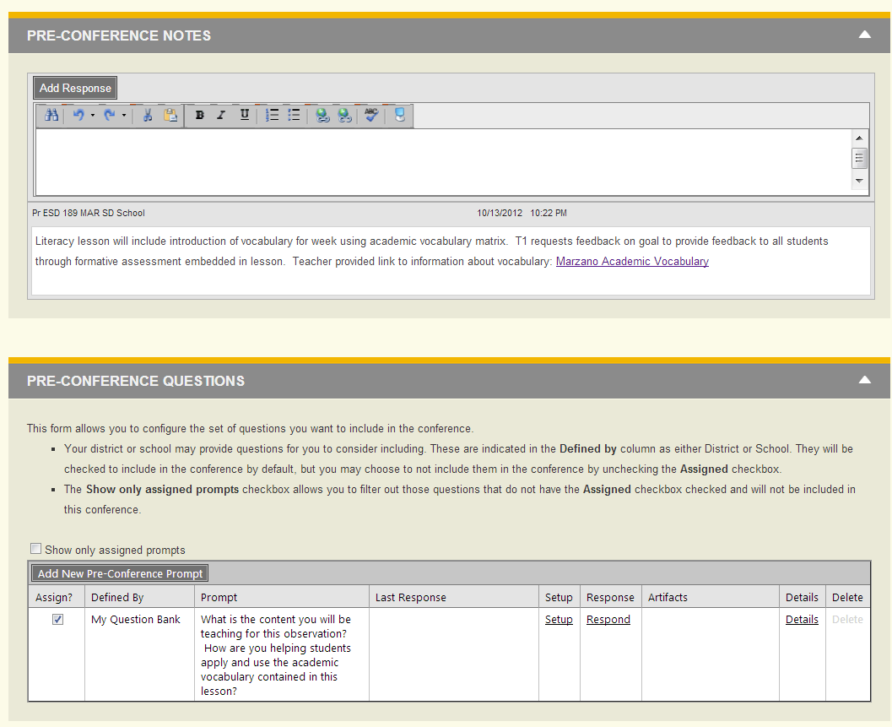
Principal Preconference Part 2

Slide 34
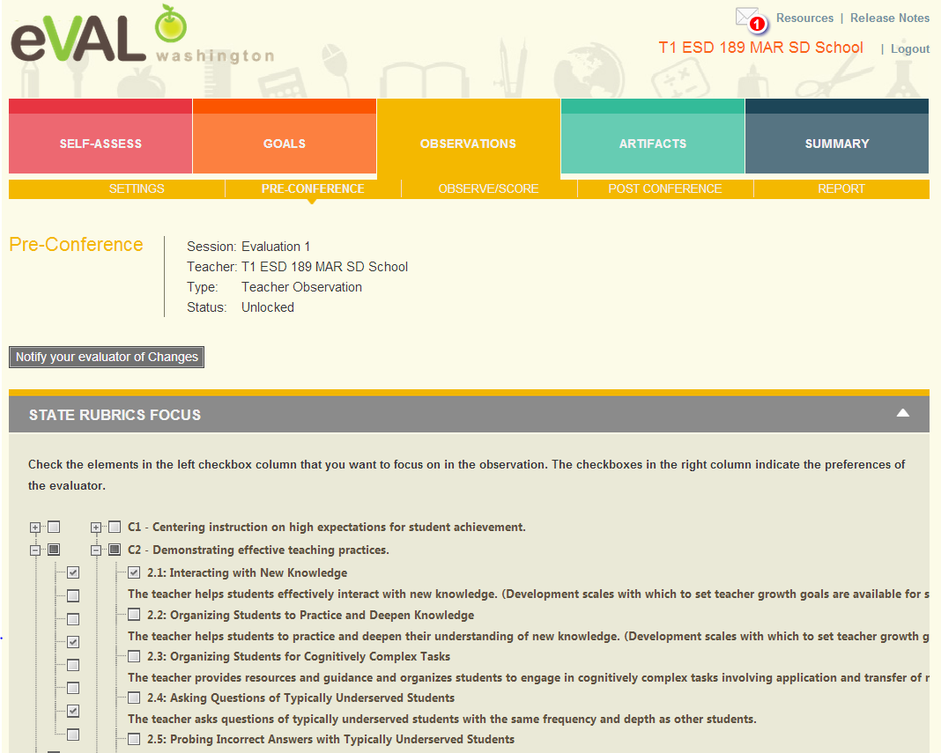
Teacher Preconference Part 1

Slide 35
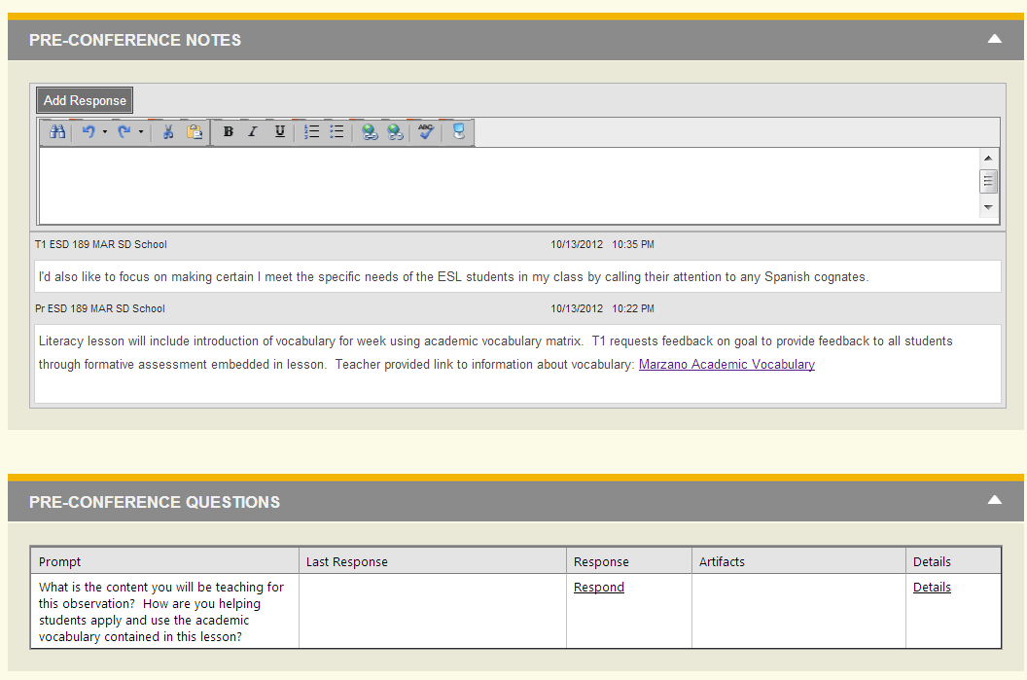
Teacher Preconference Part 2

Slide 36
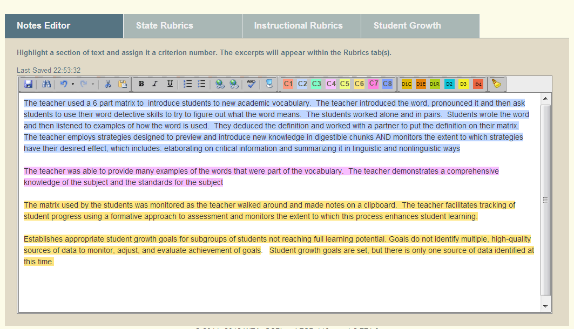
Principal Observe/Score

Slide 37
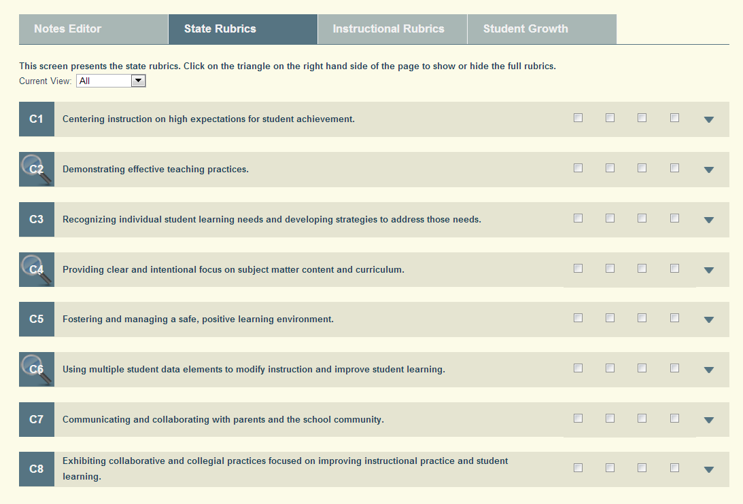
Principal State Rubrics
Magnifying
glasses
point
to
areas
of
focus

Slide 38
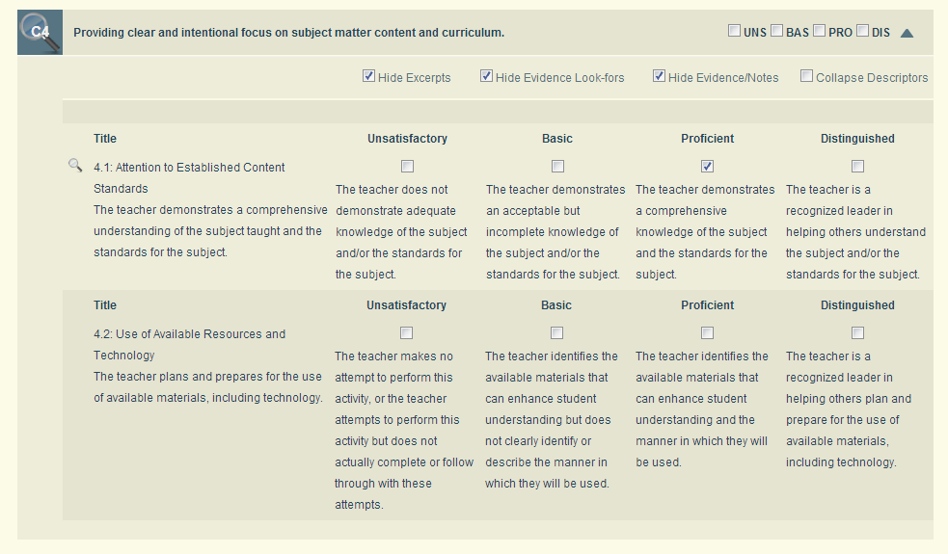
Principal C4.1 – Expanded View
Evidence notes show
up below when you
uncheck Hide
Evidence/Notes

Slide 39
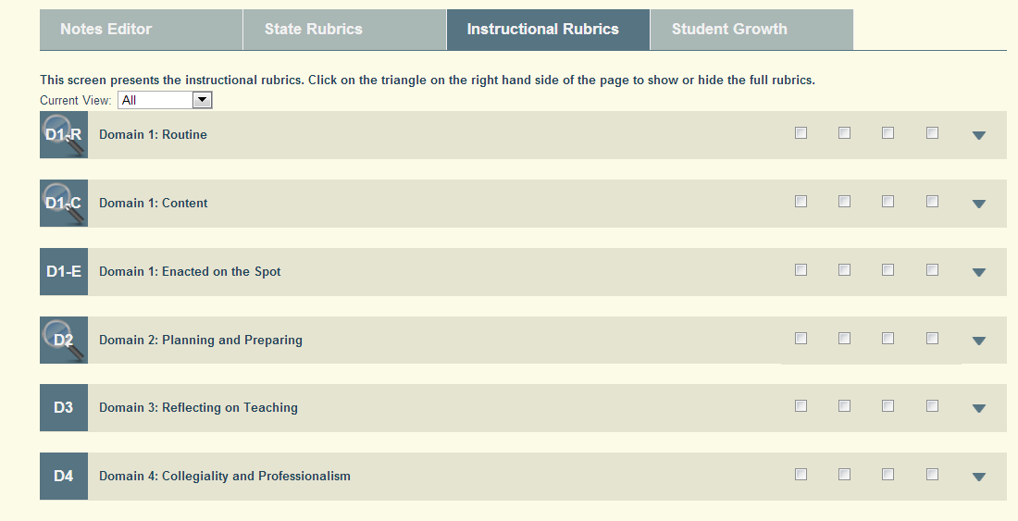
Principal Instructional Rubrics

Slide 40
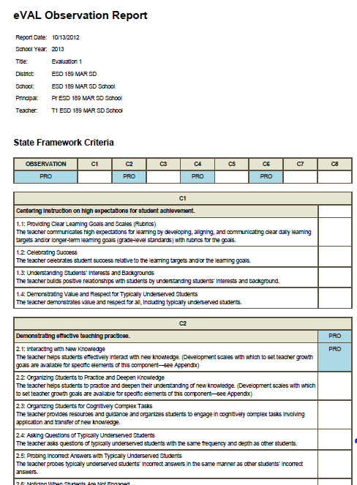
Principal – Generated Report

Slide 41
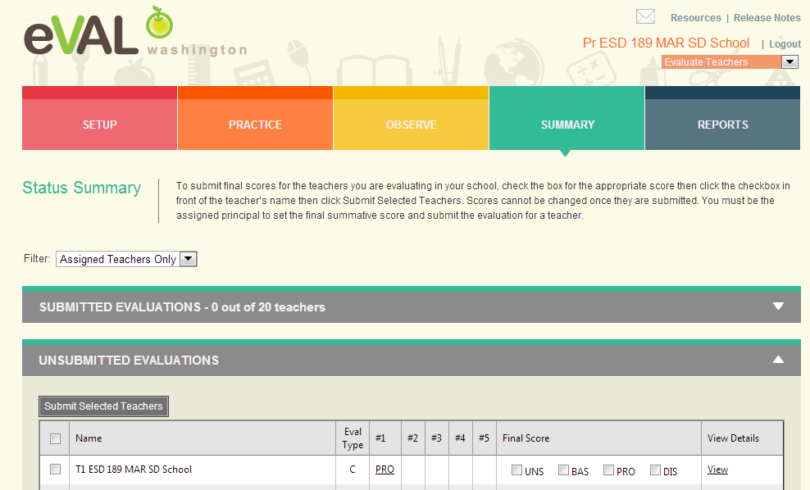
Principal – Summary View

Slide 42
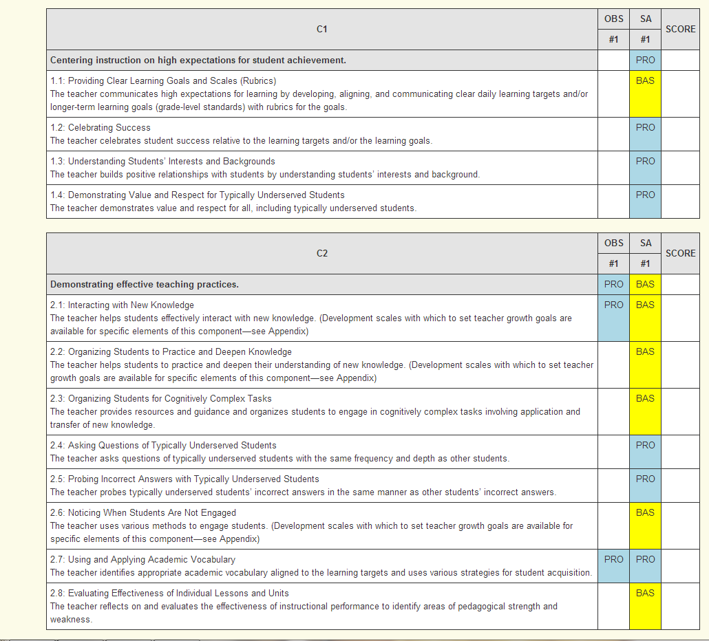
Principal – Final Report

Slide 43
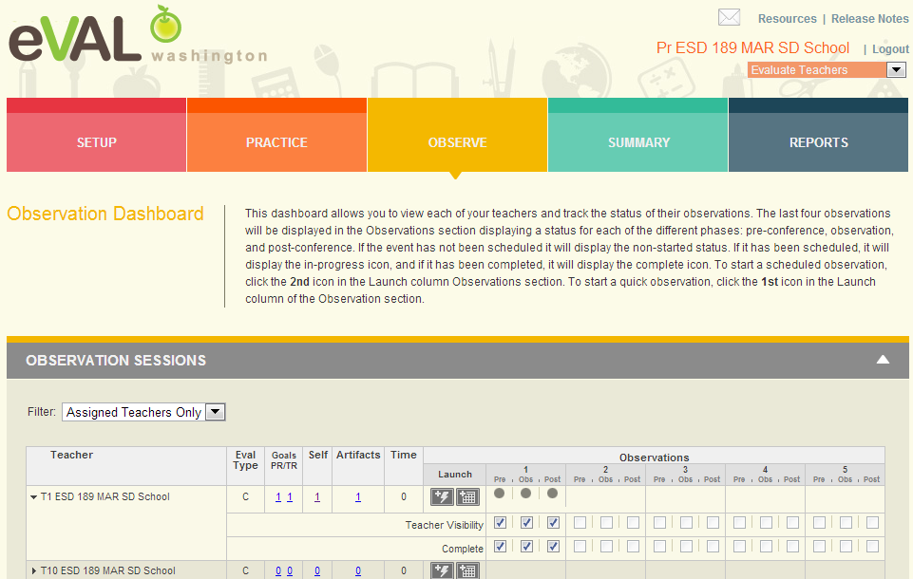
Principal – Observation 1 Complete
Another place to click on teacher name to open up section to mark complete.

Slide 44
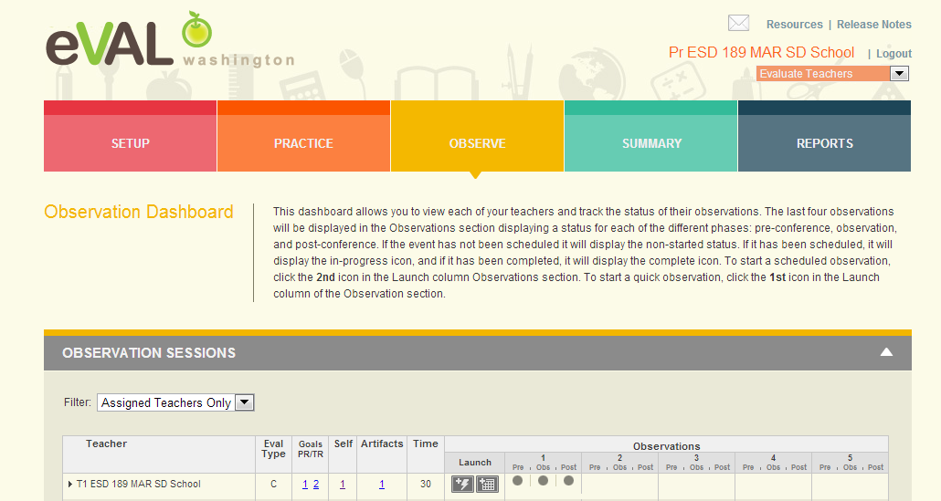
Principal Observation Dashboard

Slide 45
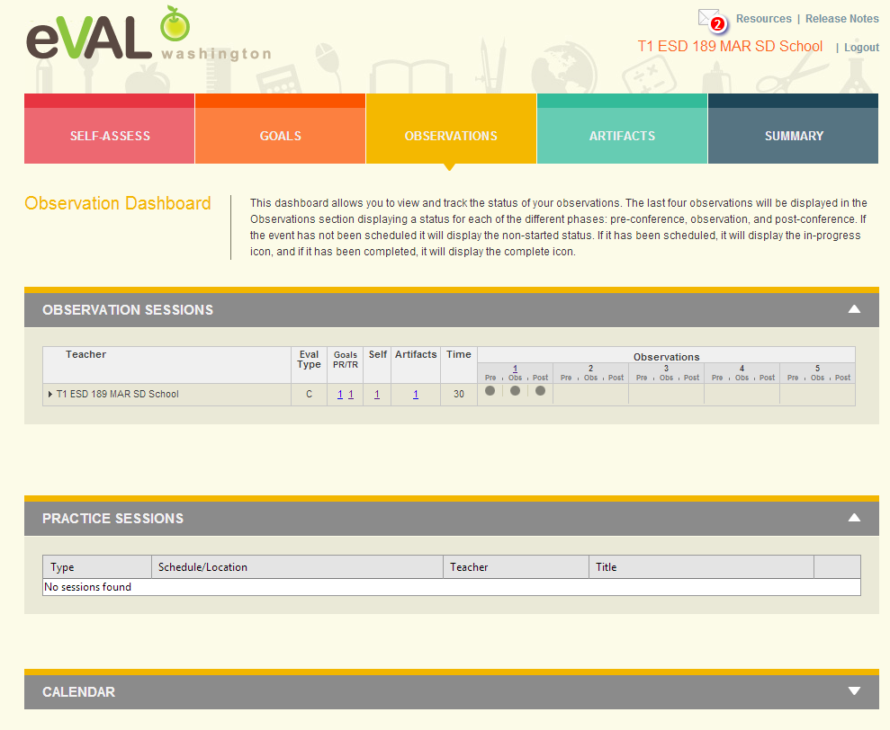
Teacher Dashboard –
Observation 1 Complete

Slide 46
Next Steps
What do you need to do next?
Who needs to be involved?
When does it need to happen?
How can I help?

Slide 47
Goals
Review evaluation steps for teacher evaluations
Understand supports offered to evaluator and evaluatee by eVAL
Understand specific tasks evaluator and evaluatee might want to do in eVAL
Understand interaction between evaluator and evaluatee roles in eVAL
Self Assessment
Your familiarity with the eVAL tool 1----5

Slide 48
Thank You!
Cathey Frederick
ESD 189 eVAL Specialist
cathey.frederick@seaotters.us
425.358.0545

