Slide 1
Funding information: Mathematics & Science Partnership under Title II, Part B Program Code: 62 CFDA 84.366B
This presentation was created as a part of the Assessing with Learning Progressions in Science (ALPS) Project, a Math Science Partnership through the Northwest Educational Service District in Washington State. We encourage others to use these materials as part of their own professional development programs. For additional information about the ALPS project or to access additional tools visit the ALPS project web page: www.nwesd.org/nwalps or contact Nancy Menard nmenard@nwesd.org

Slide 2
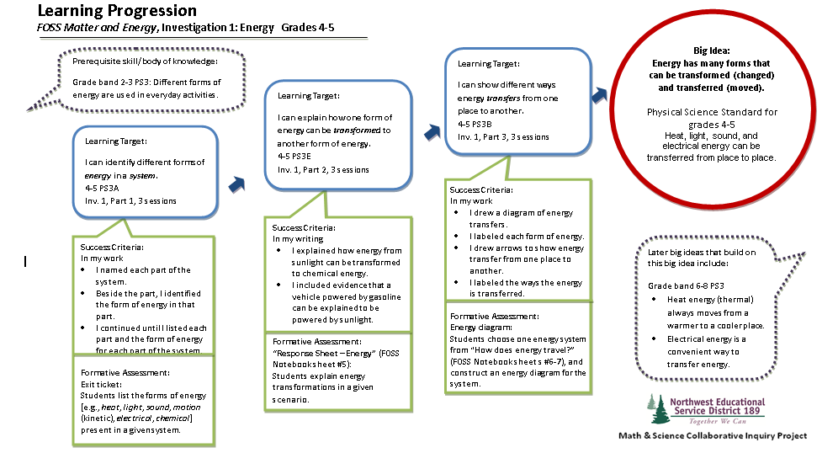
Developing Learning Progressions
Assessing with Learning Progressions in Science
Notes:
This professional development module is designed to follow the “Introduction to Formative Assessment” professional development module.
It is critical that participants have a foundational understanding of the purpose and role of formative assessment before beginning the process of creating learning progressions.
The activities in this module work best spread over two or more days of professional development. This module can precede or follow science content sessions. In the ALPS grant we found it worked well to have teachers begin a learning progression prior to their content session and then revisit and refine their progression after they had had a chance to deepen their science content knowledge.
Materials Prep List:
Participants should have access to their curricular materials, student books and teacher’s guides
Standards documents
Participants will need copies of Dylan, William. Embedded Formative Assessment. Bloomington, IN: Solution Tree, 2011. Print. Or you will need to obtain copyright permission to use excerpts from Pg. 71-73 and Pg. 101-103
Post it notes
Handouts:
Learning Progression Template: multiple copies for each participant. If you have the ability to also print poster sized copied of the templates it can be very helpful for teams building progressions collaboratively
Formative Assessment Learning Progression: one per participant
Building a Learning Progression Document: one per participant
Peer assessment, handout: one per participant
Rubric for learning progression: one per participant
Learning progression self assessment: one per participant
Stations with examples of formative assessment tasks from your curricular materials. Choose assessment tasks that use a variety of formats if possible. Provide background information such as correct answers, standards language, or research on common misconceptions to help teachers interpret each assessment task. 3-4 participants at a station seems to work best.

Slide 3
Learning progressions that clearly articulate a progression of learning in a domain can provide the big picture of what is to be learned, support instructional planning, and act as a touchstone for formative assessment.
-Margret Heritage
Notes:
The focus of this professional development is the creation of a learning progression.
A learning progression provides the infrastructure for instruction and formative assessment.

Slide 4
Know where we are going…
Learning Progression
Knowledge
Block
Building
What are the criteria for success?
How will I know?
What does it look like?
understanding
evidence of
Gather
Notes:
Use this slide to orient them to the structure of a Learning progression that we will be using. This is one example of a structure, it is not the only one or the “right” one, but it is the structure and process we will be working through together today. We encourage you to adapt this process to your own context and style once you understand it.
Each element of the learning progression comes in with a click
First we identify an overarching scientific “big idea” for a unit of study
Then we identify the building block knowledge students will need to master in order to understand the big idea. These building blocks are critical and assessable.
Then we describe each piece of building block knowledge in terms of the evidence of understanding we would look for in a student. This is sometimes called “success criteria”
Finally, we identify the assessment task or tasks we will use to elicit evidence of student understanding.

Slide 5
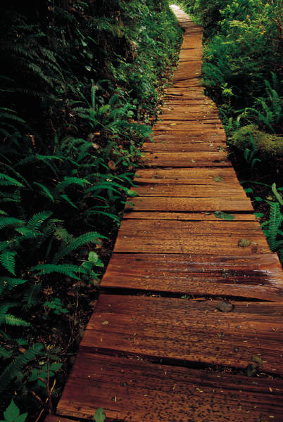
Our Learning
Progression
Clipart source: Microsoft
Notes:
What steps do we need to take to get where we are going?
Hand out the Formative Assessment Learning Progression
Explain that this learning progression describes a pathway to developing an understanding of formative assessment.
Give participants a chance to review the concepts and ideas in the learning progression and then explain that the training today will focus on the first 4 building block learning targets.
Each block in a learning progression is a stepping stone leading to deeper understanding of the destination – the big idea.

Slide 6
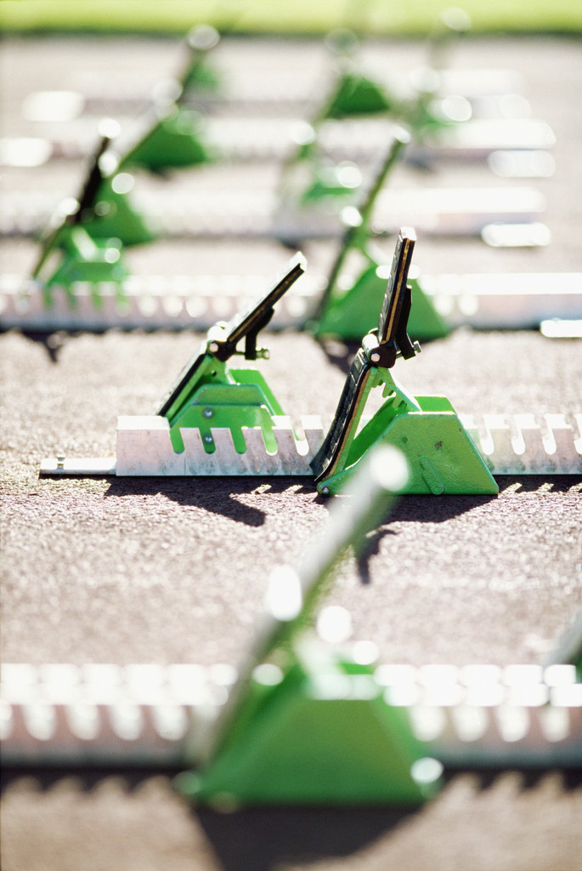
Let’s Get Started!
Clipart source: Microsoft
Notes:
Transition slide
What we will do is think about lessons in a certain way. It may seem slow at first, but this is a different way to think about planning for your units, which you already do. Once you are comfortable with this process , it will translate into your practice easily. It will be your new “unit planning.”
Hand out the Building a Learning Progression Document

Slide 7
Clipart source: Microsoft
Identify 2 to 3 Big Ideas.
Notes:
Have participants follow step 1 on the Building a Learning Progression document: identify a small number of big ideas in a curriculum unit. You may find it helpful for participants to begin with one unit, rather than an entire curriculum module.
If participants are struggling to identify “Big Ideas” I recommend having them read the NSTA publication “Concept Focused Teaching” Science and Children, December 2008 Vol. 46 No. 4
In the Washington State Science Standards, the content in the science disciplines is organized by nine Big Ideas in the major domains of science—three in Life Science, three in Earth and Space Science, and three in Physical Science. Each “Big Idea” is a single important concept that begins in the early grades, and builds toward an adult-level understanding. There is a progression of learning from kindergarten through high school for each domain.

Slide 8
Clipart source: Microsoft
Identify Important Concepts in Teaching Materials
Notes:
What does a student need to know to master a big idea? A learning progression is a series of steps or building blocks of conceptual knowledge leading to mastery of a big idea. We will look at the science standards and your teaching materials to determine these concepts.
Have participants follow step 2 on the Building a Learning Progression document. Find the list of important concepts as identified by the publisher of your teaching materials. This may be part of the curriculum overview or may be listed as objectives or unit learning goals.
Where to look:
FOSS: “Overview “ > “Module Matrix” > “Science Content”
STC: “Unit Overview and Goals” > “Concepts”

Slide 9
Meld state Content Standards with the Identified Concepts.
Notes:
Sticky note: one concept per sticky note.
Which of the identified concepts from the standards match unit learning concepts listed in your teaching materials?
Are these ideas included in your teaching materials?
Have participants follow step 3 on the Building a Learning Progression document.

Slide 10
Clipart source: Microsoft
Find state Content Standards lurking in lessons.
Notes:
Sticky note: one concept per sticky note.
Matching and melding unit learning concepts listed in your teaching materials with the standards was the easy part. Your teaching materials may address Washington standards that are not conveniently listed in the “Overview” section . You will need to look through each lesson to find those standards that are lurking in the shadows.
Have participants follow step 4 on the Building a Learning Progression document.

Slide 11
Clipart source: Microsoft
Organize the concepts
Notes:
Now you want to go back to the big ideas that you originally identified, and match the concepts to a big idea. At this point some groups will realize they might need to adjust their big ideas a bit given their new understanding of the concepts in their materials. They may also realize a need to discard some of the concepts that do not lead to an understanding of a big idea.
Have participants follow step 5 on the Building a Learning Progression document.

Slide 12
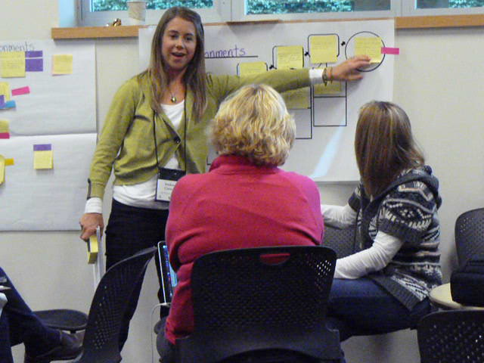
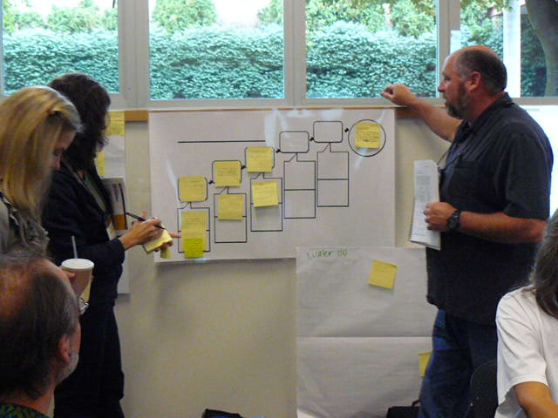
Establish Progressive Learning Targets.
Notes:
Once you have identified the concepts associated with each big idea, you are ready to arrange them as progressive learning targets. Sometimes it is clear how to order the targets, but not always. Be aware that there may be more than one ‘right’ way. Choose yours and go with it.
Have participants follow step 6 on the Building a Learning Progression document.

Slide 13
Students given learning goals perform significantly better than students who are given performance goals.
Black and William, 1998; Sheppard, 2001
Notes:
Look carefully at your targets and consider the wording. Are they performance goals or learning goals?
Performance goals often describe an activity or action students will take (create a diorama of a forest) learning goals describe a concept or skill students will understand (describe the predator prey relationships in a forest ecosystem)
Reword performance goals as learning goals.

Slide 14
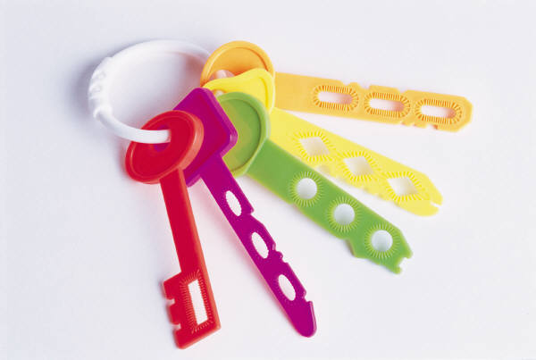
Key Idea!
Keep a learning progression sufficiently lean so that it is likely to be used. The only building blocks to include are those for which you plan to collect assessment evidence.
–Popham
Clipart source: Microsoft
Notes:
Point out this key idea…if a learning progression has too many building blocks it will be impractical. Remember that a learning progression is a plan for assessment, each building block in your progression is something that you will assess formatively during the course of your unit. It is important that you think critically about the number of building blocks it is possible to assess. In our project teachers generally found 3-5 building blocks per big idea was the most effective.
Popham, page 28, background information
Popham, page 33, source of quote

Slide 15
Is It Critical to Assess?
Notes:
Now you need to “prune”. As a group chose the building blocks that are CRITICAL to assess.

Slide 16
Identify Prerequisite Skill and later Big Ideas.
Notes:
What do the students need to know before they begin the learning on the progression – concepts from the previous grade; from a previous unit?
What big ideas will the students work toward after this unit – in a following unit of study; in the next grade level?
Participants will often be tempted to include pre-requisite knowledge in their progressions. Encourage them to identify ideas from previous grade levels in the “pre-requisite knowledge” space on the learning progression template rather than a building block in their learning progression.
Have participants follow step 7 on the Building a Learning Progression document.

Slide 17
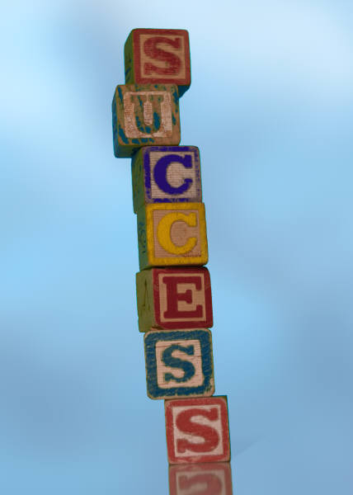
Establish Success Criteria
Clipart source: Microsoft
Notes:
Look at your learning targets. What will mastery of each target look like? How will you and the student know when s/he has mastered a learning target and is ready to move on to the next learning? When you and the student look at the student’s work, what will mastery look like? List all criteria that will help you and the student identify success.
Success criteria must be clearly related to the learning target. The teacher and the student must be able to use the success criteria to determine if the student has mastered the learning target.
Have participants follow step 8 on the Building a Learning Progression document.

Slide 18
Clipart source: Microsoft
Notes:
Suggested break point for two day PD sessions

Slide 19
Know where we are going…
Learning Progression
Knowledge
Block
Building
What are the criteria for success?
How will I know?
What does it look like?
understanding
evidence of
Gather
Notes:
Each learning progression has a destination: the big idea. The building blocks of knowledge are established. The success criteria for each building block of knowledge are clarified.
It’s time to determine how evidence of student understanding will be gathered. How will you know that the success criteria have been met?

Slide 20
Gather
Evidence of Understanding
Notes:
The students are engaged in the lesson, but do they get it?

Slide 21
Why assess the building blocks? Why not only assess the final target?
Clipart source: Microsoft
Notes:
Discussion Point…
Formative assessment is a check-up, summative assessment is a post-mortem.
Formative assessment is about assessment for learning. It is about being resilient in failure and believing that effort can lead to success. The teacher and the students realize that they are working toward a learning goal and all students have the capacity to improve.

Slide 22
Table Discussion:
How do you choose a task that gives you information about student understanding of the target?
Clipart source: Microsoft
Notes:
Talk with your team.
Two things to keep in mind:
Remember: Success criteria must be clearly related to the learning target. The teacher and the student must be able to use the success criteria to determine if the student has mastered the learning target.
The formative assessment task must clearly address the success criteria. When a student completes the task, you and the student should be able to see what criteria is/isn’t mastered.

Slide 23
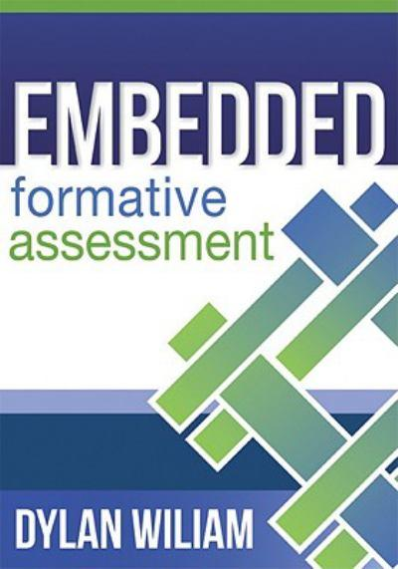
Pg. 71-73
Underline 1
“A Ha” statement
Notes:
Read pages 71-73 in Embedded Formative Assessment by Dylan Wiliam. Have participants underline 1 a-ha statement which they can share at their table.
Materials:
Dylan, William. Embedded Formative Assessment. Bloomington, IN: Solution Tree, 2011. Print.

Slide 24
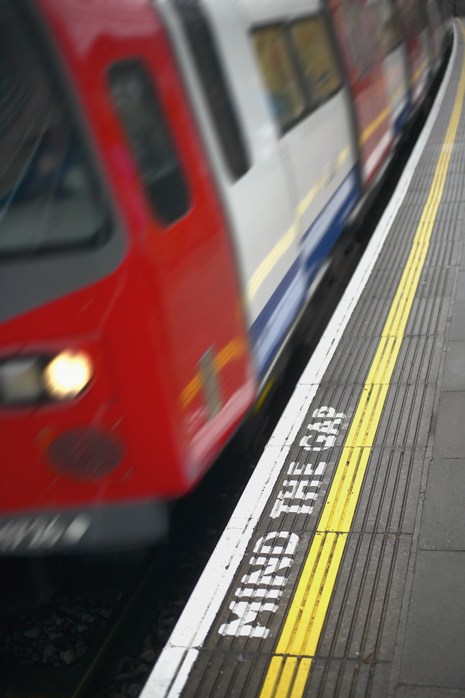
Designing assessments that elicit evidence of student understanding
Clipart source: Microsoft
Notes:
How will you determine if there is still a gap between the students’ understanding and the intended target ?
Plan for a formative assessment opportunity at critical junctures throughout the lesson. This will let you know if you can move on or of you need to spend more time helping your students build an understanding of the building block learning targets.

Slide 25
Identify students that do not have a complete understanding of the concept
Provide interpretable information about what the student does and does not understand
Notes:
There are two key elements of useful formative assessment tasks.
One: They allow the teacher to identify those students that do and do not have a complete understanding of the concept. In other words these assessments help a teacher to distinguish between the students who “get it” and those that need more help.
Two: The assessment must give information about WHY the student does not understand. For example, an assessment task might use common misconceptions as distractor items to help the teacher determine if a student holds one of those ideas.

Slide 26
Identify students that do not have a complete understanding of the concept
What was the learning target?
What does it “look like” when a student has mastered this building block concept?
Notes:
Some questions to ask yourself

Slide 27
Does this tell me why students are not understanding the target?
Does it give me information about gaps in their thinking
Provide interpretable information about what the student does and does not understand
Notes:
Additional questions

Slide 28
Pg. 101
Start at the math problem in the middle of the page and read until the end of the page
Notes:
Read the identified section of the book. Have participants discuss key ideas at their table.
Materials:
Dylan, William. Embedded Formative Assessment. Bloomington, IN: Solution Tree, 2011. Print.

Slide 29
Sample Assessment
Notes:
We will now be examining some sample assessments

Slide 30
Assessment Stations
At each station:
Complete the assessment task
Review the background information in the folder
Discuss:
What did this assessment help you to understand about student understanding?
Notes:
Set up stations with examples of formative assessment tasks from your curricular materials. Choose assessment tasks that use a variety of formats if possible. Provide background information such as correct answers, standards language, or research on common misconceptions to help teachers interpret each assessment task.
Stress with participants that they should complete the assessment themselves before they discuss the task with others or review the background information.
Materials:
Stations for participants to experience a variety of formative assessment tasks.
For formative assessment task suggestions:
Keeley, Page. Science Formative Assessment: 75 Practical Strategies for Linking Assessment, Instruction, and Learning. Thousand Oaks, CA: Corwin, 2008. Print.

Slide 31
Share
Clipart source: Microsoft
Notes:
Quickly discuss each station as a large group. Share ideas about the design of each task and what kind of information about student understanding they provided.

Slide 32
Try Your Own
Clipart source: Microsoft
Notes:
Remind them that they should first look to their own instructional materials for assessment tasks before they create their own. Also point out that sometimes powerful formative assessments are found embedded in the lessons, rather than as a part of the formal “assessment” documents that come with the materials. They should look to student tasks and teacher questions for opportunities to gather formative data about student understanding.
Have participants complete step 8 on the Building a Learning Progression document.
A great resource designing formative assessment tasks is
Science Formative Assessment: 75 Practical Strategies for Linking Assessment, Instruction, and Learning by Page Keeley, Corwin, 2008. =

Slide 33
Peer Feedback
Clipart source: Microsoft
Notes:
Have teams use the learning progression rubric and peer feedback note sheet to give each other feedback on their learning progressions.
If your teams are not yet comfortable enough to give peer feedback they can also use the rubric to self assess or use the self assessment questions.
Once teams have received feedback they may make adjustments to their learning progressions.
Materials: peer assessment, rubric for learning progression, learning progression self assessment

Slide 34
Putting Your Progression into Practice
Clipart source: Microsoft
Notes:
Table discussion: How will a learning progression be useful to you as part of your teaching practice?

Slide 35
Clipart source: Microsoft
How will you use learning progressions in your classroom? What is your first next step?
Notes:
Personal Reflection:
Ask participants to take a moment to answer the prompts in their notebooks

Slide 36
Bibliography
Dylan, William. Embedded Formative Assessment. Bloomington, IN: Solution Tree, 2011. Print.
Heritage, Margret. LEARNING PROGRESSIONS:SUPPORTING INSTRUCTION AND Formative Assessment. Tech. Los Angeles: COUNCIL OF CHIEF STATE SCHOOL OFFICERS, n.d. Print.
Keeley, Page. Science Formative Assessment: 75 Practical Strategies for Linking Assessment, Instruction, and Learning. Thousand Oaks, CA: Corwin, 2008. Print.
Olson, Joann K. "Concept Focused Teaching." Science and Children 46.4 (2008): 45-49. Print.
Popham, W. James. Transformative Assessment. Alexandria, VA: Association for Supervision and Curriculum Development, 2008. Print.

