Slide 1

Principal Evaluation PLC
2013-14

Slide 2
Introductions
1. Who is in the room?
2. Norms
3. Where are you on the rubric?
4. Your needs, desires and expectations

Slide 3
Theory of Action
If we operationally define and apply common criteria for principal performance within a leadership framework, then there will be an increased systemic coherence which will result in higher levels of performance and learning from principals, teachers and students.

Slide 4

Essential Questions
As A Professional Learning Community:
How do we deepen our knowledge of Washington’s states evaluation criteria for Principals in order to guide decisions that have promise to improve student learning?
How do we use the AWSP Principal Evaluation framework to provide us with a way to operationalize the revised evaluation system to improve teaching and learning?
How do we create a professional development plan to build Principal readiness for a new district evaluation model that will help principals grow and develop?
How do we establish and implement systems and structures in our districts that will continue to improve collaboration and communication about the evaluation system?

Slide 5
Today
Introduction: PLC formation; the law; Background on Principal Evaluation
Workshop 1-AWSP Framework
Workshop 2-The 8 criteria
Workshop 3-Evidence for Proficiency
Workshop 4-Student Growth Evidence 3-5-8
Workshop 5-Correlations in the Criteria
Homework—Think about system coherence in your district

Slide 6
Tomorrow
Report our on System Coherence in your district—what are you thinking about?
Workshop 6- Review the 8 leadership criteria
Workshop 7-Planning for self-assessment and goal setting conferences with your principals
Accountability
Sharing the forms
Workshop 8- planning for Supervisory walk throughs—formative assessment
Case study signup
Reflection and Planning for October 1

Slide 7
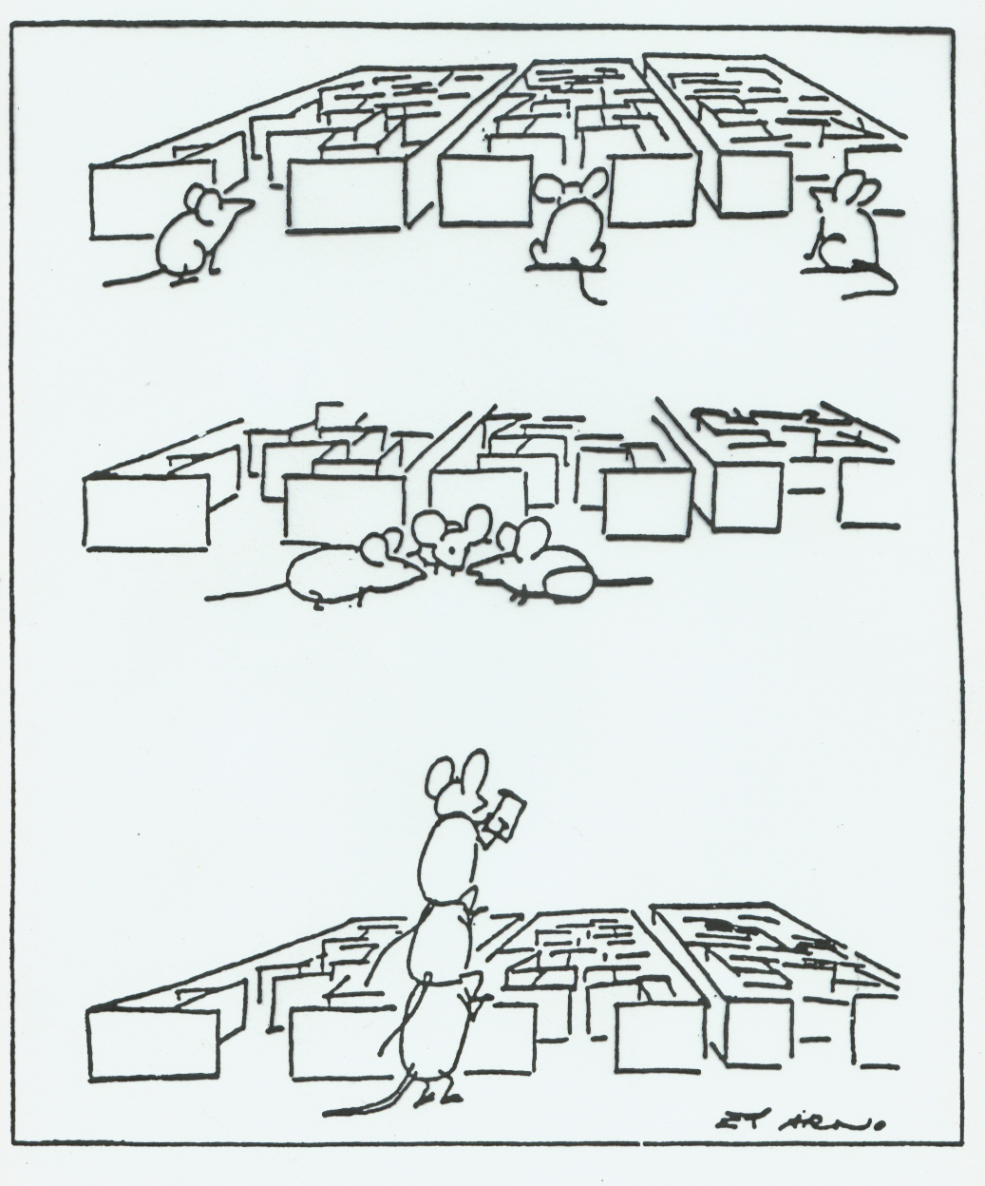
If we’re to get through this maze of pressures and questions,
it will take all of us in a truly collaborative fashion
Notes:
Display as teams come back from break

Slide 8
Comparison of Three Approaches to Adult PD:
Component | Lecture (Sage on Stage) | Guided Practice (I do, we do, you do) | Living the Learning (AA, R, S, F, A)
Format | Formal presentation on core principles Question & Answer | I do: Formal presentation on core principles We do: Shared presenter-participant activity modeling the core principles You do: Application: try it on your own | Activity sparks learning Facilitated Sharing Framing: formal language around participants’ sharing Reflection Application: put it into practice
Approx. Leader Talk | 90-95% | 40-50% | 15-30%
Learning Beliefs | We learn best by listening to the expert on the topic | We learn best by listening to the expert and then having a chance to apply it | We learn best by generating the knowledge through experience and then applying it to our context
Limitation | Adults retain 5-10% of what they hear | Leader does the heavy cognitive work: participants imitate but don’t build their own conclusions, limiting investment & retention | Requires precisely built activities that lead to the proper conclusions; takes far more time to plan & more work to facilitate

Slide 9
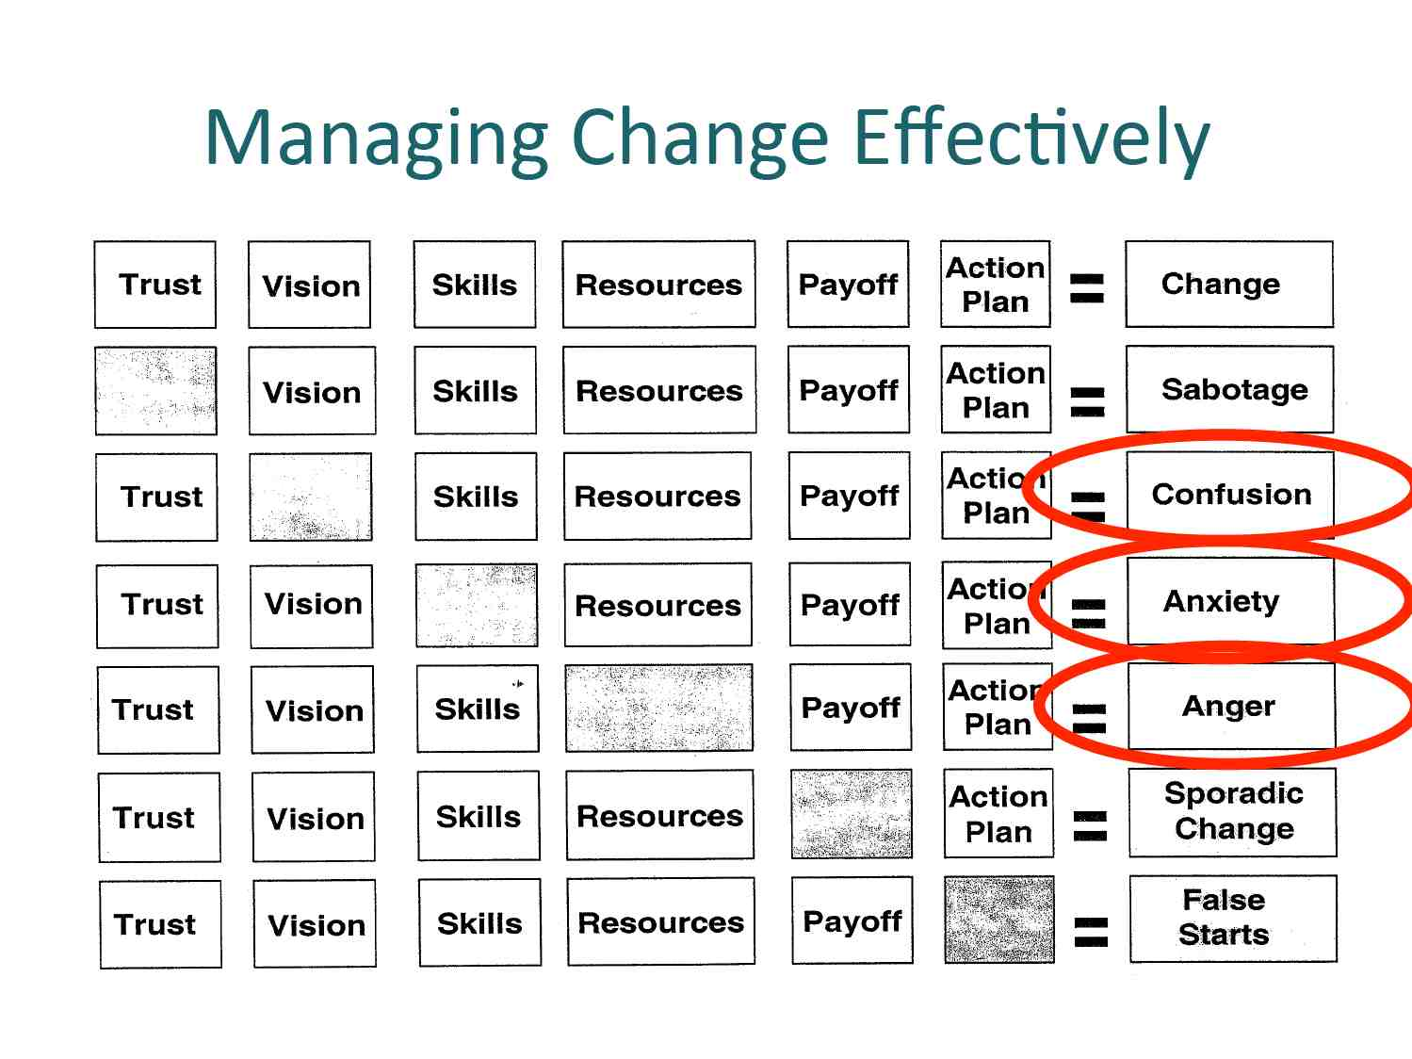

Slide 10
Professional Learning Community
What will be our norms?
How will we operate?
Support one another?
Hold each other accountable for the work that needs to be done?
Encourage each other to improve our skills, knowledge and practices?

Slide 11
Building Our Norms
Each person takes three (3) Post-It Note sheets
Write a norm on each Post-It Note sheet
Place norms in the middle of the table
Look for overlap, redundancy, differences:
  Combine overlap and redundant norms into one
Take table norms to the chart paper sheet:
  Combine like norms in one line (horizontal)
  Place different norms in one line (vertical)
Notes:
Activity – should be short

Slide 12
Self-assessment
Complete the AWSP entry task
Where are you on the rubric?

Slide 13

Your needs, desires and expectations
3x 3 post-it notes:
Topics you want
to be sure
and cover

Slide 14
Principal Evaluation
The law: WAC 392-191A-010
Jigsaw protocol 7 groups All pages 1-3
Group 1: pages 3-5
Group 2: pages 5-6
Group 3: pages 7-8
Group 4: pages 8-10
Group 5: pages 10-11
Group 6: pages 11-13
Group 7: pages 13-15

Slide 15
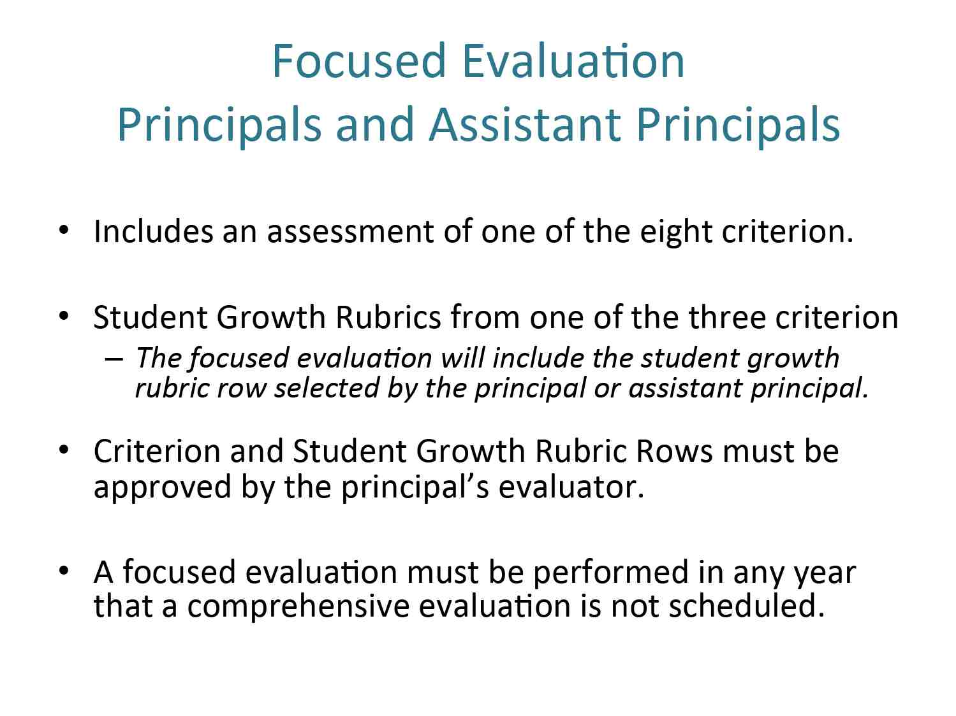

Slide 16
Quick discussion
What do districts plan to do with focus and comprehensive evaluation for principals?

Slide 17

What does the literature say about Principal Evaluation?

Slide 18

Education leadership:
How districts can grow and support a pipeline of highly effective leaders
The Wallace Foundation
July 2012
Notes:
[

Slide 19


Leadership is key to improving teaching & learning
“Leadership is second only to classroom instruction among all school related factors that contribute to what students learn at school.”
-- How Leadership Influences Student Learning,
Kenneth Leithwood, et al,
University of Minnesota,
University of Toronto, 2004
“Six years later we are even more confident about this claim.”
  -- Learning from Leadership: Investigating
  the Links to Improved Student Learning,
  Louis, et al, 2010

Slide 20
Leadership is crucial to making school reform succeed
“There seems little doubt that both district and school leadership provides a critical bridge between most educational reform initiatives, and having those reforms make a genuine difference for all students.”
-- How Leadership Influences Student Learning, 2004

Slide 21
Especially in difficult situations
“…there are virtually no documented instances of troubled schools being turned around without intervention by a powerful leader.”
-- How Leadership Influences Student Learning, 2004

Slide 22

Effective principals are key to retaining good teachers
“It is the leader who both recruits and retains high quality staff. Indeed, the number one reason for teachers’ decisions about whether to stay in a school is the quality of administrative support – and it is the leader who must develop this organization.”
    -- Preparing School Leaders for a Changing World,
    Linda Darling-Hammond, et al, Stanford University, 2007

Slide 23

What effective principals do
Shape a transformational vision of academic success for all students
Create a hospitable climate
Cultivate leadership in others
    Lead the leadership team
    Lead the professional learning community
Manage people, data and processes
All in the service of improving instruction
Source: The School Principal as Leader: Guiding Schools to Better Teaching and Learning, January 2012

Slide 24
Improving principal preparation is a cost-effective strategy
Superintendents and principals are the leaders with the most influence in schools.
“Efforts to improve their recruitment, training, evaluation and ongoing development should be considered highly cost-effective approaches to successful school improvement.”
-- How Leadership Influences Student Learning, 2004

Slide 25
What districts can do

Slide 26
Why the district role is important
“Both qualitative and quantitative evidence indicate that district priorities and actions have a measurable effect on professionals at the school level.”
Leaders in higher performing districts communicated explicit expectations for principal leadership and provided learning experiences in line with these expectations
They also monitored principal follow-through and intervened with further support where needed.
    - Wahlstrom, et al, Executive Summary of Research Findings, 2010

Slide 27
Key steps districts can take
Clearly define standards for principals – and for types of principals (such as elementary, middle, high, “turnaround”)
Define accountability and leader evaluation measures and gives principals the authority and support to achieve them
Be an active consumer of leader preparation programs to ensure high quality candidates
Place and retain effective principals in the highest needs schools
Provide timely, relevant data to enable principals to accurately diagnose and address students’ learning needs
Use leader evaluation to focus more attention on their role on improving instruction
Provide time for principals to focus on instruction
Design and implement a pipeline to develop, train, place and support effective principals for all schools

Slide 28
Best Practice
Self assessment
Goal setting conference
Formative conferences
Professional development plan
Supervisory walk through
Coaching conversations
Self reflection before the summative conversation
Summative conference
Final Written summative evaluation

Slide 29

Leverage Leadership
Leadership study done by Urban Institute:
Principals spend 6% time on instructional leadership

Slide 30
Seven Pillars of Effective Schools--Instruction:
Data-Driven Instruction
  Defining the end goal and shifting the focus from what was taught to what students learned
Planning
  Building strong curriculum plans and lesson plans as a foundation for effective teaching
Observation and Feedback
  Speeding up the feedback/improvement loop
Professional Development
  Developing knowledge base about teaching
  Providing opportunities for practice in a controlled setting

Slide 31
Seven Pillars of Effective Schools--Culture:
Student Culture
  Creating a rigorous, joyful student culture that drives learning and character development
Adult Culture
  Building a strong, supportive adult culture
Managing and Developing Leadership Teams
  Developing additional instructional leaders who can lead implementation of the instructional pillars

Slide 32
        Super levers:
        Data Driven Instruction (criteria 3 and 5)
        Culture (criteria 1 and 8)
        Chapter 9-Superintendents
        Train the leaders
        Coach them continuously
        Monitor their progress

Slide 33
Supervising
If evaluators have 7 principals to supervise: one/week
If evaluators have 15 principals to supervise: one/2 weeks
If evaluators have 30 principals to supervise: one/month

Slide 34
AWSP Model workshop 1
                TPEP website

Slide 35
Criterion
Recommended
Components
The Framework:
Criterion 5
and Recommended Components
Notes:
Remove template from this slide
35

Slide 36
Criterion’s Rubric
4-Tier Rating Scale
Elements
Student Growth
Descriptors

Slide 37
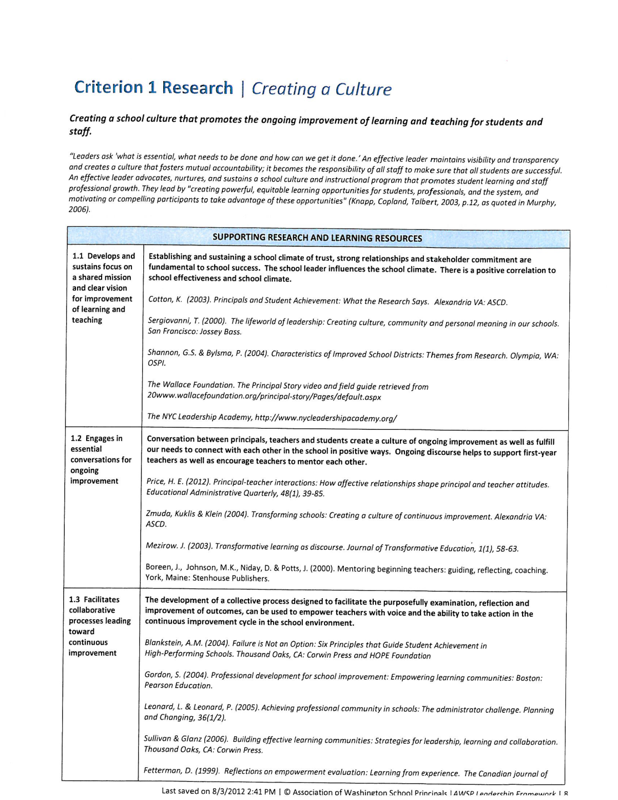

Slide 38


WORKSHOP 2: The 8 Criteria
Lets play with the 8 criteria:
Get into 8 groups-each group will be assigned one criteria
In each group divide up so that each person takes a different element.

Slide 40


Each group member looks at their criterion to answer these questions.
What would a principal be doing to demonstrate their proficiency in each of these criteria?
What would be the observables or collectibles (evidence)for a principal to demonstrate their proof of impact?
What district level support do principals need to be able to do this work?
Prepare your poster to share out
What are the most important nuggets for Principal evaluators to know about your criterion?

Slide 41
Quiz yourself
List the 8 criteria
Can you list some elements under each criterion?

Slide 42
Workshop 3: Evidence for Proficiency
Read the article Evidence vs. artifacts (AWSP)
Operationally define Evidence and artifacts
Groups 2 or 3: Take one assigned criterion and list artifacts and evidence for your criterion

Slide 43
Diving Deeper—the rubric
What would a principal be doing to demonstrate their proficiency in each of these criteria? How about distinguished?
What would a principal collect for evidence to demonstrate this?

Slide 44
Evidence
Evidence means observed practice, products or results of a certificated classroom teacher or certificated principal's work that demonstrates knowledge and skills of the educator with respect to the four-level rating system. (WAC 392-191A-030)

Slide 45
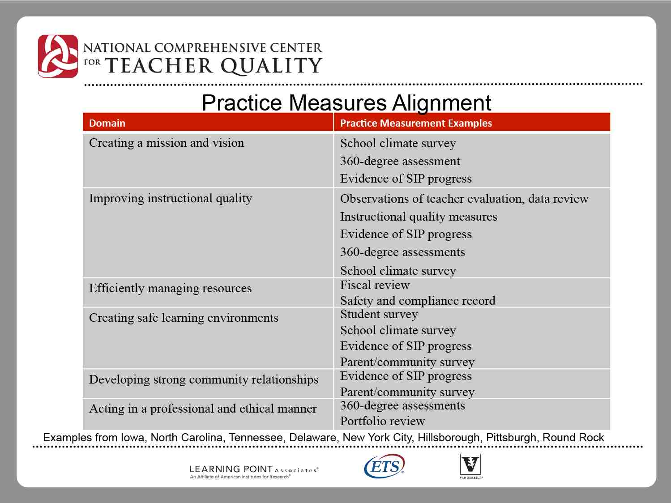

Slide 46
Workshop 4
Determining multiple measures in student growth
Student Growth Rubrics
3.4 5.2 8.3

Slide 47
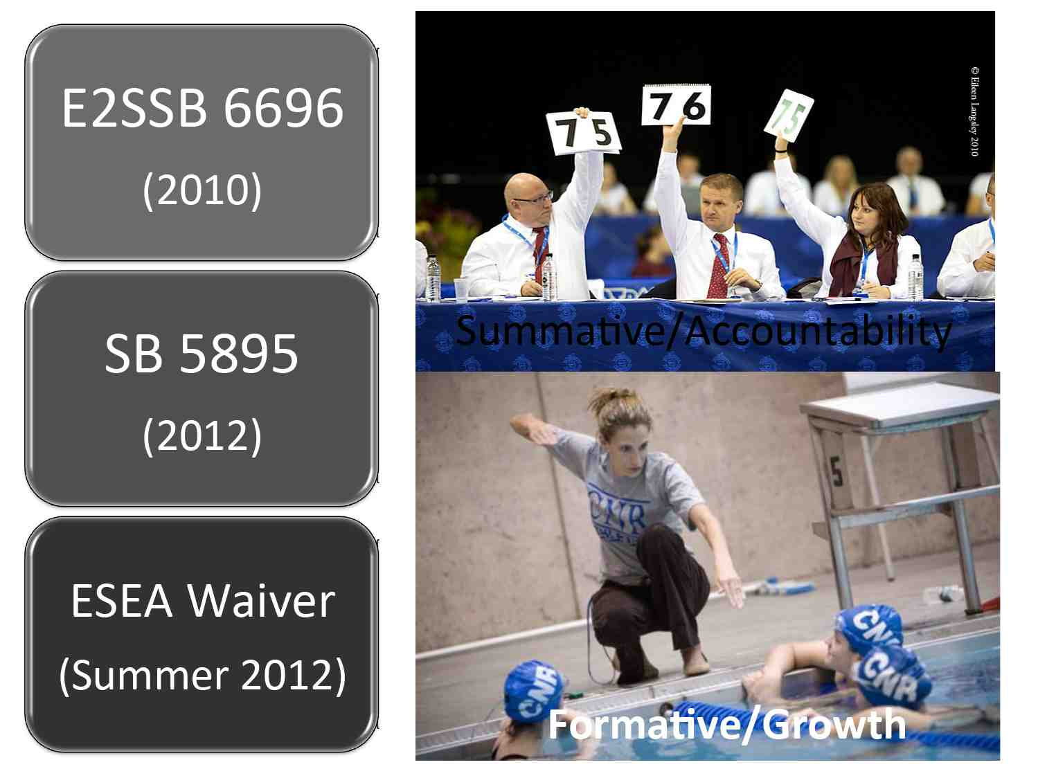

Slide 48
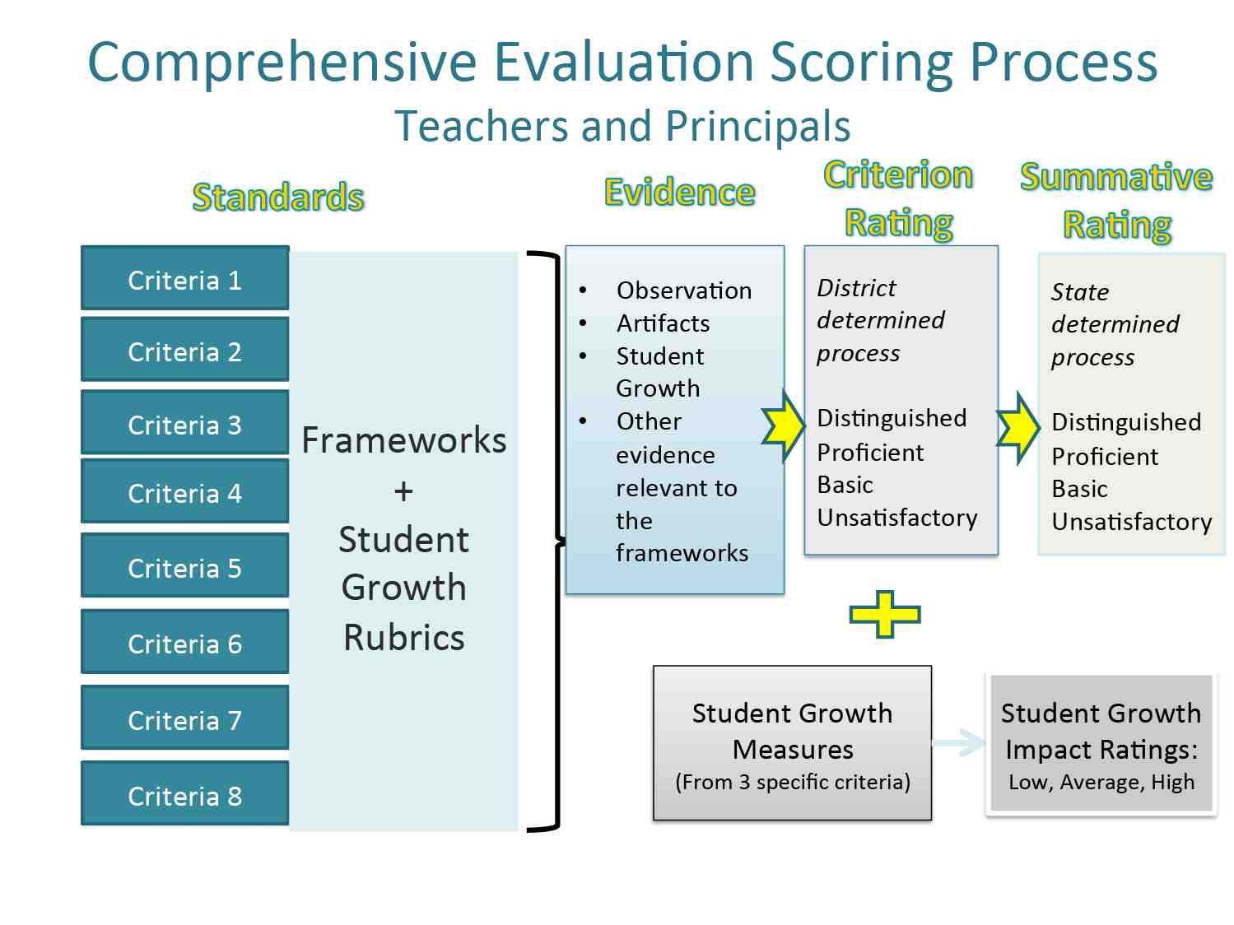

Slide 49
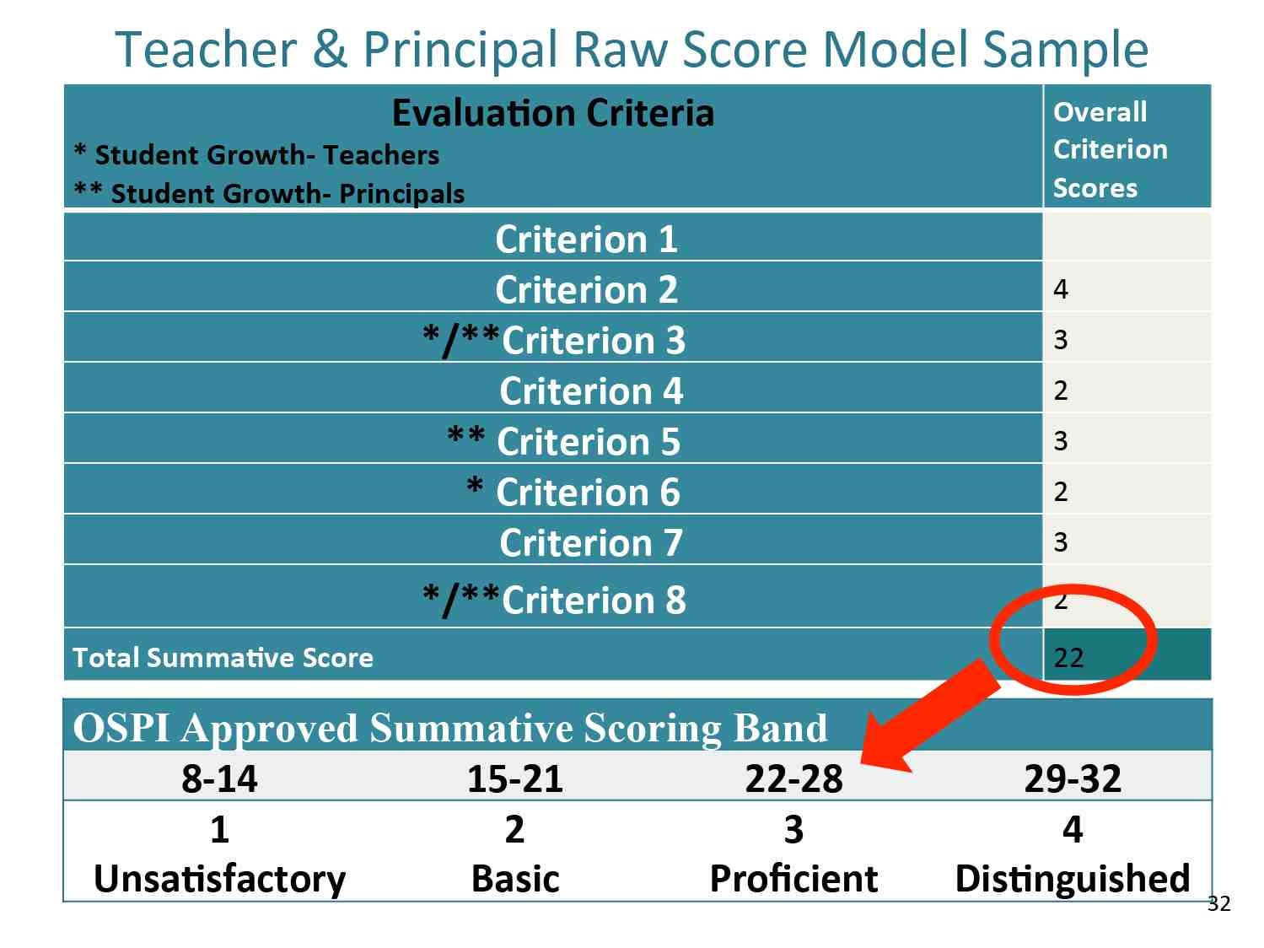

Slide 50
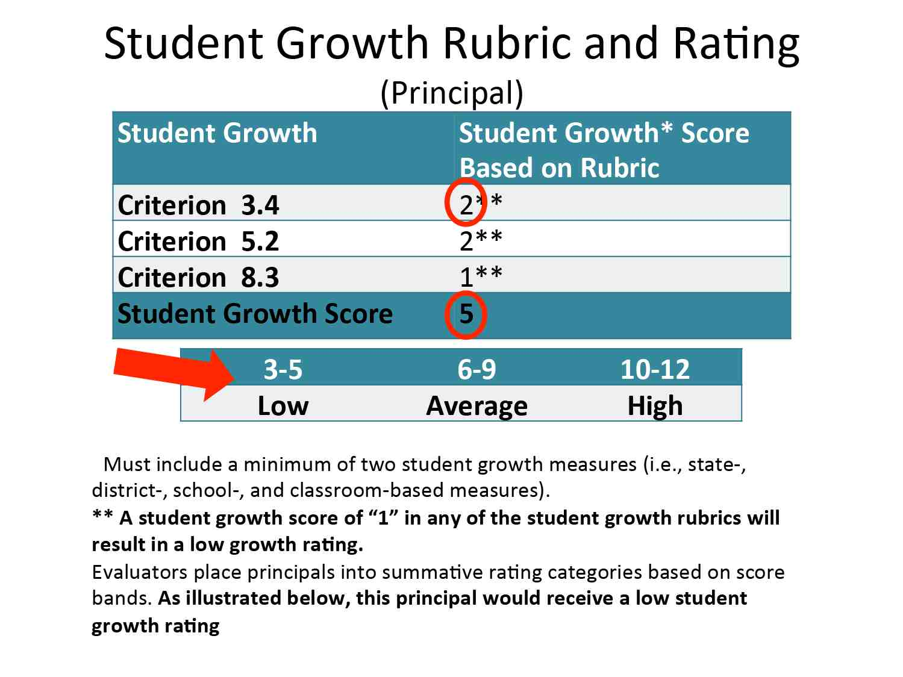

Slide 51
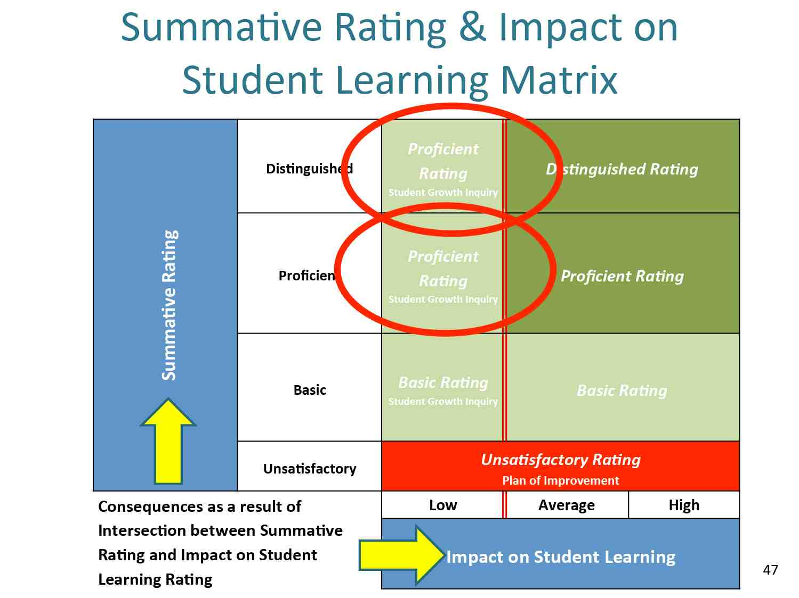

Slide 52
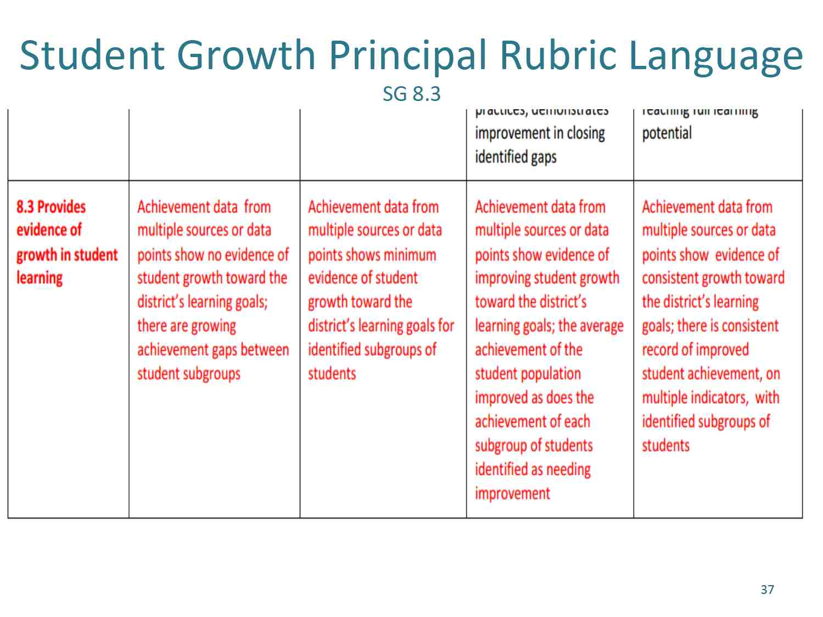

Slide 53
Protocol for student growth
Groups
3.5
5.5
8.3

