Slide 1

Student Growth 2.0
Fall, 2014
Notes:
Note to Facilitator – See Facilitator Directions on Agenda Document.

Slide 2

TPEP Sessions for 2014-15
Face-to-Face Sessions
  Student Growth 2.0
  TPEP/ Washington State Learning Standards Connections
  District Agreement Practices

Slide 3
Session Norms
Pausing
Paraphrasing
Posing Questions
Putting Ideas on the Table
Providing Data
Paying Attention to Self and Others
Presuming Positive Intentions
Notes:
Review Garmston’s Norms of Collaboration. Ask participants to reflect on one of the norms they would like to focus on for today.
Handout.

Slide 4
Intended Participant Outcomes for
This Module
Participants will:
Increase understanding of the legislative requirements for using student growth data as one of several measures in an educator’s evaluation in Washington state.
Increase deep understanding of the student growth rubric and the language within it.
Understand, through deep analysis, model student goals and related rubrics to begin development of a District Student Goal Rubric and Sample District Goals.
Consider implications for District planning.
Notes:
Be sure to align this slide with slide 4 and your presentation.
Research conducted by the UW in an August, 2014 report prepared for OSPI reflects that Student Growth Goal Setting and collecting evidence have proven to be the most challenging aspect of the revised evaluation systems.
Objectives –
1 – 2 are review
3 – has been implied, but not explicitly taught in previous sessions.
4 – 7 all contain new material.

Slide 5
Workshop 1: TPEP SG 2.0
What’s New?
Notes:
Handouts for this section include:
Tell them what you are including and why.
WACs
WAC / RCW AWSP Document
Decision Matrix

Slide 6
ESSB 5895 Establishes New Definitions Around Student Growth Measures
G!
RCW 28A.405.100
Both E2SSB 6696 and ESSB 5895 contain language around student growth, including:
Student growth data that is relevant to the teacher and subject matter must be a factor in the evaluation process and must be based on multiple measures that can include classroom-based, school-based, district-based, and state-based tools. Student growth means the change in student achievement between two points in time.
Changes…
Student growth data must be a substantial factor in evaluating the summative performance of certificated classroom teachers for at least three of the evaluation criteria.
Student growth data elements may include the teacher’s performance as a member of a grade-level, subject matter, or other instructional team within a school when the use of this data is relevant and appropriate.
Notes:
Underline important points (both 6696 and 5895)
The legislation (previously 6696 and now 5895) establishes a definition of student growth and that it must be a factor in the evaluation process and must be based on multiple measures that can include classroom-based, school-based, district-based, and state based student assessment tools.
5895 further specifies that student growth data must be a substantial factor in evaluating the summative performance of certified classroom teachers for at least three of the evaluation criteria.

Slide 7

In Washington…
G!
RCW 28A.405.100
Educator Evaluation
WAC
RCW 28A.405.100
8 Criteria - Teachers
8 Criteria - Principals
Instructional and Leadership Frameworks
Student Growth Rubrics
G!
RCW 28A.405.100
G!
RCW 28A.405.100
G!
RCW 28A.405.100
G!
RCW 28A.405.100
A capital “G!” indicates that the guidance represents Washington state law (RCW) or rules (WAC).
g
G!
RCW 28A.405.100
A lower-case “g” indicates that the guidance represents research-based best practice but is not mandated by law or rules.
Notes:
In Washington there are several key documents, two of which are RCW 5895 which is the legislation and the Washington Administrative Code (WAC) which are the procedures for implementation of the RCW.
A capital “G!” indicates that the guidance represents the Revised Code of Washington (RCW), or Washington Administrative Code (WAC).
The RCW establishes the criteria for evaluations of certificated employees, including administrators; these include legislative findings about the purpose of evaluations, training for evaluators, training for educators on required evaluation procedures, and assistance for teachers following evaluations.
The WAC establishes the minimum criteria and minimum procedural standards to be adopted in accordance with Chapter 41.59 RCW by districts for the evaluation of the professional performance capabilities and development of certificated classroom teachers and certificated support personnel.
The lower case g represents research-based best practice. Much of what we are doing today falls into this category. (See Learning Point Document from TPEP website. Share with district leads.)

Slide 8
Resources
WACs
AWSP Document
Decision Matrix: NEW!
FAQs from TPEP website: NEW!
  http://tpep-wa.org/about-tpep/faqs/
Notes:
Handouts: WACS AWSP Document and Decision Matrix. Be sure to point out the FAQ section of the TPEP website. Print a copy for yourself, read it prior to the workshop and have it on hand.
Share resources -
Suggested Optional Activities for this Section:
WAC Activity - Jigsaw the 9 sections of the WAC underlining “Student Growth”
Decision Matrix – point out what district actions pertain to student growth.
Potential Activity - Two things your district is doing well and two things your district may still need to do.

Slide 9
Inquiring Minds…..
4 minutes: Do a quick scan of the WAC document to find the term ‘inquiry’.
2 minutes: In which sections do you see the term used? Which type of evaluation do those sections define?
1 minute: Share out.
Impact of this…..???

Slide 10
Workshop 2: Student Growth in 2014-15
A Review
Notes:
Handouts:
SG Rubrics
SG Rubrics with Critical Attributes
Worksheet (Common Language – Next Steps)

Slide 11
Reviewing Key Terms
G!
RCW 28A.405.100
Student Achievement: The status of subject-matter knowledge, skills, understanding or performance at a given point in time.
Student Growth: The change in student achievement between two points in time.
It is student growth, not student achievement, that is relevant in demonstrating impacts teachers and principals have on students.
Notes:
Quick Review – Ask, what is the difference between Student Achievement and Student Growth?
Discuss connection to Washington State Learning Standards on this one.
Background Info from Student Growth Module:
OSPI Assessment uses these key terms – it is important that we use consistent language.
Washington has taken great care over the last three years to consider the shift away from a focus on achievement to a focus on growth. In 2011-12 the state convened a TPEP Student Growth Task Force and focused on creating a student growth rubric, where the TPEP Pilots and the TPEP Steering Committee were heavily involved in providing recommendations and feedback. Student growth is the focus and thinking about the continuous learning process over time.
FAQ – Does increased attendance or decrease in behavior issues constitute a learning goal?
No - The intent is that they center around the content and standards. Even more specifically, the big standards not the smaller learning of a single concept.
Possible Activity - Take a look at these terms and their definitions – what do you notice?
Possible discussion top[ics:
Would you build these definitions out any further?
What additions might you make?

Slide 12
Student Growth Rubrics
G!
RCW 28A.405.100
The TPEP steering committee organizations approved statewide rubrics for student growth to ensure consistency in implementation of the evaluation system across Washington State.
  The rubrics for student growth describe both goal setting and outputs of student learning.
OSPI has provided student growth rubrics for each of the three criterion
  Teachers: 3, 6, and 8
  Principals: 3, 5, and 8
Notes:
State that slides 13 and 14 provide some history and information on the rubric organization.

Slide 13

Student Growth Rubric for use in 14-15
G!
RCW 28A.405.100
Student Growth Criterion 3: Recognizing individual student learning needs and developing strategies to address those needs.
Student Growth 3.1: Establish Student Growth Goal(s)
Unsatisfactory – 1 | Basic – 2 | Proficient – 3 | Distinguished – 4
Does not establish student growth goal(s) or establishes inappropriate goal(s) for subgroups of students not reaching full learning potential. Goal(s) do not identify multiple, high-quality sources of data to monitor, adjust, and evaluate achievement of goal(s). | Establishes appropriate student growth goal(s) for subgroups of students not reaching full learning potential. Goal(s) do not identify multiple, high-quality sources of data to monitor, adjust, and evaluate achievement of goal(s). | Establishes appropriate student growth goal(s) for subgroups of students not reaching full learning potential. Goal(s) identify multiple, high-quality sources of data to monitor, adjust, and evaluate achievement of goal(s). | Establishes appropriate student growth goal(s) for subgroups of students not reaching full potential in collaboration with students, parents, and other school staff. Goal(s) identify multiple, high-quality sources of data to monitor, adjust, and evaluate achievement of goal(s).
Student Growth 3.2: Achievement of Student Growth Goal(s)
Unsatisfactory – 1 | Basic – 2 | Proficient – 3 | Distinguished – 4
Growth or achievement data from at least two points in time shows no evidence of growth for most students. | Multiple sources of growth or achievement data from at least two points in time show some evidence of growth for some students. | Multiple sources of growth or achievement data from at least two points in time show clear evidence of growth for most students. | Multiple sources of growth or achievement data from at least two points in time show evidence of high growth for all or nearly all students.
Notes:
Quick Review Activity:
Turn and talk – What do you think it takes to write a proficient SGG?
From Student Growth Module:
Here is a snapshot of the rubric. Let’s take a brief look at it.
As shown on the slide and as you see in the rubric in your handouts
4 levels of performance
Unsatisfactory
Basic
Proficient
Distinguished

Slide 14
Using District, School, and
Classroom-Based Data (Teachers)
G!
RCW 28A.405.100
Five Student Growth Criteria
  3.1 Establish Student Growth Goals
    Re: individual or subgroups of students (achievement/opportunity gap)
  3.2 Achievement of Student Growth Goals
    Re: individual or subgroups of students (achievement/opportunity gap)
  6.1Establish Student Growth Goals using Multiple Student
  Data Elements
    Re: whole class based on grade-level standards and aligned to school goals
  6.2 Achievement of Student Growth Goals
    Re: whole class based on grade-level standards and aligned to school goals
  8.1 Establish Team Student Growth Goals
    Re: Teacher as part of a grade-level, content area, or other school/district team
Notes:
Move on.

Slide 15


Essential Question
How have districts developed common language (and definitions) to establish and measure appropriate student growth goals?
Notes:
Say, “So what about the vocabulary used in the SG rubrics? Do the words mean the same to everyone who reads them? Why is it important for districts to have common definitions of the rubric language? They discuss.
Read the question on the slide.
Ask for volunteers to describe their process. If no responses, move on.

Slide 16
Checking on Common Understandings:
How common are you understandings of important TPEP terms?
In the next slide, you’ll see 5 terms. Each of you will individually define. Once terms are defined, you’ll reveal your answers to your peers. The data keeper will check for agreement and record such. If there are 6 of you and four agree, he/she will record 4/6.
Choose one person to be a ‘data keeper’.

Slide 17
Operational Definitions
What do these terms mean to you?
‘I’ll be ready in a minute’
‘I’m almost home’
‘I made sure the car was clean’
‘It is so hot in here!’
‘Let’s listen to some good music’

Slide 18
Operational Definitions of
Rubric Terms
How has your district defined terms such as:?
    SGG 3.1, 6.1:
      Establishes inappropriate goals
      Full learning potential
      High-quality sources of data
      Consistently and actively
      Collaborates with other grade, school, or district team members
Notes:
Ask: “What are possible consequences of not having common definitions?”
Activity: Table Talk – Next Steps for your district on creating operational definitions.
HO – Common Language – Next Steps document (an optional activity)

Slide 19

Pulse check……’To do back home..’
Where are we?
Where do we want to be?

Slide 20
Workshop 3: Using/Creating Tools to Analyze Examples
Notes:
This section was certainly implied in the Student Growth sessions for the 13-14 school year, but is well worth another look.

Slide 21
Several states have tools they have developed. . .
To guide and support teacher understanding of writing student growth goals
To assist teachers in evaluating student growth goal quality
To continue improvement in developing appropriate student growth goals within each learning context
To increase student growth over time
Notes:
Most states have some version of student growth goals—often called SLOs--We will be looking at several tools from other states to help us think about student growth goals that set students and teachers up for success. These align with our state’s Learning Point document.

Slide 22
From the Reform Support Network:
“Once written, a Student Learning Objective (SLO) usually goes through an approval process informed by a rubric or checklist, created by the State or district and designed to measure the quality of the SLO and/or determine if it meets approval standards.”
Source: https://www.engageny.org/sites/default/files/resource/attachments/rsn-slo-toolkit.pdf
Notes:
For those who have been around awhile, these are not the SLOs you remember from years ago.
In most other states Student Growth Goals are referred to as Student Learning Objectives or SLOs or SLGs Student Learning Goals.
Many of our districts are already looking at Engage New York. Some districts are piloting New York’s curriculum materials for English Language Arts and or Mathematics. These materials are marked by in-depth focus on fewer topics. The materials are a balanced combination of procedure and understanding. It is also of interest that the curriculum modules include performance tasks for administration in the middle and at the end of each module.

Slide 23
Kentucky Example
Notes:
This is just one example--Kentucky’s three-point rubric, which they have in their HO packets. What are the focus areas in this sample rubric? (This one is included in Handouts.)
The presenter can choose which of the rubrics/SMART goal rubric that fits the needs of the audience. We have included Kentucky, Oregon, Austin, Texas and a SMART Goal checklist.
Facilitator – please make sure all understand that Washington’s Rubrics are our rubrics. These growth rubrics are not revisable.
We are looking at other documents in order to help us think about writing goals that will best benefit teachers and students and that will help to ensure measurable student growth. Many are much more specific than ours.

Slide 24
Oregon Example
Baseline Data | Yes | No
Is baseline data used to make data-driven decisions for the SLG goal, including student information from past assessments and/or pre-assessment results?
Student Growth Goal (Targets)
Is the SLG goal written as a “growth” goals v. “achievement” goal? (i.e. growth goals measure student learning between two or more points in time and achievement goals measure student learning at only one point in time.)
Does the SLG goal describe a “target” or expected growth for all students, tiered or differentiated as needed based on baseline data?
Rigor of Goals
Does the goal address specific knowledge and skills aligned to the course curriculum and based on content standards?
Is the SLG goal measurable and challenging, yet attainable?

Slide 25
Washington’s ‘Guidance’
□ | Measures a change in student achievement between two points in time (WAC 392-191A-030)
□ | Identifies multiple, high-quality sources of data to monitor, adjust, and evaluate achievement of goals
□ | Is appropriate for identified sub-group, whole class, or group 

Slide 26
Student Growth Examples:
Read through the SGG examples in your packet (also posted on OSPI’s TPEP website).
Use the list of qualities of Sound Student Growth Goals to review examples.
What is common among these examples?
Use the common factors to construct a rubric for your district….
Notes:
Return to the SGG Example Handout. Let them know these goals are now posted on the TPEP website.
Give them at least 10 minutes to continue to analyze these goals.
Have each table come up with two or three insights as a result of this activity.
Share out.

Slide 27
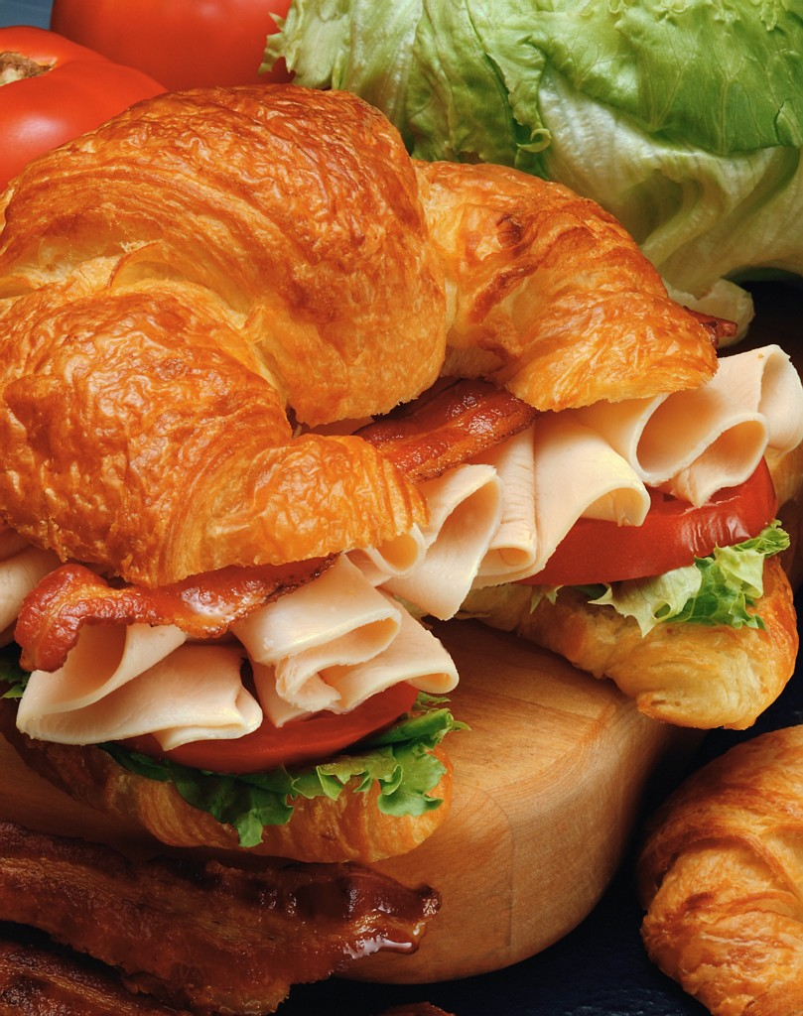
LUNCH!

Slide 28
Morning in Review
What needs to be added to your ‘what to do back home’ list???

Slide 29
5 Determining an Appropriate Goal
What is an appropriate goal for your students in your setting?

Slide 30
Follow a Sequence:
Determine the academic needs for the pertinent group (all-grade, one class, sub-group)
Determine which of those needs are enduring or transferable knowledge or skills
Determine which of those are in your control

Slide 31
Step 1: What does assessment data reveal about student learning needs?
Part 1 (5 minutes):
Look over the data charts.
Consider the strand and demographic data.
Consider the differences between classrooms.
What are the learning (and perhaps instructional) gaps?
Part 2: (10 minutes):
Share noticings and wonderings with your two nearest team members.
What might be a good goal area for 3.1, 6.1, or 8.1? Why?
Notes:
**Use the classroom data comparison sample and the school data comparison chart for subgroups. Possible indicators the participants may call to attention:
Low performing ELL in all strands
Writing program strong in conventions and organization
Vocabulary is weak for ELL
Teacher A is high performing
Teacher D is low performing

Slide 32
Step 2: What do we mean by ‘Enduring’?
For any subject taught in school, we might ask if it’s something an adult would need to know AND whether knowing it makes someone a more ‘Career and College Ready’ adult.
    If something is ‘enduring’ it is worthy of transfer – the learner should be able to use what is have learned in new and sometimes confusing settings.
(Wiggins & McTighe)
Notes:
Ask for examples.

Slide 33

Step 3: The General Goal Area
Is found in student achievement data
Is relevant to 3.1, 6.1, or 8.1
Is enduring
Is within the instructional control of the teacher
Notes:
Ask the group about the last bullet…..many things are in our locus of concern but not in our locus of control. What growth are you able and willing to ‘move’?

Slide 34
Washington and Kentucky…?
Notes:
Two states. Friends but different!

Slide 35
Kentucky and Washington
Why?
Washington is Kentucky’s ‘Critical Friend’.
Washington Leaders have been following Kentucky’s progress and learning from it.
Differences?
Kentucky requires:
2 kinds of student goals: growth and proficiency.
Use of ‘Enduring’ Skills to determine goal and use of ‘rationale’ to write the goal.
Notes:
It’s important for readers to understand that, although Kentucky is our closest state friend in terms of standards, professional learning, and educator evaluation, there are differences. So, before we review some of Kentucky’s work, we need to know how they are different so we don’t assume their rules and practices are the same as ours.

Slide 36
Scenario Protocol: 20-25 minutes
You’ll need a facilitator and a recorder….
10 minutes: You have a scenario for a teacher who went through the process of setting a student growth goal.
Read the scenario and highlight process steps you think are important for your District to consider.
10 minutes: Share ideas from the group about what worked enough that it should be replicated in your district.
Facilitator: Make sure all voices are heard.
Recorder: Record your ideas on a poster.
Notes:
The goal is to end up with ideas about what being read would be of use to those in each participating district.
Process:
You’ll need a volunteer to serve as facilitator and another to serve as recorder for each group.
Allow 10 minutes for individual reading and highlighting.
Allow 10 -15 minutes for facilitator to gather ideas from the group about what worked and what to replicate for their own district. Ideas should be recorded.
Allow 5 minutes to share out.
http://education.ky.gov/teachers/pges/tpges/documents/student%20growth%20scenarios.pdf

Slide 37
6 Writing Student Growth Goals
Your turn
Notes:
SMART Goal Handout in this section.

Slide 38
SMART Goal Process for Student Growth
S
Specific- The goal addresses student needs within the content.
The goal is focused on a specific area of need.
M
Measurable- An appropriate instrument or measure is selected to assess the goal.
The goal is measurable and uses an appropriate instrument.
A
Appropriate- The goal is clearly related to the role and responsibilities of the teacher.
The goal is standards-based and directly related to the subject and students that the teacher teaches.
R
T
Realistic- The goal is attainable.
The goal is doable, but rigorous and stretches the outer bounds of what is attainable.
The goal is bound by a timeline that is definitive and allows for determining goal attainment.
Time-bound- The goal is contained to a single school year/course.
Notes:
Go through this slide. This is an example of best practice in goal writing. You may mention that for teachers and principals in Washington State in their Pro Cert programs, SMART goals are used.
Let the group know that this slide and the next 5 slides may be used as resources—not requirements.
Take 20 minutes for the next five slides.

Slide 39
SPECIFIC
Does the goal identify a specific area of need within the content, based on a learning standard?
Is the goal necessary for the next level of instruction?
Is the goal clearly written?
Notes:
Specific also means that whatever content the teacher chooses as the basis for the goal, it represents essential or enduring skills/learning, concepts or processes.

Slide 40
MEASURABLE
Does the goal identify the sources of evidence/measures that will be used to show student growth?
Are the sources of evidence/measures appropriate for demonstrating growth for the identified area of need?
Are there two or more points in time indicated?
Notes:
Measurable means that the teacher has chosen an appropriate instrument(s) or measure(s) to assess where students are in order to establish the baseline for goal-setting. These sources should be clearly identified within the goal.
It is also important to make sure that the measures identified in the goal can be used to demonstrate growth in the area or areas of identified need.

Slide 41
APPROPRIATE
Is the goal standards-based and directly related to the subject and students taught?
Does the content selected represent enduring skills, concepts or processes?
Notes:
A goal is appropriate when it is clearly related to the roles and responsibilities of the teacher. Is the goal within the teacher’s realm of responsibility? Of course, all teachers have content area standards for which they are responsible and that is what students should master. Goals should be directly related to the subject and the students the teacher teaches.

Slide 42
REALISTIC
Is the goal doable, but rigorous enough to stretch the outer bounds of what is attainable?
Is there a good match between the goal and the level of rigor expected in the standards addressed?
Notes:
A realistic goal is one that is rigorous. In other words, it is challenging, but doable.
Ask, Does your district have a definition of or framework for Rigor? If so, what are you using?

Slide 43
TIME-BOUND
Is there sufficient time within the interval of instruction to determine goal attainment?
The goal is bound by a timeline that is definitive and allows for determining goal attainment.
Notes:
And finally, the T in SMART means time bound. Keep in mind that the interval of instruction must to be sufficient so it’s possible to determine if the goal was met.

Slide 44

Writing your Goal
Using what you have learned and reviewed today, write a goal for
3.1 and/ or
6.1 and/ or
8.1
You have 10 minutes…
Notes:
Give them 20 minutes for this part. Ask them to try and write at least two goals.
You may want to assign goals or at least check so that you get a sample of all three.
Remind the group of all the resources they have now to help them in their writing.

Slide 45
Getting Feedback
Pass the goals around the table
Each participant provides specific feedback to the writer on how to improve the goal
Keep passing until the goal returns to the writer
15 minutes for this section.
Once the goals are back with the author, he/she rewrites them based on feedback.
Shares with a partner
All participants select their best goal, write it on a Post-it and put in on the appropriate chart.
10 minutes for this section.
Notes:
Have posters up and ready for 3.1, 6.1 and 8.1 Student Growth Goal samples.
Let the group know that these goals might be shared in regional resources.
Take 20 minutes for this part of the activity.
Or you could have people get up and get feedback from two different participants, then return to their own table and rewrite at least one of the goals.

Slide 46
Almost Team Time…
Prep for the last session: creating the survey
Take a look at the survey questions. Highlight the items you would like to have your staff answer….
If you have ideas for additional items, write those on the back. Return before you go.

Slide 47
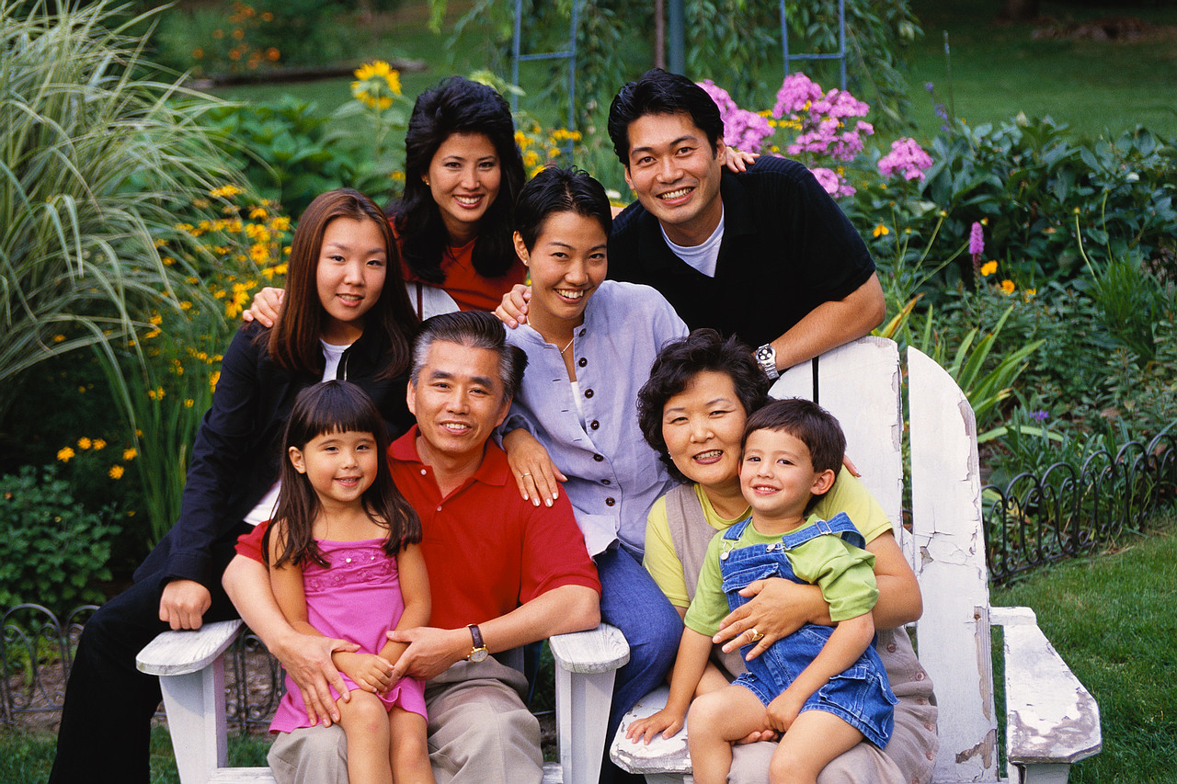
How do you take this home?

Slide 48
Team Time
Notes:
If your time allows for this. If not, be sure to delete the slide.

Slide 49
Concluding the Session

Slide 50
How did we do?
Did you Review . . .
  the legislative requirements for using student growth?
  the Student Growth Goal Rubric language and vocabulary and understand the importance of common definitions?
  Do you better Understand . . .
  the role of aligning Standards, Instruction and Assessment in the SGG process.?
  the key elements of the 2014 state-identified SGG examples?
  how to determine an appropriate goal area based on your context?
  how to write your own sound Student Growth Goal for 3.1, 6.1 and 8.2?
  how you will monitor, collect evidence and report on your Student Growth Goals?
Notes:
Again, adjust this slide to meet the professional learning session you delivered.

Slide 51
Additional Regional Professional Learning Opportunities
Topic | Date | Location
Student Growth 2.0 Repeated | 10/13/14 | OESD 114
Student Growth Supports | To be Arranged with Districts | Regionally
Wa. State Learning Standards/ TPEP Connection | 11/12/14 | OESD 114
Rater Agreement Practices | 12/3/14 | OESD 114
Resource Sharing | TBD | Webinar

