Slide 1
Including Student Growth in Educator Evaluation Day 3
Monitoring and Adjusting
February, 2014
Notes:
Welcome…introductions/ Logistics

Slide 2
Entry Task - Reflect
On your own, write about our last session.
major learnings
action steps you took
clarifications you need
Group yourself with someone from another district
share reflections
Notes:
15 minutes?

Slide 3
Norms of Collaboration
Pausing
Paraphrasing
Posing questions
Putting ideas on the table
Providing data
Paying attention to self and others
Presuming positive intentions
Anything else?
Notes:
Review and choose one.

Slide 4
Sessions Addressing Student Growth
Setting Student Growth Goals (SGGs)
Monitoring SGGs
The Evaluation Cycle: Reflecting and Evaluating SGGs
In-District Planning: Participants, Communication, Professional Learning, Etc.
Notes:
Not a one-to-one correspondence.
We will not have a March session.
The final session will be in April: 4.17 and 4.23
The final 4th and final sessions are scheduled for: Bremerton: 3/13 P.A.: 3/21

Slide 5
Another Look at Student Growth Rubrics
Operational Terms Examples
Essential components of a Student Growth Goal – SGG - (SMART)
Some possible ‘examples/non-examples’
Essential components of assessments to measure SGGs
Notes:
Review SGGs (in their binder in section 1)
Pass out “SMART Goal” cards. Have participants draw one and look at it against the appropriate SGG rubric. “How did your teacher do?”

Slide 6
SMART Goals
Consider SGGs in light of SMART Goals
Specific
Measurable
Appropriate
Realistic
Time bound
Notes:
Use SMART goals as a filter and take another look?
Which goals are SMART goals?
Pass out answer sheet (“Meeting SMART Goal Criteria”

Slide 7
Intended Outcomes for this Session
Participants will:
Understand the essential components and tools for an evaluation/growth cycle (for teachers and principals).
Examine/Analyze their model evaluation/growth cycle to determine possible additions or adjustments.
Understand the evaluation cycle as it appears in the eVal tool.
Consider implications for District planning.
Notes:
Cover and come back at the end to remind people about what we did today.

Slide 8
g
Reviewing the Teacher Evaluation/Growth Cycle
Notes:
We are going to spend some time going over the “small g” evaluation cycle. Remember, you have the WAC in your binder.
Describe the former evaluation paradigm.
Ask, “Would someone please describe the new evaluation paradigm?”
“What are the major differences?”
Let’s take a look . . .

Slide 9
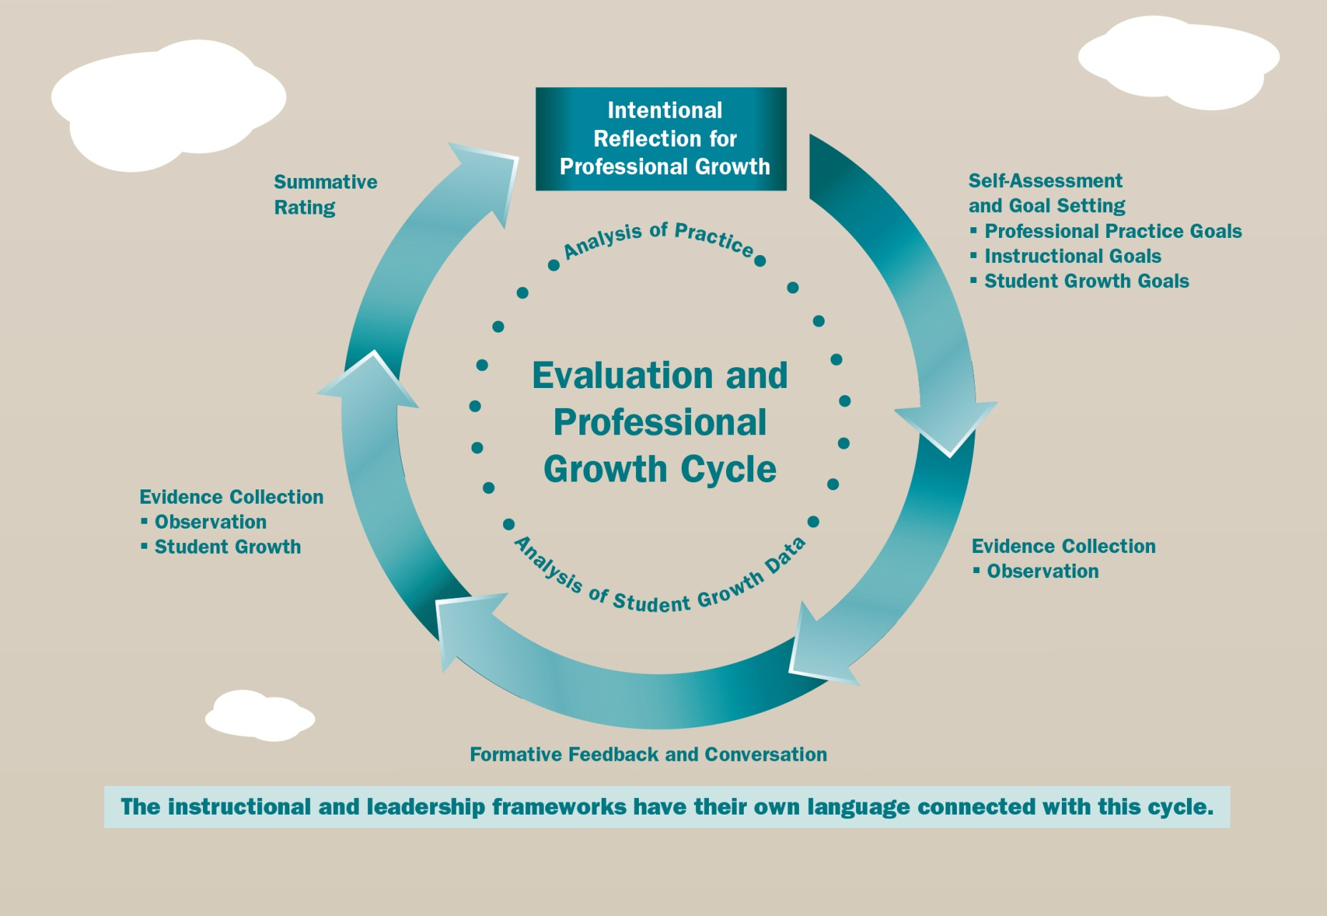
Year-Long Teacher Evaluation/Growth Cycle
g
Notes:
Say: If this were an annual cycle, with the beginning of the school year starting on the top right, and the end at the top left, what, exactly takes place during this cycle? Where are you in this professional growth/ evaluation cycle?
Where are the opportune times for monitoring SGGs?

Slide 10
The Year-Long Teacher Evaluation/Growth Cycle
By 9:35:
Organize your district team (with roles)
Use your form to note your checkpoints and tools for creating and monitoring SGGs
Create a visual of your District’s year long cycle
Post both the form and visual
Choose one team member to be the ‘spokesperson’ at the poster
Notes:
Chart paper
Link evidence to criteria
Determining level of performance

Slide 11
The Year-Long Teacher Evaluation/Growth Cycle
Break your district team in half
Each half examines half of the posted materials to gather ideas
One team member at poster to offer information
Notes:
Chart paper
Date Action Response
Post Tools and Forms. If you did not bring them, just list them on a post it.

Slide 12
Table Talk
By 9:50:
Back with your team:
Review the ideas you that you found helpful or interesting.
Make a list of those things you will explore further for possible use in your own district.
Notes:
You will use this list during team time.

Slide 13
The Principal’s Roles
In the Teacher Evaluation cycle
In the Principal/ Assistant Principal Evaluation cycle
What does the research say about the importance of the principal as instructional leader?
Notes:
Discuss the duality of the role: Evaluator and Evaluatee

Slide 14
The Research
Recent joint research project between Vanderbilt University and Stanford University, funded by the Institute of Education Sciences revealed . . .
Principal time spent directly coaching teachers is positively associated with learning and school improvement, while time spent engaged in informal classroom “walkthroughs” is negatively associated with school improvement, at least in high schools.
Notes:
Add - How he/she spends time with teachers is key, as is whether or not the teachers believe the observations are part of their professional development.

Slide 15
g
Reviewing the Principal Evaluation/Growth Cycle
Notes:
We are going to spend some time going over the “small g” evaluation cycle. Remember, you have the WAC in your binder.
Describe my experience in a former evaluation paradigm.
Same Question: Ask, “Would someone please describe the new evaluation paradigm?”
“What are the major differences?”
Let’s take a look . . .

Slide 16
g
Reflecting on goals, progress and next steps. . .
An end-of-year self assessment?
Self-Assessment/ Reflection, Personal Goal based on self-assessment/ District Goal based on District context
August/ September
Self Assessment and Goal Setting
Sept./ Oct./Nov.
Scheduling Monitoring/ Support Conferences
Initial Conference #1 (Fall)
Dec../ Jan. Feb.
Monitoring / Support Conference #2
(Winter)
March/ April
Monitoring/ Support Conference #3
(Spring)
May/ June
Summative Conference
Providing continued support, responding to questions where candidate is between two ratings.
Ongoing Monitoring and Support - visits, walk throughs and observations
Year -long Principal
Evaluation
Cycle
Ongoing Monitoring and Support - visits, walk throughs and observations, prepping for summative conf.
Ongoing Monitoring and Support - visits, walk throughs and observations
Ongoing Monitoring and Support - visits, walk throughs and observations
Ongoing Monitoring and Support - visits, walk throughs and observations
Ongoing Monitoring and Support - visits, walk throughs and observations
Notes:
Review cycle – ask for examples of what districts are doing during the cycle as you go through each season.
How might the principal support the PE teacher’s SGG?

Slide 17
A Conversation in Job-Alike Pairs/Trios
What questions might the principal ask the Health/Fitness teacher about the progress monitoring of his/ her SGG?
At what points during the evaluation cycle?
How does this play into the principal’s evaluation (see Criterion 5 on the Leadership Rubric)?
Notes:
Have district teams discuss these questions.
Pass out Criterion 5 of AWSP rubric.
Share out.

Slide 18
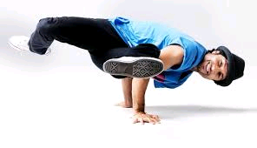
BREAK!

Slide 19
Models from the Field
Anacortes
What do I want to remember?
Conway
What do I want to remember?

Slide 20
LUNCH!

Slide 21
Monitoring Student Growth – Reflect and Share
Use the Self Reflection Sheet (5 minutes on your own).
Re-join your job-alike groups; same facilitator
Share your thinking/work regarding (15 minutes)
celebrations for work done
forms or protocols being used
questions still unanswered
Share aha’s, highlights back in the whole group (5 minutes)

Slide 22
For Teachers
Are all students making progress toward the student growth goal I set for them?
How do I know?
Who needs more support?
How do I know?
How do I determine the appropriate approach/intervention?
How do I know?
What help do I need and where do I find it?
Other questions that need addressing?
Notes:
Principal corollary

Slide 23
For Building Administrators
Are all teachers/teacher groups monitoring progress towards the student growth goals they set?
How do I know?
Who needs more support?
How do I know? How do I/we determine the appropriate approach/intervention? For students? For teachers?
What help do I/we need and where do I/we find it?
How will I ensure they get the support?
Other questions that need addressing?

Slide 24
For Central Office Administrators: As Evaluators of Principals
How do I ensure that building administrators are:
planning with data?
assisting staff to use data to monitor and adjust instruction?
connecting student growth to the school improvement plan?
evaluating staff on effective instruction and assessment practices?
tracking evidence of student growth – for all and subgroups?
Notes:
Use student growth goal rubrics for teachers and principals so that everyone can see the exact verbiage.
Questions: What would evidence be in 3.5? 5.5? 8.3?

Slide 25
eVAL
What is new?
Notes:
Jeff here

Slide 26
Reviewing the Intended Outcomes for this Session
Participants will:
Understand the essential components and tools for an evaluation cycle (for teachers and principals).
Examine/Analyze their model evaluation cycle to determine possible additions or adjustments.
Understand the evaluation cycle as it appears in the eVal tool.
Consider implications for District planning.

Slide 27
How did we do?
Plus / Delta Chart
Delta
Plus

Slide 28
Thank You
Next Meeting . . .
April 17: Cohort 1
April 23: Cohort 2

Slide 29
District Planning
Team Time

Slide 30
Principal Evaluation Progress Sharing
What’s going well?
What do you still need to work on?
What are your next steps?
Notes:
Take notes on what you hear from other districts . . .
What’s going well?
What do you still need to work on?
What are your next steps?

Slide 31
What strategy will you use back at home to share your learning?
What messages will you deliver? To whom? When? How?
What professional learning will you manage? To whom? When? How?
How can you as a leadership team add coherence to the district?
What decisions do you make?
What understandings do you have?
What operational definitions do you need to create?

