Slide 1
eVAL Self Assessment (Adapted from LaConner School Improvement Presentation)
Your Name
Your District
Your Date

Slide 2
Agenda for Today
Purpose and Success Criteria
Clock Hours
Review of new “state 8” criteria for teacher and principal evaluation
Self-Assessment using eVal tool

Slide 3
Purpose
By the end of today’s session, each teacher will successfully complete a “self-assessment” using the eVal tool on OSPI.
By the end of today’s session, most (and hopefully all) “pressing” questions staff have about the new teacher & principal evaluation will have been answered.

Slide 4
Success Criteria
Each participating teacher will have a clearer understanding of the “close correspondence” between the CEL 5D+ criteria and the “state eight” criteria
Each participating teacher will have completed a self-assessment in the eVal tool (and will give a printed copy to his/her administrator)

Slide 5
Clock Hours
Complete form and indicate the number of clock hours you earned (max is 14)
You must have signed in at each session to receive all 14 clock hours
Subtract 2 hours for each session you missed
Return completed form to Peg at DO

Slide 6
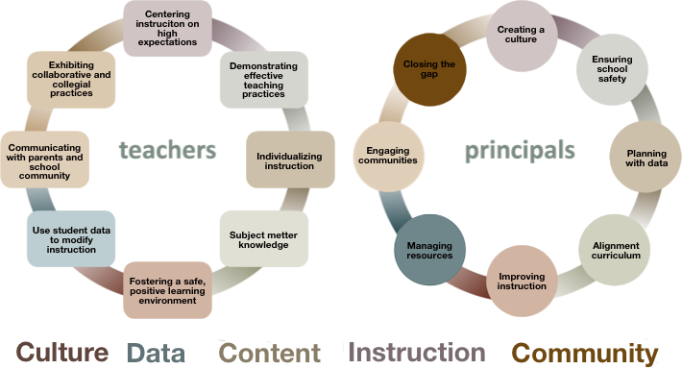
TPEP Criteria Themes

Slide 7
Changes in Teacher & Principal Evaluation Criteria
Current Teacher Evaluation Criteria | New Teacher Evaluation Criteria
Instructional skill Classroom management Professional preparation and scholarship Effort toward improvement when needed Handling of student discipline and attendant problems Interest in teaching pupils Knowledge of subject matter | Centering instruction on high expectations for student achievement Demonstrating effective teaching practices Recognizing individual student learning needs and developing strategies to address those needs Providing clear and intentional focus on subject matter content and curriculum Fostering and managing a safe, positive learning environment Using multiple student data elements to modify instruction and improve student learning Communicating with parents and school community Exhibiting collaborative and collegial practices focus on improving instructional practice and student learning
Current Principal Evaluation Criteria | New Principal Evaluation Criteria
Knowledge of, experience in and training in recognizing good professional performance, capabilities and development School administration and management School finance Professional preparation and scholarship Effort toward improvement when needed Interest in pupils, employees, patrons and subjects taught in school Leadership Ability and performance of evaluation of school personnel | Creating a school culture that promotes the ongoing improvement of learning and teaching for students and staff Providing for school safety Leads development, implementation and evaluation of a data-driven plan for increasing student achievement, including the use of multiple student data elements Assisting instructional staff with alignment of curriculum, instruction and assessment with state and local district learning goals Monitoring, assisting and evaluating effective instruction and assessment practices Managing both staff and fiscal resources to support student achievement and legal responsibilities Partnering with the school community to promote student learning Demonstrating commitment to closing the achievement gap

Slide 8
Log in to eVal within OSPI’s EDS
Uses Safari, Google Chrome, Internet Explorer as your Browser NOT Firefox
http://www.k12.wa.us
Log in to EDS (very bottom right of page)
Log in to your EDS account – “view my permissions”
Log in to eVal
Click on red “ASSESS”
Click on “New Self Assessment” – give it a title: Self-Assessment Spring 2013
Create session

Slide 10
Possible “Views” for Self-Assessment
State Rubrics (8)
Instructional Rubrics (6 from CEL)
Student Growth Rubrics (State criteria 3, 6, & 8)
***Fill in one and it transfers to the others.

Slide 12
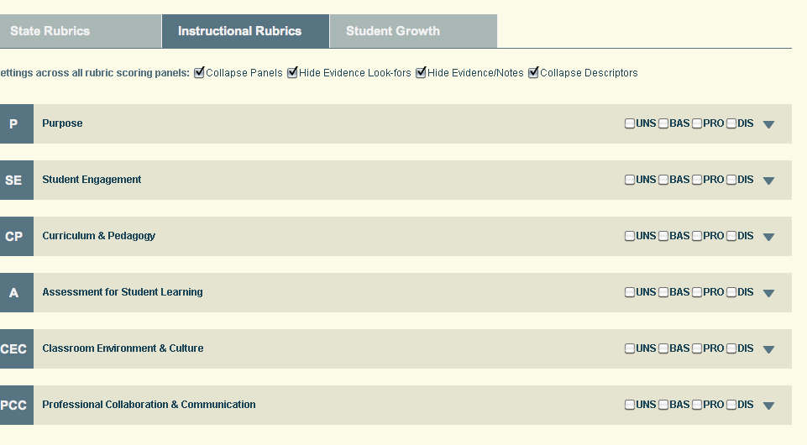
Click on Instructional Rubrics
Un-check “Collapse Descriptors” and click on down

Slide 13
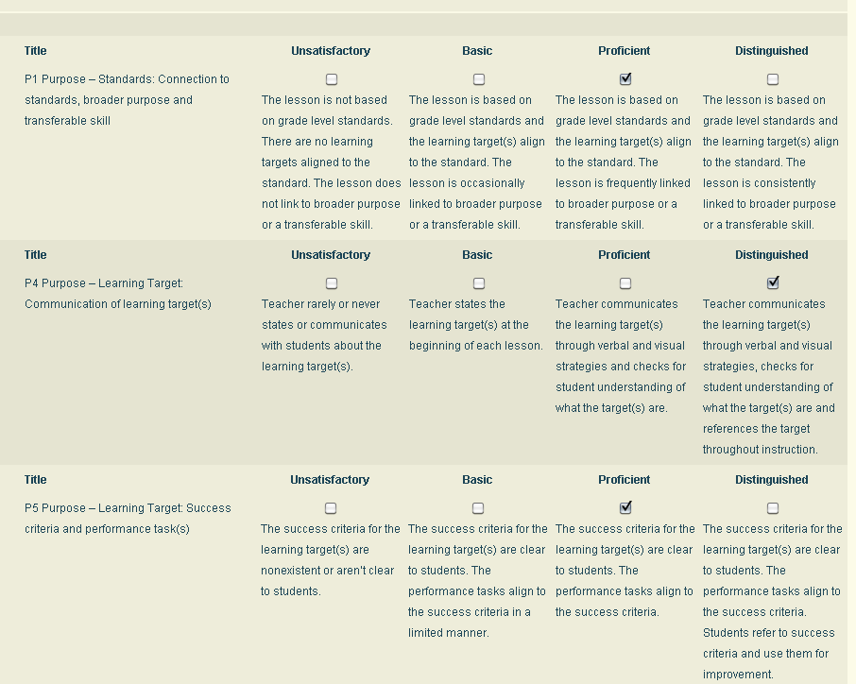
Complete the Self- Assessment

Slide 14
Things you will notice:
When you fill out Instructional Rubrics the scores transfer to the State Rubric
It will not give an “over-all criterion score” – you must do that yourself

Slide 15
Getting a Report of Self-Assessment
Click “Report”
You have a printable report to share with your principal
You can print this as:
State Rubrics
Instructional Rubrics
Growth Rubrics

Slide 16
Thank You!
Your Name
Your email address

