Slide 1
Webinar Setting up an eVAL Practice Session
Cathey Frederick
ESD 189 eVAL Specialist

Slide 2
Learning Target
To have the skills, knowledge, and confidence to be an effective user of eVAL to support the evaluation cycle for principals and teachers including:
Setting up Practice Sessions

Slide 3
Logging into eVAL Sandbox School Administrator
http://sandbox.eval-wa.org/
District Name<space>SD<space>School <space>number 1-5 <space>Role Abbreviation (AD)
Example (Concrete District, School 1, AD): Concrete SD School 1 AD) (Use your district)
Password = password (all lower case)
Notes:
Self assessment F

Slide 4
School Admin Log In Screen
Select Administrator
In live version

Slide 5
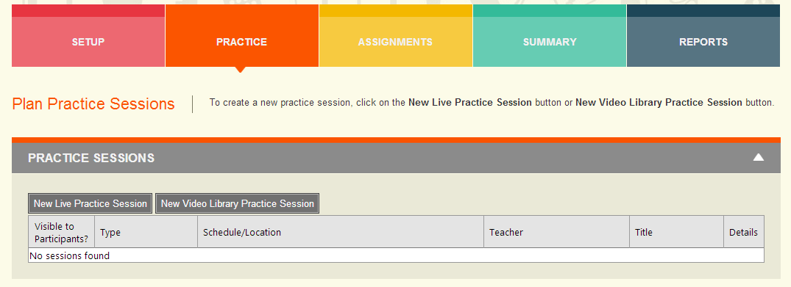
Principal/School Administrator Planning Practice Session
Click here or here
You must be logged in as School or District Administrator to set up a practice session.
Notes:
Self assessment F

Slide 6
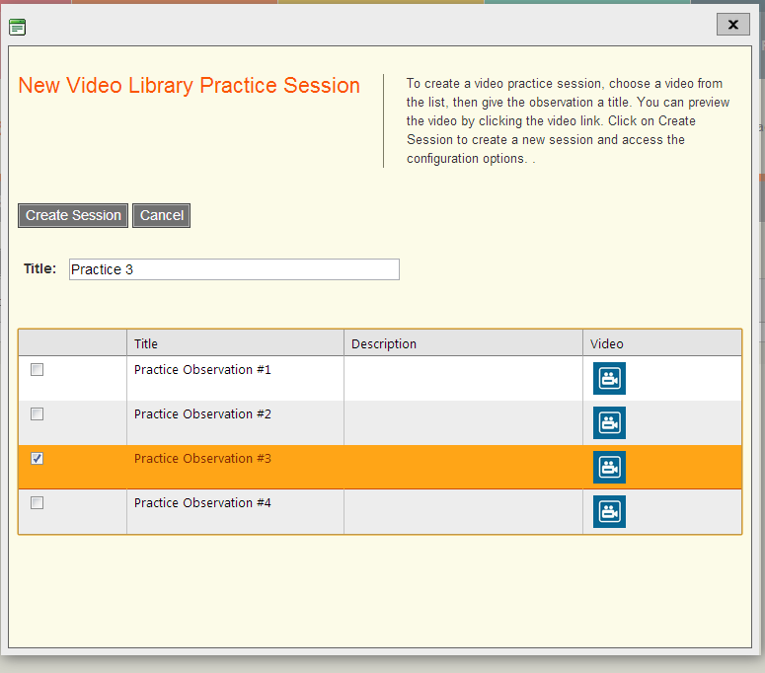
Principal/School Administrator Planning Practice Session
Be sure to
Click Create
Session to
Save
Notes:
Self assessment F

Slide 7
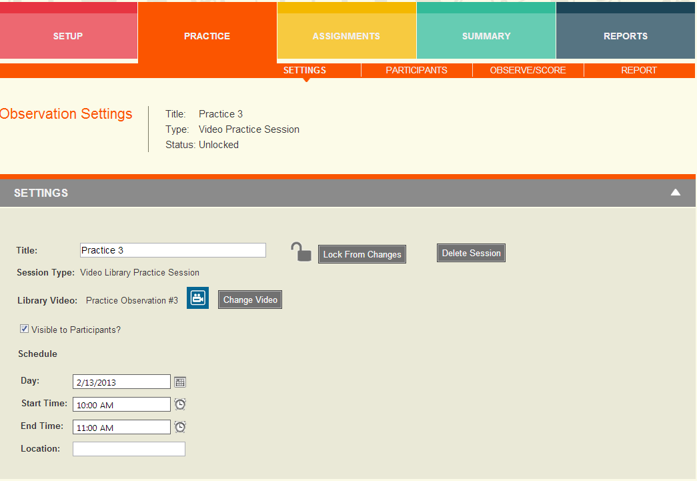
Principal/School Administrator Planning Practice Session
Be sure to
Click Make
Visible to
Participants
Notes:
Self assessment F

Slide 8
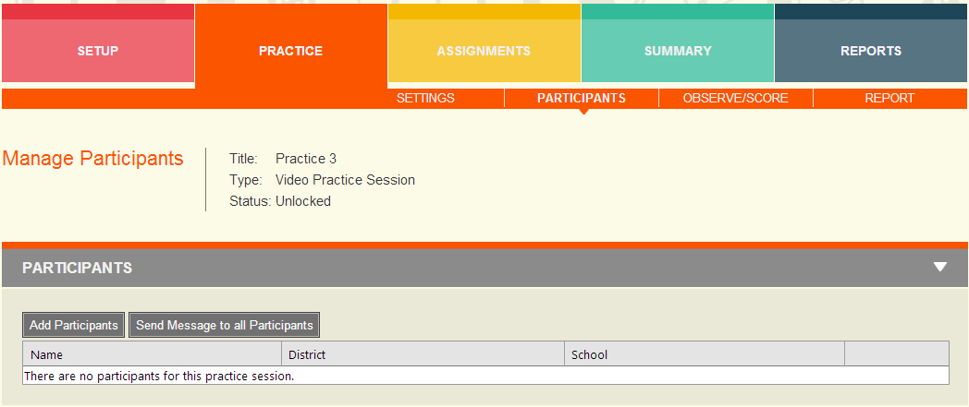
Principal/School Administrator Planning Practice Session
Click on Add Participants.
Notes:
Self assessment F

Slide 9
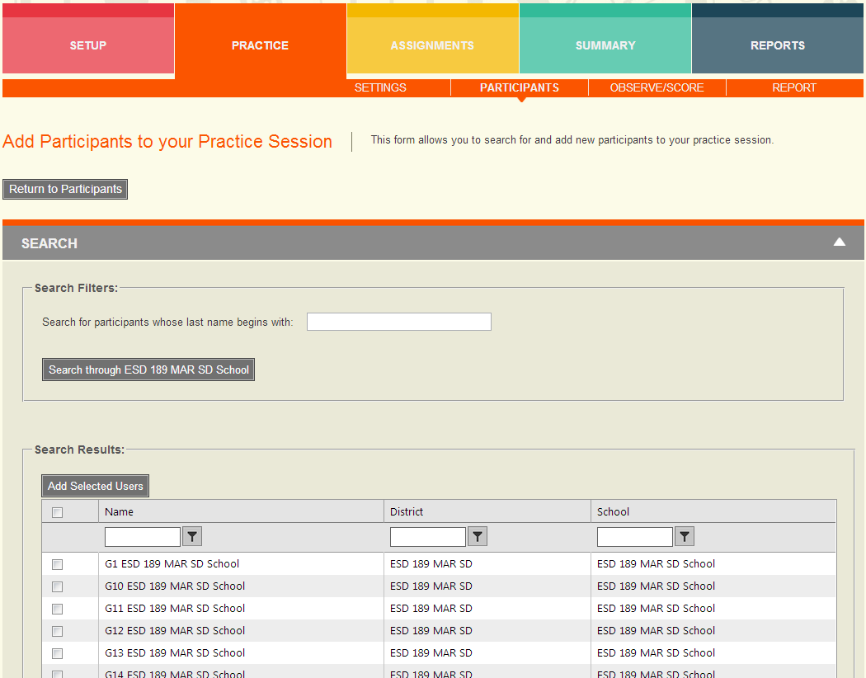
Principal/School Administrator Planning Practice Session
Select all by clicking
here
Select individual
Participants by
clicking here
Then click Add
Selected Users
Notes:
Self assessment F

Slide 10
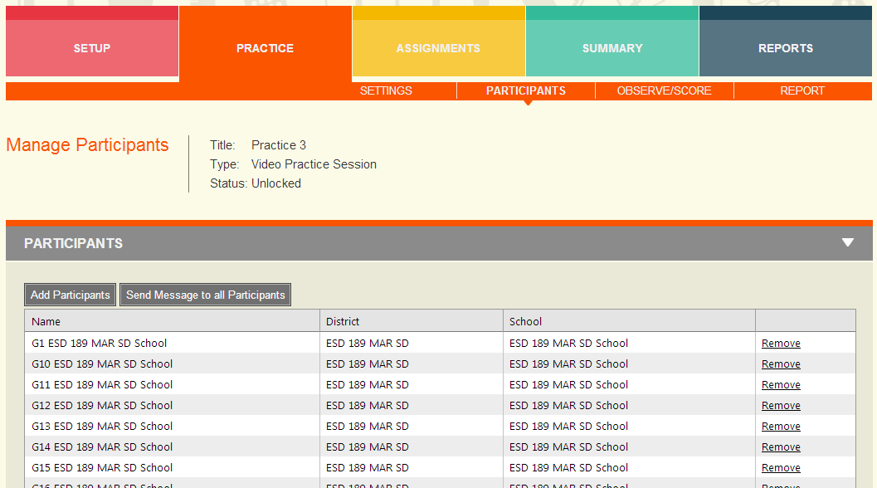
Principal/School Administrator Planning Practice Session
List of participants – you can add or remove from this screen. You can
Send a message to all participants.
Notes:
Self assessment F

Slide 11
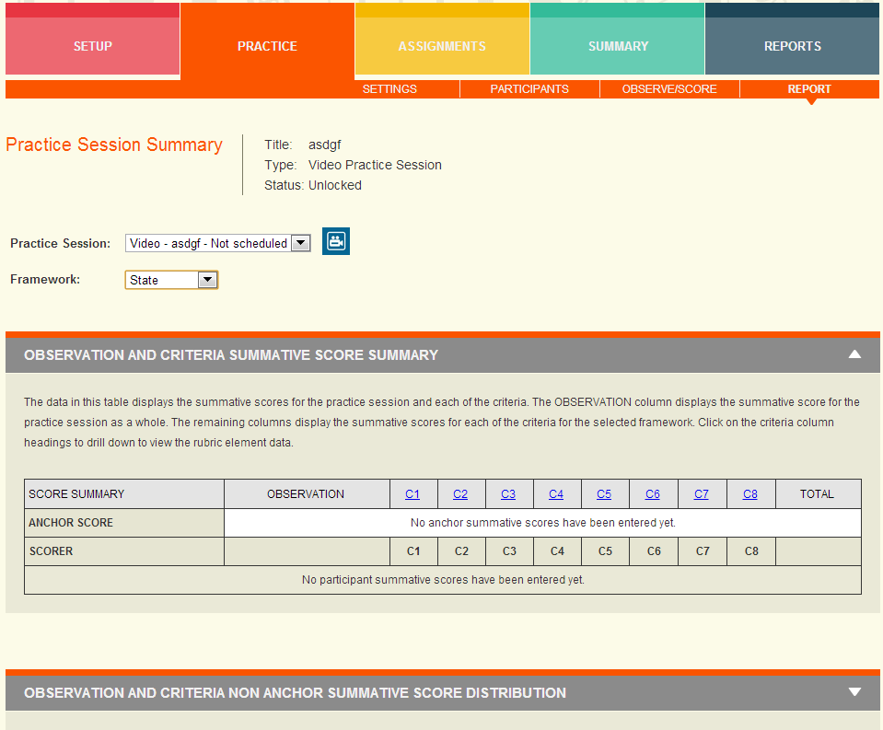
Principal/School Administrator Practice Session
To create
anchor
scores,
mark
rubrics
while
logged
in as
admin
Notes:
Self assessment F

Slide 12
Logging into eVAL Sandbox as Principal
http://sandbox.eval-wa.org/
District Name<space>SD<space>School <space>number 1-5 <space>Role Abbreviation (PR)
Example (Concrete District, School 1, PR): Concrete SD School 1 PR (Use your District)
Password = password (all lower case)
Notes:
Self assessment F

Slide 13
Principal Log In Screen

Slide 14
Teacher Log In Screen

Slide 15
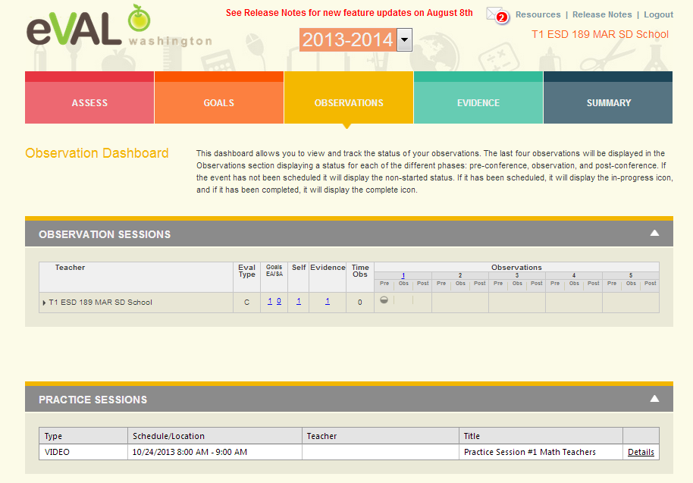
Teacher Dashboard
Click on
details

Slide 16
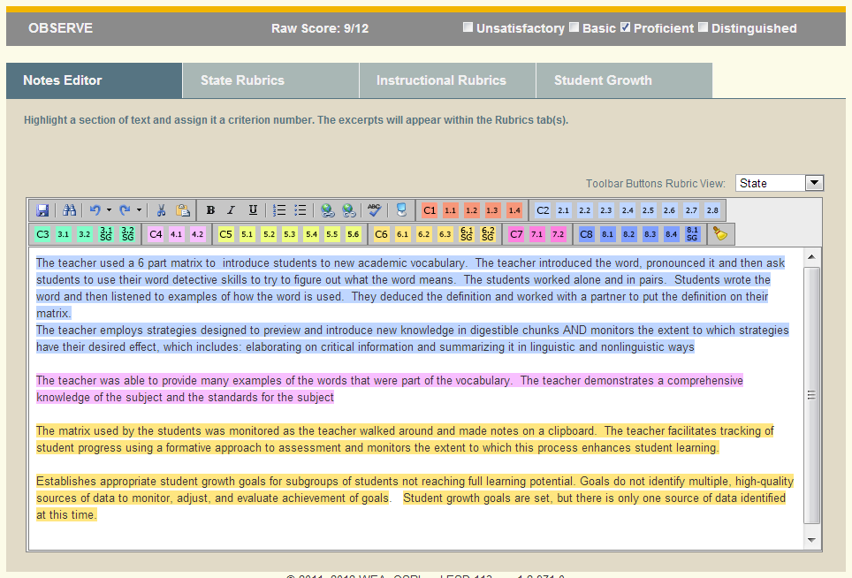
Practice Observe/Score

Slide 17
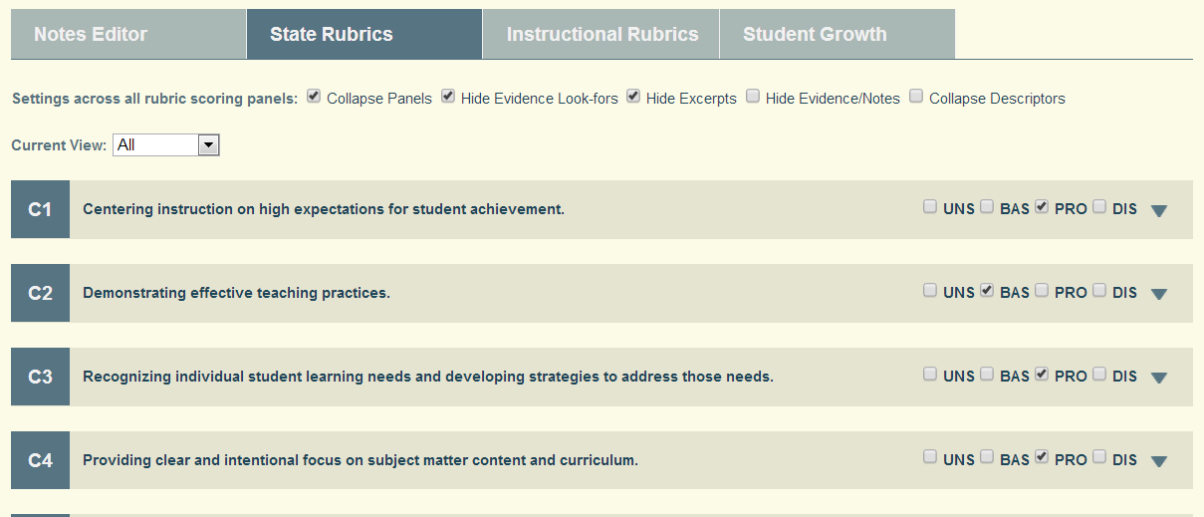
Practice Observe/Score
Use the drop down to view and score the sub criteria. Then,using preponderance
of evidence, assign a score at the criteria level. Most districts are not assigning
scores at the summative level.

Slide 18
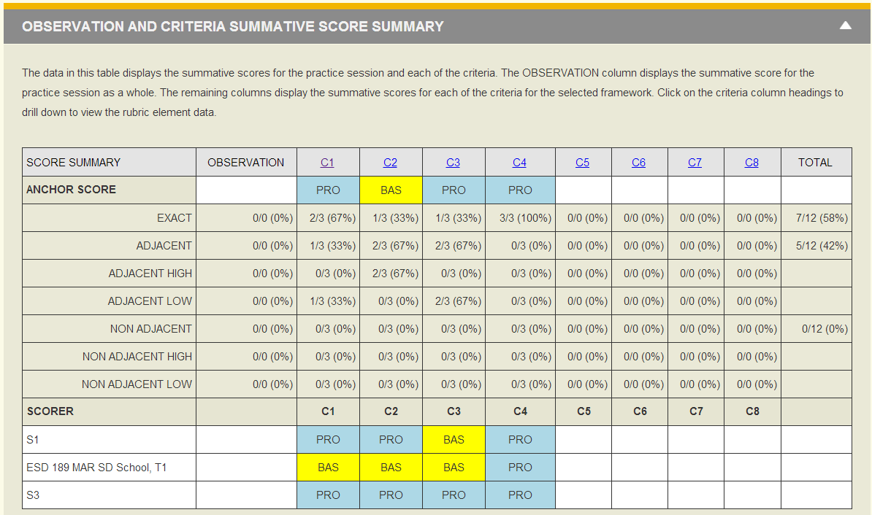
Observation and Criteria Summary Report
Click on the criteria to drill down to 4 different sub criteria reports. Return to Level 1.

Slide 19
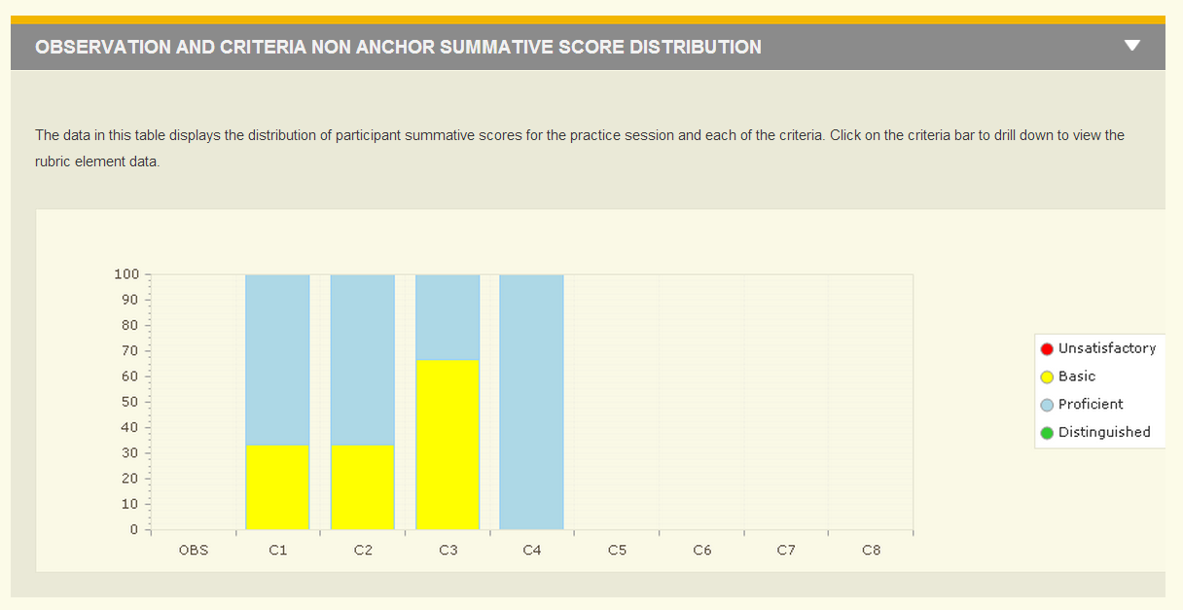
Distribution Report Non Anchor
Click on the criteria bar to drill down to 4 sub criteria reports. Return to Level 1.

Slide 20
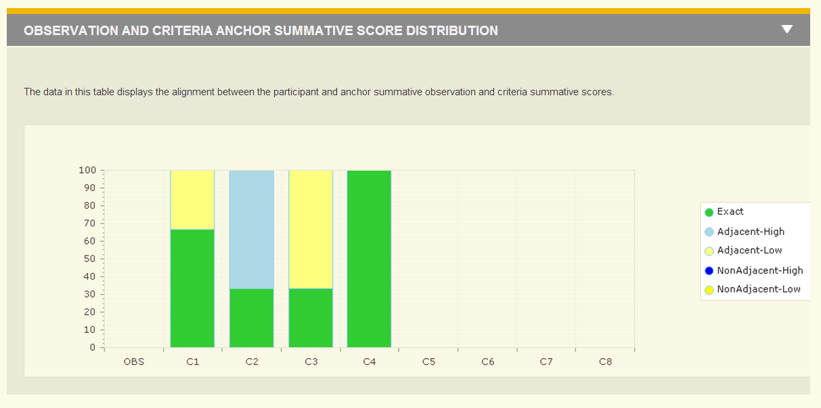
Distribution Report Anchor
This report is dependent on the entry of anchor scores by either the school
or district administrator.

Slide 21
Thank You!
Please send any questions to:
Cathey Frederick
ESD 189 eVAL Specialist
cfrederick@nwesd.org
Good Luck!

