Slide 1

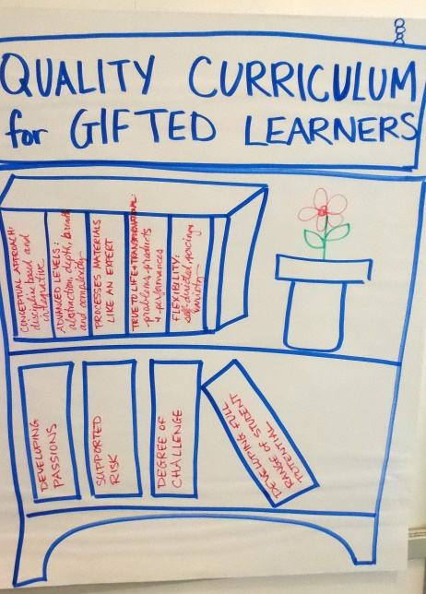
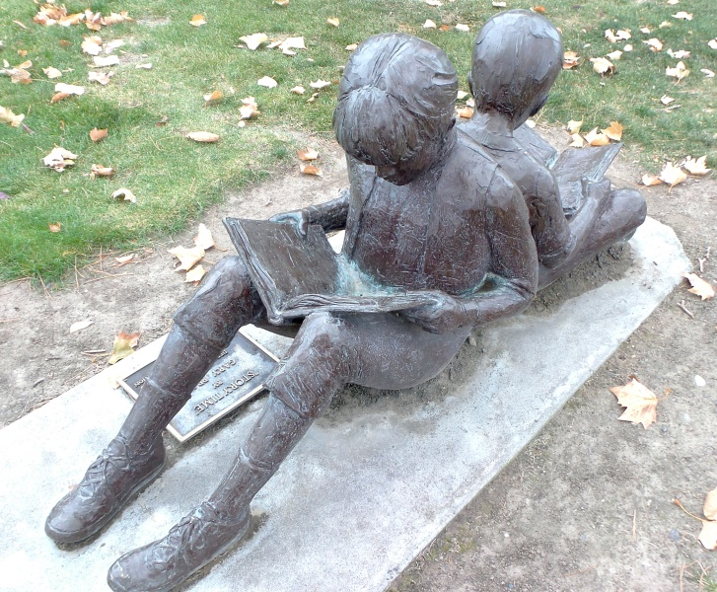
Assuring Gifted Program Quality Through Self-Study.
Gail Hanninen, Ed. D.
Gail5wood@yahoo.com

Slide 2



Essential Question??
How can the self-study process be used to assure gifted program quality and appropriateness?

Slide 3


Slide 4


The foundation for the Self-Study Process
What can be used to guide our Self-Study Process when reviewing our district’s Gifted Program?

Slide 5
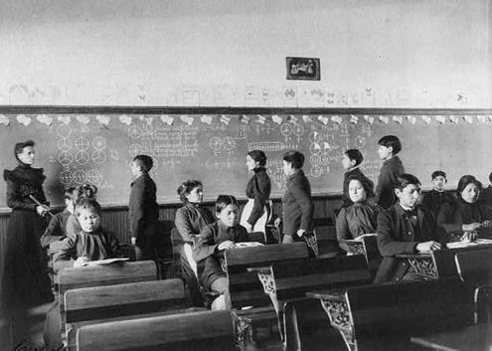
Nine Characteristics of High-Performing Schools
Prepared by: G.S.Shannon & P. Bylsma, OSPI (2007)
Clear and shared focus
High standards and expectations for all students
Effective school leadership
High levels of collaboration and communication
Curriculum, instruction and assessments aligned with state standards
Frequent monitoring of learning and teaching
Focused professional development
Supportive learning environment
High level of family and community involvement

Slide 6
Research & select practices
Monitor imple-mentation of Plan
Ready to Benefit
Evaluate Impact on Student Growth
Collect, sort & select data
Nine Characteristics of High Performing Schools
Build & Analyze Profile
Set & Prioritize Goals
Craft Action Plan
Source : OSPI & ISDE (2005 & 2008)
CONTINUOUS IMPROVEMENT

Slide 7

DOES A GIFTED PROGRAM REVIEW HAVE A SIMILAR LOOK???

Slide 8



Self-Study, program planning and development are not SINGLE EVENTS ---
BECAUSE THEY ARE COORDINATED ONGOING PROCESSES.

Slide 9

Self-Study Program Planning Process
Students
Form Task Force or Advisory Committee
Clarify Task & Define or clarify Program Mission/ Vision?
Develop programming options & prioritize
Plan for Implementa-tion of selected options
Progress Monitor Student & Program
Effectiveness
Review &
Revise
Gather Data on Program Effectiveness & Options

Slide 10
SAMPLE MISSION/GOAL/OBJECTIVE
SULTAN SCHOOL DISTRICT, Hi Cap Program Guide
Mission Statement
The mission of the Sultan Public Schools Highly Capable Program is to provide an educational program, which promotes consistent, challenging opportunities for highly capable students.
Purpose Statement
The Sultan School District’s Highly Capable program provides consistent, challenging opportunities for students with outstanding abilities to meet and exceed the state standards. This program enhances academic achievement by creating a unique learning environment beyond the regular classroom. Students will benefit from peer interactions engaging in higher level thinking experiences that are commensurate with the learner’s capacity for growth.
Philosophy Statement
We believe that a rich and accelerated learning environment provides challenging opportunities for all students. Individual program modifications for highly capable students maximize their capacity to learn and assist them to achieve beyond the regular classroom.

Slide 11
SAMPLE MISSION/GOAL/OBJECTIVE
MOUNT VERNON, Program Plan Proposal
Mount Vernon School District is committed to identifying and providing for the unique intellectual, social, emotional, and prepares college and career readiness.
Our purpose is to provide appropriate educational programs and services through instructional, curricular, and administrative modifications to create educational opportunities for Highly Capable students that will maximize their individual potential.
MOUNT VERNON, website
In the Mount Vernon School District, we believe it is important to develop the special abilities of each student and to offer appropriate academic instructional services to meet the needs of highly capable students. Our goal is to offer services that:
* expand academic and intellectual skills;
* stimulate intellectual curiosity, independence and responsibility;
* develop perseverance and understanding of the role of effort in success;
* develop a positive attitude toward self and others; and
* develop originality and creativity.

Slide 12
SAMPLE MISSION/GOAL/OBJECTIVE
ARLINGTON SCHOOL DISTRICT—iGrant
We commit to support a purposeful continuum of services for a diverse group of highly capable learners to develop each individual's fullest potential.
ARLINGTON, website
In accordance with the philosophy to develop the special abilities of each student, the District shall offer appropriate instructional programs to meet the needs of highly capable students of school age.
ANACORTES, website
• Meet the educational needs of the most highly capable students within the Anacortes School District.
• Encourage the development of enriched and extended learning opportunities for interested students within the Anacortes School District.
SEDRO-WOOLLEY, website
SWSD Highly Capable Program will provide a multi-school educational experience for K-12 students that will meet the needs of students who have exceptional ability by offering challenging and enriching learning experiences through differentiated instruction.

Slide 13



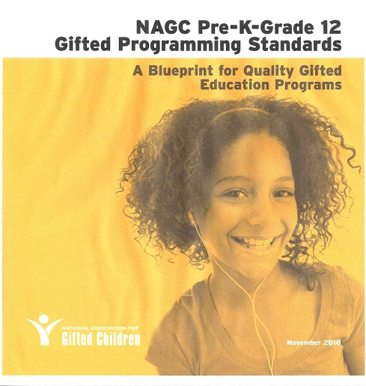
RESOURCES TO CONSIDER
Student, Teacher & Parent DATA
District Plans
Research
WAC 392-170
Options

Slide 14


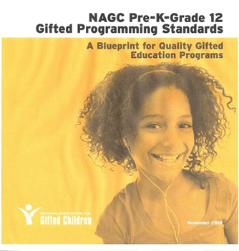
Aligning the WACs with the NAGC Standards

Slide 15



ROAD MAP FOR GUIDING OUR WORK
CRITERIA STATEMENTS: WAC 392-170- _ _ _
OUR ROUTE
GUIDE TO DATA SOURCES: NAGC Pre-K – Gr. 12 PROGRAM STANDARDS
STUDENT OUTCOMES | EVIDENCE-BASED PRACTICES
EXAMPLES OF SOURCES OF DATA INCLUDE:
STUDENT PRODUCTS,
TEACHER ANTIDOTAL REPORTS,
PARENT CONFERENCE REPORTS,
STUDENT PLANS,
TEACHER STUDENT PLANNING NOTES,
TEACHER, STUDENT, STAFF SURVEYS,
STUDENT ACADEMIC TESTING AND GRADE RECORDS, ETC.

Slide 16
HIGHLY CAPABLE PROGRAM
PLANNING GUIDE
PROGRAM AREAS
  Student Identification and Placement
  Student Program Services
  Professional Development and Support
  Program Management
  Parent/Community Involvement

Slide 17

HIGHLY CAPABLE PROGRAM PLANNING GUIDE:
ORGANIZATIONAL FORMAT
OUR FOCUS TODAY IS ON PROGRAM SERVICES:
STEP #1: Analysis of WAC 392-170
WAC 392-170-078 –
  Districts shall make a variety of appropriate program services available to students who participate in the district's program for highly capable students.
  Once services are started, a continuum of services shall be provided to the student from K-12.
  Districts shall periodically review services for each student to ensure that the services are appropriate.
WAC 392-170-080
  Each student identified as a highly capable student shall be provided educational opportunities which take into account such student's unique needs and capabilities.
  Such program shall recognize the limits of the resources provided by the state and the program options available to the district, including programs in adjoining districts and public institutions of higher education. Districts shall keep on file a description of the educational programs provided for students selected.

Slide 18
CRITERIA STATEMENTS | WAC 392-170- ……. in Planning Guide
WAC 392-170-078 2.1. | Program Services Districts shall make a variety of appropriate program services available to students who participate in the district's program for highly capable students
2.2. | Once services are started, a continuum of services shall be provided to the student from K-12.
2.3. | Districts shall periodically review services for each student to ensure that the services are appropriate.
WAC 392-170-080 2.4. | Educational program for highly capable students. Each student identified as a highly capable student shall be provided educational opportunities which take into account such student's unique needs and capabilities.
2.5. | Such program shall recognize the limits of the resources provided by the state and the program options available to the district, including programs in adjoining districts and public institutions of higher education. Districts shall keep on file a description of the educational programs provided for students selected.

Slide 19
STEP #2: Alignment of WAC 392-170 to
NAGC K-12 Programming Standards
The NAGC Pre-K-Grade 12 Gifted Programming Standards which supports program criteria stipulated in WAC 392-170-078 includes
STANDARD 1: LEARNING AND DEVELOPMENT--Educators, recognizing the learning and developmental differences of students with gifts and talents, promote ongoing self-understanding, awareness of their needs, and cognitive and affective growth of these students in school, home, and community settings to ensure specific student outcomes.
STANDARD 3: CURRICULUM PLANNING AND INSTRUCTION.
STANDARD 4: LEARNING ENVIRONMENTS
STANDARD 5: PROGRAMMING
STANDARD 6: PROFESSIONAL DEVELOPMENT

Slide 20

For each NAGC Program Standard, there are:
STUDENT OUTCOMES and EVIDENCE-BASED PRACTICES.
For our purposes today, we will only be addressing STANDARD 1: LEARNING AND DEVELOPMENT:
STUDENT OUTCOME 1.6. Cognitive & Affective Growth | EVIDENCE-BASED PRACTICES 1.6.1 1.6.2.

Slide 21
STANDARD 1: LEARNING AND DEVELOPMENT
Description: Educators, recognizing the learning and developmental differences of students with gifts and talents, promote ongoing self-understanding, awareness of their needs, and cognitive and affective growth of these students in school, home, and community settings to ensure specific student outcomes.
STUDENT OUTCOMES | EVIDENCE-BASED PRACTICES
1.6. Cognitive and Affective Growth. Students with gifts and talents benefit from meaningful and challenging learning activities addressing their unique characteristics and needs. | 1.6.1. Educators design interventions for students to develop cognitive and affective growth that is based on research of effective practices. 1.6.2. Educators develop specialized intervention services for students with gifts and talents who are underachieving and are now learning and developing their talents.

Slide 22
PROCESS = MEANINGFUL
RESULTS

Slide 23
A TIME FOR INTENSE CONVERSATIONS☺
HOW DO YOU RATE YOUR DISTRICT’S PROGRAM SERVICES?
WHAT ARE YOUR SOURCES OF EVIDENCE?
 | CRITERIA STATEMENTS | Level of Implementation | EVIDENCE
2.1. | Program services. Districts shall make a variety of appropriate program services available to students who participate in the district's program for highly capable students. WAC 392-170-078 |  Minimal  Exemplary
PLEASE REMEMBER –
AN OPINION ≠ EVIDENCE
SO HOW DO WE START THE CONVERSATIONS?

Slide 24
GUIDING QUESTIONS FOR DISCUSSION
In reflecting upon the MISSION & PURPOSE of our District’s Hi Cap Program, what do we perceive as our top needs? | In light of our perceptions, what do we currently have in place that “we think” is working well for STUDENTS? | What do we think needs to be changed and/or implemented to more appropriately meet the needs of each identified Hi Cap student? | What do we think are the greatest barriers and/or challenges needing to be addressed in order to achieve our MISSION/PURPOSE? | What and/or where do we have our greatest support and/or resources? | What ACTION ITEM is needed to address each issue/need?

Slide 25
ACTION PLAN TEMPLATE (Sample)
CRITERIA STATEMENT: _________________________________________
Outcome Needed | Related Activities | Person(s) Responsible | Target Completion Date

Slide 26


HOW DOES THE CHANGE IN BACKGROUND INFLUENCE WHAT YOU SEE?

