Slide 1
Highly Capable Program and Observations from Form Package Review
Kristina Johnstone
Highly Capable Program Supervisor
Northwest ESD 189 Cooperative Meeting
November 5, 2014

Slide 2
Identification and Program Services= Two Distinct Processes
Identification Process
A specific process for determining which students are the most highly capable
Program Services
District determines the service plan for continuing and newly identified students
Newly Selected & Continuing Students
ID Process is Complete
HCP Services & Options
Design Services for Individual HC Students
Let’s take a closer look at each Process…
NOW

Slide 3
Steps in the ID Process
1. Nomination
2. Screening
3. Assessment
4. Selection
5. Placement
Multiple objective measures which may include specific assessments as well as other data
Requires parent/legal guardian permission before starting services
Procedure for how to refer a student
Allowed but not required
Referral form cannot limit who may refer a student
Purpose: To eliminate students who do not qualify
Must use multiple objective measures
Requires parent/legal guardian permission
By Multidisciplinary Selection Committee
Must consider assessment and other data collected
Selection decision may be appealed
Placement in the District HCP
Not service specific
Policy and Written Procedure
*Annual public notification before any major ID activity (WAC 392-170-042) should occur, as appropriate, based on the district ID calendar and process.

Slide 4
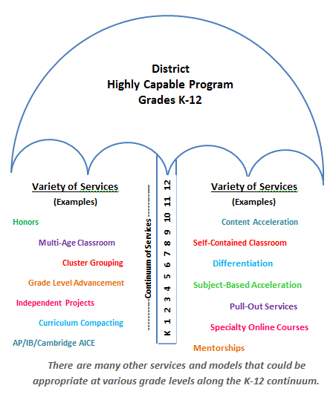
Program Services
After the ID process is finished, the district determines service plan for identified students
Services must be based on student needs
District must have a K-12 continuum
WAC 392-170-078 requires districts to periodically review services for each student to ensure that the services are appropriate

Slide 5
Form Package Review Observations
Areas for focus:
Identification
Program Services
Instructional Program
Verification that all items are in place

Slide 6
Parent/Legal Guardian Permission & Required Components
Parent/legal guardian permission to test and to place must include:
A full explanation of ID procedures
An explanation of appeal's process
An explanation of the procedures to exit a student from the program
Information on the district's program and options available to identified students
A Needs More Work (NMW) message is sent if:
District does not verify that all components are included

Slide 7
ID Process: Grades K-12
District must have an ID process for each grade, K-12
A NMW message is sent if:
No assessment data is indicated at specific grades
Multiple assessment measures are not indicated at each grade
(FP 217) If K-12 is not addressed in the ID outline

Slide 8
ID Process: Screening
Screening procedure is optional
Purpose: To eliminate students who, based on clear, current evidence, do not qualify for eligibility
Multiple, objective criteria must be used in screening process
A NMW message is sent if:
Multiple assessments are not checked for screening
Assessments are marked as screeners, but written screening procedure box is not checked

Slide 9
ID Process: Assessment Process
Assessment process must use multiple, objective criteria
Purpose: To determine, of students who were referred, which students are among the most highly capable
Objective criteria is not limited to test data
Process must be clearly defined and written
A NMW message is sent if:
Multiple measures are indicated at each grade level
Process is unclear

Slide 10
ID Process: Selection
District must have a Board Adopted Selection Policy and Written procedures
Final Selection must be:
Done by Multidisciplinary Selection Committee (MSC)
Based on a district selection system that determines which students are the most highly capable as defined under WAC 392-170-055, and other data collected in the assessment process
Based on professional judgment as to which students will benefit the most from inclusion
A NMW message is sent if:
If there is not a clear, Grades K-12, district selection system
If selection is based on one assessment result
If selection decision is not done by MSC or MSC members do not meet WAC requirements

Slide 11
Program Services
HCP is a district program
Identify program services, Grades K-12
All decisions regarding services for identified students must be done in coordination with the HCP administrator/coordinator
A NMW message sent if:
Site based services decisions are made without coordination with HCP administrator/coordinator
Program services do not include all grades, K-12
Services for specific grade levels do not occur daily, such as only offering pull-out or before/after school options

Slide 12
Instructional Program
Provide a description of the instructional program used in the program service structures, K-12
Provide greater detail for how students are served (instruction and curriculum) in the various delivery options indicated on the program services page
A NMW message is sent if:
A list of items check-marked on Program Services page are restated with no additional instructional program detail
Description does not address Grades K-12 instructional program

Slide 13
Verification of Items in Place
Most pages require district to check boxes to verify items are in place
Items are required by WAC 392-170
A NMW message is sent if:
All boxes are not checked

Slide 14
Contact Information
Kristina Johnstone
Highly Capable Program Supervisor
Office of Superintendent of Public Instruction
Kristina.johnstone@k12.wa.us

