Slide 1


Slide 2
HIGHLY CAPABLE COOP MEETING
November 5, 2014
QUESTIONS
How can we support our teachers and programs to improve achievement of all our students?
What do we need to know about current initiatives? What dates are on the horizon which require our attention?
How can we support each other?
How will I use what I learned to do my work?

Slide 3
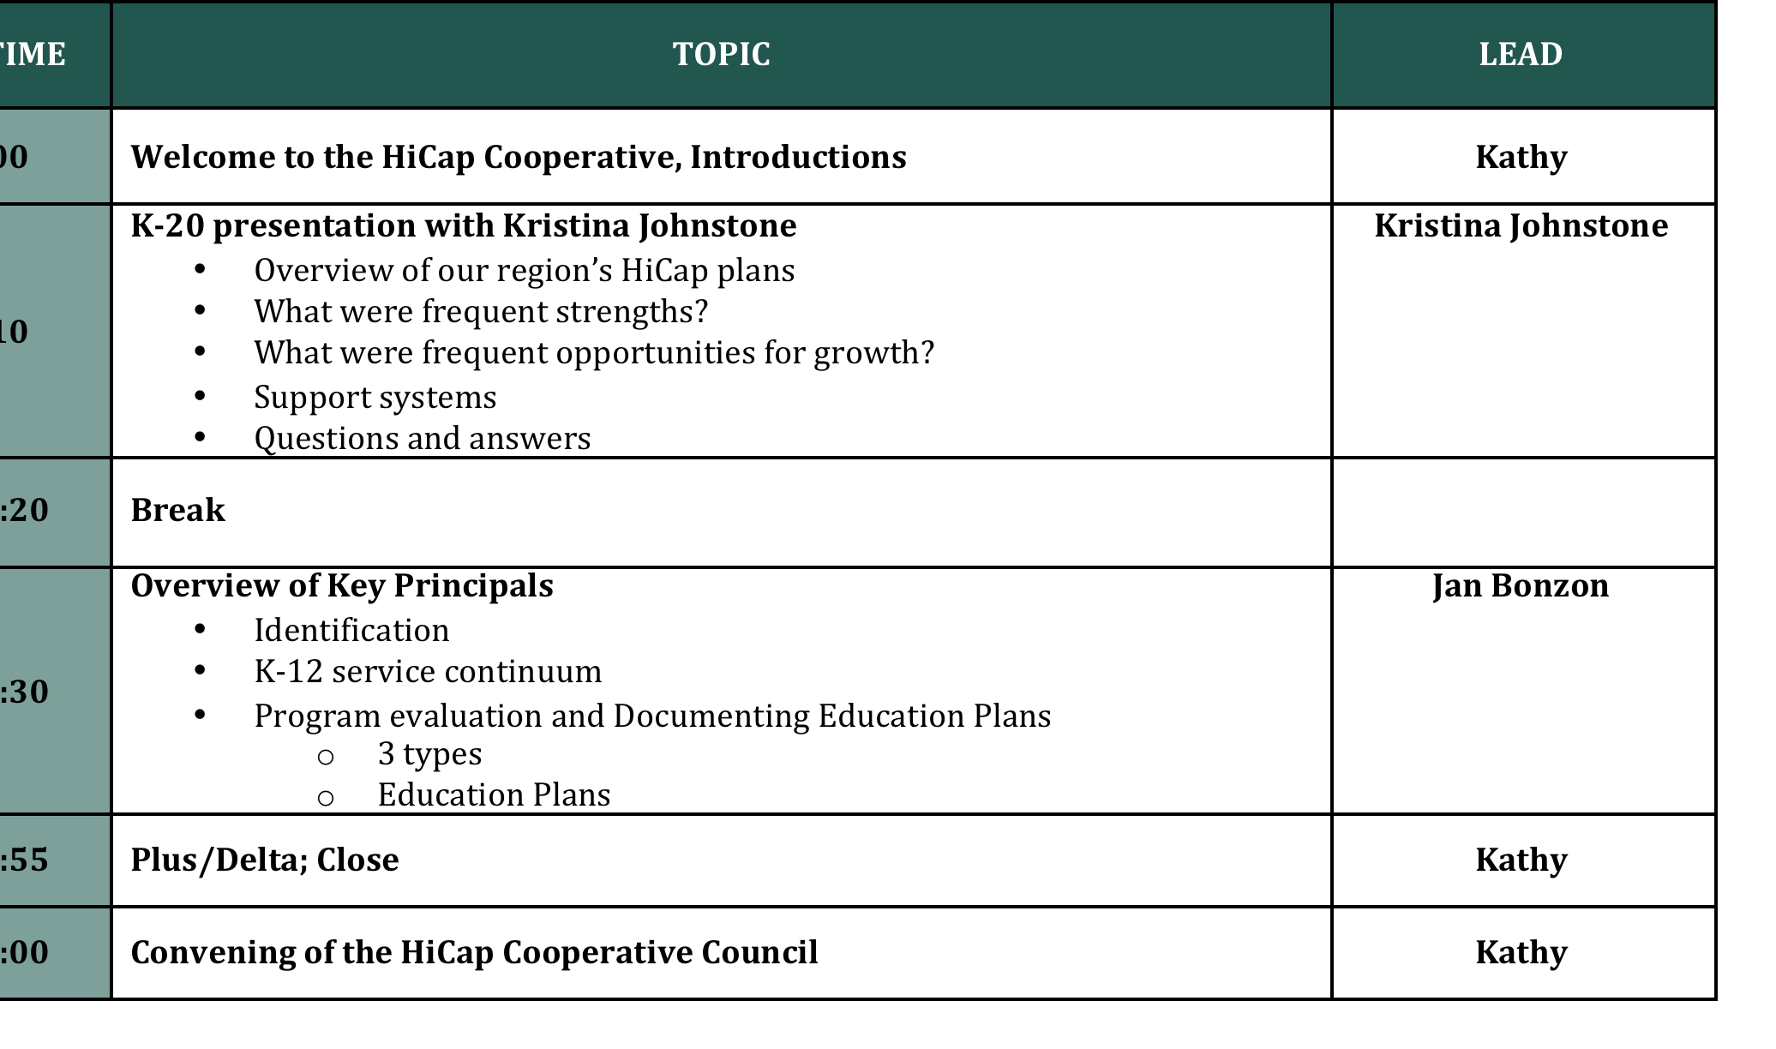
Notes:
KATHY:
iGrants, WACS might be helpful.

Slide 4
MA Education of Gifted & Talented, U of Denver, CO
Teacher of Gifted
Coordinator of Gifted Programs
Statewide Trainer, OSPI/ Centrum—Goal 3 State Reform: Critical and Creative Thinking
Principal / Assistant Principal
Oregon State Advisory Committee, Gifted Education
Rural, Suburban, International, Government
WA, OR, CO, Dept. of Defense
janbonzon@yahoo.com 270-312-7331 (cell)
Notes:
Overall, I have more than 20 years of experience in the field of gifted education but that can also be said of many people sitting in this room
Todd Christenson, Nancy Smith and others I look forward to meeting
YOU can also make contributions.
If my experience has any special relevance for Co-Op members, it my experience working for the Dept of Defense school system that I bring to the table.
During my 16 years with the Dept f Defense school, I witnesses the shift from our embrace of Renzulli’s Schoolwide Enrichment Models to our current rigorous, standards driven model matched to learner strengths in alingment with National Association of Gifted Children positions and standards.
Dr. Jann Leppein, now of Whitworth University, designed the Dept of Defense’s gifted education model, wrote our Procedure Guides and created our forms. I coordinated and taught within this model for the past 10 years.
I look forward to our year together and hope to help you make decisions in compliance with the WACs.
We have a LARGE task, but just take one step at a time. Start. Start SOMEWHERE and know that the process will take TIME—YEARS of TIME.
Now WE are also expected to update our programs to reflect NAGC standards—standards upon which Washington’s new WACs are based.
You should have picked up a copy of the new WACs/RCWs, NAGC standards, and Dr. Picanco’s ?whitworth materials as you signed in.
Your most important resources for information and training will be YOU plus the National Association of Gifted Children website.
MY purposes:
assist you with technical matters and local professional development at your school sites
Help Kathy/Co-op Board to plan Co-Op Workshop agendas based upon general needs from my experiences with you in the field.

Slide 5
Alignment of District Programs with WACs
Kristina Johnstone
Highly Capable Program Supervisor, OSPI
Kristina.Johnstone@k-12.wa.us
360-725-4991
Special Programs Office --360-725-6100.
Notes:
I met Kristina when we worked together in the Lake Stevens School District 1999-2002. I coordinated the Hi-Cap program) and she was one of the many WONDERFUL cluster teachers I had the privilege to meet. At her school, especially, the teams were enthusiastic, highly functional, creative, and amazingly skillful with students. So Kristina has lived experience working with HCP students and their families and she brings this to her new position.
She is a parent with two young children and is employed part time by OSPI to Supervise Highly Capable Programs across the state. She works under Gayle Pauley’s direction. Gayle Pauley is the Director of Hi-Cap but also directs many other programs. Gayle worked alone for many, many years so it is great to have Kristina’s expertise, passion and commitment driving this train!

Slide 6

Form new
table-groups,
4 people each.
Team members please sit at different tables..
.
Let’s Take a
10 minute
BREAK!
Notes:
During and as your return from your break, please move from your present location.
Re-form table groups of 4 people each for the final section of our agenda which will be in WORKSHOP format.
Try to disperse members of your team to different tables.

Slide 7
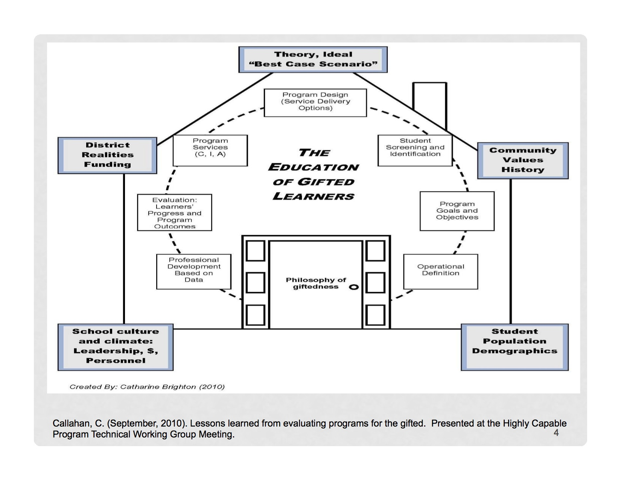
Notes:
The task before us is COMPLEX and MULTI-FACETED.
But as you enter through the doorway of this house, be clear about your PURPOSE.

Slide 8
“The natural trajectory of giftedness is not …….
a six- figure salary,
perfect happiness, and
a guaranteed place in Who's Who.
It is……
the deepening of the personality,
the strengthening of one's value system,
the creation of greater and greater challenges for oneself, and
the development of broader avenues for expressing compassion.”
—Dr. Linda K. Silverman Counseling the Gifted and Talented
Notes:
On your iGrants, you had to explain the purpose of your Hi-Cap program. It might be that your purpose is to prepare students for post-secondary education,and successful careers. We may even hope that they will develop solutions to global problem.
Dr. Silverman, a Psychologist also asks that we consider as our purpose………….
First steps: .the shaping of human potential…
If all students have potential, how do schools provide opportuntities for this potential to flourish?
For students whose development surpasses expectations, how do we identify them? How do we provide even more opportunities for growth?
.

Slide 9
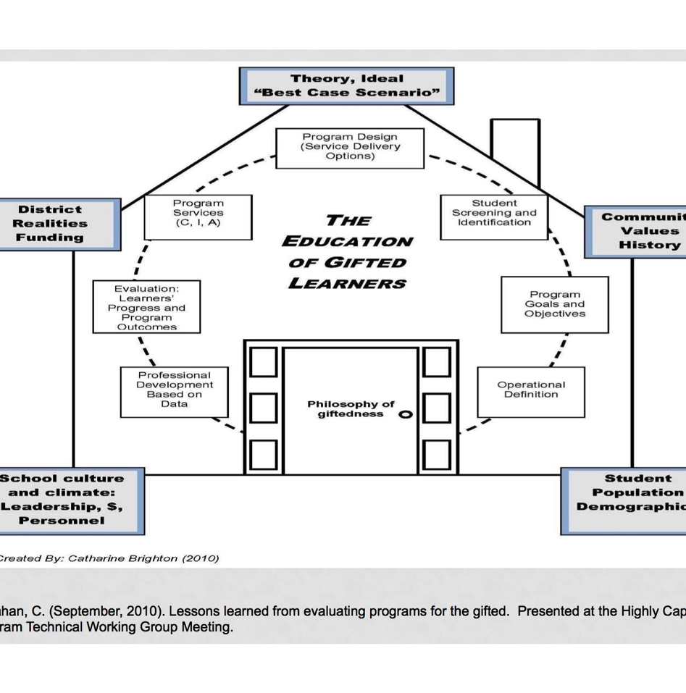
Simulation—MSC Process
Guided Simulation of
Multidisciplinary Selection Team process
Integration and Application of……
Learner Characteristics
Identification; Equity and Access
Selection process: Profile of Strengths
Matching services to K-12 Continuum
Documentation of Services
Notes:
For the rest of this morning, you will sit on a simulated Multidisciplinary Selection Committee and learn a POSSIBLE PROTOCOL for making informed decisions about nominate students.
It will hopefully integrate some of the pieces of the house framework and make sense of the mess.
This is an idealized situation best utilized with site-based decision-making.
Hopefully, you will find something of value to use back in your districts.
If successful, you may use these procedures and materials to use as a training module for your MSC. Anita made 2 sets of folders, one for YOU and one for the simulation. Feel free to write on the materials used for the activity.

Slide 10
Multidisciplinary Selection Committee
(MSC)
What is the purpose of the MSC?
Why are selection decisions made by a team of educators from different disciplines as opposed to any other method?
Notes:
Let’s begin.
With your elbow partner, see if you can answer either of these questions.

Slide 11

Paradigm Shifts—Implications for Identification

Slide 12
EXCEL Weighted FORMULA
Notes:
In the past, some districts placed all scores into an EXCEL table and identified the HCP students via numbers crunched using a weighted formula.
Student TOTAL SCORES were then ranked ordered. If the purpose were to find students for an advanced math section and there were 25 seats in the section, then the top 25 students were identified.
No longer.

Slide 13
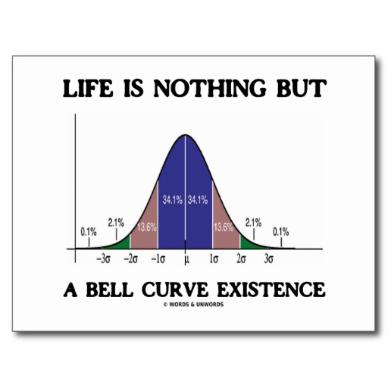
TRADITIONAL VIEW
: G Factor
Notes:
Modern theories have roots in earlier traditions that over time proved to be inadequate.
The traditional model holds that giftedness is represented by a global IQ 130+ in all domains of reasoning: verbal, non-verbal/spatial and mathematical.
Identification was simple and straightforward. The intelligence tests which measured IQ was the ONLY measure or it dominated all other measures.
A score cutoff was believed to be predictive of success in a rigorous instructional program and in life.
“Truly gifted” = 130++ IQ on an individually administered intelligence test.
One-time identification often in primary years.
Qualitative distinctions between groups of children.
Must demonstrate promise in ALL DOMAINS.
Permanent segregation in special classrooms or special schools.
Very HIGH STAKES assessment.

Slide 14

NEW PARADIGM
Gifted is a MULTI-FACETED phenomenon
AFFECTIVE
COGNITIVE
Social Contexts
Psychological Contexts
Notes:
Our understanding of cognitive science reveals that human potential is a MULTIFACETED PHENOMENON that includes both cognitive and affective qualities and is influenced by both social and psychological contexts.
The IDENTIFICATION system in Washington requires that MULTIPLE MEASURES be collected and considered.
A MULTI-DISCIPLINARY SELECTION COMMITTEE of trained professionals representing different disciplines bring their experience to all decisions concerning the education of the WHOLE CHILD>.
This PARADIGM SHIFT from the traditional view is summarized by Professor Harry Passow, a leader in the field of gifted education

Slide 15
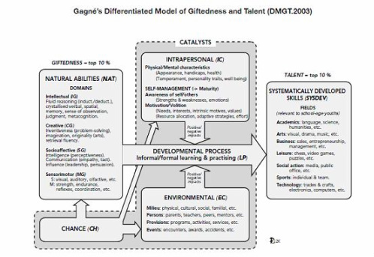
NEW VIEW: Complexity
Gagne’s
Notes:
The new concept derives from Gagne’s Differentiated Model of Giftedness and Talent demonstrates the transformation and relationship between natural abilities and systematically developed skills via catalysts such as intrapersonal and environmental, either assisting or hindering the learning developmental process of a gifted child.

Slide 16

Under-Represented Populations
RANGE
SUB GROUPS
Profoundly gifted (140+ IQ)
Primary, High School
Gifted Girls (STEM)
Underachievers
Economic Subgroup***
Ethnical/ Cultural diverse
English Language Learners
Special Education
  Health Impaired (e.g.ADHD)
  Asperger
  Emotionally Impaired
  Learning Impaired
Notes:
We have a mandate to ensure EQUITY and ACCESS to all students.
The population of HCP learners should reflect the demographics of the school
The WAC defines HCP learners as having either HIGH PERFORMANCE or HIGH POTENTIAL
The WACs also require that we pay attention to comparison groups when making decisions.

Slide 17
MULTI-DISCIPLINARY
SELECTION COMMITTEE
MEMBERS
The multidisciplinary selection committee for the final selection of the most highly capable students for participation in the district's program for highly capable students shall consist of the following professionals:
A special teacher: Provided, that if a special teacher is not available, a classroom teacher shall be appointed;
A psychologist or other qualified practitioner with the training to interpret cognitive and achievement test results;
A certificated coordinator/administrator with responsibility for the supervision of the district's program for highly capable students; and
Such additional professionals, if any, the district deems desirable. (SPED, ELL, Counselor)
WAC 392-170-070
Notes:
Because giftedness is now viewed as a multi-faceted phenomenon, personnel with expertise and knowledge about child development, education of gifted learners, theories of teaching and learning, and measurement and testing contribute their knowledge to the decision making process.
A teacher, an administrator or administrative designee, and a counselor should be part of the committee. Input from all persons who know the student well, including self, peers, parents, teachers, and others in the school community, should be encouraged.
You may invite others. Especially consider inviting specialists on a case-by-case basis to inform decisions about students with special needs, including special education, counseling services, ELL and culturally different students.

Slide 18

ROLES and RESPONSIBILITIES
Number off 1-4.
That number corresponds to your role.
READ YOUR RESPONSIBILITIES
Notes:
COUNT OFF by 4
At your table are ROLE AND RESPONSIBILITY sheets.
Your number equals your role>
Read about your responsibilities.

Slide 19
PROCESS ROLES
DISTRICT COOR/ ADMIN. Record Keeper
SPECIAL TEACHER Chair
PSYCHOLOGIST Materials
COUNSELOR Timekeeper
Notes:
For this simulation task, these are your process roles.

Slide 20

35 minutes
Notes:
HANDOUT
Protocol
Please read the Purpose and then begin.
Watch your time. 35 minutes total.___________________
When you are finished, move to task #2

Slide 21
PURPOSE OF ID:
TO REVEAL….
INFERRED or DEMONSTRATED Learning Characteristics

Slide 22

EMILY, an 8th grade transfer student
Notes:
You have copies of EMILY’s PROFILE OF STRENGTH at your tables.
She is a transfer student entering 8th grade. She has been identified as Gifted by a previous district.
In the Program Summary, check out the section of TRANSFER STUDENTS>
As a team, discuss the body of evidence on Emily and reach a decision.

Slide 23
GUIDING PRINCIPLES of Identification
Intelligence is multifaceted and manifested in many ways.
Instruments used should measure diverse abilities and talents.
Student identification should be based on culturally fair, valid, and reliable measures with recent norms..
No single instrument or score should be used to determine eligibility.
Assessment of students should continue over time.
A profile of each student’s strengths and areas of need should be developed and maintained.
A knowledgeable committee should review student assessments and determine eligibility.
Written procedures should include matters of consent, eligibility, retention, exit, and appeals.
Once a student has been identified as eligible, the services, not the status, may change to meet needs.
Notes:
Please feel free to consult these General GUIDING PRINCIPLES if needed.

Slide 24
What constitutes quality evidence?
What are the best ways to obtain and analyze quality evidence?
Did this process help the MSC to make an informed decision?
What aspects of the process would you KEEP or IMPROVE?
TASK # 2

Slide 25
DISTRICT TEAMS

Slide 26
QUESTIONS

Slide 27
Professional Development
NWESD189
WAETAG
Whitworth University
Heritage Online Institute
NAGC
SENG
Summer EduFest (Boise, Id)
Northwest Gifted Child Association
Notes:
Training opportunities are available through NWESD, online through Whitworth University,
A separate handout and link from the ESD website will provide you with additional information about professional development opportunities for the SPECIAL TEACHER, counselors and Psychologists, cluster and general educators.

Slide 28

National Assoc. of Gifted Children
NAGC
http://www.nagc.org
STANDARDS
Research
Position Papers
PROFESSIONAL DEVELOPMENT
Webinars
Administrators Tool Kit
Notes:
The NAGC website should be your guide. It is rich and deep and it is the NAGC standards and positions which drives Washington’s WACs on HCP education.

Slide 29

NW ESD 189
http://www.nwesd.org
Articles and Book Chapters
Forms
Links to resources
Professional Development
Slide presentations, Whitworth University Professors
Website
Notes:
We have about an hour together.
After making about a half- dozen PPs on different aspects of this very complex and multi-faceted mandate, have decided to engage you in a guided simulation of the roles and responsibilities of the MULTIDISCIPLINARY SELECTION COMMITTEE in order to demonstrate several of the paradigm shifts required by the new WACs.
At the ESD website, you can find plenty of information and useful links on the mechanics of this process and many others.
I hope all of you will also add content to the website…..

