Slide 1
Mathematics Acceleration and Differentiation for Advanced Mathematics Students
April 28, 2016
NWESD
Hi-Cap Cohort
Mary Ellen Huggins

Slide 2
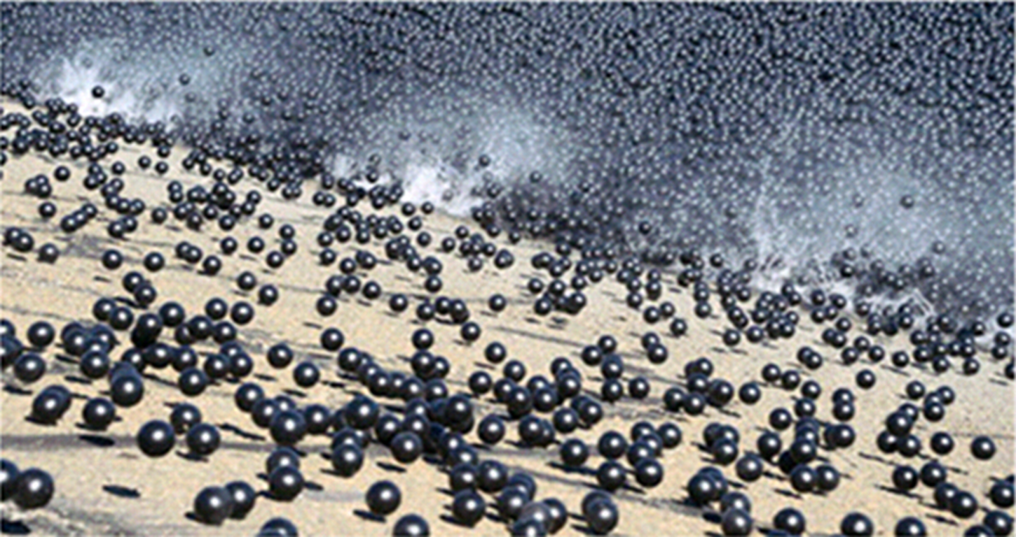
What is This?

Slide 3
“This is a blend of how engineering really meets common sense," said LADWP General Manager Marcie Edwards. "We saved a lot of money; we did all the right things.” LA Times
August 11, 2015
Notes:
The idea for L.A.’s shade balls came when a now-retired LADWP biologist learned about the application of “bird balls” in ponds along airfield runways. Airports have detention basins to collect stormwater runoff. As the ponds fill up, they attract birds. So airports float the balls on the ponds to keep the birds off. $250 million dollars cheaper than any other method.

Slide 4
The idea for L.A.’s shade balls came when a now-retired LADWP biologist learned about the application of “bird balls” in ponds along airfield runways. Airports have detention basins to collect stormwater runoff. As the ponds fill up, they attract birds. So airports float the balls on the ponds to keep the birds off.
December, 2015
www.dailynews.com/.../garcetti-officials-release-
Notes:
The idea for L.A.’s shade balls came when a now-retired LADWP biologist learned about the application of “bird balls” in ponds along airfield runways. Airports have detention basins to collect stormwater runoff. As the ponds fill up, they attract birds. So airports float the balls on the ponds to keep the birds off. $250 million dollars cheaper than any other method.

Slide 5

Definition of Learning Characteristics
WAC 392-170-036
Capacity to learn with unusual depth of understanding, to retain what has been learned, and to transfer learning to new situations.
Capacity and willingness to deal with increasing levels of abstraction and complexity earlier than their chronological peers.
Creative ability to make unusual connections among ideas and concepts.
Ability to learn quickly in their area(s) of intellectual strength.
Capacity for intense concentration and/or focus.
Notes:
5 minutes “Read over these state definitions of HC. What words and phrases stand out to you? Turn and talk.”

Slide 6
Definition of Learning Characteristics
WAC 392-170-036
Capacity to learn with unusual depth of understanding, to retain what has been learned, and to transfer learning to new situations.
Capacity and willingness to deal with increasing levels of abstraction and complexity earlier than their chronological peers.
Creative ability to make unusual connections among ideas and concepts.
Ability to learn quickly in their area(s) of intellectual strength.
Capacity for intense concentration and/or focus.
Notes:
“So what is unique about this group of learners, is it isn’t all of your straight A students. HC kids think differently! In a few minutes, we will explore the various profiles of gifted learners.”

Slide 7
Objectives for Today
Part 1:
Participants will understand better how to create a math pathway that addresses the needs of highly capable math students
Part 2:
Participants will examine strategies and structures within a unit of study that address differentiation for highly capable math students

Slide 8
What do You Notice, What do You Wonder?
Refer to Math Pathways 1 and 2
Pair up with a partner and choose to look at one of the Math Pathways
Record what you notice and what you wonder about each pathway
Move from pair to quartet to share out
Share with whole group

Slide 9
Common Core State Standards Math Guidelines
Appendix A has outline for compacted curriculum for the middle school mathematics.
Accelerate after 6th grade
Compact 3 years of math into 2 years
7th grade: All 7th grade standards and appropriate 8th grade standards
8th grade: Remaining 8th grade standards and Algebra 1 standards

Slide 10
Common Core State Standards Math Guidelines
Compacted courses should include identical CC Math
Standards as non-compacted courses.
Decisions to accelerate students into the CCSS for
HS Math before 9th grade
    should not be rushed
    should be based on solid evidence of student learning
Menu of challenging options available after 3rd year of
math - all students encouraged to take 4 years of math
in HS

Slide 11
How to Accelerate Students after 9th Grade
Allow students to take two mathematics courses simultaneously or both semesters with block scheduling
Offer summer courses designed to provide equivalent experience of a full course in all regards
Creating different compaction ratios, including 4 years of HS content into 3 years beginning in 9th grade or a hybrid Algebra 2- Pre calculus course so students can go straight to Calculus

Slide 12
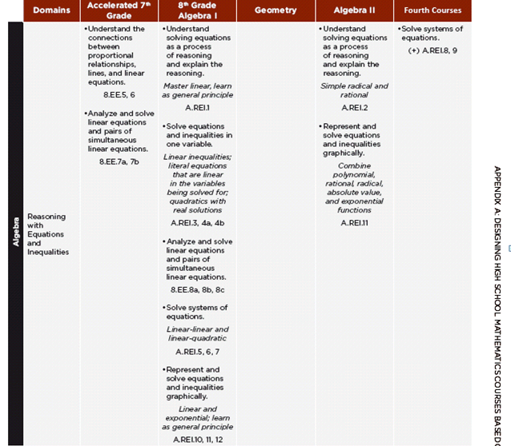
A Look at the Compacted Curriculum
Notes:
Page 85

Slide 13
Components of Secondary Highly Capable Math Courses
Curricula
Creative Thinking
Critical Thinking
Problem Solving
Independent Study
Assessment
F and S
Process and product (tasks-modeling)
Independent learning can be assessed
Contextual
Levels of Cognitive Demand
Notes:
Learning and assessment are harmonious from Handbook of Secondary Gifted Education Dixon and Moon, 2015

Slide 14
Differentiating an Honors Course
Take a few minutes to reflect on what you believe is the difference between a general education mathematics course and an honors mathematics course.
Share with an elbow partner.
Share out as whole group.

Slide 15
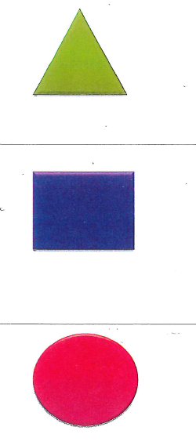
Reflection
Complete your Reflection sheet.
Choose one of the three comments
to share with someone you have not
talked with yet this morning.

Slide 16
Objectives for Today
Part 2:
Strategies and structures within a unit of study that address differentiation for our advanced mathematics students

Slide 17
Building a Unit for Hi-Cap
Determine the standards for a given unit
2. Pre assess for students’ understanding
Create a menu of tasks - include modeling
Offer required and choice tasks
5. Post assess

Slide 18
Modeling
Estimate how much water and food is needed for emergency relief in a devastated city of 3 million people and how it might be distributed
Plan a table tennis tournament for 7 players at a club with 4 tables where each player plays against each other player.
Relate population statistics to predictions you have made
Analyze the stopping distance of a car

Slide 19
Ratios and Proportional Relationships
Understand ratio concepts and use ratio reasoning to solve problems.
Use ratio and rate reasoning to solve real‐world and mathematical problems, e.g., by reasoning about tables of equivalent ratios, tape diagrams,
double number line diagrams, or equations.
  A. Make tables of equivalent ratios relating quantities with whole ‐ number measurements, find missing values in the tables, and plot the pairs of values on the coordinate plane.
  B. Use tables to compare ratios. Use ratio reasoning to convert measurement units; manipulate and transform units appropriately when multiplying or dividing quantities.

Slide 20
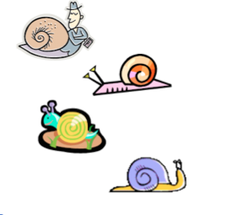
Assess Before Teaching Content Students Already Have Mastered
Snail A traveled 25 inches in an hour
Snail B spent 15 minutes traveling ⅔ foot
Snail C traveled 8 inches in 15 minutes
Determine a rate for Snail D based on the following
parameters: Snail D traveled faster than Snail A but
slower than Snail B.
Graph the pathway of Snail A and Snail B on the same coordinate grid.
Make up a question of your own and choose a friend to solve it.
Notes:
Teach to High Expectations and scaffold when needed. Aim at 19%

Slide 21
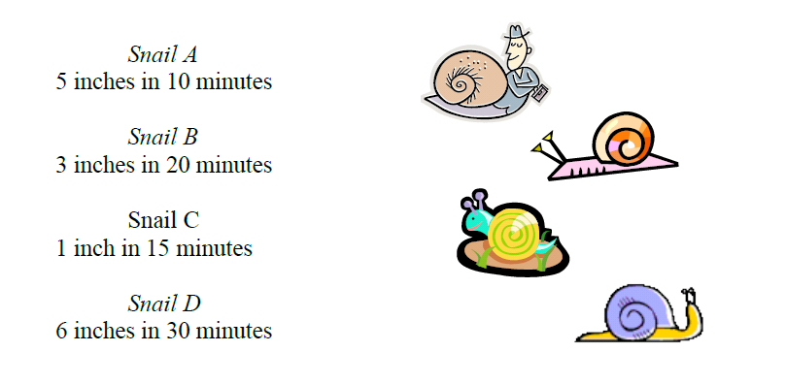
Assess Before Teaching Content Students Already Have Mastered
Notes:
Teach to High Expectations and scaffold when needed.

Slide 22
Menu
Use Resources
  Grade level curriculum
  Illustrative Mathematics
  Inside Mathematics
  Youcubed.org
  Math Assessment Project
Create a list of tasks aligned to a cluster heading

Slide 23
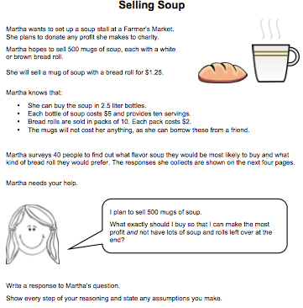
Menu
Post the tasks on classroom walls
  DOK levels (1-3)
  Contextual
  Games
  Include modeling

Slide 24
Menu
Individualize for students and offer choice
  Students complete 3-4 of the assigned tasks
  Additional tasks depending on Pre-Assessment
  Advanced students asked to extend their learning
  Mid-menu debrief of 1-2 of the mandatory tasks
  Teacher indicates 1 task to score; students select one task as best work

Slide 25
Expressions and Equations Menu
  Properties of Exponents
  Growing Dots a & b& c
  Increasing Patterns #1a & #1b
  Cubes Patterns # 1a & #1b
  Navigating the Pentagon
  Navigating the Pentagon II
  Increasing Patterns #4a & #4b
  Increasing Pattern #5
Desert
  Janet’s Conundrum
  Miles of Tiles
  Cubes Pattern #4
Notes:
MENU6.RP.A Understand ratio concepts and use ratio reasoning to solve problems
6.RP.A Understand ratio concepts and use ratio reasoning to solve problems

Slide 26
POST ASSESSMENT
Example:
Two groups of campers had pizza parties. At Bear Camp, there were two pizzas for every three campers. At Wolf Camp, there were three pizzas for every five campers. Which campers had the most pizza to eat?
Share your thinking and justify your answer in at least 2 ways.

Slide 27
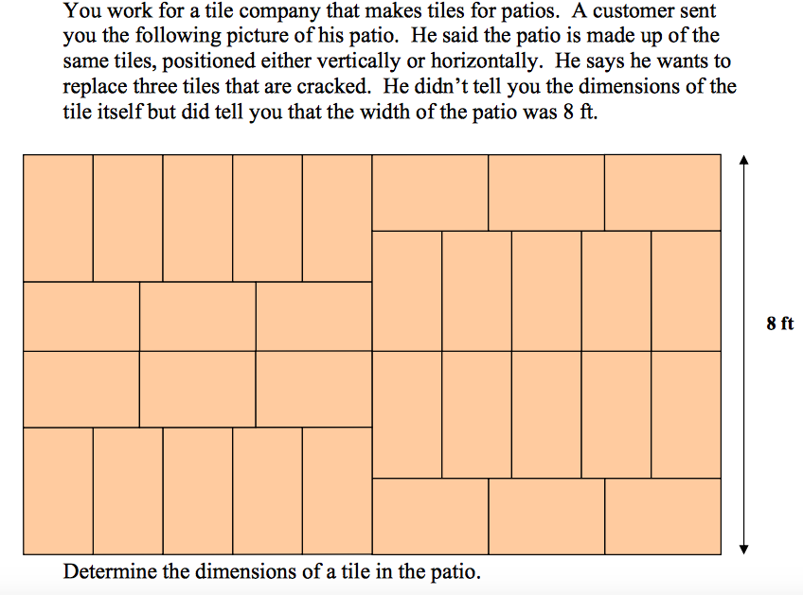
Notes:
Tiles measure 1.5 by 2.5 feet

Slide 28
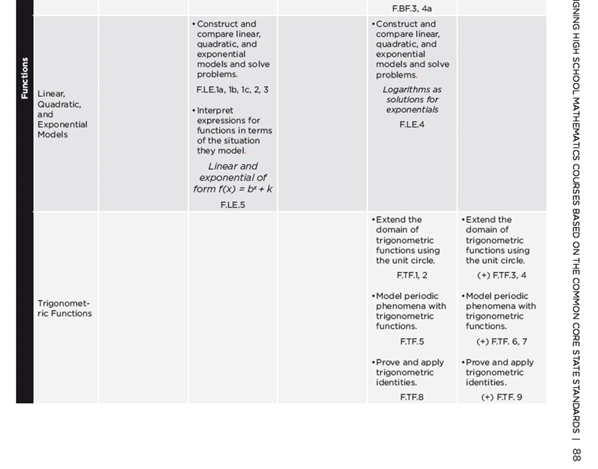
A Look at the Standards

Slide 29
Pre Assessment-F.TF.1 & 2
Determine the sine and cosine of the following angles.
Explain how you determined the sine an cosine.
Angle Measure | Sine | Cosine
0°
30°
45°
60°
90°

Slide 30
What Does Instruction Look Like?
What would you expect to see students and teachers doing?
Share with table group.

Slide 31
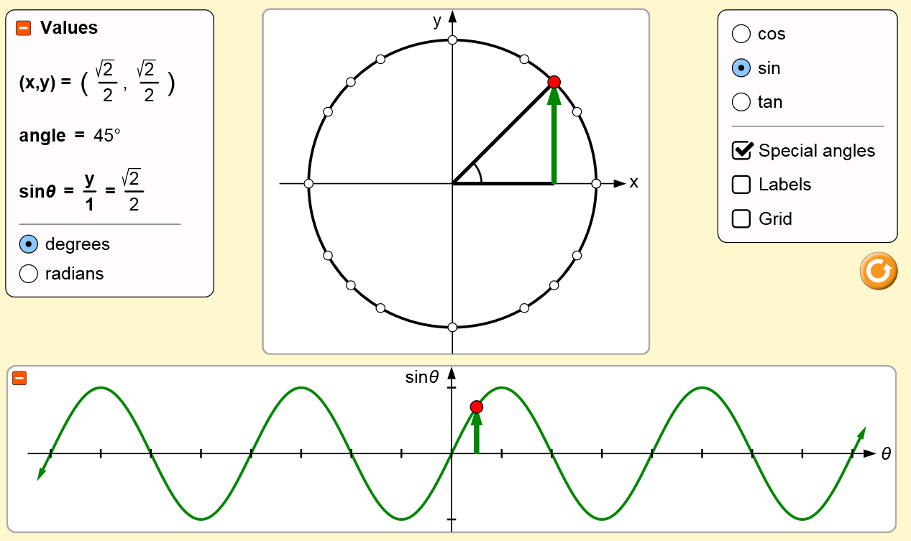
Looking at the Unit Circle and the
Graphs of Trigonometric Functions
Notes:
https://phet.colorado.edu/en/simulations/category/math

Slide 32
Post Assessment
Notes:
Smarter Balanced Practice Test- Grade 11

Slide 33
Reflection
What is one idea you could bring back to your honors/advanced teachers to start a conversation around differentiation in their math classes?
Share with an elbow partner.

