Slide 1



What’s Possible? Making Inroads in Designing Curriculum for Advanced Learners
Jann H. Leppien, Ph.D.
Whitworth University, Spokane, WA
jleppien@whitworth.edu
http://tinyurl.com/knjoa9h

Slide 2

Rules for the Road
Quality curriculum requires student understanding and student engagement.
Understanding comes from student interaction with conceptually-based, rigorous curriculum that gradually increases in sophistication.
Student engagement is derived from curriculum that connects to the heart and mind of a learner.

Slide 3

High Quality Curriculum & Instruction
clearly focused on essential understandings and skills of the discipline that a professional would value (authentic)
mentally and affectively engaging to the learner
joyful-or at least satisfying
provides guided choices
allows meaningful collaboration
focuses on products that matter to students
connects with students’ lives and world

Slide 4

High Quality Curriculum & Instruction
fresh and surprising
seems real (is real) to the student
coherent (organized, unified, sensible) to the student
rich, deals with profound ideas (concept-based)
stretches the student (rigorous)
calls on students to use what they learn in interesting and important ways
involves the student in setting goals for their learning and assessing progress toward those goals

Slide 5
A Continuum of

Slide 6
Teacher Response to Student Development of AID

Slide 7
Expertise in

Slide 8
Expertise in

Slide 9
Expertise in

Slide 10
Expertise in

Slide 11
Ascending Levels of Intellectual Demand
Vary the depth
Adjust the abstraction
Change the complexity
Make contexts and examples more or less novel or familiar
Adjust the pace
Use more/less advanced materials and text
Provide more/less scaffolding
Provide frequent/intermittent feedback
Provide/let students infer related strategies
Infer concepts from applications and problem solving
Provide more/fewer examples
Be more/less explicit/inductive
Provide simpler/more complex problems and applications
Vary the sophistication level
Provide lengthier/briefer texts
Provide more/less text support
Require more/less independence or collaboration
Require more/less evidence
Ask for/provide analogies
Teach to concepts before/after examples
Teach principles before/after examples or concepts

Slide 12

What do the CCSS Mean for Academically Advanced Learners?
Careful reading of the English/Language Arts standards reveals only two references to academically advanced students:
An acknowledgment that the documents do not address expectations for students who meet the standards before the completion of secondary school, but simply suggest that advanced work should be available.
Confirmation that the standards do not define strategies or materials for those students who are performing well above grade level.
http://www.corestandards.org/ELA-Literacy/

Slide 13
Students With Potential in Mathematics
“Students with potential in Mathematics should experience rigorous Mathematics courses through a carefully constructed, compacted and telescoped curriculum.”
    Use of pre-assessments and ongoing assessments to ensure match between knowledge and skills and the student’s current level of achievement and that above grade-level.
    Information about possible accelerated pathways for advanced high school students can be found in Appendix A of the CCSS for Mathematics. (See http://www.corestandards.org/ for additional information.)

Slide 14
To prepare students for high school mathematics in eighth grade, districts are encouraged to have a well-crafted sequence of compacted courses.
When in doubt read through the appendices of the Common Core Standards.
http://www.corestandards.org/Math/

Slide 15
To prepare students for high school mathematics in eighth grade, districts are encouraged to have a well-crafted sequence of compacted courses.
TIP
The compacted traditional sequence, or, “Accelerated Traditional,” compacts grades 7, 8, and High School Algebra I into two years: “Accelerated 7th Grade” and “8th Grade Algebra I.” Upon successfully completion of this pathway, students will be ready for Geometry in high school.
The compacted integrated sequence, or, “Accelerated Integrated,” compacts grades 7, 8, and Mathematics I into two years: “Accelerated 7th Grade” and “8th Grade Mathematics I.” At the end of 8th grade, these students will be ready for Mathematics II in high school. While the K-7 CCSS effectively prepare students for algebra in 8th grade, some standards from 8th grade have been placed in the Accelerated 7th Grade course to make the 8th Grade courses more manageable.

Slide 16
Other Ways to Accelerate Students Recommended
in the Math Standards
Just as care should be taken not to rush the decision to accelerate students, care should also be taken to provide more than one opportunity for acceleration. Some students may not have the preparation to enter a “Compacted Pathway” but may still develop an interest in taking advanced mathematics, such as AP Calculus or AP Statistics in their senior year. Additional opportunities for acceleration may include:
Allowing students to take two mathematics courses simultaneously (such as Geometry and Algebra II, or Precalculus and Statistics).
Allowing students in schools with block scheduling to take a mathematics course in both semesters of the same academic year.
Offering summer courses that are designed to provide the equivalent experience of a full course in all regards, including attention to the Mathematical Practices.
Creating different compaction ratios, including four years of high school content into three years beginning in 9th grade.
Creating a hybrid Algebra II-Precalculus course that allows students to go straight to Calculus.

Slide 17
Collaboration Between Teachers in Regular Classroom Settings and Those Who Teach Advanced Learners
TIP
CCSS does not reduce or eliminate the need for qualitatively different education for those who are more advanced.
Effective teaching practices such as pre-assessment, compacting, flexible grouping, accelerated content, pace and complexity, all of which have been in place for decades, continue to be appropriate.

Slide 18
Why Students Will Still Require Differentiation
The varying characteristics that students possess require us to modify, adapt, and to escalate their learning experiences. The Common Core recognizes this, but now is your opportunity to make suggestions. The learner characteristics include:
Faster pace of learning (2-3 repetitions)
Precocity for information and making sense
Intensity of learning in areas of interest
Ability to synthesize information within and across disciplines
Retrieval of conceptual ideas that mirror that of more expert-like thinking behavior

Slide 19
Causes of Underachievement
1
High-Quality Curriculum for Gifted Learners Promotes Advanced Levels of Understanding Beyond the General Education
Curriculum Through Abstraction, Depth, Breadth, and Complexity
st

Slide 20
https://newsela.com
Guidelines for Text Complexity
High Text Complexity: Structure
Complex, implicit, and unconventional structures
More frequent use of flashbacks, flash-forwards, multiple points of view and other manipulations of time and sequence.
Informational text contain a variety of structures (like academic textbook or history book)
Graphics provide an independent source of information and are essential to understanding a text.
High Text Complexity: Language Conventionality and Clarity
Texts that rely on figurative, ironic, ambiguous, purposefully misleading, archaic, or otherwise unfamiliar (academic and domain-specific vocabulary)

Slide 21
Guidelines for Text Complexity
High Text Complexity: Knowledge Demands
Texts that make assumptions about the extent of readers’ life experiences and depth of their cultural/literary and content/disciplinary knowledge.
High Text Complexity: Levels of Meaning (Literary Texts) and Purpose (Informational Texts)
Literary texts with multiple levels of meaning (such as satires, in which the author’s literal message is intentionally at odds with his/her underlying message).
Informational texts with implicit, hidden, or obscure purpose.

Slide 22
Recommendations for Texts and Tasks
TIP
Match texts to particular tasks or classes of students. Harder texts may be appropriate for highly knowledgeable or skilled readers, who are often willing to put in the extra effort required to read harder texts that tell a story or contain complex information. Students who have a great deal of interest or motivation in the content are also likely to handle more complex texts.
Grapple with works of exceptional craft and thought whose range extends across genres, cultures, and centuries. Such works offer profound insights into the human condition and serve as models for students’ own thinking and writing.”
Texts be selected to build coherent knowledge within grades and across grades. For example, the Common Core State Standards illustrate a progression of selected texts across grades K-5 that systematically build knowledge regarding the human body.
Read Appendix A in the CCSS for ELA for appropriate measurement tools for determining text complexity.

Slide 23
Examples of Grade Level Placement for Reading Texts
CCSS ELA Recommendations | Gifted Curriculum
Roll of Thunder, Hear My Cry (Grades 6-8) | Roll of Thunder, Hear My Cry (Grade 4)
Jabberwocky (Grades 6-8) | Jabberwocky (Grades 3-4)
Fahrenheit 451 (Grades 9-10) | Fahrenheit 451 (Grade 7)
The Book of Thief (Grades 9-10) | The Book of Thief (Grades 6-8)
I Know Why the Caged Bird Sings (Grades 9-10) | I Know Why the Caged Bird Sings (Grades 6-8)
Jane Eyre (Grades 11-12) | Jane Eyre (Grades 6-8)
Recommendations from: Penny Britton Kolloff, Ph.D. (NAGC Webinar)

Slide 24
Examples of Grade Level Placement for Reading Texts
CCSS ELA Recommendations | Gifted Curriculum
Charlotte’s Web (Read aloud Grades 2-3) | Charlotte’s Web (Grades 1-2)
The Cricket in Times Square (Read aloud Grades 2-3) | The Cricket in Times Square (Read aloud Grades 1-2)
Little Women (Grades 6-8) | Little Women (Grades 4-6)
A Wrinkle in Time (Grades 6-8) | A Wrinkle in Time Grades 4-6)
“The Raven” (Grades 9-10) | “The Raven” (Grades 6-8)
The Grapes of Wrath (9-10) | The Grapes of Wrath (6-8)
Recommendations from: Penny Britton Kolloff, Ph.D. (NAGC Webinar)

Slide 25

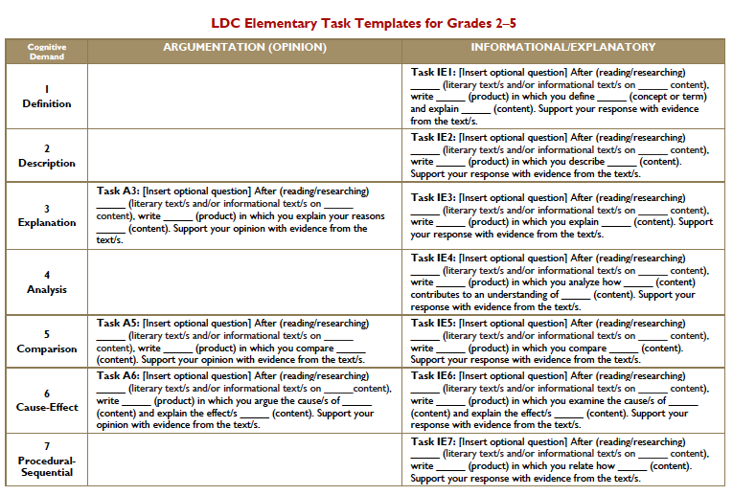
Literacy Design Collaborative
http://www.ldc.org

Slide 26
Module Section 1: What Task?
What task sets clear, measurable goals for learning?
YOU select template
YOUR CCSS standards are “hard-wired” in
YOU add your state/local content standards
YOU “plug and play” to build teaching task
YOU score results using LDC common rubric
Task 2 Template (Argumentation/Analysis L1, L2, L3): [Insert essential question] After reading _____ (literature or informational texts), write an _________(essay or substitute) that addresses the question and support your position with evidence from the text(s). L2 Be sure to acknowledge competing views. L3 Give examples from past or current events or issues to illustrate and clarify your position.
Notes:
Example Talking Points:
Elmore work on tasks– tasks are central
Ruth Mitchell quote: “Students can do no better than the quality of the assignments they are given”
Point out “template task” in box. Use term.
.

Slide 27
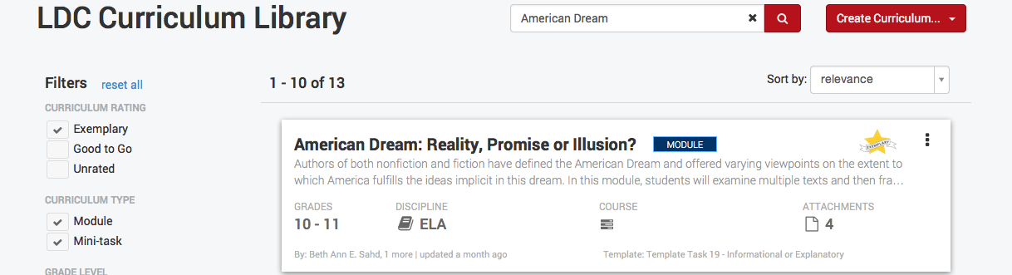
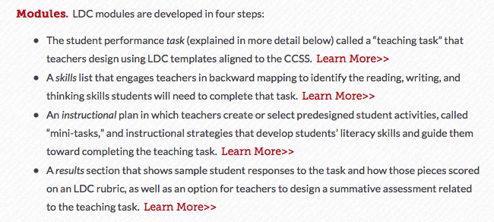
There are learning tasks and modules

Slide 28
American Dream: Reality, Promise or Illusion?
Beth Ann E. Sahd and Lindsay M. Sigman
Authors of both nonfiction and fiction have defined the American Dream and offered varying viewpoints on the extent to which America fulfills the ideas implicit in this dream. In this module, students will examine multiple texts and then frame an analysis as to whether or not, or to what extent, America fulfills these ideals. Prior to this module, students have completed a study of The Great Gatsby by F. Scott Fitzgerald.For this module, students will read: Excerpts from Letters From An American Farmer by Jean de Crevecoeur, excerpts from the U.S. Constitution and The Declaration of Independence, "I Hear America Singing" by Walt Whitman, and "I, Too, Sing America" by Langston Hughes.Additional poems by Walt Whitman and Langston Hughes (or any other relevant text) may be added to differentiate this module for students needing enrichment.

Slide 29

EduCore
http://educore.ascd.org/channels/c8920746-9ae8-49bf-bae3-f8b6cac46173

Slide 30
Causes of Underachievement
2
High-Quality Curriculum for Gifted Learners Uses a Conceptual Approach to Organize or Explore Content that is Discipline-Based
and Integrative
nd

Slide 31

So What Can We Do Now That We Will Be Using the CCSS?
Curriculum That Can Open Doors
..emerges not from a list of names, dates, facts, and terms, but from a longing that springs from a connection or a need to make one. Our teaching was turned on its head by reading Phil Phenix’s(1964) ideas about asking the big questions. Phenix said that once human beings evolved to a point when they no longer had to spend all their time building fires and slaying dinner, they began to see answers to a single question. We are born-and we die-asking, “What is life, and who am I in it?” Human beings developed the disciplines of history, the arts, English, science, and math to answer that question.

Slide 32
Connecting with Students
    Connections with students drive the opening of doors. It’s far more fulfilling to listen for and respond to the multiple rhythms that students bring into the classroom than to see students as essentially interchangeable and unknowable. Students need connections to learn---and so do teachers.
When a teacher understands that there are many examples or topics that share the same idea, it becomes easier to modify the learning experiences.

Slide 33
SE Influences
Concepts and Essential Questions
Help teachers to think about designing curricular units around interesting concepts and understandings, paradoxical situations or problems. These type of units foster interdisciplinary thinking, examination of complex issues, problem finding, and problem solving to stimulate discussion, debate, reasoning, and related skills of persuasion, which are progressively targeted as learners move from K-6 through secondary education.

Slide 34
Discipline Based Knowledge
THEORY
Activities, cognitive processes, tools, techniques,resources,and products
GENERALIZATIONS
Representative topics
PRINCIPLES
CONCEPTS
FACTS
Notes:
Invite participants to examine this diagram. It illustrates how knowledge—in any discipline—is organized.
Provide participants with an example of a fact, cpncept, and principle in a content area of your choice.
Then, with their new understanding about the nature of facts, concepts and principles, ask them to share where they think CT classroom teaches spend the largest proportion of their time: On facts, concepts or principles.
Participants will agree, for the most part, that most classroom time is spent on facts.
With this realization as a backdrop, begin segueing into the notion, once again, about the nature of rigorous curriculum. It must be based, not strictly on facts, but rather the proper balance among facts, concepts and principles.
This will be a new idea to many people, so make sure they know what they are looking for in terms of RIGOROUS curriculum standards. Without absolute clarity about the rigorous learning destination, any DI that is offered will be “off base.”

Slide 35

Concepts
serves as “integrating lens” and encourages the transfer of ideas within and across the disciplines “as students search for patterns and connections in the creation of new knowledge.”
MACROCONCEPTS
Broadest, most abstract concepts; often used as a conceptual lens to develop breath of understanding (systems, structure, interdependence, change, conflict, power, balance.
MICROCONCEPTS
Sub-concepts, more specific concepts tied to a discipline (slope, value, niche, value)

Slide 36
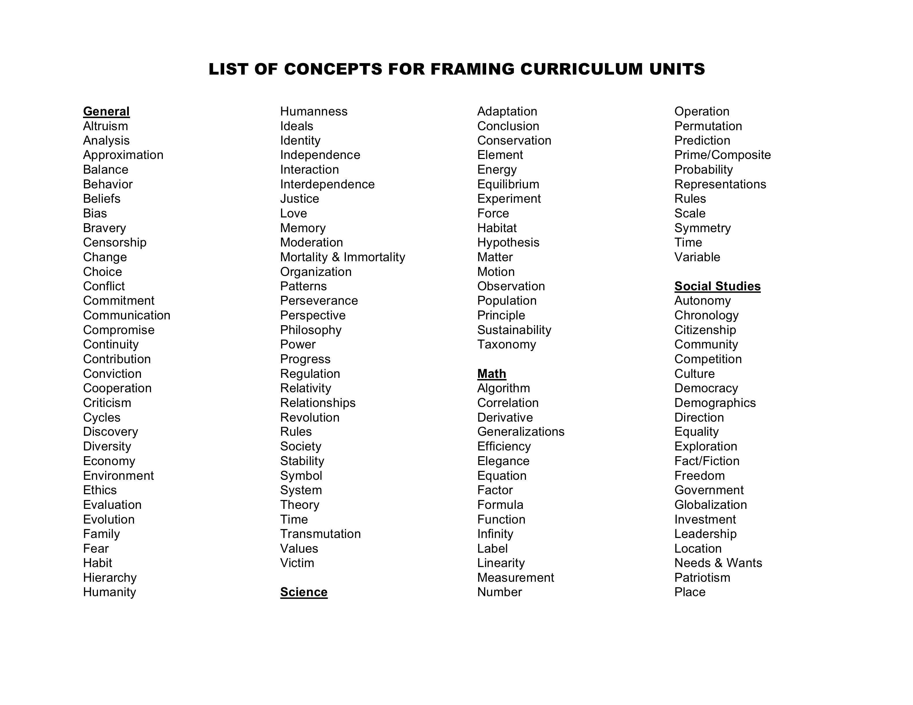

Slide 37
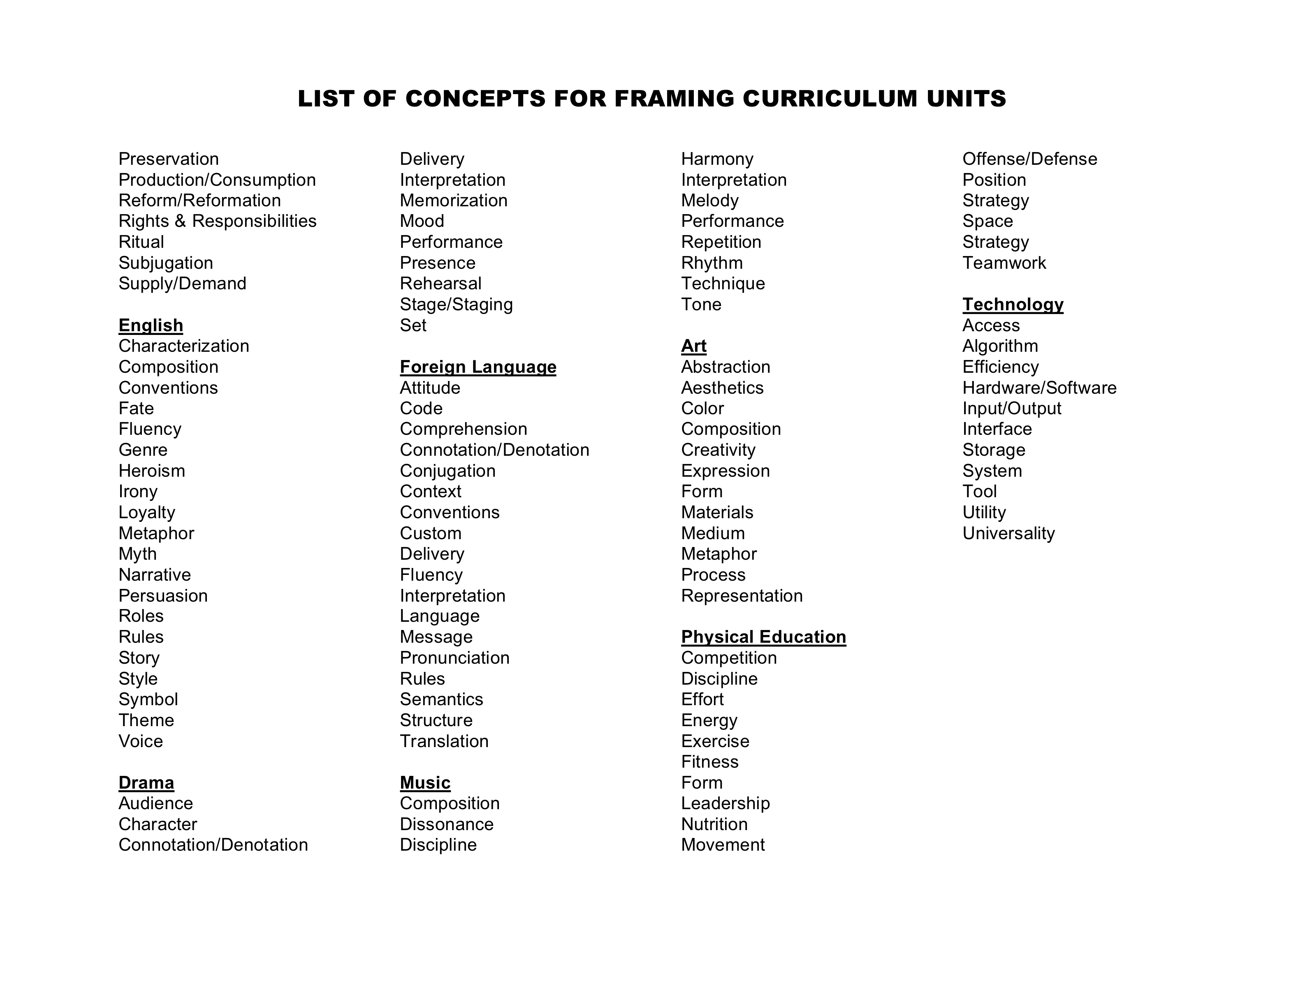

Slide 38
Curriculum designed around big ideas helps…
    Kindergarteners see that a change in their lives is something like a change in the weather or the change that happens in a story.
    1st graders answer the question, “What is a true friend” when they read Frog and Toad are Friends, and answer it years later reading A Separate Peace in high school, and yet again when they study international relations in college.
    Lift the concept of witch hunt from the pages of The Crucible to the study of American history to the evening news, to the school cafeteria, and to the dark corners of our own minds.
    And Does Not Neglect the details of content. It helps students see a reason for these details and makes them memorable, useful, and transferable.

Slide 39
Understandings:
These are the conceptual objectives you have for your students. They are statements that…
…Usually revolve around and contain important concepts.
…Represent big ideas that have enduring value beyond the classroom.
…Reside at the heart of the discipline and are worthy of exploration
…Require “uncoverage” rather than coverage (of abstract or often misunderstood ideas)
…Offer potential for engaging students
² Wiggins and McTIghe – Understanding by Design, 1998

Slide 40
“Understand” Objectives
These are the written statements of truth, the core to the meaning(s) of the lesson(s) or unit. These are what connect the parts of a subject to the student’s life and to other subjects. Understandings are purposeful. They focus on the key ideas that require students to understand information and make connections while evaluating the relationships that exit within the understandings.
Stated as a full sentence ……….
Begin with, “I want students to understand THAT…” (not HOW… or WHY… or WHAT)
  Multiplication is another way to do addition.
  People migrate to meet basic needs.
  All cultures contain the same elements.
  Entropy and enthalpy are competing forces in the natural world.
  Voice reflects the author’s perspective and background.

Slide 41
“Know” Objectives
These are the facts, vocabulary, dates, names, places, and examples you want students to give you.
There are 50 states in the US.
Thomas Jefferson-the third president of the United States and other biographical data.
1492-the year that Columbus is reported to have discovered the Americas.
The “Continental Divide”-a divide separating river systems that flow to opposite sides of a continent.
The multiplication tables
The steps of the scientific method

Slide 42
“Be-Able-To-Do” Objectives
Skills (basic skills, skills of the discipline, skills of independence, social skills, skills of production)
The skill portion encourages the students to “think like the professionals who use the knowledge and skill daily as a matter of how they do business. This is what it means to “be like a writer, a scientist, an artist)
Verbs or phrases (not the whole activity)
  Analyze the pattern or trend
  Solve a problem to find perimeter
  Write a well supported argument
  Evaluate work according to specific criteria
  Contribute to the success of a group or team
  Use graphics to represent data appropriately

Slide 43
“Skills” (Be Able to Do) Objectives
Thinking skills, skills of the discipline, habits of mind, procedural skills, organizational skills. Verb phrases--not the whole activity.
Discern bias among news sources.
Design a routine for public performance
Create a self-portrait
Identify sources using a database.
Factor whole numbers into primes.
Justify a position.
Compose a variation on a theme.
Form a plausible hypothesis
Contribute to the success of a group or team
Revise written work for clarity.
Analyze the author’s argument.
Plan a fitness regimen.
Predict the outcome of an experiment
Compare map projections.

Slide 44
Essential Questions
The great questions want to be answered in each of us. We almost can’t help but attend when those questions are raised. To teach is to help our students raise questions they care about and to set out together to look for answers.
  are arguable - and important to argue about?
  are at the heart of the subject?
  recur - and should recur - in professional work, adult life, as well as in classroom inquiry?
  raise more questions – provoking and sustaining engaged inquiry?
  often raise important conceptual or philosophical issues?
  can provide organizing purpose for meaningful & connected learning?

Slide 45
Humanity vs. Inhumanity
Conceptual Questions:
What examples of inhumanity can you cite from our world today?
What acts of humanity can you cite from our present day world?
How are beliefs, values, and perspectives related to views of humanity and inhumanity?
Factual Questions:
Why was the Holocaust a significant event in world history?
What beliefs did Hitler hold that drove his actions?
Why is Hitler’s persecutions of the Jewish people considered inhuman?
Essential Question: Can one be inhuman and civilized at the same time?

Slide 46
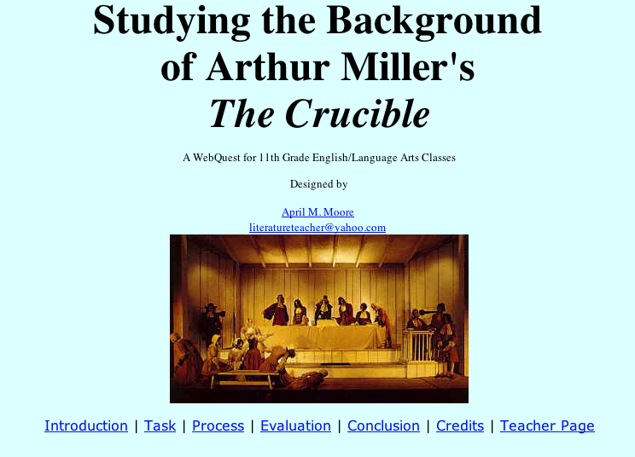
Notes:
The curricular design that this teacher uses regarding the topic of Salem witch trials” lifts the concepts of conflict, change, and perspectives and witch hunt from the pages of The Crucible to the study of American history to the evening news, to the school cafeteria, and to the dark corners of our own minds. And Does Not Neglect the details of content. It helps students see a reason for these details and makes them memorable, useful, and transferable.

Slide 47
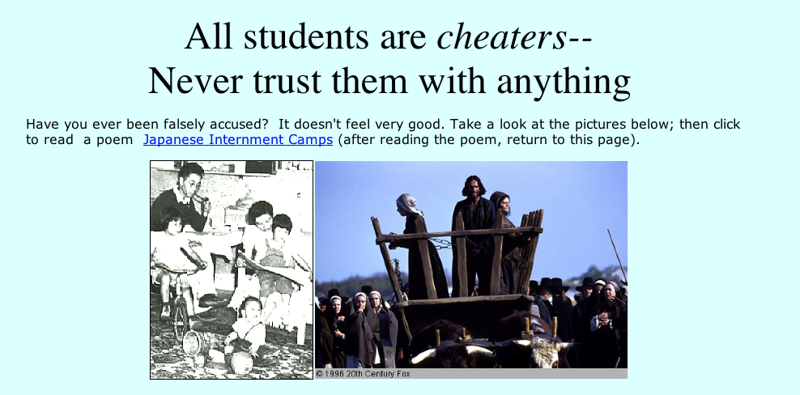

Slide 48
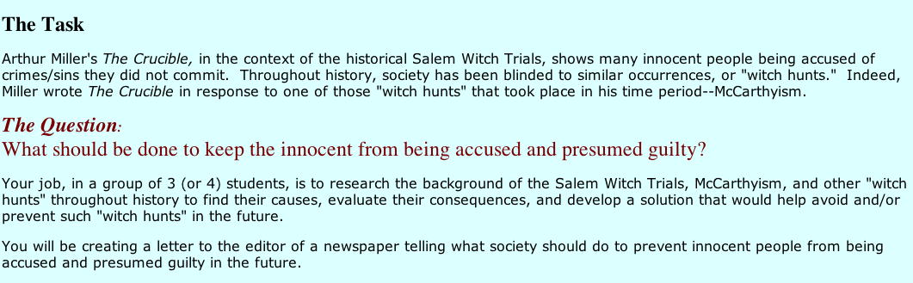

Slide 49

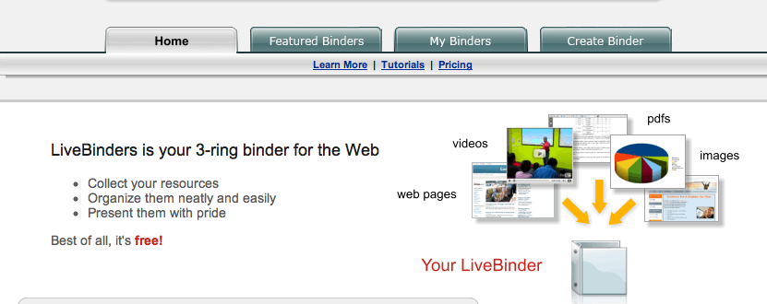
www.LiveBinders.com
To Kill A Mockingbird:
http://livebinders.com/edit?id=50325

Slide 50
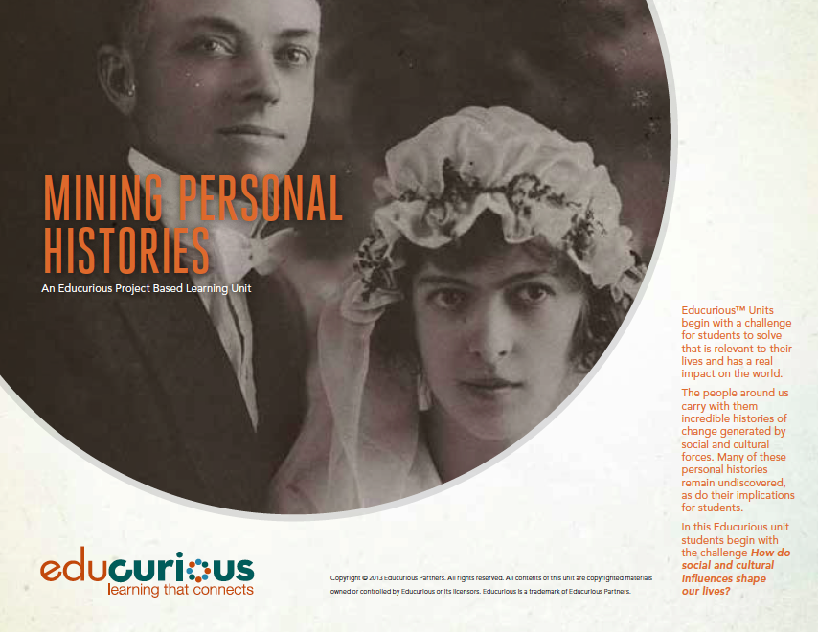
EDUCURIOUS
http://educurious.org/solutions/project-based-courses/
How do social and cultural influences shape our lives? In this course, students will read, analyze, discuss, and write nonfiction; they will craft nonfiction stories of people in their community; and they will present those stories to the world. Project: Students’ culminating project, completed with significant input from classmates, the teacher, and local experts, will be a written documentary proposal and a video documentary presenting the nonfiction story of a community member they have interviewed and researched.
https://prezi.com/hqjqus5s9tiq/mining-personal-histories/?utm_campaign=share&utm_medium=copy#

Slide 51
3
Cluster and compress standards around higher level skills.
rd

Slide 52
Claude Steele
Provide Pathways To Accelerate The CCSS For Gifted Learners.
Some of the CCSS address higher-level skills and concepts that should receive focus throughout the years of schooling, such as a major emphasis on the skills of argument in English Language Arts and the skills of patterning and problem solving
in Mathematics. However, there are also more discrete skills that may be clustered across grade levels and compressed around higher-level skills and concepts for more efficient mastery by gifted students.

Slide 53
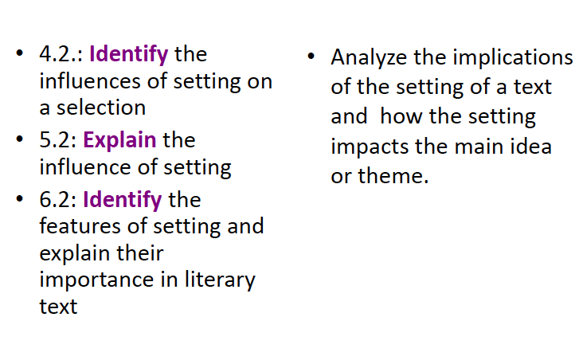
Cluster Standards to Design Complex Tasks

Slide 54
Cluster Standards to Design Complex Tasks
Socratic Seminar on The Lottery and Harrison Bergeron
What does The Lottery OR Harrison Bergeron teach us about the nature of bystanders in a time of crisis?
Leading Questions: In what ways do bystanders enable tyranny to rule and negative traditions to continue? What happens when no one stands up to repressive practices? What do bystanders gain through their passivity?
Focus on one negative practice/custom/ritual that takes place in our culture and dissect its insidious nature. In what ways does it reflect intentional ignorance as demonstrated in The Lottery?
Leading Questions: From what mindset does this custom originate? What do the participants achieve through this act (think lower centers of consciousness)? Why does this practice continue?

Slide 55
Cluster Standards to Design Complex Tasks
Analyze how fear in individuals plays a major role in propagating repressive societies.
Leading Questions: Of what are people most afraid? From what does this fear stem? How can fear paralyze people and keep them from acting in everyone’s best interest? Is the fear legitimate or imagined?
By reading Harrison Bergeron, what mindset, characteristics, and actions allow individuals to break free from controlling communities?
Leading Questions: What does it take for one to become an upstander in society? What do upstanders gain from their actions? If we admire heroic behavior, why does it not come naturally for most?
Analyze the nature of violence in ONE short story. What does the connection between violence and control suggest about humans?
Leading Questions: Can we be civilized and still kill others? Is violence necessary to keep order? How does violence reflect our repressed animal instincts? In what way(s) does harming others make us feel safe? What do we gain by controlling others?

Slide 56
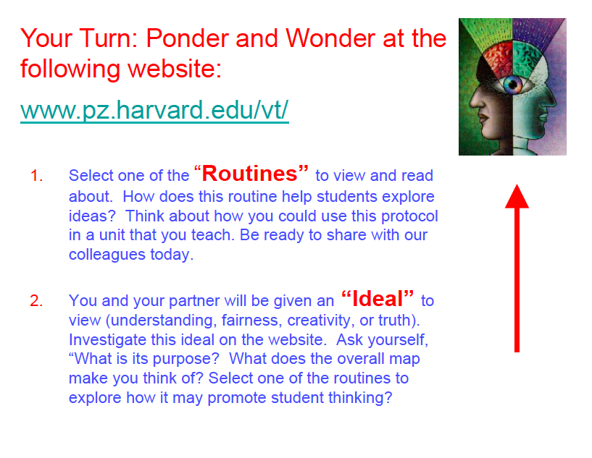
http://www.visiblethinkingpz.org/VisibleThinking_html_files/03_ThinkingRoutines/03b_Introduction.html

Slide 57
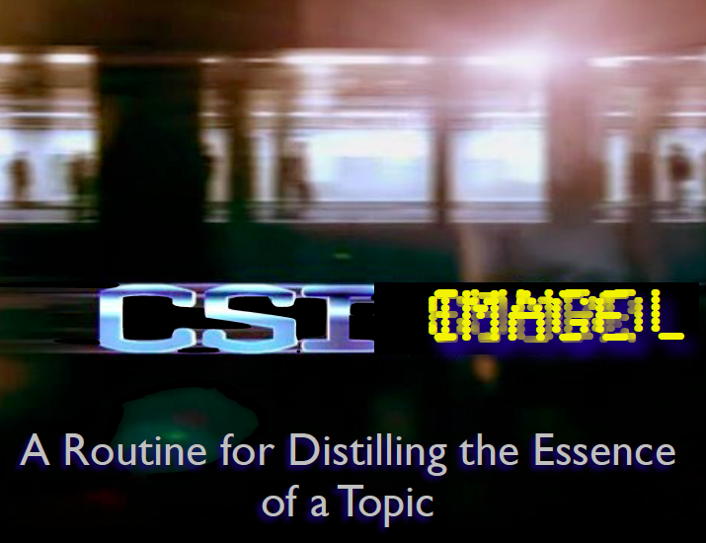

Slide 58


Slide 59
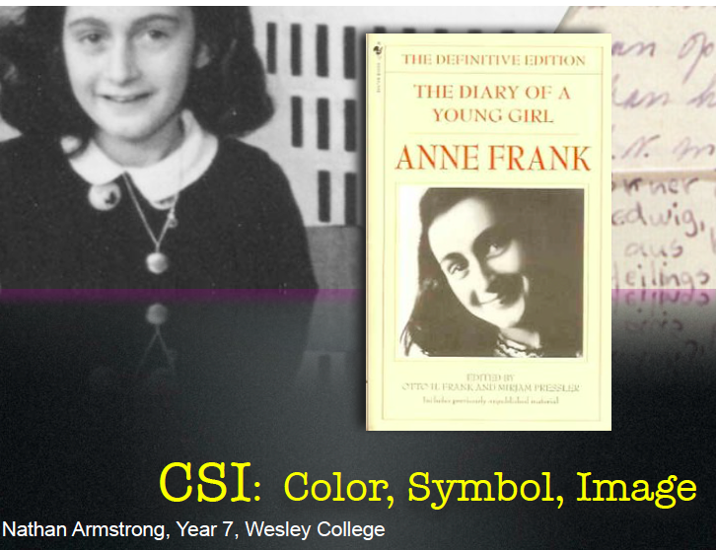

Slide 60
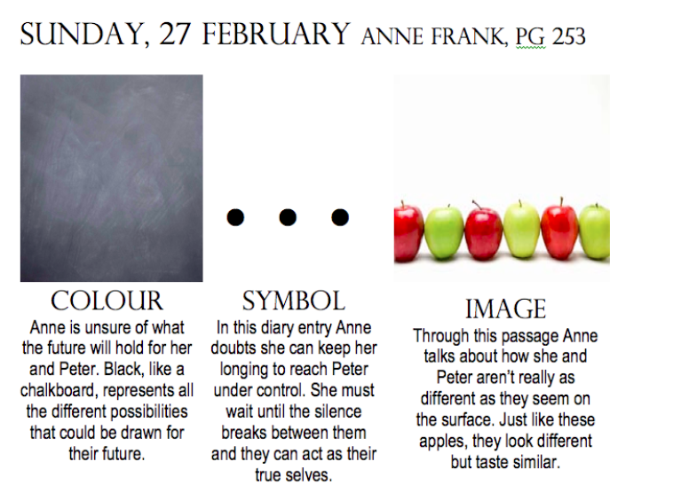

Slide 61
4
Advance the task demand.
th

Slide 62
Sternberg Choices
Provide examples of differentiated task demands to address specific standards.
The differentiated examples should show greater complexity and creativity, using a more advanced curriculum base.
While typical learners might interpret a grade level graph to satisfy the data interpretation standard in Mathematics, the advanced learners might use real world and multiple data sets to interpret and show trends in data over time.

Slide 63
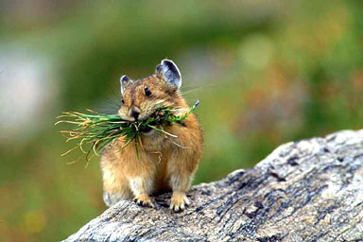
A Science Example: Migration
Know: animals’ traits and needs
Understand: that animals migrate in order to meet their needs.
Be able to: trace an animal’s migratory path and explain why it follows
that pattern
Analytical – Find two animals that share a similar migration pattern. Chart their similarities and differences. Be sure to include information on each animal’s characteristics, habitat(s), adaptations, needs, migratory path, movement time frames, etc., as well as the reasoning behind these facts. Include an explanation as to why you think they share this pattern.
Practical – National Geographic has asked you to research the migratory habits of _________ (your choice). They would like you to share your findings with other scientists AND to offer them recommendations about the best manner of observing in the future. Be sure to include information on the animal’s characteristics, habitat(s), adaptations, needs, migratory path, movement time frames, etc., as well as the reasoning behind these facts. Include a “How To” checklist for future scientists to use in their research pursuits of this animal.
Creative – You have just discovered a new species of ____________. You have been given the honor of naming this new creature and sharing the fruits of your investigation with the scientific world via a journal article or presentation. Be sure to include information on this newly-discovered animal’s characteristics, habitat(s), adaptations, needs, migratory path, movement time frames, etc., as well as the reasoning behind these facts. Include a picture of the animal detailed enough that other scientists will be able to recognize it.
Kristi Doubet 05

Slide 64
Friendly Persuasion
UNDERSTAND:
Language is a powerful tool for expression and persuasion.
ESSENTIAL QUESTIONS:
In what ways and for what purposes is language used?
What elements of language determine the message?
How is language changed to manipulate the message?
What other elements of communication can be used to convey meaning.
KNOW:
The structure of a novel
Persuasive techniques and how they are used in the novel in various situations
BE ABLE TO DO:
Develop questions and ideas to initiate and refine research
Conduct research to answer questions and evaluate information and ideas
Recognize perspective in others
Apply persuasive techniques
Apply the elements of writing a business letter

Slide 65
Friendly Persuasion Prompt
You have finished reading To Kill a Mockingbird by Harper Lee. In the novel, several characters use language and other forms of communication to persuade other characters to adopt a certain course of action.
To Kill a Mockingbird is the only novel Harper Lee has ever written. She now lives quietly and anonymously in the South, rarely granting interviews. Many are disappointed that she has never written another book.
You have been hired by your hometown newspaper to persuade Ms. Lee to grant you an interview. As you plan your project, you will want to consider the following steps:
    Conduct background research on the author;
    Prepare a list of at least three sources in correct bibliographical form;
    Write a letter to the author which uses two or more persuasive techniques to request an interview;
    Develop a list of compelling questions and Ms. Lee’s (hypothetical) answers in which you demonstrate a perceptive understanding of the author and of her only novel;
    Write an article on Harper Lee which reflects your analysis and interpretation of the information you have gained from your research, your interview, and your study of the novel.
Pattonville School District

Slide 66
Curriculum of Practice Task: Can Art Shape Perspective?
Students will:
Analyze a historical painting reproduction to draw inferences about the concept of Manifest Destiny
Compare and contrast his or her personal analyses with that of a historian who studies primary and secondary sources of the past and how the historical artifacts reveal potential intentions of a painting
Draw conclusions about how the visual images artists create can have intention and motive, and shape individual perspective
Conduct research to locate other primary documents during the 1800s that do not support the concept of Manifest Destiny

Slide 67
Student Instructions
Part 1: The job of an historian is to study the past. Historians gather information, documents, and images of the past, analyze and study them for significance, and share their findings with the world. Questions they often ask themselves about a historical time period include: What issues, concerns, or conflicts were people experiencing? What were their perspectives or beliefs about these major issues? How did these varying perspectives shape the types of actions taking place?
Today you will assume the role of an historian and analyze a painting called the American Progress. This painting came to symbolize a growing belief, called the Manifest Destiny, as our Nation grew and expanded during the 1800s.
Your job is to analyze this painting, looking for details in what the painting might be suggesting to you. The graphic organizer will guide your observations and your thinking about this painting as you try to hypothesize what the visual images might be suggesting about various groups of people in the painting, actions that are taking place, and objects that may symbolically represent an idea or belief.

Slide 68


Slide 69
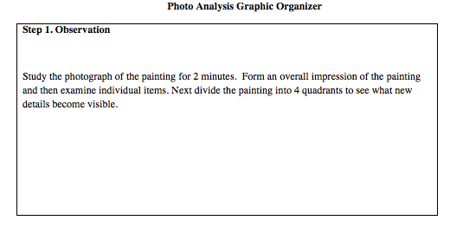

Slide 70
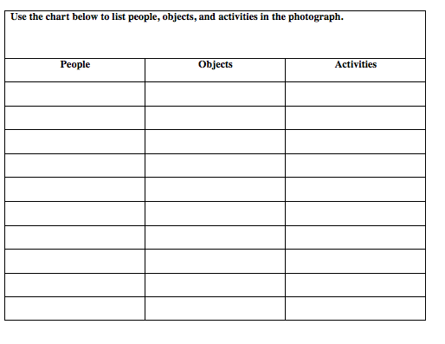

Slide 71
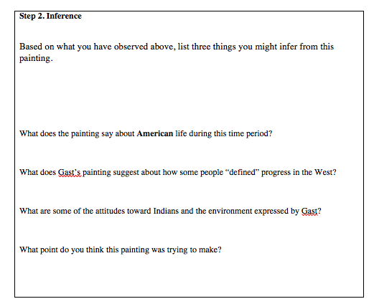
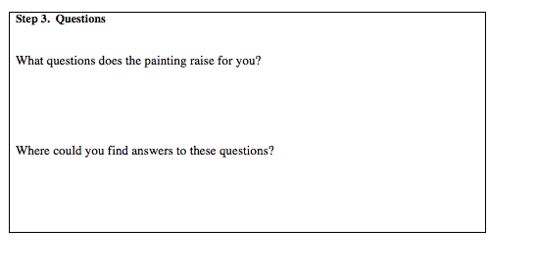

Slide 72
A Historian’s Interpretation
Part 2: Now go to this site (http://picturinghistory.gc.cuny.edu/item.php?item_id=180)
to read how this historian interprets the images in this same painting. In a journal entry in your notebook write your responses to the following questions:
In what way were some of your ideas similar to hers? How did your ideas vary?
What other research did she have to conduct in order to interpret the meaning of the symbols and images used by this painter to convey certain beliefs?
What does her analysis suggest to you about the purpose of the painting during this time in history?
Do you think that a painting can influence or shape someone’s perspective? If so, what might be some of the positive and negative outcomes on various groups of people during this time?
What does this make you think about the progress America will soon make during this time period?
Is this progress a negative thing or a positive thing?

Slide 73
Part 3: Now that you have experienced what kind of thinking goes on in the minds of historians as they try to figure out what went on in the past, locate another historical document, journal entry, newspaper, or photograph during this time period (Manifest Destiny) that reflects a different perspective than the one that is suggested in the painting you just analyzed. It is important to realize that not all people in a given historical time period share the same perspectives or beliefs. As a historian you want to act like a detective to gather clues that might suggest different points of view about social, economic, political, and cultural actions. By identifying varying perspectives historians can make hypotheses about what caused certain conflicts to exist and what effects resulted from trying to resolve these conflicts. Understanding perspective helps you to understand how conflict occurs during a historical time period.
To locate one of these historical artifacts, potential search topics might include: Manifest Destiny, Manifest Destiny historical documents, Westward Expansion, US History 1890, etc. After you locate one of these artifacts and you reveal its significance in helping to understand how history is a study in perspectives, create a presentation (in a format of your choice, IPod cast, PowerPoint, Glogster, etc.) that demonstrates how historical perspective can shape what we learn about the past, the present, and the future.

Slide 74
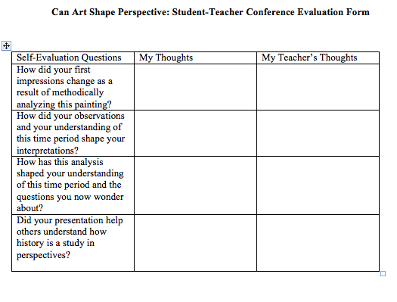
Part 4: Use the Can Art Shape Perspective: Student-Teacher Conference Evaluation Form to discuss your performance.

Slide 75
Causes of Underachievement
5
High-Quality Curriculum for Gifted Learners Asks Students to Use Processes and Materials That Approximate Those of an Expert,
Disciplinarian, or Practicing Professional
th

Slide 76
C
Interdisciplinary Product Demands
reate
Align the project work that you have designed for advanced students to show how they connect to the CCSS and how multiple standards could be addressed across content areas.
For example, research projects could be designed that address the research standard in English Language Arts and the data representation standard in Mathematics by delineating a product demand for research on an issue, asking researchable questions, using multiple sources to answer them, and then representing findings in tables, graphs, and other visual displays that are explained in text and presented to an audience with implications for a plan of action.
***Such a project might be possible for the gifted learner at an earlier grade than for a typical learner.***

Slide 77

Learn how a discipline studies itself.
The great questions want to be answered in each of us. We almost can’t help but attend when those questions are raised. To teach is to help our students raise questions they care about and to set out together to look for answers.
Notes:
Interesting activities to develop big ideas. The teachers big idea was to help students understand that The stories that are told in history are revealed by those who lived the conflict. So this represents an authentic way to engage students in the hunt for ideas.

Slide 78

Kids as Professionals
Delano Heroes film was made 5 years ago. I worked with a group of GT kids on that project. We did mini workshops on how to interview, run the camera, created a set of ten essential questions for each interviewee and set up appointments for every WWII vet in Delano that was willing. Some interviews were done at school in our studio. We went to some homes and the nursing home. It was a fabulous experience for everyone. We had about ten hours of interviews. Honor society students and a parent volunteer transcribed all the tapes, and the I edited it originally down to 30 minutes that included interviews from everyone. The final film is what you see on my website that has been edited from ten hours to ten minutes. My husband did the voice over narration and Reader's Digest gave us rights to the archival footage. About half of the vets we interviewed are now gone. I am still proud of that project because of the collaborative nature of it. It ran for a while on cable in the metro on pay per view through the History Center greatest generation project.
See film at: http://chaseproductionfilm.com/delano-heroes.html
In line with the ELA standards’ recommendations, to promote students' continued development of research skills, teachers of the gifted may also infuse opportunities for research in students’ areas of interests as well as creative production.

Slide 79

Thinking Like A Historian:
Rethinking History Instruction
was written by Bobbie Malone
and Nikki Mandell.
http://www.uww.edu/cls/history/for-teachers

Slide 80
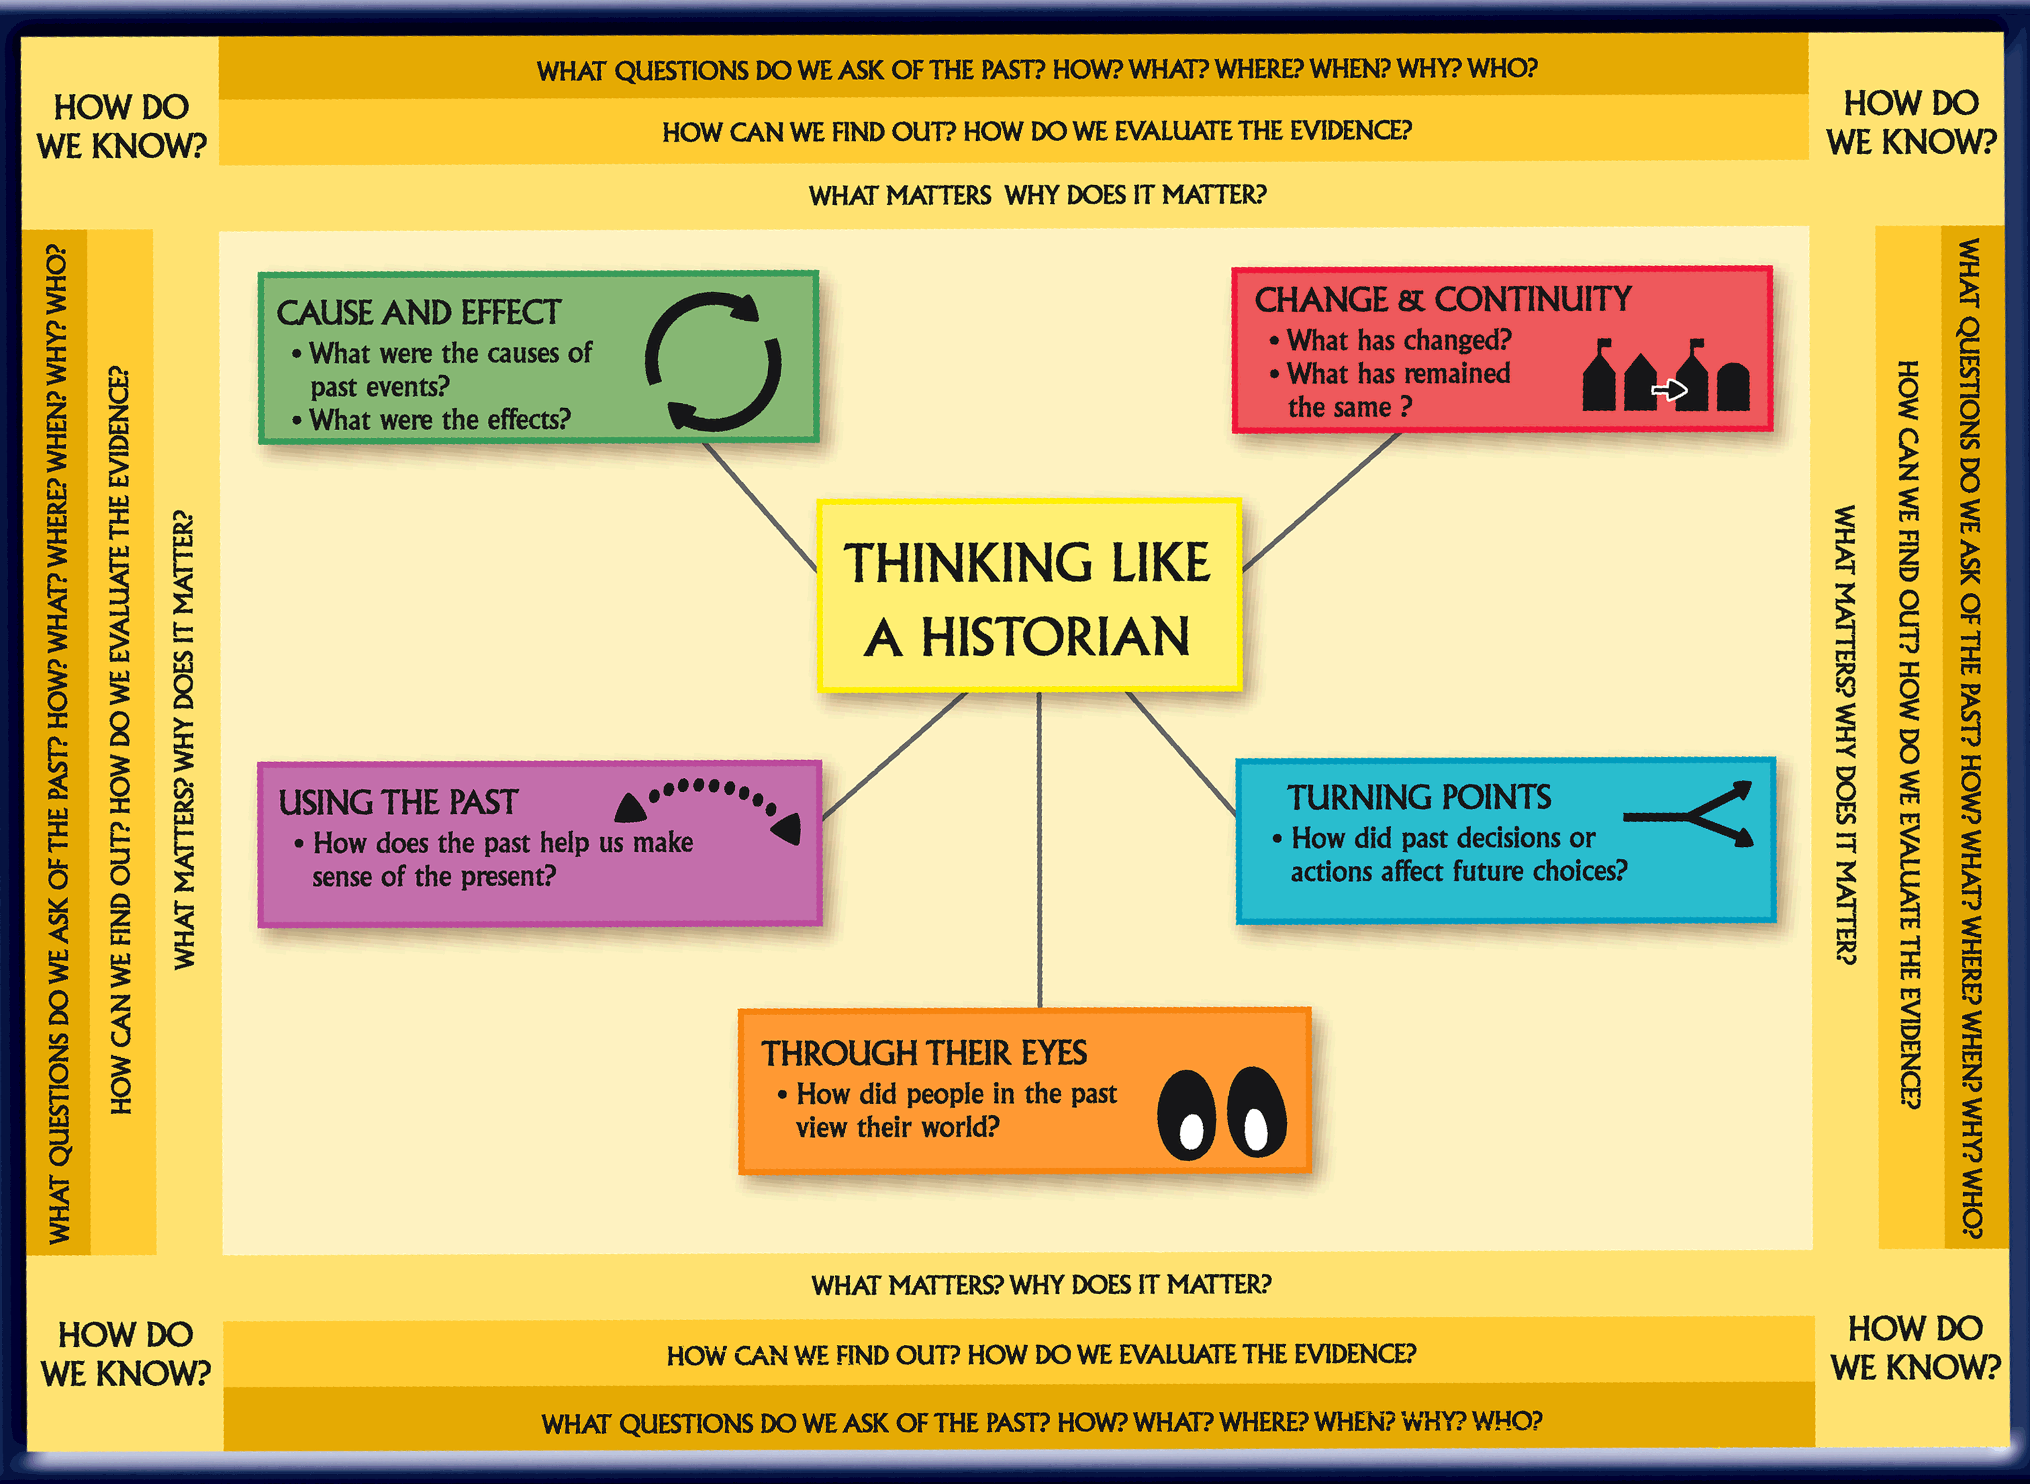

Slide 81
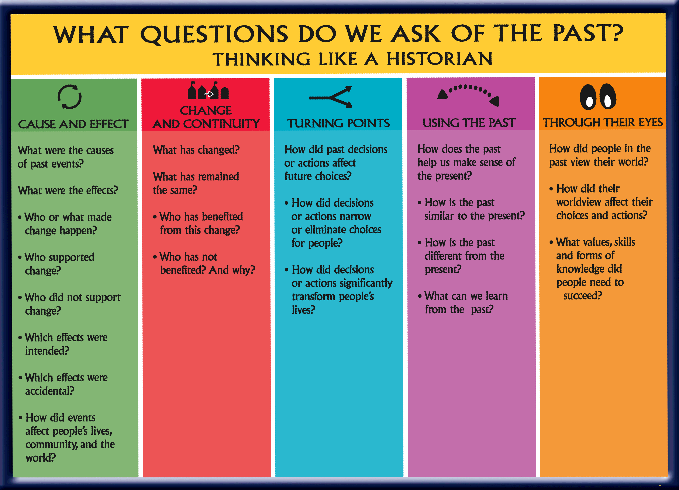

Slide 82


Stanford History
Education Group
https://www.teachingchannel.org/videos/reading-like-a-historian-sourcing-complete-lesson
http://sheg.stanford.edu

Slide 83



Resources
http://www.archives.gov/education
/
http://www.nchs.ucla.edu/Standards/
http://www.readingquest.org/strat/home.html

Slide 84
Causes of Underachievement
6
Resources to Support the Learning of Advanced Students in the Content Areas
th

Slide 85

http://csip.cornell.edu/Curriculum_Resources/default.html

Slide 86
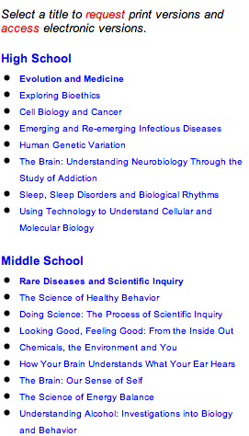

http://science.education.nih.gov/index.html
https://www.bighistoryproject.com/home

Slide 87

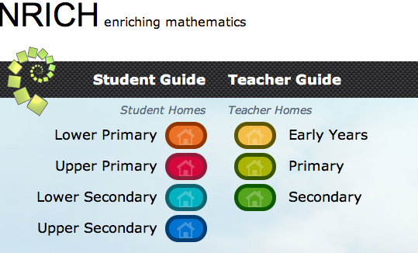

Mathematical Resources
Dr. Linda Sheffield
http://www.lindajsheffield.com
http://map.mathshell.org/materials/index.php
http://www.insidemathematics.org/tools-for-educators
https://www.illustrativemathematics.org
http://nrich.maths.org/frontpage

Slide 88


Problem Based Learning
Buck Institute for Education
http://bie.org/project_search
Problem-Based Learning Units-
http://www.rfwp.com/pages/shelagh-gallagher/
https://www.oercommons.org

