Slide 1

BASIC PRINCIPLES OF IDENTIFICATION
NWESD Jan. 28, 2016 Jan Bonzon & Todd Christensen
Notes:
Preset
NWESD website
NAGC Admin Toolbos
Two ABD District files
INTRODUCTIONS
GLAD YOU ARE HERE!
JOT DOWN YOUR QUESTIONS.
LEARN from your TABLE MATES
I”VE TAKEN THE LEAD for designing this workshop. Both of us have different experiences to share with you. So we will be tag-teaming.

Slide 2
WORKSHOP OUTCOMES
KNOW, UNDERSTAND and DO
Current research and best practices in IDENTIFICATION
Washington’s new WACs, how they differ from previous WACs and why… (alignment with current NAGC National Standards)
Basics of Measurement, Appropriate Tools, Testing
Timelines and Steps in the ID Process
Appropriate documentation and forms
The Multidisciplinary Selection Committee: roles and responsibilities
How all the pieces come together
Notes:
We will spend the first hour front loading the BIG IDEAS
THEN you will participate in 2 SIMULATION EVENTS so that you see how the steps come together to form decisions
NEW QUESTIONS will arise and we will try to answer them as we go!

Slide 3

National Assoc. of Gifted Children
NAGC
http://www.nagc.org
STANDARDS
Research
Position Papers
PROFESSIONAL DEVELOPMENT
Webinars
Administrators Tool Kit
Notes:
HO—Resource list
The NAGC deep website should be your guide for information and guidance.
Washington’s WACs for Hi-Cap were based on NAGC Standards which, in turn, are based on up-to-date research.
On your ReSOURCE LIST, you’ll find the NAGC link……and many others.

Slide 4



Peters, S.J., Matthews, M.S., McBee, M.T, & McCoach, B. (2014). Beyond gifted education: Designing and implementing advanced academic programs. Waco, TX: Prufrock Press.
Hunsaker, S.L (2012). Identification: The theory and practice of identifying students for gifted and talented education services. Waco, TX: Prufrock Press.
http://www.prufrock.com
Johnsen, S. K. (2011). Identifying gifted students: A practical guide. Waco, TX: Prufrock Press.
http://www.prufrock.com
Notes:
For your own reference libraries, These three books on Identification are recommended by Dr. Jan Leppein of Whitworth University
All are available through Prufrock Press.
.

Slide 5
Notes:
HO—agenda
SHOW HOW TO GO TO THE ESD WEBSITE TO ACCESS ELECTRONIC LINKS
POWER POINT—some of the presentation slides may be in a different order from those you have here.
---ELECTRONIC AGENDA
--OSPI HANDBOOK
Forms and Procedures.
We’ll be adding a few additional forms in YELLOW
Dividers available
Hole punch
We will be BUSY!!
The agenda timeline is FLEXIBLE
There is more information on the PP slides that we will probably have time to cover. Your questions will guide us.
Todd and I will stay 12:30-1:30 to work with any individuals/teams who would like individual assistance.
The room is available for teams to meet as you desire.

Slide 6
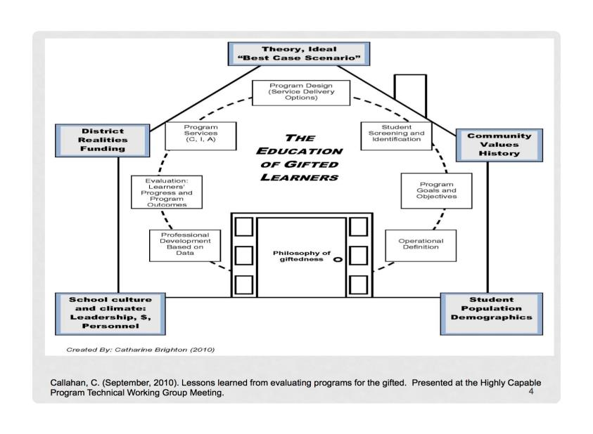
Notes:
THE HOUSE
Most of you have seen this graphic before.
Today we focus on the singular element of IDENTIFICATION.
But the elements of the OUTER RING need to be considered as you make ID DECISIONS
Demographics—tools and criteria
FUNDING—Tools, time
etc.

Slide 7
DISCUSS: “In reviewing your district’s ID process, to what extent does it reflect these components?”
Systematic—be incorporated into school-wide initiatives and programming across all grade levels K-12
Collaborative— the responsibility of all staff members working in a collaborative fashion to meet student needs
Sustainable— an integral part of the district’s staffing and funding plans.
Responsive—responsive to local student demographics…
Fluid—flexible and continuously adapt to student needs. Hi-Cap plans may vary from district to district and school to school.
Comprehensive—consider the “whole child”….
Aligned—have components that are clear and aligned with WACs, NAGC standards, research, effective practice.
Notes:
HO---ARTICLE
Ask participants to read
INDIVIVUALLY READ: Key Characteristics of Highly Capable Program Plans (Hanninen/OSPI)
TABLE GROUPS: DISCUSS In reviewing your district’s ID process, to what extent are these components reflected in that process?
LARGe GROUP SHARE OUT

Slide 8

SELF-STUDY
Notes:
HO—Self-STUDY
HO—Self-Study
WHERE ARE YOU NOW????
This 20 item self-study survey was drawn from 3 documents.
We hope it will be useful to you
PUT YOUR NAME/DISTRICT on the survey. We will collect after you’ve finished to make a frequency chart to help us today.
INDIVUDALLY or as a DISTRICT Team complete the SELF-STUDY.
?????? ON CHART PAPER, l20 numbers.
PRIORITIZE YOUR 5 GREATEST NEEDs (NO or MAYBE)
Place a CHECK MARK by the 5 NUMERS corresponding to your greatest needs

Slide 9

Paradigm Shifts—Implications for Identification
Notes:
SOME OF YOU ARE JUST STARTING THE PROCESS
SOME need to UPDATE ID processes
SOME want to understand THE FOUNDATIONS

Slide 10
PARADIGM SHIFT--Services
OLD
NEW
Some grade levels, not others
Decisions driven by economics or politics
Programming disconnected from schoolwide initiatives, programs, curriculum
Fixed “program”; One-size-fits-all
K-12 Services
Growth oriented
Articulated scope and sequence of curriculum matched to Hi-Cap learner goals
Connected; Standards driven
Notes:
IS YOUR DISTRICT USING THE OLD or the NEW PARADIGMS?
DO you have QUESTIONS?

Slide 11
PARADIGM SHIFT—Equity and Access
OLD
NEW
Predominantly rich white kids!
Under-representation from:
  Economic sub-groups
  2e, Twice Exceptional (SPED/Hi-CAP)
  English Language Learners and
  Linguistically or Culturally Diverse
Inclusivity Mandate:
  Include traditionally under-represented populations.
  Fair evaluation instruments and processes selected for intended populations and purposes.
  Multiple objective measures

Slide 12
PARDIGM SHIFT—Nature of Intelligence
OLD--FIXED
NEW--FLUID
INTELLIGENCE is FIXED
IQ TESTS
SINGLE SCORES
APTITUDE driven
FIXED CUT-OFF SCORES
INTELLIGENCE is FLUID
COLLECT “BODY OF EVIDENCE”
Multiple objective measures
Different types of data
Data from across time/place
Qualitative and Quantitative
HOLISTIC CASE STUDY:
No single score includes or excludes a learner from consideration

Slide 13
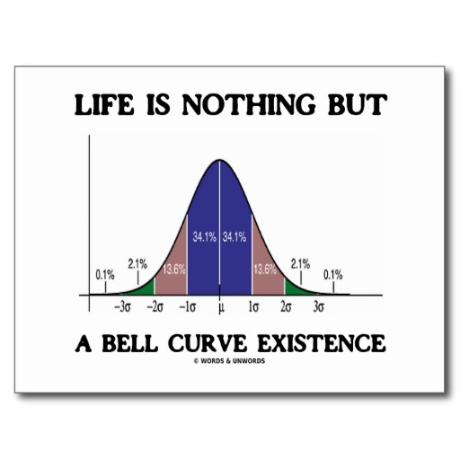
TRADITIONAL VIEW: G Factor
Notes:
Modern theories have roots in earlier traditions that over time proved to be inadequate.
The traditional model holds that giftedness is represented by a global IQ 130+ in all domains of reasoning: verbal, non-verbal/spatial and mathematical.
Identification was simple and straightforward. The intelligence tests which measured IQ was the ONLY measure or it dominated all other measures.
A score cutoff was believed to be predictive of success in a rigorous instructional program and in life.

Slide 14
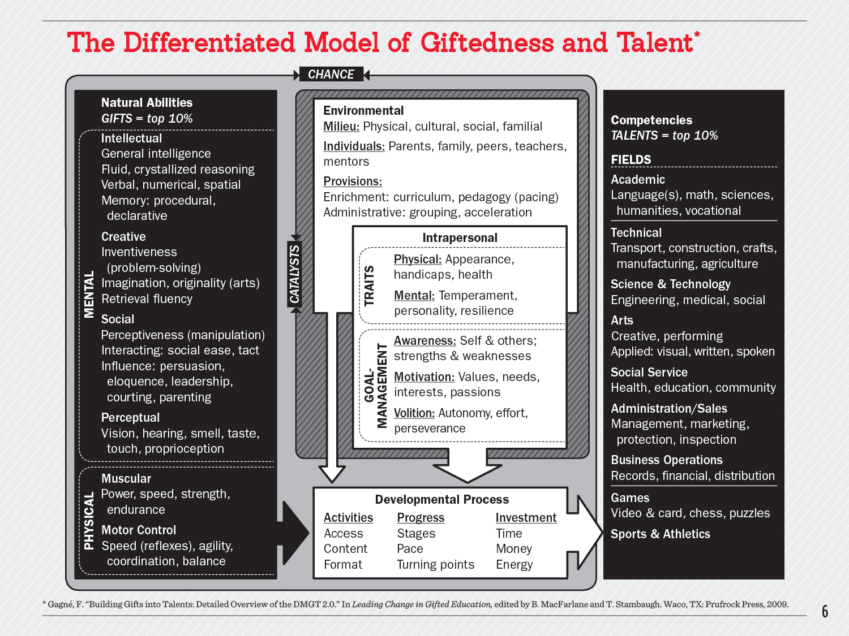
Notes:
Gifts are not manifested as talents without either the interplay of CHANCE or the provision of CATALYSTS.
Catalysts may inhibit or promote growth.
. A gifted student will not necessarily develop talents unless particular catalysts are in place.
The purpose of ID process is to locate students with enormous potential, provide catalysts that will develop potential into talents.
These students are the ones most likely to solve global problems as researchers, designers, inventors, leaders, policy developers, etc.

Slide 15
Gagne and Passow
One Philosophical Position
“What educators and psychologists recognize as giftedness in children is really potential giftedness, which denotes promise rather than fulfillment and probabilities rather than certainties about future accomplishments.
How high these probabilities are in any given case depends much on the match between a child’s budding talents and the kinds of nurturance provided.”
^{Harry Passow, 1985}
Notes:
Here is what Harry Passow, a leader in the field for decades, had to say about giftedness.

Slide 16

NEW PARADIGM: a MULTI-FACETED phenomenon
AFFECTIVE
COGNITIVE
Social Contexts
Psychological Contexts
Notes:
Giftedness is now viewed as multifaceted phenomenon that includes both cognitive and affective qualities and is influenced by both social and psychological contexts.
Our understanding of cognitive science reveals that human potential is a MULTIFACETED PHENOMENON that includes both cognitive and affective qualities and is influenced by both social and psychological contexts.
The IDENTIFICATION system in Washington requires that MULTIPLE MEASURES be collected and considered.
A MULTI-DISCIPLINARY SELECTION COMMITTEE of trained professionals representing DIFFERENT WAYS OF THINKING ==THEY bring their experience to all decisions concerning the education of the WHOLE CHILD>.

Slide 17
EXCEL Weighted FORMULA
WEIGHTED FORMULAS NO LONGER APPROVED !!!!
Notes:
In the past, some districts placed all scores into an EXCEL table and identified the HCP students via numbers crunched using a weighted formula.
Student TOTAL SCORES were then ranked ordered and quotas were filled.
No longer.

Slide 18
IDENTIFICATION—Old and New
TRADITIONAL: High Stakes Selectivity for Life
NEW PARADIGM: Talent Development
“Truly gifted” = 130++ IQ on an individually administered intelligence test.
One-time identification often in primary years.
Qualitative distinctions between groups of children.
Must demonstrate promise in ALL DOMAINS.
Permanent segregation in special classrooms or special schools.
Very HIGH STAKES assessment.
Ongoing identification process. Direct link between ID and curriculum activities.
Expects that some student will cycle in/out as they mature and level of support that they need changes. (Revolving Door)
Multidimensional identification model. Use of local and sub-group norms.
Students expected to excel in 1-2 domains but not all.
Educational programming guided by current levels of talent development, regardless of background. (Differentiation, flexible grouping)

Slide 19
BIG IDEA for ID
Holistic--Case Study Evaluation
ID protocols ensure equity and access to intentionally include under-represented populations

Slide 20

STEPS ---IDENTIFICATION PROCESS

Slide 21
NAGC Administrator’s Toolbox
http://www.nagc.org/resources-publications/resources-administrators/administrator-toolbox
Notes:
HO---WACS
HO—STEPS PACKET
SHOW how to access electronically
STARTS WITH DECISION about district CAPACITY—course sequences, identifying gaps and needs. WHO is being left out?
2. Design a MULTI-FACETED ID process and select tools

Slide 22
Notes:
LEFT SIDE CAPTURES THE WACS for ID
RIGHT SIDE is a FLOW CHART.
NOTE—
ANNUAL NOTICE
PERMISSION TO ASSESS
REFERRAL—TWO TYPES, USED SIMULTANEOUSLY—not SEQUENTIALLY
APPEAL PROCESS
PERMISSION TO PLACE
ANNUAL REVIEW

Slide 23

ANNUAL EVALUATION OF ID PROCESS
The ID process must be reviewed annually to ensure that students, particularly those who are vulnerable to being overlooked, have the opportunity to be considered.
Identified population should resemble demographics of the district.
Evaluate procedures annually in order to limit “false positives” and “false negatives” within each sub-population.
Notes:
TODD
FORMS 217
CPR

Slide 24
PURPOSE OF ID:
TO REVEAL….
INFERRED or DEMONSTRATED Learning Characteristics

Slide 25
IDENTIFICATION STARTS WITH…
Washington State Definition
Outstanding abilities are seen within students’…..
general intellectual aptitudes,
specific academic abilities, and/or
creative productivities within a specific domain.
WAC 392-170-035
Notes:
REFER TO YOUR WACs
APTITUDE
ABILITIES (Achievement) in specific domains (verbal, quantitative, non-verbal symbol systems……or ELA, Math, Science/Engineering)
OPTION of identifying students who are creatively PRODUCTIVE within a symbol system or subject area.

Slide 26
Capacity for unusual depth of understanding, to retain what has been learned, and to transfer learning to new situations;
Capacity and willingness to deal with increasing levels of abstraction and complexity earlier than their chronological peers;
Creative ability to make unusual connections among ideas and concepts;
Ability to learn quickly in their area(s) of intellectual strength; and
Capacity for intense concentration and/or focus.
WAC 392-170-036
Notes:
These are the COGNTIVE characteristics associated with gifted learners. and are needed to be successful in a rigorous gifted program.
There are other characteristics we associate with gifted behavior but THESE are observable in both traditional gifted students and gifted learners from under-represented sub-groups.
Rate of learning is the most important observable characteristic and creates defensiblility.
Also consider INTENSITY and the degree to which the students are OUT OF SYNC with their peer group
Younger students may also stand out for how their physical development is out of sync with their cognitive and/or emotional development..
A five year old, for example, might read a third-grade book but lack the small motor skills necessary for successful completion of kindergarten art projects. This kindergartner may have lengthy conversations with adults, yet struggle to effectively communicate with peers—all at the same time.

Slide 27
IDENTIFICATION STARTS WITH…
Washington State Definition
Highly capable students are students who perform or show potential for performing at significantly advanced academic levels when compared with others of their age, experiences, or environments.
WAC 392-170-035
Notes:
EQUITY and ACCESS is now mandated.
Look for both potential and performance
Compare students with members of their sub-groups when looking for EXCEPTIONAL ADVANCEMENT

Slide 28

Under-Represented Populations
RANGE
SUB GROUPS
Profoundly gifted (140+ IQ)
Primary Gifted,
Gifted Girls (STEM)
Underachievers
Economic Subgroup***
Ethnically/ Culturally diverse
English Language Learners
Special Education, 2e, Twice Exceptional
  Health Impaired (e.g.ADHD)
  Asperger
  Emotionally Impaired
  Learning Impaired
Notes:
TODD
ToDD: LOCAL NORMS, Z Scores, Top percentles of disagragated data
JAN: BUILDING-BASED MSC teams

Slide 29
HOW WOULD YOU
IDENTIFY or MEASURE ?
GENERAL INTELLECTUAL APTITUDE | SPECIFIC ACADEMIC ABILITIES | CREATIVE PRODUCTIVITY within a DOMAIN
ALERT:
Different developmental stages may require different tools.
Notes:
With PARTNER and ORGANIZER,
BRAINSTORM different ways to collect data for each category.
CODE for OBJECTIVE (QUANTITATIVE) or SUBJECTIVE (QUALITATIVE)

Slide 30
DIRECTIONS:
Brainstorm types of tools that could be used to objectively or subjectively gather data about the student’s potential or performance.
Remember that tools may change across the developmental stages. Do you want to look K-12 or at only one developmental stage?
If you would like to zoom-in on one particular stage of development, see Jan or Todd for further information.
ANSWER KEY:
ANSWERS on slides……31-42

Slide 31
TESTING General Intellectual Aptitude
SELECTING TESTS
GROUP, PAPER, ONLINE
Cognitive Abilities Test *
InView Aptitude Test *
Otis Lennon Aptitude Test—NO
Naglieri NonVerbal Aptitude Test—Only to ID Non-Verbal intelligence.
INDIVIDUALLY ADMINISTERED—gold standard
Stanford Binet Aptitude Test
WISC IV-R
Standardized
Norm-referenced; most current norms
Non-biased
Valid: Measure what they purport to measure
Reliable: Low SES, developmentally appropriate
Many items
Gives VERBAL, QUANTITATIVE, NON-VERBAL scores rather than a GLOBAL score.
Security Protected
  e.g. don’t use SAGE since parents can purchase it
Notes:
One-on-one INTELLIGENCE testing is best but not often practical. HOWEVER, they are the BEST test for reliably determining the aptitudes of students with behavioral or neurological issues. If a student has already been identified for SPED services, this testing may already have been completed. ADD, ADHD, Asperger’s, Learning Impairments, Emotional impairment, etc-- Use and IQ test. Psychologist needs to have experience administering these tests to HIGH ABILITY students.
GROUP TESTS—COgAT is used extensively in Washington. Elsewhere, the InView Aptitude Test is also used successfully.
The Otis Lennon does not seem to correlate with results from CogAT. The items are mixed up (verbal, math, nonverbal) and it only yields a GLOBAL score which does not help you to determine area of cognitive strength and help determine services.

Slide 32
INFERRING General Intellectual Aptitude
QUALITATIVE
TEACHER, PARENT, COMMUNITY, SELF
Rating Scales, Questionnaires, Narratives WITH EVIDENCE
Demonstration of student’s thought processes
Writing: IDEAS
Math Problem solving processes
Performance Task—analysis, creativity
Literature discussions --insights
Projects—depth and complexity
Observations of Behavioral Characteristics associated with exceptional reasoning ability within specific….
SYMBOL SYSTEMS
  Quantitative
  Verbal
  Non-Verbal / Spatial

Slide 33
TESTS--Specific Academic Achievement
QUANTITATIVE
GROUP ACHIEVEMENT TESTS examples
Iowa Assessment (ITBS)
WaKIDS
COMMON CORE STANDARDS example
Smarter Balance
LONGITUDINAL SYSTEMS example
STAR, MAP
SUBJECT-SPECIFIC examples
Reading Levels (DRA, BAS, Lexile, etc)
Math Skills Readiness (Pre-tests; Skills inventories -Acc. Math, STAR Math; Iowa Algebra Aptitude Test)
Norm-referenced,
Standardized tests
SPECIFIC academic abilities….
  Verbal--Reading, Writing
  Mathematical
  Non-Verbal / Spatial
  Science or other subjects

Slide 34
INFERRING--Specific Academic Achievement
QUALITATIVE
Skills are revealed to far above grade level
Curriculum tests
Reading preferences
Grades--Demonstrated success in Advanced Courses/ Content
Intense, Advanced Interests
Clubs (Robotics, Journalism))
Community --Eagle Scout, History Re-enactor, Beach restoration Project
Honors and Accomplishments within wider world….
1st place State Science Fair
Leadership: Student Body President
Poetry is Published by reputable publisher
Work Samples demonstrate very high level of skill
Observations + Evidence

Slide 35
Creativity Productivity within a DOMAIN
TESTS
  Torrance Test of Creative Thinking
OBSERVATIONAL SCALES
  Creative Behaviors—Rating Scales
PRODUCTS
  Domain-specific
  Culturally influenced
  Compare to similar population
BEHAVIORAL CHARACTERISTICS (some)
Tolerance for ambiguity
Adaptable; flexible thinking
Synthesizes; sees patterns
Multiple perspectives; divergent thinking
Lots of ideas; fluent
Possibility thinker
Takes risks; non-conformist
Imaginative; playfulness of mind

Slide 36

Special Considerations:
Characteristics YOUNG GIFTED
Might be more MATURE
Strong Language and/or Mathematical skills
High READINESS
Readers: Beyond Phonics
Self-Reliant
Question Everything!

Slide 37
ID for Primary-Aged Students
Developmentally Appropriate
Infer aptitude from observations, performance tasks, interviews, work products
Measure achievement→significantly above gd. level
  WaKids (level 9, perhaps 8)
  Reading Tests
  Math Tests
Assess interests, motivation, intensity

Slide 38
Special ID Considerations:
YOUNG CHILDREN
CONSIDER
Developmental Issues
IDENTIFICATION
Modifications
Consider length of tests
  Shorter tests, or
  Over longer period of time
Remove time limits
**Focus on qualitative data**
  OBSERVATIONS: Interview parents, students
  Portfolio of Best Work over time and different locations
  Curriculum Assessments
  Performance Assessments
Attention span; energy
Test-taking experience/skills
Asynchronicity
Rapid and Unpredictable Growth
Wide Standard Error of Measure (SEM)

Slide 39
CRITERIA
Aptitude 95^{th+} percentile stanine 9 evidence
Achievement 97th+ percentile stanine 9 evidence
Creativity evidence
“… compared with others of their age, experiences, or environments.”
IDEAS:
      Building -specific MSC vs Centralized Process
      Local norms, converting to z scores
      Disaggregate data and locate top
Notes:
TODD

Slide 40
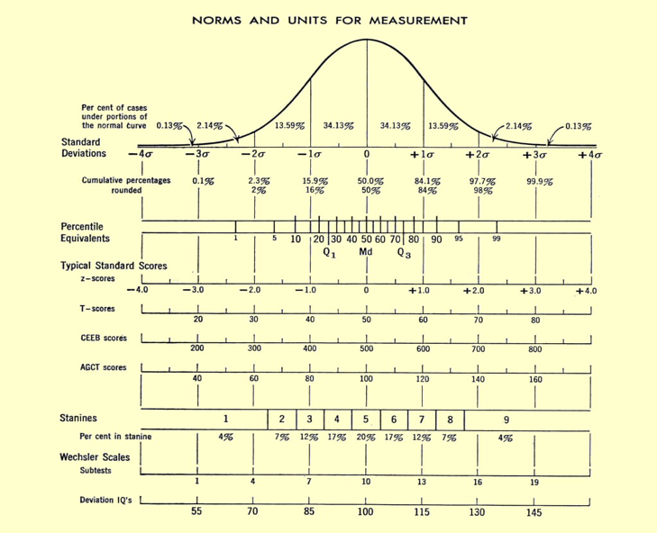
4%
Stanine 9 = 4%
Notes:
TODD

Slide 41
IMPORTANT!!!!!!
RAISE THE TEST’s CEILING—Administer ABOVE-LEVEL Testing by 1 to 2 grade levels
DATA SHOULD BE RECENT----Not older than 2 years
DEVELOPMENTALLY APPROPRIATE
Time, energy, focus to take the test (K/1 vs older children)
Familiarity of testing environment, administrator
CONSISTENT across all tests, testing situations, district participants
CONSIDER Standard Error of Measurement
Notes:
TODD

Slide 42
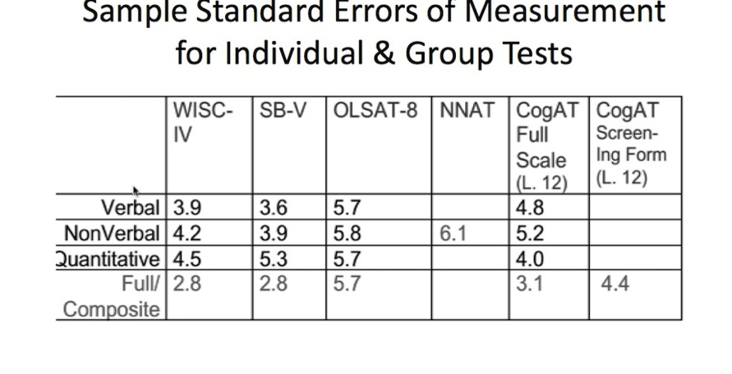
Notes:
HO—Packet on SEM
TODD and JAN

Slide 43

There is NO PERFECT Identification system.
Assessments are only “rough estimates” of aptitudes and potential talents.
Abilities can be “inferred” objectively and subjectively.
Certainty increases as you collect sufficient triangulating qualitative and quantitative data.
Ongoing and continuous process; ID can occur over TIME
Notes:
TODD

Slide 44

APPLYING our KNOWLEDGE
Notes:
BREAK?????
9:30
OPEN LINKS

Slide 45
CONTENT
Guided Simulation
of Multidisciplinary Selection Team process
Integration of……
    Learner Characteristics
    Equity and Access
    Multiple Measures
    Profile of Strengths—electronic vs paper
    Alignment of data -> strengths-> services
    Documentation of ID process
    Communicating with parents, district staff
Notes:
Synthesize WACs and the STANDARDS they are based upon into a practical task.
TWO MODELS

Slide 46
GUIDING PRINCIPLES of Identification
Intelligence is multifaceted and manifested in many ways.
Instruments used should measure diverse abilities and talents.
Student identification should be based on valid and reliable measures.
No single instrument or score should be used to determine eligibility.
Assessment of students should continue over time.
A profile of each student’s strengths and areas of need should be developed and maintained.
A knowledgeable committee should review student assessments and determine eligibility.
Written procedures should include matters of consent for ID and placement, eligibility, appeals, exit, re-entry
Once a student has been identified as eligible, the services, not the status, may change to meet needs.
Notes:
HO--Principles

Slide 47
GATHER and RECORD INFORMATION from multiple sources—
Does the data on Verbal Ability “TRIANGULATE” ?
5th grade girl
STAR READING—Fall 98 percentile, Winter 92 percentile, Spring 95 percentile LEXILE—Fall 99 percentile, Winter 95 percentile, Spring 88 percentile TEACHER NARRATIVE: Student reads all the time, even when not permitted. Reads at the top of her “zone”; gravitates towards classic literature and novels by Hispanic authors. Tends to be “dramatic” and “intense.” Enjoys debating. Above grade level skills in writing: strong “voice” in her narrative writing; persuasive writing is well organized.
COGAT 7-- VERBAL SUBTEST 97 percentile PARENT NARRATIVE: Advanced early milestone—talked early and in complete sentences. Put on puppet plays for the neighbors beginning age 6. “Gets” subtle adult verbal humor and puns. Enjoyed making up song lyrics, poems, riddles in elementary school. Sensitive.
STUDENT INTEREST SURVEY: English and Spanish are spoken in the home. Student is creating a poetry anthology of original poems and poems by famous poets; hopes to publish her poetry in an online journal. Member of the drama club and has performed leading roles at the local community theatre.
Notes:
BIG IDEA is to COLLECT enough information from different sources to see if the DATA CLUSTERS around a domain of strength.
The use professional judgement to determine whether the strengths are so outstanding or profound that the student needs services of the Hi-Cap program
Have a look. WHAT DO YOU THINK?

Slide 48
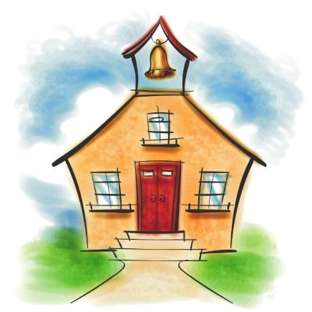
ABC SCHOOL DISTRICT’s
IDNEITIFCATION PROCESS
Notes:
HO---eXCEL woRKSHEET
PULLUP TWO DATA SETS—each table should have 2-3 laptops working.
20 minutes or so to work to answer questions on the HO.
FACILITATOR
REPORTER

Slide 49


XYZ SCHOOL DISTRICT’s
IDENTIFICATION PROCESS
Notes:
Both of the simulations can be used for training your Multi-disciplinary committees.
You each have all the forms needed to run this simulation back in your districts.
The purpose of THIS simulation is for you
to examine different types of QUALITATIVE DATA,
learn how to EEK OUT the CHARACTERISTICS of gifted learners from the NARRATIVES,
look for triangulation
Make decisions for an INDIVIDUAL TRANSFER STUDENT.
_________________________________________

Slide 50
MULTI-DISCIPLINARY
SELECTION COMMITTEE
The multidisciplinary selection committee for the final selection of the most highly capable students for participation in the district's program for highly capable students shall consist of the following professionals:
A special teacher: Provided, that if a special teacher is not available, a classroom teacher shall be appointed;
A psychologist or other qualified practitioner with the training to interpret cognitive and achievement test results;
A certificated coordinator/administrator with responsibility for the supervision of the district's program for highly capable students; and
Such additional professionals, if any, the district deems desirable. (SPED, ELL, Counselor)
WAC 392-170-070
Notes:
Because giftedness is now viewed as a multi-faceted phenomenon, personnel with expertise and knowledge about child development, education of gifted learners, theories of teaching and learning, and measurement and testing to the decision making process.
You may and SHOULD invite others. Especially consider inviting specialists on a case-by-case basis to inform decisions about students with special needs, including special education, counseling services, ELL and culturally different students.

Slide 51
SPECIAL TEACHER
A special teacher is a teacher who has training, experience, advanced skills, and knowledge in the education of highly capable students. Areas of competence should include knowledge of the following: Identification procedures, academic, social and emotional characteristics, program design and delivery, instructional practices, student assessment, and program evaluation.
WAC 392-170-038
MEMBER-- Multi-Disciplinay Selection Committee
Notes:
Please note the qualifications of the SPECIAL TEACHER assigned to the Multi-disciplinary selection committee.
Your district may or may not currently have a person adequately trained for this position. Training of this SPECIAL TEACHER should be a priority.
Training opportunities are available through NWESD, online through Whitworth University

Slide 52

ROLES and RESPONSIBILITIES
Number off 1-4.
That number corresponds to your role.
READ YOUR RESPONSIBILITIES
Notes:
HO—FOLDERS
PULLOUT AQUA PAPER on R/R of MSC members
COUNT OFF by 4
At your table are ROLE AND RESPONSIBILITY sheets.
Your number equals your role>
Read about your responsibilities.

Slide 53
PROCESS ROLES
DISTRICT COOR/ ADMIN. Record Keeper: Minutes
SPECIAL TEACHER Chair: Manages Process
3. PSYCHOLOGIST Expert: Written ID procedures
from District’s Program
Summary (PINK)
4. OTHER Timekeeper
OTHER Record Keeper
Notes:
For this simulation task, these are your process roles.

Slide 54
TASK # 1: SETTING THE STAGE
DIRECTIONS: 12-15 minutes
CHAIR: READ ALOUD “Introduction of Student” to your MSC Team. (2 min)
CHAIR: READ ALOUD the “Task” to your MSC Team. Ask for questions. (2 min)
MATERIALS: Everyone reads XYZ District’s HIGHLY CAPABLE PROGRAM Summary (8 minutes)
  CHAIR: Ask Team to Silently skim the SUMMARY
  As a Team, review the Definitions bottom page 1.
  As a Team, review the district’s ID Procedures for grade 6-8.

Slide 55
TASK # 2 WHAT DO WE NEED TO KNOW?
8-10 minutes
MATERIALS: Everyone take out “Portfolio of Strength” SCORE REPORTING FORM
CHAIR: Discuss the SCORE REPORTING FORM (Time Keeper: 10 min)
  What types of data must be collected? (Column 1)
  What types of instruments will be used to collect each type of data? (Column 2)
  Into which subject domains could the data be clustered?
  What decisions will result? (Bottom)

Slide 56
TASK #3: EVALUATING THE EVIDENCE
15-20 minutes
MATERIALS: Take out LETTER FROM EMILY’s MOTHER
CHAIR: Ask members to silently read this letter from Emily’s mother. Ask members to highlight information provided by the mother that correlates with Hi-Cap Learner Characteristics. Note COGNITIVE CHARACTERISTICS but also make a note of SOCIAL/EMOTIONAL needs.
CHAIR: Ask members to share what they found that relates to each of the categories below. Then DISCUSS: (10 min.)
C = cognitive/ aptitude
A = academic/ achievement
B = behavioral/motivation
CR =creativity
CHAIR: Now ask members to repeat the same instructions using the “Letter from the Teacher.” DISCUSS (10 min)
WHERE WOULD THIS INFORMATION BE REPORTED ON THE “PORTFOLIO”??

Slide 57
TASK #4: EVALUATING and RECORDING NARRATIVE EVIDENCE continued…
10 minutes
MATERIALS: Look at your copy of “Emily’s Individual Learning Plan” and “Emily’s Interests and Accomplishments.” CHOOSE ONE.
CHAIR: CHOOSE ONE item. Highlight data that correlates to the Characteristics of the Hi-Cap Learner as you did before on the letters.
Into which areas of the Portfolio Reporting Form would you record this information?
CHAIR: Return to the “Introduction of Student” --- questions listed in the TASK BOX. DISCUSS AS A GROUP. REACH DECISIONS.

Slide 58
TASK #5: MAKING ELIGIBILITY DECISIONS
10 minutes
MATERIALS: Record Keeper takes out “Eligibility Decisions” minutes form on which to summarize important information about how the eligibility decision is made.
MATERIALS: Each person review the Portfolio of Evidence
CHAIR: Look for TRIANGULATION of supportive evidence when making decisions.
Chair may pass out the incomplete “answer key” at any time to aid discussion
CHAIR: Lead discussion to answer this questions:
  Are we able to make a determination of eligibility or ineligibility based on available data from side B, etc.
  If so, in what domain(s)?
  If we need more information, what other data should be collect?

Slide 59
TASK #7: ASSIGNING SERVICES
Time permitting
CHAIR: Leads discussion about services for Emily in area(s) of eligibility.
Go back to the District Plan, pgs. 3-4.
What appropriately challenging services does Emily need in area(s) of eligibility?
What courses are offered by our school district that might challenge
Emily?
Do we need to create anything beyond our course offerings in order that Emily will be adequately challenged in area(s) of talent?
Do we need to consider Social-Emotional or Career/College-Readiness services?

Slide 60
What constitutes quality evidence?
What are the best ways to obtain and analyze quality evidence?
Did this process help the MSC to make an informed decision?
What aspects of the process would you KEEP or IMPROVE?
DISCUSS

Slide 61
DISCUSSION QUESTIONS
FOR UNDER-REPRESENTED POPULATIONS
1. Consider the information presented on identifying giftedness across cultural,
linguistic, and socioeconomic communities (page 7). Examine the data you
collected on students identified for and participating in programs or services for gifted learners.

2. Is the percentage of students in your general population roughly correlated
with the percentage of students in gifted services? Are particular groups
underrepresented? Overrepresented? (e.g., if Asian students represent 21
percent of the general population, is roughly 21 percent of the gifted population
Asian?)

3. What efforts has your school or district made to locate gifted students across
cultural, linguistic, and socioeconomic communities?
PLC/Book Study Guide for Differentiation for Gifted Learners
by Diane Heacox, Ed.D., and Richard M. Cash, Ed.D.,
copyright © 2014. Free Spirit Publishing Inc., Minneapolis, MN; 1-800-735-7323; www.freespirit.com. All rights reserved
Notes:
11:30 TODD

Slide 62
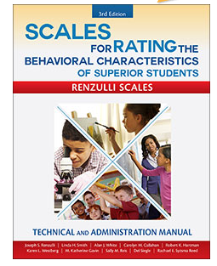
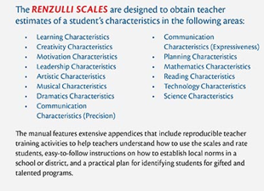

Scales for Rating the Behavioral Characteristics of Superior Students (SRBCSS-3rd edition)
TEACHERS scales K-12
Teacher Training Exercises Included
Grades K-12 with the exception of
Math, Reading, Technology and Science Grades 3-8
http://www.prufrock.com/Scales-for-Rating-the-Behavioral-Characteristics-of-Superior-Students-Technical-and-Administration-Manual-3rd-ed-P1823.aspx
Notes:
K-12
Online or paper/pencil
For teachers (often also given to parents)

Slide 63
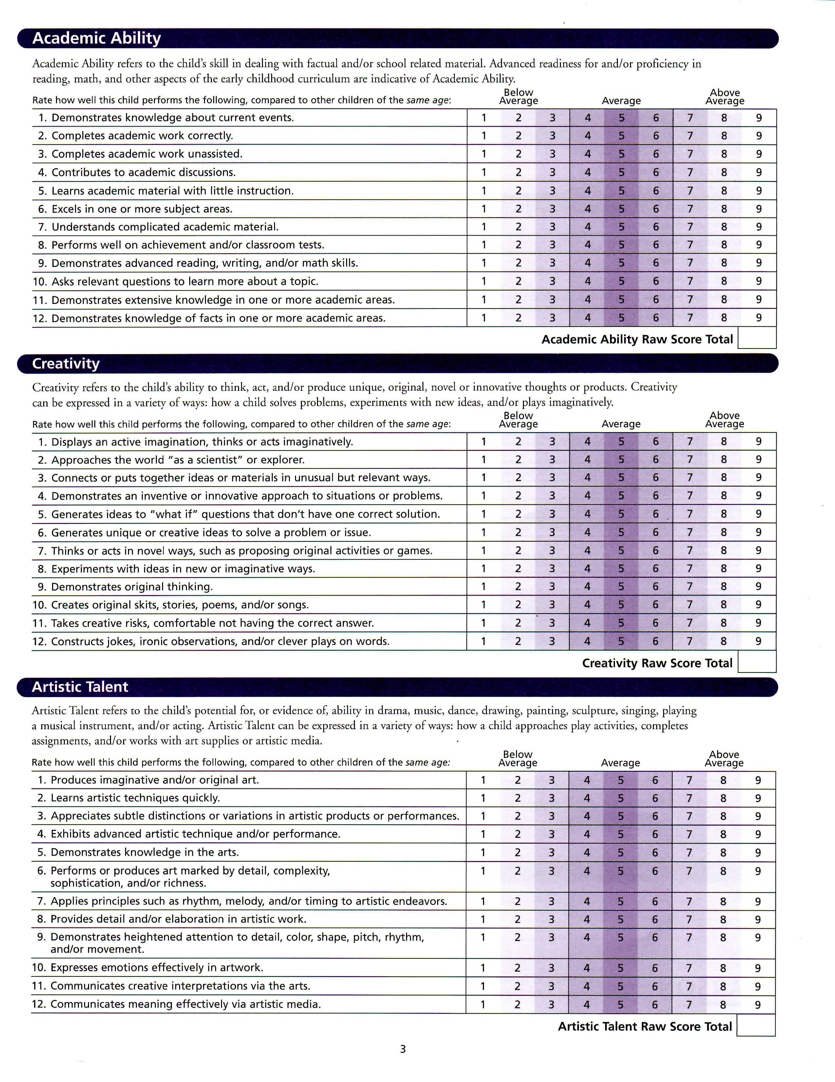
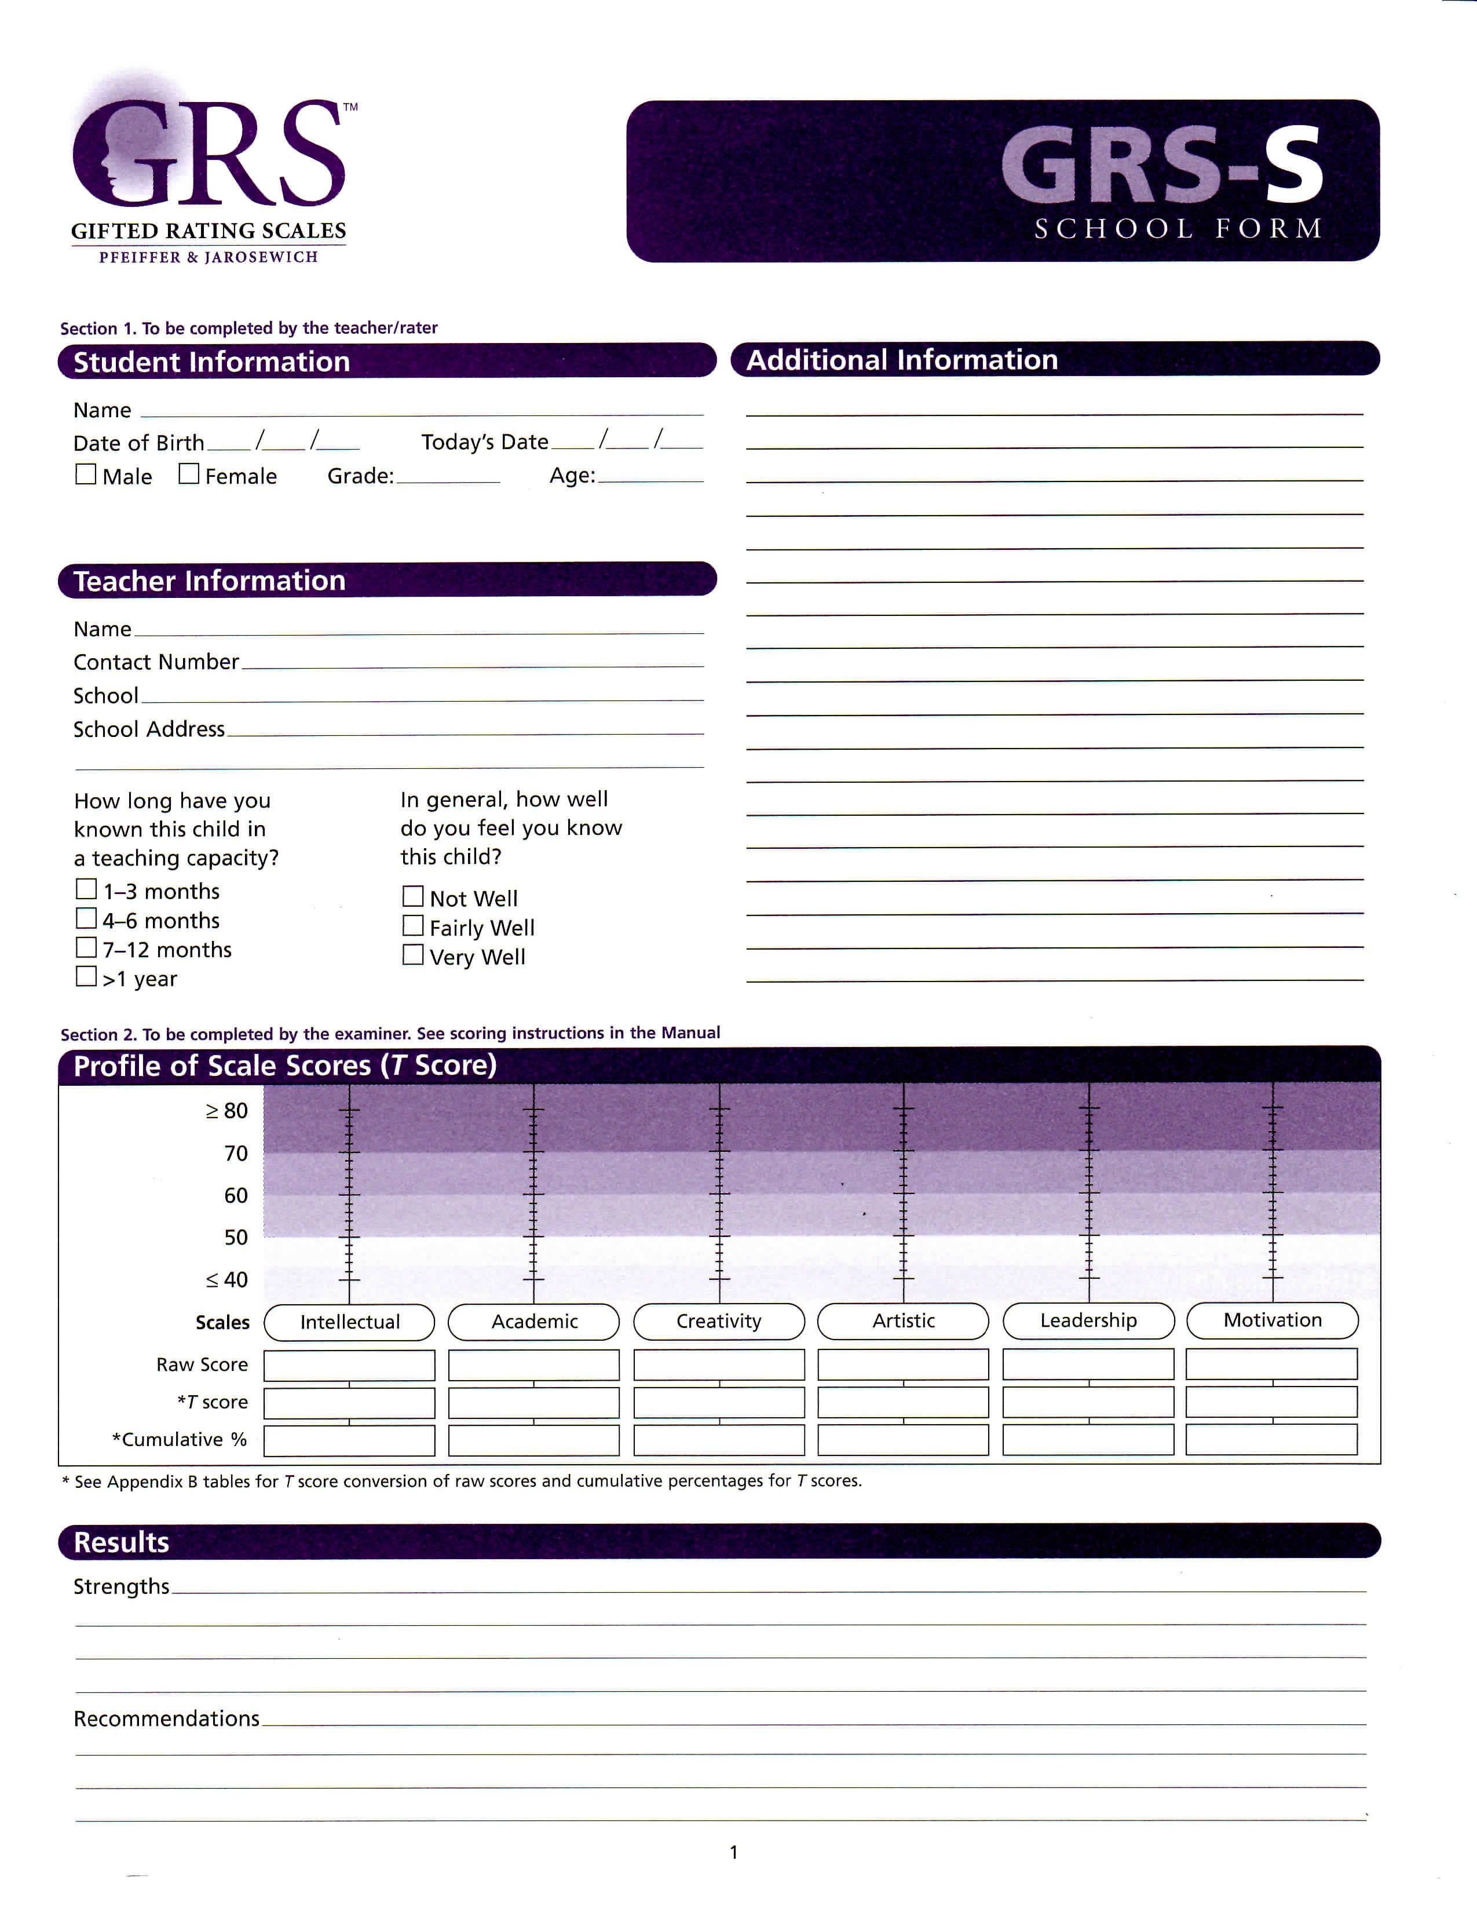

Slide 64
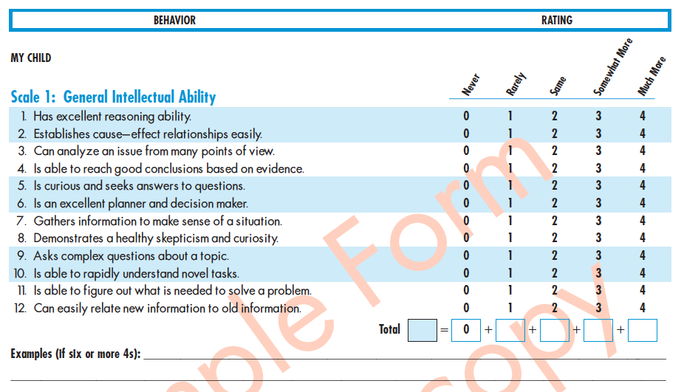
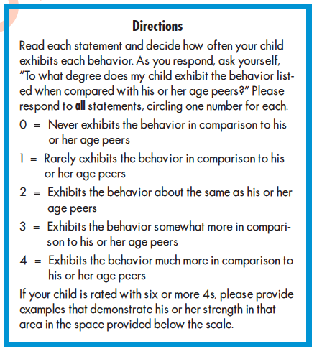
Scales for Identifying Gifted Students (SIGS)
Ryser & McConnell, 2004
Home and School Version Ages 5-18
7 Scales-(general intellectual ability, language
arts, math, science, social studies, creativity, and
leadership.
http://www.prufrock.com/SIGS-Complete-Kit-Scales-for-Identifying-Gifted-Students-P123.aspx

Slide 65
Why Involve Teachers?
(Teacher=any member of staff including specialists)
Can help “catch” students missed by traditional means (testing)-especially traditionally underrepresented students.
      Students with low SES
      Ethnically/racially diverse
      Underachiever
      SPED
Teachers are better nominators when they have received professional development in how to use the teacher rating scales
Teachers can be good nominators of talent, IF given specific behaviors for which to look
Notes:
RATING SCALES are subjective and only a part of a complete PORTFOLIO OF STRENGTH
Teachers and parent should be asked to supply written EVIDENCE to support claims.
TEACHERS: Can add work samples, photos, etc.
PARENTS:
Ask them to provide info ACROSS THE LIFESPAN (early to walk, talk, read, etc)

Slide 66
TEACHER RATING SCALES CAUTION!!!!
Teacher Rating scales, if used, should capture the degree to which the characteristics of gifted learners may be present in the school setting.
Recommendation but not Requirement: RS should be valid and reliable
        ‘Renzulli’ Scales * GRS
        SIG * HOPE
Should match the definition and goals of the HCP program.
Reduce BIAS!
  Train teachers! Use RS characteristics, NAGC “Myths”
  Teachers must provide EVIDENCE to support their ratings.
SUPPLEMENTAL ONLY.
Notes:
OSPI doesn’t require that the scales be research based.
Districts ay create their own.
But especially in this circumstance, it is best to REQUIRE supportive evidence.
Supportive evidence (narrative, anecdotal info; work samples) ARE VERY VALUABLE.

Slide 67
PARENT NARRATIVES
Parents can provide valuable information regarding home/community accomplishments as compared to other children of the same age and environment.
Narratives should provide examples that illustrate their child’s strengths and talents across the life span, including early developmental milestones.
Parents may be asked to complete a rating scale or questionnaire….or may be interviewed.
This questionnaire may be locally constructed; it does not have to be research-based.
SUPPLEMENTAL

